Slide 1
Compilation and “Backend-Independent” Optimizations for Multi-Party Computation
Benjamin Levy* (RPI) and Ben Sherman* (RPI),
Ana Milanova (RPI),
Muhammad Ishaq (Purdue),
Vassilis Zikas (Purdue)
Notes:
Hello.

Slide 2
Programming Technology for MPC
FairPlayMP [Ben-David et al. 2008], Sharemind [Bogdanov et al. 2008]
PICCO [Zhang et al. 2013], Obliv-C [Zahur and Evans 2015], TinyGarble [Songhori et al. 2015]
SCALE-MAMBA [Aly et al. 2019], ABY [Demmler et al. 2015], HyCC [Büscher et al. 2018], MOTION [Braun et al. 2022]
Wysteria [Rastogi et al. 2014], Wys* [Rastogi et al. 2017], Viaduct [Acay et al. 2021]

Slide 3
Our Focus
MPC Source intermediate language [Ishaq et al. 2019]
“Backend-independent” optimizations
  Analogous to machine-independent optimizations
Wysteria
MOTION
Primitives
“Backend-independent”
optimization
Viaduct
Optimized
MPC Source
SPDZ
Primitives
IMP Source
MPC Source
Obliv-C
OUR FOCUS
???
Primitives
???
…
FRONT END
BACK END
Notes:
There has been less focus on the “middle end” of the compiler.
Therefore, we focus on an IR, specifically the MPC Source IR and “backend indep. Optimiz”

Slide 4
Central Thesis
Many optimizations available at level of MPC Source
  Classical compiler optimizations
  MPC-specific optimizations
    SIMD-vectorization (N ops “at once” << N ops one-by-one)
    Protocol mixing (Arithmetic GMW, Boolean GMW, Yao)
    Scheduling
    Divide-and-conquer parallelization
    Other
Optimizations interact closely with each other

Slide 5
Running Example: Biometric Matching
def biometric(C: shared[list[int]],J: int, S: shared[list[int]],I: int) -> shared[tuple[int,int]]:
min_sum = MAX_INT
min_index = 0
for i in range(I):
sum = 0
for j in range(J):
d = S[i , j] - C[j]
p = d * d
sum = sum + p
if sum < min_sum:
min_sum = sum
min_index = i
return (min_sum, min_index)
min( Ʃ_{j=0..J-1}(S[0,j]-C[j])², …, Ʃ_{j=0..J-1}(S[I-1,j]-C[j])² )

Slide 6
Vectorization Is a Prerequisite for Mixing
for i in range(I):
sum = 0
for j in range(J):
d = S[i , j] - C[j]
p = d * d
sum = sum + p
if sum < min_sum:
min_sum = sum
min_index = i
return (min_sum, min_index)
J*𝛂_{A} + 𝛂_{A2Y} ? J*𝛂_{Y}
Arithmetic GMW
J*3,100μs + 1,700μs > J*2,100μs
I*(J*3,100μs + 1,700μs) >> I*J*2,100μs
sum A2Y(sum)
Yao’s Garbled Circuits
* Costs for simulated WAN from [Ishaq et al. 2019]
Notes:
It is well known in MPC compilers that Biometric matching benefits from protocol mixing.
But how do we make this conclusion, given an implementation of Biometric sharing, e.g., the program I just wrote. Notice that this is an iterative program that executes each arithmetic operation one-by-one.
In order to benefit from mixing of protocols, the cost of for-j-loop using Arithmetic sharing plus the cost of conversion from A 2 Y must be lower that the cost of the loop using Yao sharing.

Slide 7
Vectorization Is a Prerequisite for Mixing
…
d[I,J] = S[I,J] - C[I,J]
p[I,J] = d[I,J] * d[I,J]
… sum = sum + p …
for i in range(I):
if sum < min_sum:
min_sum = sum
min_index = i
return (min_sum, min_index)
J*𝛂_{A}^{Amortized} + 𝛂_{A2Y}^{Amortized} ? J*𝛂_{Y}^{Amortized}
J*200μs + 1,700μs < J*12,000μs
I*(J*200μs + 1,700μs) << I*J*12,000μs
sum A2Y(sum)
* Costs for simulated WAN from [Ishaq et al. 2019]

Slide 8
Outline
MPC Source
SIMD-vectorization algorithm
Experimental results
Related work
Conclusion and future work

Slide 9
MPC Source, By Construction
Semantic Analysis
IR Code Generation
Cytron’s
Algorithm
Conditional Φ -> MUX
Loop Φ -> pseudo PHI
Source syntax:
  s ::= s ; s |
  x = e | A[e] = e | if e then: s else: s | for i in range(I): s | skip
Semantic restrictions on source:
  Loop bounds are compile-time constants
  Array subscripts are plaintext expressions
  Arrays are one dimensional (implementation)
  Array writes restricted to “canonical writes” (implementation)
    A[i,j] = … along enclosing loop for i … for j …
Source
3-address CFG
SSA Form
MPC Source

Slide 10
MPC Source: Linear, Block-Structured SSA Form
def biometric(…):
min_sum = MAX_INT
min_index = 0
for i in range(I):
sum = 0
for j in range(J):
d = S[i,j] - C[j]
p = d * d
sum = sum + p
if sum < min_sum:
min_sum = sum
min_index = i
return (min_sum, min_index)
min_sum!1 = MAX_INT
min_index!1 = 0
for i in range(I):
min_sum!2 = PHI(min_sum!1, min_sum!4)
min_index!2 = PHI(min_index!1, min_index!4)
sum!2 = 0
for j in range(J):
sum!3 = PHI(sum!2, sum!4)
d = SUB(S[i,j],C[j])
p = MUL(d,d)
sum!4 = ADD(sum!3,p)
t = CMP(sum!3,min_sum!2)
min_sum!3 = sum!3
min_index!3 = i
min_sum!4 = MUX(t, min_sum!3, min_sum!2)
min_index!4 = MUX(t, min_index!3, min_index!2)
return (min_sum!2, min_index!2)

Slide 11
MPC Source, Syntax and Semantics
Linearization semantics:
ˠ(s) = ˠ(s₁); ˠ(s₂)
ˠ(x[i,J,k] = op_SIMD(y[i,J,k],z[i,J,k])) =
x[i,0,k] = op_SIMD(y[i,0,k],z[i,0,k]) ∥ …
x[i,J-1,k] = op_SIMD(y[i,J-1,k],z[i,J-1,k])
ˠ(for i in range(I): s) = ˠ(s)[0/i] ; ˠ(s)[1/i] ; …
…
Syntax:
s ::= s₁; s₂
| x[i,J,k] = op_SIMD(y[i,J,k],z[i,J,k])
| for i in range(I): s
…
Semantic restrictions:
x is 3-d array
x[i,J,k] = … in for i ... for k … loops
binding i and k

Slide 12
SIMD-Vectorization
Simple, due to linear, block-structured SSA-form IR
Phase 1: Scalar expansion
  Variables (implicitly) expand to dimensionality of enclosing loop nest
Phase 2: Loop vectorization
  Extends classical [Allen and Kennedy 1987]
Phase 3: Clean up

Slide 13
Phase 1: Scalar Expansion
…
for i in range(I):
…
sum!2 = 0
for j in range(J):
sum!3 = PHI(sum!2, sum!4)
d = SUB(S[i,j], C[j])
p = MUL(d, d)
sum!4 = ADD(sum!3, p)
t = CMP(sum!3, min_sum!2)
…
C’ = raise_dim(C, (j:J), (i:I,j:J)) …
for i in range(I):
…
sum!2 = [0,0,…0]
for j in range(J):
sum!3 = PHI(sum!2’, sum!4)
d = SUB(S[I,J], C’[I,J])
p = MUL(d, d)
sum!4 = ADD(sum!3, p)
t = CMP(sum!3’, min_sum!2)
…
sum!3[I,J]
sum!2’ = raise_dim(sum!2, (j:J))
sum!3’ = drop_dim(sum!3)
Notes:
Each variable is expanded (implicitly) to its corresponding loop dimensionality.

Slide 14
Phase 2: Loop Vectorization
C’ = raise_dim(C, (j:J), (i:I,j:J)) …
for i in range(I):
…
sum!2 = [0,0,…0]
sum!2’ = raise_dim(sum!2, (j:J))
for j in range(J):
sum!3 = PHI(sum!2’, sum!4)
d = SUB(S, C’)
p = MUL(d, d)
sum!4 = ADD(sum!3, p)
sum!3’ = drop_dim(sum!3)
t = CMP(sum!3’, min_sum!2)
…
C’ = raise_dim(C, (j:J), (i:I,j:J)) …
for i in range(I):
…
sum!2 = [0,0,…0]
sum!2’ = raise_dim(sum!2, (j:J))
d[I,J] = SUB(S[I,J], C’[I,J])
p[I,J] = MUL(d[I,J], d[I,J])
for j in range(J):
sum!3[I,j] = PHI(sum!2’[…], sum!4[…])
sum!4[I,j] = ADD(sum!3[I,j], p[I,j])
sum!3’ = drop_dim(sum!3)
t = CMP(sum!3’, min_sum!2)
…

Slide 15
Phase 2: Loop Vectorization
C’ = raise_dim(C, (j:J), (i:I,j:J)) …
for i in range(I):
min_sum!2 = PHI(min_sum!1, min_sum!4)
min_index!2 = PHI(min_index!1, min_index!4)
d[I,J] = SUB(S[I,J], C’[I,J])
p[I,J] = MUL(d[I,J], d[I,J])
for j in range(J):
sum!3[I,j] = PHI(sum!2’[…], sum!4[…])
sum!4[I,j] = ADD(sum!3[I,j], p[I,j])
sum!3’ = drop_dim(sum!3)
t = CMP(sum!3’, min_sum!2)
min_sum!3 = sum!3’
min_index!3 = i
min_sum!4 = MUX(t, min_sum!3, min_sum!2)
min_index!4 = MUX(t, min_index!3, min_index!2)
C’ = raise_dim(C, (j:J), (i:I,j:J)) …
d[I,J] = SUB(S[I,J], C’[I,J])
p[I,J] = MUL(d[I,J], d[I,J])
for j in range(J):
sum!3[I,j] = PHI(sum!2’[…], sum!4[…])
sum!4[I,j] = ADD(sum!3[I,j], p[I,j])
sum!3’ = drop_dim(sum!3)
min_index!3[I] = [0,1,…I-1]
min_sum!3[I] = sum!3’[I]
for i in range(I):
min_sum!2[i] = PHI(min_sum!1[i], min_sum!4[i-1])
min_index!2[i] = PHI(min_index!1[i], min_index!4[i-1])
t[i] = CMP(sum!3’[i], min_sum!2[i])
min_sum!4[i] = MUX(t[i], min_sum!3[i], min_sum!2[i])
min_index!4[i] = MUX(t[i], min_index!3[i], min_index!2[i])

Slide 16
Phase 3: Clean up
C’ = raise_dim(C, (j:J), (i:I,j:J))
…
d[I,J] = SUB(S[I,J], C’[I,J])
p[I,J] = MUL(d[I,J], d[I,J])
for j in range(J):
sum!3[I,j] = PHI(sum!2’[I,j], sum!4[I,j-1])
sum!4[I,j] = ADD(sum!3[I,j], p[I,j])
…
C’ = raise_dim(C, (j:J), (i:I,j:J))
…
d[I,J] = SUB(S[I,J], C’[I,J])
p[I,J] = MUL(d[I,J], d[I,J])
for j in range(J):
sum!3 = PHI(sum!2, sum!4)
sum!4 = ADD(sum!3, p[I,j])
…
sum!2’, sum!3, sum!4 turn into 1-d size-I arrays

Slide 17
Extension with Array Writes
Classical SSA’s handling of arrays may give rise to spurious cycles
for i in range(I):
A!2 = PHI(A!0, A!k)
…
… = A!2[f(i)] …
A!k = update(A!2, f’(i), value)

Slide 18
Extension with Array Writes
Classical SSA’s handling of arrays may give rise to spurious cycles
Algorithm removes certain spurious def-use edges
  Reduces problem to previous case, expands vectorization
for i in range(I):
A!2 = PHI(A!0, A!k)
…
… = A!2[f(i)] …
A!k = update(A!2, f’(i), value)

Slide 19
Compiler Back End
MOTION framework [Braun et al. 2022]
  SIMD-ified operations
    Amortized cost
    Improvement in memory throughput
  Different protocols (Arithmetic GMW, Boolean GMW, BMR) and share conversion
MPC Source -> MOTION C++
  Iterative MPC Source -> MOTION C++ -> Iter. Circuit
  Vectorized MPC Source -> MOTION C++ -> Vec. Circuit
  Each instantiated with Boolean GMW and BMR

Slide 20
Compiler Back End
Annotations only on shared inputs
  E.g., def biometric(C: shared[list[int]],J: int,
  S: shared[list[int]],I: int): …
  plain <: shared
Standard taint analysis partitions MPC Source program into
  shared variables and shared instructions
  and plain-text variables and plain-text instructions
Note: upcast leads to input gates
  x = op(y, z)

Slide 21
Outline
MPC Source
SIMD-vectorization algorithm
Experimental results
Related work
Conclusion and future work

Slide 22
Benchmarks
ABY [Demmler et al. 2015] and OPA [Ishaq et al. 2019]
    Biometric Matching, Histogram, PSI
HyCC [Büscher et al. 2018]
    Inner Product, Cryptonets Max Pooling, Database Join, Database Variance, K-means Iteration, MNIST ReLU
Parsynt [Farzan and Nicolet 2021]
    Minimal Points, Convex Hull, Count 102, Count 10s, Longest 102, Max. Dist. Between Symbols

Slide 23
Experimental Setup
CloudLab (https://www.cloudlab.us/)
2PC in LAN Setting
  c6525-25g machines for both parties; 16-core AMD 7302P 3.0GHz processor and 128GB of RAM
  10Gbps bandwidth and sub-ms latency
2PC in WAN Setting
  c6525-25g machine (located in Utah) for party A
  c220g1 machine (in Wisconsin) for party B; two Intel E5-2630 8-core 2.40GHz processors and 128GB of RAM
  560Mbps bandwidth and 38ms RTT (measured)

Slide 24
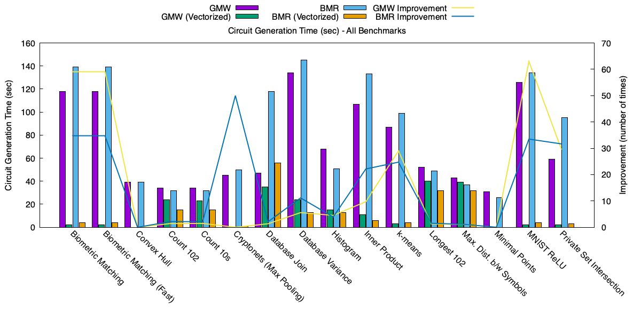
Circuit Generation (24x GMW, 20x BMR)

Slide 25
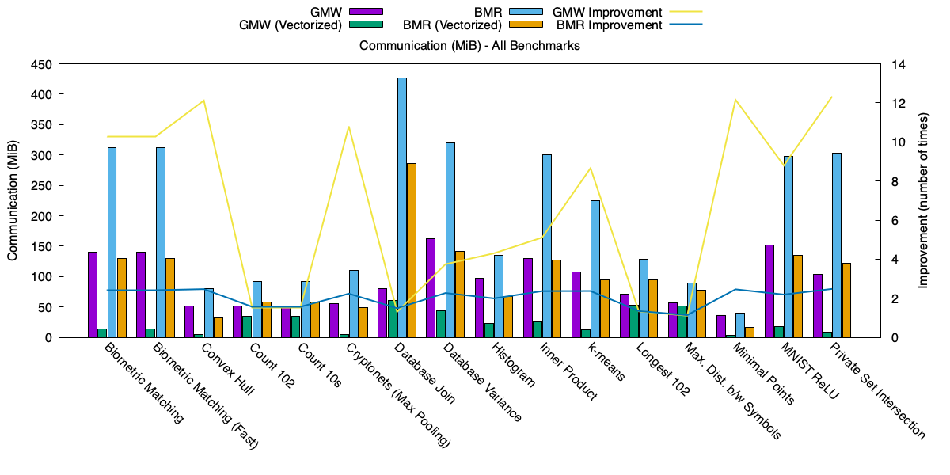
Communication (7x GMW, 2x BMR)

Slide 26
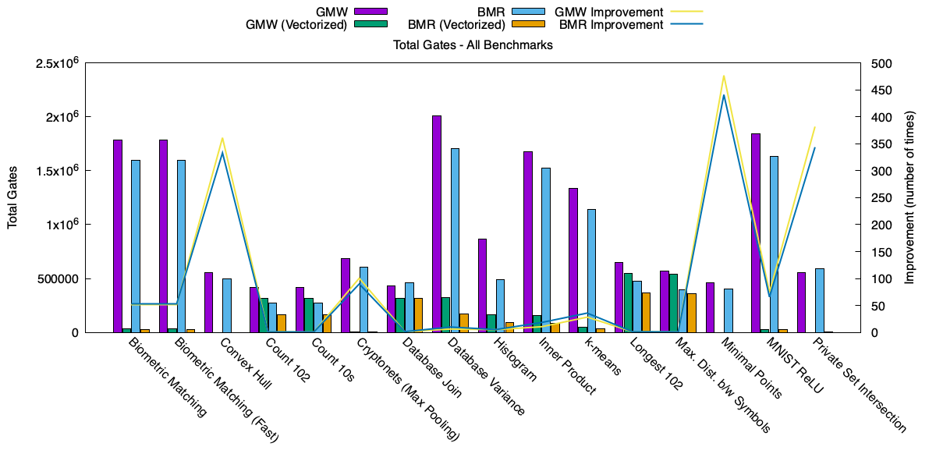
# Gates (97x GMW, 91x BMR)

Slide 27
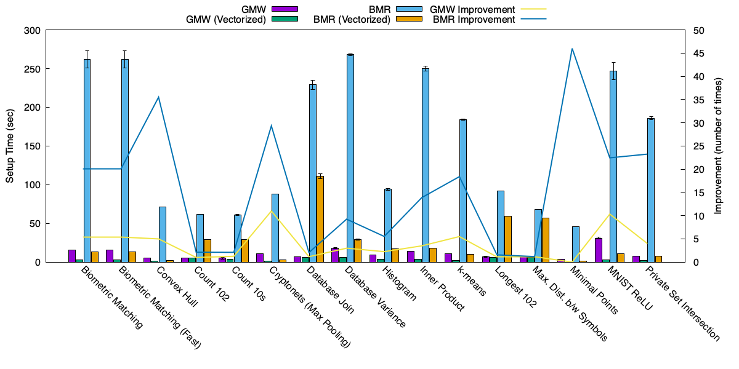
LAN Setup Time (4x GMW, 23x BMR)

Slide 28
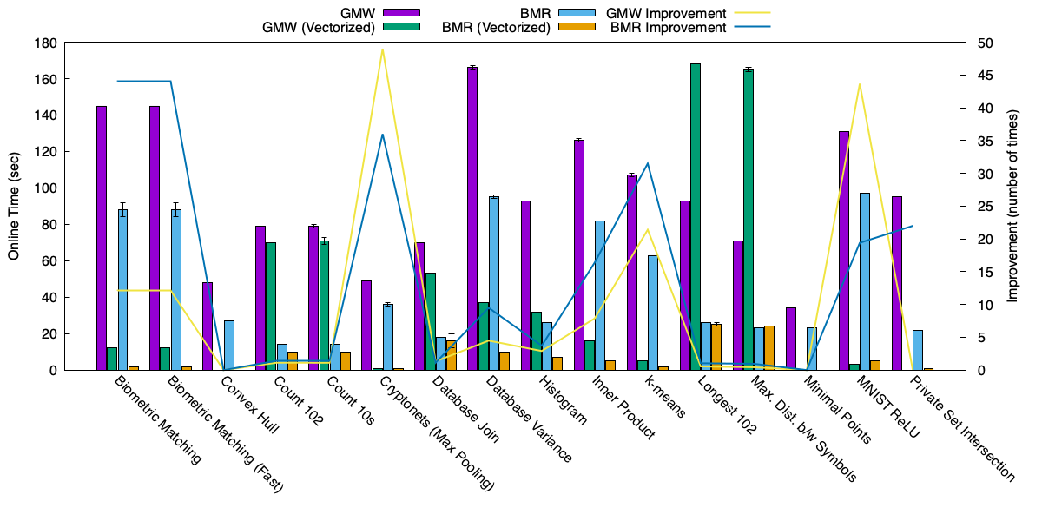
LAN Online Time (21x GMW, 18x BMR)

Slide 29
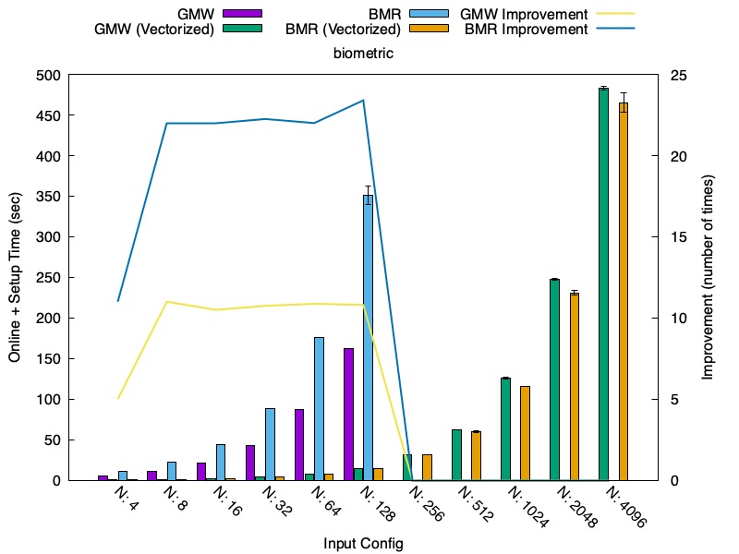
Biometric Matching, J=4

Slide 30
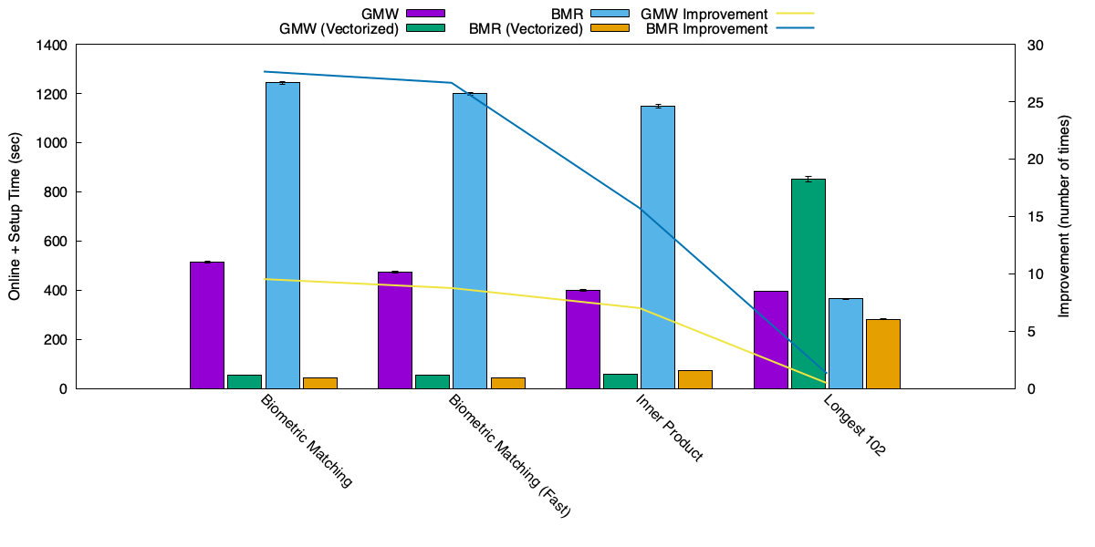
WAN Experiments
???

Slide 31
A Caveat… and a Silver Lining
Comparison
MOTION-native IP vs. Compiler-generated IP
  A negative result, but with a silver lining!
Boolean GMW
mult = MUL_SIMD(A,B);
mult_unsimidified = mult.Unsimdify();
for (i=0; …) result += mult_unsimdified[i];
mult = MUL_SIMD(A,B);
mult_unsimidified = mult.Unsimdify();
for (i=0; …) {
if (i!=0) { prev = result; }
result = prev + mult_unsimdified[i];
}
≈
<<

Slide 32
A Caveat… and a Silver Lining
mult = MUL_SIMD(A,B);
mult_unsimidified = mult.Unsimdify();
for (i=0; …) result += mult_unsimdified[i];
mult = MUL_SIMD(A,B);
mult_unsimidified = mult.Unsimdify();
for (i=0; …) {
if (i!=0) { prev = result; }
result = prev + mult_unsimdified[i];
}
≈
Deeper semantic analysis (on MPC Source) can uncover opportunities for optimization
<<

Slide 33
Related Work
High-performance computing
  Classical loop parallelization [Allen and Kennedy 1987]
  Polyhedral parallelization, e.g., [Benabderrahman et al. 2010]
    Generally, analysis is at a higher level of IR (AST)
    Conditional control flow is a known issue
  Whole function vectorization [Karrenberg 2015]
HyCC [Büscher et al. 2018] uses an off-the-shelf polyhedral compiler (https://github.com/Par4All/par4all)
  Our thesis: vectorization better done “natively”
    MPC Source facilitates vectorization
    Vectorization interacts closely with other optimizations

Slide 34
Conclusion
MPC Source
  A linear, block-structured SSA-form IR
  Suitable for optimizations
SIMD-vectorization over MPC Source
Implementation and evaluation
  15 benchmarks (more in our Github)
  Significant improvement in circuit generation, # messages, # gates, circuit evaluation, and communication size
https://github.com/milana2/ParallelizationForMPC/tree/gh-pages

Slide 35
Future Work
Integrate SIMD-vectorization with other optimizations
  Classical compiler optimizations
  Protocol Mixing
  Divide-and-conquer parallelization
  Scheduling
Inter-procedural (context-sensitive) program analysis
Program synthesis

Slide 36
Thank You!

