Slide 1
Seven Habits of Highly Effective Proposal Writers J. Hendler hendler@cs.rpi.edu
Thesis proposal (I propose you admit me to candidacy)
Thesis Defense (I propose you give me my degree)
Grant Proposal (I propose you give me some research $$)
Grant Report (I propose you give me more $$ next time)
And many others…*
* You’re on your own for marriage proposals and the like…

Slide 2
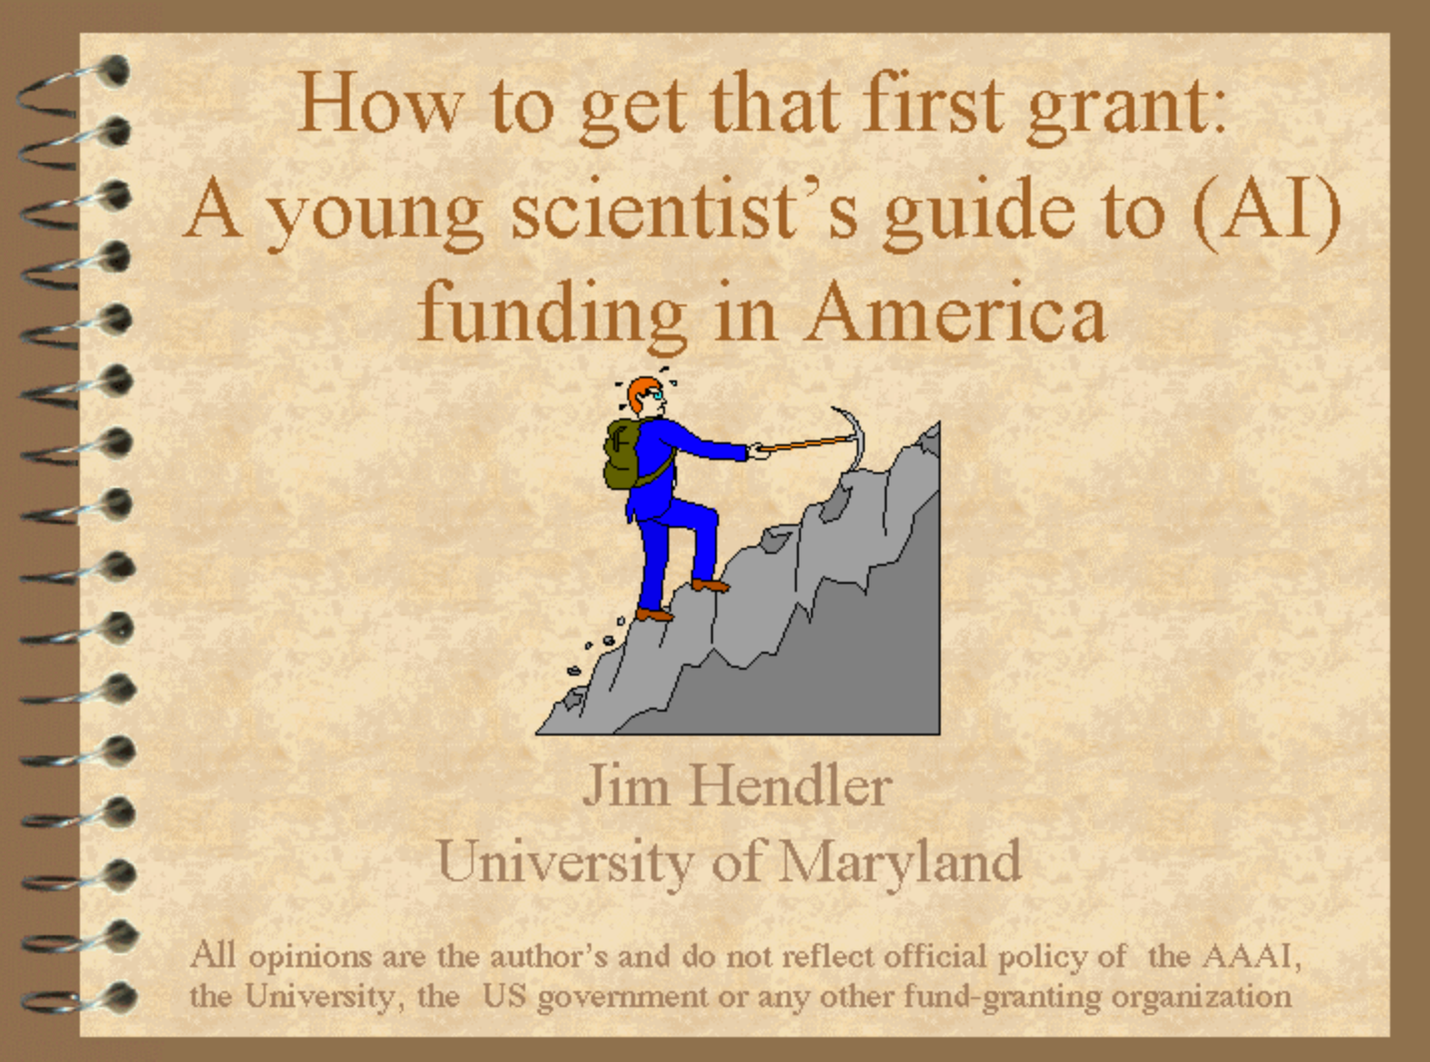
Slides today will include some from
A talk on proposals from 1999
http://www.cs.rpi.edu/~hendler/funding-talk/index.htm
My most downloaded presentation ever
Updated periodically, but very minor changes
I’m going to select some relevant slides – those are the ones that look like this:

Slide 3
Before we start:
And like any skill, practice is important!
But also there are some “rules” to performing

Slide 4
RULE 1: A good proposal tells a story…
Goldilocks jumped off quickly and went over to the middle-sized chair. But this chair was far too soft, and when she tried the porridge from the middle-sized bowl it was too cold. So she went over to the little chair and picked up the smallest spoon and tried some of the porridge from the tiny bowl
Mother Bear said in a quiet gentle voice. "Somebody has been sitting in my chair. Then little Bear said in small squeaky baby voice. "Somebody has been sitting in my chair and has broken it!"
Then Father Bear looked at his bowl of porridge and saw the spoon in it and he said in his great big growly voice,
He squeaked so loudly that Goldilocks woke up with a start. She jumped out of bed, and away she ran, down the stairs and out into the forest. And the three bears never saw her again.
One morning, their breakfast porridge was too hot to eat, so they decided to go for a walk in the forest. While they were out, a little girl called Goldilocks came through the trees and found their house. She knocked on the door and, as there was no answer, she pushed it open and went inside.
…
Compare this

Slide 5
RULE 1: … in a coherent (ordered) way
Once upon a time there were three bears who lived in a house in the forest. There was a great big father bear, a middle-sized mother bear and a tiny baby bear.
One morning, their breakfast porridge was too hot to eat, so they decided to go for a walk in the forest. While they were out, a little girl called Goldilocks came through the trees and found their house. She knocked on the door and, as there was no answer, she pushed it open and went inside.
In front of her was a table with three chairs, one large chair, one middle-sized chair and one small chair. On the table were three bowls of porridge, one large bowl, one middle-sized bowl and one small bowl – and three spoons.
Goldilocks was hungry and the porridge looked good, so she sat in the great big chair, picked up the large spoon and tried some of the porridge from the big bowl. But the chair was very big and very hard, the spoon was heavy and the porridge too hot.
Goldilocks jumped off quickly and went over to the middle-sized chair. But this chair was far too soft, and when she tried the porridge from the middle-sized bowl it was too cold. So she went over to the little chair and picked up the smallest spoon and tried some of the porridge from the tiny bowl.
…
To this

Slide 6
Rule 2: The story you MUST tell…
The Question you are trying to answer
(Good questions are harder to formulate than good answers)
The proposed work
Current work

Slide 7
Rule 2: …and it’s key points
What you have not done already, and will NOT do in this proposed work.
What you have not done already, but propose to do. (Must be achievable in required time frame)
What you have done already. (Must provide evidence for yellow box)

Slide 8
Rule 2: …and it’s key points
What you have not done already, and will NOT do in this proposed work.
What you have not done already, but propose to do. (Must be achievable in required time frame)
HOW IT WILL BE EVALUATED !!
What you have done already. (Must provide evidence for yellow box)

Slide 9
Rule 3: You must include a work plan/schedule of some kind

Slide 10
3a: Evaluation
Your claims must be clear
You need to evaluate what you are claiming.
I can do everything!
Here’s one example…
See A Letter from the Editor: Avoiding Rejection. IEEE Intell. Syst. 20(5): 2-4 (2005)

Slide 11
Rule 4: Know your audience
Compare this

Slide 12
Rule 4: Know your audience
To this

Slide 13
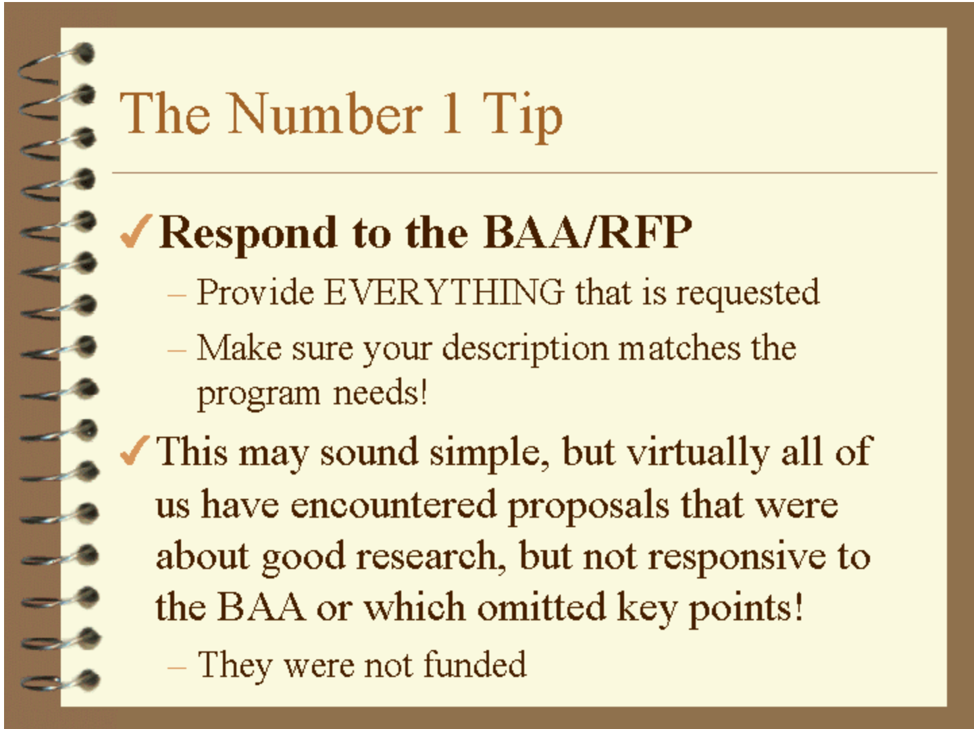
Rule 5: Learn (and follow) the rules of the proposal
This is the number 1 response when I asked people about what to know about submitting grant proposals in 1999, 2005, 2010, 2015, and 2017.

Slide 14
Rule 5: Learn (and follow) the rules of the proposal
Note this is also true of thesis proposals and theses:
There are required elements
vary a bit between CS subfields
ask your advisor
get a copy of successful examples from your peers
This is the number 1 response when I asked people about what to know about submitting grant proposals in 1999, 2005, 2010, 2015, and 2017.

Slide 15
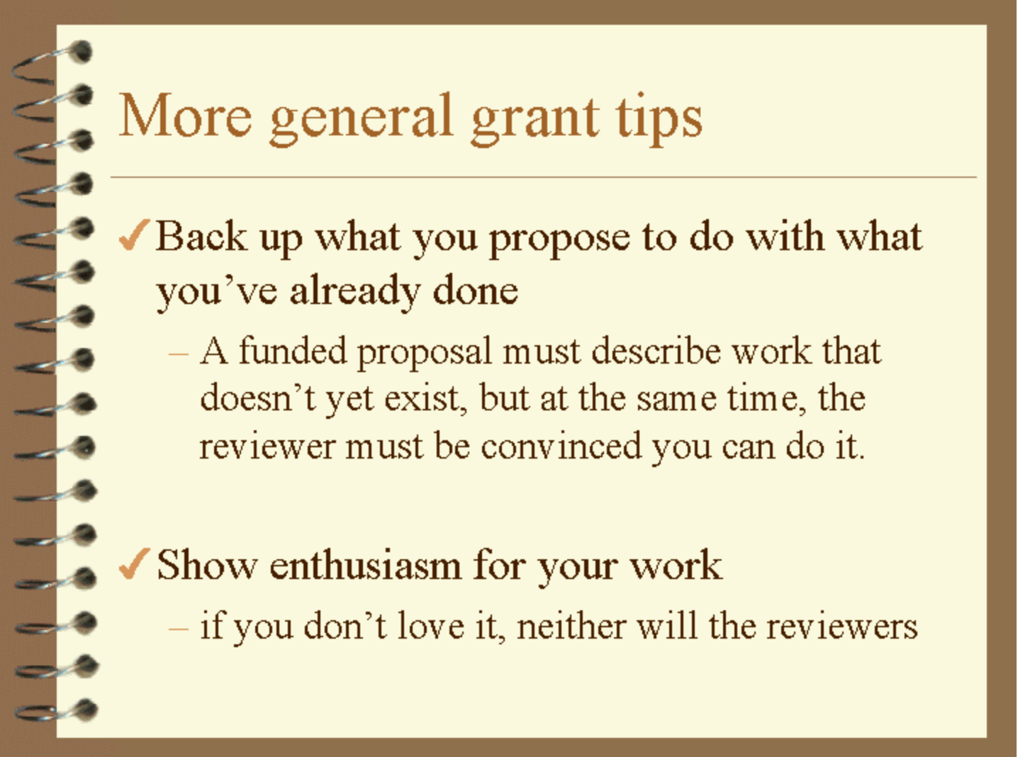
Rule 6: “Sell” it
(or professors on your committee)

Slide 16
Rule 7: Writing counts!!!!!!!!!
Members of your committee are busy professors – your thesis proposal/thesis is a “book” – how much time do they have to read carefully?
(your advisor will read it carefully!)

Slide 17
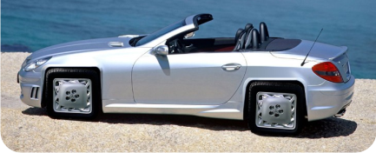
But wait, there’s more
There are other criteria
Novelty is necessary but not sufficient
Difficulty is necessary but not sufficient
Utility is necessary but not sufficient

Slide 18
Reviewing the rules
Rule 1: Tell a coherent story
Rule 2: Remember the three boxes (including what is beyond the current work) and esp. how it will be evaluated
Rule 3: A time frame/work plan/schedule is crucial
3a: Evaluation needs to fit claim
Rule 4: Know your audience
Rule 5: Follow the rules of the proposal (and these rules too)
Rule 6: You must convince people it is important
Rule 7: Writing Counts!
Rule 8: Balance motivation, approach and conclusion

Slide 19
rpi

