Slide 1
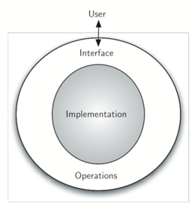
Abstract Data Types (ADTs)
Notes:
1

Slide 2
Abstraction
Abstraction: hiding unnecessary low-level details
An abstraction is a simplified view of an entity, which omits unimportant details
An abstraction can go wrong if
It includes details that are not important
Increases the cognitive load of the programmer
It omits important details
Programmer doesn't have necessary information to use the module, class, function, etc.
CSCI 2600 Spring 2021
2
Notes:
As an example, consider a file system. The abstraction provided by a file system omits many details, such as the mechanism for choosing which blocks on a storage device to use for the data in a given file. These details are unimportant to users of the file system (as long as the system provides adequate performance). However, some of the details of a file system’s implementation are important to users. Most file systems cache data in main memory, and they may delay writing new data to the storage device in order to improve performance. Some applications, such as databases, need to know exactly when data is written through to storage, so they can ensure that data will be preserved after system crashes. Thus, the rules for flushing data to secondary storage must be visible in the file system’s interface.
2

Slide 3
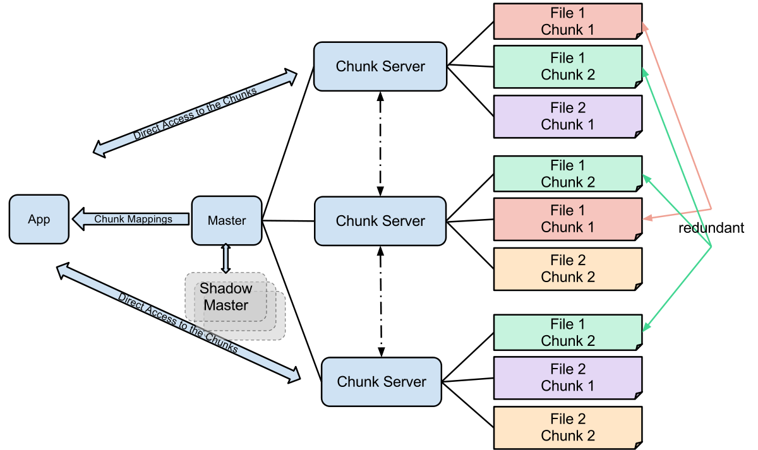
Abstraction
A file system is an abstraction
Omits many details, such as the mechanism for choosing which blocks on a storage device to use for the data in a given file
Most users don't care about these details
Some of the details of a file system’s implementation are important to some users
Most file systems cache data in main memory, and they may delay writing new data to the storage device in order to improve performance.
Some applications, such as databases, need to know exactly when data is written through to storage, so they can ensure that data will be preserved after system crashes.
Thus, the rules for flushing data to secondary storage must be visible in the file system’s interface.
Abstraction should provide appropriate detail to appropriate users

Slide 4
Control Abstraction
Control abstraction (procedural abstraction)
A procedure (method) implements the details of an algorithm
One part of abstraction: signature, provides name, parameter types, return type.
E.g., int binarySearch(int[] a, int key)
Another part: specification, provides details about behavior and effects
Reasoning about code connects implementation to specification

Slide 5
Data Abstraction
Data abstraction
Types: abstract away from the details of data representation
E.g., type String is an abstraction
E.g., C type struct Person is an abstraction
Abstract Data Type (ADT): high-level data abstraction
The ADT is operations + state
A specification mechanism
A way of thinking about programs and design
CSCI 2600 Spring 2021
5
Notes:
For a String, we don't usually want to worry about how the data is stored. Is it C style string or is there a header with length, UTF type etc.?
5

Slide 6
Abstract Data Types are Important
ADTs are about organizing and manipulating data
Organizing and manipulating data is pervasive.
Inventing and describing algorithms is not
Start your design by thinking about the data model.
What is the data?
Consider what operations are needed.
Implementation
Chose data structures carefully.
Will they allow necessary operations to be efficient?
Write code to access and manipulate data.
CSCI 2600 Spring 2021
6
Notes:
Users become interested in algorithms when something goes wrong, i.e. violates the spec.
What is the data?
In a String, it's typically the characters.
In a Polynomial, it's the coefficients, degree.
6

Slide 7
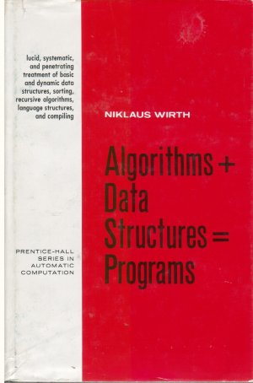
Data dominates. If you've chosen the right data structures and organized things well, the algorithms will almost always be self-evident. Data structures, not algorithms, are central to programming.
~ Rob Pike
Notes:
Rob Pike wrote the first window system for Unix. He was involved with the development of Go and Plan 9

Slide 8
ADT is a way of thinking about programs and design
From domain concept
E.g., the math concept of a polynomial, a set of integers, the concept of a library item, etc.
abstract
through ADT
Describes domain concept in terms of specification fields and abstract operations
Abstract
Specification fields – what are the important pieces of information?
Operations – what manipulations will be needed
to implementation
Implements ADT with representation fields and concrete operations
Concrete
Abstraction is how programmers deal with complexity
CSCI 2600 Spring 2021
8
Notes:
8

Slide 9
Example: Polynomial with Integer Coefficients - ADT
ADT:
Overview description:
A Poly is an immutable polynomial
with integer coefficients. A Poly is:
c₀ + c₁x + c₂x² + …
Specification fields c₀, c₁ etc.
Set of abstract operations:
add, mul, eval, etc. with PSoft style specs referencing abstract specification fields
CSCI 2600 Spring 2021
9
Notes:
Specification fields indicate how the abstract data type is described.
Immutable signals our intention that that this will not be a changeable object.
9

Slide 10
Example: Polynomial with Integer Coefficients - Implementation
class Poly {
// rep. invariant: d = coeffs.length-1
private int d; // degree of the polynomial
private int[] coeffs; // coefficients
// operations add, sub, mul, // eval, in terms of rep. fields coeffs, d.
}
class Poly {
// rep. invariant: …
private List<Term> terms; // terms of poly
// operations add, sub, mul, eval, etc. in terms of terms
// term – object specifying coefficient and exponent
}
CSCI 2600 Spring 2021
10
Notes:
More about rep invariants later
Rep invariant is a condition that must hold for the representation to be valid.
Both have the same ADT. The implementations differ.
A term is an object which contains the int coefficient and the int power.
The first implementation function is: polynomial is the sum of coeffs[i]x^i for i ranging from 0 to degree-1.
The second function is: polynomial is the sum of the terms.
Each has advantages and disadvantages. What are they?
Advantage of first: easy to code polynomial arithmetic. Disadvantage: if polynomial has many zero terms in the middle, we will waste a lot of space. E.g., we will need an array of size 100 to represent the single term polynomial x^99.
Advantage of second: space efficient in the above case. Disadvantage: for “dense” polynomials, it is less space efficient. Also, implementing polynomial arithmetic is less trivial.
Choice of representation depends on the application domain. How will object be used?
10

Slide 11
Another Example: A Meeting: Domain Concept & ADT
ADT:
Overview description:
An appointment for a meeting.
With date, room, attendees
Set of abstract operations:
e.g., addAttendee, scheduleRoom, etc. with PSoft style specs referencing abstract specification fields
Specification fields.
CSCI 2600 Spring 2021
11
Notes:
Note we don't specify attendees as Set<Person> - is that too much implementation detail for an ADT or not enough? What is Person?
Maybe
An appointment for a meeting, consisting of a Date, Room, and attendees.
11

Slide 12
Why ADTs?
Bridges gap between domain concept and implementation
Formalizes domain concept, provides basis for reasoning about correctness of the implementation
Shields client from implementation. Implementation can vary without affecting client!
Information hiding
Client code interacts with object through a set of abstract operations
CSCI 2600 Spring 2021
12
Notes:
Watch out that you don’t include too many implementation details.
12

Slide 13
An ADT has a Set of Operations
Operations act on data
ADT is about the meaning of data
ADT is about the use of data
Data representation (implementation) may change without causing problems for the client.
Instead, think of a type as a set of operations: create, getBase, getAltitude, getBottomAngle, etc.
Force clients to call operations to access data
Client doesn't need to know the details of representation
class RightTriangle {
float base, altitude;
}
class RightTriangle {
float base, angle;
}
CSCI 2600 Spring 2021
13
Notes:
This one reason we use getter and setter to access class attributes.
Even in languages like Python that don't enforce privacy, use getters and setters. Python decorators provide an easy way to do this.
13

Slide 14
Are These Types Same or Different?
class Point {
float x;
float y;
}
class Point {
float r;
float theta;
}
They are different! Different implementations
They are the same! Both implement the concept of a 2D point.
Goal of ADT methodology is to express sameness
Clients depend only on the set of operations: x(), y(), r(), theta(), etc.
Data representation can be changed: to change algorithms, to fix bugs, etc.
CSCI 2600 Spring 2021
14
Notes:
We often refer to this as “information hiding” or “encapsulation”.
14

Slide 15
Are These Types Same or Different?
class Poly {
private int d;
private int[] coeffs;
}
Same ADT
Clients depend only on the set of operations: add(Poly), mul(Poly), etc.
class Poly {
private List<Term> terms;
}
CSCI 2600 Spring 2021
15
Notes:
15

Slide 16
Abstraction Barrier
Abstraction Barrier:
x()
y()
theta()
Point()
etc.
Implementation (data representation)
…
Client
ADT provides an abstraction barrier
Clients access the ADT through its operations.
They never access the data representation.
CSCI 2600 Spring 2021
16
Notes:
Hide details of implementation from client
16

Slide 17
ADT Methods
We group the access methods of an ADT into
Creators
Create a brand new object
Constructors are creators
Observers
Return information about this object
Producers
Return a new object of this type by performing operations on the current object
Poly add(Poly p) – return a new Poly, this + p
Mutators
Change the current object

Slide 18
2D Point abstract methods
class Point {
// A 2D point in the plane
public float x();
public float y();
public float r();
public float theta();
// … can be created
public Point(); // (0,0)
public Point(float x, float y);
public Point swapXY();
Observers
Creators
Producer
CSCI 2600 Spring 2021
18
Notes:
Creators create a new object.
Producers generate a new object of the same type.
18

Slide 19
2D Point as an ADT
// class Point continued
…
// … can be moved
public void translate(float delta_x, float delta_y);
public void scaleAndRotate(float delta_r,
float delta_theta);
}
Mutators
CSCI 2600 Spring 2021
19
Notes:
Mutators modify this.
19

Slide 20
Specifying an ADT
immutable mutable
class TypeName class TypeName
1. overview 1. overview
2. specification fields 2. specification fields
3. creators 3. creators
4. observers 4. observers
5. producers 5. producers (mutators are more common)
6. no mutators 6. mutators
CSCI 2600 Spring 2021
20
Notes:
We will talk about overview and specification fields (also known as abstract fields) later.
Why so much emphasis on immutability? We talked about “modifies” clause. Now we talk about immutable vs. mutable datatypes?
Producers are common with immutable objects, less so with mutable objects.
20

Slide 21
Poly, an immutable datatype: overview
/**
* A Poly is an immutable polynomial with
* integer coefficients. A Poly is:
* c₀ + c₁x + c₂x² + …
*/
class Poly {
Overview: Always state whether mutable or immutable
Define abstract model for use in specification of
operations. In ADTs, state is abstract, not concrete
I.e., these are NOT actual, implementation fields of Poly, just what we call specification fields.
Abstract state (specification fields). More on this later.
CSCI 2600 Spring 2021
21
Notes:
21

Slide 22
Poly, an immutable datatype: creators
// modifies: none
// effects: makes a new Poly = 0
public Poly()
// modifies: none
// effect: makes a new Poly = cx^{n}
// throws: NegExponentException if n < 0
public Poly(int c, int n)
Creators: This is an example of overloading, two Poly
constructors with different signatures.
New object is part of effects, not preexisting state. Hence, modifies is none.
CSCI 2600 Spring 2021
22
Notes:
In the interest of space we’re not showing full spec
22

Slide 23
Poly, an immutable datatype: observers
// returns: degree of this polynomial
public int degree()
// returns: the coefficient of the term of
// this polynomial, whose power is d
public int coeff(int d)
Observers: Used to obtain information about this polynomial.
Return values of other types.
Observers should not modify the abstract state!
this: the current Poly object. Also called the receiver
Poly x = new Poly(…) // creator
int c = x.coeff(3); // observer
CSCI 2600 Spring 2021
23
Notes:
Keep modification separate from observation.
23

Slide 24
Poly, an immutable datatype: producers
// modifies: none
// returns: a new Poly with value this + q
public Poly add(Poly q)
// modifies: none
// returns: a new Poly with value this * q
public Poly mul(Poly q)
Producers: Operations on a type that create other objects
of the same type. Common in immutable types.
Should have no side effects
i.e., should not change _abstract_ values of any existing object
CSCI 2600 Spring 2021
24
Notes:
If for some reason a produce has a side effect, document it carefully.
24

Slide 25
Poly, an immutable datatype: Mutators
Poly is an immutable ADT
It has no mutators

Slide 26
IntSet, a mutable datatype: overview, creators and observers
/*
* Overview: An IntSet is a mutable,
* unbounded set of integers. E.g.,
* { x₁, x₂ , … x_{n} } with no duplicates
*/
class IntSet {
// effects: makes a new empty IntSet
public IntSet()
// returns: true if x in this IntSet,
else false
public boolean contains(int x)
Creator
Observer
CSCI 2600 Spring 2021
26
Notes:
You will have to specify the “modifies” clause! I omit due to space constraints.
Contains is an observer
26

Slide 27
IntSet, a mutable datatype: mutators
// modifies: this
// effects: this_{post} = this_{pre} U { x }
public void add(int x)
// modifies: this
// effects: this_{post} = this_{pre} - { x }
public void remove(int x)
Mutators: operations that modify receiver, this. Rarely
modify anything other than this.
effects: describe how this changes.
Often, mutators have no return value.
Although they may return true or false to indicate success
Mutators
CSCI 2600 Spring 2021
27
Notes:
Maybe should specify what happens in remove if x is not found, typically nothing.
27

Slide 28
Exercise: String, an immutable datatype
Overview?
an immutable sequence of characters, example “abc”
don’t say array or list of characters
Creators?
String(), String(char[] value), String(String original), …
Observers?
charAt, compareTo, contains, endsWith, …
Producers?
concat, format, substring, …
Mutators?
None!
CSCI 2600 Spring 2021
28
Notes:
Overview: an immutable sequence of characters, example “abc”, don’t say array or list of characters
Creators
String() creates an empty string
Observers
charAt(int i) returns character at the ith position of this. Throws indexOutOfBounds if i < 0 or i >= length of this
28

Slide 29
Exercise: The Stack datatype
public Stack()
public boolean empty()
public E peek()
public void push(E item)
public E pop()
CSCI 2600 Spring 2021
29
Notes:
What is the ADT?
Last in, first out (LIFO) abstract data type and linear data structure. A stack is characterized by two fundamental operations, called push and pop (or pull).
push and pop? Mutators
Mutable or immutable?
Does it have any producers? Are pop and push producers or mutators? Mutators. They change the state of this.
Observers? peek
E – some type
29

Slide 30
ADTs and Java Language Features
Java classes
ADT operations are public
Other operations are private
Clients can only access ADT operations
Java interfaces
Clients only see the ADT operations
Cannot see fields
Implementing classes must provide all operations
CSCI 2600 Spring 2021
30
Notes:
30

Slide 31
Reasoning About ADTs
ADT is a specification, a set of operations
E.g., contains(), add(), etc., (the IntSet ADT)
add(Poly q), mul(Poly q), etc., (the Poly ADT)
When specifying ADTs, there is no mention of data representation!
Basic information hiding principle
When implementing the ADT, we must select a specific data representation
Reasoning connects implementation to specification:
is our implementation correct?
CSCI 2600 Spring 2021
31
Notes:
So far our main concern was to SPECIFY THE ADT.
31

Slide 32
Implementation of an ADT is Provided by a Class
To implement the ADT
We must select the representation
Implement concrete operations in terms of that rep
E.g., the rep of our Poly can be
a) int[] coeffs or
b) List<Term> terms
Choose representation such that
It is possible to implement all operations
Most frequently used operations are efficient
CSCI 2600 Spring 2021
32
Notes:
But which ones will those most frequently used operations be???
32

Slide 33
Connecting Implementation to Specification
Representation invariant: Object → Boolean
Maps the object to a true or false value
Indicates whether data representation is well-formed.
If rep is not-well formed, operations may produce incorrect results
Only well-formed representations are meaningful
Defines the set of valid values
Abstraction function: Object → abstract value
What the data structure really means
E.g., array [2, 3, -1] represents -x^2 + 3x + 2
How the data structure is to be interpreted
CSCI 2600 Spring 2021
33
Notes:
But how do we know that our implementation is correct?
Well-formed representation means it contains only valid values
33

Slide 34
The Representation Invariant
States data structure well-formedness
E.g., IntSet objects, whose data array contains duplicates are not valid values
Must hold before and after every method!
Not necessarily in the middle of a method.
Correctness of operation implementation (methods in the class) depends on it!
CSCI 2600 Spring 2021
34
Notes:
34

Slide 35
IntSet ADT
/** Abstraction: An IntSet is a mutable set
* of integers with no duplicates.
* E.g., { x₁, x₂ , … x_{n} }, {}.
*/
// rep invariant: data has no duplicates
// effects: makes a new empty IntSet
public IntSet();
// modifies: this
// effects: this_{post} = this_{pre} U { x }
public void add(Integer x);
// modifies: this
// effects: this_{post} = this_{pre} - { x }
public void remove(Integer x);
// returns: (x in this)
public boolean contains(Integer x)
// returns: cardinality of this
public int size()
CSCI 2600 Spring 2021
35
Notes:
NOTE: This overview (essentially our abstraction function), implies that our set contains no duplicates!
35

Slide 36
One Possible Implementation
class IntSet {
private List<Integer> data
= new ArrayList<Integer>();
public void add(Integer x) { data.add(x); }
public void remove(Integer x) {
data.remove(x);
}
public boolean contains(Integer x) {
return data.contains(x)
}
public int size() { return data.size(); }
}
CSCI 2600 Spring 2021
36
Notes:
Depends on ArrayList methods
NOTE: What can go wrong with this implementation?
36

Slide 37
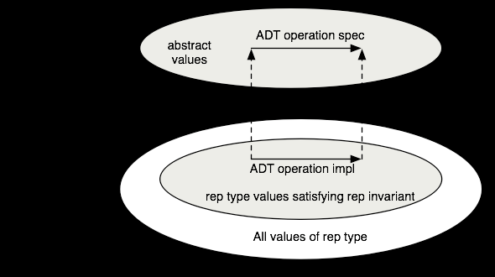
The Representation Invariant
s = new IntSet(); s.add(1); s.add(1); s.remove(1); System.out.println(s.contains(1));
What is wrong with this code?
Representation invariant tells us
class IntSet {
// Rep invariant: data has no duplicates
private List<Integer> data; …
CSCI 2600 Spring 2021
37
Notes:
37

Slide 38
The Representation Invariant
class IntSet {
// Rep invariant:
// data no duplicates
private List<Integer> data
= new ArrayList<Integer>();
public void add(Integer x) {
data.add(x);
}
// Rep invariant does not hold after second add!
}
CSCI 2600 Spring 2021
38
Notes:
NOTE: How can we fix it?
38

Slide 39
The Representation Invariant
class IntSet {
// Rep invariant:
// data has no duplicates
private List<Integer> data
= new ArrayList<Integer>();
public void add(Integer x) {
if (!data.contains(x))
data.add(x);
}
// Rep invariant now holds after add
}
CSCI 2600 Spring 2021
39
Notes:
NOTE: How can we fix it?
Contains uses the type’s equals. Integer.equals overrides Object.equals, so it is testing values.
How does this differ from the problem that arose in hw00?
39

Slide 40
The Representation Invariant
Rep invariant excludes values that do not correspond to abstract values
class LineSegment {
//Rep invariant: !(x1 == x2 && y1 == y2)
private float x1, y1; // start point
private float x2, y2; // end point
Conceptually, a line segment is defined by two distinct points.
Thus, values with the same start and end point (e.g., x1=x2=1, y1=y2=2), are meaningless.
Rep invariant excludes them
CSCI 2600 Spring 2021
40
Notes:
40

Slide 41
The Representation Invariant
Rep invariant excludes data representation values that do not correspond to abstract values
class RightTriangle {
// Rep invariant: 0 < angle < 90 &
// base > 0
float base, angle;
// Objects that don’t meet the above constraints are
// not right triangles
CSCI 2600 Spring 2021
41
Notes:
We will want to check this conditions in creators and modifiers
41

Slide 42
Additionally…
Rep invariant states constraints imposed by specific data structures and algorithms
E.g., Tree has no cycles, array must be sorted, at most one term per exponent in Poly (if we choose the term representation)
Rep invariant states constraints between fields that are synchronized with each other
E.g., degree and coefficients fields in Poly (if we choose the array data representation)
In general, rep invariant states correctness constraints
if not met, implementation may behave incorrectly!
CSCI 2600 Spring 2021
42
Notes:
In addition…
42

Slide 43
Rep Invariant Example
class Account {
// Rep invariant:
// balance >= 0
// balance = Σ_{i}transactions.get(i).amount
// transactions != null
// no nulls in transactions
private int balance;
// history of transactions
private List<Transaction> transactions;
…
}
CSCI 2600 Spring 2021
43
Notes:
These are correctness constraints. If they are not met object is invalid and should produce an error
43

Slide 44
More Rep Invariant Examples
class Polynomial {
//Rep. invariant: degree = coeffs.length-1
// Poly is the sum of coeffs[i]*x^i for i ranging from 0 to
// degree
private int degree;
private int[] coeffs;
// operations add, sub, mul, eval, etc.
}
class Polynomial {
//Rep. invariant: for any 0 <= i,j < terms.size(), i != j => terms_{i}.getExp() != terms_{j}.getExp()
// Poly is sum of terms…
private List<Term> terms;
// operations add, sub, mul, eval, etc.
}
CSCI 2600 Spring 2021
44
Notes:
A Term is an object which contains the Rational coefficient and the int power.
The first abstraction function is: polynomial is the sum of coeffs[i]x^i for i ranging from 0 to degree (=coeffs.length-1).
The second abstraction function is: polynomial is the sum of the terms.
Each has advantages and disadvantages. What are they?
Advantage of first: easy to code polynomial arithmetic. Disadvantage: if polynomial has many zero terms in the middle, we will waste a lot of space. E.g., we will need an array of size 100 to represent the single term polynomial x^99.
Advantage of second: space efficient in the above case. Disadvantage: for “dense” polynomials, it is less space efficient. Also, implementing polynomial arithmetic is less trivial.
44

