Slide 1
Reasoning About ADTs, Assertions and Exceptions
Notes:
1

Slide 2
How to Design Your Code
The hard way: Start hacking. When something doesn’t work, hack some more
The easier (and professional) way: Plan carefully
Write specs, rep invariants, abstraction functions
Write tests (first!), reason about code, refactor
Less apparent progress at first, but faster completion times, better product, less frustration, less debugging
CSCI 2600 Spring 2021
2
Notes:
2

Slide 3
How to Verify Your Code
The hard way: hacking, make up some inputs
An easier way: systematic testing
Black-box testing techniques (more later)
High white-box coverage (more later)
Both use JUnit framework
Also: reasoning, complementary to testing
Prove that code is correct
Implementation satisfies specification
Rep invariant is preserved
We will write informal proofs
CSCI 2600 Spring 2021
3
Notes:
3

Slide 4
Uses of Reasoning
Goal: show that code is correct
Verify that the implementation satisfies its specification. Hard!
Forward reasoning: show that if precondition holds, postcondition holds
Backward reasoning: compute weakest precondition, then show stated precondition implies the weakest precondition
Reasoning is an important debugging tool
Prove (using informal manual proofs) that rep invariant holds. This is sometimes easy, sometimes hard…
CSCI 2600 Spring 2021
4
Notes:
4

Slide 5
Goal: Show that Rep Invariant Is Satisfied
Testing
Choose representative objects and check rep
Add checkRep() method that verifies representation after each method use.
Problem: it is often impossible to exhaustively test, therefore, we have to choose well
Reasoning
Prove that all objects satisfy rep invariant
Sometimes easier than testing, sometimes harder
You should know how to use it appropriately
Why not always leave checkRep() in code?
CSCI 2600 Spring 2021
5
Notes:
Why not? Maybe checkRep() is expensive.
5

Slide 6
Ways to Make New Objects
a = constructor
b = a.producer
a’ = a.mutator
a’’ = a.observer
c = b.producer
b’ = b.mutator
b’’ = b.observer
…
Very many objects but limited number of types of operations!
CSCI 2600 Spring 2021
6
Notes:
6

Slide 7
Verify that Rep Invariant Is Satisfied
We can have very many objects, but limited number of operations
How do we prove all objects satisfy rep invariant?
Induction!
Consider all ways to make a new object
Constructors
Producers
All ways to modify an existing object
Mutators
Observers, producers.
Should producers, observers modify the existing object?
CSCI 2600 Spring 2021
7
Notes:
What is the difference between constructors and producers?
Make sure observers and producers don’t modify object.
Do observers and producers return the right thing?
Benevolent side-effects? Are they really benevolent?
7

Slide 8
Benevolent Side Effects in Observers
An implementation of observer IntSet.contains:
boolean contains(int x) {
int i = data.indexOf(x);
if (i == -1)
return false;
// move-to front optimization
// speeds up repeated membership tests
Integer y = data.elementAt(0);
data.set(0,x);
data.set(i,y);
return true;
}
Mutates rep (even though it does not change abstract value), must show rep invariant still holds!
CSCI 2600 Spring 2021
8
Notes:
Other reasons too! If there is an accidental mutation, we’ll catch it when trying to prove that the rep invariant holds!
8

Slide 9
Induction
Proving facts about many objects
Base step
Prove rep invariant holds on exit of constructor
Inductive step
Assume rep invariant holds on entry of method
Then prove that rep invariant holds on exit
Intuitively: there is no way to make an object, for which the rep invariant does not hold
Assumes no rep exposure
Remember, our proofs are informal
CSCI 2600 Spring 2021
9
Notes:
9

Slide 10
The IntSet ADT
/** Overview: An IntSet is a mutable set
* of integers. E.g., { x₁, x₂ , … x_{n} }, {}.
* There are no nulls and no duplicates in the set.
*/
// effects: makes a new empty IntSet
public IntSet()
// modifies: this
// effects: this_{post} = this_{pre} U { x }
public void add(int x)
// modifies: this
// effects: this_{post} = this_{pre} - { x }
public void remove(int x)
// returns: (x in this)
public boolean contains(int x)
// reruns: cardinality of this
public int size()
CSCI 2600 Spring 2021
10
Notes:
Abstract definition
10

Slide 11
Implementation of IntSet
class IntSet {
// Rep invariant:
// data has no nulls and no duplicates
private List<Integer> data;
public IntSet() {
data = new ArrayList<Integer>();
}
public void add(int x) {
if (!contains(x)) data.add(x);
}
public void remove(int x) {
data.remove(new Integer(x));
}
public boolean contains(int x) {
return data.contains(x);
}
}
CSCI 2600 Spring 2021
11
Notes:
11

Slide 12
Proof. IntSet Satisfies Rep Invariant
Rep invariant: data has no nulls and no duplicates
Base case: constructor
public IntSet() {
data = new ArrayList<Integer>();
}
Rep invariant trivially holds
Inductive step: for each method
Assume rep invariant holds on entry
Prove rep invariant holds on exit
CSCI 2600 Spring 2021
12
Notes:
12

Slide 13
Inductive Step, contains
Rep invariant: data has no nulls and no duplicates
public boolean contains(int x) {
return data.contains(x);
}
List.contains does not change data, so neither does IntSet.contains
Therefore, rep invariant is preserved.
Why do we even need to check contains?
CSCI 2600 Spring 2021
13
Notes:
We might need to check if contains does some optimization.
13

Slide 14
contains with Benevolent Side Effects
An implementation of observer IntSet.contains:
boolean contains(int x) {
int i = data.indexOf(x);
if (i == -1)
return false;
// move-to front optimization
// speeds up repeated membership tests
Integer y = data.elementAt(0);
data.set(0,x);
data.set(i,y);
return true;
}
We swapped elements of data at positions i and 0. If there were no duplicates and no nulls on entry, there are no duplicates and no nulls on exit
CSCI 2600 Spring 2021
14
Notes:
Need to be sure this code doesn’t violate rep invariant
14

Slide 15
Inductive Step, remove
Rep invariant: data has no nulls and no duplicates
public void remove(int x) {
data.remove(new Integer(x));
}
ArrayList.remove has two behaviors
Removes an element
If there were no duplicates on entry, remove can’t change that.
Only addition can violate rep invariant
Therefore, rep invariant is preserved
CSCI 2600 Spring 2021
15
Notes:
15

Slide 16
Inductive Step, add
Rep invariant: data has no nulls and no duplicates
public void add(int x) {
if (!contains(x))
data.add(x);
}
Case 1: x in data_{pre}
data is unchanged, thus rep invariant is preserved
Case 2: x is not in data_{pre}
New element is not null (ints can’t be null) or a duplicate, thus rep invariant holds at exit
Uses autoboxing
CSCI 2600 Spring 2021
16
Notes:
How does contains determine that an object is already in array?
Returns true if this list contains the specified element. More formally, returns true if and only if this list contains at least one element e such that (o==null ? e==null : o.equals(e)).
Relies on Integer.equals doing value equality.
16

Slide 17
Inductive Step, add
How does contains determine that an object is already in array?
JavaDocs says:
Returns true if this list contains the specified element. More formally, returns true if and only if this list contains at least one element e such that (o==null ? e==null : o.equals(e)).
Notice that it uses equals() for contained type
Integer overrides equals()

Slide 18
Reasoning About Rep Invariant
Inductive step must consider all possible changes to the rep
Including representation exposure!
If the proof does not account for representation exposure, then it is invalid!
Exposure of immutable rep is OK.
Exposure of mutable rep is not!
CSCI 2600 Spring 2021
18
Notes:
Rep exposure is just what it sounds like; the details of the representation are available to calling code.
18

Slide 19
Problem: Willy Wazoo’s IntStack
Help Willy implement an IntStack with an IntMap
class WillysIntStack implements IntStack {
private IntMap theRep;
int size;
…
Write a rep invariant and abstraction function
CSCI 2600 Spring 2021
19
Notes:
Willy’s IntMap is probably derived from HashMap or something similar. HashMap doesn’t allow primitives as keys, but autoBoxing will probably let Willy get away with using ints in his IntStack
IntMap see slide 4
19

Slide 20
IntMap Overview
The Overview:
/** An IntMap is a mapping from integers to integers.
* It implements a subset of the functionality of Map<int,int>.
* All operations are exactly as specified in the documentation for Map.
*
* IntMap can be thought of as a set of key-value pairs:
*
* @specfield pairs = { <k1, v1>, <k2, v2>, <k3, v3>, ... }
*/
CSCI 2600 Spring 2021
20
Notes:
Overview is essentially our abstraction function
20

Slide 21
IntMap Description
class IntMap {
IntMap() {…}
/** Associates specified value with specified key in pairs. */
bool put(int key, int value) {…}
/** Removes the mapping for key from pairs if it is present. */
void remove(int key) {…}
/** Returns true if pairs contains a mapping for the specified key. */
bool containsKey(int key) {…}
/** Returns the value to which specified key is mapped, or 0 if this map contains no mapping for the key. */
int get(int key) {…}
}
CSCI 2600 Spring 2021
21
Notes:
21

Slide 22
Review Problem: Willy’s IntStack
class IntStack {
// Rep invariant: |theRep| = size
// and theRep.keySet = {i | 1 ≤ i ≤ size}
private IntMap theRep = new IntMap();
private int size = 0;
public void push(int val) {
size = size+1;
theRep.put(size,val);
}
public int pop() {
int val = theRep.get(size);
theRep.remove(size);
size = size–1;
return val;
}
CSCI 2600 Spring 2021
22
Notes:
AF: Willy’s IntStack is a LIFO collection consisting of a map between positions and data: Map <1, data1>, <2, Data2> … <size, data_size> -> stack data1, data2…data_size
Data is only accessed at size position.
Possible problem: doesn’t check for empty stack on pop.
22

Slide 23
Willy’s IntStack
AF: Willy’s IntStack is a LIFO collection consisting of a map
between positions and data:
Map <1, data1>, <2, Data2> … <size, data_size> -> stack data1, data2…data_size
Rep invariant: size of theRep == size
Data is only accessed at size position.
Possible problem: doesn’t check for empty stack on pop.

Slide 24
Review Problem: Willy’s IntStack
Base case
Prove rep invariant holds on exit of constructor
Inductive step
Prove that if rep invariant holds on entry of method, it holds on exit of method
push
pop
For brevity, ignore popping an empty stack
CSCI 2600 Spring 2021
24
Notes:
Base case: map is empty, size == 0. Willy doesn't check for empty stack, but rep invariant holds.
Push:
Does the rep invariant hold after a push?
24

Slide 25
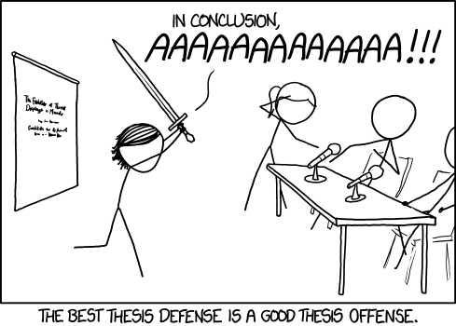
Practice Defensive Programming
Check
Precondition
Postcondition
Rep invariant
Other properties we know must hold
Loop invariants
Check statically via reasoning
“Statically” means before execution
Works in simpler cases can be difficult in general
Motivates us to simplify and/or decompose our code!
CSCI 2600 Spring 2021
25
Notes:
Do the checks in development/debugging; in production code if not too expensive.
25

Slide 26
Practice Defensive Programming
Check dynamically via assertions
At run time
assert index >= 0;
assert coeffs.length-1 == degree : “Bad rep”
assert coeffs[degree] != 0 : “Bad rep”
Write assertions, as you write code
Not to be confused with JUnit method such as assertEquals!
CSCI 2600 Spring 2021
26
Notes:
26

Slide 27
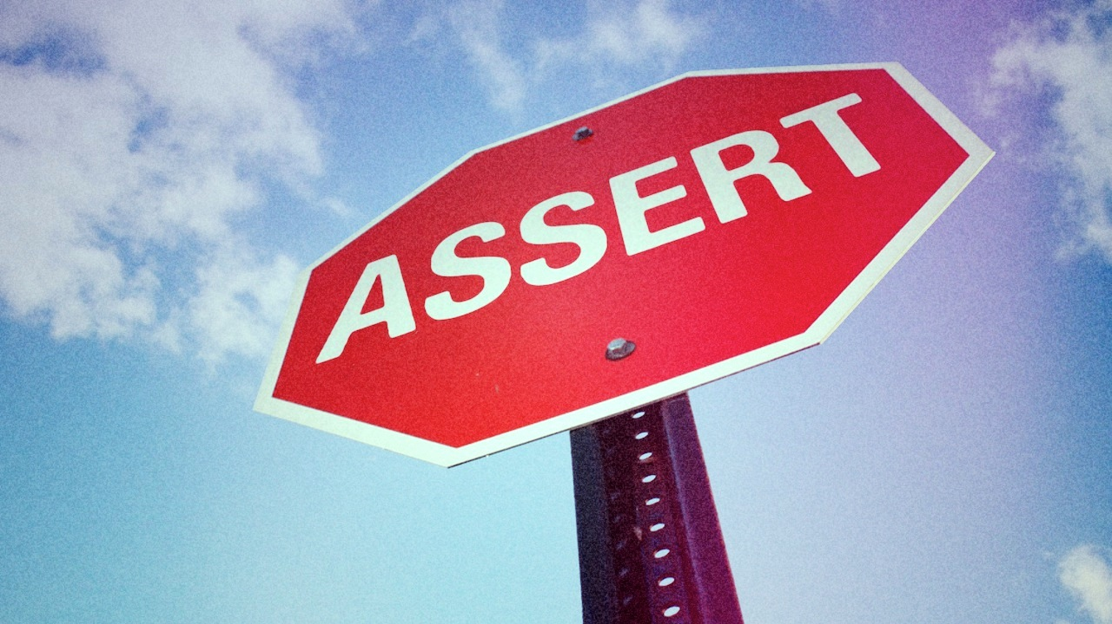
Assertions
java runs with assertions disabled (default)
Submitty run Java with assertions disabled
java –ea runs Java with assertions enabled
For Eclipse, see http://stackoverflow.com/questions/5509082/eclipse-enable-assertions
Always enable assertions during development. Turn off in rare circumstances
assert (index >= 0) && (index < names.length);
If assertion fails, program exits:
Exception in thread "main" java.lang.AssertionError
at Main.main(Main.java:34)
CSCI 2600 Spring 2021
27
Notes:
Check to see if assertions are enabled
int flag = 0;
assert ( (flag=1) == 1 );
If (flag) enabled;
else disabled;
Cleaner method
boolean assertsEnabled = false;
assert assertsEnabled = true; // Intentional side-effect!!! If assertions not enabled, nothing happens
// Now assertsEnabled is set to the correct value
27

Slide 28
When NOT to Use Assertions
Useless:
x = y+1;
assert x == y+1;
When there are side effects
assert list.remove(x);
// Better:
boolean found = list.remove(x);
assert found;
CSCI 2600 Spring 2021
28
Notes:
int flag = 0;
assert ( (flag=1) == 1 );
If (flag) enabled;
else disabled;
Cleaner method
boolean assertsEnabled = false;
assert assertsEnabled = true; // Intentional side- effect!!!
// Now assertsEnabled is set to the correct value
28

Slide 29
Check Assertions
Check to see if assertions are enabled
boolean assertEnabled;
int flag = 0;
assert ( (flag=1) == 1 );
if (flag == 1) assertEnabled = true;
else assertEnabled = false;
Cleaner method
boolean assertsEnabled = false;
// Intentional side-effect!!!
// If assertions not enabled, nothing happens
assert assertsEnabled = true;
// Now assertsEnabled is set to the correct value

Slide 30
Failure
Some causes of failure
1. Misuse of your code
Precondition violation
2. Errors in your code
Bugs, rep exposure, many more
3. Unpredictable external problems
Out of memory
Missing file
Memory corruption
Connection failure
Etc.
CSCI 2600 Spring 2021
30
Notes:
Java’s exception handling deals with failure.
30

Slide 31
What to Do When Something Goes Wrong?
Fail friendly, fail early to prevent harm
Goal 1: Give information
To the programmer, to the client code
Goal 2: Prevent harm
Abort: inform a human, cleanup, log error, etc.
Retry: problem might be temporary
E.g. file busy
Not always possible, be cautious
Skip subcomputation: permit rest of program to continue
Warn user this is happening
Fix the problem (usually infeasible)
Can be dangerous
CSCI 2600 Spring 2021
31
Notes:
31

Slide 32
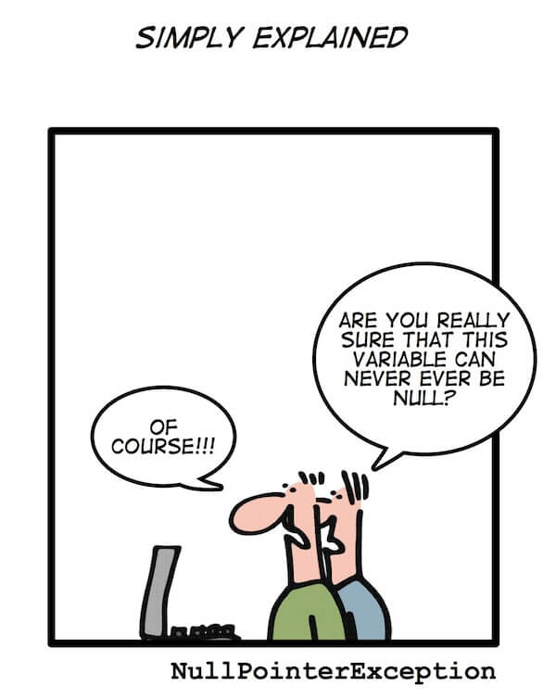
Preconditions vs. Exceptions
A precondition tells client not to misuse your code
Adding preconditions weakens the spec
A precondition ducks the problem
Behavior of your code when precondition is violated is unspecified!
Does not help clients violating precondition of your code
Removing a precondition requires specifying the new behavior.
Strengthens the spec
Example: specify that an exception is thrown
Exceptions specify behavior when some constraint is violated
It’s almost always better to specify behavior rather than leave it unspecified
CSCI 2600 Spring 2021
32
Notes:
32

Slide 33
Which One Is Better?
Choice 1:
// modifies: this
// effects: removes element at index from this
// throws: IndexOutOfBoundsException if index < 0 ||
// index >= this.size
public void remove(int index) {
if (index >= size() || index < 0)
throw new IndexOutOfBoundsException(“Info…”);
else
// remove element at index from collection
}
Choice 2:
// requires: 0 <= index < this.size
// modifies: this
// effects: removes element at index from this
public void remove(int index) {
// no check, remove element at index
}
CSCI 2600 Spring 2021
33
Notes:
#1 requires less of client, throws exception when index is out of bounds.
The second will probably throw an IndexOutOfBoundsException if the precondition is violated, but in Choice 1 the client is prepared for it.
The second specification also allows for an implementation that ignores the “remove” client request silently when index is out of bounds.
33

Slide 34
Preconditions vs. Exceptions
In certain cases, a precondition is the right choice
When checking would be expensive. E.g., array is sorted
In private methods
Whenever possible, remove preconditions from public methods and specify behavior
Often, this entails throwing an Exception
Stronger spec, easier to use by client
CSCI 2600 Spring 2021
34
Notes:
34

Slide 35
Square Root, With Precondition and Assertions
// requires: x >= 0
// returns: approximation to square root of x
public double sqrt(double x) {
assert x >= 0 : “Input must be >=0”;
double result;
… // compute result
return result;
}
CSCI 2600 Spring 2021
35
Notes:
But what if assertions are disabled?
This is still uninformative to the client, as behavior under misuse is unspecified! There are situations when the client would like to use sqrt with negative inputs and react appropriately to the outcome. But if the behavior under negative inputs is not specified, the client will not be able to use it with negative inputs!
35

Slide 36
Better: Square root, Specified for All Inputs
// throws: IllegalArgumentException if x < 0
// returns: approximation to square root of x
public double sqrt(double x)
throws IllegalArgumentException {
double result;
if (x < 0)
throw new IllegalArgumentException(“…”);
… // compute result
return result;
}
CSCI 2600 Spring 2021
36
Notes:
Doesn’t check result. That becomes client responsibility
36

Slide 37
Better: Square root, Specified for All Inputs
Client code:
try {
y = sqrt(-1);
} catch (IllegalArgumentException e) {
e.printStackTrace(); // or take same other action
}
Exception is handled by catch block associated with nearest dynamically enclosing try
Top-level handler: print stack trace, terminate program
CSCI 2600 Spring 2021
37
Notes:
37

Slide 38
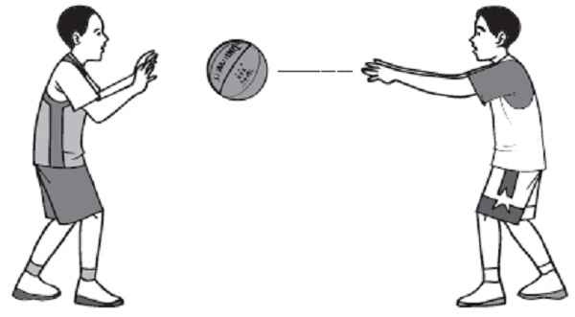
Throwing and Catching
Java maintains a call stack of methods that are currently executing
When an exception is thrown, control transfers to the nearest method with a matching catch block
If none found, top-level handler
Exceptions allow non-local error handling
A method far down the call stack can handle a deep error!
.
.
.
decodeChar
readChar
readLine
readFile
main
CSCI 2600 Spring 2021
38
Notes:
Is non-local handling good or bad? It may be hard to find where the error occurred, on the other hand, it makes non-error code clearer to read/write.
38

Slide 39
The finally Block
finally is always executed
No matter whether exception is thrown or not
Useful for clean-up code
FileWriter out = null;
try {
out = new FileWriter(…);
… write to out; may throw IOException
} finally {
if (out != null) {
out.close();
}
}
CSCI 2600 Spring 2021
39
Notes:
39

Slide 40
Propagating an Exception up the Call Chain
// throws: IllegalArgumentException if no real
// solution exists
// returns: x such that ax^2 + bx + c = 0
double solveQuad(double a, double b, double c)
throws IllegalArgumentException {
…
// exception thrown by sqrt is declared, // no need to catch it here
return (-b + sqrt(b*b – 4*a*c))/(2*a);
}
CSCI 2600 Spring 2021
40
Notes:
We can catch an exception or we can propagate an exception up the call chain.
Better to catch it and throw a more appropriate one, such as NoRealSolutionException.
40

Slide 41
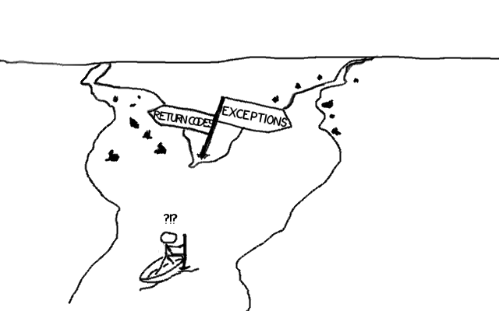
Informing the Client of a Problem
Special value
null – Map.get(x)
-1 – List.indexOf(x)
NaN – sqrt of negative number
Problems with using special value
Hard to distinguish from real values
Hard to propagate up call stack
Error-prone: programmer forgets to check result? The value is illegal and will cause problems later
Ugly
Exceptions are often a better solution
CSCI 2600 Spring 2021
41
Notes:
In C++, you may have handled this by returning a bool and passing result back by reference.
Another idea (particularly used in functional programming languages) is to return a pair, e.g.:
pair(bool, int) find(array,element)
returns (true, i) if array[i] == element
returns (false, i) if not found, and inserting element at index i would keep array sorted.
Functional languages have record types that make creating arbitrary “pairs” and pattern matching against them really easy.
41

Slide 42
Exceptions vs. Special Values
Why exceptions?
Handling special values is verbose
if(doSomething() == val1) {
if(doSomethingElse() == val2) {
if(doSomethingElseAgain() == val3) {
// etc.
}
else {
// react to failure of doSomethingElseAgain
}
}
else {
// react to failure of doSomethingElse
}
}
else {
// react to failure of doSomething
}
try {
doSomething() ;
doSomethingElse() ;
doSomethingElseAgain() ;
}
catch(SomethingException e1) {
// react to failure of doSomething
}
catch(SomethingElseException e2) {
// react to failure of doSomethingElse
}
catch(SomethingElseAgainException e3) {
// react to failure of doSomethingElseAgain
}
vs.

Slide 43
Exceptions vs. Special Values
Return codes can cause problems when ignored.
Method returns null reference; reference is used later in program.
Exceptions are typed.
So are special values, but a method can throw multiple types of exception
Methods can only return one type
Java.lang.Math returns NaN for many standard math functions
NaNs are "sticky"
SomeType o = add(a, div(b, c)) ;
May be difficult to know where NaN arose
General Rule of Thumb:
Throw when something should not happen
Return a special value when something unusual but generally expected can happen and client code can react to it.
Many (not all) java.lang.Math methods return NaN
Some post Java 7 methods throw ArithmeticException

Slide 44
Two Distinct Uses of Exceptions
(External) failures (e.g., device failure)
Unexpected by your code
Usually unrecoverable. If condition is left unchecked, exception propagates up the stack
Special results
Expected by your code
Always check and handle locally.
Maybe take special action and continue computing
May throw a module-level exception, e.g.
In solveQuad, catch an ArithmeticException and throw a NoRealSolutionException.
CSCI 2600 Spring 2021
44
Notes:
44

Slide 45
Java Exceptions: Checked vs. Unchecked Exceptions
Checked exceptions
Anything that is a subclass of java.lang.Exception
Except for RuntimeException
Unchecked Exceptions
Subclasses of java.lang.RuntimeException and Error
Calls throwing checked exceptions need to be enclosed in a try{} block or handled in a level above in the caller of the method.
In that case the current method must declare that it throws the exceptions so that the callers can make appropriate arrangements to handle the exception.
CSCI 2600 Spring 2021
45
Notes:
45

Slide 46
Java Exceptions: Checked vs. Unchecked Exceptions
Checked exceptions are checked at compile time.
The method must either handle the exception or it must specify the exception using throws keyword.
// compile error – FileReader, etc. throw IOException
// IOException is a checked exception
// compiler gives unhandled exception error
class Main {
public static void main(String[] args) {
FileReader file = new FileReader("C:\\test\\a.txt");
BufferedReader fileInput = new BufferedReader(file);
// Print first 3 lines of file "C:\test\a.txt"
for (int counter = 0; counter < 3; counter++)
System.out.println(fileInput.readLine());
fileInput.close();
}
}
Notes:
See IOExcDemo.java

Slide 47
Java Exceptions: Checked vs. Unchecked Exceptions
Checked are checked at compile time.
The method must either handle the exception or it must specify the exception using throws keyword.
Compiler checks that the exception is being handled
class Main {
public static void main(String[] args) throws IOException {
FileReader file = new FileReader("C:\\test\\a.txt");
BufferedReader fileInput = new BufferedReader(file);
// Print first 3 lines of file "C:\test\a.txt"
for (int counter = 0; counter < 3; counter++)
System.out.println(fileInput.readLine());
fileInput.close();
}
}

Slide 48
Java Exceptions: Checked vs. Unchecked Exceptions
Unchecked exceptions are not checked at compile time.
Exceptions under Error and RuntimeException classes are unchecked exceptions, everything else under throwable is checked.
In C++, all exceptions are unchecked
Checked exceptions are preferred
Compiler checks that exception will be handled
Error class exception should be used for serious problems.

Slide 49
Java Exceptions: Checked vs. Unchecked Exceptions
Checked exceptions. For special results
Library: must declare in signature
Client: must either catch or declare in signature
It is guaranteed there is a dynamically enclosing catch
Unchecked exceptions. For failures
Library: no need to declare
Client: no need to catch
RuntimeException and Error
Often indicates a code problem, i.e. a bug
From the JavaDoc documentation:
If a client can reasonably be expected to recover from an exception, make it a checked exception. If a client cannot do anything to recover from the exception, make it an unchecked exception
CSCI 2600 Spring 2021
49
Notes:
FileNotFound
49

Slide 50
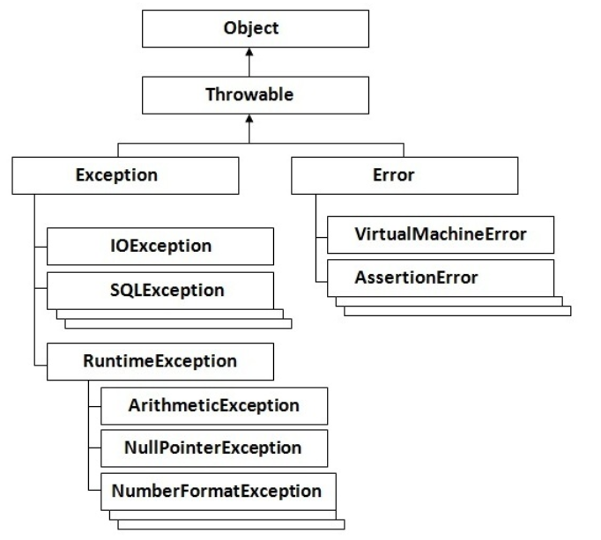
Should not be caught
In general, fix the problem

Slide 51
Don’t Ignore Exceptions
An empty catch block is poor style!
Often done to hide an error or get program to compile
try {
readFile(filename);
} catch (IOException e) {} // do nothing on error
At a minimum, print the exception
} catch (IOException e) {
e.printStackTrace();
}
CSCI 2600 Spring 2021
51
Notes:
51

Slide 52
Exceptions, review
Use an exception when
Checking the condition is feasible
Used in a broad or unpredictable context
Use a precondition when
Checking would be prohibitive
E.g., requiring that a list is sorted
Used in a narrow context in which calls can be checked
CSCI 2600 Spring 2021
52
Notes:
52

Slide 53
Exceptions, review
Avoid preconditions because
Caller may violate precondition
Program can fail in an uninformative or dangerous way
Program should fail as early as possible
Stronger preconditions -> Weaker specifications
Use checked exceptions most of the time
Handle exceptions sooner rather than later
CSCI 2600 Spring 2021
53
Notes:
53

Slide 54
Checked vs. Unchecked exceptions
Unchecked exceptions are better if clients will usually write code that ensures the exception will not happen
The exception reflects completely unanticipated failures
Otherwise, use a checked exception
Must be caught and handled – prevents program defects
Checked exceptions should be locally caught and handled
Checked exceptions that propagate long distance are bad design
If not caught, generates a program termination
Java sometimes uses null or NaN as special value
CSCI 2600 Spring 2021
54
Notes:
54

