Slide 1
Design Patterns
Notes:
1

Slide 2
Outline
The Unified Modeling Language (UML)
Design patterns
Intro to design patterns
Creational patterns
Factories: Factory method, Factory object, Prototype
Sharing: Singleton, Interning
Structural patterns
Adapter, Composite, Decorator, Proxy
CSCI 2600, Spring 2021
2
Notes:
2

Slide 3
UML Class Diagrams
Unified Modeling Language (UML) is the “lingua franca” of object-oriented modeling and design
Common language
UML class diagrams show classes, their interrelationships (inheritance and composition), their attributes and operations
UML sequence diagrams can also show dynamics of the system
CSCI 2600, Spring 2021
3
Notes:
UML has sequence diagrams as well, which are concerned with the dynamics of the system.
Sequence diagrams are less useful in general.
3

Slide 4
Classes and Inheritance
Shape
Editor
draw()
Notation: Boxes are classes (e.g., Shape, Circle).
denotes inheritance
(Square is a subclass of Shape.)
Italics denote abstract
(Shape is abstract, draw() is abstract)
Square
Circle
draw()
draw()
CSCI 2600, Spring 2021
4
Notes:
4
There is space for the attributes and space for the operations. I only show the operations.

Slide 5
Classes and Inheritance
<<interface>>
MapEntry
equals()
getKey() …
denotes interface inheritance
(SimpleEntry implements interface MapEntry)
ImmutableEntry extends abstract
class SimpleEntry
SimpleEntry
equals()
getKey() …
ImmutableEntry
getKey()
…
CSCI 2600, Spring 2021
5
Notes:
5
Is_a relationship
Is_a: class is a subclass of superclass.

Slide 6
Associations
top and next are associations
Stack
Link
class Stack { Link top;
…
}
class Link {
Link next;
int data;
…
}
top
next
push()
pop() …
int data
…
int data is an attribute
push() and pop() are operations
A UML association often represents a composition relationship: object of one class encloses the object(s) of the other. Above, Stack -> Link is a typical composition (has-a) relationship --- the Stack encloses/encapsulates its Link.
CSCI 2600, Spring 2021
6
Notes:
Note: usually UML classes show both fields (attributes) and methods (operations). But you can skip one part if you want.
Has-a relationships. – item enclosed in class. Class has_a some_other_class
6

Slide 7
Exercise
Draw a UML class diagram that shows the interrelationships between the classes from HW0
ObjectAid
http://objectaid.com/home
Add-on for Eclipse to draw class diagrams
There are many tools available for drawing, editing, and generating code from UML
CSCI 2600, Spring 2021
7
Notes:
7

Slide 8
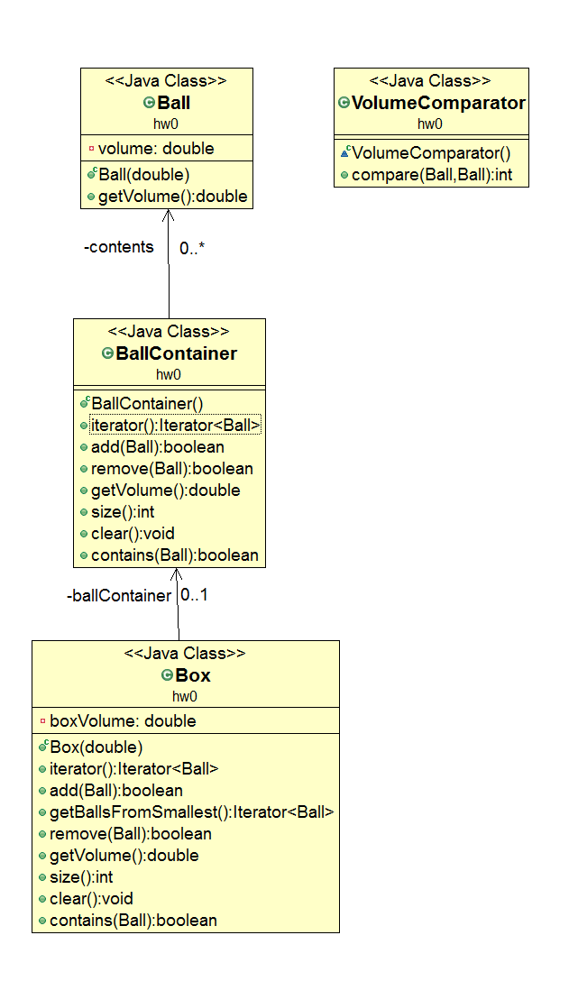
CSCI 2600, Spring 2021
8
Notes:
Temp/bworkspace_class/csci2600/src/hw0
ObjectAid from Eclipse marketplace was used to draw these.
New/Other…/ObjectAidClassDiagram
Drag class files to windows
8

Slide 9
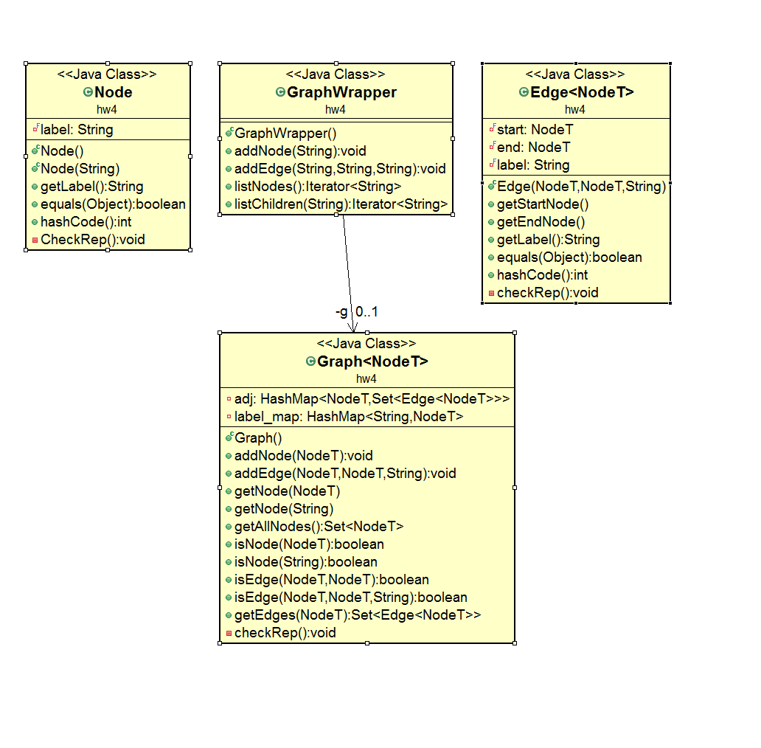
CSCI 2600, Spring 2021
9
Notes:
9

Slide 10
UML
Can use UML to model abstract concepts (e.g., Meeting) and their interrelationships
Attributes and associations correspond to specification fields
Operations correspond to ADT operations
Can use UML to express designs
Close correspondence to implementation
Attributes and associations correspond to representation fields
Operations correspond to methods
CSCI 2600, Spring 2021
10
Notes:
10

Slide 11
Solutions to common programming problems
Programming solutions
Encapsulation
Subclassing
Iteration
Exceptions
Generics
Notes:
https://courses.cs.washington.edu/courses/cse331/18au/lectures/lect10-design-patterns-1.pdf

Slide 12
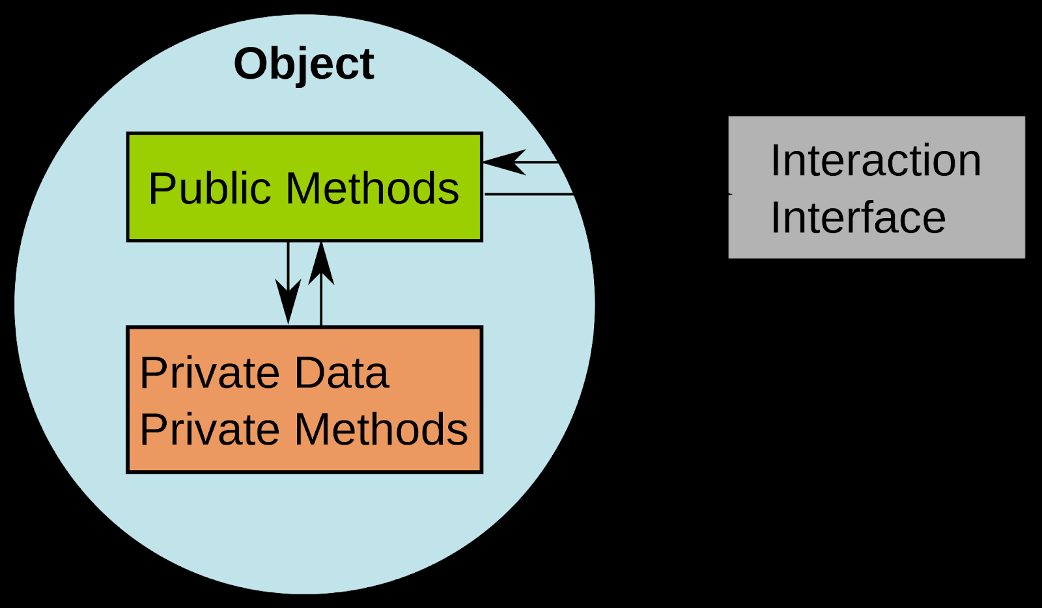
Encapsulation (information hiding)
Problem: Exposed fields can be directly manipulated
Violations of the representation invariant
Dependences prevent changing the implementation
Solution:
Hide some components
Constrain ways to access the object
Disadvantages:
Interface may not (efficiently) provide all desired operations
Indirection may reduce performance

Slide 13
Subclassing (inheritance)
Problem: Repetition in implementations
Similar abstractions have similar members (fields, methods)
Solution:
Inherit default members from a superclass
Select an implementation via run-time dispatching
Disadvantages:
Code for a class is spread out, and thus less understandable
Run-time dispatching introduces slight overhead

Slide 14
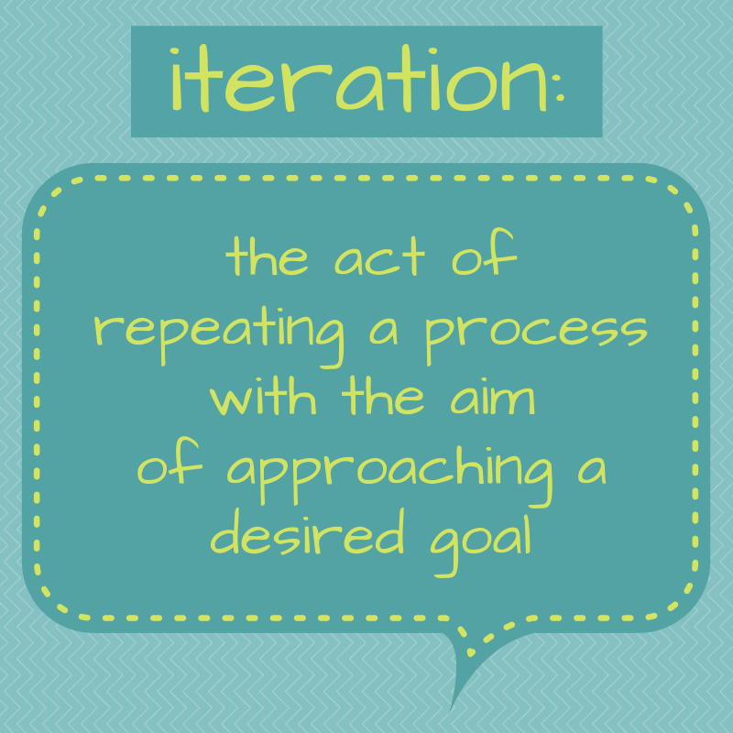
Iteration/Recursion
Problem: To access all members of a collection, must perform a specialized traversal for each data structure
Introduces undesirable dependences
Does not generalize to other collections
Solution:
The implementation performs traversals, does bookkeeping
The implementation has knowledge about the representation
Results are communicated to clients via a standard interface (e.g., hasNext(), next())
Disadvantages:
Iteration order is fixed by the implementation and not under the control of the client

Slide 15
Exceptions
Problem: Errors in one part of the code should be handled elsewhere.
Code should not be cluttered with error-handling code.
Return values should not be preempted by error codes.
Solution:
Language structures for throwing and catching exceptions
Disadvantages
Code may still be cluttered.
It may be hard to know where an exception will be handled.
Use of exceptions for normal control flow may be confusing and inefficient.

Slide 16
Generics
Problem: Well-designed data structures hold one type of object
Solution:
Programming language checks for errors in contents
List<Date> instead of just List
Disadvantages:
More verbose types

Slide 17
Other problems
Reuse implementation without subtyping
Reuse implementation, but change interface
Permit a class to be instantiated only once
Constructor that might return an existing object
Constructor that might return a subclass object

Slide 18
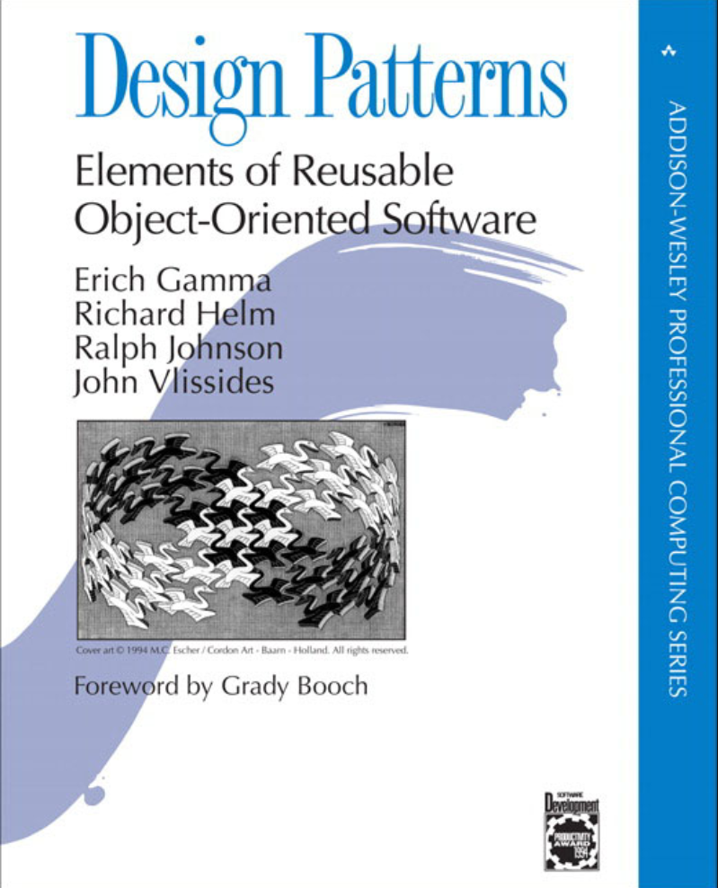
Design Patterns
A design pattern is a solution to a design problem that occurs over and over again
The reference: Gang of Four (GoF) book
“Design Patterns: Elements of Reusable Object-Oriented Software”, by Erich Gamma, Richard Helm, Ralph Johnson and John Vlissides (the Gang of Four), Addison Wesley 1995
Documents 23 still widely used design patterns
CSCI 2600, Spring 2021
18
Notes:
18

Slide 19
Design Patterns
Design patterns promote extensibility and reuse
Help build software that is open to extension but closed to modification
the “Open/Closed principle”
Majority of design patterns exploit subtype polymorphism
Design patterns are key in OOP
SOLID + Design Patterns
SRP The Single Responsibility Principle: -- a class should have one, and only one, responsibility.
OCP The Open Closed Principle: -- you should be able to extend a class's behavior, without modifying it.
LSP The Liskov Substitution Principle: -- derived classes must be substitutable for their base classes.
ISP The Interface Segregation Principle: -- Many client-specific interfaces are better than one general-purpose interface
DIP The Dependency Inversion Principle -- depend on abstractions not on concrete implementations.
CSCI 2600, Spring 2021
19
Notes:
19

Slide 20
Why Should You Care?
You can discover those solutions on your own
But you shouldn’t have to
A design pattern is a known solution to a known problem
Well designed software uses design patterns extensively
Understanding software requires knowledge of design patterns
Be careful
Design patterns are descriptive, not prescriptive
Give a common vocabulary for describing programming solutions
CSCI 2600, Spring 2021
20
Notes:
20

Slide 21
Why Should You Care?
Programming languages do not have built-in solutions to every problem
Best solution depends on context
Every language has shortcomings
So does every paradigm: OO, functional, declarative, ...
Language features often start out as design patterns

Slide 22
Design Patterns Don’t Solve All Problems
But, they can help
Get something basic working first
Improve it once you understand it - refactor
Design patterns can increase or decrease understandability
Improve modularity, separate concerns, ease description
Add indirection, increase code size
Use whatever increases maintainability and efficiency
If your design or implementation has a problem, consider design patterns that address that problem
Canonical reference: the "Gang of Four" book
Design Patterns: Elements of Reusable Object-Oriented Software by Erich Gamma, Richard Helm, Ralph Johnson, and John Vlissides, Addison-Wesley, 1995.
Another good reference for Java
Effective Java: Programming Language Guide by Joshua Bloch, Addison-Wesley, 2018.
CSCI 2600, Spring 2021
22
Notes:
22

Slide 23
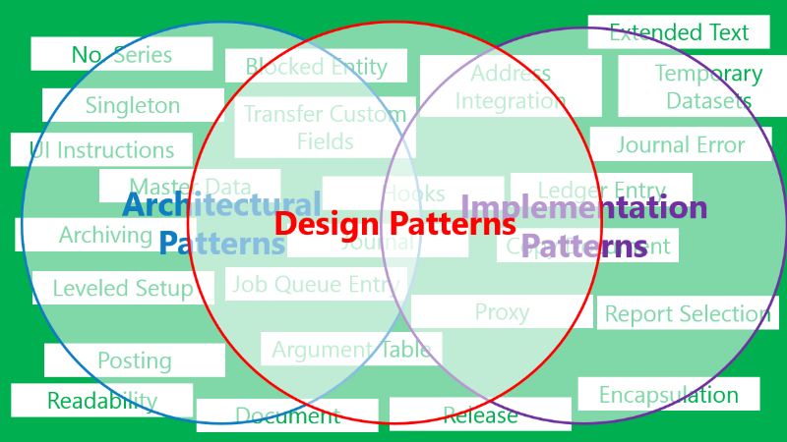
Design Patterns
Three categories
Creational patterns
Constructing objects
Abstract Factory, Builder, Factory, Prototype, Singleton
Structural patterns
Combining objects, control object structure
Adapter, Bridge, Composite, Decorator, Façade, Flyweight, Proxy
Behavioral patterns
Control object behavior
Chain of Responsibility, Command, Interpreter, Iterator, Mediator, Memento, Observer, State, Strategy, Template, Visitor
CSCI 2600, Spring 2021
23
Notes:
https://airbrake.io/blog/design-patterns/software-design-patterns-guide
23

Slide 24
Creational Patterns
Problem: constructors in Java (and other OO languages) are inflexible
1. Can’t create a subtype of the type to which they belong
2. Always return a fresh new object, can’t reuse the same object
“Factory” creational patterns present a solution to the first problem
Factory method, Factory object, Prototype
“Sharing” creational patterns present a solution to the second problem
Singleton, Interning
CSCI 2600, Spring 2021
24
Notes:
Singleton examples – a logger, a load balancer, drivers
24

Slide 25
Factories
Problem: client desires more control over object creation
Factory Method
Hides decisions about object creation
Implementation: Define an interface for creating an object, but let subclasses decide which class to instantiate
Factory object
Bundles factory methods for a family of types
Implementation: put code in a separate object
Prototype
Every object is a factory, can create more objects like itself
Implementation: put code in clone methods
CSCI 2600, Spring 2021
25
Notes:
25

Slide 26
Factory Patterns
Factory patterns are examples of creational patterns
Creational patterns abstract the object instantiation process.
They hide how objects are created and help make the overall
system independent of how its objects are created and composed.
Class Factory patterns use inheritance to decide the object to be instantiated
Factory Method
Object Factory patterns delegate the instantiation to another object
Factory Object
Also called Abstract Factory

Slide 27
Factory Method
Define an interface for creating an object, but let subclasses decide which
class to instantiate. Factory Method lets a class defer instantiation to
subclasses.
Use the Factory Method pattern in any of the following situations:
A class can't anticipate the class of objects it must create
A class wants its subclasses to specify the objects it creates
Create objects without exposing the creation logic to the client
Refer to newly created object using a common interface.

Slide 28
Factory Method
Subtypes support multiple implementations
Interface Matrix { ... }
class SparseMatrix implements Matrix { ... }
class DenseMatrix implements Matrix { … }
Clients use the supertype (Matrix)
Still need to use a SparseMatrix or DenseMatrix constructor
Switching implementations requires code changes
Matrix<Double> m = new DenseMatrix<Double>(100, 100);
CSCI 2600, Spring 2021
28
Notes:
28

Slide 29
Factory Instead
Factory
Clients call createMatrix, not a particular constructor
Advantages
To switch the implementation, only change one place
Can decide what type of matrix to create
Factory:
class MatrixFactory{
public static Matrix createMatrix(...) {
if (...)
return new SparseMatrix(...);
else
return new DenseMatrix(...);
}
}
Matrix m = MatrixFactory.createMatrix();
CSCI 2600, Spring 2021
29
Notes:
Static method, user calls
Matrix m = MatrixFactory.createMatrix();
29

Slide 30
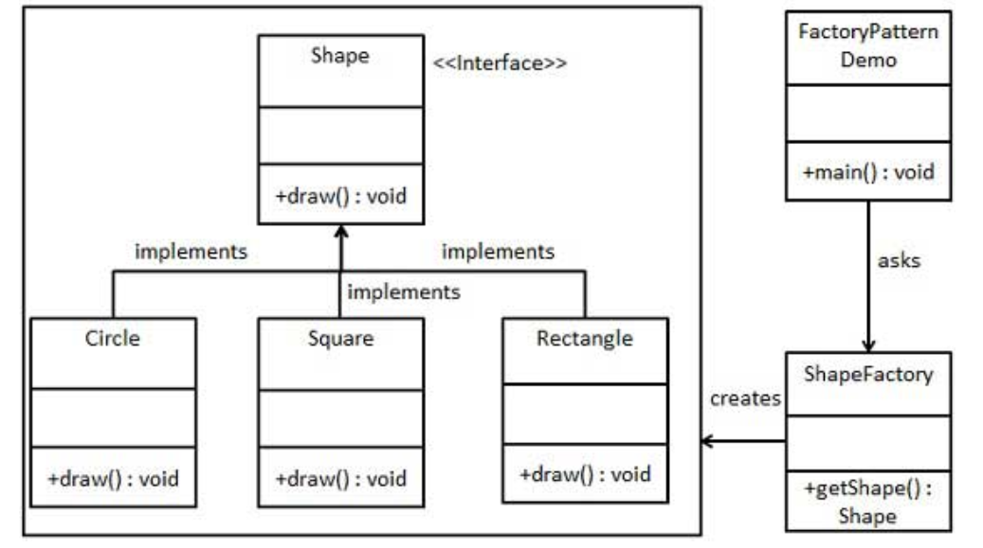
Example: A Shape Factory
https://www.tutorialspoint.com/design_pattern/factory_pattern.htm
CSCI 2600, Spring 2021
30
Notes:
FactoryPattern.java
30

Slide 31
public interface Shape {
void draw();
}
public class ShapeFactory {
//use getShape method to get object of type shape
public Shape getShape(String shapeType){
if(shapeType == null){
return null; // maybe better to throw an exception?
}
if(shapeType.equalsIgnoreCase("CIRCLE")){
return new Circle();
} else if(shapeType.equalsIgnoreCase("RECTANGLE")){
return new Rectangle();
} else if(shapeType.equalsIgnoreCase("SQUARE")){
return new Square();
}
return null; // maybe better to throw an exception
}
}
public class Rectangle implements Shape {
@Override
public void draw() {
System.out.println("Inside Rectangle::draw() method.");
}
}
public class Square implements Shape {
@Override
public void draw() {
System.out.println("Inside Square::draw() method.");
}
}
// similar for circle etc.
Notes:
See FactoryPatternDemo.java
31

Slide 32
public class FactoryPatternDemo {
public static void main(String[] args) {
ShapeFactory shapeFactory = new ShapeFactory();
//get an object of Circle and call its draw method.
Shape shape1 = shapeFactory.getShape("CIRCLE");
//call draw method of Circle
shape1.draw();
//get an object of Rectangle and call its draw method.
Shape shape2 = shapeFactory.getShape("RECTANGLE");
//call draw method of Rectangle
shape2.draw();
//get an object of Square and call its draw method.
Shape shape3 = shapeFactory.getShape("SQUARE");
//call draw method of circle
shape3.draw();
}
}
Notes:
32

Slide 33
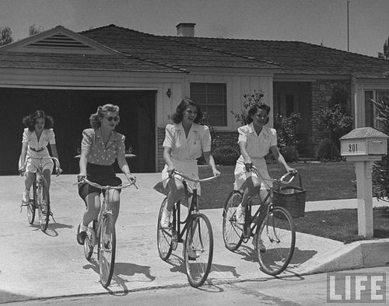
Another Example
class Race {
Race createRace() {
Bicycle bike1 = new Bicycle();
Bicycle bike2 = new Bicycle(); …
}
}
class TourDeFrance extends Race {
Race createRace() {
Bicycle bike1 = new RoadBicycle();
Bicycle bike2 = new RoadBicycle(); …
}
}
class Cyclocross extends Race {
Race createRace() {
Bicycle bike1 = new MountainBicycle();
Bicycle bike2 = new MountainBicycle(); …
}
}
CSCI 2600, Spring 2021
33
Notes:
Problem with this code:
Code duplication: createRace is very similar among the 3 classes, why not have a single createRace in Race?
33

Slide 34
Using a Factory Method
class Race {
Bicycle createBicycle() { … }
Race createRace() {
Bicycle bike1 = this.createBicycle();
Bicycle bike2 = this.createBicycle(); …
}
}
class TourDeFrance extends Race {
Bicycle createBicycle() {
return new RoadBicycle();
}
}
class Cyclocross extends Race {
Bicycle createBicycle() {
return new MountainBicycle();
}
}
Factory
CSCI 2600, Spring 2021
34
Notes:
See Bicycle1Demo.java
Where is the Factory Method? createBicycle()
this.createBicycle calls appropriate method
Race t = new TourDeFrance();
t.createRace(); // calls Race.createRace()
Race,createRace() calls this,createBicycle() – this is a TourDeFance
34

Slide 35
Factory Method
Where is the Factory Method?
createBicycle()
this.createBicycle calls appropriate method
Race t = new TourDeFrance();
t.createRace(); // calls Race.createRace()
Race.createRace() calls this.createBicycle()
this is a TourDeFrance object, so TourDeFrance.createBicycle() is called
Returns a RoadBicycle

Slide 36
Parallel Hierarchies
Can extend with new Races and Bikes with no modification to createRace!
Bicycle
Race
Client
setSpeed()
…
createBicycle()
createRace();
Creates
RoadBicycle
MountainBicycle
TourDeFrance
Cyclocross
setSpeed()
…
setSpeed()
…
createBicycle()
createBicycle()
CSCI 2600, Spring 2021
36
Notes:
In our case, Client doesn’t need access to the Bicycle interface.
We can create a new bicycle type and a new kind of race by subclassing bicycle and race.
For example, we could create a TriCycle bike and a TriCycle race without modifying the superclasses.
Subtype polymorphism --- subtyping in Races and subtyping in Bicycles.
36

Slide 37
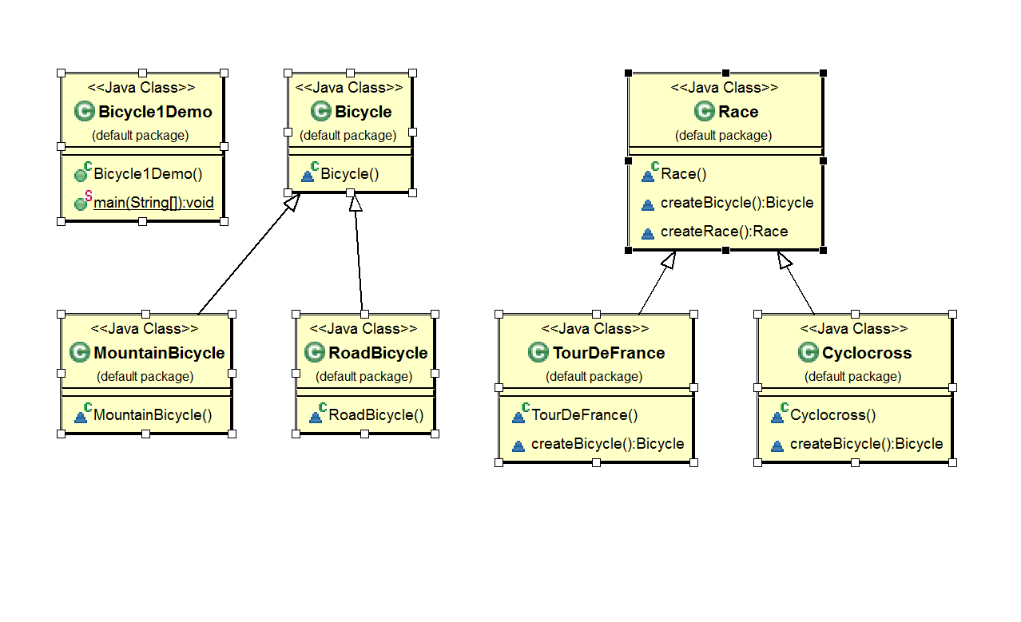
CSCI 2600, Spring 2021
37
Notes:
Bicycle1Demo.java
37

Slide 38
Maze Game
public Maze createMaze() {
Maze maze = new Maze();
Room r1 = new Room(1);
Room r2 = new Room(2);
Door door = new Door(r1, r2);
maze.addRoom(r1);
maze.addRoom(r2);
r1.setSide(Direction.NORTH, new Wall());
…
return maze;
}

Slide 39
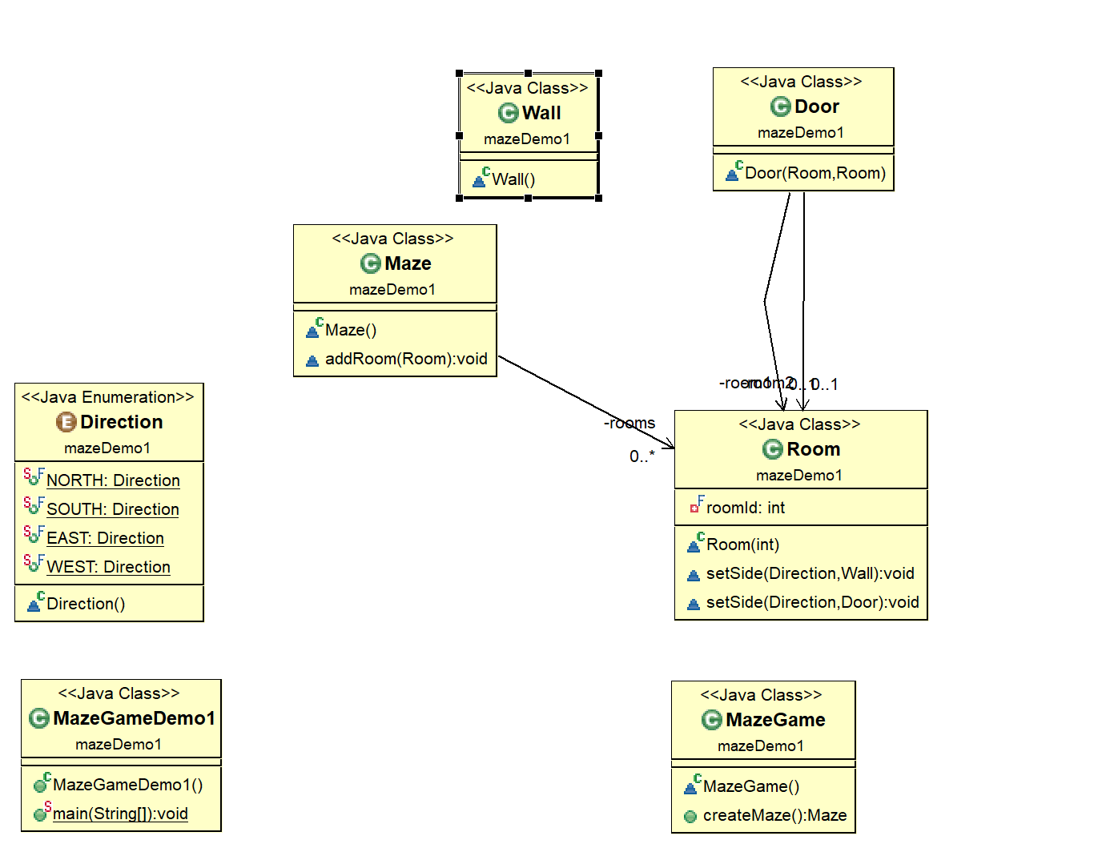
Maze Game
Notes:
See MazeGameDemo1.java

Slide 40
Maze Game
The problem with this createMaze() method is its
inflexibility.
What if we wanted to have enchanted mazes with
EnchantedRooms and EnchantedDoors?
Or a secret agent maze with DoorWithLock and WallWithHiddenDoor?
We would have to make significant edits

Slide 41
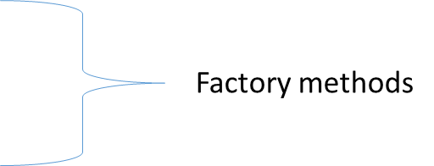
Maze Game version 2
class MazeGame {
// Create the maze.
public Maze makeMaze() {return new Maze();}
public Room makeRoom(int n) {return new Room(n);}
public Wall makeWall() {return new Wall();}
public Door makeDoor(Room r1, Room r2)
{return new Door(r1, r2);}
public Maze createMaze() {
Maze maze = this.makeMaze();
Room r1 = this.makeRoom(1);
Room r2 = this.makeRoom(2);
Door door = this.makeDoor(r1, r2);
// the rest is the same as before ...
…
}

Slide 42
Maze Game version 2
We made createMaze() just slightly more complex, but a lot more
flexible!
Consider this EnchantedMazeGame class:
public class EnchantedMazeGame extends MazeGame {
public Room makeRoom(int n) {return new EnchantedRoom(n);}
public Wall makeWall() {return new EnchantedWall();}
public Door makeDoor(Room r1, Room r2)
{return new EnchantedDoor(r1, r2);}
}
The createMaze() method of MazeGame is inherited by
EnchantedMazeGame and can be used to create regular mazes or
enchanted mazes without modification

Slide 43
Maze Game version 2
We can extend MazeGame to make an EnchantedMazeGame
Override makeRoom() etc. Like we did with Bicycle to return specialized rooms, walls, etc.

Slide 44
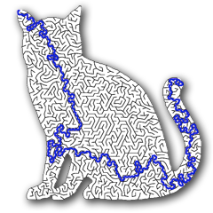
Yet Another Factory Method
Abstraction
abstract class MazeGame {
abstract Room createRoom();
abstract Wall createWall();
abstract Door createDoor();
Maze createMaze() {
…
Room r1 = createRoom(); Room r2 = …
Wall w1 = createWall(r1,r2);
Door d1 = createDoor(w1);
…
}
…
}
Factory methods
CSCI 2600, Spring 2021
44
Notes:
See http://www.buyya.com/254/Patterns/Factory-2pp.pdf
Where are the Factory methods: createRoom, createWall, createDoor.
Abstract classes can be extended but not implemented. You can’t do new MazeGame()
You override the abstract methods. If you don’t then must declare the same abstract method.
44

Slide 45
Yet Another Factory Method Example
class EnchantedMazeGame extends MazeGame {
Room createRoom() {
return new EnchantedRoom(castSpell());
}
Wall createWall(Room r1, Room r2) {
return
new EnchantedWall(r1,r2,castSpell());
}
Door createDoor(Wall w) {
return new EnchantedDoor(w,castSpell());
}
}
// Inherits createMaze from MazeGame
CSCI 2600, Spring 2021
45
Notes:
An Enchanted Maze Game defines its own implementation for the products (Rooms, Walls, Doors).
There will also be a Wall interface and subtype EnchantedWall
45

Slide 46
Yet Another Factory Method Example
class BombedMazeGame extends MazeGame {
Room createRoom() {
return new RoomWithBomb();
}
Wall createWall(Room r1, Room r2) {
return new BombedWall(r1,r2);
}
Door createDoor(Wall w) {
return new DoorWithBomb(w);
}
}
// Again, inherit createMaze from MazeGame
CSCI 2600, Spring 2021
46
Notes:
An Bombed Maze Game defines its own implementation for the products (Rooms, Walls, Doors).
46

Slide 47
Factories
The Bicycle and Maze examples conform with the GoF definition of Factory method
Parallel hierarchy of Objects and their Products and each Object class creates its own product.
The term “factory method” is used outside of this context.
In general “Factory method” refers to any method that can return a Product (maybe a subtype), depending on the context.

Slide 48
Factory Object
Also know as Abstract Factory
The responsibility of object creation is delegated to a factory object
Provide an interface for creating families of related or dependent objects
without specifying their concrete classes.
The Factory Object pattern is very similar to the Factory Method pattern.
The main difference between the two is that with the Factory Object
pattern, a class delegates the responsibility of object instantiation to
another object via composition
The Factory Method pattern uses inheritance and relies on a subclass
to handle the desired object instantiation.
Actually, the delegated object frequently uses factory methods to perform
the instantiation!

Slide 49
Bicycle Factory Object
class BicycleFactory {
Bicycle createBicycle() { ... }
Frame createFrame() { ... }
Wheel createWheel() { ... }
...
}
class RoadBicycleFactory extends BicycleFactory {
Bicycle createBicycle() {
return new RoadBicycle();
}
}
class MountainBicycleFactory extends BicycleFactory {
Bicycle createBicycle() {
return new MountainBicycle();
}
}
CSCI 2600, Spring 2021
49
Notes:
Bicycle2Demo.java
We can extend this idea and encapsulate the creation of bicycles.
49

Slide 50
Using a Factory Object
class Race {
BicycleFactory bfactory;
// constructor
Race() {
bfactory = new BicycleFactory();
}
Race createRace() {
Bicycle bike1 = bfactory.createBicycle();
Bicycle bike2 = bfactory.createBicycle();
...
}
}
class TourDeFrance extends Race {
// constructor
TourDeFrance() {
bfactory = new RoadBicycleFactory();
…
}
}
class Cyclocross extends Race {
// constructor
Cyclocross() { bfactory = new MountainBicycleFactory();
…
}
CSCI 2600, Spring 2021
50
Notes:
Bicycle2Demo.java
Calls appropriate bfactory to create a bicycle
Race t = new TourDeFrance();
t.createRace();
Runtime t is aTourDeFrance
TourDeFrance constructor creates a bfactory = RoadBicycleFactory object
t.createRace() calls bfactory.createBicycle()
50

Slide 51
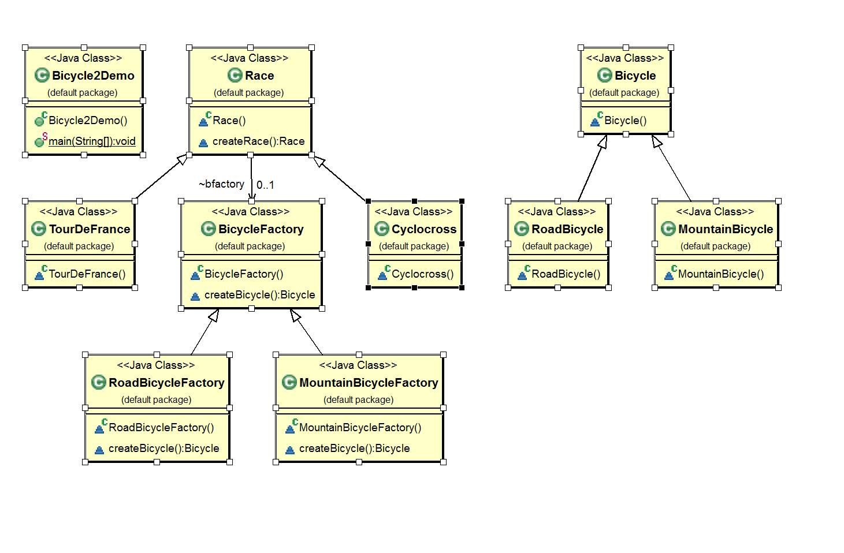
CSCI 2600, Spring 2021
51
Notes:
Bicycle2Demo.java
51

Slide 52
Let’s Use Factory Object
class Race {
BikeFactory bfactory;
Race() { bfactory = new BikeFactory(); }
Race createRace() {
Bicycle bike1 = bfactory.createBicycle();
Bicycle bike2 = bfactory.createBicycle();
…
}
}
class TourDeFrance extends Race {
// constructor
TourDeFrance() {
bfactory = new RoadBikeFactory()
}
}
// analogous constructor for Cyclocross
CSCI 2600, Spring 2021
52
Notes:
52

Slide 53
The Factory Hierarchy
class BikeFactory {
Bicycle createBicycle() {}
Frame createFrame() { … }
Wheel createWheel() { … }
}
class RoadBikeFactory extends BikeFactory {
Bicycle createBicycle() {
return new RoadBicycle();
}
}
class MountainBikeFactory extends BikeFactory {
Bicycle createBicycle() {
return new MountainBicycle();
}
}
Factory methods encapsulated
into Factory classes
CSCI 2600, Spring 2021
53
Notes:
53

Slide 54
Separate Control Over Races and Bicycles
Control over Bike creation is now passed to BikeFactory
class Race {
BikeFactory bfactory;
Race(BikeFactory bfactory) {
this.bfactory = bfactory;
}
Race createRace() {
Bicycle bike1 = bfactory.createBicycle();
Bicycle bike2 = bfactory.createBicycle();
…
}
}
No special constructor for TourDeFrance and Cyclocross
CSCI 2600, Spring 2021
54
Notes:
See Bicycle3.Demo.java
54

Slide 55
Separate Control Over Races and Bicycles
Client can specify the race and the bicycle separately:
Race race=new TourDeFrance(new TricycleFactory());
To specify a different race/bicycle need only change one line:
Race race=new Cyclocross(new TricycleFactory());
or
Race race=new Cyclocross(new MountainBikeFactory());
Rest of code, uses Race, stays the same!
CSCI 2600, Spring 2021
55
Notes:
What’s the advantages of this Factory Class design over Factory Method?
Answer: Now Races and Bikes can vary independently: We can crate a Cyclocross with Trycicles etc. With FactoryMethod each Product was tied to a particular Race. TourDeFrance -> RoadBikes, Cyclocross -> MountainBikes.
Race t = new TourDeFrance(new MountainBicycleFactory());
t.createRace();
TourDeFrance passes MountainBikeFactory objects to constructor
Constructor pass object to Race constructor
Race constructor sets this (TourDeFrance) bfactory to MountainBikeObject
createRace calls .bfactory.createBicycle which return a mountain bike
Easy to extend with new Races and New Bikes. Easy to make change in client code without affecting most of the existing code.
55

Slide 56
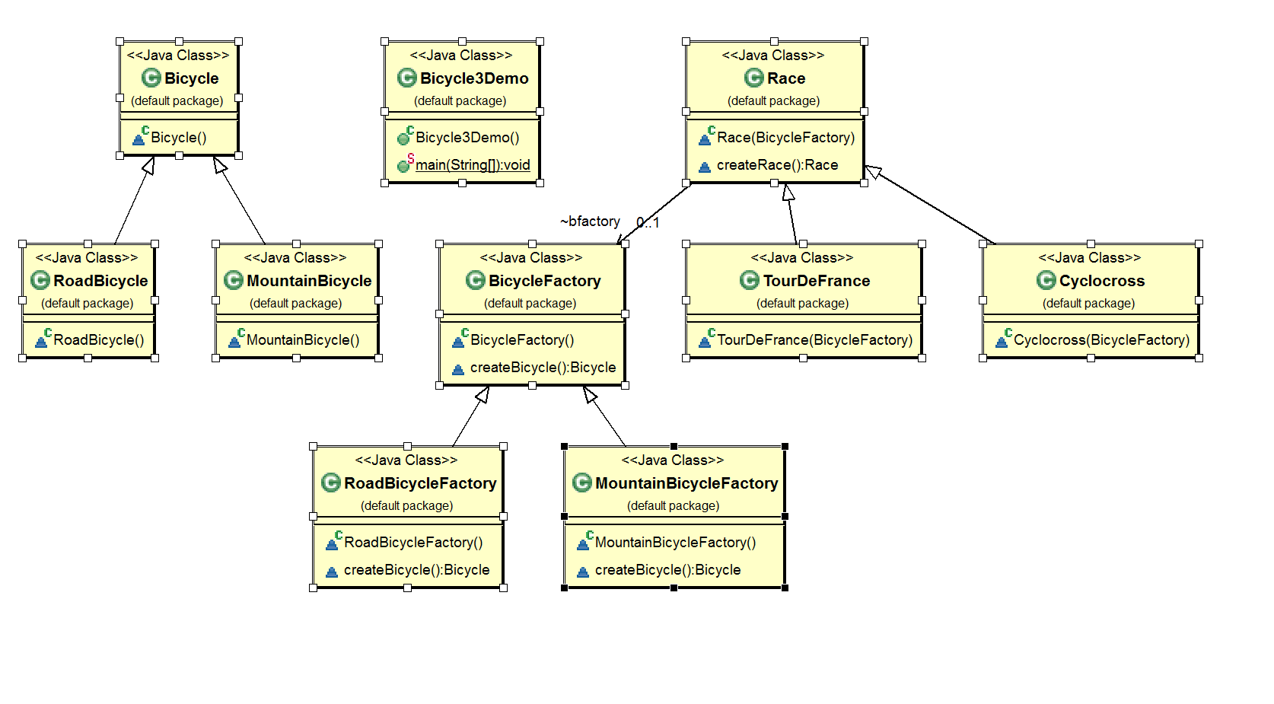
CSCI 2600, Spring 2021
56
Notes:
See Bicycle3.Demo.java
56

Slide 57
Bicycle Factories
In the Bicycle factory method, Race class is the factory
createRace() uses createBicycle() to instantiate bikes
Subclasses override createBicycle() to return appropriate bike type
In Bicycle object factory, Race class contains a BicycleFactory Object
Race uses factory object to create bikes
Subclasses instantiate the appropriate BicycleFactory object
We can also pass the BicycleFactory object to the subclass constructors
For example, TourDeFrance could use MountainBicycleFactory or RoadBicycleFactory

Slide 58
Extended Example
http://www.fluffycat.com/Java-Design-Patterns/Factory-Method/
Extended example of a Soup Factory
CSCI 2600, Spring 2021
58
Notes:
58

Slide 59
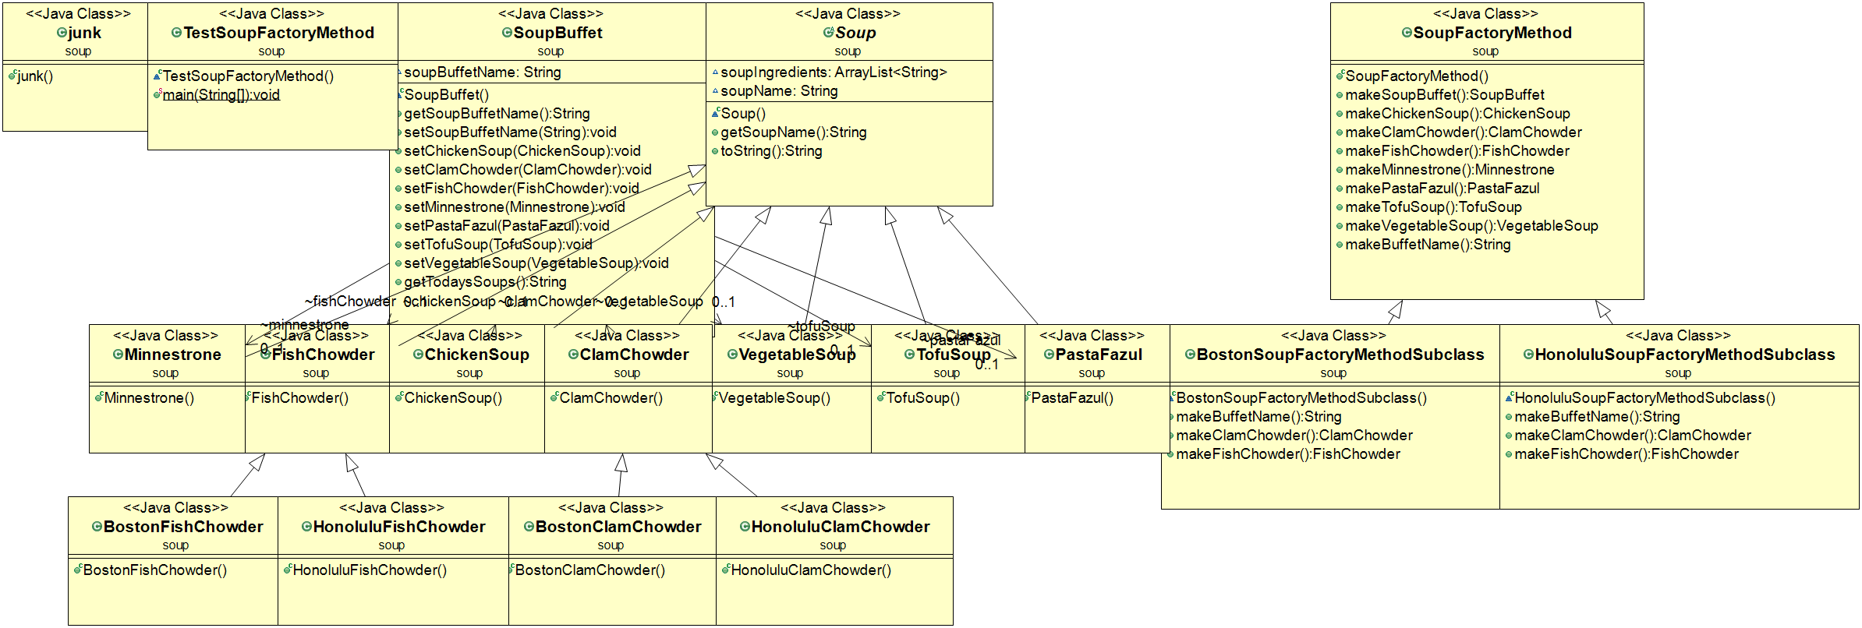
CSCI 2600, Spring 2021
59
Notes:
59

Slide 60
Factories in the JDK
DateFormat class encapsulates knowledge on how to format a Date
Options: Just date, Just time, date+time, where in the world.
DateFormat df1 = DateFormat.getDateInstance();
DateFormat df2 = DateFormat.getTimeInstance();
DateFormat df3 = DateFormat.getDateInstance
(DateFormat.FULL.Locale.FRANCE);
DateFormat.getDateInstance(); returns an object that can create the appropriate type of date, i.e. a factory.
Date today = new Date();
df1.format(today); // “Jul 4, 1776”
df2.format(today); // “10:15:00 AM”
df3.format(today); // “jeudi 4 juillet 1776”
CSCI 2600, Spring 2021
60
Notes:
Most DateFormat methods are all static, return a DateFormatter object.
The examples I used so far conform with the GoF definition of Factory method: we have the parallel hierarchy of Objects and their Products and each Object class creates its own product.
The term “factory method” is used outside of this context. In general “Factory method” refers to any method that can return a Product (maybe a subtype), depending on the context.
DateFormat.getDateInstance(); returns an object that can create the appropriate type of date, i.e. a factory.
60

Slide 61
Functional Factory Pattern
Replace factory class with a Supplier
function method that “supplies” an object
interface Bicycle {
Bicycle getBike();
}
class MountainBicycle implements Bicycle {
public Bicycle getBike() {
System.out.println("Mountain Bicycle");
return this;
}
}
final Supplier<Bicycle> mountainBikeFactory = () -> {
return new MountainBicycle();
};
To use it
Bicycle b1 = mountainBikeFactory.get().getBike();
Notes:
See FunBicycleDemo.java
Java Supplier is a functional interface that represents a supplier of results.
It has a get method to return that result.

Slide 62
Dependency Injection
In Java, we can decide what Factory to initialize with at runtime
An external file specifies a value for “BikeFactory”, factory in plain text, say “TricycleFactory”
Read file and uses Java reflection to load and instantiate class, TricycleFactory
CSCI 2600, Spring 2021
62
Notes:
String factory = // String read from file
Class factoryClazz = Class.forName(factory);
BikeFactory bfactory = (BikeFactory) factoryClazz.newInstance();
62

Slide 63
Dependency Injection
public static void main(String[] args) {
try {
File f = new File("Data/bikefactory");
BufferedReader b = new BufferedReader(new FileReader(f));
String factory = b.readLine(); // get the factory type from file
if(factory != null) {
// need to add package so forName can find the class
Class factoryClazz = Class.forName(factory);
BicycleFactory bfactory = (BicycleFactory) factoryClazz.newInstance();
Race t = new TourDeFrance(bfactory); // we could change bike type here
t.createRace();
}
} catch (IOException | ClassNotFoundException e) {
e.printStackTrace();
} catch (InstantiationException e) {
e.printStackTrace();
} catch (IllegalAccessException e) {
e.printStackTrace();
}
}
CSCI 2600, Spring 2021
63
Notes:
See InjectionDemo.java
Read “TricycleFactory” from file
63

Slide 64
Factory Pattern
Factory pattern encapsulates creation of different variations of objects
Factory method
Factory object
Helps overcome limitations of object constructors
CSCI 2600, Spring 2021
64
Notes:
64

Slide 65
The Prototype Pattern
Every object itself is a factory
Each class can define a clone method that returns a copy of the receiver object
class Bicycle {
Bicycle clone() { … }
}
Often Object is the return type of clone
Object class declares protected Object clone()
CSCI 2600, Spring 2021
65
Notes:
65

Slide 66
Prototype
Prototype interface creates a clone of the current object.
Useful when creation of the object directly is costly.
For example, an object is to be created after a costly database operation
Cache the object
return its clone on next request
only update the database when needed
Reduces database calls
CSCI 2600, Spring 2021
66
Notes:
66

Slide 67
Java Clone
Dictionary: “make an identical copy of“.
By default, Java cloning is “field by field copy”
Object class has clone() method
Object class does not have idea about the structure of class on which clone() method will be invoked.
JVM when called for cloning, does the following things:
If the class has only primitive data type members then a completely new copy of the object will be created and the reference to the new object copy will be returned.
If the class contains members of any class type then only the object references to those members are copied
The member references in both the original object as well as the cloned object refer to the same object.
You can always override this behavior and specify your own. This is done by overriding the clone() method.

Slide 68
Java Clone
If a class needs to support cloning it has to do following things:
You must implement Cloneable interface.
You must override clone() method from Object class.
clone() method is not in Cloneable interface
A class implements the Cloneable interface to indicate to the Object.clone() method that it is legal for that method to make a field-for-field copy of instances of that class.
Invoking Object's clone method on an instance that does not implement the Cloneable interface results in the exception CloneNotSupportedException being thrown.

Slide 69
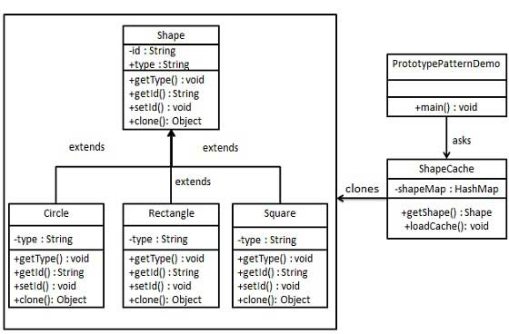
https://www.tutorialspoint.com/design_pattern/prototype_pattern.htm
CSCI 2600, Spring 2021
69
Notes:
See PrototypeDemo2.java
69

Slide 70
public abstract class Shape implements Cloneable {
private String id;
protected String type;
abstract void draw();
public String getType(){
return type;
}
public String getId() {
return id;
}
public void setId(String id) {
this.id = id;
}
public Object clone() {
Object clone = null;
try {
clone = super.clone(); // call Object.clone()
} catch (CloneNotSupportedException e) {
e.printStackTrace();
}
return clone;
}
}
public class Rectangle extends Shape {
public Rectangle(){
type = "Rectangle";
}
@Override
public void draw() {
System.out.println("Inside Rectangle::draw() method.");
}
}
// similar classes for Circle and Square
CSCI 2600, Spring 2021
70
Notes:
Object.clone() returns a copy of the object.
Note that Shape implements the Cloneable interface.
70

Slide 71
import java.util.Hashtable;
public class ShapeCache {
private static Hashtable<String, Shape> shapeMap = new Hashtable<String, Shape>();
public static Shape getShape(String shapeId) {
Shape cachedShape = shapeMap.get(shapeId);
return (Shape) cachedShape.clone(); // return a clone of the object
}
// for each shape run database query and create shape
// shapeMap.put(shapeKey, shape);
// for example, we are adding three shapes
public static void loadCache() {
Circle circle = new Circle();
circle.setId("1");
shapeMap.put(circle.getId(),circle);
Square square = new Square();
square.setId("2");
shapeMap.put(square.getId(),square);
Rectangle rectangle = new Rectangle();
rectangle.setId("3");
shapeMap.put(rectangle.getId(), rectangle);
}
}
CSCI 2600, Spring 2021
71
Notes:
71

Slide 72
public class PrototypePatternDemo {
public static void main(String[] args) {
ShapeCache.loadCache();
Shape clonedShape = (Shape) ShapeCache.getShape("1");
System.out.println("Shape : " + clonedShape.getType());
Shape clonedShape2 = (Shape) ShapeCache.getShape("2");
System.out.println("Shape : " + clonedShape2.getType());
Shape clonedShape3 = (Shape) ShapeCache.getShape("3");
System.out.println("Shape : " + clonedShape3.getType());
}
}
Output:
Shape : Circle
Shape : Square
Shape : Rectangle
CSCI 2600, Spring 2021
72
Notes:
72

Slide 73
Using Prototypes
class Race {
Bicycle bproto;
// constructor
Race(Bicycle bproto) {
this.bproto = bproto;
}
Race createRace() {
Bicycle bike1 = bproto.clone();
Bicycle bike2 = bproto.clone();
…
}
}
How do we specify the race and the bicycle?
new TourDeFrance(new Tricycle());
CSCI 2600, Spring 2021
73
Notes:
See Bicycle4Demo.java
73

Slide 74
Are clones dangerous?
Object.clone() performs field (variable) by field copy
If fields are references, reference is copied
The fields in the original and the clone refer to the same objects
If the class allows changes to a referenced object, it is changed for both objects.
Same problem for Lists, Maps, etc.
If you make a copy, only references are copied
If the references refer to mutable objects, they can be changed – possible rep exposure
To avoid this make a deep copy
Make a clone of each referenced object recursively
Watch out for sets or arrays of mutable objects

Slide 75
Sharing
Recall that constructors always create a new object, never a pre-existing one
In many situations, we would like a pre-existing object
Singleton pattern: only one object ever exists
A factory object is almost always a singleton
Device drivers, music players, database interface
Interning pattern: only one object with a given abstract value exists
CSCI 2600, Spring 2021
75
Notes:
75

Slide 76
Singleton Pattern
Motivation: there must be a single instance of the class
class Bank {
private Bank() { … }
private static Bank instance;
public static Bank getInstance() {
if (instance == null)
instance = new Bank();
return instance;
}
// methods of Bank
}
Factory method --- it produces
the instance of the class
CSCI 2600, Spring 2021
76
Notes:
The private constructor means that clients cannot directly create Bank objects.
76

Slide 77
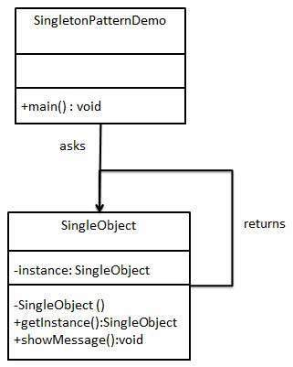
https://www.tutorialspoint.com/design_pattern/singleton_pattern.htm
CSCI 2600, Spring 2021
77
Notes:
See SingletonPatternDemo.java
77

Slide 78
public class SingleObject {
//create an object of SingleObject
// executed when object is loaded
private static SingleObject instance = new SingleObject();
//make the constructor private so that this class cannot be
//instantiated from the ouside
private SingleObject(){}
//Get the only object available
public static SingleObject getInstance(){
return instance;
}
public void showMessage(){
System.out.println("Hello World!");
}
}
CSCI 2600, Spring 2021
78
Notes:
78

Slide 79
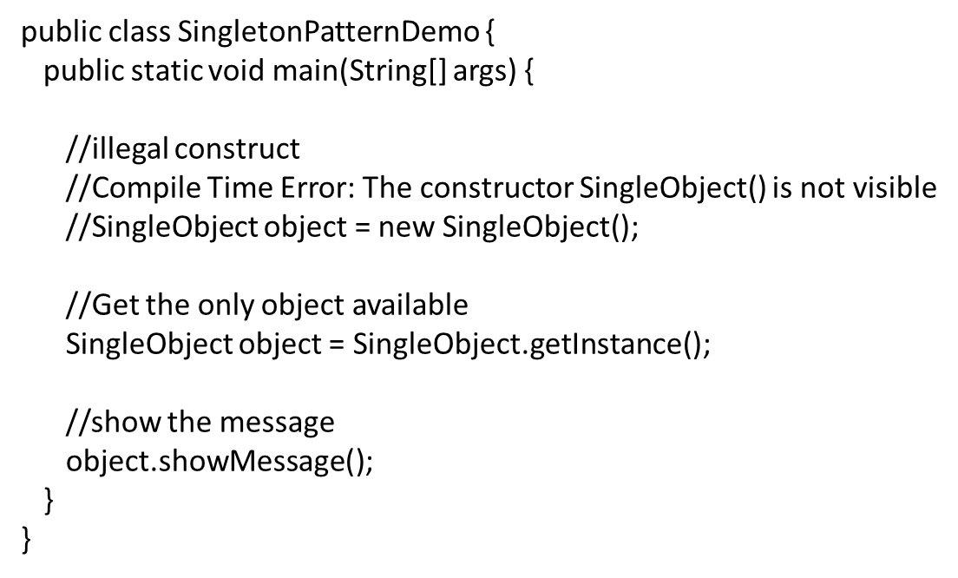
CSCI 2600, Spring 2021
79
Notes:
79

Slide 80
Another Singleton Example
Static initializer --- executed
when class is loaded
public class UserDatabaseSource
implements UserDatabase { private static UserDatabase theInstance =
new UserDatabaseSource();
private UserDatabaseSource() { … }
public static UserDatabase getInstance() {
return theInstance; }
public User readUser(String username) { … }
public void writeUser(User user) { … }
}
CSCI 2600, Spring 2021
80
Notes:
80

Slide 81
Interning Pattern
Not a GoF design pattern
Reuse existing object with same value, instead of creating a new one
E.g., why create multiple Strings “car”? Create a single instance of String “car”!
Less space
May compare with == instead of equals and speed the program up
Interning is applied to immutable objects only
CSCI 2600, Spring 2021
81
Notes:
81

Slide 82
Interning Pattern
1-100
(Street-NumberSet)
1-100
(Street-NumberSet)
“Univ. Way”
(String)
(Street-Segment)
(Street-Segment)
“Univ. Way”
(String)
“O2139”
(String)
“O2139”
(String)
101-200
(Street-NumberSet)
101-200
(Street-NumberSet)
“Univ. Way”
(String)
(Street-Segment)
(Street-Segment)
“O2139”
(String)
CSCI 2600, Spring 2021
82
Notes:
The two string-segment objects reuse the String objects with same value.
82

Slide 83
Interning Pattern
Why not a HashSet but HashMap?
Maintain a collection of all names
If an object already exists return that object
HashMap<String,String> names;
String canonicalName(String n) {
if (names.containsKey(n))
return names.get(n);
else {
names.put(n,n);
return n;
}
}
Java supports interning for Strings:
s.intern() returns a canonical representation of s
CSCI 2600, Spring 2021
83
Notes:
Why not a HashSet?
HashSet only supports “contains”, not “get”, so no way of accessing canonical object.
HashSet only stores names, we may want other info stored
Similar to memoization.
83

Slide 84
Java Strings Can be Interned
public static void main(String[] args) {
String a = "cat";
String b = "cat";
String c = new String("cat");
System.out.println(a == b); // prints true
System.out.println(a.equals(b)); // prints true
System.out.println(a == c); // prints false
System.out.println(a.equals(c)); // prints true
}
CSCI 2600, Spring 2021
84
Notes:
84

Slide 85
JavaDoc for String.intern()
public String intern()
Returns a canonical representation for the string object.
A pool of strings, initially empty, is maintained privately by the class String.
When the intern method is invoked, if the pool already contains a string equal
to this String object as determined by the equals(Object) method, then the string
from the pool is returned. Otherwise, this String object is added to the pool and
a reference to this String object is returned.
It follows that for any two strings s and t, s.intern() == t.intern() is true if and
only if s.equals(t) is true.
All literal strings and string-valued constant expressions are interned.
String literals are defined in section 3.10.5 of the The Java™ Language Specification.
Returns:
a string that has the same contents as this string, but is guaranteed to be
from a pool of unique strings.
CSCI 2600, Spring 2021
85
Notes:
85

Slide 86
Why Not HashSet?
Maintain a collection of all names
If an object already exists return that object
HashSet<String> names;
String canonicalName(String n) {
if (names.contains(n))
return n;
else {
names.add(n);
return n;
}
}
CSCI 2600, Spring 2021
86
Notes:
Why not a HashSet?
86

Slide 87
What’s wrong with java.lang.Boolean?
public class Boolean {
private final boolean value;
public Boolean(boolean value) {
this.value = value;
}
public static Boolean FALSE=new Boolean(false);
public static Boolean TRUE=new Boolean(true);
public static Boolean valueOf(boolean value) {
if (value) return TRUE;
else return FALSE;
}
}
Factory method --- produces
the appropriate instance
CSCI 2600, Spring 2021
87
Notes:
valueOf is just like canonicalName on the previous slide, it returns the canonical TRUE or FALSE, as requested.
87

Slide 88
What’s wrong with java.lang.Boolean?
Note: It is rarely appropriate to use this constructor. Unless a new instance is required,
The static factory valueOf(boolean) is generally a better choice.
It is likely to yield significantly better space and time performance.
Deprecated since Java 9
CSCI 2600, Spring 2021
88
Notes:
88

Slide 89
What’s wrong with java.lang.Boolean?
Boolean constructor should have been private: would have forced interning through valueOf
Spec warns against using the constructor
Joshua Bloch, lead designer of many Java libraries, in 2004: The Boolean type should not have had public constructors. There's really no great advantage to allow multiple trues or multiple falses, and I've seen programs that produce millions of trues and millions of falses creating needless work for the garbage collector.
So, in the case of immutables, I think factory methods are great.
CSCI 2600, Spring 2021
89
Notes:
89

