Slide 1
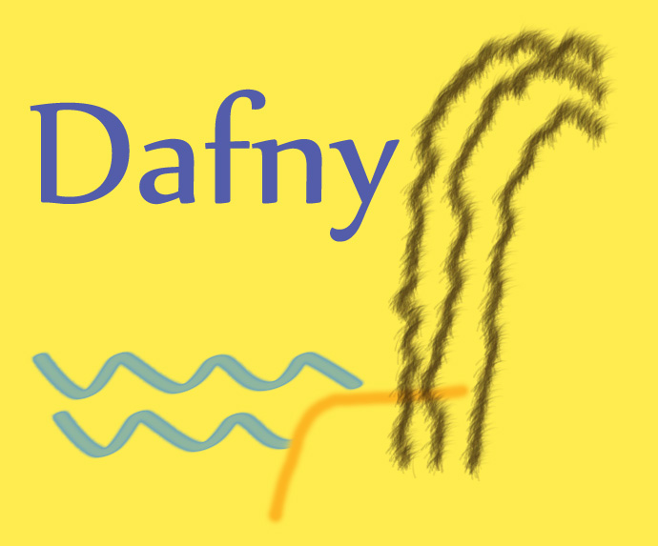
Dafny
A Language and Program Verifier for Functional Correctness
designed to support the static verification of programs
https://www.microsoft.com/en-us/research/project/dafny-a-language-and-program-verifier-for-functional-correctness/
https://en.wikipedia.org/wiki/Dafny
Available for download
https://github.com/Microsoft/dafny
Run in browser
http://rise4fun.com/dafny/Hello
Tutorial
http://rise4fun.com/Dafny/tutorial/Guide
CSCI-2600 Spring 2021
Notes:
Dafny is a language which helps us to verify whether the program we have written matches the specifications. We can build completely verified programs with the help of pre and post conditions, loop invariants and so on. If a program is accepted by Dafny, it means it will terminate and satisfies the specifications. There are several ways in which you can download Dafny. The easiest being the rise4fun website, where you can write Dafny code and play around with examples. Then you can download Dafny from the links provided. It can also be incorporated to be used with Visual Studio.
1

Slide 2
Dafny uses annotations to reason about code
Generates a proof that the code matches the annotations
Annotations are a form of specification
Example
All elements of array a are greater than 0.
Proves that there are no runtime errors, null references, etc.
Syntax is unique
Not the same as Java, C++ etc.
Targets C#
forall k: int :: 0 <= k < a.Length ==> 0 < a[k]
Notes:
So how does Dafny help us in reasoning?
We can provide high level specifications to explain the desired behavior of a code. Dafny generates a proof to verify whether the code matches these annotations. These annotations are simple to write and are thus less error prone.
Here is an example,
This says that for all integers k that are indices into the array, the value at that index is greater than zero. By writing these annotations, one is confident that the code is correct.
Other than the specifications we provide, Dafny also helps to ascertain that there are no run time errors, loops terminate, null references, etc.

Slide 3
Dafny Basics
the smallest unit of verification is the method
assignment operator is :=
preconditions use the requires keyword
postconditions use the ensures keyword
method MethodName( x: int, y: int ) returns ( z: int, w: int )
requires x == 0 && y >= 0 // PRECONDITION
ensures z != 0 || w != 0 // POSTCONDITION
{
...
}
CSCI-2600 Spring 2021
Notes:
Now let’s come to the basics of Dafny syntax which will help us to start off writing some code.
Methods: One of the basic units in Dafny code is a method. This is a piece of executable code. The syntax to write a method is shown here, where we provide a method name, specify the parameter and return types.
There are two keywords : ensures and requires. Ensures- used to specify post conditions and requires- for pre conditions. So the pre and post conditions we have learnt so far can be easily expressed in Dafny using this syntax. And the reasoning that we were doing by hand can be checked in Dafny.
3

Slide 4
Dafny Basics
Hello World in Dafny
Fibonacci
method Main() {
print "hello, Dafny\n";
assert 10 < 2; // this assertion fails
}
This should be:
function Fibonacci(n: int): int
decreases n
{
if n < 2 then n else Fibonacci(n-2) + Fibonacci(n-1)
}
function Fibonacci(n: int): int
decreases n // this recursive condition is violated
{
// what is wrong here?
if n < 2 then n else Fibonacci(n+2) + Fibonacci(n+1)
}
CSCI-2600 Spring 2021
Notes:
function Fibonacci(n: int): int
decreases n
{
if n < 2 then n else Fibonacci(n-2) + Fibonacci(n-1)
}
Decreases is like a decrement function
4

Slide 5
Dafny Basics - Assertions
method Abs(x: int) returns (y: int)
ensures y>= 0
ensures (x < 0 && y == -1*x) || (y == x)
{
y := x;
if (y < 0)
{ y := y * -1; }
}
method Testing()
{
var v := Abs(3);
assert v == 3;
assert 0 < v;
assert 0 <= v;
}
method Abs(x: int) returns (y: int)
{
y := x;
if(y < 0) { y:= y * -1; }
}
method Testing()
{
var v := Abs(3);
assert v == 3;
assert 0 < v;
assert 0 <= v;
}
CSCI-2600 Spring 2021
Notes:
Assertions are a powerful tool for debugging annotations, by checking what Dafny is able to prove about your code. For example, we can use it to investigate what Dafny knows about the Abs function.
Every time Dafny encounters an assertion, it tries to prove that the condition holds for all executions of the code. In this example, there is only one control path through the method, and Dafny is able to prove the annotation easily because it is exactly the postcondition of the Abs method. Abs guarantees that the return value is non-negative, so it trivially follows that v, which is this value, is non-negative after the call to Abs.
Let us see how this code works on Dafny.
What happens if we change 3 to 0?
What happens if we put a negative number as input?

Slide 6
Dafny Basics – Loop invariants
Compute x + y
method Add(x: int, y: int) returns (r: int)
ensures r == 2*x + y
{
r := x;
var n := y;
while n != 0
invariant r == x+y-n && 0 <= n // loop invariant
{
r := r + 1;
n := n - 1;
}
}
What are the corrections required here?
CSCI-2600 Spring 2021
Notes:
method Add(x: int, y: int) returns (r: int)
requires 0 <= x && 0 <= y
ensures r == x + y
{
r := x;
var n := y;
while n != 0
invariant r == x+y-n && 0 <= n
{
r := r + 1;
n := n - 1;
}
}
When you specify an invariant, Dafny proves two things: the invariant holds upon entering the loop, and it is preserved by the loop.
6

Slide 7
Dafny Basics
Recursively multiply x * y
method Mul(x: int, y: int) returns (r: int)
requires 0 <= x && 0 <= y
ensures r == x*y
decreases x
{
if x == 0 {
r := 0;
} else {
var m := Mul(x-1, y); // var declares a new variable
r := m + x; }
}
What is the correction required here?
CSCI-2600 Spring 2021
Notes:
Should be r := m + y;
7

Slide 8
Dafny Basics
// Can you make the program verify?
method M(n: int) returns (r: int)
ensures r == n
// what precondition do we need?
{
var i := 0;
while i < n
// what invariant do we need here?
{
i := i + 1;
}
r := i;
}
CSCI-2600 Spring 2021
Notes:
CountToAndReturnN
Add requires n >= 0
invariant i <= n
8

Slide 9
Exercise
// a function returning a bool
predicate method isLeapYear(y: int) {
y % 4 == 0 && (y % 100 != 0 || y % 400 == 0)
}
// Does this method terminate?
method WhichYear_InfiniteLoop(d: int) returns (year: int) {
var days := d;
year := 1980;
while days > 365 {
if isLeapYear(year) {
if days > 366 {
days := days - 366;
year := year + 1;
}
} else {
days := days - 365;
year := year + 1;
}
}
}
What are the issues in this code and how can they be solved to make this code verified?
CSCI-2600 Spring 2021
Notes:
Exercise to students
If leap year and days = 366, infinite loop.
Should be
method WhichYear_InfiniteLoop(d: int) returns (year: int)
requires d > 0
ensures year >= 1980
{
var days := d;
year := 1980;
while days > 365
decreases days
{
if isLeapYear(year) {
if days > 366 {
days := days - 366;
year := year + 1;
}
else {
break;
}
} else {
days := days - 365;
year := year + 1;
}
}
}
there is an infinite loop if it’s a leap year and days is less than 366
9

Slide 10
method WhichYear_InfiniteLoop(d: int) returns (year: int)
requires d > 0
ensures year >= 1980
{
var days := d;
year := 1980;
while days > 365
decreases days
{
if isLeapYear(year) {
if days > 366 {
days := days - 366;
year := year + 1;
}
else {
break;
}
} else {
days := days - 365;
year := year + 1;
}
}
}
Solution for the preceding problem:
There is an infinite loop if it’s a leap year and days is equal to 366
Needs requires and ensures
Needs a break; statement after leap year test
Loop needs a decreases statement
CSCI-2600 Spring 2021

Slide 11
Dafny Basics
method Find(a: array<int>, key: int) returns (index: int)
requires a != null
ensures 0 <= index ==> index < a.Length && a[index] == key
ensures index < 0 ==> forall k :: 0 <= k < a.Length ==> a[k] != key
{
index := 0;
while index < a.Length
invariant 0 <= index <= a.Length
invariant forall k :: 0 <= k < index ==> a[k] != key
{
if a[index] == key { return; }
index := index + 1;
}
index := -1;
}
CSCI-2600 Spring 2021
Notes:
Find is in tutorial
Ensures conditions say that if index >= 0, index is < length and index indicates the key. If index < 0, key was not found
Note the invariant. The second says that for all values of k < than the current index, the key was not found yet.
A quantifier introduces a temporary name for each element of the set it is considering. A pair of colons (::) separates the bound variable and its optional type from the quantified property (which must be of type bool).
11

Slide 12
predicate sorted(a: array<int>)
requires a != null
reads a
{
forall j, k :: 0 <= j < k < a.Length ==> a[j] <= a[k]
}
method BinarySearch(a: array<int>, value: int) returns (index: int)
requires a != null && 0 <= a.Length && sorted(a)
ensures 0 <= index ==> index < a.Length && a[index] == value
ensures index < 0 ==> forall k :: 0 <= k < a.Length ==> a[k] != value
{
var low, high := 0, a.Length;
while low < high
invariant 0 <= low <= high <= a.Length
invariant forall i ::
0 <= i < a.Length && !(low <= i < high) ==> a[i] != value
{
var mid := (low + high) / 2;
if a[mid] < value {
low := mid + 1;
}
else if value < a[mid] {
high := mid;
}
else {
return mid;
}
}
return -1;
}
Binary Search
CSCI-2600 Spring 2021
Notes:
A predicate is a function which returns a boolean. It is a simple but powerful idea that occurs throughout Dafny programs. The use of predicates makes our code shorter, as we do not need to write out a long property over and over. It can also make our code easier to read by giving a common property a name.
Introducing “reads” keyword- The reading frame of a function (or predicate) is all the memory locations that the function is allowed to read. The reason we might limit what a function can read is so that when we write to memory, we can be sure that functions that did not read that part of memory have the same value they did before. For example, we might have two arrays, one of which we know is sorted. If we did not put a reads annotation on the sorted predicate, then when we modify the unsorted array, we cannot determine whether the other array stopped being sorted. While we might be able to give invariants to preserve it in this case, it gets even more complex when manipulating data structures. In this case, framing is essential to making the verification process feasible.
Reads is required because a is not in sorted’s reading frame. The reading frame is memory that a function can read.
Reads is an annotation. Methods don’t have to declare what they read, but they need to use a modifies annotation if they modify an array.
12

