Slide 1
Design Patterns So Far
Creational patterns: Factories, Prototype, Singleton, Interning
Problem: constructors in Java (and other OO languages) are inflexible
1. Can’t return a subtype of the type they belong to. “Factory” patterns address the issue: Factory method (e.g. createBicycle()), Factory class/object, Prototype
2. Always return a fresh new object, can’t reuse.
“Sharing” patterns address the issue: Singleton, Interning
CSCI 2600 Spring 2021
1
Notes:
1

Slide 2
Design Patterns
FlyWeight
Many objects are similar
Objects have many common components
Wrappers: Adapter, Decorator, Proxy
Structural patterns: when we want to change interface or functionality of an existing class, or restrict access to an object
Composite
A structural pattern: expresses whole-part structures, gives uniform interface to client
Patterns for traversal of composites: Interpreter, Procedural and Visitor
CSCI 2600 Spring 2021
2
Notes:
2

Slide 3
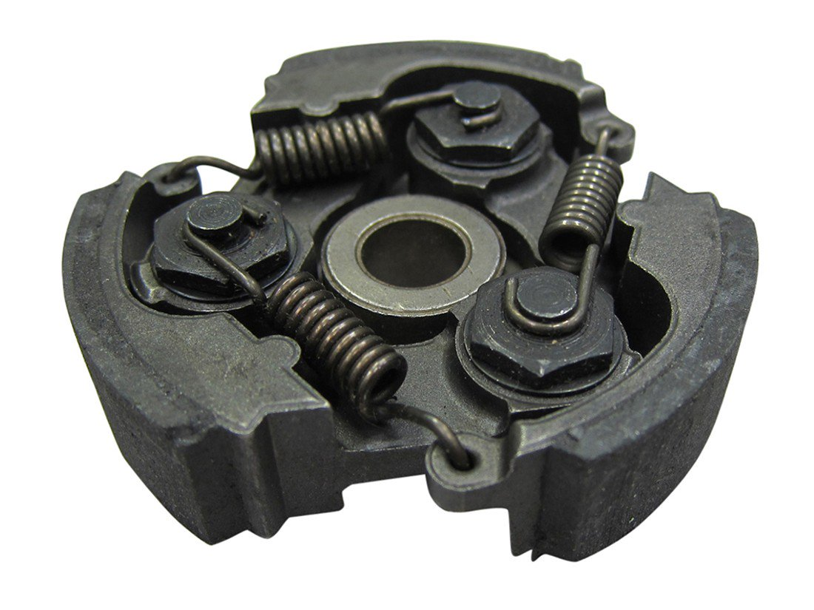
Flyweight Pattern
Good when many objects are mostly the same
Interning works only if objects fall into groups and objects in each group are completely the same and immutable
If there is an intrinsic state that is the same across all objects
Intern it
If there is an extrinsic state that is different for different objects
Extrinsic - not part of the essential nature of someone or something; coming or operating from outside.
Represent it explicitly
CSCI 2600 Spring 2021
3
Notes:
3

Slide 4
Flyweight Pattern
The flyweight pattern is primarily used to reduce the number of objects created
decrease memory footprint
increase performance
decrease object count
creates new object when no matching object is found.
Flyweight pattern often involves a Factory or composition
CSCI 2600 Spring 2021
4
Notes:
4

Slide 5
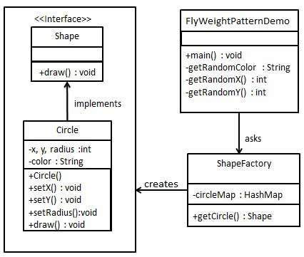
Flyweight Example
We will demonstrate this pattern by drawing 20 circles
at different locations but we will create only 5 objects.
Only 5 colors are available, so the color property is used to check already existing Circle objects.
Similar to memoization.
https://www.tutorialspoint.com/design_pattern/flyweight_pattern.htm
CSCI 2600 Spring 2021
5
Notes:
FlyWeightPatternDemo2.java
In computing, memoization or memoisation is an optimization technique used primarily to speed up computer programs by storing the results of expensive function calls and returning the cached result when the same inputs occur
5

Slide 6
public interface Shape {
void draw();
}
public class ShapeFactory {
private static final HashMap<String, Shape> circleMap =
new HashMap<String, Shape>();
public static Shape getCircle(String color) {
Circle circle = (Circle)circleMap.get(color);
if(circle == null) {
circle = new Circle(color);
circleMap.put(color, circle);
System.out.println("Creating circle of color : " + color);
}
return circle;
}
}
public class Circle implements Shape {
private String color; // intrinsic
private int x;
private int y;
private int radius;
public Circle(String color){
this.color = color;
}
@Override
public void draw() {
System.out.println("Circle: Draw() [Color : " + color +
", x : " + x + ", y :" + y + ", radius :" + radius);
}
…
}
CSCI 2600 Spring 2021
6
Notes:
circleMap keeps track of already existing circles. We only create one with a color if it doesn’t already exist.
This example is similar to interning
6

Slide 7
public class FlyweightPatternDemo {
private static final String colors[] = { "Red", "Green", "Blue", "White", "Black" };
public static void main(String[] args) {
for(int i=0; i < 20; ++i) {
Circle circle = (Circle)ShapeFactory.getCircle(getRandomColor());
circle.setX(getRandomX());
circle.setY(getRandomY());
circle.setRadius(100);
circle.draw();
}
}
private static String getRandomColor() {
return colors[(int)(Math.random()*colors.length)];
}
private static int getRandomX() {
return (int)(Math.random()*100 );
}
private static int getRandomY() {
return (int)(Math.random()*100);
}
}
CSCI 2600 Spring 2021
7
Notes:
7

Slide 8
Creating circle of color : Black
Circle: Draw() [Color : Black, x : 36, y :71, radius :100
Creating circle of color : Green
Circle: Draw() [Color : Green, x : 27, y :27, radius :100
Creating circle of color : White
Circle: Draw() [Color : White, x : 64, y :10, radius :100
Creating circle of color : Red
Circle: Draw() [Color : Red, x : 15, y :44, radius :100
Circle: Draw() [Color : Green, x : 19, y :10, radius :100
Circle: Draw() [Color : Green, x : 94, y :32, radius :100
Circle: Draw() [Color : White, x : 69, y :98, radius :100
Creating circle of color : Blue
Circle: Draw() [Color : Blue, x : 13, y :4, radius :100
Circle: Draw() [Color : Green, x : 21, y :21, radius :100
Circle: Draw() [Color : Blue, x : 55, y :86, radius :100
Circle: Draw() [Color : White, x : 90, y :70, radius :100
Circle: Draw() [Color : Green, x : 78, y :3, radius :100
Circle: Draw() [Color : Green, x : 64, y :89, radius :100
Circle: Draw() [Color : Blue, x : 3, y :91, radius :100
Circle: Draw() [Color : Blue, x : 62, y :82, radius :100
Circle: Draw() [Color : Green, x : 97, y :61, radius :100
Circle: Draw() [Color : Green, x : 86, y :12, radius :100
Circle: Draw() [Color : Green, x : 38, y :93, radius :100
Circle: Draw() [Color : Red, x : 76, y :82, radius :100
Circle: Draw() [Color : Blue, x : 95, y :82, radius :100
CSCI 2600 Spring 2021
8
Notes:
What’s the Flyweight part? The circles share color.
8

Slide 9
Flyweight and Interning
The previous example looks a lot like interning
It is.
Only a single instance of a circle with a color is created
Flyweight often uses interning.
To store the common parts of object
In example, color is common part
Other parts are set by getCircle()

Slide 10
Another Flyweight Example
Paint Brush application where client can use brushes on three types – THICK, THIN and MEDIUM.
All the thick (thin or medium) brushes will draw the content in a similar fashion
only the content color will be different.
Brush color is the extrinsic attribute which will be supplied by client
Everything else will remain the same for the Pen.
Client creates three THIN pens
2 YELLOW, 1 BLUE
Runtime there is only one pen object of each color type
Looks a lot like interning
See FlyWeightDemo3.java
Notes:
See FlyWeightDemo3.java

Slide 11
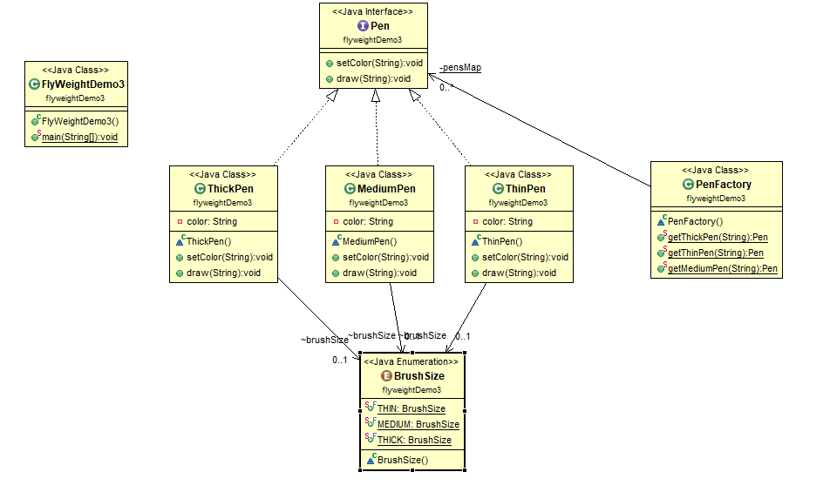

Slide 12
Example: bicycle spokes
32 to 36 spokes per wheel
Only 3 varieties per bike model
In a bike race, hundreds of spoke varieties
Thousands of instances
class Wheel {
FullSpoke[] spokes;
...
}
class FullSpoke {
int length;
int diameter;
bool tapered;
Metal material;
float weight;
float threading;
bool crimped;
int location; // rim and hub holes this is installed in
CSCI 2600 Spring 2021
12
Notes:
12

Slide 13
Alternatives to FullSpoke
class IntrinsicSpoke {
int length;
int diameter;
boolean tapered;
Metal material;
float weight;
float threading;
boolean crimped;
}
Intern IntrinsicSpoke
Doesn’t save space.
Same as FullSpoke
class InstalledSpokeFull extends IntrinsicSpoke {
int location;
}
Composition -
Saves space because of interning
class InstalledSpokeWrapper {
IntrinsicSpoke s; // refer to interned object
int location;
}
CSCI 2600 Spring 2021
13
Notes:
Intern IntrinsicSpoke objects
Location is the part that varies.
13

Slide 14
Align (true) a Wheel
class FullSpoke {
// Tension the spoke by turning the nipple the
// specified number of turns.
void tighten(int turns) {
... location ... // location is a field
}
}
class Wheel {
FullSpoke[] spokes;
void align() {
while ( wheel is misaligned) {
// tension the ith spoke
... spokes[i].tighten(numturns) ...
}
}
}
What is value of location in spokes[i]
CSCI 2600 Spring 2021
14
Notes:
It's in full spoke.
14

Slide 15
Flyweight code to true (align) a wheel
class IntrinsicSpoke {
void tighten(int turns, int location) {
... location ... // location is a parameter
}
}
class Wheel {
IntrinsicSpoke[] spokes;
void align() {
while (wheel is misaligned) {
// tension the ith spoke
... spokes[i].tighten(numturns, i) ... // pass the location to tighten()
}
}
}
CSCI 2600 Spring 2021
15
Notes:
15

Slide 16
Flyweight Pattern
What if FullSpoke contains a wheel field pointing at the Wheel containing it?
Wheel methods pass this to the methods that use the wheel field.
What if Fullspoke contains a boolean indication of a broken spoke
Add an array of booleans parallel to spokes
Flyweight used when there are very few mutable (extrinsic) fields
Complicates code
Use when profiling has determined that space is a serious problem
CSCI 2600 Spring 2021
16
Notes:
16

Slide 17
When to use the Flyweight Pattern
Thousands of new instantiation occurrences of a memory intensive heavy object
The objects created via the heavy object have very similar features
in every instantiation occurrence
The object pool contains many similar objects and two objects from
the pool don’t differ significantly
The object creation consumes high memory usage
Objects have the shareable ability

Slide 18
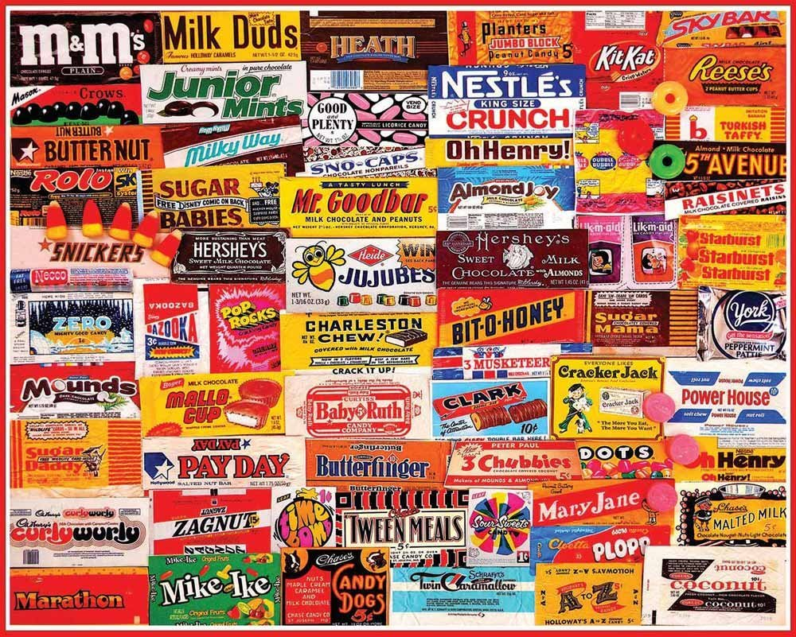
Wrappers
A wrapper uses composition/delegation
A wrapper is a thin layer over an encapsulated class
Modify the interface
GraphWrapper
Extend behavior of encapsulated class
Restrict access to encapsulated object
The encapsulated object (delegate) does most work
Wrapper is not a GoF pattern
Similar to Adapter and Façade GoF patterns
CSCI 2600 Spring 2021
18
Notes:
Wrapper not a GoF pattern but similar to Adapter pattern or Façade pattern
18

Slide 19
Structural Patterns
Pattern | Function | Interface
Adapter | Same | Different
Decorator | Different | Same/Different
Proxy | Same | Same
Notes:
Adapter provides a new interface to an object. Doesn't change function of object.
Decorator adds new behavior to existing object
Proxy is often used to restrict access to an object.

Slide 20
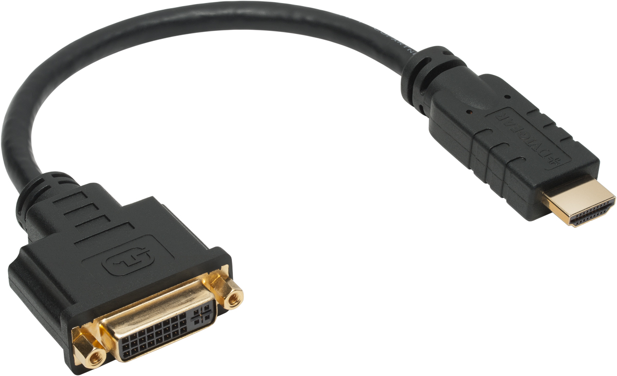
Adapter Pattern
The purpose of the Adapter is:
change an interface, without changing the functionality of the encapsulated class
Allows reuse of functionality
Protects client from modification of encapsulated class
Reasons
Rename methods
Convert units
Reformat output
Example
Angles passed in radians instead of degrees
CSCI 2600 Spring 2021
20
Notes:
20

Slide 21
Adapter Pattern
Bridge between two incompatible interfaces
Single class which is responsible to join functionalities of independent or incompatible interfaces.
Example: SD card reader which acts as an adapter between memory card and a laptop.
CSCI 2600 Spring 2021
21
Notes:
21

Slide 22
Adapter Example
Mapping a user-friendly common interface to legacy-specific peculiar interfaces.
Line and Rectangle both have draw methods
Different classes, not subtypes of a common supertype
Adapter methods are subtypes of Shape
Provide a draw methods
Client codes against Shape
Client can use common methods
See AdapterDemo.java

Slide 23
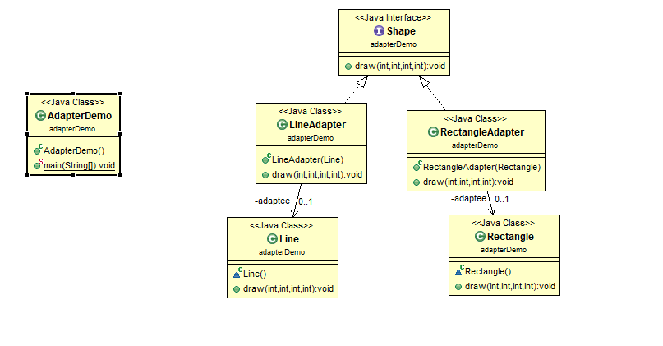
Notes:
See AdapterDemo.java

Slide 24
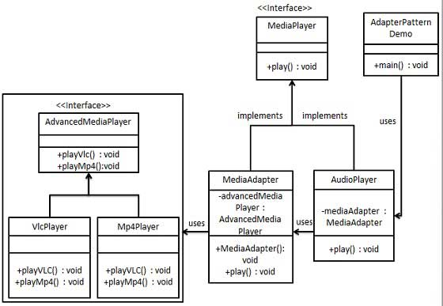
Adapter Example
https://www.tutorialspoint.com/design_pattern/adapter_pattern.htm
CSCI 2600 Spring 2021
24
Notes:
24

Slide 25
public class VlcPlayer implements AdvancedMediaPlayer{
@Override
public void playVlc(String fileName) {
System.out.println("Playing aac file. Name: "+ fileName);
}
…
@Override
public void playMp4(String fileName) {
//do nothing
}
}
public interface MediaPlayer {
public void play(String audioType, String fileName);
}
public interface AdvancedMediaPlayer {
public void playVlc(String fileName);
public void playMp4(String fileName);
}
public class Mp4Player implements AdvancedMediaPlayer{
@Override
public void playVlc(String fileName) {
//do nothing
}
@Override
public void playMp4(String fileName) {
System.out.println("Playing mp4 file. Name: "+ fileName);
}
}
CSCI 2600 Spring 2021
25
Notes:
25

Slide 26
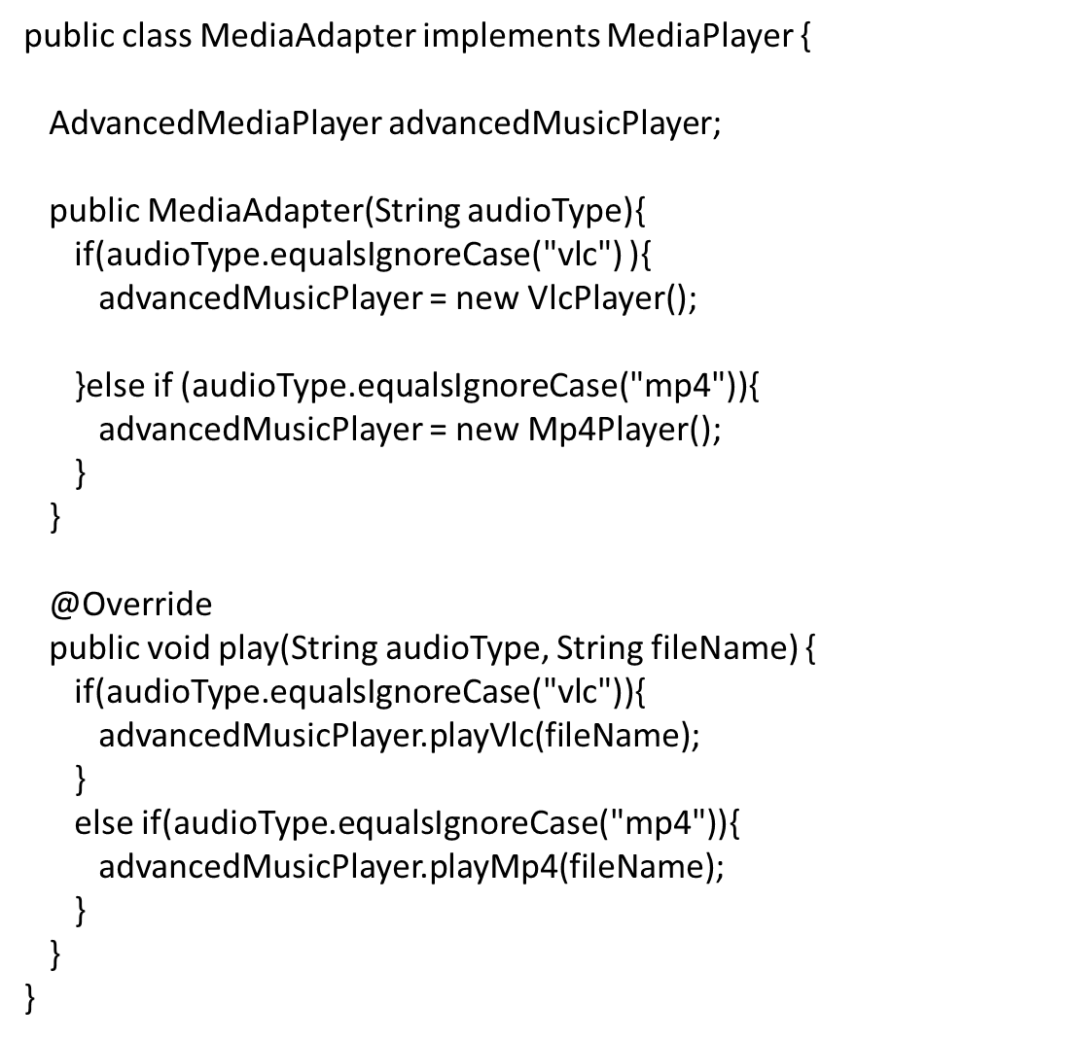
CSCI 2600 Spring 2021
26
Notes:
26

Slide 27
public class AudioPlayer implements MediaPlayer {
MediaAdapter mediaAdapter;
@Override
public void play(String audioType, String fileName) {
//inbuilt support to play mp3 music files
if(audioType.equalsIgnoreCase("mp3")){
System.out.println("Playing mp3 file. Name: " + fileName);
}
//mediaAdapter is providing support to play other file formats
else if(audioType.equalsIgnoreCase("vlc") || audioType.equalsIgnoreCase("mp4")){
mediaAdapter = new MediaAdapter(audioType);
mediaAdapter.play(audioType, fileName);
}
else{
System.out.println("Invalid media. " + audioType + " format not supported");
}
}
}
public class AdapterPatternDemo {
public static void main(String[] args) {
AudioPlayer audioPlayer = new AudioPlayer();
audioPlayer.play("mp3", "beyond the horizon.mp3");
audioPlayer.play("mp4", "alone.mp4");
audioPlayer.play("vlc", "far far away.vlc");
audioPlayer.play("avi", "mind me.avi");
}
}
CSCI 2600 Spring 2021
27
Notes:
Where’s the adapter? MediaAdapter
27

Slide 28
Adapter Pattern
Motivation: reuse a class with an interface different than the class’ interface
Shape
Editor
BoundingBox() CreateManipulator()
TextView
Adapter
GetExtent()
text
Line
Text
BoundingBox() CreateManipulator()
BoundingBox() CreateManipulator()
return text.GetExtent();
CSCI 2600 Spring 2021
return new TextManipulator;
28
Notes:
The problem here is the following: We would like to use TextView, which contains a completed implementation. However, the client Editor expects the Shape interface. If we changed Editor to work with TextView, then we’d have to modify hundreds of places in Editor where Editor uses the Shape interface: e.g., we have to change all calls to BoundedBox() to calls to GetExtent().
The Adapter pattern allows us to change Editor minimally and still use the implementation of TextView. We’ll create an Adapter class Text, which encloses TextView and redirects the calls to BoundingBox() to text.GetExtent(); Editor refers to a Text object, so it keeps calling BoundingBox(), which uses TextView.
28

Slide 29
Adapter Pattern
We would like to use TextView, which contains a completed implementation.
However, the client Editor expects the Shape interface.
If we changed Editor to work with TextView, then we’d have to modify hundreds of places in Editor where Editor uses the Shape interface:
e.g., we have to change all calls to BoundedBox() to calls to GetExtent().
The Adapter pattern allows us to change Editor minimally and still use the implementation of TextView.
We’ll create an Adapter class Text, which encloses TextView and redirects the calls to BoundingBox() to text.GetExtent();
Editor refers to a Text object, so it keeps calling BoundingBox(), which uses TextView

Slide 30
GoF Adapters
GoF (Gang of Four) describes two major kinds of adapters:
Class adapters
Use multiple inheritance to adapt one interface to another.
Java doesn't allow multiple inheritance.
We need to use interfaces.
Object adapters
Depend on the object compositions.

Slide 31
Adapter Example: Scaling Rectangles
interface Rectangle {
void scale(int factor); //grow or shrink by factor
void setWidth();
float getWidth();
float area(); …
}
class Client {
void clientMethod(Rectangle r) {
… r.scale(2);
}
}
class NonScalableRectangle {
void setWidth(); …
// no scale method!
}
Can we use NonScalableRectangle in Client instead?
CSCI 2600 Spring 2021
31
Notes:
Can we have myClass work with NonScalableRectangle? I.e., can we adapt NonScalableRectangle to the Interface of Rectangle?
31

Slide 32
Class Adapter
Class adapter adapts via subclassing
class ScalableRectangle1
extends NonScalableRectangle
implements Rectangle {
void scale(int factor) {
setWidth(factor*getWidth());
setHeight(factor*getHeight());
}
}
CSCI 2600 Spring 2021
32
Notes:
32

Slide 33
Object Adapter
Object adapter adapts via delegation: it forwards work to delegate
class ScalableRectangle2 implements Rectangle {
NonScalableRectangle r; // delegate
ScalableRectangle2(NonScalableRectangle r) {
this.r = r;
}
void scale(int factor) {
r.setWidth(factor * r.getWidth());
r.setHeight(factor * r.getHeight());
}
float getWidth() { return r.getWidth(); }
…
}
CSCI 2600 Spring 2021
33
Notes:
composition
33

Slide 34
Subclassing Versus Delegation
Subclassing
Automatically gives access to all methods in the superclass
More efficient
Delegation
Permits removal of methods
Multiple objects can be composed
More flexible
Some wrappers have qualities of adapter, decorator, and proxy
Differences are subtle
CSCI 2600 Spring 2021
34
Notes:
34

Slide 35
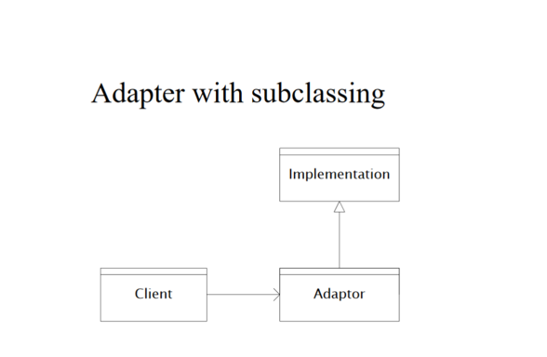

Slide 36
Another Example
A Point-of-Sale system needs to support services from different third-party vendors:
Tax calculator service from different vendors
Credit authorization service from different vendors
Inventory systems from different vendors
Accounting systems from different vendors
Each vendor service has its own API, which can’t be changed
What design pattern helps solve this problem?
CSCI 2600 Spring 2021
36
Notes:
36

Slide 37
The Solution: Object Adapter
<<interface>> ITaxCalculatorAdapter getTaxes(Sale) : List of TaxLineItems
POS System
TaxMasterAdapter getTaxes(Sale) : List of TaxLineItems
GoodAsGoldTaxProAdapter getTaxes(Sale) : List of TaxLineItems
<<interface>> IAccountingAdapter
postReceivable(CreditPayment) postSale(Sale)
<<interface>> ICreditAuthorizationServiceAdapter
requestApproval(CreditPayment, TerminalID, MerchantID)
CSCI 2600 Spring 2021
37
Notes:
TaxMasterAdapter adapts the TaxMaster interface to the expected interface. Same for the GoodAsGoldTaxProAdapter. The client, POS System uses the interface defined in ITaxCalculatorAdapter. So if the POS System needs to change from one vendor’s system to another, the changes to the POS System client will be minimal to none!
37

Slide 38
Object Adapter
TaxMasterAdapter adapts the TaxMaster interface to the expected interface.
Same for the GoodAsGoldTaxProAdapter.
The client, POS System uses the interface defined in ITaxCalculatorAdapter.
If the POS System needs to change from one vendor’s system to another, the changes to the POS System client will be minimal to none!

Slide 39
Exercise
Who creates the appropriate adapter object?
Is it a good idea to let some domain object from the Point-of-Sale system (e.g., Register, Sale) create the adapters?
That would assign responsibility beyond domain object’s logic. We would like to keep domain classes focused, so, this is not a good idea
Violates principle of single responsibility for a class
How to determine what type of adapter object to create? We expect adapters to change.
What design patterns solve this problem?
CSCI 2600 Spring 2021
39
Notes:
39

Slide 40
The Solution: Factory
ServiceFactory
accountingAdapter : IAccountingAdapter inventoryAdapter : IInventoryAdapter taxCalculatorAdapter : ITaxCalculatorAdapter
getAccountingAdapter() : IAccountingAdapter getInventoryAdapter () : IInventoryAdapter getTaxCalculatorAdapter () : ITaxCalculatorAdapter
CSCI 2600 Spring 2021
40
Notes:
40
This is a variation of the Factory object/class pattern we discussed in class. Factory class encapsulates the factory methods that create the right adapters. It also encapsulates the instances (single instances!) of the adapter objects.

Slide 41
Using the Factory
public ITaxCalculatorAdapter getTaxCalculatorAdapter() { if (taxCalculatorAdapter == null) { String className = System.getProperty(“taxcalculator.classname”); taxCalculatorAdapter = (ITaxCalculatorAdapter) Class.forName(className).newInstance(); } return taxCalculatorAdapter;
}
What design pattern(s) do you see here?
Java reflection: creates a brand
new object from String className!
CSCI 2600 Spring 2021
41
Notes:
Property must have been previously set by System.setProperty()
Singleton pattern (a slight variation of the singleton pattern): ensures that each adapter has a single instance!
Dependency injection pattern: the correct adapter is created through reflection and external dependency injection.
Also uses Singleton/Interning pattern. Only one instance of taxCalculatorAdapter.
41

Slide 42
Exercise
Who creates the ServiceFactory?
How is it accessed?
We need a single instance of the ServiceFactory class
What pattern solves these problems?
CSCI 2600 Spring 2021
42
Notes:
42

Slide 43
The Solution: Singleton
Special UML notation.
ServiceFactory
- instance: ServiceFactory
- accountingAdapter : IAccountingAdapter - inventoryAdapter : IInventoryAdapter - taxCalculatorAdapter : ITaxCalculatorAdapter
+ getInstance() : ServiceFactory
+ getAccountingAdapter() : IAccountingAdapter + getInventoryAdapter() : IInventoryAdapter + getTaxCalculatorAdapter() : ITaxCalculatorAdapter
1
In UML, - means private, + means public. All (shown) fields in ServiceFactory are private and all methods are public.
underline means static. instance and getInstance are static. Single instance of ServiceFactory ensures single instance of adapter objects.
CSCI 2600 Spring 2021
43
Notes:
43

Slide 44
Composite Pattern
Client treats a composite object (a collection of objects) the same as a simple object (an atomic unit)
Good for part-whole relationships
Can represent arbitrarily complex objects
Composite pattern composes objects in terms of a tree structure to represent the part as well as the whole hierarchy.
This pattern creates a class that contains a group of objects.
The class provides ways to modify its group of objects.
CSCI 2600 Spring 2021
44
Notes:
44

Slide 45
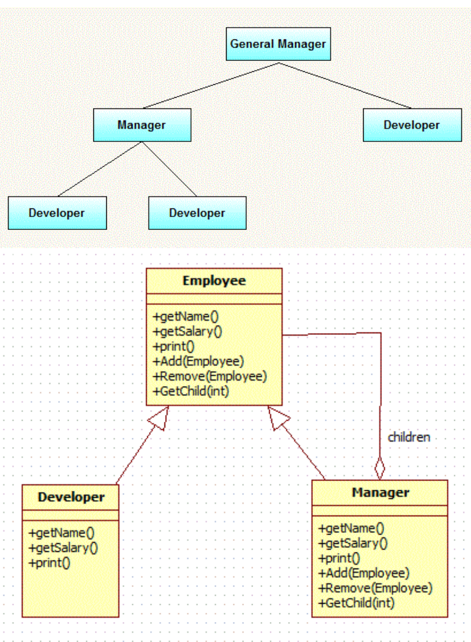
Organization Chart
CSCI 2600 Spring 2021
45
Notes:
45

Slide 46
public interface Employee {
public void add(Employee employee);
public void remove(Employee employee);
public Employee getChild(int i);
public String getName();
public double getSalary();
public void print();
}
public class Manager implements Employee{
private String name;
private double salary;
public Manager(String name, double salary){
this.name = name;
this.salary = salary;
}
List<Employee> employees = new ArrayList<Employee>();
public void add(Employee employee) {
employees.add(employee);
}
public Employee getChild(int i) {
return employees.get(i);
}
…// implements print – traverses employees
}
CSCI 2600 Spring 2021
46
Notes:
CompositeDemo.java
46

Slide 47
public class Developer implements Employee{
private String name;
private double salary;
public Developer(String name, double salary){
this.name = name;
this.salary = salary;
}
public void add(Employee employee) {
//this is leaf node so this method is not applicable to this class.
}
public Employee getChild(int i) {
//this is leaf node so this method is not applicable to this class.
return null;
}
…
}
public static void main(String[] args) {
Employee emp1=new Developer("John", 10000);
Employee emp2=new Developer("David", 15000);
Employee manager1=new Manager("Daniel",25000);
manager1.add(emp1);
manager1.add(emp2);
Employee emp3=new Developer("Michael", 20000);
Manager generalManager=new Manager("Mark", 50000);
generalManager.add(emp3);
generalManager.add(manager1);
generalManager.print();
}
}
CSCI 2600 Spring 2021
47
Notes:
47

Slide 48
Composite Example
Compose objects into tree structures to represent part-whole hierarchies.
Composite lets clients treat individual objects and compositions of objects uniformly.
Example
Every sentence is composed of words which are in turn composed of characters.
Each of these objects is printable and they can have something printed before or after them
Sentence always ends with full stop
Word always has space before it
See CompositeDemo.java

Slide 49
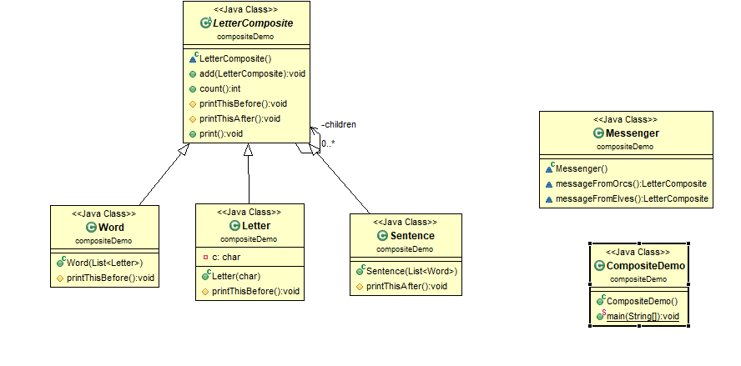
Notes:
See CompositeDemo.java

Slide 50
Example: Bicycle
Bicycle
Wheel
Skewer
Lever
Body
Cam
Rod
Acorn nut
Hub
Spokes
…
Frame
…
CSCI 2600 Spring 2021
50
Notes:
50

Slide 51
Example: Methods on Components
abstract class BicycleComponent {
…
float cost();
}
class Skewer extends BicycleComponent {
float price;
float cost() { return price; }
}
class Wheel extends BicycleComponent {
float assemblyCost;
Skewer skewer;
Hub hub;
…
float cost() { return assemblyCost+
skewer.cost()+hub.cost()+… }
}
Skewer is an atomic unit
Wheel is a collection of objects
CSCI 2600 Spring 2021
51
Notes:
How can we change this code to make it more general?
A quick release skewer is a mechanism for attaching a wheel to a bicycle. It consists of a rod threaded on one end and with a lever operated cam assembly on the other.
51

Slide 52
Even Better
abstract class BicycleComponent {
…
float cost();
}
class Skewer extends BicycleComponent {
float price;
float cost() { return price; }
}
class Wheel extends BicycleComponent {
float assemblyCost;
BicycleComponent skewer;
BicycleComponent hub;
…
float cost() { return assemblyCost+
skewer.cost()+hub.cost()+… }
}
The skewer and hub are BicycleCompoenents, so we can use BicycleComponent!
CSCI 2600 Spring 2021
52
Notes:
52

Slide 53
Another Example: Boolean Expressions
A Boolean expression can be
Variable (e.g., x)
Boolean constant: true, false
Or expression (e.g., x or true)
And expression (e.g., (x or true) and y)
Not expression (e.g., not x, not (x or y))
And, Or, Not: collections of expressions
Variable and Constant: atomic units
Maybe we should intern the Boolean constants?
See BooleanDemo.java
CSCI 2600 Spring 2021
53
Notes:
BooleanDemo.java
Should we intern Boolean constants?
53

Slide 54
Interpreter Pattern
See BooleanDemo.java

Slide 55
Using Composite to Represent Boolean Expressions
abstract class BooleanExp {
boolean eval(Context c);
}
class Constant extends BooleanExp {
private boolean const;
Constant(boolean const) { this.const=const; }
boolean eval(Context c) { return const; }
}
class VarExp extends BooleanExp {
String varname;
VarExp(String var) { varname = var; }
boolean eval(Context c) {
return c.lookup(varname);
}
}
CSCI 2600 Spring 2021
55
Notes:
55

Slide 56
Using Composite to Represent Boolean Expressions
class AndExp extends BooleanExp {
private BooleanExp leftExp;
private BooleanExp rightExp;
AndExp(BooleanExp left, BooleanExp right) {
leftExp = left;
rightExp = right;
}
boolean eval(Context c) {
return leftExp.eval(c) && rightExp.eval(c);
}
}
// analogous definitions for OrExp and NotExp
CSCI 2600 Spring 2021
56
Notes:
56

Slide 57
Composite Pattern: Class diagram
1
BooleanExp
2
Client
…
…
2
Constant
VarExp
NotExp
OrExp
AndExp
1
1
1
Atomic Units
Composite Objects
CSCI 2600 Spring 2021
57
Notes:
57

Slide 58
Object Structure
Expression (x or true) and y
new AndExp(
new OrExp(
new VarExp(“x”),
new Constant(true)
),
new VarExp(“y”)
)
AndExp:
(x or true) and y
leftExp
rightExp
OrExp: x or true
VarExp: y
leftExp
rightExp
VarExp: x
Constant: true
CSCI 2600 Spring 2021
58
Notes:
58

Slide 59
Exercise: Object Structure
Draw the object structure (a tree!) for expression (x and true) and (y or z)
CSCI 2600 Spring 2021
59
Notes:
new AndExp(new AndExp(new AndExp(new VarExp(“x”), new Constant(true)), new OrExp(new VarExp(“y”), new VarExp(“z”))))
59

Slide 60
(x and true) and (y or z)
new AndExp(new AndExp(new VarExp(“x”) new Constant(true)), new OrExp(new VarExp(“y”), new VarExp(“z”)))
AndExp: x and true and (y or z)
AndExp: x and true
OrExp: y or z
VarExp: x
Constant: true
VarExp: y
VarExp: z
CSCI 2600 Spring 2021
60
Notes:
60

Slide 61
General Structure of Composite
Component
Client
operation()
Leaf
Composite
operation()
operation()
children
CSCI 2600 Spring 2021
61
Notes:
Leaf has no children
61

Slide 62
Structure of Composite
Component
Typically declared as an interface.
Implements default behavior for the interface common to all classes as appropriate.
Declares an interface for accessing and managing its child components.
Leaf
Represents leaf objects. A leaf has no children.
Defines behavior for primitive objects in the composition.
Composite
Defines behavior for components having children.
Stores child components.
Implements child related operations in the component interface.
Client
Manipulates objects in the composition through the component interface.

Slide 63
Add Operations to Manage Composites
Component
Client
operation() add(Component) remove(Component) getChild(int)
Leaf
Composite
operation()
operation() add(Component) remove(Component) getChild(int)
children
CSCI 2600 Spring 2021
63
Notes:
We may optionally add methods to help manage Composites --- add, remove, getChild(n).
What is the danger here? Danger is that Composite may not be a true subtype of Component. The client must take extra care and distinguish between Leaf components and Composite components.
63

Slide 64
Decorators
A GoF pattern
Adapter is a wrapper
Composite is not
Decorators can add functionality without changing the interface
When to use
Add to existing method to do something in addition while preserving the interface and spec
Similar to subclassing
Not all subclassing is decoration
CSCI 2600 Spring 2021
64
Notes:
64

Slide 65
Decorators
The decorator pattern allows a user to add new functionality to an existing object without altering its structure.
This pattern creates a decorator class which wraps the original class and provides additional functionality keeping class method’s signatures intact.
CSCI 2600 Spring 2021
65
Notes:
65

Slide 66
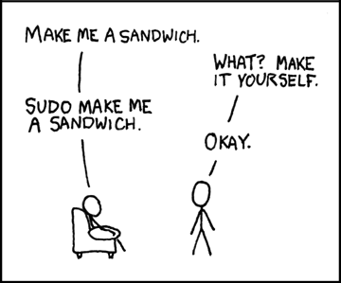
https://xkcd.com/149/

Slide 67
Decorator Example
Sandwich class
We can have a basic sandwich – bread, filling
Might want to add cheese, tomato, lettuce, or other additions
decorations
We could make a subclass for each combination of additions
Each combo has a different price
Effective if we have a small number of combinations
Decorator pattern allows extension of the functionality of Sandwich at runtime, based upon customer's request
We can decorate a sandwich by adding ingredients and charging additional cost
Notes:
See SandwichDemo.java

Slide 68
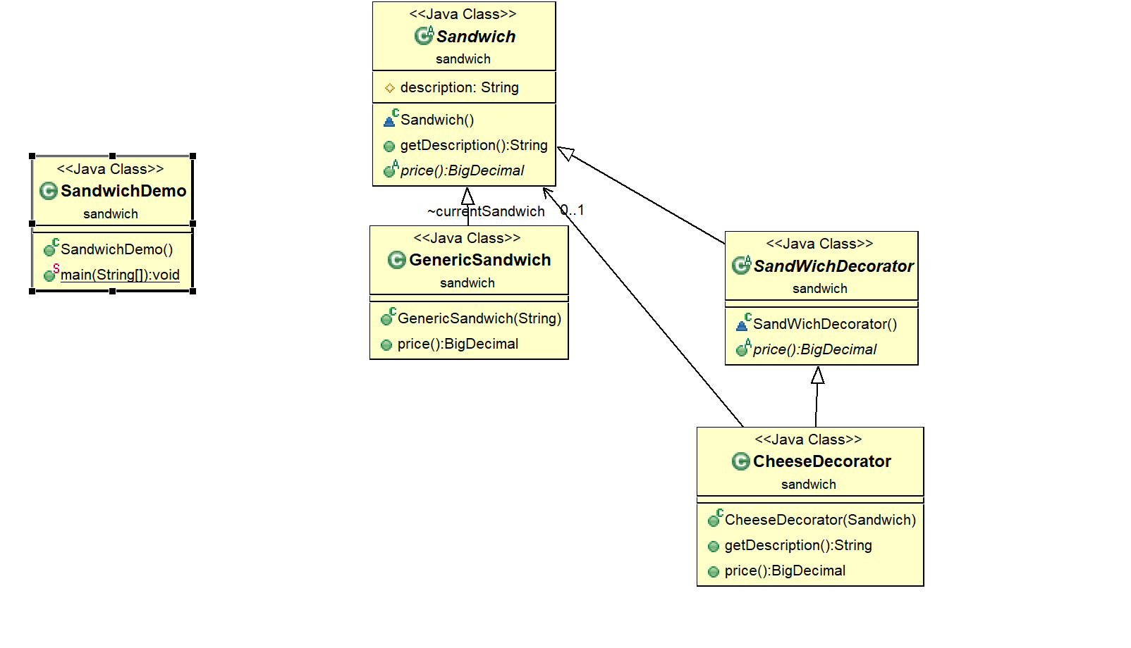
See SandwichDemo.java

Slide 69
Decorators
The decorator must be of the same type of object, which they are decorating.
This can be achieved either by implementing the interface of the object or by extending an abstract class
Decorator is usually based on Composition
This is achieved by creating a constructor of the decorator class which accepts a base type of original object.
In the example the constructor of CheeseDecorator accepts a Sandwich object.
The Decorator pattern is an example of Open/Closed design principle
We don't have to change Sandwich to add cheese.
The Decorator pattern affects objects at runtime

Slide 70
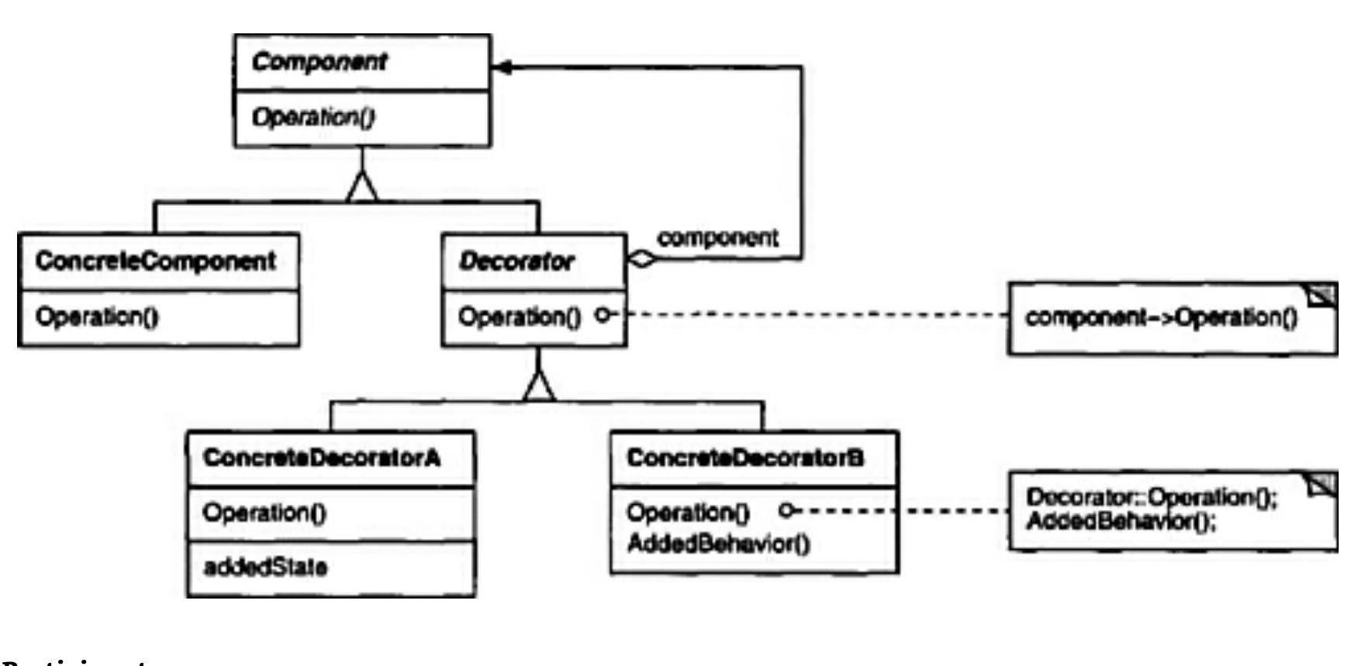
Structure of Decorator
Motivation: add small chunks of functionality without changing the interface

Slide 71
Example
abstract class Component { void draw(); }
class TextView extends Component {
public void draw() {
// Draw the TextView
}
}
abstract class Decorator extends Component {
private Component component;
public Decorator(Component c) {
this.component = c;
}
public void draw() {
component.draw();
… // additional functionality
}
}
CSCI 2600 Spring 2021
71
Notes:
71

Slide 72
Example: Bordered Windows
Adds a border to the text view
class BorderDecorator extends Decorator {
public BorderDecorator(Component c,
int borderwidth) {
super(c);
…
}
private void drawBorder() { … }
public void draw() {
super.draw();
drawBorder();
}
}
class ScrollDecorator extends Decorator {
…
}
Calls Decorator.draw which redirects
work to the enclosed component
Adds a scroll bar to the text view
CSCI 2600 Spring 2021
72
Notes:
72

Slide 73
Example
public class Client {
public static void main(String[] args) {
TextView textView = new TextView();
Component decoratedComponent =
new BorderDecorator(
new ScrollDecorator(textView),1);
}
…
decoratedComponent.draw();
…
}
CSCI 2600 Spring 2021
73
Notes:
What happens here?
73

Slide 74
Bordered Windows: Another Version
interface Window {
// rectangle bounding the window
Rectangle bounds();
// draw this on the specified screen
void draw(Screen s);
...
}
class WindowImpl implements Window {
...
}
CSCI 2600 Spring 2021
74
Notes:
74

Slide 75
Bordered Windows: Delegation
// subclassing
class BorderedWindow1 extends WindowImpl {
void draw(Screen s) {
super.draw(s);
bounds().draw(s);
}
}
// Via delegation:
class BorderedWindow2 implements Window {
Window innerWindow;
BorderedWindow2(Window innerWindow) {
this.innerWindow = innerWindow;
}
void draw(Screen s) {
innerWindow.draw(s);
innerWindow.bounds().draw(s);
}
}
Delegation permits multiple
borders on a window, or a window
that is both bordered and shaded
(or either one of those)
CSCI 2600 Spring 2021
75
Notes:
75

Slide 76
Java I/O Package InputStream: byte input streams
FilterInputStream is a Decorator. Enables the “chaining” of streams
Each FilterInputStream redirects input action to the enclosed InputStream
InputStream
FileInputStream
PipedInputStream
…
FilterInputStream
in
BufferedInputStream #byte[] buf
CheckedInputStream
DataInputStream
CSCI 2600 Spring 2021
76
Notes:
InputStream is the Java hierarchy, which interfaces with the OS to read byte-based data.
76

Slide 77
Readers: character input streams
Reader
Class FilterReader extends Reader {
Reader in;
int read() {
return in.read();
}
…
}
StringReader
PipedReader
BufferdReader
FilterReader
in
PushbackReader
CSCI 2600 Spring 2021
77
Notes:
Slightly different hierarchy
77

Slide 78
Another Decorator Example
public class UppercaseConvertor extends
FilterReader {
public UppercaseConvertor(Reader in) {
super(in);
}
public int read() throws IOException {
int c = super.read();
return ( c==-1 ? c :
Character.toUpperCase((char)c));
}
}
We also have LowercaseConverter extends
FilterReader, which (surprise!) converts to lowercase
CSCI 2600 Spring 2021
78
Notes:
See CharConverter.java
public int read(char[] buf, int offset, int count) {
int nread = super.read(buf, offset, count);
for (int i = offset; i< offset+nread; i++)
buf[i] = Character.toUpperCase(buf[i]);
return nread;
}
78

Slide 79
Another Decorator Example
public static void main(String[] args) {
Reader f =
new UppercaseConverter( new LowercaseConvertor(
new StringReader(args[0])));
int c;
while ((c = f.read()) != -1)
System.out.print((char)c);
System.out.println();
}
What is the object structure of f?
What does this code do?
CSCI 2600 Spring 2021
79
Notes:
FilterRead extends Reader. FilterReader has a field, in. in is a Reader. StringReader is a Reader. It is passed to LowerCaseConverter which extends FilterReader. LowerCaseConverter is passed to UpperCaseConverter.
Convert all of the letters to uppercase
79

Slide 80
Aside: Convert Characters the functional way
public static List<String> convertToUpperCase8(List<String> inList) {
return inList.stream() // Convert collection to Stream
.map(String::toUpperCase) // Convert each element to upper case
.collect(toList()); // Collect results to a new list
Notes:
FunCharConvertDemo.java
https://www.tuturself.com/posts/view?menuId=6&postId=739

Slide 81
Proxy Pattern
Same interface and functionality as the enclosed class
Control access to enclosed object
Communication: manage network details when using a remote object
Locking: serialize access by multiple clients
Security: permit access only if proper credentials
Creation: object might not yet exist (creation is expensive). Hide latency when creating object. Avoid work if object never used
Similar to singleton/interning
CSCI 2600 Spring 2021
81
Notes:
See ProxyDemo.java
81

Slide 82
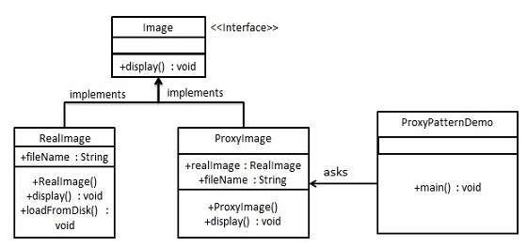
Recap: Simple Proxy Example
https://www.tutorialspoint.com/design_pattern/proxy_pattern.htm
CSCI 2600 Spring 2021
82
Notes:
82

Slide 83
public interface Image {
void display();
}
public class ProxyImage implements Image{
// delegation
private RealImage realImage;
private String fileName;
public ProxyImage(String fileName){
this.fileName = fileName;
}
@Override
public void display() {
if(realImage == null){
realImage = new RealImage(fileName);
}
realImage.display();
}
}
public class RealImage implements Image {
private String fileName;
public RealImage(String fileName){
this.fileName = fileName;
loadFromDisk(fileName);
}
@Override
public void display() {
System.out.println("Displaying " + fileName);
}
private void loadFromDisk(String fileName){
System.out.println("Loading " + fileName);
}
}
CSCI 2600 Spring 2021
83
Notes:
83

Slide 84
public class ProxyPatternDemo {
public static void main(String[] args) {
Image image = new ProxyImage("test_100mb.jpg");
//image will be loaded from disk
image.display();
System.out.println("");
//image will not be loaded from disk
image.display();
}
}
CSCI 2600 Spring 2021
84
Notes:
84

Slide 85
Proxy Example: Manage Creation of Expensive Object
Graphic
Editor
draw() getExtent() store() load()
if (image == null) { // load image } image.draw();
Image
ImageProxy
draw() getExtent() store() load()
ImageImp extent
image
draw() getExtent() store() load()
fileName extent
if (image == null) { return extent; } else { return image.getExtent(); }
CSCI 2600 Spring 2021
85
Notes:
85

Slide 86
Proxy Example: Manage Details When Dealing with Remote Object
Recovery from remote service failure in the Point-Of-Sale system
When postSale is sent to an accounting service (remember, an AccountingAdapter), if connection cannot be established, failover to a local service
Failover should be transparent to Register
I.e., it should not know whether postSale was sent to the accounting service or to some special object that will redirect to a local service in case of failure
CSCI 2600 Spring 2021
86
Notes:
86

Slide 87
Proxy Example: Manage Details When Dealing with Remote Object
<<interface>>
IAccountingAdapter
+ postSale( Sale )
Register
accounting:IAccountingAdapter
+makePayment()
- completeSaleHandling()
1
1
2
1
ExternalAccounting Adapter
+ postSale( Sale )
AccountingRedirectionProxy
- externalAccounting : IAccountingAdapter
- localAccounting : IAccountingAdapter
+ postSale( Sale )
Proxy determines whether to call local or remote server
LocalAccounting Adapter
+ postSale( Sale )
CSCI 2600 Spring 2021
87
Notes:
87

Slide 88
Traversing Composites
Question: How to perform operations on all parts of a composite?
E.g., evaluate a boolean expression, print a boolean expression
CSCI 2600 Spring 2021
88
Notes:
88

Slide 89
Perform Operations on boolean expressions
Need to write code for each Operation/Object pair
Question: do we group together (in a class) the code for a particular operation or the code for a particular object?
Objects
 | VarExp | Constant | AndExp | OrExp | NotExp
evaluate
pretty- print
Operations
CSCI 2600 Spring 2021
89
Notes:
89

Slide 90
Interpreter and Procedural Patterns
Interpreter: groups code per object, spreads apart code for similar operations
Procedural: groups code per operation, spreads apart code for similar objects
 | VarExp | AndExp
evaluate
pretty- print
 | VarExp | AndExp
evaluate
pretty- print
CSCI 2600 Spring 2021
90
Notes:
90

Slide 91
 | VarExp | AndExp
evaluate
pretty- print
Interpreter Pattern
abstract class BooleanExp {
abstract boolean eval(Context c);
abstract String prettyPrint();
}
class VarExp extends BooleanExp {
…
boolean eval(Context c);
String prettyPrint();
}
class AndExp extends BooleanExp {
boolean eval(Context c);
String prettyPrint();
}
Add a method to each class
for each supported operation
Dynamic dispatch chooses
right implementation at call
myExpr.eval(c);
CSCI 2600 Spring 2021
91
Notes:
See BooleanDemo.java
Interpreter pattern is not a Wrapper
91

Slide 92
Interpreter Pattern
class AndExp extends BooleanExp {
private BooleanExp leftExp;
private BooleanExp rightExp;
AndExp(BooleanExp left, BooleanExp right) {
leftExp = left;
rightExp = right;
}
boolean eval(Context c) {
return leftExp.eval(c) && rightExp.eval(c);
}
String prettyPrint() {
leftExp.prettyPrint(); rightExp.prettyPrint();
}
}
// analogous definitions for OrExp and NotExp
CSCI 2600 Spring 2021
92
Notes:
See BooleanDemo.java
Which one is easier with Interpreter, to add operations or to add objects to the hierarchy of elements?
Thus if we anticipate a constant set of operations, we can implement all those operations with the Interpreter pattern.
If we wanted to add prettyPrint to BooleanDemo.java, we need to edit each expression to add the new method.
What if we anticipate that we will want to add a lot of new operations? The Visitor pattern makes it easy to do so.
92

Slide 93
Interpreter Pattern
1
BooleanExp
2
Client
…
boolean eval()
String prettyPrint()
2
Constant
VarExp
NotExp
OrExp
AndExp
eval() prettyPrint()
eval() prettyPrint()
eval() prettyPrint()
eval() prettyPrint()
eval() prettyPrint()
1
1
1
CSCI 2600 Spring 2021
93
Notes:
See BooleanDemo.java
Difficulty each subtype must have eval() and prettyPrint()
93

Slide 94
Interpreter Pattern
See BooleanDemo.java

Slide 95
 | VarExp | AndExp
evaluate
pretty- print
Procedural pattern
// Classes for expressions don’t have eval
class Evaluate {
boolean evalConstExp(Constant c) {
c.value(); // returns value of constant
}
boolean evalAndExp(AndExp e) {
BooleanExp leftExp = e.leftExp;
BooleanExp rightExp = e.rightExp;
//Problem: How to invoke the right
//implementation for leftExp and rightExp?
}
}
CSCI 2600 Spring 2021
95
Notes:
95

Slide 96
 | VarExp | AndExp
evaluate
pretty- print
Procedural pattern
// Classes for expressions don’t have eval
class Evaluate {
Context c;
…
boolean evalExp(BooleanExp e) {
if (e instanceof VarExp)
return evalVarExp((VarExp) e);
else if (e instanceof Constant)
return evalConstExp((VarExp) e);
else if (e instanceof OrExp)
return evalOrExp((OrExp)e);
else …
}
}
What is the problem with this code?
CSCI 2600 Spring 2021
96
Notes:
Maintaining this code is tedious and error prone.
The cascaded if-tests will likely run slow.
We must repeat this code for class PrettyPrint and every other operation class.
96

Slide 97
Visitor Pattern, a variant of the Procedural pattern
Visitor helps traverse a hierarchical structure
Nodes (objects in the hierarchy) accept visitors
Visitors visit nodes (objects)
class SomeBooleanExp extends BooleanExp {
void accept(Visitor v) {
for each child of this node {
child.accept(v);
}
v.visit(this);
}
}
class Visitor {
void visit(SomeBooleanExp e) { do work on e }
}
n.accept(v) traverses the
structure root at n, performing v’s
operation on every element
CSCI 2600 Spring 2021
97
Notes:
See BoolDemo2.java
97

Slide 98
Visitor Pattern
class VarExp extends
BooleanExp {
void accept(Visitor v) {
v.visit(this);
}
}
class AndExp extends
BooleanExp {
BooleanExp leftExp;
BooleanExp rightExp;
void accept(Visitor v) {
leftExp.accept(v);
rightExp.accept(v);
v.visit(this);
}
}
class Evaluate
implements Visitor {
void visit(VarExp e)
{
//evaluate var exp
}
void visit(AndExp e)
{
//evaluate And exp
}
}
class PrettyPrint
implements Visitor {
…
}
CSCI 2600 Spring 2021
98
Notes:
n.accept(v) traverses the structure root at n, performing v’s operation on every element
98

Slide 99
The Visitor Pattern
1
BooleanExp
2
Client
accept(Visitor v)
2
Constant
VarExp
NotExp
OrExp
AndExp
accept (Visitor v)
accept (Visitor v)
accept (Visitor v)
accept (Visitor v)
accept (Visitor v)
1
1
1
CSCI 2600 Spring 2021
99
Notes:
Advantage: easy to add operations (just add a new Visitor class), hard to add new objects.
99

Slide 100
The Visitor Pattern
Visitor
visit(Constant e) visit(VarExp e) visit(NotExp e) visit(AndExp e) visit(OrExp e)
EvaluateVisitor
PrettyPrintVisitor
visit(Constant e) visit(VarExp e) visit(NotExp e) visit(AndExp e) visit(OrExp e)
visit(Constant e) visit(VarExp e) visit(NotExp e) visit(AndExp e) visit(OrExp e)
CSCI 2600 Spring 2021
100
Notes:
100

Slide 101
Visitor Pattern
Must add definitions of visit (in Visitor hierarchy) and accept (in Object hierarchy)
visit may do many different things: evaluate, count nodes, pretty print, etc.
It is easy to add operations (a new Visitor class), hard to add nodes (must modify entire hierarchy of Visitors)
Visitors are similar to iterators but different because they have knowledge of structure not just sequence
CSCI 2600 Spring 2021
101
Notes:
101

Slide 102
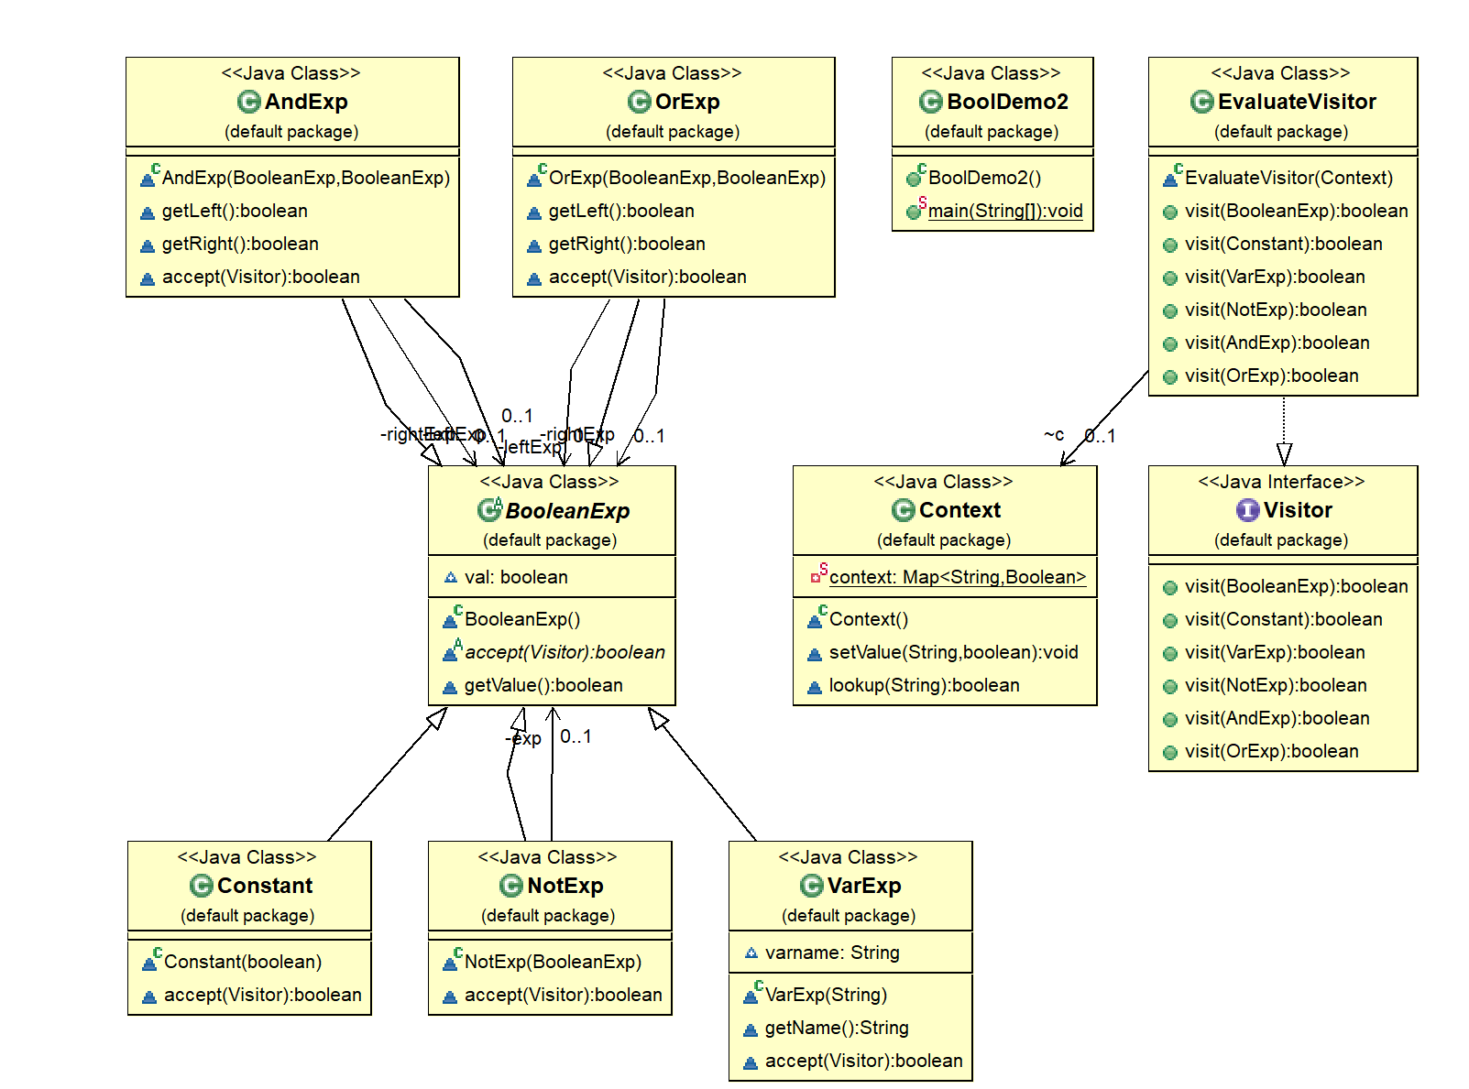
See BoolDemo2.java

Slide 103
Visitor Pattern Dispatch
In BoolDemo2
exp.accept(new EvaluateVisitor(c))
We pass exp's accept() method an instance of an evaluator
OrExp passes the evaluator to its children, when done, it calls the evaluator’s visit method which calculates the result.
To add PrettyPrint, we need to add a PrettyPrint Visitor which does the printing. PrettyPrint would implement Visitor.
Open/closed principle

Slide 104
 | VarExp | AndExp
evaluate
pretty- print
Visitor Pattern’s Double Dispatch
myExp.accept(v): we want to choose the right operation
myExp.accept(v) // dynamically dispatch the right
// implementation of accept, e.g., AndExp.accept
class AndExp {
void accept(Visitor v) {
…
v.visit(this); // at compile-time, chooses
} // visit(AndExp). At
} // runtime, dispatches the right implementation of // visit(AndExp), e.g., // EvaluateVisitor.visit(AndExp)
CSCI 2600 Spring 2021
104
Notes:
BoolDemo2.java
exp.accept(new EvaluateVisitor(c))
We pass exp accept method an instance of an evaluator
OrExp passes the evaluator to its children, when done, it calls the evaluator’s visit method calculates the result.
To add PrettyPrint, we need to add a PrettyPrint Visitor which does the printing. PrettyPrint would implement Visitor.
104

Slide 105
Design Patterns Summary so Far
Factory method, Factory class, Prototype
Creational patterns: address problem that constructors can’t return subtypes
Singleton, Interning
Creational patterns: address problem that constructors always return a new instance of class
Wrappers: Adapter, Decorator, Proxy
Structural patterns: when we want to change interface or functionality of an existing class, or restrict access to an object
CSCI 2600 Spring 2021
105
Notes:
105

Slide 106
Design Patterns Summary so Far
Composite
A structural pattern: expresses whole-part structures, gives uniform interface to client
Interpreter, Procedural, Visitor
Behavioral patterns: address the problem of how to traverse composite structures
CSCI 2600 Spring 2021
106
Notes:
DesignPatterns3 – continue with last DesignPatterns4
106

