Slide 1
Loops

Slide 2
Weakest Precondition and Loops
We would like to be able to find the weakest precondition {P}:
{P} while(b) S; {Q} is a Hoare triple
It turns out that computing the weakest precondition for loops is, in general, a hard problem
Instead, we'll assume we can find an invariant for the loop
  Something that gives us information about the loop and can be relied upon to be true before and after each the execution of the loop
{ P }
while(b) {
S;
}
{ Q }
CSCI-2600 Spring 2021

Slide 3
Weakest Precondition for Loops
If we knew how many iterations, we could unroll the loop.
  Compiler optimization does this
In general, finding the weakest precondition is complicated even for simple loops
{??} while(x > 0) x = x-1; {x = 0}
WP = ¬(x > 0) → x = 0 ^ (x > 0) →[¬(x-1 > 0) → x-1 = 0 ^ (x-1 > 0) →[¬(x-2 > 0) →x-2 = 0 ^ (x-2 > 0) →[...
  When do we stop expanding the loop into a logical condition?
CSCI-2600 Spring 2021

Slide 4
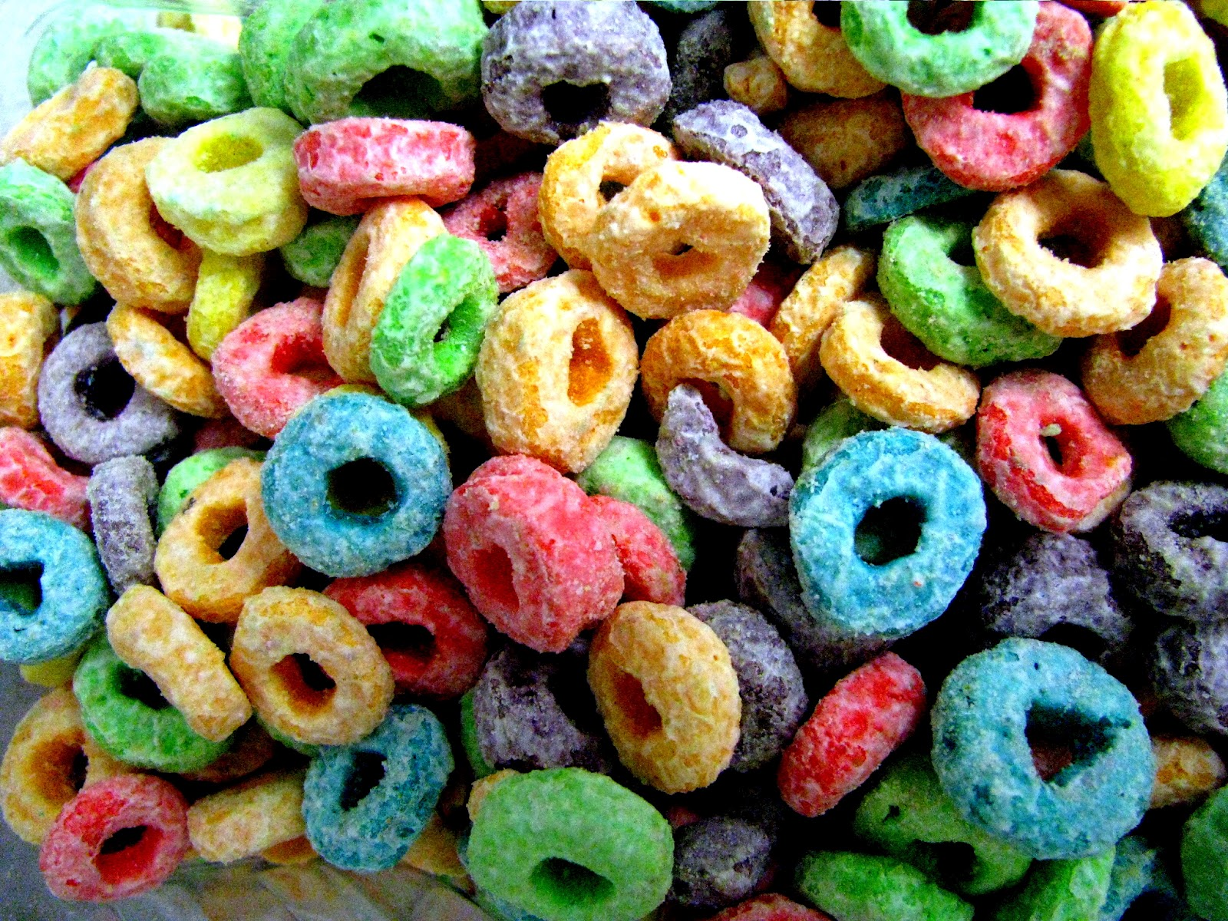
Reasoning about Loops
Reasoning about loops is a bit more complicated than
reasoning about sequence or if … else …
-- Unknown number of iterations and unknown number of paths
-- Recursion adds an additional level of complexity
Instead we will use a loop invariant to reason about a loop
Two things to prove about loops:
-- It computes correct values (partial correctness)
That is, the postcondition holds on loop exit
-- It terminates (it is not an infinite loop)
Total correctness = Partial correctness + Loop termination
CSCI-2600 Spring 2021
4
Notes:
If we knew how many iterations, we could unroll the loop. If there is a break statement, it's more complicated.
{??} while(x > 0) x = x-1; {x == 0}lWP is¬(x > 0) →x == 0 ^ (x > 0) →[¬(x-1 > 0) →x-1 == 0 ^ (x-1 > 0) →[¬(x-2 > 0) →x-2 == 0 ^ (x-2 > 0) →[...
4

Slide 5
Loop Invariant
A loop invariant is a property of a program loop
      That is true before 1st iteration of the loop
  That is true after each iteration.
  Not necessarily between statements in the loop
  It is a logical assertion
  Abstract specification of the loop
  A statement about the loop
  To show partial correctness
    Loop exit condition and the LI must imply the desired postcondition
    That is, if the loop exits, the correct result is calculated
    Why do we care?
    If we have an LI that implies the postcondition at exit, we can be somewhat confident that the loop computes the correct result
    How do we show partial correctness?
    Induction
CSCI-2600 Spring 2021
Notes:
What do we mean by partial correctness? If we exit loop, we compute the correct value.
If we have an LI that implies the postcondition at exit, we can be somewhat confident that the loop computes the correct result.

Slide 6
Reasoning about Loops
PRECONDITION: {x ≥ 0} // assume all variables are ints
i = x;
z = 0;
{ LOOP INVARIANT (LI): i + z = x ^ i ≥ 0 }
while ( i > 0 ) {
z = z + 1;
i = i - 1;
}
POSTCONDITION: x = z
Questions:
(A) Is LI true before 1st iteration?
(B) Is LI true after each iteration?
(C) If loop terminates, do loop exit condition and LI imply postcondition?
(D) Does the loop terminate?
CSCI-2600 Spring 2021
6
Notes:
It must be true before the loop, base case, for induction to work.
If we can show that LI is true for each iterations and it implies postcondition, we can be confident that it computes what we want.
If we are confident that the loop computes what we want, will we get to the end? I.e. does it terminate?
6

Slide 7
Reasoning about Loops
Proof by Induction
(1) BASE CASE: Initially, i = x and z = 0 gives us i+z=x, i.e.,
LI holds at iteration 0 (before the loop code executes)
from precondition x ≥ 0 ^ i = x => i ≥ 0
(2) INDUCTION: Assuming i+z=x holds after iteration k, we show
that i+z=x holds after iteration k+1
z_new = z + 1 and i_new = i - 1
therefore, i_new + z_new = i - 1 + z + 1 = i + z = x
at iteration k, i > 0 or we have exited loop, i_new=i-1 ^ i > 0=>
i_new + 1 > 0 = (i_new ≥ 0)
(3) If the loop terminates, we know i = 0.
( ¬(i>0) ^ (i ≥ 0 ^ i+z=x) )
=> ( i = 0 ^ i+z = x )
=> ( z = x )
we have z = x (i.e., the POSTCONDITION)
(4) How do we know if the loop terminates?
-- the PRECONDITION x ≥ 0 guarantees that i ≥ 0 before the loop.
At every iteration, i decreases by 1, thus it eventually reaches 0
We will get a bit more formal about this in a while.
CSCI-2600 Spring 2021
7
Notes:
Sounds a bit like how we think about recursion
7

Slide 8
Reasoning about Loops
Reasoning about Loops using Induction
-- i+z=x is a loop invariant, meaning that it holds true before
the loop and also after each/every iteration of the loop
-- even though i and z change within the loop code,
i+z=x stays true at the END of each iteration
true at the closing "}" of the loop
-- Above we made an inductive argument over the number of iterations
of the given loop
-- Proof by Induction -- also called Computational Induction
-- Establish that the LI holds before iteration 0
-- Assuming LI holds after iteration k, show that it holds
after iteration k+1
CSCI-2600 Spring 2021
8
Notes:
Note: invariant must be true at the end of each iteration, but not between statements in the loop.
z = z +1
// invariant doesn’t have to be true here
i = i -1
// invariant must be true here
8

Slide 9
Loop Invariant
{ P } // Hoare triple
while (b) S;
{ Q }
Find an invariant, LI, such that
1. P ⇒ LI // true initially
2. { LI & b } S {LI } // true if the loop executes
3. {LI & ¬b} ⇒ Q // establishes the postcondition
Finding the invariant is the key to reasoning about loops.
Inductive assertions are a “complete method of proof”
CSCI-2600 Spring 2021

Slide 10
Reasoning about Loops
Partial Correctness
-- Establish and prove the loop invariant (LI) using computational induction
-- Loop exit condition and the LI must imply the desired postcondition
-- ¬ (i > 0) (loop exit condition) and (i ≥ 0 ^ i+z=x) (LI) imply z=x
Termination
-- Establish some decrementing function D such that
D = minimum value implies loop exit condition
D = minimum => ¬ b
b is the loop condition
D decreases at each loop iteration.
Show that D reaches its minimum
Ideally minimum D = 0
CSCI-2600 Spring 2021
10
Notes:
If minimum D = 0 and you can rewrite the loop as
while(D > 0) {
…
}
You have successfully proved termination
10

Slide 11
Example
precondition: arr != null ^ arr.length = len ^ len >= 0; assume ints
int sum = 0;
int i = 0;
while ( i < len ) {
sum = sum + arr[i];
i = i + 1;
}
postcondition: (result is the sum of all elements in array arr)
sum = arr[0] + arr[1] + ... + arr[arr.length-1]
CSCI-2600 Spring 2021
11
Notes:
One way to guess a loop invariant here is to look at the postcondition
After the last iteration, we want sum = the sum of all of the array elements up to arr.length-1 at the end AND i = len AND i = arr.length
Think backwards: at next to last iteration, sum has to contain sum up to len - 2 AND i = len -1
…
LI: sum = sum of arr from 0 to i-1 AND i <= len
sum = arr[0] + arr[1] + … arr[i-1] && I <= len
11

Slide 12
LI: i <= len ^ sum = arr[0] + ... + arr[i-1]
(1) BASE CASE: does the LI hold before the loop?
i <= len ^ sum = arr[0] + ... + arr[i-1]
the LI holds, given that i = 0 and that no values from
the array arr have been summed yet. sum is initially 0.
(i <= len) = (0 <= len) by precondition
(2) INDUCTION: assume the LI holds at iteration k, does it hold
at iteration k+1?
sum_new == sum + arr[i] = arr[0] + … + arr[i-1] + arr[i]
i_new == i + 1
sum_new = arr[0] + ... + arr[i_new-1]
i_new <= len also holds; i < len at iteration k.
If i = len at iteration k, there would be no iteration k+1
(3) LI ^ !b => postcondition
i <= len ^ sum = arr[0] + ... + arr[i-1] ^ !(i<len)
=> (i=len) ^ sum = arr[0] + ... + arr[i-1]
=> sum = arr[0] + ... + arr[len-1]
=> sum = arr[0] + ... + arr[arr.length-1] // by precondition
CSCI-2600 Spring 2021
12
Notes:
i==0 && sum == arr[0] + ... + arr[i-1],
Can't sum to arr[-1], so no sum takes place
12

Slide 13
Does loop terminate?
Define D = len – i // initially i = 0 and len >=0, D >= 0
Loop can be rewritten:
while((len-i) > 0) { // i.e. while(D > 0)
sum = sum + arr[i];
i = i +1; // D_new = len – (i+1) = (len-i)-1 = D - 1
}
D decreases by 1 with each step.
D eventually reaches 0.
D = 0 => loop exit condition i=len
When D = 0, loop exits
CSCI-2600 Spring 2021

Slide 14
What A Loop Invariant Is Not
A loop invariant is not just some statement that is true before, during, and after the loop.
It must be effective.
LI ^ exit condition => postcondition
For example,
// precondition: x > 0
x = 10;
y = 0;
z = 42; // LI: z = 42, D=x
while(x > 0) {
x = x – 1;
y = y + 1;
}
// postcondition: y=x
z is always 42, but it has nothing to do with the loop. It is not a valid or useful loop invariant.
Exit condition and LI do not imply postcondition
CSCI-2600 Spring 2021

Slide 15
What is a LI?
Precondition: x >= 0 ^ y = 0
while(x != y) {
y = y + 1;
}
Postcondition: x = y
Assume ints.
Since initially x >= 0 ^ y=0 we can rewrite the loop:
D = x – y >= 0
while((x-y) > 0) {
y = y+1;
}
At the end D=0 => x-y= 0 => x = y
Initially, x >= 0 ^ y = 0 => x >= y (good guess?)
We want to show by induction:
Assume at iteration k: x >= y_k:
but if x = y_k, we would exit so x > y_k
y_new=y_k + 1
x > y_k => x >= y_new
LI: x >= y
CSCI-2600 Spring 2021
Notes:
True also works as LI. (Termination requires x>=0)
If loop condition were “x>y”, then “true” would not be sufficient LI.

Slide 16
Check the LI
LI: x>= y
Base case:
x>=0 ^ y=0 => x>=y
Assume: x >= y holds at iteration k
If x = y at iteration k, we would exit loop
x > y at iteration k
y_new = y + 1
x >= y_new
At exit: !(x!=y) ^ x>=y => x = y
D = x – y
D_new = D – (y+1) = D-1 // D decreases at each iteration
D = 0 => x = y
Precondition: x >= 0 ^ y = 0
while(x != y) {
y = y + 1;
}
Postcondition x = y
CSCI-2600 Spring 2021
Notes:
True also works as LI. (Termination requires x>=0)

Slide 17
What is a weaker LI?
Notice that the negation of the loop condition immediately
implies the postcondition.
A better (weaker) invariant: true.
LI: true
Base case:
x>=0 ^ y=0 => true
Assume: true holds at iteration k,
true also holds after iteration k+1.
At exit: !(x!=y) ^ true => x = y
D = x – y
D_new = D – (y+1) = D-1 // D decreases at each iteration
D = 0 => x = y
Precondition: x >= 0 ^ y = 0
while(x != y) {
y = y + 1;
}
Postcondition: x = y
CSCI-2600 Spring 2021
Notes:
True also works as LI. (Termination requires x>=0)

Slide 18
Example
Assume ints
PRECONDITION: n >= 0
i = 0;
r = 1;
while ( i < n ) {
i = i + 1;
r = r * i;
}
POSTCONDITION: r = n!
what is the LI here?
CSCI-2600 Spring 2021
18
Notes:
What decreases at each iteration? n-i
D = n-i
At end D=0 && i=n && r=n!
After last iteration r = n! and i = n,
Thinking backwards
In order for the postcondition to be true, at the next to last iteration, r must equal (n-1)! AND i = n - 1 => r = i!
LI: r = i! AND i <= n
18

Slide 19
PRECONDITION: n >= 0
i = 0;
r = 1;
while ( i < n ) {
i = i + 1;
r = r * i;
}
POSTCONDITION: r=n!
POSTCONDITION: r = n!
D = n-i
LI: r = i! ^ i <= n
show the above to be true in terms of Partial Correctness
BASE CASE: i = 0 and r = 1
(r = i!) = (r = 0!) = (1 = 0!)
(i <= n) = (0 <= n) // precondition
both parts of LI hold
INDUCTIVE CASE:
assume: r_old = i_old!
i_new = i_old + 1
// assume r_old = i_old!
r_new = r_old * i_new
r_new = (i_new-1)! * i_new = i_new!
r_new = i_new!
i_old <= n; if i_old = n, we would have exited
i_old < n
i_new = i_old + 1 <= n
AT EXIT: !(i < n) ^ (i <= n ^ r=i!)
=> i=n ^ r=i!
=> r=n!
Initially D >= 0
D: n – i
D_old = n – i_old
i_new = i_old + 1
D_new = n – i_new
= n – (i_old + 1)
= D_old – 1
D = 0 => i = n // loop exit condition
CSCI-2600 Spring 2021
19
Notes:
19

Slide 20
Termination
Termination, a little more formally...
-- We need to find a decrementing function D
{ P } while ( b ) S { Q }
We need D such that
(1) { LI ^ b } S { D_after < D_before } // One iteration of the loop
reduces the value of D
(2) D=min => ¬b // Exit condition
Note: In this case, if 0 is D's minimal value and
must imply the loop exit condition.
You can replace b with D > 0
CSCI-2600 Spring 2021
20
Notes:
20

Slide 21
Total correctness = Partial correctness + Loop termination
Establish that the loop terminates
Suppose the loop always reduces some variable’s value
  Does the loop terminate if the variable is a
    Natural number
    Integer
    Non-negative real
    Boolean
    List or Array
  Loop terminates if the variable values are a subset of a well-ordered set and D decreases with each iteration
    For an ordered set, every non-empty subset has a least element
CSCI-2600 Spring 2021
21
Notes:
21

Slide 22
Decrementing Function
Decrementing function maps program variables to some well-ordered set
Is x-y a good decrementing function?
// precondition: x ≥ 0 ^ y = 0
// Loop invariant: true
// D: (x-y)
while (x != y) {
y = y + 1;
}
// postcondition: x = y
CSCI-2600 Spring 2021
22
Notes:
22

Slide 23
Decrementing Function
Does the loop reduce the decrementing function’s value?
If the function is at a minimum does the loop exit?
CSCI-2600 Spring 2021
23
Notes:
x doesn't change
23

Slide 24
Example
PRECONDITION: x ≥ 0
i = x;
z = 0;
{ LOOP INVARIANT (LI): i + z = x }
while ( i > 0 ) {
z = z + 1;
i = i - 1;
}
POSTCONDITION: x = z
a decrementing function D is D = i
CSCI-2600 Spring 2021
24
Notes:
Does D decrease with each iteration?
Does D=min => not(i > 0)
i=0 => not(i > 0)
24

Slide 25
Exercise
precondition: arr.length = len ^ len ≥ 0
int sum = 0;
int i = 0;
while ( i < len ) {
sum = sum + arr[i];
i = i + 1;
}
postcondition: (result is the sum of all elements on array arr)
sum = arr[0] + arr[1] + ... + arr[arr.length-1]
D = len - i
CSCI-2600 Spring 2021
25
Notes:
D = len – I
Rewrite loop
while(D >0) { … }
LI: sum = arr[0] + ... + arr[i-1] && i <= len
Termination:
D=0 => len = i => !(i < len)
25

Slide 26
Exercise
PRECONDITION: x > 0
zeros = 0;
y = x;
while ( y % 10 == 0 ) {
y = y / 10; // integer division
zeros = zeros + 1;
}
zeros
POSTCONDITION: x = y * 10 ^ (y % 10 != 0)
CSCI-2600 Spring 2021
26
Notes:
If x = 1100 at end x = 11 * 10^2
Get number of trailing zeros
D = String.valueOf(num).length() - String.valueOf(num).replaceAll("0*$","").length(); // number of trailing 0’s
Alternative: (y % 10 == 0 ? 1 : 0) * floor(log10(y))
D = floor(log(y)) is one less than the number of digits in y – fails for x=0 (precondition: x > 0)
LI: x=y*10^zeros
Proof
Before: y = x && z = 0 => x = y*10^z
Iteration k
Assume x = y_old * 10^z_old
y_new = y_old/10
z_new = z_old+1
y_new * 10^z_new = (y_old/10) * 10 ^ (z_old + 1) = y_old * 10^z_old (since y_old % 10 = 0)
= x (by inductive hypothesis)
At Exit:
(y %10 != 0) && x=y*10^zeros
D=0 => no trailing 0’s => (1 <= y <= 9) && x=y*10^zeros => (y % 10 != 0)
26

Slide 27
Exercise
PRECONDITION: x1 > 0 ^ x2 > 0
y1 = x1;
y2 = x2;
while ( y1 != y2 ) {
if ( y1 > y2 ) {
y1 = y1 - y2;
}
else {
y2 = y2 - y1;
}
}
POSTCONDITION: y1 = gcd( x1, x2 )
CSCI-2600 Spring 2021
27
Notes:
See gcd_notes.pdf
Gcd is the largest positive integer that divides the two numbers with no remainder
D: max(y1, y2) – gcd(y1,y2); min = 0
LI: gcd(y1,y2)=gcd(x1,x2)
Proof
At beginning: y1 = x1 && y2 = x2 => gcd(x1, x2) = gcd(y1, y2)
Iteration k
Assume( gcd(y1_old, y2_old) = gcd(x1, x2)
2 branches
Y1_old > y2_old
y1_new = y1_old – y2_old
Gcd((y1_new, y2_new) = gcd(y1_new, y2_old) = gcd(y1_old – y2_old, y2_old) = gcd(y1_old, y2_old) =gcd(x1,x2)
Y1_old < y2_old
Y2_new = y2_old – y1_old
Gcd((y1_new, y2_new) = gcd(y1_old y2_new) = gcd(y1_old , y2_old – y1_old) = gcd(y1_old, y2_old) =gcd(x1,x2)
y1>y2 && gcd(y1, y2) = gcd(y1-y2, y2) || y2 > y1 && gcd(y1,y2)=gcd(y1, y2-y1) || y1=y2 && gcd(y1,y2)=y1=y2
D_old = max(y1_old, y2_old) – gcd(y1_old, y2_old)
Y1_old > y2_old && y1_new = y1_old – y2_old
D_new = max(y1_new – y2_new) – gcd(y1_new, y2_new) = max(y1_old-y2_old, y2_old) – gcd(y1_old-y2_old, y2_old) =
max(y1_old-y2_old, y2_old) – gcd(y1_old, y2_old) < max(y1_old, y2_old) – gcd(y1, y2) = D_old (max decreases because we have decreased the larger value)
Similar argument for y1_old <= y2_old
Termination:
(gcd(y1,y2)=gcd(x1,x2)) ^ (max(y1,y2)-gcd(y1,y2) = 0) => max(y1,y2)=gcd(y1,y2)=>y1 = y2
Either max(y1,y2)=y1=gcd(y1,y2), therefore y1 = y2 or max(y1,y2)=y2=gcd(y1,y2) therefore y1=y2
27

Slide 28
Loops - Summary
Total correctness = Partial correctness + Loop termination
(1) Partial correctness
-- "Guess" then prove the loop invariant (LI) by induction
-- Loop invariant and the loop exit condition must imply
the given postcondition
-- This gives us:
"If the loop terminates, then the postcondition holds."
(2) Loop termination
-- "Guess" the decrementing function D.
Each iteration of the loop decrements D, until D reaches a minimum.
D at min must imply loop exit condition
CSCI-2600 Spring 2021
28
Notes:
28

Slide 29
Rules for Backward Reasoning: Method Call
// precondition: ??
x = foo();
// postcondition: Q
If method has no side-effects, just like assignment
// precondition: ??
x = Math.abs(y)
// postcondition: x = 1
Precondition is y = 1 v y = -1
CSCI-2600 Spring 2021
29
Notes:
29

Slide 30
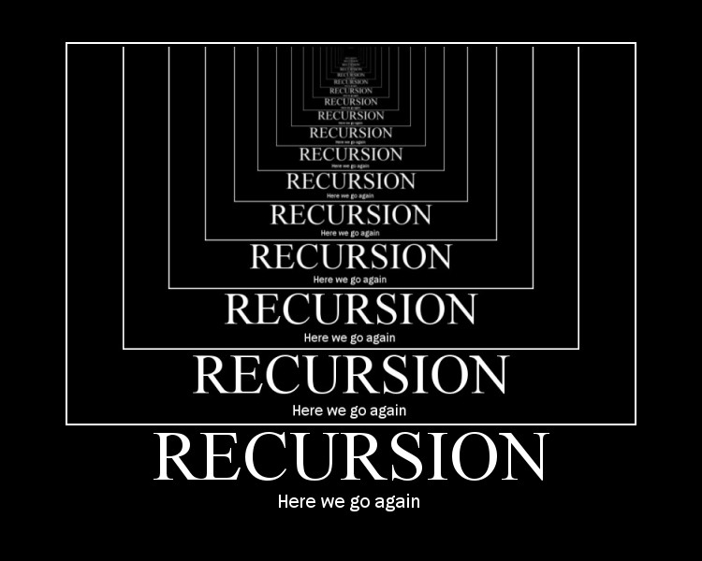
Recursion
An effective recursive routine must
  Have a base case
  Assume algorithm is valid for step k
  Show how to get from step k to step k+1
  Show that algorithm terminates
    Recurses towards base case
Sounds like computational induction
CSCI-2600 Spring 2021

Slide 31
Example
// precondition: x > 0
int factorial(int x) {
if(x == 1) { // base case
return 1;
} else {
return x * factorial(x-1);
}
}
// postcondition: returns x!
Invariant:
factorial(x) = x! ^ x>= 1
Base case:
1! = 1
Induction:
Assume factorial(y) = y! For y < x
factorial(x) = x * factorial(x-1) = x * (x-1)! = x!
Termination:
D = x-1; x decreases at each iteration
D = 0 ^ factorial(x) = x! ^ x>= 1 => x=1
CSCI-2600 Spring 2021

Slide 32
Summary So Far
Intro to reasoning about code. Concepts
  Specifications, preconditions and postconditions, forward and backward reasoning
Hoare triples
Rules for backward reasoning
  Rule for assignment
  Rule for sequence of statements
  Rule for if-then-else
CSCI-2600 Spring 2021
32
Notes:
32

Slide 33
In Practice
Write loop invariants when unsure about a loop
When you have evidence that a loop is not working
  Add invariant and decrementing function
  Write code to check them
  Understand why the code doesn't work
  Fix
  Reason to ensure that no similar bugs remain
CSCI-2600 Spring 2021
33
Notes:
33

Slide 34
In Practice
Use the loop invariant to guide writing the loop
  Determine the set of variables for the loop
  Express the required condition at the end of the loop
    Postcondition for the loop
  Determine what holds before the loop executes
    Precondition
  Determine a decrementing function
    What decreases with each iteration
    Try to find a decrementing function with 0 as a minimum
  Construct a loop invariant
    What has to be true after each iteration
  Use the loop invariant to construct the loop body
CSCI-2600 Spring 2021
34
Notes:
34

Slide 35
Why Do We Care?
Correctness is important
  Bugs are frustrating, expensive, and in some case dangerous
Pre and postconditions for functions are specifications
Optimizing compilers
  Transform loops
  Is the transformed loop the same as the original?
Thinking about code in a formal way leads to better code
  Helps us solve problems
  Helps us create code from specifications
CSCI-2600 Spring 2021
35
Notes:
35

