Slide 1
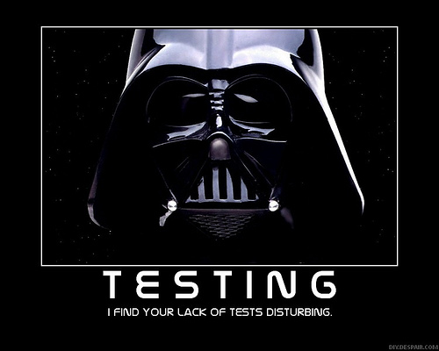
Testing
Notes:
1

Slide 2
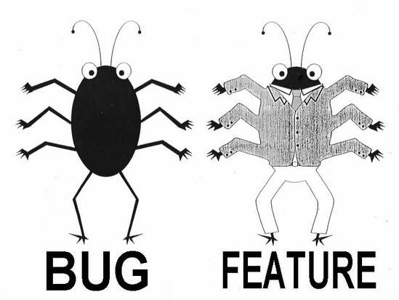
What is Testing?
Testing: the process of executing software with the intent of finding errors
Good testing: a high probability of finding yet-undiscovered errors
Successful testing: discovers unknown errors
“Program testing can be used to show the presence of bugs, but never to show their absence.” Edsger Dijkstra 1970
CSCI 2600 Spring 2021
2
Notes:
Edsger Dijkstra is another Turing Award winner (1972), again for fundamental contributions to programming languages and software engineering.
Nevertheless testing is important. Why?
2

Slide 3
Quality Assurance (QA)
The process of uncovering problems and improving the quality of software. Testing is the major part of QA
QA is testing plus other activities:
Static analysis (finding bugs without execution)
Proofs of correctness (theorems)
Code reviews (people reading each other’s code)
Software process (development methodology)
No single activity or approach can guarantee software quality
Reasoning about code
CSCI 2600 Spring 2021
Notes:
3

Slide 4
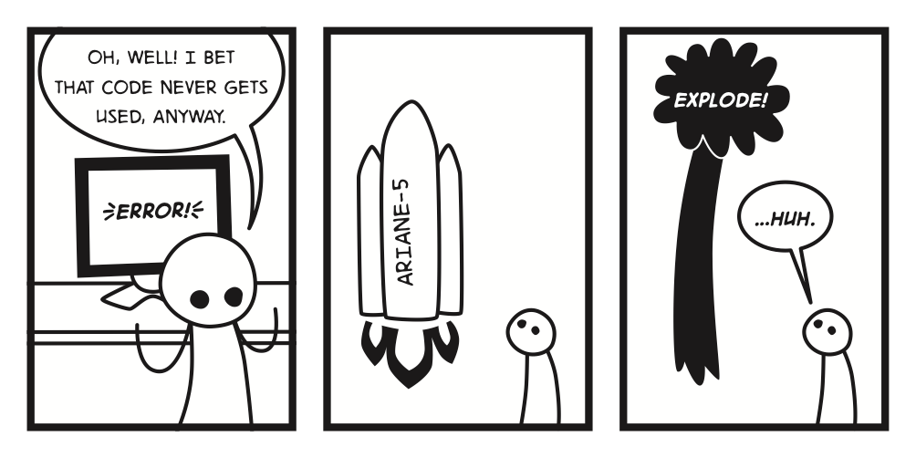
Famous Software Bugs
Ariane 5 rocket’s first launch in 1996
The rocket exploded 37 seconds after launch
Reason: a bug in control software
Cost: over $1 billion
Therac-25 radiation therapy machine
Excessive radiation killed patients
Reason: software bug linked to a race condition, missed during testing
CSCI 2600 Spring 2021
4
Notes:
Ariane-5 rocket’s first launch in 1996.
4

Slide 5
Famous Software Bugs
Mars Polar Lander
Legs deployed after sensor falsely indicated craft had touched down 130 feet above surface
Reason: one bad line of software
Cost: $110 million
And many more…
Northeast blackout (2003)
Toyota Prius breaks and engine stalling (2005)
Facebook bug made 14 million users’ posts public
Mt. Gox hack – 200,000 bitcoins lost
Security "bug" lead to theft
And many, many more…
https://raygun.com/blog/costly-software-errors-history/
https://en.wikipedia.org/wiki/List_of_software_bugs
CSCI 2600 Spring 2021
5
Notes:
Mars Surveyer ’98 was launched by NASA in 1999.
5

Slide 6
Cost to Society (NIST)
Software errors cost the US ~$60 billion annually
http://www.ashireporter.org/HomeInspection/Articles/Software-Errors-Cost-U-S-Economy-59-5-Billion-Annually/740
The study also found that, although all errors cannot be removed, more than a third of these costs, or an estimated $22.2 billion, could be eliminated by an improved testing infrastructure
Testing typically accounts for 50% of software development cost
CSCI 2600 Spring 2021
6
Notes:
6

Slide 7
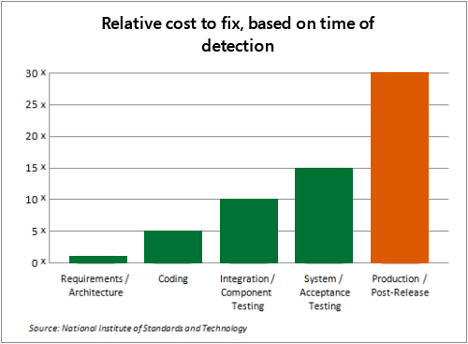
https://www.microsoft.com/en-us/SDL/about/benefits.aspx
CSCI 2600 Spring 2021
7
Notes:
7

Slide 8
Scope (Phases) of Testing
Unit testing
Does each module do what it is supposed to do?
Integration testing
Do the parts, when put together, produce the right result?
System testing
Does program satisfy functional requirements?
Does it work within overall system?
Behavior under increased loads, failure behavior, etc.
CSCI 2600 Spring 2021
8
Notes:
8

Slide 9
Seven Rules of Testing
Exhaustive testing is usually not possible
Defect Clustering
a small number of modules usually contain most of the defects
Pesticide Paradox
Repetitive use of the same pesticide builds stronger bugs
If the same set of repetitive tests are conducted, the method will be useless for discovering new defects.
Testing shows the presence of defects
Not absence
Absence of Error – fallacy
Absence of evidence is not evidence of absence
Test early and often
Testing is context dependent
Testing an e-mail app is different than testing a student information system
Different data will give different results, reveal different bugs
https://www.guru99.com/software-testing-seven-principles.html

Slide 10
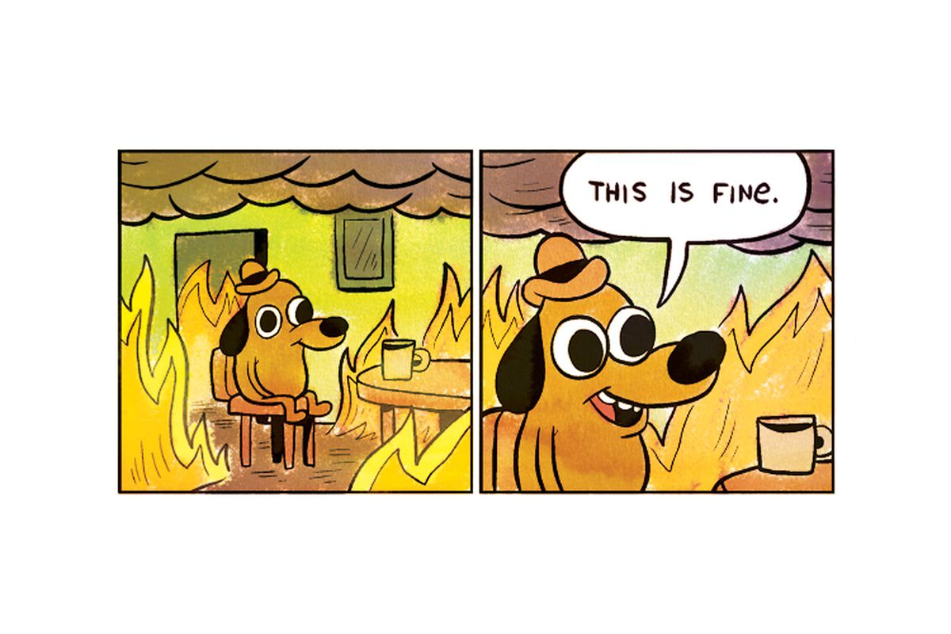
Without Proper Testing

Slide 11
Unit Testing
Tests a single unit in isolation from all others
In object-oriented programming, unit testing mostly means class testing
Tests a single class in isolation from others
JUnit testing
CSCI 2600 Spring 2021
11
Notes:
11

Slide 12
Why Is Testing So Hard?
// requires: 1 <= x,y,z <= 10000
// returns: computes some f(x,y,z)
int proc(int x, int y, int z)
Exhaustive testing would require 1 trillion runs! And this is a trivially small problem
Doesn’t test what happens when you violate preconditions
The key problem: choosing a set of inputs (i.e., test suite)
Small enough to finish quickly
Large enough to validate program
CSCI 2600 Spring 2021
12
Notes:
This where to start adding stuff about AI/ML testing
12

Slide 13
sqrt Example
// throws: IllegalArgumentException if x < 0
// returns: approximation to square root of x
public double sqrt(double x)
What are some values of x worth trying?
x < 0 (exception thrown)
x >= 0 (returns normally)
0 and around 0 (boundary conditions)
Perfect squares, non-perfect squares
x < 1 (sqrt(x) > x in this case), x = 1, x > 1
Big numbers: 2,147,483,647, 2,147,483,648
Edge Cases are important!
CSCI 2600 Spring 2021
13
Notes:
13

Slide 14
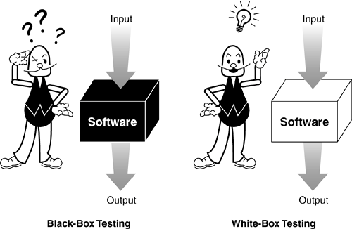
Testing Strategies
Test case: specifies
Inputs + pre-test state of the software
Expected result (outputs and post-test state)
Black box testing:
We ignore the code of the program. We look at the specification
given some input, was the produced output correct according to the spec?
Choose inputs without looking at the code
White box (clear box, glass box) testing:
We use knowledge of the code of the program
we write tests to “cover” internal paths
Choose inputs with knowledge of implementation
CSCI 2600 Spring 2021
14
Notes:
14

Slide 15
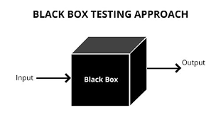
Black Box Testing Advantages
Robust with respect to changes in implementation
Independent of implementation
Test data need not be changed when code is changed
Allows for independent testers
Testers need not be familiar with implementation
Tests can be developed before code based on specifications.
Do this in HW4!
Special test methods are needed for black boxes based on AI/ML, IoT, sensors, etc. methods
CSCI 2600 Spring 2021
15
Notes:
15

Slide 16
Black Box Testing Heuristic
Choose test inputs based on paths in specification
// returns: a if a > b
// b if b > a
// a if a == b
int max(int a, int b)
3 paths, 3 test cases:
(4,3) => 4 (input along path a > b)
(3,4) => 4 (input along path b > a)
(3,3) => 3 (input along path a == b)
CSCI 2600 Spring 2021
16
Notes:
16

Slide 17
Black Box Testing Heuristic
Choose test inputs based on paths in specification
// returns: index of first occurrence of value in a // and -1 if value does not occur in a
int find(int[] a, int value)
What are good test cases?
([4,3,5,6], 5) => 2
([4,3,5,6], 7) => -1
([4,5,3,5], 5) => 1
([], 1) => -1
CSCI 2600 Spring 2021
17
Notes:
More needed. What happens when a = [ ]? Duplicate values?
17

Slide 18
sqrt Example
// throws: IllegalArgumentException if x < 0
// returns: approximation to square root of x
public double sqrt(double x)
What are some values of x worth trying?
We used this heuristic in sqrt example. It tells us to try a value of x < 0 (exception thrown) and a value of x >= 0 (returns normally) are worth trying
Probably should try 0 (edge condition), very large number
CSCI 2600 Spring 2021
18
Notes:
18

Slide 19
Black Box Heuristics
“Paths in specification” heuristic is a form of equivalence partitioning
Equivalence partitioning divides input and output domains into equivalence classes
Intuition: values from different classes drive program through different paths
Intuition: values from the same equivalence class drive program through “same path”, program will likely behave “equivalently”
We will not formally define equivalence classes
Intuitively
Input values have valid and invalid ranges
We want to choose tests from the valid, invalid regions and values near or at the boundaries of the regions
CSCI 2600 Spring 2021
19
Notes:
Heuristic – rule of thumb
a practical method, not guaranteed to be optimal, perfect, logical, or rational, but instead sufficient for reaching an immediate goal.
19

Slide 20
Equivalence partitioning
Equivalence partitioning
Divides the input data of a software unit into partitions of equivalent data from which test cases can be derived.
Usually applied to input data
Try to test each partition at least once
Informally, a method allows valid input for some range of arguments
Fails for others
Example int representation of months
Valid for 1..12
Invalid for < 1 and > 12
3 classes of inputs
Boundary regions are important also
CSCI 2600 Spring 2021
20
Notes:
20

Slide 21
Black Box Heuristics
Choose test inputs from each equivalence class
// returns: 0 <= result <= 5
// throws: SomeException if arg < 0 || arg > 10
int proc(int arg)
There are three equivalence classes: “arg < 0”, “0 <= arg <= 10” and “10 < arg”.
We write tests with values of arg from each class
Stronger vs. weaker spec. What if the spec said
requires: 0 <= arg <= 10 and doesn't throw anything?
CSCI 2600 Spring 2021
21
Notes:
Should try arg = 0, arg = 10
Weaker spec
Try arg < 0, 0 <= arg <= 10, arg > 10
Also arg= 0, arg = 10
What happens when arg < 0 || arg > 10 is undefined.
21

Slide 22
Equivalence Partitioning
Examples of equivalence classes
Valid input x in interval [a..b]: this defines three classes “x<a”, “a<=x<=b”, “x>b”
Input x is boolean: classes “true” and “false”
Choosing test values
Choose a typical value in the middle of the “main” class (the one that represents valid input)
Also choose values at the boundaries of all classes: e.g., use a-1,a, a+1, b-1,b,b+1
CSCI 2600 Spring 2021
22
Notes:
A fine point. We can only run “invalid” inputs (i.e., inputs from classes that represent invalid input) if the spec defines behaviors in case of invalid input (e.g., throws Exception). We cannot run invalid inputs otherwise (e.g., if spec says // requires 5 <= arg <= 10. This is because we don’t know what to expect if the input is outside the required interval, the spec does not define this!
Thus, black box tests are specification tests. They test whether implementation conforms to specification. We can also run implementation tests that have knowledge of the particular implementation (e.g., a particular implementation checks whether input is in the required range and if not, throws an exception).
22

Slide 23
Note:
We can only run tests on invalid arguments if the spec tells us what will happen for invalid data
If behavior is undefined if client violates requirements, how do we test undefined behaviors?
Black box tests are specification tests.
They test whether implementation conforms to specification
Argues for strong specs
CSCI 2600 Spring 2021
23
Notes:
23

Slide 24
Black Box Testing Heuristic: Boundary Value Analysis
Choose test inputs at the edges of the equivalence classes
Why?
Off-by-one bugs, forgot to handle empty container, overflow errors in arithmetic
Cases at the edges of the “main” class have high probability of revealing these common errors
Complements equivalence partitioning
CSCI 2600 Spring 2021
24
Notes:
24

Slide 25
Equivalence Partitioning and Boundary Values
Suppose our specification says that valid input is an array of 4 to 24 numbers, and each number is a 3-digit positive integer
One dimension: partition size of array
Classes are “n<4”, “4<=n<=24”, “n > 24”
Chosen values: 3,4,5, 14, 23,24,25
Another dimension: partition integer values
Classes are “x<100”, “100<=x<=999”, “x > 999”
Chosen values: 99,100,101, 500, 998,999,1000
Dimensions are orthogonal
We need to test a range of array sizes and values in the array
CSCI 2600 Spring 2021
25
Notes:
Note that we can chose 3 and 25 (outside of the “main” class) only if our spec defines behavior in “invalid input” case. Otherwise, chose 4,5, 14, 23, 24.
Same for the other dimension.
25

Slide 26
Equivalence Partitioning and Boundary Values
Equivalence partitioning and boundary value analysis apply to output domain as well
Suppose that the spec says “the output is an array of 3 to 6 numbers, each one an integer in the range 1000 - 2500”
Test with inputs that produce (for example):
3 outputs with value 1000
3 outputs with value 2500
6 outputs with value 1000
6 outputs with value 2500
More tests…
Of course, in this case we need to know what input values produce the various output values
CSCI 2600 Spring 2021
26
Notes:
26

Slide 27
Equivalence Partitioning and Boundary Values
// returns: index of first occurrence of value in a,
and -1 if value does not occur in a
int find(int[] a, int value)
What is a good partition of the input domain?
One dimension: size of the array
People often make errors for arrays of size 1, we decide to create a separate equivalence class
Classes are “empty array”, “array with one element”, “array with many elements”
What happens if a is null?
Previously, we partitioned the output domain: we forced -1, we forced normal output.
Need to test data values also
CSCI 2600 Spring 2021
27
Notes:
Previously, we partitioned the output domain: we forced -1, we forced normal output, we forced normal output, we forced first.
27

Slide 28
Equivalence Partitioning and Boundary Values
We can also partition the output domain: the location of the value
Four classes: “first element”, “last element”, “middle element”, “not found”
Array Value Output
Empty 5 -1
[7] 7 0
[7] 2 -1
[1,6,4,7,2] 1 0 (boundary, start)
[1,6,4,7,2] 4 2 (mid array)
[1,6,4,7,2] 2 4 (boundary, end)
[1,6,4,7,2] 3 -1
CSCI 2600 Spring 2021
28
Notes:
Note that this heuristic complements our “paths in specification heuristic”. It can be a good idea to have the outputs partitioned this way and have duplicate elements too!
What about testing null?
28

Slide 29
Other Boundary Cases
Arithmetic
Smallest/largest values
Zero
Objects
Null
Circular list
Same object passed to multiple arguments (aliasing)
CSCI 2600 Spring 2021
29
Notes:
29

Slide 30
Boundary Value Analysis: Arithmetic Overflow
// returns: |x|
public int abs(int x)
What are some values worth trying?
Equivalence classes are x < 0 and x >= 0
x = -1, x = 1, x = 0 (boundary condition)
How about x = Integer.MIN_VALUE?
// this is -2147483648 = -2³¹
// System.out.println(Math.abs(x) < 0) prints true!
CSCI 2600 Spring 2021
30
Notes:
So, what happens here? According to the Javadoc of Math.abs(int a), if a is Integer.MIN_VALUE, the result is the same value, which is negative.
The problem is, the largest positive integer is 2^31 – 1! This is one less than |Integer.MIN_VALUE| and cannot be represented as an integer, i.e., overflow occurs in this case.
Integer.MIN_VALUE is -2147483648, but the highest value a 32 bit integer can contain is +2147483647. Attempting to represent +2147483648 in a 32 bit int will effectively "roll over" to -2147483648. This is because, when using signed integers, the two's complement binary representations of +2147483648 and -2147483648 are identical. This is not a problem, however, as +2147483648 is considered out of range.
30

Slide 31
Boundary Value Analysis: Aliasing
// modifies: src, dest
// effects: removes all elements of src and appends them // in reverse order to the end of dest
void appendList(List<Integer> src, List<Integer> dest) {
while (src.size() > 0) {
Integer elt = src.remove(src.size()-1);
dest.add(elt);
}
}
What happens if we run appendList(list,list)?
Aliasing.
Infinite loop – why?
CSCI 2600 Spring 2021
31
Notes:
This is an example of alising: src and dst are aliased, i.e., they are different names for the same object! Aliasing can be dangerous. That is why it is a good idea to test with same object as argument at different places.
Descends into infinite loop because all we do is remove the last element of the list, then add it again to the end of the list!
31

Slide 32
Black Box Testing
Even with simple numerical arguments, testing can be complex
With more complex arguments (names, addresses, complex objects, etc.) finding the correct argument partitions can be difficult
Test complex systems early, often
At each stage of integration
Use mock objects to test complex arguments

Slide 33
Summary So Far
Testing is hard. We cannot run all inputs
Key problem: choose test suites such that
Small enough to finish in reasonable time
Large enough to validate the program (reveal bugs, or build confidence in absence of bugs)
All we have is heuristics!
We saw black box testing heuristics: run paths in spec, partition input/output into equivalence classes, run with input values at boundaries of these classes
There are also white box testing heuristics
CSCI 2600 Spring 2021
33
Notes:
33

Slide 34
White/Clear Box Testing
Testing with knowledge of the code
Ensure test suite covers (covers means executes) all of the program
Executes each statement
Measure quality of test suite with % coverage
Assumption: successful tests with high coverage implies few errors in program
Focus: features not described in specification
Control-flow details
Performance optimizations
Alternate algorithms (paths) for different cases
CSCI 2600 Spring 2021
34
Notes:
34

Slide 35
White Box Complements Black Box
boolean[] primeTable[CACHE_SIZE]
// Requires x >= 0
// returns: true if x is prime, false otherwise
boolean isPrime(int x) {
if (x > CACHE_SIZE) {
for (int i=2; i<=sqrt(x); i++)
if (x%i==0) return false;
return true;
}
else return primeTable[x];
}
CSCI 2600 Spring 2021
35
Notes:
Using black box heuristics, we’ll try small values 1,3,4,5, then some larger ones, e.g., 3571 or larger.
But what if CACHE_SIZE is much larger than the largest prime we test with?
Something important happens at around CACHE_SIZE.
What happens when x == CACHE_SIZE?
Should be CACHE_SIZE – 1 or x >= CACHE_SIZE
35

Slide 36
White Box Testing: Control-flow-based Testing
Control-flow-based white box testing:
Extract a control flow graph (CFG)
Test suite must cover (execute) certain elements of this control flow graph
Idea: Define a coverage target and ensure test suite covers target
Targets: nodes, branch edges, paths
Coverage target approximates “all of the program”
CSCI 2600 Spring 2021
36
Notes:
Coverage target approximates “all of program”.
36

Slide 37
Control-flow Graph (CFG)
Can be obtained from the program’s flow graph
Each node represents a basic block
Two designated blocks:
Entry block
Exit block
Directed! Edges represent jumps in the control flow
Every edge A → B (except for entry/exit edges) has the property: outdegree(A) > 1 or indegree(B) > 1 (or both)
Indegree is the number of incoming edges
Outdegree is the number of outgoing edges
CSCI 2600 Spring 2021
Notes:
37

Slide 38
Control-flow Graph (CFG)
Assignment x=y+z => node in CFG:
If-then-else
if (b) S1 else S2 =>
x=y+z
b
True
False
CFG for S1
CFG for S2
CSCI 2600 Spring 2021
38
Notes:
38

Slide 39
Aside: Control-flow Graph (CFG)
Loop
while (b) S =>
b
True
False
CFG for S
CSCI 2600 Spring 2021
39
Notes:
39

Slide 40
Aside: Control Flow Graph (CFG)
Draw the CFG for the code below:
1 s:= 0; 2 x:= 0; 3 while (x<y) { 4 x:=x+3; 5 y:=y+2; 6 if (x+y<10) 7 s:=s+x+y; else 8 s:=s+x-y;
}
CSCI 2600 Spring 2021
40
Notes:
40

Slide 41
Statement Coverage
Traditional target: statement coverage. Write test suite that covers all statements, or in other words, all nodes in the CFG
Motivation: code that has never been executed during testing may contain errors
Often this is the “low-probability” code
CSCI 2600 Spring 2021
41
Notes:
41

Slide 42
Example
Suppose that we write and execute two test cases
Test case #1: follows path 1-2-7 (e.g., we never take the loop)
Test case #2: 1-2-3-4-6-2-3-4-6-2-7 (loop twice, and both times take the true branch)
Problems?
1
2
F
T
T
F
3
4
5
6
7
CSCI 2600 Spring 2021
42
Notes:
42
This test cases achieves 6/7 or ~86% statement coverage. Problem! We want 100% statement coverage.
Skips 5

Slide 43
Example
We need to cover the red branch edges
Test case #1: follows path 1-2-7
Test case #2: 1-2-3-4-6-2-3-4-6-2-7
What is % branch coverage?
1
2
F
T
T
F
3
4
5
6
7
CSCI 2600 Spring 2021
43
Notes:
43
This test suite achieves only 3/4 or 75% branch coverage. We want 100% branch coverage. It misses the 3-5 branch.

Slide 44
Branch Coverage
Target: write test cases that cover all branch edges at predicate nodes
True and false branch edges of each if-then-else
The two branch edges corresponding to the condition of a loop
All alternatives in a switch statement
In modern languages, branch coverage implies statement coverage
CSCI 2600 Spring 2021
44
Notes:
Branch coverage implies statement coverage: if we have a test suite that achieves 100% branch coverage then this same test suite achieves 100% statement coverage. The reverse is not true.
44

Slide 45
Branch Coverage
Motivation for branch coverage: experience shows that many errors occur in “decision making” (i.e., branching). Plus, it implies statement coverage
Statement coverage does not imply branch coverage
I.e., a suite that achieves 100% statement coverage does not necessarily achieve 100% branch coverage
Can you think of an example?
CSCI 2600 Spring 2021
45
Notes:
45

Slide 46
Example
static int min(int a, int b) {
int r = a;
if (a <= b)
r = a;
return r;
}
Let’s test with min(1,2)
What is the statement coverage?
What is the branch coverage?
What happens with min(2,1)?
CSCI 2600 Spring 2021
46
Notes:
We miss the bug! Suppose we try min(2,1).
min(1,2) achieves 100% statement coverage. However, it misses the FALSE branch edge of the IF-THEN statement. min(1.2) achieves 50% branch coverage.
46

Slide 47
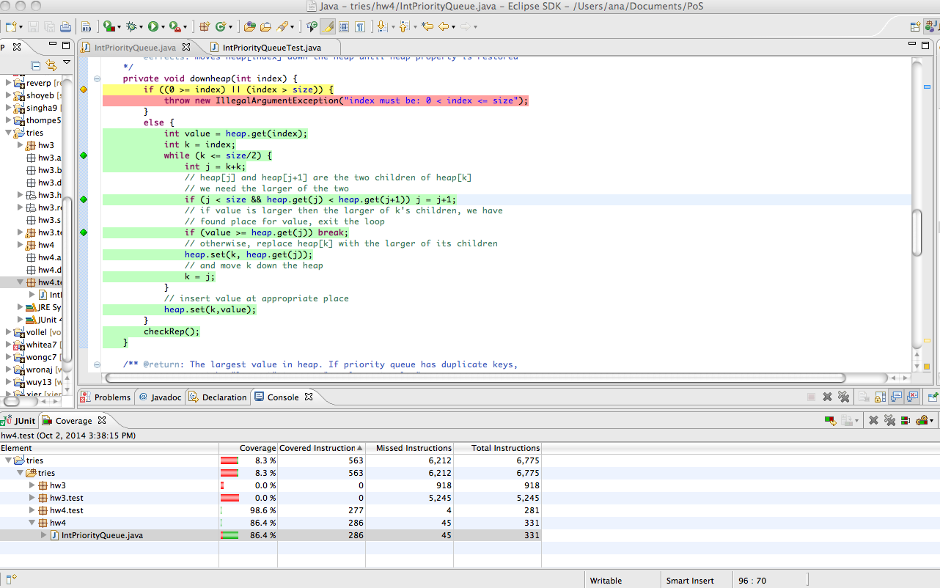
Code Coverage in Eclipse
CSCI 2600 Spring 2021
47
Notes:
In hw4, you will install eclEmma, a tool for showing test coverage
47

Slide 48
Other White Box Heuristics
Equivalence partitioning and boundary value analysis
Loop testing
Skip loop
Run loop once
Run loop twice
Run loop with typical value
Run loop with max number of iterations
Run with boundary values near loop exit condition
Branch testing
Run with values at the boundaries of branch condition
CSCI 2600 Spring 2021
48
Notes:
48

Slide 49
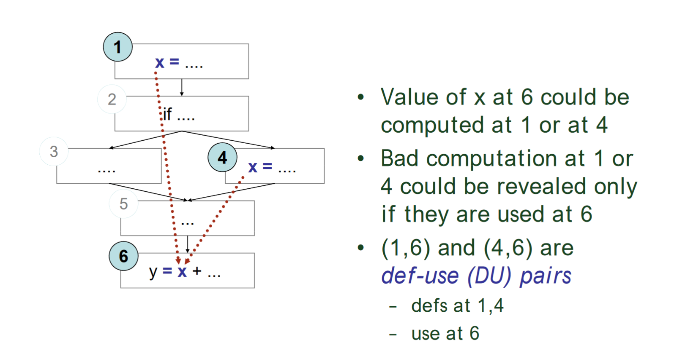
Difficulties
From http://www.inf.ed.ac.uk/teaching/courses/st/2015-16/Ch13.pdf
CSCI 2600 Spring 2021
49
Notes:
Code difficulties cause testing difficulties
49

Slide 50
Definition-use Pairs
A def-use (DU) pair
A pair of a definition and use of a variable such that at least one path exists from the definition to the use
x = 1; // definition
y = x + 3 // use
DU path
A path from the definition of a variable to a use of the same variable with no other definition of the variable on the path
Loops can create infinite DU paths
CSCI 2600 Spring 2021
50
Notes:
50

Slide 51
From http://www.inf.ed.ac.uk/teaching/courses/st/2015-16/Ch13.pdf
CSCI 2600 Spring 2021
51
Notes:
51

Slide 52
Adequacy
We want to test:
All DU pairs
Each DU pair tested at least once
All DU paths
Each path is tested at least once
All definitions
For each definition, there is at least one test that exercises a DU path containing it
Every computed value is used at least once
CSCI 2600 Spring 2021
52
Notes:
52

Slide 53
Difficulties
x[i] = some_value; y = x[j];
DU pair only if i == j
Obj x = new Obj(); y = x;
y is an alias of x
What happens when x or y is used? ( x.setVal(newVal);)
If x is changed, y is changed, and viceversa
m.putFoo(); y = n.getFoo();
Are m and n the same object?
Do m and n share a foo?
Aliases can be a problem
CSCI 2600 Spring 2021
53
Notes:
53

Slide 54
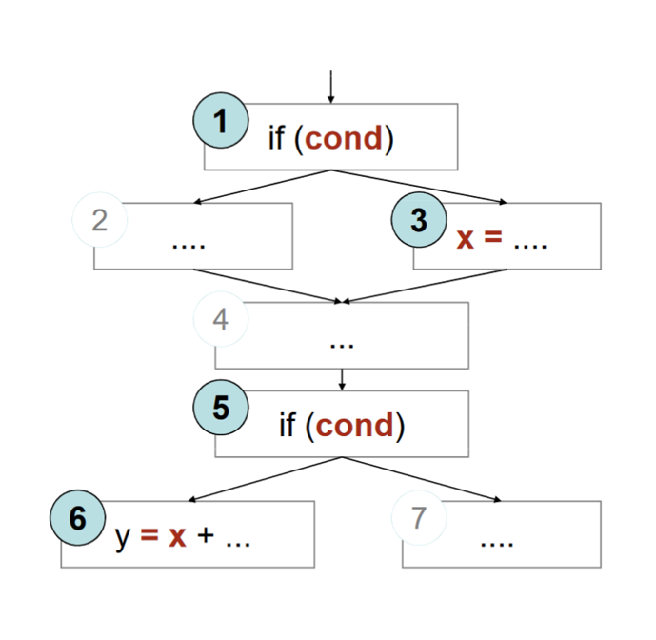
Infeasibility
Suppose cond doesn’t change between 1 and 5
Or conditions could be different, but 1 implies 5
(3, 6) is not a feasible DU path
It is very difficult to find infeasible paths
Infeasible paths are a problem
Difficult to find
Impossible to test
CSCI 2600 Spring 2021
54
Notes:
54

Slide 55
Infeasibility
Detecting infeasibility can be difficult
Combination of elements matter
No general way to detect infeasible paths
In practice the goal is reasonable coverage
Number of paths can be large
Doing all DU paths might be impractical
Problems
Aliases
Infeasible paths
Worst case is bad
Exponential number of paths
Undecidable properties
Be pragmatic
CSCI 2600 Spring 2021
55
Notes:
55

Slide 56
Testing Guidelines
Do it early and do it often
Write tests first
Best to catch bugs soon, before they hide
Automate the process
Regression testing will save time
Be systematic
Writing tests is a good way to understand the spec
Specs can be buggy too!
When you find a bug, write a test first, then fix
CSCI 2600 Spring 2021
56
Notes:
Regression testing is the process of testing changes to computer programs to make sure that the older programming still works with the new changes.
56

