Slide 1
CSCI-2600:
Principles of Software
Spring 2021
Carlos Varela, Instructor
Konstantin Kuzmin, Co-Instructor
psoftstaff@cs.lists.rpi.edu
https://www.cs.rpi.edu/academics/courses/spring21/csci2600/
Notes:
1

Slide 2
Acknowledgements
Some of the material in this course comes from:
Prof. Milanova, Prof. Goldschmidt, Prof. Thompson
Prof. Michael Ernst - University of Washington
Thanks to Prof. Cutler and the Submitty team
Many others
Thanks to our teaching staff:
TAs: Ankita Bhaumik, Lilian Ngweta, Vipula Rawte, Jiawen Zhang.
Mentors: Kongmin Cao, Dennis Chau, Rory Eiffe, Robin Hong, Richard Le, Zhangcheng Li, Zachary McDaniel, Ruben McWilliams, Joseph Napolitano, Emma Skantze.
Instructional Support Coordinator: Shianne Hulbert

Slide 3
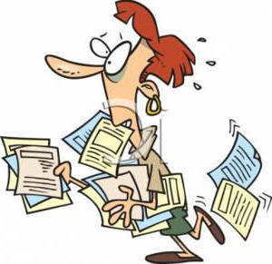
Some Administrative Notes
CSCI 2600 is restricted to CSCI majors.
This semester we are enforcing this restriction.
We are also enforcing the pre-requisites: CSCI 1200 and CSCI 2200.
Given the synchronous teaching format, and final exam scheduling and other potential conflicts, no concurrent courses (with time conflicts) were approved. You should plan on attending lectures synchronously.
If a student is adding the dual major or switching to CSCI, they must do that before registering for CSCI 2600.
Students should contact the SoS Advising Hub to declare the dual major
Please email: sciencehub@rpi.edu
Notes:
ITWS majors too?

Slide 4
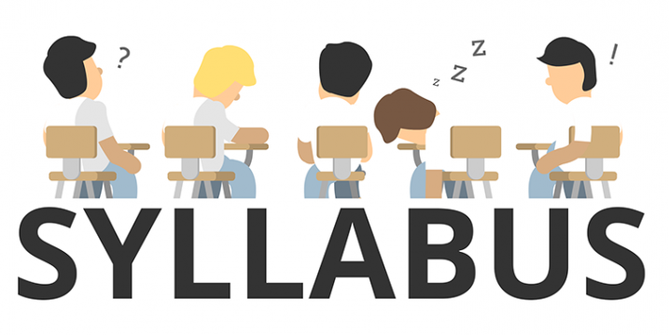
The class web site is https://www.cs.rpi.edu/academics/courses/spring21/csci2600/
Please carefully read the syllabus and ask any questions you have on the Submitty forum
https://submitty.cs.rpi.edu/s21/csci2600/forum
If you are not able to log onto Submitty, please let us know immediately.
You should ask course questions in Submitty whenever possible.
If you need to contact only the course teaching staff, you can email psoftstaff@cs.lists.rpi.edu
All homework assignments must be completed individually! Submit only your own work.
Cheating will not be tolerated
Discussion is encouraged on Submitty, but do not post code (whether correct or incorrect) for any gradeable assignment.
Notes:
review web site and syllabus
Describe Moss
4

Slide 5
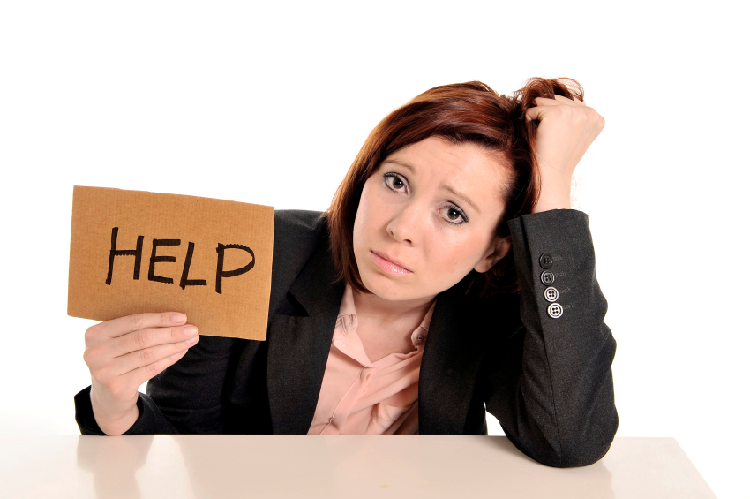
How to ask for help
Before asking for help
Read the docs.
Fix all compiler errors.
Examine all compiler warnings. Fix them if possible.
Read and try to understand the error messages.
Try and fix the problem yourself.
Test your code with relevant data.
Read the forum/mailing list, the question may have been answered.
When reporting a problem, say what you were doing,
what you expected to happen and what actually happened.
Give information.
“My code doesn’t work. What’s wrong?” is useless to you and your audience.
If your code worked, you wouldn’t be asking.
Before posting a question, read it yourself and ask if you would understand it.
If not, add more info. Remember other people are not there with you so they can't see what's on your screen.
Be polite. Say "thank you". Expressing frustration may make you feel better, but it doesn’t
help solve the problem and may just annoy people who might help you.
Remember: It’s almost never the hardware or the server. It’s usually your code.

Slide 6
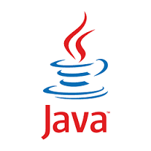
Java and Git Environments
As part of Homework 0, you will install Eclipse (general-purpose IDE)
https://www.cs.rpi.edu/academics/courses/spring21/csci2600/handout-files/files_25_01/eclipse_and_git.pdf
Homework will be released and also turned in using Git on Submitty
Git – Version Control System (VCS)
To turn in your homework, commit into your repository, push the files to Submitty, then push the files to the Homework Submission Server
Commit early and often
More details on Git, JUnit, etc. to follow

Slide 7
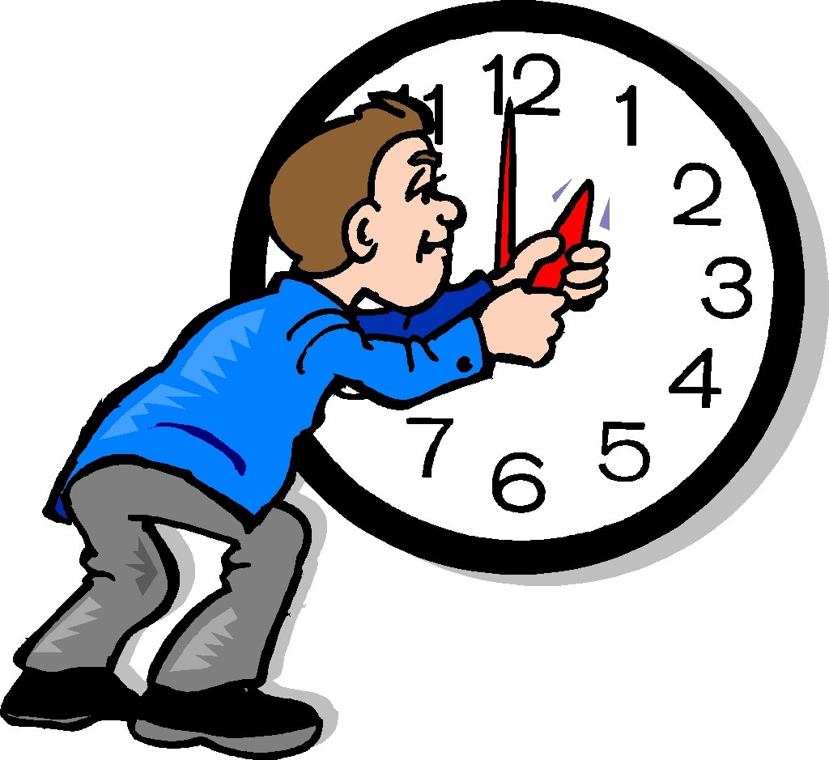
Homework Assignments
Homework assignments must be submitted (via Submitty) by 11:59 PM on the given due date
The Submitty URL is https://submitty.cs.rpi.edu/home
You have seven late days (7) for the entire semester (use them wisely)
You have a maximum of two late days per assignment
Requests for extensions beyond the two late days due to illness or other extenuating circumstances must be backed by a note from the Student Success Office or other school authority

Slide 8
Remember This!
You must click this button for your homework to be graded.
Just committing and pushing your repo is not enough.

Slide 9
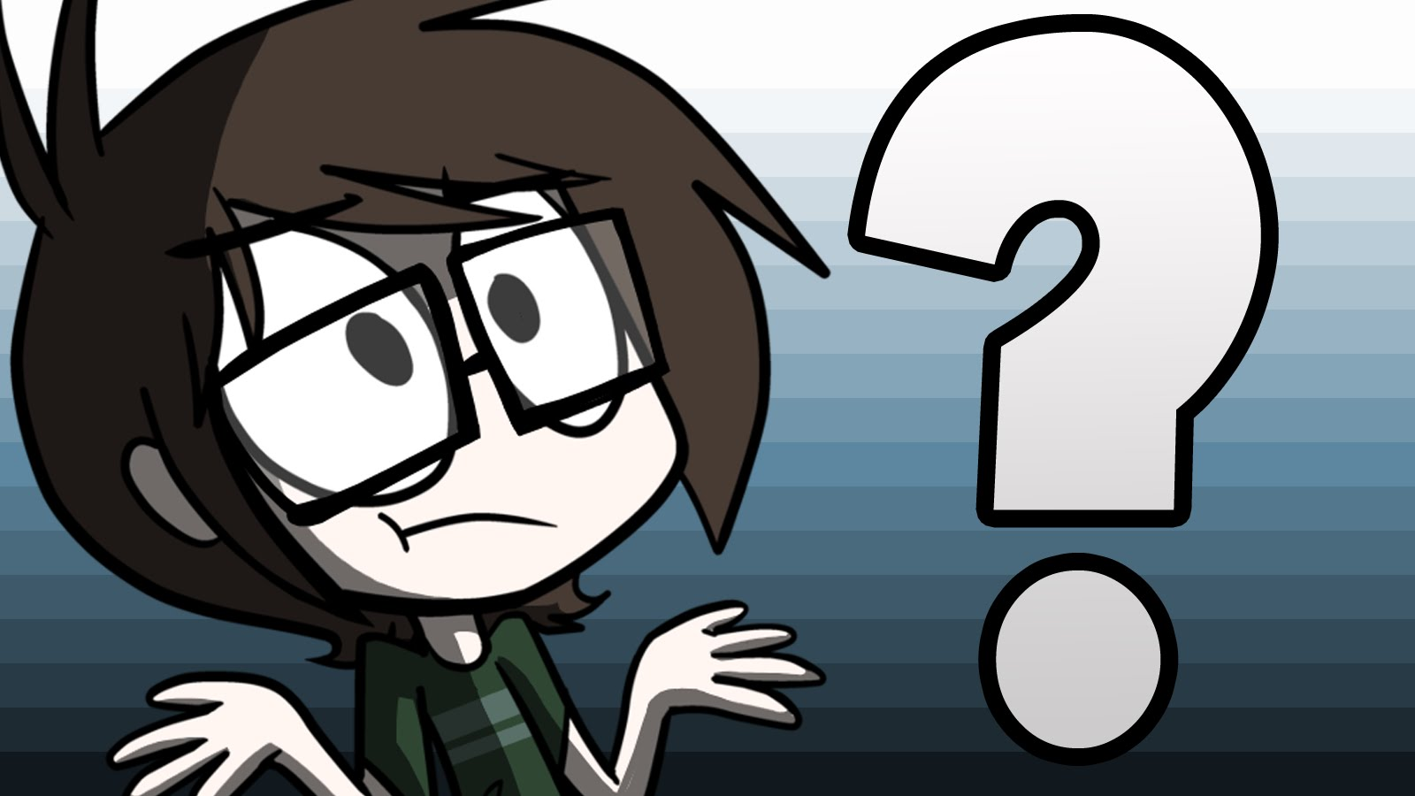
What This Course is About
Writing correct code
Error-free code
Does what the programmer intended
How can we describe what we intend?
How can we guarantee the code matches our descriptions?
How can we make our code maintainable
Reasoning about Code
Object-Oriented Programming: Inheritance and Polymorphism
Design Patterns
Notes:
The course has two broad parts. The first is technical – how do we reason about code and involves reasoning, specifications, polymorphism. The second part is about general guidelines to produce maintainable code and involves design patterns, anti-patterns, usability.
Correct code is not necessarily the same as good code
We know that code can be
Malware
Insecure
Misleading to users
Discriminatory towards individuals and groups
Evil

Slide 10
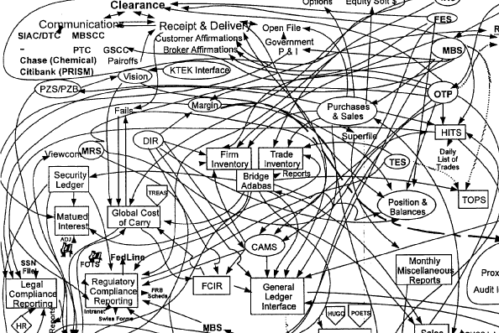
Why is software so hard?
Programming is about managing complexity
Complexity is anything related to the structure of a software system that makes it hard to understand and modify the system
See John Ousterhout’s “A Philosophy of Software Design” (Chapter 2)
Common indications are antipatterns and code smells
Notes:
See Philosophy of Software Design Chapter 2

Slide 11
Why is software so hard?
Poor Design Symptoms
Change Amplification
Simple changes require changes in many different places
One of the goals of good design is to reduce the amount of code that is affected by each design decision, so design changes don’t require very many code modifications
Cognitive Load
How much does a developer need to know to complete a task
Unknown unknowns
Occurs when it is not obvious which pieces of code must be modified to complete a task, or what information a developer must have to carry out the task successfully
Notes:
See Philosophy of Software Design Chapter 2

Slide 12
Causes of Complexity
Dependencies
A dependency exists when a given piece of code cannot be understood and modified in isolation
There will always be dependencies, but they should be made obvious
Obscurity
Obscurity occurs when important information is not obvious
Often a documentation problem
Complexity is incremental
It creeps in

Slide 13
Goal – Manage Complexity
Complexity comes from an accumulation of dependencies and obscurities.
As complexity increases, it leads to change amplification, a high cognitive load, and unknown unknowns.
As a result, it takes more code modifications to implement each new feature.
Developers spend more time acquiring enough information to make the change safely.
In the worst case, they can’t even find all the information they need.
The bottom line is that complexity makes it difficult and risky to modify an existing code base.

Slide 14
How Do We Manage Complexity?
Modular design
Software is decomposed into a collection of modules that are relatively independent
Classes, subsystems, services
In an ideal world, modules would be independent of one another
In the real world, there are always dependencies
Our goal is to manage these dependencies to reduce complexities
Separate interface from implementation
The user of a module interacts with the module through an interface
How the module performs the operation is hidden from the user
Write correct specifications
Programmer codes to the spec, not the code
Follow correct practices

Slide 15
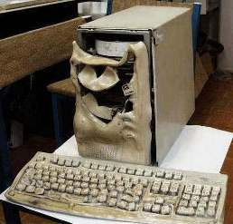
Correctness - why do we care?
Programming errors cost the U.S. economy $60 billion yearly in lost efficiency and real harms.
http://outfresh.com/knowledge-base/6-famous-software-disasters-due-lack-testing/
Crash of an Airbus A400M transport plane (2015)
Caused by error in software configuration
Mars Climate Orbiter crash (1998)
Command software incorrectly used English units instead of metric
Nissan Airbag Malfunction (2013)
System couldn’t determine if passenger seat was occupied
Northeast blackout (2003)
Programming error caused alarm failure

Slide 16
Goals – Correctness
We want to write correct and maintainable programs
What does it mean for a program to be correct?
Matches specifications
What are ways to achieve correctness?
Principled design and development
Abstraction and modularity
Documentation
What are ways to verify correctness?
Reasoning about code
Testing
Automated verification
Notes:
What is a specification? How do we write specifications? How do we prove that the program obeys the specifications?
These are the questions we will explore in the coming weeks.
What is our notion of “correctness” in data driven/big data programs?
Notions of correctness may vary with the domains. In ML or scientific programming, it can be based on statistics.
16

Slide 17
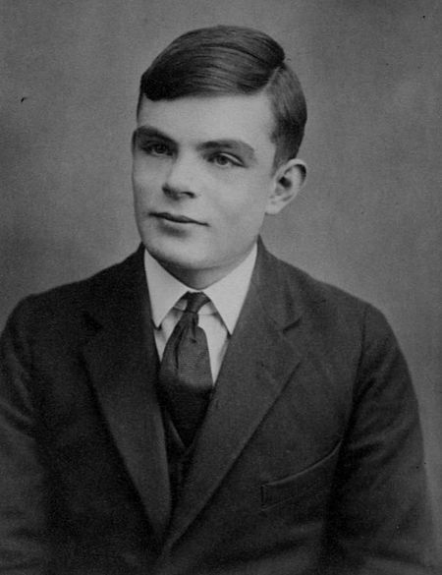
Writing Correct Code is Hard
"Program testing can be used to show the presence of bugs, but never to show their absence!" Edsger Dijkstra
Halting problem
For any non-trivial property of partial functions, no algorithm can decide whether or not a program (TM) M computes a partial function with that property.
Rice’s Theorem
TM = Turing Machine
Why?
See http://blog.paralleluniverse.co/2016/07/23/correctness-and-complexity/
Notes:
The halting problem is the problem of determining, from a description of an arbitrary computer program and an input, whether the program will finish running (i.e., halt) or continue to run forever. Alan Turing proved in 1936 that a general algorithm to solve the halting problem for all possible program-input pairs cannot exist.
Rice's theorem states that all non-trivial, semantic properties of programs are undecidable. A semantic property is one about the program's behavior (for instance, does the program terminate for all inputs), unlike a syntactic property (for instance, does the program contain an if-then-else statement). A property is non-trivial if it is neither true for every computable function, nor false for every computable function.

Slide 18
Writing Correct Code is Hard
That doesn’t mean we can’t do it in specific cases
The possibilities as to what one may do are immense. One of our difficulties will be the maintenance of an appropriate discipline, so that we do not lose track of what we are doing.
Alan Turing
Almost all (92%) of the catastrophic system failures are the result of incorrect handling of non-fatal errors explicitly signaled in software… In 58% of the catastrophic failures, the underlying faults could easily have been detected through simple testing of error handling code
Ding Yuan et al., Simple Testing Can Prevent Most Critical Failures: An Analysis of Production Failures in Distributed Data-Intensive Systems, 2014

Slide 19
Goals – Maintainability
What does it mean for a program to be maintainable?
Well-organized
Consistent
Well-documented and understandable
Open for extension but closed for modification
Example:
Suppose we have an editor that manipulates two-dimensional shapes
We have coded Square and Circle objects and have tons of code that manipulates these objects
It should be “easy” to add Triangle (open for extension) without any changes to the existing code that manipulates shapes (closed for modification)
Notes:
Open for extension but closed for modification: it should be easy to add a feature without making extensive changes to the code
19

Slide 20
Goals – Maintainability
What are ways to achieve maintainability?
Principled design and development
Abstraction and modularity
Correct object-oriented approach, especially polymorphism, facilitates achieving maintainability
Documentation!
Notes:
We also look at other approaches, in particular, functional programming.
20

Slide 21
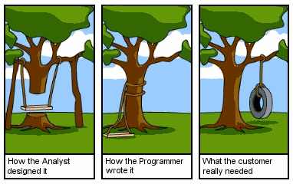
Software Engineering
Building “correct” software is difficult!
Large software systems are enormously complex
Lots of moving parts
Ever-changing requirements, interfaces, devices, etc.
Often face problems scaling up
Software is often put to new uses, sometimes without relevant experience
Software engineering focuses on:
Mitigating and managing complexity
Managing change
Handling software failures
Handling software project failures

Slide 22
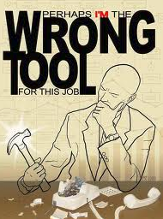
A Summary of Tools
Principles are more important than tools!
However, good tools are important
Java – an industry standard object-oriented programming language
Eclipse – powerful integrated development environment (IDE)
Git – version control (more on this coming up...)
JUnit 4 – testing framework for Java
Submitty
Homework Submission Server
Developed by RPI and RCOS, a system for submitting assignments, auto-testing such submissions, assigning grades, etc.
Notes:
“if all you have is a hammer, everything looks like a nail”
IDEs for Java: NetBeans, IntlleJ, Jsource, DrJava, Visual Studio Code
22

Slide 23
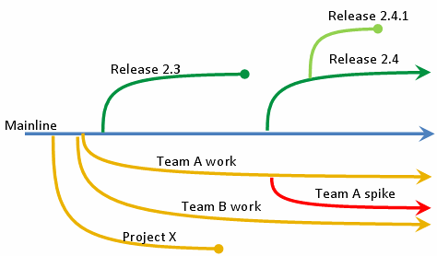
Version Control
What does a version control system do?
Records changes to a set of files over time
Manages changes by a single user or multiple users
Maintains a centralized repository of files, from which users may checkout all or some of the files on a local machine
Reverts to older versions, reviews changes made over time, tracks all changes, reviews who introduced what issues, etc.
We will use Git.
SVN is a popular alternative

Slide 24
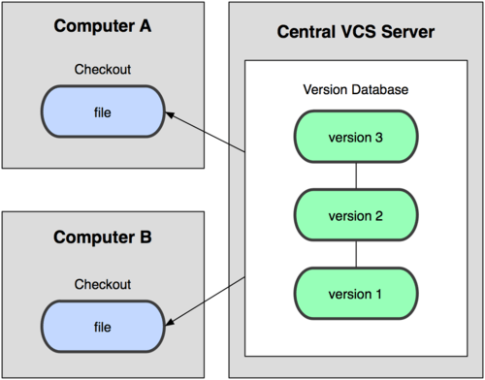
Version Control – Basic Schematic
Notes:
24

Slide 25
Version Control – Key Functions
Checkout a set of files, from a centralized repository to a local machine
Typically just done once unless you wish to revert to an older version
Add new files to a repository, i.e., to version control
Store newly created local file(s) in the centralized repository
Enables other users to see/obtain/modify files
Commit files, i.e., push changes to the repository
In other words, commit your changes
Update files, i.e., obtain changed file(s) from the repository
In other words, get your local machine or instance up to date

Slide 26
Version Control – Merges
Merges occur when multiple users have modified the same file
Changes must be merged together into the file in the centralized repository
Hopefully, the changes do not overlap or conflict
If a conflict does occur, a merge must be performed manually
In this class, we hope you will not need to worry about merges
Each of you will have your own repository on the Submitty server
If you think you require a merge, let us know....

Slide 27
JUnit testing framework
JUnit is a unit testing framework for Java that supports writing and running unit tests
What is unit testing?
Testing in which the scope of the test is one unit (or module or component)
Example units include a subroutine, function, class, file, etc.
In object-oriented programming, the smallest testable unit is the class
Unit testing is essentially class testing
After unit testing, we have integration testing, then system testing

Slide 28
Junit 4.x
JUnit uses annotations to specify test runs:
@BeforeClass – static method to configure the test run
The JUnit framework runs this method before all tests
This method creates an instance of the class being tested
@Test – this annotation marks a method as a test method
The JUnit framework runs this method as a test
Test methods:
assertEqual( message, expected result, actual expression )
assertTrue( message, Boolean expression )
Notes:
28

Slide 29
Junit 4.x Example
By the naming convention, this is a test of the Sale class
public class SaleTest {
private static Sale sale = null;
private static double ITEM_PRICE = 2.5;
@BeforeClass
public static void setupBeforeTests() { sale = new Sale(); }
@Test
public void testGetTotal() {
sale.makeLineItem( "item1", 1, ITEM_PRICE );
sale.makeLineItem( "item2", 2, ITEM_PRICE );
assertEquals( "sale.getTotal()", 7.5, sale.getTotal() );
}

Slide 30
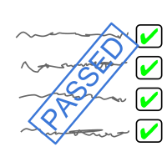
Unit Testing
Modern software development methodologies, such as Extreme Programming (XP) and the Unified Process (UP), place great emphasis on unit testing
They advocate Test-Driven Development (TDD)
test-first development
Key point is that developers first write the unit tests
before the unit (class) being tested is actually implemented!

Slide 31
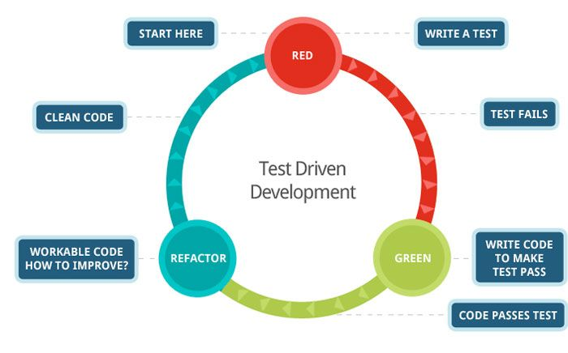
Test-Driven Development (TDD)
Write unit tests first! Why?
The unit tests actually get written
Programmer satisfaction that leads to more consistent test writing
Clarification of correct interface behavior
Forces one to think of necessary inputs and outputs, as well as “corner cases”
Repeatable, automated verification
More confidence in making changes to individual unit (i.e., “unit tests all passed”)

Slide 32
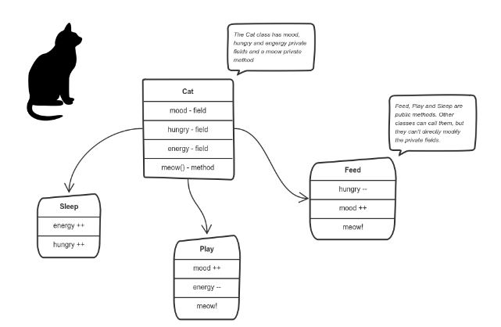
Object Oriented Programming (OOP)
Object
Software “unit” that contains state and methods
State – maintains values
Methods – perform operations
This class will mainly focus on object oriented programming concepts
Inheritance
Encapsulation
Abstraction
Polymorphism

Slide 33
Object Oriented Programming
OOP requires discipline
Design Patterns
SOLID
Single responsibility principle
A class should only have a single responsibility
Open–closed principle
Software entities should be open for extension but closed for modification.
Liskov substitution principle
Objects in a program should be replaceable with instances of their subtypes without altering the correctness of that program.
Interface segregation principle
Many client-specific interfaces are better than one general-purpose interface.
Dependency inversion principle
One should depend upon abstractions, [not] concrete implementations
Notes:
interface-segregation principle (ISP) states that no client should be forced to depend on methods it does not use
ISP splits interfaces that are very large into smaller and more specific ones so that clients will only have to know about the methods that are of interest to them.
Paul Graham has suggested that OOP's popularity within large companies is due to "large (and frequently changing) groups of mediocre programmers". According to Graham, the discipline imposed by OOP prevents any one programmer from "doing too much damage".^{[46]}

Slide 34
It's not the only way to think about software
Object Oriented Programming puts the Nouns first and foremost. Why would you go to such lengths to put one part of speech on a pedestal? Why should one kind of concept take precedence over another? It's not as if OOP has suddenly made verbs less important in the way we actually think. It's a strangely skewed perspective.
Steve Yegge
Other approaches
imperative in which the programmer instructs the machine how to change its state
procedural which groups instructions into procedures,
declarative in which the programmer merely declares properties of the desired result, but not how to compute it
functional in which the desired result is declared as the value of a series of function applications,
logic in which the desired result is declared as the answer to a question about a collection of facts and rules,
mathematical in which the desired result is declared as the solution of an optimization problem

Slide 35
What happens Next?
Review the course syllabus and schedule
Be sure you are on Submitty
Log in with your RCS ID
The first part of your @rpi.edu email address
Check the Submitty forum regularly for announcements
Quizzes, homework, etc. will be announced there
Make sure you are registered for the course on SIS
Start programming in Java

