Slide 1
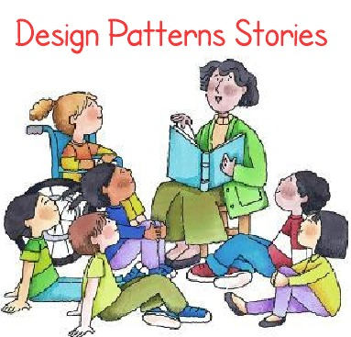
More Design Patterns
Notes:
1

Slide 2
Observer Pattern
Question: how to handle an object (model), which has many “observers” (views) that need to be notified and updated when the object changes state
For example, an interface toolkit with various presentation formats (spreadsheet, bar chart, pie chart). When application data, e.g., stocks data (model) changes, all presentations (views) should change accordingly
CSCI 2600 Spring 2021
2
Notes:
2

Slide 3
A Naïve Design
Client stores information in Data
Then Data class updates the views accordingly
Problem: to add a view, or change a view, we must change Data. Better to insulate Data from changes to Views!
Single responsibility principle
Client
SpreadsheetView
Data
BarChartView
CSCI 2600 Spring 2021
3
Notes:
Remember, this is a central issue in design. Where Design patterns help. We would like to build systems that are open for extension (easy to change, add Views), but close to modification (we want to insulate Data from the change).
3

Slide 4
A Better Design
Data class has minimal interaction with Views
Only needs to update Views when it changes
Old, naïve design:
Better design:
class Data {
…
void updateViews() {
spreadSheet.update(newData);
barChart.update(newData);
// Edit this method when // different views are added.
// Bad!
}
class Data {
List<Observer> observers;
void notifyObservers() {
for (obs : observers)
obs.update(newData);
}
}
interface Observer {
void update(…);
}
CSCI 2600 Spring 2021
4
Notes:
In second version Data has a list of Observers. When data changes, it notifies the observers.
4

Slide 5
Class Diagram
1
*
Data attach(Observer) detach(Observer) notifyObservers()
Observer update(...)
observers
for (Observer obs : observers) obs.update(…)
SpreadsheetView update(…)
BarChartView update(…)
Client is responsible for creation: data = new Data(); data.attach(new BarChartView());
Data keeps list of Views, notifies them when change.
Data is minimally connected to Views!
CSCI 2600 Spring 2021
5
Notes:
What can be a problem?
5

Slide 6
Even Better
1
*
Observable attach(Observer) detach(Observer) notifyObservers(…)
Observer update(...)
observers
for (Observer obs : observers) obs.update(…)
SpreadsheetView update(…)
BarChartView update(…)
Data …
…
// when a notable change occurs // calls notifyObservers(…)
CSCI 2600 Spring 2021
6
Notes:
Observable maintains a list of observers. Attach/detach modify list.
Data is a subclass of Observer. When data changes, notify observers.
SpreadsheetView, BarChartView are subclasses of Observer.
6

Slide 7
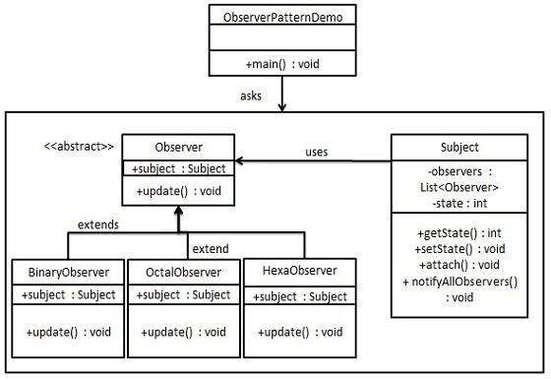
https://www.tutorialspoint.com/design_pattern/observer_pattern.htm
CSCI 2600 Spring 2021
7
Notes:
See ObserverDemo.java
7

Slide 8
import java.util.ArrayList;
import java.util.List;
public class Subject { // an Observable
private List<Observer> observers = new ArrayList<Observer>();
private int state;
public int getState() {
return state;
}
public void setState(int state) {
this.state = state;
notifyAllObservers();
}
public void attach(Observer observer){
observers.add(observer);
}
public void notifyAllObservers(){
for (Observer observer : observers) {
observer.update();
}
}
}
CSCI 2600 Spring 2021
8
Notes:
8

Slide 9
public abstract class Observer {
protected Subject subject;
public abstract void update();
}
public class BinaryObserver extends Observer{
public BinaryObserver(Subject subject){
this.subject = subject;
this.subject.attach(this);
}
// get the state of the subject
@Override
public void update() {
System.out.println( "Binary String: " + Integer.toBinaryString( subject.getState() ) );
}
}
CSCI 2600 Spring 2021
9
Notes:
9

Slide 10
public class OctalObserver extends Observer{
public OctalObserver(Subject subject){
this.subject = subject;
this.subject.attach(this);
}
@Override
public void update() {
System.out.println( "Octal String: " + Integer.toOctalString( subject.getState() ) );
}
}
public class HexaObserver extends Observer{
public HexaObserver(Subject subject){
this.subject = subject;
this.subject.attach(this);
}
@Override
public void update() {
System.out.println( "Hex String: " + Integer.toHexString( subject.getState() ).toUpperCase() );
}
}
CSCI 2600 Spring 2021
10
Notes:
10

Slide 11
public class ObserverPatternDemo {
public static void main(String[] args) {
Subject subject = new Subject();
new HexaObserver(subject);
new OctalObserver(subject);
new BinaryObserver(subject);
System.out.println("First state change: 15");
subject.setState(15);
System.out.println("Second state change: 10“);
subject.setState(10);
}
}
Output:
First state change: 15
Hex String: F
Octal String: 17
Binary String: 1111
Second state change: 10
Hex String: A
Octal String: 12
Binary String: 1010
CSCI 2600 Spring 2021
11
Notes:
11

Slide 12
Push vs. Pull Model
Question: How does the object (Data in our case) know what info each observer (View) needs?
Push model: Object sends the info to Observers
Pull model: Object does not send info directly. It gives access to itself to the Observers and lets each Observer extract the data they need
CSCI 2600 Spring 2021
12
Notes:
Previous example was pull model
12

Slide 13
Observer Pattern
1
*
Data attach(Observer) detach(Observer) notifyObservers(…)
getStockPrice();
Observer update(Data)
observers
for (Observer obs : observers) obs.update(this)
SpreadsheedView update(Data)
BarChartView update(Data)
Pull model: observers have access to Data, they can pull the info they need.
CSCI 2600 Spring 2021
13
Notes:
What can be a problem?
Possible rep exposure
13

Slide 14
THE MODEL
Example of Observer
From JDK
public class SaleItem extends Observable {
private String name;
private float price;
public SaleItem(String name, float price) {
this.name = name;
this.price = price;
}
public void setName(String name) {
this.name = name;
setChanged();
notifyObservers(name);
}
public void setPrice(float price) {
// analogous to setName
}
}
From JDK. Marks that object has changed.
From JDK. If object has changed, calls obs.update(this, name)
CSCI 2600 Spring 2021
14
Notes:
Observable is an SDK class.
notifyObservers calls update() on each Observer
This is the model.
14

Slide 15
An Observer of Name Changes (Push)
THE VIEW
public class NameObserver implements Observer {
private String name;
public void update(Observable obj, Object arg) {
// we ignore obj in this example
if (arg instanceof String) {
name = (String)arg;
System.out.println("NameObserver: Name changed to " + name);
}
else
System.out.println("NameObserver:
Some other change to observable!");
}
}
From JDK
Implements update from JDK. Results in callback!
CSCI 2600 Spring 2021
15
Notes:
Observer is a Java SDK interface.
update(Observable obj, Object arg) allows for both Push and Pull models.
Update is called from notifyObservers, which is a library method! notifyObservers() calls update(this, null) and notifyObservers(arg) calls update(this, arg).
An Observer (such as NameObserver) can choose to use the first argument of update, the Observable obj, cast it to the appropriate type and extract the info it needs (the Pull model) or it can choose to ignore Observable obj, and use the argument Object arg, which the data sends (the Push model).
15

Slide 16
Observables and Observers
update(Observable obj, Object arg) allows for both Push and Pull models.
update is called from notifyObservers, which is a library method!
notifyObservers() calls update(this, null)
notifyObservers(arg) calls update(this, arg).
An Observer (such as NameObserver) can choose to use the first argument of update, the Observable obj, cast it to the appropriate type and extract the info it needs (the Pull model)
or it can choose to ignore Observable obj, and use the argument Object arg, which the data sends (the Push model).
CSCI 2600 Spring 2021
16
Notes:
16

Slide 17
ANOTHER VIEW
An Observer of Price Changes (Push)
public class PriceObserver implements Observer {
private Float price;
public void update(Observable obj, Object arg) {
if (arg instanceof Float) {
price = (Float)arg;
System.out.println(”PriceObserver: Price changed to " + price);
}
else
System.out.println(”PriceObserver:
Some other change to observable!");
}
}
We don’t care about this right now.
CSCI 2600 Spring 2021
17
Notes:
SaleItem pushed the data, i.e., arg – the new data
17

Slide 18
An Observer of Changes (Pull)
THE VIEW
public class PriceObserver implements Observer {
private String name;
private float price;
public void update(Observable obj, Object arg) {
name = ((SaleItem) obj).name;
price = ((SaleItem) obj).price;
System.out.println("NameObserver: Name changed to " + name +
“Price is “ + price);
}
}
From JDK
Implements update from JDK. Results in callback!
CSCI 2600 Spring 2021
18
Notes:
Pull PriceObserver has access to this
This method has access to the object, so it could do more.
Could be dangerous
18

Slide 19
The Client
THE CONTROLLER
// SaleItem implements Observable
SaleItem si = new SaleItem("Corn Pops", 1.29f);
// Observers
NameObserver nameObs = new NameObserver();
PriceObserver priceObs = new PriceObserver();
// Now add observers
si.addObserver(nameObserver);
si.addObserver(priceObserver);
// Make changes to the Subject.
si.setName("Frosted Flakes");
si.setPrice(4.57f);
si.setPrice(9.22f);
si.setName("Sugar Crispies");
JDK. Since si is Observable!
CSCI 2600 Spring 2021
19
Notes:
SaleItem implements Observable
NameObserver implements Observer
What happens here? Is this the push model or the pull model? This is the push model: SaleItem pushes the data observers need to know (name String or price Float). Observers don’t know what SaleItem is!
Advantage of push is that Observers don’t need knowledge of obj’s details.
19

Slide 20
MVC
We have just implemented the Model-View-Controller (MVC)
method
SaleItem – The Model
PriceObserver, NameObserver – The View
Client – The Controller

Slide 21
Another Example
An application that computes a path on a map and displays the path. When user requests different path, display changes
Initially, application displays using a simple text-based UI
Therefore, a text-based View (i.e., Observer)
Later, application will display using a GUI interface
A GUI-based View (another Observer)
CSCI 2600 Spring 2021
21
Notes:
Google Navigator – has text view and map view
21

Slide 22
Another Example of Observable
THE MODEL
// Represents sign-up sheet of students
public class SignupSheet extends Observable {
private List<String> students =
new ArrayList<String>();
public void addStudent(String student) {
students.add(student);
notifyObservers();
}
public int size() {
return students.size();
}
}
CSCI 2600 Spring 2021
22
Notes:
Where is the bug?
setChanged() has not been called, so notifyObservers() will not notify anybody of anything because hasChanged will return false.
According to https://docs.oracle.com/javase/8/docs/api/java/util/Observable.html#notifyObservers--:
If this object has changed, as indicated by the hasChanged method, then notify all of its observers and then call the clearChanged method to indicate that this object has no longer changed.
See https://courses.cs.washington.edu/courses/cse331/17wi/lec16/lec16-events-4up.pdf
22

Slide 23
Example of Observer
THE VIEW
The SignupSheet observable was sent when notifyObservers called update(this,…)
public class SignupObserver implements Observer {
// called from notifyObservers, which
// was called when SignupSheet changed
public void update(Observable o,
Object arg) {
System.out.println(“Signup count: “
+ ((SignupSheet)o).size());
}
}
We don’t care about arg now.
CSCI 2600 Spring 2021
23
Notes:
Pull model
23

Slide 24
The Client
THE CONTROLLER
SignupSheet s = new SignupSheet();
s.addStudent(“Ana”);
// nothing visible happens. Why?
s.addObserver(new SignupObserver());
s.addStudent(“Katarina”);
// what happens now?
What model’s used here? Push model or pull model?
CSCI 2600 Spring 2021
24
Notes:
Pull model because the Observer needs to cast into the Observable type then call its methods.
24

Slide 25
Where is the observable?
Where is the observer?
{ propertyListeners.add(lis); }
Sale
addPropertyListener(PropertyListener lis) publishPropertyEvent(name,value) setTotal(Money newTotal)
for each pl in propertyListeners pl.onPropertyEvent (this,name,value);
notify()
propertyListeners
*
<<interface>> PropertyListener onPropertyEvent(source, name, value)
update()
{ if (name.equals(“sale.total”)) saleTextField. setText(value.toString()) }
SaleTotalFrame onPropertyEvent(source, name,value) initialize(Sale sale)
{ sale.addPropertyListener(this); }
CSCI 2600 Spring 2021
25
Notes:
Sale is observable, a model
SaleTotalFrame is observer
25

Slide 26
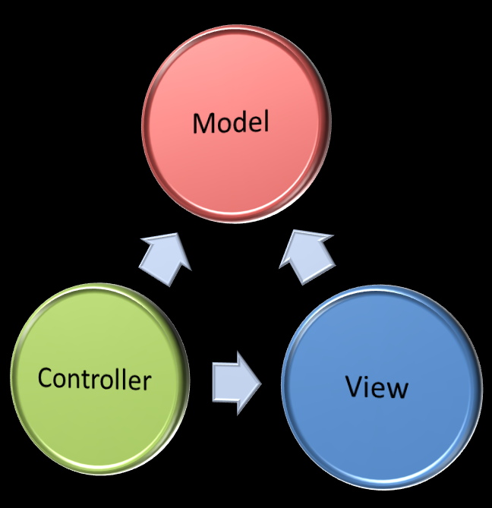
Model-view Principle
Observer pattern known as Model-view or Model-view-controller
“Model” objects (e.g., Sale, SignupSheet) should not know much about concrete “view” objects (e.g., SaleTotalFrame, SignupObserver)
Domain layer should be minimally connected with presentation layer
Open/closed principle: if user decides to change/upgrade interface, the change shall trigger no modification to domain layer
CSCI 2600 Spring 2021
26
Notes:
26

Slide 27
Observer and Observable are deprecated in Java 9 – why?
They didn't provide a rich enough event model for many applications.
For example, they could support only the notion that something has changed, but only convey indirect information about what has changed.
All Observables are the same.
You have to implement the logic that is based on instanceof and cast object to concrete type in Observable.update() method.
Not Serializable
Since, Observable doesn't implement Serializable. So, you can't Serialize Observable nor its subclass.
Not thread safe
The methods can be overridden by its subclasses, and event notification can occur in different orders and possibly on different threads, which is enough to disrupt any "thread safety".
Observable is a class not an interface

Slide 28
Another Example – Functional This Time
package twitterDemo; // This is the O-O version
import java.util.List;
import java.util.ArrayList;
interface Observer {
void inform(String tweet);
}
class NYTimes implements Observer {
@Override
public void inform(String tweet) {
if (tweet != null && tweet.contains("money")) {
System.out.println("Breaking news in NY!" + tweet);
}
}
}
… other news sources – similar to above
}
}
Notes:
TwitterDemo.java

Slide 29
interface Subject {
void registerObserver(Observer o);
void notifyObservers(String tweet);
}
class Feed implements Subject {
private final List<Observer> observers = new ArrayList < > ();
public void registerObserver(Observer o) {
this.observers.add(o);
}
public void notifyObservers(String tweet) {
observers.forEach(o -> o.inform(tweet));
}
}
public class TwitterDemo {
public static void main(String[] args) {
Feed f = new Feed();
f.registerObserver(new NYTimes());
f.registerObserver(new Guardian());
f.registerObserver(new LeMonde());
f.notifyObservers(“Save money.!");
}
}
Notes:
Redundant code

Slide 30
A Functional Observer
public class FunTwitterDemo {
public static void main(String[] args) {
Feed feedLambda = new Feed();
feedLambda.registerObserver((String tweet) -> {
if (tweet != null && tweet.contains("money")) {
System.out.println("Breaking news in NY! " + tweet);
}
});
feedLambda.registerObserver((String tweet) -> {
if (tweet != null && tweet.contains("queen")) {
System.out.println("Yet another news in London... " + tweet);
}
});
feedLambda.notifyObservers("Money money money, give me money!");
}
}
Notes:
FunTwitterDemo
Removes boilerplate code.
We register a functional object
https://dzone.com/articles/refactoring-observer-design-pattern-with-lambdas

Slide 31
Façade Pattern
Question: how to handle the case, when we need a subset of the functionality of a powerful, extensive and complex library
Example: We want to perform secure file copies to a server. There is a powerful and complex general-purpose security library. What is the best way to interact with this library?
Example: Protect code against unstable/in progress API.
Example: Travel booking system
Must interact with airline, limo, hotel systems, etc.
Systems have different APIs
Provide uniform interface
CSCI 2600 Spring 2021
31
Notes:
31

Slide 32
Façade Pattern
Build a Façade to the library, to hide its (mostly irrelevant) complexity. SecureCopy is the Façade.
SecureCopy
CSCI 2600 Spring 2021
32
Notes:
32

Slide 33
Façade Pattern
Façade reduces interactions between client and the complex library
Façade hides (mostly irrelevant) complexity of the library
If library changes, we’ll only need to change the Façade, the client remains insulated
Open/closed principle: when change happens, the change has minimal impact
Kind of like a proxy or even an adapter pattern
Main difference is that Façade is designed to hide complexity or underlying system
CSCI 2600 Spring 2021
33
Notes:
33

Slide 34
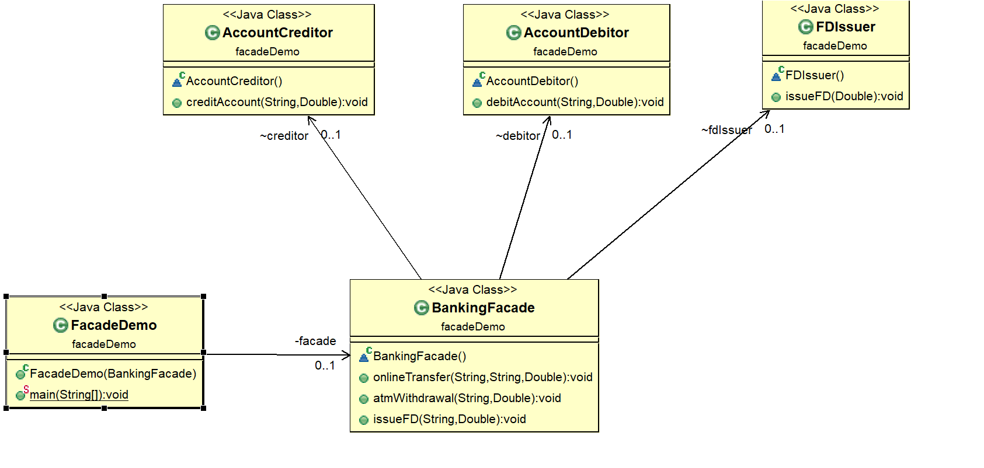
Façade Demo
FacadeDemo.java

Slide 35
Façade Pattern
Façade pattern decreases coupling between the client and subsystems
The higher-level interface can absorb any changes which might happen in the lower subsystems interfaces
Provide a consistent interface to client
Subsystem interfaces are not aware of Façade and they shouldn’t have any reference of the Façade interface.
The purpose of the Façade Pattern is to provide a single interface rather than multiple interfaces that do similar kinds of jobs.

Slide 36
Similar Patterns
Adapter
adapts a given class/object to a new interface.
Solves the problem of non-compatible interfaces
Façade
a simple gateway to a complicated set of functionality.
You make a black-box so your clients worry less
i.e. make interfaces simpler.
seems a bit like an adapter
Proxy
provides the same interface as the proxied-for class
and typically does some housekeeping stuff on its own.
Used to solve the problem of the client having to manage a heavy and/or complex object.
Used to restrict access to object
Has aspects of Singleton and Interning.
Decorator
used to add more functionality to your objects.
You do not hide the existing interfaces of the object but rather extend it at runtime.
Notes:
https://stackoverflow.com/questions/3489131/difference-between-the-facade-proxy-adapter-and-decorator-design-patterns#3489187

Slide 37
Interactions Between Modules
Interactions between modules (in our designs, module = class) cause complexity
To simplify, split design into parts that don’t interact as much
refactor
Coupling is the amount of interaction among classes
Roughly, if class A calls methods/uses fields of class B, then there is coupling from A to B
In design, we strive towards low (weak) coupling, i.e., minimal, necessary interactions
CSCI 2600 Spring 2021
37
Notes:
37

Slide 38
Low Coupling
Arrow means dependency. Here, A depends on C.
A’
A
B’
C’
B
C
Bad Design:
Classes strongly coupled
Better Design:
Weaker coupling
CSCI 2600 Spring 2021
38
Notes:
38

Slide 39
Coupling is the Path to the Dark Side
Coupling leads to complexity
Complexity leads to confusion
Confusion leads to suffering
If once you start down the dark path, forever will it dominate your destiny, consume you it will
CSCI 2600 Spring 2021
39
Notes:
39

Slide 40
Observer promotes low coupling
Bad. Data does not need to depend on Views
Better: Weaken dependency of Data on Views
Introduce a weaker spec in the form of interface
Client
SpreadsheetView
Data
BarChartView
Data
Observer
SpreadsheetView
BarChartView
CSCI 2600 Spring 2021
40
Notes:
40

Slide 41
Façade promotes low coupling
Façade weakens the dependency between Client and library.
Introduce Façade object: reduce #dependences from 3*5 to 3+5
SecureCopy
CSCI 2600 Spring 2021
41
Notes:
41

Slide 42
User interfaces: appearance vs. content
It’s easy to tangle up appearance and content
E.g. in dragging a line in a drawing program
Where are endpoints stored
Program state stored in widgets in dialog boxes
Not a good idea
Dialog boxes are transient, state is more general
Neither content nor appearance is easily understood or changed
Destroys flexibility
Leads to subtle bugs
Callbacks, listeners, and other patterns can help
Stick to single purpose principle
CSCI 2600 Spring 2021
42
Notes:
42

Slide 43
Shared Constraints
Coupling can arise from shared constraints
A module that writes a file and a module that reads a file in the same format
Even if there’s no dependency on each other’s code
If one fails to write the correct format, the other fails
Shared constraints are easier to reason about/debug if they are encapsulated
Place all format information in a single module used by both read and write module
CSCI 2600 Spring 2021
43
Notes:
43

Slide 44
A Design Exercise
We are building a document editor --- a large rectangle that displays a document. Document can mix text, graphical shapes, etc. Surrounding the document are the menu, scrollbars, borders, etc.
Structure, Formatting, Embellishing the UI, User commands, Spell checking
CSCI 2600 Spring 2021
44
Notes:
44

Slide 45
Structure
Hierarchical structure --- document is made of columns, a column is made up of rows, a row is made up of words, images, etc.
Editor should treat text and graphics uniformly. Editor should treat simple and complex elements uniformly
What design pattern?
CSCI 2600 Spring 2021
45
Notes:
45

Slide 46
The Composite Pattern
1
Glyph
Editor
…
draw() intersect()
*
Character
Polygon
Word
Row
draw() intersect()
draw() intersect()
draw() intersect()
draw() intersect()
1
What’s missing from this picture?
CSCI 2600 Spring 2021
46
Notes:
Lots missing
46

Slide 47
Formatting
Formatting displays the document
Many different formatting strategies are possible
We would use different formatting strategies over the same hierarchical structure
Each formatting strategy is complex
CSCI 2600 Spring 2021
47
Notes:
Formatting is kind of like a view.
47

Slide 48
The Strategy Pattern
Encapsulates an algorithm in an object
Glyph
*
draw() …
FormattingStrategy
…
compose() setDocument()
Document
1
draw() insert(…)
Strategy1
Strategy2
Strategy3
compose()
compose()
compose()
CSCI 2600 Spring 2021
48
Notes:
48

Slide 49
Strategy Pattern
Also known as the Policy Pattern
Define multiple algorithms and let client application pass the algorithm to be used as a parameter
Reduces coupling
Program to an interface, not an implementation
Collections.sort is an example
It takes Comparator parameter.
Based on the different implementations of Comparator interfaces, the Objects are getting sorted in different ways.
Strategy pattern is very similar to State and Command Patterns.
Strategy pattern is useful when we have multiple algorithms for a specific task and we want our application to be flexible to choose any of the algorithms at runtime for the specific task.

Slide 50
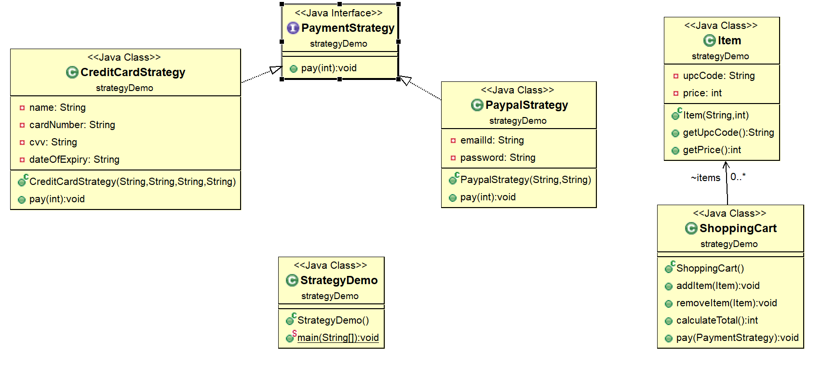
StrategyDemo.java

Slide 51
Functional Strategy Pattern
@FunctionalInterface
interface Strategy {
double apply(double a, double b);
};
public class FunStrategyDemo {
public static double execute(double a, double b,
Strategy strategy) {
return strategy.apply(a, b);
}
public static void main(String[] args) {
System.out.println(execute(10, 5, (a, b) -> a + b));
System.out.println(execute(10, 5, (a, b) -> a - b));
System.out.println(execute(10, 5, (a, b) -> a * b));
}
}
FunStrategyDemo.java
Notes:
Compare to ObjStrategyDemo.java

Slide 52
Embellishing the UI
We would like to embellish the document display. One embellishment adds a border around the document area, another one adds a horizontal scroll bar and a third one adds a vertical scroll bar
We would like to do this dynamically --- one can create any combination of embellished documents
What pattern?
CSCI 2600 Spring 2021
52
Notes:
52

Slide 53
The Decorator Pattern
Adds functionality, preserves interface
1
Glyph
*
draw() intersect()
component.draw();
Document
1
DecoratedGlyph
draw() intersect() insert()
1
draw()
component
BorderDecorator
ScrollDecorator
draw() drawBorder()
draw() drawScroll()
CSCI 2600 Spring 2021
53
Notes:
53

Slide 54
User Commands
Editor supports many user “commands”: open and close, cut and paste, etc.
There is different user interface for the same command
E.g., close document through a pull-down menu item, close button, key shortcut, other
Supports undo and redo!
CSCI 2600 Spring 2021
54
Notes:
54

Slide 55
A Naïve Design
What’s wrong with this design?
UIWidget
draw() …
Document
draw() intersect() insert()
MenuItem
ShortcutButton
draw() …
draw() …
CloseItem
CloseButton
…
…
…
…
CSCI 2600 Spring 2021
55
Notes:
Hard to extend. To add undo, we need to add it in several places.
55

Slide 56
The Command Pattern
Separates MenuItems from Commands that do the work
MenuItem
Command
onClick() …
command
execute()
1
1
Document
command.execute();
Save
Close
open() save() close()
execute() …
execute() …
… = new MenuItem(“Save”, new Save(document));
… = new MenuItem(“Close”, new Close(document));
…
… = new ShortcutButton(“Save”, new Save(document));
CSCI 2600 Spring 2021
56
Notes:
Each item operation is a subtype of Command Menu, buttons use Command. Operations are localized.
56

Slide 57
Easy to Add Undo/Redo!
Editor maintains a history (e.g., a stack) of commands that have been executed
MenuItem
Command
onClick() …
command
execute() unexecute()
1
1
command.execute();
Cut
Paste
Document
open() save() close()
execute() unexecute()
storedState
execute() unexecute()
storedState
CSCI 2600 Spring 2021
57
Notes:
Starts looking like something a visitor pattern might simplify
57

Slide 58
Aside: Command Pattern
Command pattern is a data driven design pattern
behavioral pattern
A request is wrapped in an object and passed to an invoker object.
Invoker object looks for the appropriate object which can handle this command and passes the command to the corresponding object which executes the command.

Slide 59
Command Pattern
In the Command Pattern, the request is sent to the invoker object and the invoker passes it to the encapsulated command object.
The client creates the receiver object and then attaches it to the Command.
Then it creates the invoker object and attaches the command object to perform an action.

Slide 60
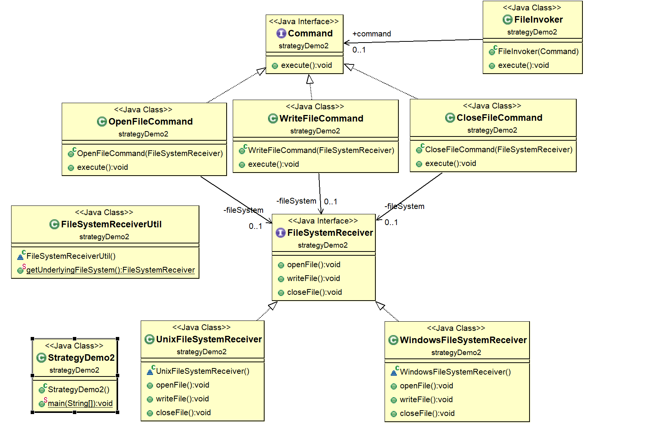
CommandDemo.java

Slide 61
Command Pattern
Command class is the core of the command design pattern. It defines the contract for implementation.
Receiver implementation is separate from command implementation.
Command implementation class choses the method to invoke on receiver object, for every method in receiver there will be a command implementation. It works as a bridge between receiver and action methods.
Invoker class just forwards the request from client to the command object.
Client is responsible for instantiating the appropriate command and receiver implementations and associating them.
Client is also responsible for instantiating the invoker object and associating the command object with it and executing the action method.
Command design pattern is easily extensible, we can add new action methods in receivers and create new Command implementations without changing the client code.
The drawback is that the code can get huge and confusing with high number of action methods and because of so many associations.

Slide 62
Adding Spell Checking
Requires traversal of document hierarchy
We want to avoid writing this functionality into the document structure
We would like to add other traversals in the future, e.g., search, word count, hyphenation
What pattern?
62
CSCI 2600 Spring 2021
Notes:
62

Slide 63
The Visitor Pattern
Glyph
*
*
draw() intersect()
accept(Visitor)
Document
Polygon
Word
draw() intersect() insert()
accept(Visitor)
draw() intersect()
accept(Visitor)
draw() intersect()
accept(Visitor)
1
1
CSCI 2600 Spring 2021
63
Notes:
63

Slide 64
Design Patterns so Far
Factory method, Factory class, Prototype
Creational patterns: address problem that constructors can’t return subtypes
Singleton, Interning
Creational patterns: address problem that constructors always return a new instance of class
Wrappers: Adapter, Decorator, Proxy
Structural patterns: when we want to change interface or functionality of an existing class, or restrict access to an object
CSCI 2600 Spring 2021
64
Notes:
64

Slide 65
Design Patterns so Far
Composite
A structural pattern: expresses whole-part structures, gives uniform interface to client
Interpreter, Procedural, Visitor
Behavioral patterns: address the problem of how to traverse composite structures
Observer
Model-View
Model-View-Controller
here is one-to-many relationship between objects such as if one object is modified, its dependent objects are to be notified automatically
CSCI 2600 Spring 2021
65
Notes:
DesignPatterns3 – continue with last DesignPatterns4
65

Slide 66
Design Patterns So Far
Façade
we need a subset of the functionality of a powerful, extensive and complex library
Somewhat like proxy
Strategy
create objects which represent various strategies and a context object whose behavior varies as its strategy object.
Command
Request is passed to an invoker object. Invoker object looks for the appropriate object which can handle this command and passes the command to the corresponding object which executes the command.
CSCI 2600 Spring 2021
66
Notes:
66

Slide 67
Are Design Patterns The Last Word in Software Design?
Design Patterns are elements of reusable object-oriented software
There are other programming approaches
Procedural
Functional
Is the world made of nouns or verbs?
Object oriented programming is about nouns
Procedural programming is about verbs
Imperative programming
Do this, do this, etc.,
Functional programming is about nouns and verbs
Verbs (functions) are first class objects
Many of the GoF patterns are part of the language
Pure functional programming is stateless

Slide 68
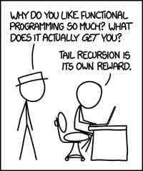
Imperative vs Functional Programming
 | Imperative approach | Purely Functional approach
Programmer focus | How to perform tasks (algorithms) and how to track changes in state. | What information is desired and what transformations are required.
State changes | Important. | Non-existent.
Order of execution | Important. | Low importance.
Primary flow control | Loops, conditionals, and function (method) calls. | Function calls, including recursion.
Primary manipulation unit | Instances of structures or classes. | Functions as first-class objects and data collections.

Slide 69
Functional Programming in Java
Java 8 added functional programming constructs.
For example, java.util.Function<T, R> interface and lambda
Example: Factory function
FunBicycleFactory.java
Example: Lambda functions
LambdaDemo.java

Slide 70
Functional Strategy Example
package funStategyDemo;
@FunctionalInterface
interface Strategy {
double apply(double a, double b);
};
public class FunStrategyDemo {
public static double execute(double a, double b, Strategy strategy) {
return strategy.apply(a, b);
}
public static void main(String[] args) {
System.out.println(execute(3, 4, (a,b) -> a > b ? a : b ));
System.out.println(execute(3, 4, (a,b) -> a < b ? a : b ));
System.out.println(execute(3, 4, (a,b) -> (a + b) / 2 ));
}
}
Functional version uses fewer lines of text.
Code intention is clearer.
No side effects. Context is not needed.

