Slide 1
Java
Notes:
1

Slide 2
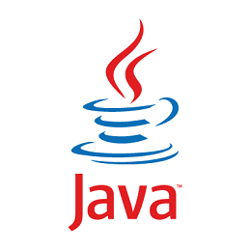
Java
Java is a successor to a number of languages, including Lisp, Simula67, CLU, and SmallTalk.
Java is superficially similar to C and C++ because its syntax is borrowed from them. However, at a deeper level it is very different from these languages.
Java is an object-oriented language.
Most of the data manipulated by programs are contained in objects
Objects contain both state and operations
State is called fields, variables
Operations are called methods, functions
What is a variable?
2
Notes:
2

Slide 3
What is a Variable?
Value Model for Variables
a ← b;
a is an l-value (location)
b is an r-value
Data that is stored somewhere
Variables are “boxes” that hold a value
A named container for a value
b ← 2;
c ← b; // copy data stored at location b to location c
a ← b + c; // combine data at b and c and copy to a
What happens if we now include b ← 3; and ask for the value at c?
b
2
2
a
4
c
3
Notes:
← is just to show that this is an assignment. Different languages may use different symbols for the assignment operator.
← Means get the r-value data and copy it to location l-value
b ← 2;
c ← b; // copy data stored at location b to location c
a ← b + c; // combine data at b and c and copy to a
b ← 3;
What is value of c? 2
3

Slide 4
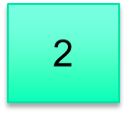
Reference Model for Variables
A variable is a reference to an object that has a value
Every variable is an l-value
A location value
Dereference to get r-value
b ← 2; // copy 2 to the location that b references
c ← b; // copy reference not value
a ← b + c; // what does this do?
What happens if we now execute
b ← 3 and ask for the value that c references?
b
c
b
3
a
4
c
4
Notes:
Reference variables "refer" to the object
b←2 // copies literal 2 to l-value b
c←b // difference here is that the assignment operator doesn’t fetch the value at b, it copies the l-value b to l-value c
a←b+c // the + operator dereferences b and c, adds their values, stores the result in the location that a references
What happens to c if we added the statement b <- 3 after the 3 statements above?
Literal 3 is copied to l-value b
c and b refer to the same object. If we dereference c, we will get the value 3.
4

Slide 5
Models for Variables
C++ uses the value model
It does have references, but they are different from Java references
C++ references are aliases
C++ uses pointers
Java and Python use a mixed model
Primitive types use the value model
byte, short, int, long, float, double, char, boolean
Class types use reference model
Objects created with new
int x = 7; // value model
char c = ‘A’;
String s = new String(“cat”); // reference model, s contains a reference
// to an object containing "cat"
5
Notes:
Java
See workspace_1 JavaVariables.java
Python
>>> x = 3
>>> y = x
>>> print(x, y)
3 3
>>> x = 5
>>> print(x, y)
5 3
>>>
>>>
>>> a = [1,2,3]
>>> b = a
>>> print(a, b)
[1, 2, 3] [1, 2, 3]
>>> a[0] =5
>>> print(a, b)
[5, 2, 3] [5, 2, 3]
>>>
5

Slide 6
Java Uses a Mixed Models for Variables
Local variables, such as those declared within methods, reside on the runtime stack
space is allocated for them when the method is called and deallocated when the method returns
Variables of primitive types are r-values
Value model
Methods that return primitives return the value of the primitive
Return a copy of the value of the variable
Variables of all other types, including strings and arrays, contain references to objects that reside on the heap
Reference model
Created with new
For local reference variables, a reference is stored on stack, object data is stored in heap
6
Notes:
6

Slide 7
void some_method() {
int i = 6;
int j; // uninitialized
int [ ] a = {1,3,5,7,9}; // creates a 5-element array
int [ ] b = new int[3]; // auto initialized to 0
String s = new String("abcdef“); // creates a new string
String t = null; // null is a reference
j = i; // copy a value
b = a; // copy a reference; now nothing refers to [0,0,0]
t = s; // now s and t refer to the same object
a[0] = 6;
t = t +”g”; // make a new string. Why?
}
7
Notes:
SomeMethod.java
http://docs.oracle.com/javase/tutorial/java/nutsandbolts/datatypes.html
It's not always necessary to assign a value when a field is declared. Fields that are declared but not initialized will be set to a reasonable default by the compiler. Generally speaking, this default will be zero or null, depending on the data type. Relying on such default values, however, is generally considered bad programming style.
Local variables are slightly different; the compiler never assigns a default value to an uninitialized local variable. If you cannot initialize your local variable where it is declared, make sure to assign it a value before you attempt to use it. Accessing an uninitialized local variable will result in a compile-time error. Instance variables (variables in a class) are initialized,
In b, {0,0,0} becomes garbage
In c, a new string is created because Strings are immutable (can’t be changed once created).
7

Slide 8
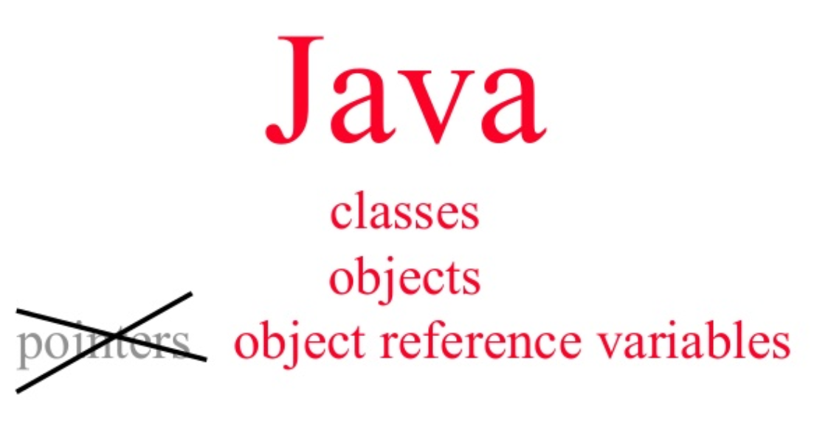
Differences between Java reference and C++ pointer variables
There's no "reference arithmetic"
https://softwareengineering.stackexchange.com/questions/141834/how-is-a-java-reference-different-from-a-c-pointer
References might be implemented by storing the address.
In Java there might be an additional level of indirection
References are strongly typed
C/C++ pointers can point to any object by casting
Java doesn’t have explicit pointers; C/C++ does
Well, you can get addresses using the Unsafe class, but it's usually a bad idea
8
Notes:
You can use addresses and pointers using the Unsafe class. However as the name suggests, these methods are UNSAFE and generally a bad idea. Incorrect usage can result in your JVM randomly dying (similar to the problem you get using pointers incorrectly in C/C++)
8

Slide 9
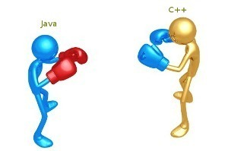
Java: Differences with C++
Model for variables
Java uses the reference model for class types
No explicit pointers.
references instead
Explicitly create objects:
Foo f = new Foo();
Two types of equal:
== and equals.
Remember: when comparing string values, use equals!
Types and type checking, type safety
Interpretation vs. Compilation
Interfaces, inheritance, etc. are handled differently
9
Notes:
== compares references, returns true when the two variables refer to the same object.
9

Slide 10
Java: Differences with C++
Access control modifiers -- public, private, protected
Determine class member visibility
Java: has package visibility as default;
A package is a namespace
protected is slightly different than C++
Java has built-in garbage collection
C++ does not
In C++, the programmer is responsible for memory management
The dreaded memory leak!
Prematurely freeing memory can also cause errors.
In Java you don’t need to explicitly free memory
10
Notes:
In java,
Protected members can be accessed from within the class, its subclasses and from all the classes present in same package,
“It’s possible to have a memory leak in Java but the compiler warns you about it“
10

Slide 11
Java Access Modifiers
 | Class | Package | Subclass | World
public | Y | Y | Y | Y
protected | Y | Y | Y | N
No modifier | Y | Y | N | N
private | Y | N | N | N
For example, a protected object is visible to the class containing it,
the classes in the package, any subclasses of the class,
but not to the outside world.
Private objects are only visible to the class containing the object.
Notes:
For example, a protected object is visible to the class containing it, the files in the package, any subclasses of the class containing it, but not to the outside world. Private objects are only visible to the class containing the object.

Slide 12
Java: Differences with C++
C++ allows multiple inheritance
The dreaded triangle inheritance dilemma
Java allows only for single class inheritance
it does allow for multiple interface inheritance
class B extends A implements J, K, L, .....
public interface ShapeInterface {
public void draw();
public double getArea();
}
public class Square implements ShapeInterface {
…
}
12
Notes:
Extends is used for inheritance
Classes that can be extended are called concrete classes.
Implements is used for interfaces
12

Slide 13
Java: Differences with C++
Interface cannot contain any implementation, just method signatures
Contract between interface class and subclasses.
Can’t be instantiated
Abstract classes can contain implementations for some methods
Can’t be directly instantiated but can be subclassed
public abstract class AbstractMapEntry<K,V> implements MapEntry<K,V> {
public abstract K getKey(); // must be implemented by subclass
public abstract V getValue();
public boolean equals( Object o ) {
if ( o == this ) // etc.
}
...
}
13
Notes:
an instance is a concrete occurrence of an object.
See AbstractDemo and InterfaceDemo in workspace_2
String s = new String(“cat”);
s is an instance of class String
When an abstract class is subclassed, the subclass usually provides implementations for all of the abstract methods in its parent class. However, if it does not, then the subclass must also be declared abstract.
Instantiation means to create an instance of an object
List is an interface. You can't do List<String> l = new List<String>();
You need to create a new concrete class: List<String> l = new ArrayList<String>();
13

Slide 14
Fibonacci?
n = 0, 1 returns 1 according to combinatorial definition.
Use this for homework
You may see messages in STDERR_0.txt like this
If you didn't lose points on the test, you may safely ignore it.
Student Standard Error (STDERR_0.txt)
/bin/cp: missing destination file operand after 'hw0/'
Try '/bin/cp --help' for more information.

Slide 15
Mutability
All objects are either immutable (non-changeable) or mutable (changeable)
Strings are immutable
t = t + “g”;
Creates a new string object
t now references the new object
Arrays are mutable
a[i] = 27;
a’s ith item has changed
If an object is shared (referenced) by two variables, it can be accessed through either of them.
If a mutable object is shared by two variables, changes made through one of the variables will be visible when the object is accessed through the other.
15
Notes:
15

Slide 16
Aside: What happens under the hood with String concatenation?
String a = new String(“cat”);
String b = new String(“ and dog”);
String c = a + b;
// equivalent
String c = new StringBuilder(a).append(b).toString();
StringBuilder creates a mutable sequence of characters from a, concatenates the string from b, and finally converts the whole thing to a String.
Java overloads the “+” operator for the String class.
Unlike C++, users can’t overload operators in Java.

Slide 17
Types and Type Checking, Type Safety
What is the role of types?
Data abstraction
Safety!
Types and type checking prevent the program from going wrong.
Disallows operations on objects that do not support those operations
a+b where a and b are 2DPoints is rejected by the type checker
a.substring(0,10)where a is an Integer is rejected too
17
Notes:
17

Slide 18
Types and Type Checking, Type Safety
Java is a strongly typed language
Java checks code to ensure each assignment and method call is type correct
Every variable declaration gives the variable type
The header of every method and constructor defines its type signature
the types of its arguments and results and also the types of any exceptions it throws
Legal Java programs are guaranteed to be type safe
No type errors when the program runs
If you eliminate "raw type" warnings
Java provides automatic storage management for all objects.
Java checks all array accesses to ensure they are within bounds
18
Notes:
18

Slide 19
Type Safety
Type safety: no operation is ever applied on object of the wrong type (i.e., object that does not support that operation)
Java is type safe while C/C++ is type unsafe
In Java, the type system never allows operations on objects of the wrong type
no execution
In C++, the type system prevents most errors, but it is possible to write a program where operations on objects of the wrong type occur
Java Goal: catch errors as early as possible!
19
Notes:
19

Slide 20
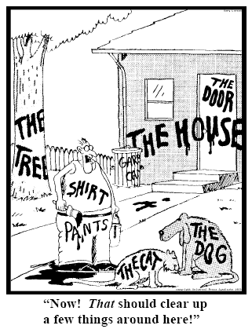
Types and Type Checking
Java and C/C++ are statically typed
A statically typed language typically requires type annotations;
performs substantial amount of type checking before runtime
Expressions have static (compile-time) types
Objects have dynamic (run-time) types
Alternative is dynamically typed
Perform substantial type checking during runtime
Python
Strongly dynamically typed
20
Notes:
A statically typed languages associates types with expressions and performs substantial type checking before program execution.
The point of type checking is to catch as many erroneous operations as possible and prevent them from happening at runtime.
Statically-typed languages do a lot of type checking at compile time.
20

Slide 21
C++ can be Type Unsafe
// C++:
void* x = (void *) new A;
B* q = (B*) x; //a safe downcast?
int case1 = q->foo(1);//what happens?
// Java:
Object x = new A();
B q = (B) x; //a safe downcast?
int case1 = q.foo(1); //what happens?
Note: In Java, all methods are virtual; use final keyword to force non-virtual
A
virtual foo()
B
virtual foo()
virtual foo(int)
Throws ClassCastException here!
Runtime never reaches bad call.
21
Notes:
ExceptionTest.java
Virtual – the method to be executed is determined at runtime
In C++ this is undefined behavior! The compiler may generate code which calls foo(int) of B and apply foo(int) on a wrong type, type A.
This is erroneous behavior that may or may not cause problems at runtime. It usually does cause problems!
https://stackoverflow.com/questions/2391679/why-do-we-need-virtual-functions-in-c
In C++, x points to an A object. q points to an A object, but compiler thinks it's a pointer to a B object. q->foo(1) will be compiled to something. It may push 1 on the stack and call A->foo(), but now the stack is not properly configured.
The Java snippet compiles but fails at runtime. The Java runtime system checks whether x holds a B (or a subtype of B). It does not, so it throws an exception. The point is, execution NEVER reaches q.foo(1), so foo(int) will never be applied on the wrong type.
21

Slide 22
C++ is Type Unsafe
Java: B q; … q.foo(1);
Java “honors” its promise that at runtime it will find a q.foo(1)
if q is not null, q is a B (or subclass of B).
i.e. q has a foo(int)
C++: B* q; … q->foo(1);
C++ does not “honor” its promise. At runtime, q can be a B or an A or a Duck or whatever
22
Notes:
22

Slide 23
Memory Management
Java manages heap memory
No need to free an object when it goes out of scope
Garbage collector frees unused objects
Objects that are referenced by strong reference variables are not freed
Objects that are referenced by weak reference variables may be freed
https://dzone.com/articles/java-memory-management
https://stackoverflow.com/questions/299659/whats-the-difference-between-softreference-and-weakreference-in-java
C++ requires the programmer to manage heap memory
Can lead to memory leaks if programmer fails to free object when it goes out of scope
Microsoft reports:
The majority of vulnerabilities fixed and with a CVE (Common Vulnerability and Exposures) assigned are caused by developers inadvertently inserting memory corruption bugs into their C and C++ code.
https://msrc-blog.microsoft.com/2019/07/16/a-proactive-approach-to-more-secure-code/
Notes:
Weak references are created by the WeakReference class.

Slide 24
Type Safety
Java ensures type safety with a combination of compile-time (static) and runtime (dynamic) type checking
Compiler rejects plenty of programs.
String s = 1 is rejected,
String s = new Integer(1) is rejected
Some checks are left for runtime. Why?
B b = (B) x;
the Java runtime checks if x refers to a B, and throws an Exception if it doesn’t
Is Python type safe?
Duck typing
an object's suitability is determined by the presence of certain methods and properties, rather than the type of the object
24
Notes:
See duck.py
24

Slide 25
Equality in the Reference Model
Two kinds of equality
Reference equality
Do the variables refer to the same object?
Java ==
For primitives (int, char, etc.), == compares values
Python is
Value equality
Do the variables reference objects with the same value?
Java .equals() method
Python ==
25
Notes:
See equals.py
>>> x = 3
>>> y = x
>>> print(x, y)
3 3
>>> x = 5
>>> print(x, y)
5 3
>>>
>>>
>>> a = [1,2,3]
>>> b = a
>>> print(a, b)
[1, 2, 3] [1, 2, 3]
>>> a[0] =5
>>> print(a, b)
[5, 2, 3] [5, 2, 3]
>>>
>>> print(x is y)
False
>>> print(a is b)
True
>>>
25

Slide 26
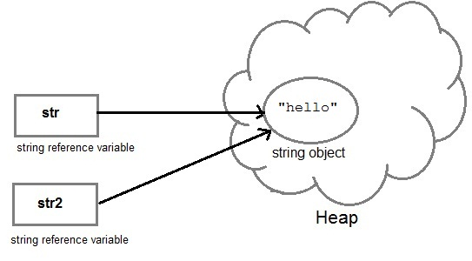
Testing for Equality
Testing for equality: == and equals()
public class Point2D {
int x,y; // package access
// constructor
Point2D(int x, int y) {
this.x = x;
this.y = y;
}
public static void main(String[] args) {
Point2D a = new Point2D(2, 5);
Point2D b = new Point2D(2, 5);
Point2D c = b;
// what does this print?
System.out.println(a == b);
System.out.println(b == c);
}
}
26
Notes:
See TestEquals/Point2D.java
false
true
26

Slide 27
What About Strings?
Testing for equality: == and equals()
public class StringTest {
public static void main(String[] args) {
String a = new String("cat");
String b = new String("cat");
String c = b;
// what does this output?
System.out.println(a == b);
System.out.println(c == b);
System.out.println(a.equals(b));
System.out.println(b.equals(c));
}
}
27
Notes:
See TestEqualStrings/StringTest.java
false
true
true
true
27

Slide 28
Point2D inherits Object.equals()
public class Point2D {
int x,y;
Point2D(int x, int y) {
this.x = x;
this.y = y;
}
public static void main(String[] args) {
Point2D a = new Point2D(2, 5);
Point2D b = new Point2D(2, 5);
Point2D c = b;
System.out.println(a.equals(b));
System.out.println(b.equals(c));
}
}
28
Notes:
false
True
Huh?
28

Slide 29
Point2D Inherits equals from Object Class
java.lang.Object is the top-level class
Every other class is a subclass of Object
Every class implements its methods
It is the superclass of all classes
Like object in Python
It’s a very simple class
https://docs.oracle.com/javase/10/docs/api/java/lang/Object.html
Object.equals() uses ==
Tests for identity; does not test for equality of contents

Slide 30
Point2D inherits Object.equals()
public boolean equals( Object obj ) {
return this == obj;
}
30
Notes:
Object is the top level object. Everything inherits from Object.
30

Slide 31
String Class Overrides the equals() Method
String a = new String( "ABCD" );
String b = new String( "ABCD" );
a == b // true or false? false
a.equals( b ) // true or false? true
String.equals compares contents
String class overrides Object.equals
https://docs.oracle.com/javase/8/docs/api/java/lang/String.html#equals-java.lang.Object-
For Point2D to test for equal contents, it must override Object.equals.
The way it is currently written, it does not.
31
Notes:
31

Slide 32
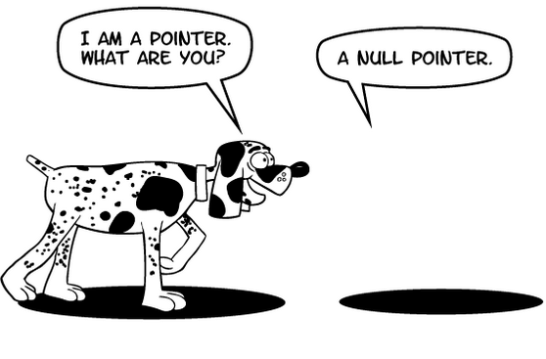
Java Throws Lots of Exceptions!
E.g.:
ArrayIndexOutOfBounds at x[i]=0; if i is out of bounds for array x
ClassCastException at B q = (B) x; if the runtime type of x is not a B
NullPointerException at x.f=0; if x is null
32
Notes:
32

Slide 33
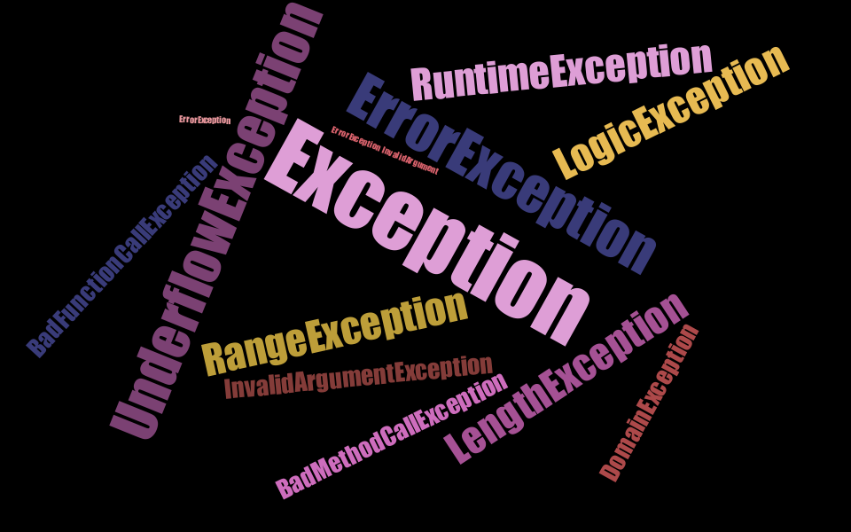
Java Throws Lots of Exceptions
Exceptions are a good thing!
Tells us what went wrong
Prevents application of operation on wrong type
--- stops program from doing harm down the road
Object x = new A();
B q = (B) x; // ClassCastException
// because A is not a B
… int case1 = q.foo(1);
Exception prevents execution from reaching q.foo(1) and applying foo(1) on an object (A) that does not support foo(int)
33
Notes:
33

Slide 34
Java Throws Lots of Exceptions
class A {
A() {
System.out.println("I'm an A");
}
void foo() {
System.out.println("A foo");
}
}
class B extends A {
B() {
System.out.println("I'm a B");
}
void foo() {
System.out.println("B foo");
}
void foo(int x) {
System.out.print("B foo int ");
System.out.println(x);
}
}
public class ExceptionTest {
public static void main(String[] args) {
Object a = new A();
B b = (B) a; // this is not allowed
}
}
Notes:
See ExceptionTest.java

Slide 35
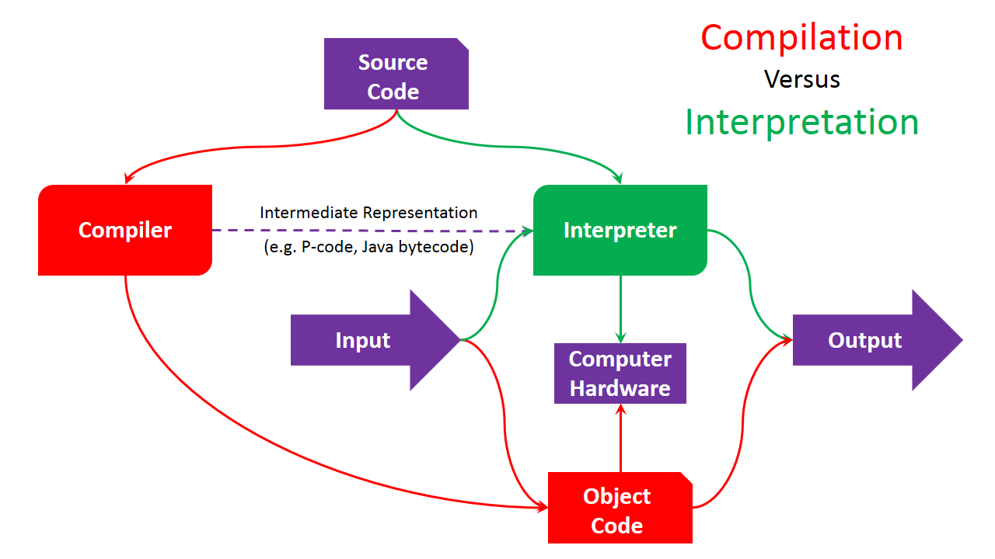
Compilation vs. Interpretation
Compilation
A “high-level” program is translated into executable machine code
C++ uses compilation
Pure interpretation
A program is translated and executed one statement at a time
Interpreter
Hybrid interpretation
A program is “compiled” into intermediate code; intermediate code is “interpreted”
Both a compiler and an interpreter.
Java
35
Notes:
35

Slide 36
Compilation
COMPILER
character stream
Scanner (lexical analysis)
Machine-independent code improvement
token stream
Parser (syntax analysis)
parse tree
modified
intermediate form
Semantic analysis and
intermediate code generation
Code Generation
target language
(assembler)
abstract syntax tree
and/or intermediate form
Machine-dependent code improvement
36
Notes:
36
The compiler is a sequence of phases (passes) where the output
of each phase is the input to the next phase.
The Scanner takes as input a character stream (the program code) and outputs a token stream.
The Parser takes the token stream and outputs a parse tree. The Semantic analysis and intermediate code generation phase takes the parse tree and outputs the abstract syntax tree or another intermediate form. And so on.
Last, the left side of this picture, namely the Scanner, Parser,
Semantic analyzer and intermediate code generator form the
FRONT END (or machine-independent part) of the COMPILER.
The optimizer and code generator form the BACK END
(machine-dependent part) of the COMPILER.

Slide 37
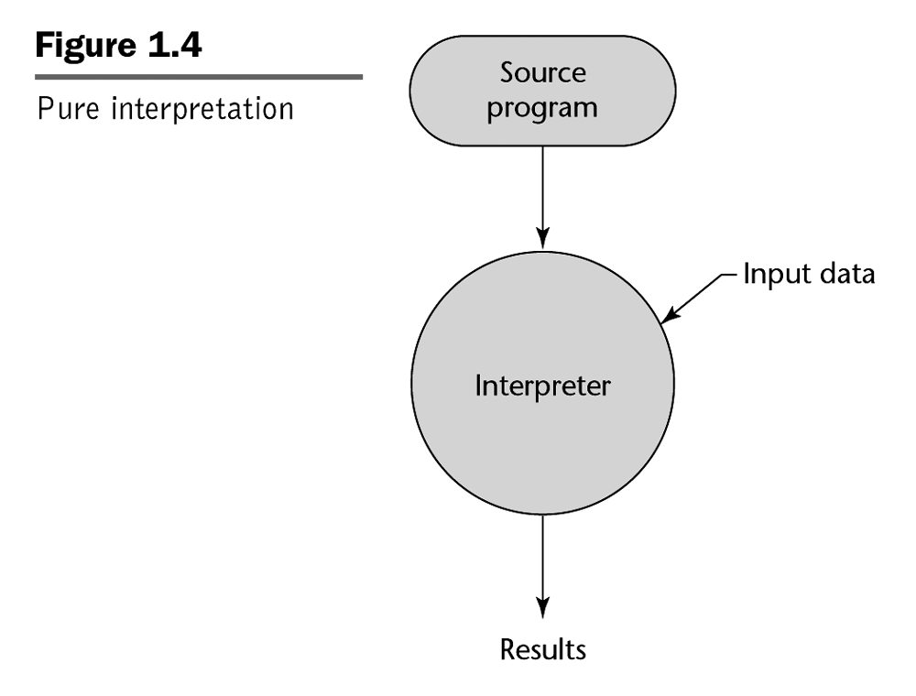
Pure Interpretation
e.g. BASIC
REM COMMENT
LET X = 5
LET Y = 8
PRINT X
PRINT Y
LET Z = X
PRINT Z
...
37
Notes:
37
Even simple BASIC implementations are usually not “pure” interpreters. The code is usually split into simplified tokens for keywords etc.

Slide 38
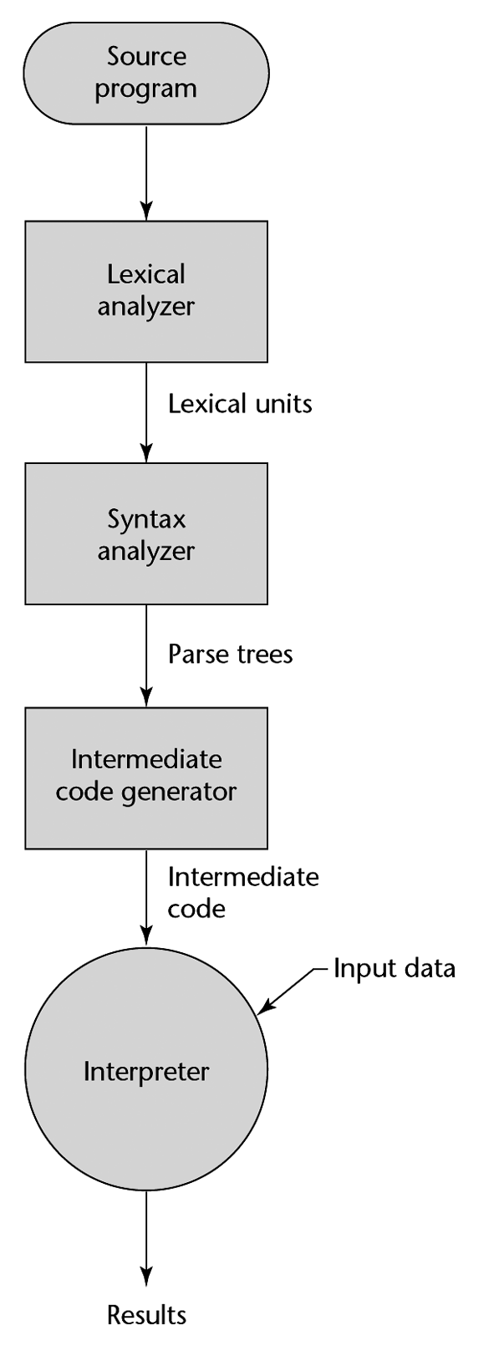
Hybrid Interpretation
09 AB 19 29 99 73 09 AB 19 29 99 73 09 AB 19 29 99 73 09 AB 19 29 99 73 09 AB 19 29 99 73 09
Compiler
e.g. Java byte code
e.g. Java Virtual Machine (JVM)
Also Perl, Python etc.
38
Notes:
38
Note that Lexical analyzer is another term (often used in texts) for Scanner.
Similarly, Syntax analyzer is another term for Parser.

Slide 39
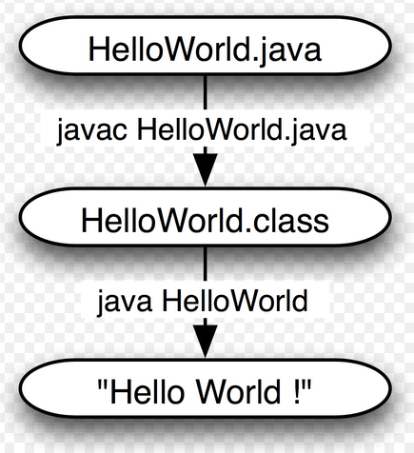
Compiling and Running Java
Command line:
javac HelloWorld.java produces HelloWorld.class
java HelloWorld // runs the interpreter
Eclipse:
Automatically parses for syntax errors
Compiles automatically when you save!
Run -> Run runs the interpreter
39
Notes:
39

Slide 40
Compilation vs. Interpretation
Advantages of compilation?
Faster execution
Usually, but it depends on many factors
Advantages of interpretation?
Greater flexibility
Portability, sandboxing
Dynamic semantic (i.e., type) checks
Other dynamic features are much easier
Easier to write an interpreter
40
Notes:
Compiled/Interpreter languages like Java can generate code on a par with C++
JIT languages like Julia can run at C++ speed.
JIT – compiled at runtime.
40

Slide 41
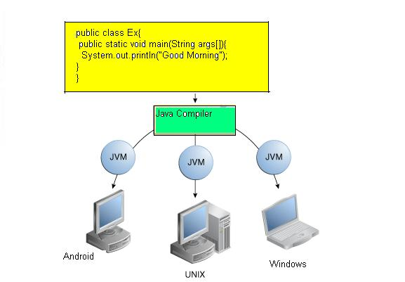
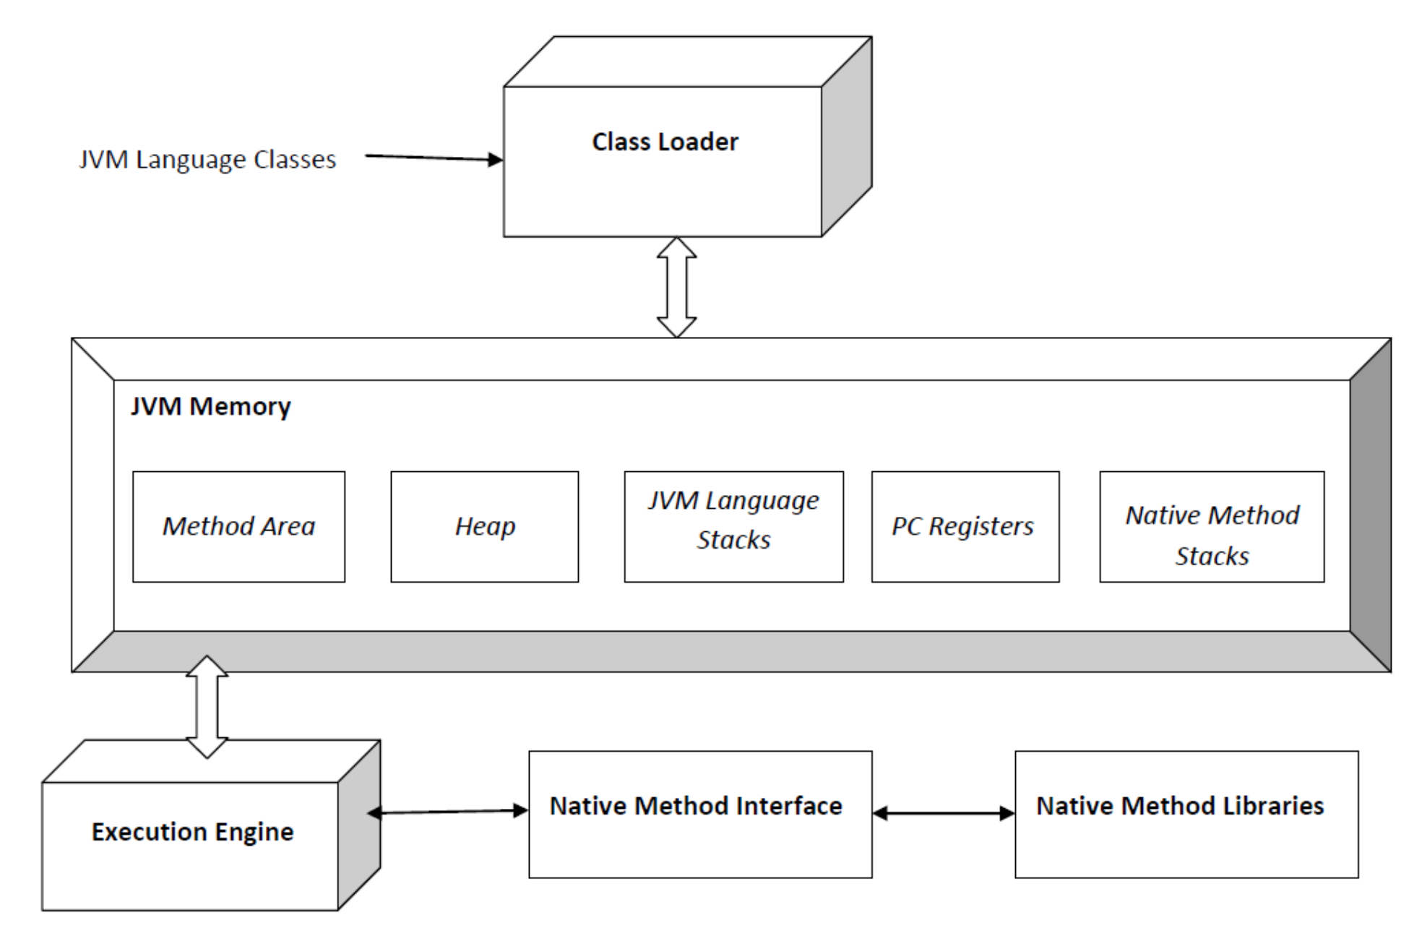
Java Virtual Machine
Java virtual machine (JVM) I
a virtual machine that enables a computer to run Java programs
Runs programs written in other languages that are compiled to Java bytecode
Clojure, a functional Lisp dialect
Groovy, a dynamic programming and scripting language
JRuby, an implementation of Ruby
Jython, an implementation of Python
Kotlin, a statically-typed language from JetBrains, the developers of IntelliJ IDEA
Scala, a statically-typed object-oriented and functional programming language
Many others
https://en.wikipedia.org/wiki/List_of_JVM_languages

Slide 42
Some Terminology
C++: Base class and derived class
Java: Superclass and subclass
C++: Member variable, member function
Java: field (instance or static), method (again instance or static)
Java has interfaces (collections of method signatures)
Single class inheritance (class B extends A {…),
Multiple interface inheritance (class A implements I,J,K {…)
class B extends A implements I,J,K {…
42
Notes:
I use the terms superclass and subclass.
42

Slide 43
Subtyping and Dynamic Method Binding
Subtyping and subtype polymorphism
The ability to use a subclass where a superclass is expected
Open for extension but closed for modification
abstract class Shape {
abstract void draw();
}
class Circle extends Shape { ... } // implements draw()
class Square extends Shape { ... } // implements draw()
void DrawAll( Shape[] list ) {
for ( int i = 0 ; i < list.length ; i++ ){
Shape s = list[i];
s.draw();
}
}
43
Notes:
This is the sort of thing for which you would use virtual functions in C++
The correct s for s.Draw() is selected at runtime.
43

Slide 44
Subtyping and Dynamic Method Binding
In C++, static binding is default
dynamic binding is specified with keyword virtual
In Java, dynamic binding is default
private, final or static methods in a class use static binding.
Static binding happens at compile time
Static methods cannot be overridden
Compiler knows class of object
Dynamic binding happens at runtime
Methods can be overridden
Compiler doesn’t know what type object will be at runtime
44
Notes:
See StaticBindingDemo/Dog.java and DynamicBinding/Dog.java
44

Slide 45
Difference Between Static and Dynamic Binding in Java
Static binding occurs at compile time
Dynamic binding occurs at runtime
Overloaded methods are bound using static binding
Overridden methods are bound using dynamic binding
Overloading is the ability to use same method name but with different arguments
void foo() and void foo(int)
Overriding is used in the context of inheritance
When there is a need to change the behavior of a particular inherited method, it will be overridden in the sub-class.
Argument types must be the same, but return type may be different
45
Notes:
Method overloading is an example of static binding where binding of method call to its definition happens at Compile time.
class DisplayOverloading {
public void disp(char c) { System.out.println(c); }
public void disp(char c, int num) { System.out.println(c + " "+num); }
}
class Sample {
public static void main(String args[]) {
DisplayOverloading obj = new DisplayOverloading();
obj.disp('a');
obj.disp('a',10); }
}
}
45

Slide 46
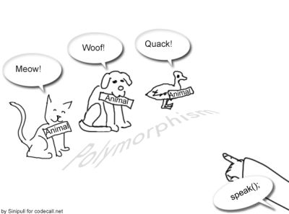
Benefits of Subtype Polymorphism
Enables extensibility and reuse
we can extend the Shape hierarchy further modifying Circle, Square, DrawAll() method
We can reuse Shape and DrawAll
Subtype polymorphism enables the open/closed principle
open to extension, but closed to modification
46
Notes:
46

Slide 47
Dispatching
String t = new String("ab“);
Object o = t + "c"; // concatenation
String r = new String("abc“);
boolean b = o.equals(r);
Are o and r “equal”?
What does “equal” mean here?
Object equals compares references
String equals compares values
The compiler doesn’t necessarily know what code to call at compile time
Compiler knows the apparent type
o - Object
At runtime, the object has an actual type
o - String
47
Notes:
True
See DispatchTest.java
47

Slide 48
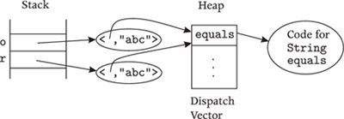
Dispatching
Dispatching calls code in the actual type
Returns true
48
Notes:
48

