Slide 1
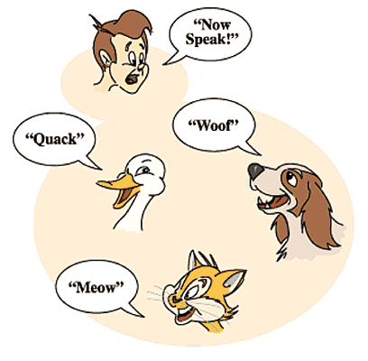
Subtype Polymorphism, Subtyping vs. Subclassing, Liskov Substitution Principle
Notes:
1

Slide 2
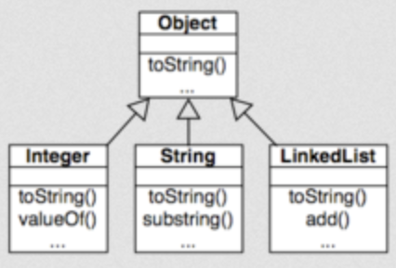
What is Polymorphism
Polymorphism is the ability in programming to present the same interface for differing underlying data types.
Ad-Hoc Polymorphism
Functions that can be applied to arguments of different types, but that behave differently depending on the type of the argument to which they are applied
Overloading, operator overloading
Parametric polymorphism
A function or a data type to be written generically, so that it can handle values uniformly without depending on their type.
C++ Templates, Java Generics
Subtype polymorphism
A name denotes instances of many different classes related by some common superclass
Java Subtyping
Override
CSCI 2600 Spring 2021

Slide 3
Overriding vs. Overloading
Method overloading is when two or more methods in the same class have the same name but different parameters
When overloading, one changes either the type or the number of parameters for a method that belongs to the same class.
Deciding which method to call happens at compile time
Method overriding is when a derived class requires a different definition for an inherited method
The method can be redefined in the derived class.
In overriding a method, the method name and arguments remains exactly the same. The method definition, what the method does, is changed slightly to fit in with the needs of the child class.
Java supports covariant return types for overridden methods. This means an overridden method may have a more specific return type. That is, as long as the new return type is assignable to the return type of the method you are overriding, it's allowed.
Deciding which method to call happens at runtime
CSCI 2600 Spring 2021
3
Notes:
3

Slide 4
Subtype Polymorphism
Subtype polymorphism – the ability to use a subclass where a superclass is expected
Thus, dynamic method binding
class A { void m() { … } }
class B extends A { void m() { … } }
class C extends A { void m() { … } }
Client: A a; … a.m(); // Call a.m() can bind to any of A.m, B.m or C.m at runtime!
Subtype polymorphism is the essential feature of object-oriented languages
Java subtype: B extends A or B implements I
A Java subtype is not necessarily a true subtype!
override A.m
CSCI 2600 Spring 2021
4
Notes:
What is polymorphism? In programming languages, (very roughly!) polymorphism refers to the fact that the same variable can hold entities of different types and this one variable can be used uniformly through a common interface, regardless of actual type.
Another important notion (in addition to subtype polymorphism) is parametric polymorphism, which you know of as “templates” in C++, or generics in Java.
4

Slide 5
Benefits of Subtype Polymorphism
Example: Application draws shapes on screen
Possible solution in C:
enum ShapeType { circle, square };
struct Shape { ShapeType t };
struct Circle
{ ShapeType t; double radius; Point center; };
struct Square
{ ShapeType t; double side; Point topleft; };
CSCI 2600 Spring 2021
5
Notes:
5

Slide 6
Benefits of Subtype Polymorphism
void DrawAll(struct Shape *list[], int n) {
int i;
for (i=0; i< n; i++) {
struct Shape *s = list[i];
switch (s->t) {
case square: DrawSquare(s); break;
case circle: DrawCircle(s); break;
}
}
}
What’s bad about this solution?
CSCI 2600 Spring 2021
6
Notes:
Maintenance problem. What if we add a Triangle? We need to change DrawAll to include a switch that accounts for drawing a Triangle.
Adding a new shape requires changes to client code.
6

Slide 7
Benefits of Subtype Polymorphism
Example: OO Solution in Java:
abstract class Shape { public void draw(); }
class Circle extends Shape { … draw() }
class Square extends Shape { … draw() }
class Triangle extends Shape { … draw() }
void DrawAll(Shape[] list) {
for (int i=0; i < list.length; i++) {
Shape s = list[i];
s.draw();
}
}
CSCI 2600 Spring 2021
7
Notes:
7

Slide 8
Benefits of Subtype Polymorphism
Enables extensibility and reuse
In our example, we can extend Shape hierarchy with no modification to the client of hierarchy, DrawAll
Thus, we can reuse Shape and DrawAll
Subtype polymorphism enables the Open/closed principle
Software entities (classes, modules) should be open for extension but closed for modification
Credited to Bertrand Meyer
Design Patterns
Design patterns promote design for extensibility and reuse
Nearly all design patterns make use of subtype polymorphism
CSCI 2600 Spring 2021
8
Notes:
8

Slide 9
Examples of Subtypes
Subset subtypes
Integer is a subtype (subset) of Number
range [0..10] is a subtype of range [-10…10]
Other subtypes
Every book is a library item
Every DVD is a library item
Every triangle is a shape
Etc.
Shape
Item
Triangle
Rombus
Book
DVD
CSCI 2600 Spring 2021
9
Notes:
9

Slide 10
What is True Subtyping?
True Subtyping, conceptually
B is subtype of A means every B is an A
An is_a relationship
Example: every ArrayList is a List
In other words, a B object can be substituted where an A object is expected
Subtypes are substitutable for supertypes
Instances of subtypes won’t surprise client by requiring “more” than the supertype
Instances of subtypes won’t surprise client by returning “less” than its supertype
Java subtyping is realized through subclassing
Java subclass is not the same as true subtype!
CSCI 2600 Spring 2021
10
Notes:
10

Slide 11
Subtyping and Subclassing
Subtyping and substitutability --- specification notions
B is a subtype of A if and only if a B object can be substituted where an A object is expected, in any context
Subclassing and inheritance --- implementation notions
B extends A, or B implements A
B is a Java subclass of A, but not necessarily a true subtype of A!
CSCI 2600 Spring 2021
11
Notes:
11

Slide 12
Subtyping and Subclassing
Subtype
Substitution
B is a subtype of A iff an object of type B can masquerade as an object of type A in any context
Subclass
Inheritance
Abstracts out repeated code
To create a new class just code the differences
Every subclass is a Java subtype
But not necessarily a true subtype
CSCI 2600 Spring 2021
12
Notes:
12

Slide 13
True Subtype
We say that (class) B is a true subtype of A if B is a subclass of A and has a stronger specification than A
Maybe weaker requirements
Maybe stronger results
Be aware of this when designing inheritance hierarchies!
Java subtypes that are not true subtypes can be confusing and dangerous
Can cause subtle, hard to find bugs
CSCI 2600 Spring 2021
13
Notes:
13

Slide 14
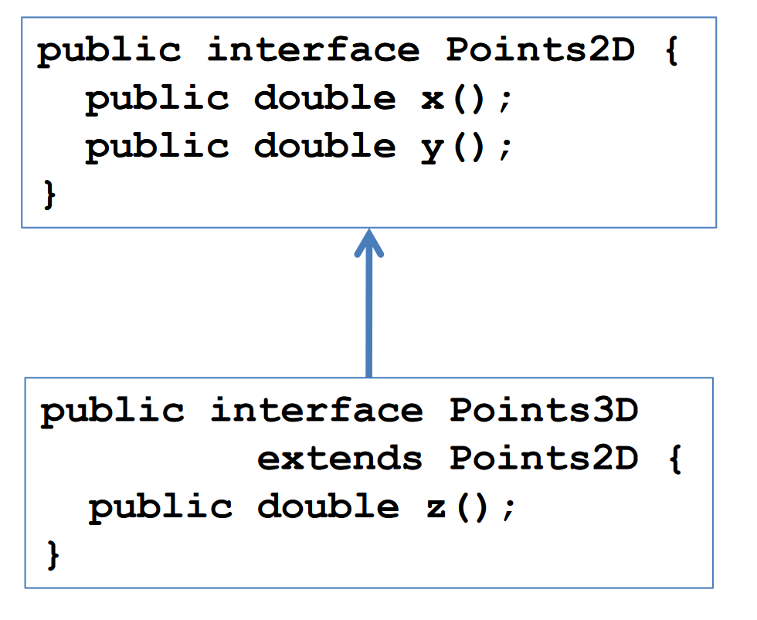
True Subtypes
B is a subtype of A means that a B can always be substituted for an A
A Points3D can always be treated as a Points2D
Points3D adds a property – the z-coordinate

Slide 15
Subclassing. Inheritance Makes it Easy to Add Functionality
class Product {
private String title;
private String description;
private float price;
public float getPrice() { return price; }
public float getTax() {
return getPrice()*0.08f;
}
}
… and we need a class for Products that are on sale
CSCI 2600 Spring 2021
15
Notes:
15

Slide 16
Code cloning is a bad idea! Why?
class SaleProduct {
private String title;
private String description;
private float price;
private float factor; // extends Product
public float getPrice() {
return price*factor; } // extends Product
public float getTax() {
return getPrice()*0.08f;
}
}
CSCI 2600 Spring 2021
16
Notes:
Maintenance problem
16

Slide 17
Subclassing
What’s a better way to add this functionality?
class SaleProduct extends Product {
private float factor;
public float getPrice() {
return super.getPrice()*factor;
}
}
Subclassing keeps small extensions small
An alternative to SaleProduct extends Product would have been composition!
Composition is a has_a relationship
CSCI 2600 Spring 2021
17
Notes:
An alternative to SaleProduct extends Product would have been composition!
17

Slide 18
Benefits of Subclassing
Don’t repeat unchanged fields and methods
Simpler maintenance: fix bugs once
Differences are clear (not buried under mass of similarity!)
Modularity: can ignore private fields and methods of superclass
Can substitute new implementations where old one is expected (the benefit of subtype polymorphism)
Another example: Timestamp extends Date
Disadvantage
May break equality
See Duration example from previous lecture
If we implement equality for SaleProduct in the most intuitive way, equality won’t be symmetric when comparing a SaleProduct and a Product!
CSCI 2600 Spring 2021
18
Notes:
Disadvantage: may break equality.
If we implement equality for SaleProduct in the most intuitive way, equality won’t be symmetric when comparing a SaleProduct and a Product!
18

Slide 19
Subclassing Can Be Misused
Poor planning leads to muddled inheritance hierarchies. Requires careful planning
If a class is not a true subtype of its superclass, it can surprise client
If class depends on implementation details of superclass, changes in superclass can break subclass. “Fragile base class problem”
CSCI 2600 Spring 2021
19
Notes:
19

Slide 20
Classic Example of Subtyping vs. Subclassing:
Every Square is a Rectangle, right?
Thus, class Square extends Rectangle { … }
But is a Square a true subtype of Rectangle? In other words, is Square substitutable for Rectangle in client code?
class Rectangle {
// effects: this_{post}.width=w,this_{post}.height=h
public void setSize(int w, int h);
// returns: area of rectangle
public int area();
…
}
CSCI 2600 Spring 2021
20
Notes:
20

Slide 21
Every Square is a Rectangle, right?
class Square extends Rectangle { … }
// requires: w = h
// effects: this_{post}.width=w,this_{post}.height=h
Choice 1: public void setSize(int w, int h);
// effects: this_{post}.width=w,this_{post}.height=w
Choice 2: public void setSize(int w, int h);
// effects: this_{post}.width=s,this_{post}.height=s
Choice 3: public void setSize(int s);
// effects: this_{post}.width=w,this_{post}.height=h
// throws: BadSizeException if w != h
Choice 4: public void setSize(int w, int h);
CSCI 2600 Spring 2021
21
Notes:
We want Square’s spec to be stronger than Rectangle’s.
21

Slide 22
Every Square is a Rectangle, right?
Choice 1 is not good
It requires more! Clients of Rectangle are justified to use
In formal terms: spec of Square’s setSize is not stronger than spec of Rectangle’s setSize
It weakens Rectangle’s setSize spec.
Thus, Square can’t be substituted for a Rectangle
Rectangle r = new Square();
r.setSize(5, 4);
CSCI 2600 Spring 2021
22
Notes:
Choice 1 requires more of client.
22

Slide 23
Every Square is a Rectangle, right?
Choice 4?
It throws an exception that clients of Rectangle are not expecting and not handling
If BadSizeException is an unchecked exception, then Java will permit the method to compile, but client code won't expect it.
Choice 4 throws a new exception for values in domain. See Specifications.pdf. It shouldn’t throw an exception for values that clients of Rectangle know are OK.
Thus, a Square might cause a problem if substituted for a Rectangle
CSCI 2600 Spring 2021
23
Notes:
Choice 4 throws new exception for values in domain. See Specifications.pdf It shouldn’t throw an exception for values that clients of Rectangle know are OK.
23

Slide 24
Every Square is a Rectangle, right?
Choice 3?
Clients of Rectangle can write … r.setSize(5,4). Square works with r.setSize(5)
Overload, not an override
Square expects all sides to have equal length
Clients can break the square invariant by calling the inherited 2-argument setSize method.
Client could do Rectangle r = new Square(); r.setSize(5,4);
Choice 2?
Client: Rectangle r = new Square(); … r.setSize(5,4); assert(r.area()==20) // r.area() returns 25
Again, Square surprises client with behavior that is different from Rectangle’s
CSCI 2600 Spring 2021
24
Notes:
Choice 3
Could do
Rectangle r = new Square();
r.setSize(3,4);
24

Slide 25
Every Square is a Rectangle, right?
Square is not a true subtype of Rectangle
Rectangles are expected to have height and width that can change independently
Squares violate that expectation. Surprises clients
Is Rectangle a true subtype of Square?
No. Squares are expected to have equal height and width. Rectangles violate this expectation
One solution: make them unrelated
Shape
Square
Rectangle
CSCI 2600 Spring 2021
25
Notes:
In other words, Square cannot be substituted for a Rectangle!
Building inheritance hierarchies can be tricky
25

Slide 26
Liskov Substitution Principle (LSP)
Due to Barbara Liskov, Turing Award 2008
IEEE John von Neumann Medal (2004)
LSP: A subclass should be substitutable for superclass. I.e., every subclass should be a true subtype of its superclass
Ensure that B is a true subtype of A by reasoning at the specification level
B should not remove methods from A
For each B.m that “substitutes” A.m, B.m’s spec does not weaken A.m’s spec
Client: A a; … a.m(int x,int y); Call a.m can bind to B’s m. B’s m should not surprise client
Any property guaranteed by supertype must be guaranteed by subtype
The subtype is permitted to strengthen and add properties
Anything provable about A is provable about B
If instance of subtype is treated purely as supertype – only supertype methods and fields queried – then result should be consistent with an object of the supertype being manipulated
Functions that use pointers or references to base classes must be able to use objects of derived classes without knowing it.
CSCI 2600 Spring 2021
26
Notes:
This is why we needed to reason about which specification is stronger! Most of the time though you won’t need formal reasoning, you can do by-hand reasoning!
These are general rules for object-oriented languages, not just Java.
26

Slide 27
Liskov Substitution Principle Rules
http://www.ckode.dk/programming/solid-principles-part-3-liskovs-substitution-principle/
Contravariance of method arguments in the subtype. (Parameter types of A.m may be replaced by supertypes in subclass B.m.)
Java doesn't allow this in overrides
Java override method arguments must be invariant
Covariance of return types in the subtype. (Return type of A.m may be replaced by subtype in subclass B.m)
Java override return types are covariant
No new exceptions should be thrown, unless the exceptions are subtypes of exceptions thrown by the parent. If B.m has weaker preconditions, new unchecked exceptions can be thrown outside A.m’s preconditions (See Specifications2.pdf)
Preconditions cannot be strengthened in the subtype. (You cannot require more than the parent)
Postconditions cannot be weakened in the subtype. (You cannot guarantee less than the parent)
Invariants must be preserved in the subtype.
History Constraint – the subtype must not be mutable in a way the supertype wasn’t. For instance MutablePoint cannot be a subtype of ImmutablePoint without violating the History Constraint (as it allows mutations which its supertype didn’t)
CSCI 2600 Spring 2021
27
Notes:
http://www.ckode.dk/programming/solid-principles-part-3-liskovs-substitution-principle/
Again these are general rules for object-oriented languages.
1-3 signature constraints
4-7 specification constraints
Supertypes are weaker. Weaker precondition
Subtypes are stronger. Stronger postcondition
An invariant is a condition which must hold true BOTH before and AFTER running a method. You have to be sure when you override a method anything unchangeable must remain unchanged after your overridden method executed. This can be hard to do because the invariant may not be explicit.
History Constraint: When overriding a method you are not allowed to modify an un-modifiable property in the base class.
---
cvarela-2021: Added: “If B.m has weaker preconditions, new unchecked exceptions can be thrown outside A.m’s preconditions.” (see Slides 23,35 in Specifications2.pdf). This strengthens postcondition (by guaranteeing more) and it does not surprise clients since behavior outside A.m’s preconditions is undefined. “Unchecked" is necessary since Java compiler would complain otherwise since it has no way of specifying or checking pre-conditions.
27

Slide 28
Substitution Principle for Classes
If B is a true subtype of A, a B can always be substituted for an A
Any property guaranteed by supertype must be guaranteed by subtype
Subtype can strengthen and add properties
Anything provable about A is provable about B
A's rep invariant must hold in B
If an instance of subtype is treated purely as a supertype (only methods and fields queried) then result should be consistent with results from supertype
No specification weakening
No method removal
Not straight forward to do in Java
Throw an exception if accessed
Overridden methods have a stronger spec
CSCI 2600 Spring 2021
28
Notes:
Code that expects an A should be able to use a B without problems.
28

Slide 29
Substitution principle for methods
Constraints on methods
For each method in supertype, subtype may have a corresponding override method
May also introduce new methods
Each overridden method must have a stronger (or equal) spec
Ask nothing extra of client
Weaker (or equal) precondition
Requires clause is at most as strict as supertype requires
May substitute supertypes as arguments in some languages
Not in Java overrides
Java overload
Guarantee as much as supertype
Stronger (or equal) postcondition
Effects clause is at least as strict as supertype
No new entries in modifies clause
May substitute subtype as return type
No new exceptions in domain, unless inside strictly weaker preconditions.
CSCI 2600 Spring 2021
29
Notes:
29

Slide 30
CSCI 2600 Spring 2021
30
Notes:
30

Slide 31
Overload vs. Override – Why do we care?
Consider this code
class MyClass {
// overload not override
boolean equals(MyClass m) {
return true;
}
}
Set<MyClass> myClasses = new HashSet<>();
myClasses.add(new MyClass());
myClasses.add(new MyClass());
System.out.println(myClasses.size()); // prints 2?!
MyClass myClass = new MyClass();
System.out.println(new MyClass().equals(myClass)); // true
Object o = new MyClass();
System.out.println(new MyClass().equals(o)); // false
Notes:
https://stackoverflow.com/questions/12787947/overriding-object-equals-vs-overloading-it
OverrideVsOverload.java

Slide 32
Overload vs. Override – Why do we care?
You might expect all instances of MyClass to be equivalent
add() uses contains()
contains() uses hashCode() to determine bin
myClasses.add(new MyClass());
myClasses.add(new MyClass());
Different hashCodes
new MyClass().equals(o) returns false
At runtime, JVM looks for equals(Object o)
equals(Object o) uses reference equality
Override redefines the method.
Overload defines an entirely new method

Slide 33
Aside: Why doesn't Java allow contravariant parameters in overrides?
Java and C++ don't allow contravariant arguments
It makes resolving what method to call more complicated
Some languages allow contravariant arguments
Sather, OCaml
class A {
public void f(String s) {...}
public void f(Integer i) {...}
}
class B extends A {
public void f(Object o) {...} // Which A.f should this override?
}
…

Slide 34
Box is a BallContainer?
class BallContainer {
// modifies: this
// effects: adds b to this container if b is not
// already in
// returns: true if b is added, false otherwise
public boolean add(Ball b);
…
}
class Box extends BallContainer { // good idea?
// modifies: this
// effects: adds b to this Box if b is not
// already in and this Box is not full
// returns: true if b is added, false otherwise
public boolean add(Ball b);
…
}
CSCI 2600 Spring 2021
34
Notes:
So, is Box a true subtype of BallContainer? No. Client is justified writing this code:
BallContainer c; …
while (i++<100) { c.add(new Ball(20)); }
assert(c.getVolume() == 2000)
Can't substitute Box for BallContainer. It guarantees less.
Returns false in cases where supertype would return true.
34

Slide 35
Box is a BallContainer?
So, is Box a true subtype of BallContainer?
No. Client is justified writing this code:
BallContainer c = new Box();
while (i++<100) { c.add(new Ball(20)); }
assert(c.getVolume() == 2000)
May fail if capacity of Box is exceeded
Can't substitute Box for BallContainer. It guarantees less.
Returns false in cases where supertype would return true.

Slide 36
Summary So Far
Java subtypes (realized with extends, implements) must be true subtypes
Java subtypes that are not true subtypes can be confusing and lead to difficult to find bugs.
When B is a Java subtype of A, ensure
B does not remove methods from A
A substituting method B.m has stronger spec than method A.m which it substitutes
Guarantees substitutability
If B is a true subtype of A, a B can always be substituted for an A
Liskov Substitution Principle is a principle, not a command
Java doesn't allow contravariant arguments in overrides
Override - method to be called is determined at runtime
Overload - method signature corresponds to a different method family
CSCI 2600 Spring 2021
36
Notes:
36

Slide 37
Type Signature is a Specification
Type signature (parameter types + return type) is a contract too
E.g., double f(String s, int i) {…}
Precondition: arguments are a String and an int
Postcondition: result is a double
We need reasoning about behavior and effects, so we added requires, effects, etc.
CSCI 2600 Spring 2021
37
Notes:
37

Slide 38
Function Subtyping, in general
In programming languages, function subtyping deals with substitutability of functions
Question: under what conditions on the parameter and return types A,B,C and D, is function A f(B) substitutable for C f(D)
Reason at the level of the type signature
Rule: A f(B) is a function subtype of C f(D)
if A is a subtype of C and B is a supertype of D
A could be a subtype of C and B the same type as D
This is only case Java allows for overrides
B could be a supertype of D and A the same type as C
Java overload
Guarantees substitutability
Specification
Return type is stronger
Argument type is weaker
The same type for Java overrides
CSCI 2600 Spring 2021
38
Notes:
A , C return types
B, D arg types
Java treats subtypes in arguments as overloads
38

Slide 39
Type Signature of Substituting Method is Stronger
Method parameters (inputs) in object-oriented languages:
Parameter types of A.m may be replaced by supertypes in subclass B.m. ”contravariance”
E.g., A.m(String p) and B.m(Object p)
B.m places no extra requirements on the client!
E.g., client: A a; … a.m(q). Client knows to provide q a String.
In languages which allow this, client code will work fine with B.m(Object p), which asks for less: an Object, and clearly, every String is an Object
Java does not allow change of parameter types in an overriding method
A
B
CSCI 2600 Spring 2021
39
Notes:
Think of parameters and return as part of the method specification (not including behavior).
Think of the arguments as a precondition.
Subtype should have stronger spec. For arguments, this means weaker arguments, i.e. supertypes of superclass’s arguments.
39

Slide 40
class Animal {
String name;
Animal(String name) {
this.name = name;
}
void sayHello(Giraffe g) {
System.out.println("Animal.sayHello: My name is " + name);
}
}
class Giraffe extends Animal {
Giraffe(String name) {
super(name);
}
void sayHello(Animal g) {
System.out.println("Giraffe.sayHello: My name is " + name);
}
}
public class ContraVariance {
public static void main(String[] args) {
Animal a = new Animal("Generic Animal");
Animal g = new Giraffe("Alice");
g.sayHello(a); // compiler error
g.sayHello(g); // also an error
}
}
Notes:
See Contravariance.java
Why doesn't this work?
Because of overloading. There is no sayHello(Animal) in the class animal at compile time. G is an animal at compile time
contraVariance/ContraVariance.java:33: error: incompatible types: Animal cannot be converted to Giraffe
The method sayHello(Giraffe) in the type Animal is not applicable for the arguments (Animal)
The method sayHello(Giraffe) in the type Animal is not applicable for the arguments (Animal)
The method sayHello(Giraffe) in the type Animal is not applicable for the arguments (Animal)
The method sayHello(Giraffe) in the type Animal is not applicable for the arguments (Anima)
Try changing Giraffe to Animal in Animal and Animal to Giraffe in Giraffe

Slide 41
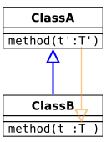
Contravariant Arguments
Doesn't work in Java overrides
sayHello() is an overload
At compile time a and g belong to the Animal class
There is no method Animal.sayHello(Animal)
C++ treats functions with contravariant arguments as overloads
Sather language allows contravariant argument types
Java treats contravariant arguments as overloads, not overrides
Method family determined at compile time
Compiler determines that a and g are animals at compile time
Notes:
See Contravariant.java

Slide 42
Type Signature of Substituting Method is Stronger
Method returns (results):
Return type of A.m may be replaced by subtype in subclass B.m. “covariance”
E.g., Object A.m() and String B.m()
B.m does not violate expectations of the client!
Result type of A.m() may be replaced by a subtype in B.m() in the subclass
Doesn’t violate client expectations
E.g., Object o = a.m(). Client expects an Object. Thus, String will work fine
String is an Object
No new exceptions. Existing exceptions can be replaced by subtypes
Java does allow a subtype return type in an overriding method!
A
B
CSCI 2600 Spring 2021
42
Notes:
Think of return type as part of the postcondition of the spec.
Subtype should have stronger spec. For return values , this means stronger return, i.e. subtypes of superclass’s return.
42

Slide 43
class Animal {
String name;
Animal(String name) {
this.name = name;
}
Animal cloneIt() {
return new Animal(name);
}
}
class Giraffe extends Animal {
Giraffe(String name) {
super(name);
}
Giraffe cloneIt() {
return new Giraffe(name);
}
}
public class Covariant {
public static void main(String[] args) {
Animal a = new Giraffe("Alice");
Animal g = a.cloneIt(); // OK
g.sayHello();
}
}
Notes:
See Covariant.java
What happens here?
At compile time a is an Animal. At runtime, a is a Giraffe. Finds Giraffe.
a.cloneIt() – at compile time a is an Animal. At runtime, it is a Giraffe. JVM looks starts looking in runtime class for cloneIt(), finds it in Giraffe.
a.cloneIt() returns a Giraffe.

Slide 44
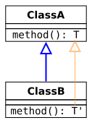
Covariant Return Type
Covariant (subclass) return types are safe
Java override
Dynamic
Determined at runtime
Stronger return type
Java overrides
Invariant argument types
Covariant return types

Slide 45
Properties Class from the JDK
Properties stores String key-value pairs. It extends
Hashtable so Properties is a Java subtype of Hashtable. What’s the problem?
class Hashtable {
// modifies: this
// effects: associates value with key
public void put(Object key, Object value);
// returns: value associated with key
public Object get(Object key);
}
class Properties extends Hashtable { // simplified
// modifies: this
// effects: associates String value with String key
public void put(String key, String value) {
super.put(key, value);
}
// returns: value associated with key
public String get(String key) {
return (String) super.get(key);
}
CSCI 2600 Spring 2021
45
Notes:
45

Slide 46
Exercise
class Hashtable {
public void put(Object key, Object value);
public Object get(Object key);
}
class Properties extends Hashtable {
public void put(String key, String value);
public String get(String key);
}
CSCI 2600 Spring 2021
46
Notes:
Properties.put(String,String) is the substituting “subtype” method. Substitutability requires that Properties.put has stronger signature: parameters that are supertypes of Hashtable.put’s parameters and return result that is subtype of Hashtable.put’s result. String is NOT A SUPERTYPE OF Object, thus substitutability requirement is not met.
Substituting Properties.put might violate clients expectations. Requiring String is a stronger @requires statement, weaker spec.
Similar reasoning for Properties.get(String). The argument is NOT a supertype of Object. The return is (as required) a subtype of Object.
These are overloads not overrides.
46

Slide 47
Exercise
class Product {
Product recommend(Product p);
}
Which one is a function subtype of Product.recommend?
class SaleProduct extends Product {
Product recommend(SaleProduct p);
SaleProduct recommend(Product p);
Product recommend(Object p);
Product recommend(Product p) throws
NoSaleException;
}
CSCI 2600 Spring 2021
47
Notes:
See ProductDemo2.java
Run this, then comment out SaleProduct recommend(Product p); see difference
Not OK, overload
OK
Ok, but overload
Not OK, duplicate method; Exception IOException is not compatible with throws clause in
Product.recommend(Product)
47

Slide 48
Exercise
class Product {
Product recommend(Product p);
}
Which one is a function subtype of Product.recommend?
class SaleProduct extends Product {
Product recommend(SaleProduct p); // overload
SaleProduct recommend(Product p); // OK
Product recommend(Object p); // OK but overload
Product recommend(Product p) throws
NoSaleException; // bad
}
CSCI 2600 Spring 2021
48
Notes:
See ProductDemo2.java
Exception won't be expected by client.
48

Slide 49
Reasoning about Specs
Function subtyping reasons with type signatures
Remember, type signature is a specification!
Precondition: requires arguments of given type
Postcondition: promises result of given type
Compiler checks function subtyping
Behavioral specifications add reasoning about behavior and effects
Precondition: stated by requires clause
Postcondition: stated by modifies, effects, returns and throws clauses
To ensure A is a true subtype of B, we must reason about behavioral specifications (as we did earlier)
CSCI 2600 Spring 2021
49
Notes:
49

Slide 50
Reason about Specs
Behavioral subtyping generalizes function subtyping
B.m is a true function subtype (behavioral subtype) of A.m
B.m has weaker precondition than A.m
Contravariance
B.m has stronger postcondition than A.m
Generalizes “B.m’s return is a subtype of A.m’s return”
Covariance
These 2 conditions guarantee B.m’s spec is stronger than A.m’s spec, and B.m is substitutable for A.m
All other things being equal
CSCI 2600 Spring 2021
50
Notes:
50

Slide 51
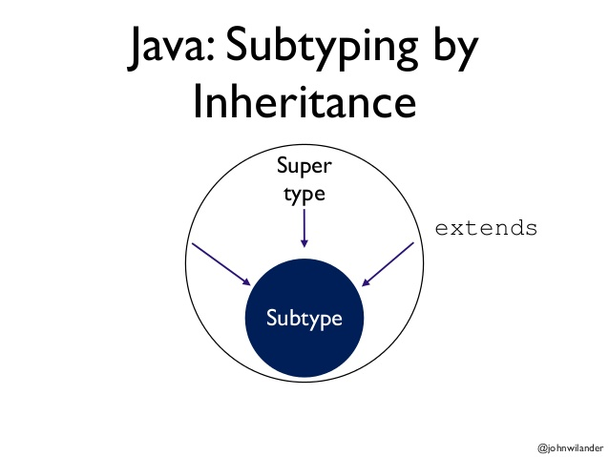
Java Subtypes
Java types are defined by classes, interfaces, primitives
Java subtyping stems from declarations
B extends A
B implements A
In a Java subtype, a “substituting” method is an overriding method
Has same parameter types
Has compatible (same or subtype) return type
Has no additional declared exceptions
CSCI 2600 Spring 2021
51
Notes:
Overriding
51

Slide 52
Overloading vs. Overriding
If a method has same name, but different parameter types, it overloads not overrides
class Hashtable {
public void put(Object key, Object value);
public Object get(Object key);
}
class Properties extends Hashtable {
public void put(String key, String value);
public String get(String key);
}
overload Hashtable’s put and get
CSCI 2600 Spring 2021
52
Notes:
Now Properties has 4 methods:
void put(Object key, Object key) // inherited from Hashtable
Object get(Object key) // inherited from Hashtable
void put(String key, String key) // overloaded put
String get(String key) // overloaded get
Suppose we have
Properties p = …
String s1, s2;
Integer i1, i2;
p.put(s1,s2); // Which put is called here? put(String s1, String s2), it is a better match!
p.put(s1,i2); // put(Object,Object)!
52

Slide 53
Overloading vs. Overriding
A method family contains multiple implementations of same name + parameter types (but not necessarily the same return type!)
Which method family? is determined at compile time based on compile-time types
E.g., family put(Object key, Object value)
or family put(String key, String value) // different family
Which implementation from the method family runs, is determined at runtime based on the runtime type of the receiver
CSCI 2600 Spring 2021
53
Notes:
53

Slide 54
Java Types
Java objects have two types
Compile time type
Also called declared type
Also called static type
Also called apparent type
Compiler determines
Runtime type
Also called actual type
Also called dynamic type
Looked up in heap
Runtime type must be the same as compile time type or subtype of compile time type

Slide 55
Static and Dynamic Types
B extends A and C extends B.
The dynamic type of an object (the type used after the new statement) is its runtime type
it defines the actual methods that are present for an object.
The static type of an object reference (a variable) is a compile-time type
Also called the apparent type
it declares which methods can be called on the object that the variable references.
The static type of a variable should always be of the same type or a supertype of the dynamic type of the object it references.
Runtime type is the same or a subtype of the compile time type
Java Language Spec on method invocation is complex
CSCI 2600 Spring 2021
55
Notes:
55

Slide 56
Java Subtyping Guarantees
A variable’s runtime type (i.e., the class of its runtime object) is a Java subtype of the variable’s declared class (Not true in C++!)
Object o = new Date(); // OK
Date d = new Object(); // Compile-time error
Thus, objects always have implementations of the method specified at the call site
Client: B b; … b.m() // Runtime object has m()
If all subtypes are true subtypes, spec of runtime target m() is stronger than spec of B.m()
CSCI 2600 Spring 2021
56
Notes:
This is type safety. It rules out a huge class of bugs! Compare with C++!
In the case of Object o = new Date() if we use o, it will have Object methods because Date is_a Object
For Date d = new Object() d will have methods that Object doesn’t have
56

Slide 57
How does a Method Call Execute?
For example, x.foo(5);
Compile time
Determine what class to look in – compile time class
Look at static type of receiver (x above)
Determine the method signature (family)
Find all methods in the class with the right name
Includes inherited methods
Look for overrides, return type may be a subtype
Keep only methods that are accessible and applicable
e.g. a private method is not accessible to calls from outside the class
The types of the actual arguments (e.g. 5 has type int above) must be subtypes of the corresponding formal parameter type
Select the most specific method
m1 is more specific than m2, if each argument of m1 is a subtype of the corresponding argument of m2
Keep track of the method’s signature (argument types) for run-time
CSCI 2600 Spring 2021
57
Notes:
https://www.cs.cmu.edu/~aldrich/courses/15-214-11fa/slides/method-dispatch.pdf
How does compiler know what the actual type is? It doesn't, so compile type of argument in inherited class may be a subtype of object in method family.
57

Slide 58
How does a Method Call Execute?
Run time
Determine the run-time type of the receiver
x in this case
Look at the object in the heap to find out what its run-time type is
Locate the method to invoke
Starting at the run-time type, look for a method with the right name and argument types found statically, i.e. method family
The types of the actual arguments may be subtypes of the corresponding formal parameter type
If it is found in the run-time type, invoke it.
Otherwise, continue the search in the superclass of the run-time type
Look only at family members
This procedure will always find a method to invoke, due to the checks done during static type checking
CSCI 2600 Spring 2021
58
Notes:
Actual = runtime
More details are in the Java Language Specification, at http://java.sun.com/docs/books/jls/third_edition/html/expressions.html#15.12
58

Slide 59
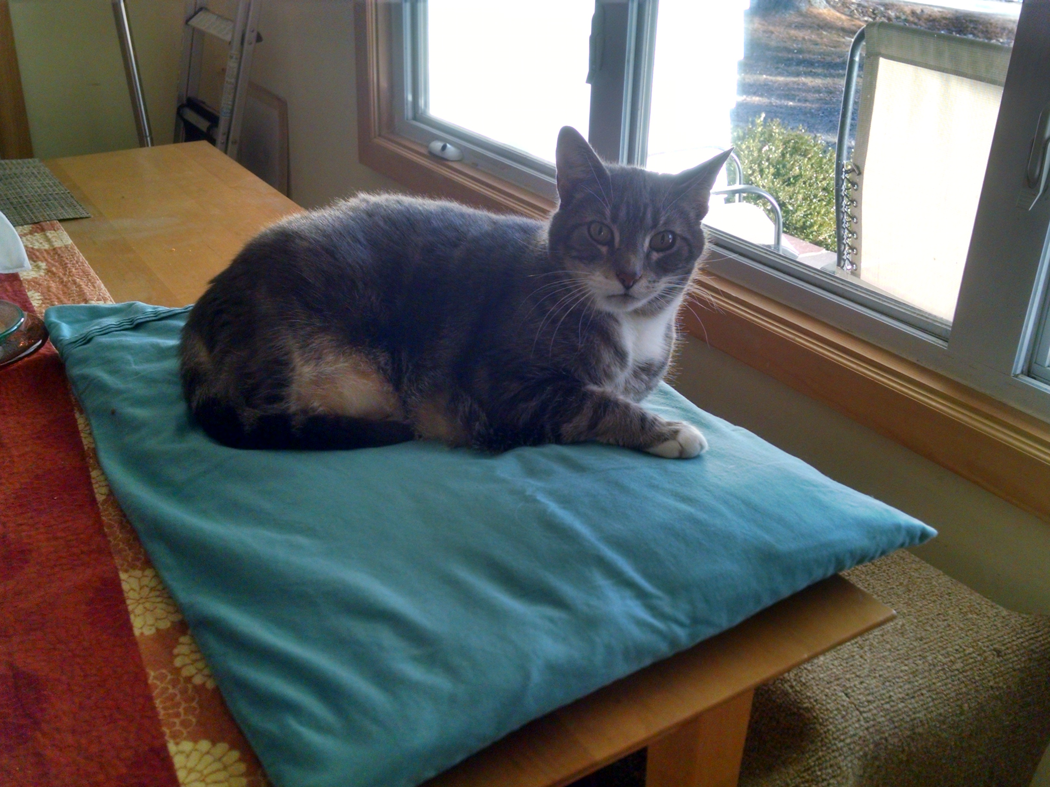
Example
class GenericAnimal {
public String talk() {
return "Noise"; }
}
class Bird extends GenericAnimal {
public String talk(){
return "Chirp"; }
}
class Cat extends GenericAnimal {
public String talk(){
return "Meow"; }
}
class Dog extends GenericAnimal {
public String talk(){
return "Woof"; }
}
class GizmoTheCat extends Cat {
public String talk(){
return "Hello, I would like some oatmeal."; }
}
CSCI 2600 Spring 2021
59
Notes:
59

Slide 60
public class AnimalTalk {
public static void main(String[] args) {
GenericAnimal A = new GenericAnimal();
System.out.println(A.talk());
GenericAnimal B = new Bird();
System.out.println(B.talk());
GenericAnimal C = new Cat();
System.out.println(C.talk());
GenericAnimal G = new GizmoTheCat();
System.out.println(G.talk());
// what does this print?
GizmoTheCat G2 = new GizmoTheCat();
GenericAnimal F = G2; // Compile time type? Runtime type?
System.out.println(F.talk());
}
}
CSCI 2600 Spring 2021
60
Notes:
See AnimalTalk.java
G2 – compile time GizmoTheCat, runtime GizmoTheCat
F – compile time GenericAnimal, runtime GizmoTheCat
Prints: Hello, I would like some oatmeal.
60

Slide 61
Remember Duration
Two method families.
class Object {
public boolean equals(Object o);
}
class Duration {
public boolean equals(Object o); // override
public boolean equals(Duration d);
}
Duration d1 = new Duration(10,5);
Duration d2 = new Duration(10,5);
System.out.println(d1.equals(d2));
// Compiler choses family equals(Duration d)
CSCI 2600 Spring 2021
61
Notes:
See Duration1 in workspace_1
Compile time d1 is a Duration. Chooses red family
At runtime d1, d2 can only be Duration or subtype of Duration
61

Slide 62
Remember Duration
class Object {
public boolean equals(Object o);
}
class Duration {
public boolean equals(Object o);
public boolean equals(Duration d);
}
Object d1 = new Duration(10,5);
Duration d2 = new Duration(10,5);
System.out.println(d1.equals(d2));
// At compile-time: equals(Object o) (method family)
// At runtime: Duration.equals(Object o)
CSCI 2600 Spring 2021
62
Notes:
See Duration6.java
d1.equals(d2)
Compile time type of d1 = object; locate equals in object, find equals in inherited method; the blue lines are method family.
Actual parameter d2 Duration is a subtype of object
Choose blue family.
Runtime type = Duration
Start looking in Duration for matching member of method family
Uses Duration.equals(Object)
Suppose we hadn't overridden Duration.equals(Object). Compile time is the same. Runtime we call Object.equals(Object).
62

Slide 63
Remember Duration
class Object {
public boolean equals(Object o);
}
class Duration {
public boolean equals(Object o);
public boolean equals(Duration d);
}
Object d1 = new Duration(10,5);
Object d2 = new Duration(10,5);
System.out.println(d1.equals(d2));
// Compiler choses equals(Object o)
// At runtime: Duration.equals(Object o)
// receiver type is Duration at runtime
CSCI 2600 Spring 2021
63
Notes:
See Duration2.java
Compile time type of d1 is object
Look in object and children for equals methods
Choose blue family.
Runtime type is Duration, look in Duration for match
Uses Duration.equals(Object)
63

Slide 64
Remember Duration
class Object {
public boolean equals(Object o);
}
class Duration {
public boolean equals(Object o);
public boolean equals(Duration d);
}
Duration d1 = new Duration(10,5);
Object d2 = new Duration(10,5);
System.out.println(d1.equals(d2));
// Compiler chooses equals(Object o)
// At runtime: Duration.equals(Object o)
// receiver type is Duration at runtime
CSCI 2600 Spring 2021
64
Notes:
Duration7.java
Compile time type is Duration, look in Duration for matching equals
parameter is Object– choose equals(object), blue family
Runtime – look in Duration
64

Slide 65
Exercise
class Y extends X { … }
class A {
X m(Object o) { … }
}
class B extends A {
X m(Z z) { … }
}
class C extends B {
Y m(Z z) { … }
}
A a = new B();
Object o = new Object();
// Which m is called?
X x = a.m(o);
A a = new C();
Object o = new Z();
// Which m is called?
X x = a.m(o);
CSCI 2600 Spring 2021
65
Notes:
Diapatch1.java
Two method families: red and blue
Compile time – a is of type A
Start in A and look for match of arguments.
Actual parameter is objects – only match is red m
Runtime – look B for match, none
Look in superclass A
2nd case A’s X is called
In C, m() overrides B’s m but not A’s
Compile time – a is of type A
Start in A and look for match of arguments
Actual argument type is object – match is red
Runtime start looking in C, look in supertypes
A's m is called
65

Slide 66
Exercise
class Y extends X { … }
class W extends Z { … }
class A {
X m(Z z) { … }
}
class B extends A {
X m(W w) { … }
}
class C extends B {
Y m(W w) { … }
}
A a = new B();
W w = new W();
// Which m is called?
X x = a.m(w);
B b = new C();
W w = new W();
// Which m is called?
X x = b.m(w);
CSCI 2600 Spring 2021
66
Notes:
Dispatch2.java
1st case A’s m
in B X m(W w), W is not a superclass of Z. This is not an override of A's X m()
Compile time a is an A
Look in A for match. Actual parameter is W which is a subtype of Z, so it’s a match
Chose red
Runtime, start in B, look in superclasses
A's m is called
2nd case C’s m
C's X m(W w) is an override
Compile time – b is type B
Look in B and inherited classes for match, actual parameter type is W
Blue family
Runtime – start looking in C
Choose m in C
66

Slide 67
Subclassing is Difficult
Before:
class B {
private int c=0;
void inc1() { c++; }
void inc2() { c++; }
}
class A extends B {
@Override
void inc2() {
inc1();
}
}
public class IncTest {
public static void
main(String[] args) {
A a = new A();
a.inc2();
System.out.println(a.get());
}
}
After a tiny change:
class B {
private int c=0;
void inc1() { inc2(); }
void inc2() { c++; }
}
class A extends B {
@Override
void inc2() {
inc1();
}
}
CSCI 2600 Spring 2021
67
Notes:
See IncTest.java
After change, you have an infinite loop and a stack overflow exception.
Which inc2() is called?
Infinite loop, why?
In second case, this is an A. Looks in runtime type (A) and finds inc2.
67

Slide 68
Fragile Base Class Problem
Previous slide showed an example of the Fragile Base Class Problem
Occurs when the implementation of a subclass depends on implementation details in the superclass. Seemingly innocuous changes in the superclass can break the subclass
CSCI 2600 Spring 2021
68
Notes:
68

Slide 69
Subclassing is Difficult
A set that counts the number of attempted additions:
class InstrumentedHashSet extends HashSet {
private int addCount = 0;
public InstrumentedHashSet(Collection c) {
super(c);
}
public boolean add(Object o) {
addCount++; return super.add(o);
}
public boolean addAll(Collection c) {
addCount += c.size(); return super.addAll(c);
}
public int getAddCount() { return addCount; }
}
CSCI 2600 Spring 2021
69
Notes:
69

Slide 70
Subclassing is Difficult
InstrumentedHashSet is a true subtype of
HashSet. But… Something goes quite wrong here
class InstrumentedHashSet extends HashSet {
private int addCount = 0;
public InstrumentedHashSet(Collection c) {
super(c);
}
public boolean add(Object o) {
addCount++; return super.add(o);
}
public boolean addAll(Collection c) {
addCount += c.size(); return super.addAll(c);
}
public int getAddCount() { return addCount; }
}
CSCI 2600 Spring 2021
70
Notes:
InstrumentedHashSet depends on the implementation of HashSet!
70

Slide 71
Subclassing is Difficult
InstrumentedHashSet s = new InstrumentedHashSet();
System.out.println(s.getAddCount()); // 0
s.addAll(Arrays.asList(“One”,”Two”));
System.out.println(s.getAddCount()); // Prints?
HashSet
… this.add(o);…
add(Object o)
addAll(Collection c)
addCount++; super.add(o);
addCount += c.size();
super.addAll(c);
InstrumentedHashSet
add(Object o)
addAll(Collection c)
CSCI 2600 Spring 2021
71
Notes:
Method family includes HashSet add and InstrumetedHashSet add.
HashSet add calls this.add(). this is InstrumetedHashSet at runtime
71

Slide 72
The Yo-yo Problem
this.add(o) in superclass HashSet calls InstrumentedHashSet.add! Callback.
Example of the yo-yo problem. Call chain “yo-yos” from subclass to superclass back to subclass
InstrumentedHashSet.addAll calls HashSet.addAll calls InstrumentedHashSet.add
Behavior of HashSet.addAll depends on subclass InstrumentedHashSet!
CSCI 2600 Spring 2021
72
Notes:
72

Slide 73
Why Set and not HashSet? Avoid implementation detail
Java Subtyping with Interfaces
class InstrumentedHashSet implements Set {
private final Set s = new HashSet();
private int addCount = 0;
public InstrumentedHashSet(Collection c) {
this.addAll(c);
}
public boolean add(Object o) {
addCount++; return s.add(o);
}
public boolean addAll(Collection c) {
addCount += c.size(); return s.addAll(c);
}
public int getAddCount() { return addCount; }
// … Must add all methods specified by Set
}
CSCI 2600 Spring 2021
73
Notes:
A nice useful trick. “implements Set” allows our InstrumentedHashSet to be treated as a Set. On the other hand it does not extend anything. It reuses HashSet through Composition.
Resolves problem because we are calling a HashSet add directly. InstrumentedHashSet is not a subclass of HashSet
73

Slide 74
Java Subtyping with Interfaces
interface inheritance
Client codes against type signature of interface methods, not concrete implementations
Behavioral specification of an interface method often unconstrained
Often, any (later) implementation is stronger!
Facilitates composition and wrapper classes as in the InstrumentedHashSet example
CSCI 2600 Spring 2021
74
Notes:
74

Slide 75
Java Subtyping with Interfaces
In JDK and the Android SDK
Implement multiple interfaces, extend single abstract superclass (very common!)
Abstract classes minimize number of methods new implementations must provide
Abstract classes facilitate new implementations
Using abstract classes is optional, so they don’t limit freedom
Extending a concrete class is problematic (e.g., Properties, Timestamp, which we saw in the Equality lecture)
CSCI 2600 Spring 2021
75
Notes:
Inheritance is overrated as a means for code reuse. Composition is better.
75

Slide 76
Why prefer implements A over extends A
A class has exactly one superclass. In contrast, a class may implement multiple interfaces. An interface may extend multiple interfaces
Interface inheritance gets the benefit of subtype polymorphism
And avoids the pitfalls of subclass inheritance, such as the fragile base class problem, etc.
Multiple interfaces, single abstract superclass gets most of the benefit
CSCI 2600 Spring 2021
76
Notes:
76

Slide 77
Composition
Properties is not a true subtype of Hashtable. Thus, cannot subclass. An alternative solution?
Subclassing is a bad idea for the InstrumentedHashSet too. An alternative?
Box is not a true subtype of BallContainer. Cannot subclass.
Composition!
CSCI 2600 Spring 2021
77
Notes:
77

Slide 78
Properties Class from the JDK
Properties stores String key-value pairs. It extends
Hashtable so Properties is a Java subtype of Hashtable. What’s the problem?
class Hashtable {
// modifies: this
// effects: associates value with key
public void put(Object key, Object value);
// returns: value associated with key
public Object get(Object key);
}
class Properties extends Hashtable { // simplified
// modifies: this
// effects: associates String value with String key
public void put(String key, String value) {
super.put(key, value);
}
// returns: value associated with key
public String get(String key) {
return (String) super.get(key);
}
CSCI 2600 Spring 2021
78
Notes:
78

Slide 79
Wrapping class
Properties
The delegate
class Properties { // simplified
private Hashtable ht = new Hashtable();
// modifies: this
// effects: associates value with key
public void setProperty(String key,String value)
{
ht.put(key,value);
}
// returns: value associated with key
public String getProperty(String key)
{
return (String) ht.get(key);
}
CSCI 2600 Spring 2021
79
Notes:
Composition to the rescue
Properties no longer extends HashTable. It contains a HashTable
79

Slide 80
InstrumentedHashSet
The delegate
class InstrumentedHashSet {
private final Set s = new HashSet();
private int addCount = 0;
public InstrumentedHashSet(Collection c) {
s.addAll(c);
}
public boolean add(Object o) {
addCount++; return s.add(o);
}
public boolean addAll(Collection c) {
addCount += c.size(); return s.addAll(c);
}
public int getAddCount() { return addCount; }
}
CSCI 2600 Spring 2021
80
Notes:
There is a bug on this slide. Can you find it?
addCount += c.size() is needed in the constructor.
80

Slide 81
Box
The delegate
class Box {
private BallContainer ballContainer;
private double maxVolume;
public Box(double maxVolume) {
this.ballContainer = new BallContainer();
this.maxVolume = maxVolume;
}
public boolean add(Ball b) {
if (b.getVolume() + ballContainer.getVolume()
> maxVolume)
return false;
else
return ballContainer.add(b);
}
…
CSCI 2600 Spring 2021
81
Notes:
81

Slide 82
Composition
Implementation reuse without inheritance
More common than reuse through subclassing
Easy to reason about
Works around badly-designed classes
Disadvantages
Adds level of indirection
Tedious to write
Does not preserve subtyping
CSCI 2600 Spring 2021
82
Notes:
82

Slide 83
Composition Does not Preserve Subtyping
InstrumentedHashSet is not a Set anymore
So can’t substitute it
It may be a true subtype of Set!
But Java doesn’t know that
That nice trick with interfaces to the rescue
Declare that the class implements interface Set
Requires that such interface exists
CSCI 2600 Spring 2021
83
Notes:
83

