Slide 1
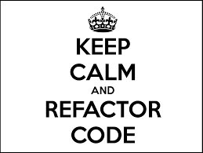
Refactoring
Many thanks to Profs. Milanova, Goldschmidt,
and Michael Ernst, U. Wash.)
Notes:
1

Slide 2
Refactoring
Introduction to Refactoring
Programming is just refactoring a blank screen
~ unknown source
Refactorings
Extract method, Move method
Replace temp with query
Replace type code with State/Strategy
Replace conditional with polymorphism
Form Template Method
Replace magic number with symbolic constant
We’ll learn more about the State, Strategy and Template Method design patterns
CSCI 2600 Spring 2021
2
Notes:
2

Slide 3
So Far
We studied techniques for writing correct and maintainable code
Correctness: careful planning, specifications, reasoning about code, testing
Understandability and maintainability: Design patterns promote low coupling and “open/closed” designs
designs that are “open for extension but closed to modification”
CSCI 2600 Spring 2021
3
Notes:
3

Slide 4
So Far
How to design your code
The hard way: Start hacking. Hack some more…
Seems like the easy way
The easier way: Plan carefully
How to verify your code
The hard way: Make up some inputs…
An easier way: systematic testing and reasoning
The hard way leads down the dark path
But we do get down the dark path
CSCI 2600 Spring 2021
4
Notes:
down the dark path, forever will it dominate your destiny, consume you it will
4

Slide 5
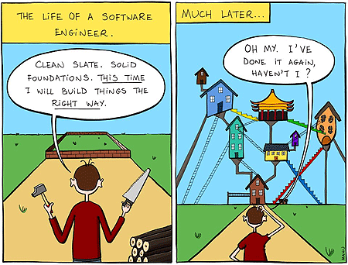
https://usercontent2.hubstatic.com/8530569.gif
CSCI 2600 Spring 2021
5

Slide 6
Refactoring
Premise: we have written complex, possibly ugly, code, but it works! Can we simplify this code?
Two opposite tendencies
“Don’t fix it, if it’s not broken.”
When it breaks, it can be a real mess
Refactoring: disciplined rewrite of code
Small-step behavior-preserving transformations
Followed by execution of test cases
Depends on having a good suite of tests
Continuous refactoring combined with testing is an essential software development practice
CSCI 2600 Spring 2021
6
Notes:
6

Slide 7
Technical Debt
Technical debt reflects the extra development work that arises when code that is easy to implement in the short run is used instead of applying the best overall solution.
Refactoring helps prevent accumulation of technical debt
Caused by
Business pressures
Lack of understanding
Tightly coupled modules
Not enough/improper testing
Lack of documentation
Lack of collaboration
Etc.
AntiPatterns are a source of technical debt
CSCI 2600 Spring 2021
7

Slide 8
Refactoring
Refactorings attack code smells
Code smells/AntiPatterns – bad coding practices leading to technical debt
Code Smells
any characteristic in the source code of a program that possibly indicates a deeper problem.
E.g., big method
An oversized “God” class
Similar methods, classes or subclasses
Little or no use of subtype polymorphism
High coupling between objects,
Etc.
CSCI 2600 Spring 2021
8
Notes:
8

Slide 9
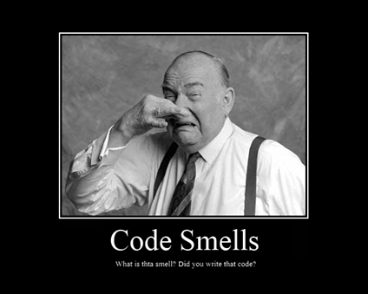
Code Smells
Smells are certain structures in the code that indicate violation of
fundamental design principles and negatively impact design quality.
Code smells are not necessarily bugs
not necessarily technically incorrect
indicate possible weakness in code
indicator of possible technical debt
similar to but not always antipatterns
Examples
Duplicated code: identical or very similar
code exists in more than one location.
Contrived complexity: forced usage of overcomplicated design patterns.
Shotgun surgery : a single change needs to be applied to multiple classes
at the same time.

Slide 10
More Code Smells
Large class: a class that has grown too large. God object.
Feature envy: a class that uses methods of another class excessively.
Inappropriate intimacy: a class that has dependencies on implementation
details of another class.
Refused bequest: a class that overrides a method of a base class in such a way
that the contract of the base class is not honored by the
derived class. See Liskov substitution principle.
Lazy class / freeloader: a class that does too little.
Excessive use of literals: these should be coded as named constants
Cyclomatic complexity: too many branches or loops
Downcasting: a type cast which breaks the abstraction model
Orphan variable or constant class: a class that typically has a collection of constants
which belong elsewhere
Data clump: Occurs when a group of variables are passed around together in
various parts of the program. This suggests that it would be more
appropriate to formally group the different variables together into
a single object.

Slide 11
Refactoring Activities
Make long methods shorter
Remove duplicate code
Introduce design patterns
Remove the use of hard-coded constants
Etc…
Goal: achieve code that is short, tight, clear, and without duplication
CSCI 2600 Spring 2021
11
Notes:
Smells make code error-prone, difficult to understand and maintain
11

Slide 12
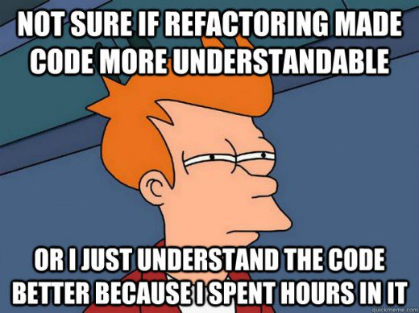
Refactoring Activities
Rule:
Make small disciplined changes
Test after each change
CSCI 2600 Spring 2021
12

Slide 13
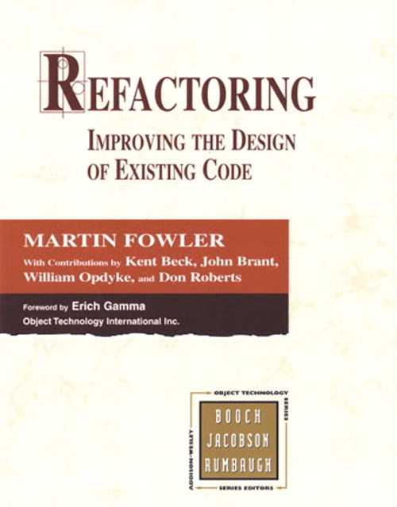
A Refactoring (noun)
A refactoring is a named, documented algorithm that attacks a specific bad coding practice
E.g., Extract method, Move method, Replace constructor call with Factory method
Relatively well-defined mechanics, can be automated
Eclipse can automate some of these
Canonical Reference:
Refactoring, Improving the Design of Existing Code by Martin Fowler
Initial catalog of 72 refactorings, 1999
Currently, more than 100 documented refactorings
CSCI 2600 Spring 2021
13
Notes:
13

Slide 14
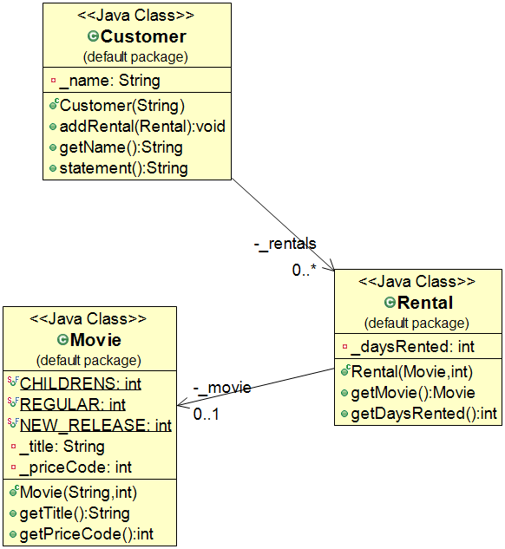
Movie Rentals (Fowler)
Does anyone remember movie
rental stores?
https://martinfowler.com/articles/refactoring-video-store-js/#DecomposingIntoSeveralFunctions
CSCI 2600 Spring 2021
14
Notes:
Additional connection – statement() uses Movie
14

Slide 15
Movie Rentals
public class Movie {
// immutable class!
public static final int CHILDRENS = 2;
public static final int REGULAR = 0;
public static final int NEW_RELEASE = 1;
private String _title;
private int _priceCode;
public Movie(String title, int priceCode) {
_title = title;
_priceCode = priceCode;
}
public String getTitle() {
return _title;
}
public int getPriceCode() {
return _priceCode;
}
}
CSCI 2600 Spring 2021
15
Notes:
From Fowlers 1999 book
Does anyone remember movie rental stores? RedBox at convenience stores
15

Slide 16
Movie Rentals (Fowler, 1999)
public class Rental {
// an immutable class
private Movie _movie;
private int _daysRented;
public Rental(Movie movie, int daysRented) {
_movie = movie;
_daysRented = daysRented;
}
public Movie getMovie() {
return _movie;
}
public int getDaysRented() {
return _daysRented;
}
}
CSCI 2600 Spring 2021
16
Notes:
Question. Why there is no (dangerous) representation exposure here?
Movie is immutable
16

Slide 17
Class Customer
public class Customer {
// mutable class
private String _name;
private List<Rental> _rentals;
public Customer (String name) {
_name = name;
_rentals = new ArrayList<Rental>();
}
public void addRental(Rental arg) {
_rentals.add(arg);
… // other methods
}
CSCI 2600 Spring 2021
17
Notes:
17

Slide 18
Method statement() in Customer, composes a Customer statement
public String statement() { double totalAmount = 0; int frequentRenterPoints = 0; Iterator<Rental> rentals = _rentals.iterators(); String result =
“Rental Record for ” + getName()+“\n”; while (rentals.hasNext()) { // process current rental
double thisAmount = 0; // amount for this rental Rental each = rentals.next(); // Next, compute amount due for current rental (each)
CSCI 2600 Spring 2021
18
Notes:
18

Slide 19
Method statement()
switch (each.getMovie().getPriceCode()) { case Movie.REGULAR: thisAmount += 2; if (each.getDaysRented() > 2) thisAmount += (each.getDaysRented()-2)*1.5; break;
case Movie.NEW_RELEASE: thisAmount += each.getDaysRented()*3; break;
case Movie.CHILDRENS: thisAmount += 1.5; if (each.getDaysRented() > 3) thisAmount += (each.getDaysRented()-3)*1.5; break;
} // end of switch statement
CSCI 2600 Spring 2021
19
Notes:
19

Slide 20
Method statement()
// add frequent renter points contributed by current rental
frequentRenterPoints++;
if ((each.getMovie().getPriceCode() == Movie.NEW_RELEASE) && each.getDaysRented() > 1) frequentRenterPoints++;
result += “\t” + each.getMovie().getTitle() + “\t” + String.valueOf(thisAmount) + “\n”;
totalAmount += thisAmount;
} // end of the while loop over the _rentals
// add totalAmount and frequentRenterPoints to result
return result; // Finally DONE!
} // end of method statement()
} // end of Customer class
CSCI 2600 Spring 2021
20
Notes:
20

Slide 21
Discussion
What code smells can you find?
There are many…
Code smells:
big method
strong coupling between objects
Uses _rentals, Movie.getMovie()
little or no use of subtype polymorphism
and so on
CSCI 2600 Spring 2021
21
Notes:
21

Slide 22
The Extract Method Refactoring
Problem: Method Customer.statement() is too big, difficult to understand and maintain
Solution: Find a logical chunk of code to be extracted out of statement(), and perform the Extract Method refactoring
Key point: safety – refactoring preserves behavior. Test after every refactoring!
What part of statement() would you extract?
CSCI 2600 Spring 2021
22
Notes:
One piece to remove might be body of while loop.
22

Slide 23
Extract Method, Mechanics
Create a new method, name it appropriately
Copy the extracted code in the new method
Scan the extracted code for references to local variables
If local variables are used only in extracted code, declare them in the new method
See if any local variables are modified by the extracted code – tricky part…
Are they used in previous method?
Pass as parameters local variables that are not modified but are only used by the extracted code
Compile
Replace the extracted code with a method call
Compile and test!!!
CSCI 2600 Spring 2021
23
Notes:
23

Slide 24
Extract Method, extracted code
double thisAmount = 0; // thisAmount is local to while loop
switch (each.getMovie().getPriceCode()) {
// each is local to while loop too case Movie.REGULAR: thisAmount +=2; if (each.getDaysRented() > 2) thisAmount += (each.getDaysRented()-2)*1.5; break;
case Movie.NEW_RELEASE: thisAmount += each.getDaysRented()*3; break;
case Movie.CHILDRENS: thisAmount += 1.5; if (each.getDaysRented()>3) thisAmount += (each.getDaysRented()-3)*1.5;
break;
}
totalAmount += thisAmount;
CSCI 2600 Spring 2021
24
Notes:
Note: we didn't extract frequentRenterPoints code. Try to keep logical functions together.
24

Slide 25
Extract Method. The new method
private double amountFor(Rental each) {
double thisAmount = 0;
switch (each.getMovie().getPriceCode()) {
case Movie.REGULAR:
thisAmount +=2;
if (each.getDaysRented() > 2)
thisAmount += (each.getDaysRented()-2)*1.5;
break;
case Movie.NEW_RELEASE:
thisAmount += each.getDaysRented()*3;
break;
case Movie.CHILDRENS:
thisAmount += 1.5;
if (each.getDaysRented()>3)
thisAmount += (each.getDaysRented()-3)*1.5;
break;
}
return thisAmount;
}
For readability, rename thisAmount to result
CSCI 2600 Spring 2021
25
Notes:
Rename variable is also a refactoring. Rename class is a refactoring too! Eclipse can do many of these refactorings automatically.
Maybe change each to something more relevant.
25

Slide 26
Extract Method. The new method, still in class Customer
private double amountFor(Rental each) {
double result = 0; switch (each.getMovie().getPriceCode()) { case Movie.REGULAR: result +=2; if (each.getDaysRented() > 2) result += (each.getDaysRented()-2)*1.5; break;
case Movie.NEW_RELEASE: result += each.getDaysRented()*3; break;
case Movie.CHILDRENS: result += 1.5; if (each.getDaysRented()>3) result += (each.getDaysRented()-3)*1.5;
break; }
return result;
}
What’s still “wrong” here?
CSCI 2600 Spring 2021
26
Notes:
This method in Customer seems to be calling functions in Rental and Movies - coupling
26

Slide 27
The Move Method Refactoring
Problem: Unnecessary coupling from Customer to Rental through getDaysRented().
Unnecessary coupling to Movie too.
Customer does not have the “information” to compute the rental amount
Solution: Move amountFor(Rental) to the class that is the logical “information expert”
Key point: safety. Test after refactoring!
What class has the information to compute the charge amount?
CSCI 2600 Spring 2021
27
Notes:
Rental might be a choice.
27

Slide 28
Move Method, Mechanics
Examine all features used by the source method that are defined on the source class. Consider if they should be moved also.
Check the sub- and superclasses for other declarations of the method.
Declare the method in the target class.
Appropriately copy the code from source to target.
Compile the target class.
Reference the correct target object from the source.
Turn the source method into a delegating method.
Compile and test.
CSCI 2600 Spring 2021
28
Notes:
28

Slide 29
Move Method. getCharge(), now in class Rental
double getCharge() { // now in Rental! Name change
double result = 0;
// No reference to each!
// No each, Rental object has info
switch (getMovie().getPriceCode()) {
case Movie.REGULAR: result +=2; if (getDaysRented() > 2) result += (getDaysRented()-2)*1.5; break;
case Movie.NEW_RELEASE: result += getDaysRented()*3; break;
case Movie.CHILDRENS: result += 1.5; if (getDaysRented()>3) result += (getDaysRented()-3)*1.5;
break;
}
return result;
}
CSCI 2600 Spring 2021
29
Notes:
What changed? On the fly we applied the Rename Method refactoring too: renamed amountFor to getCharge.
29

Slide 30
Move Method
Initially, replace body of old method with delegation:
class Customer {
private double amountFor(Rental aRental) { return aRental.getCharge();
}
}
Compile and test to see if it works.
Next, find each reference to amountFor and replace
with call to the new method:
thisAmount = amountFor(each); becomes
thisAmount = each.getCharge();
Compile and test!
CSCI 2600 Spring 2021
30
Notes:
30

Slide 31
New and improved statement()
public String statement() { double totalAmount = 0; int frequentRenterPionts = 0; Iterator<Rental> rentals = _rentals.iterator();
String result = “Record for “ + getName() + “\n”; while (rentals.hasNext()) { double thisAmount = 0; Rental each = rentals.next(); thisAmount = each.getCharge(); // BIG CHANGE!
// …code for frequent renter points
result += “\t” + each.getMovie().getTitle() + “\t” + String.valueOf(thisAmount) + “\n”;
totalAmount += thisAmount;
}
// code to add totalAmount and
// frequentRenterPoints to result string, return result
// and DONE!
}
Is thisAmount necessary?
CSCI 2600 Spring 2021
31
Notes:
31

Slide 32
The Replace Temp with Query Refactoring
Problem: Temporary variable thisAmount is meaningless, hinders readability
Solution: Replace thisAmount with “query method” each.getCharge()
Claim: A “query method” is more informative
Aside: “query methods” must be free of side effects (i.e., they modify nothing)
Key point: safety. Test after refactoring!
CSCI 2600 Spring 2021
32
Notes:
Sometime adding local variables is useful for debugging. You can break and examine temporary results. Be sure to replace them later for readability.
32

Slide 33
Replace Temp With Query, Mechanics
Look for a temporary variable that is assigned to only once. Why?
Declare the temp as final
Compile (makes sure temp is assigned once!)
Extract the right-hand side of the assignment into a “query”; replace all occurrences of temp with query
Method computing the value of temp should be a “query” method, i.e., it should be free of side effects! Why?
Compile and test
CSCI 2600 Spring 2021
33
Notes:
33

Slide 34
Replace Temp with Query
public String statement() { double totalAmount = 0; int frequentRenterPoints = 0; Iterator<Rental> rentals = _rentals.iterator(); String result = “Record for “ + getName() + “\n”; while (rentals.hasNext()) { Rental each = rentals.next();
double thisAmount = each.getCharge(); // …code for frequent renter points
result += “\t” + each.getMovie().getTitle() + “\t” +
String.valueOf(each.getCharge()) + “\n”;
totalAmount += each.getCharge();
}
// code to add totalAmount and
// frequentRenterPoints to result string, return result and DONE!
}
We got rid of thisAmount temp, replaced it with each.getCharge(). Do you see issues with this refactoring?
CSCI 2600 Spring 2021
34
Notes:
Why do we need the temp be assigned only once?
Why do we need the method to be a “query method”, i.e., side-effect free?
Watch out if query is expensive?
34

Slide 35
What else can we do?
public String statement() { double totalAmount = 0; int frequentRenterPoints = 0; Iterator<Rental> rentals = _rentals.iterator(); String result = “Record for “ + getName() + “\n”; while (rentals.hasNext()) { Rental each = rentals.next(); frequentRenterPoints++; if ((each.getMovie().getPriceCode() == Movie.NEW_RELEASE)
&& each.getDaysRented() > 1) frequentRenterPoints++;
result += “\t” + each.getMovie().getTitle() + “\t” + String.valueOf(each.getCharge()) + “\n”;
totalAmount += each.getCharge();
} // end while
// code to add totalAmount and
// frequentRenterPoints to result string, return result, and DONE!
}
CSCI 2600 Spring 2021
35
Notes:
We’re incrementing frequentRenterPoints several times
35

Slide 36
Extract Method + Move Method
public String statement() {
… while (… ) { … // add frequent renter and other bonus points: frequentRenterPoints++; if ((each.getMovie().getPriceCode() ==Movie.NEW_RELEASE) && each.getDaysRented() > 1)
frequentRenterPoints++;
…
}
// code to add totalAmount and frequentRenterPoints to result
}
After Extract Method & Move Method we have:
frequentRenterPoints += each.getFrequentRenterPoints();
CSCI 2600 Spring 2021
36
Notes:
We extract and move code for computation of frequent renter points. Same reason as for extraction of getCharge.
36

Slide 37
Replace Temp with Query, again
public String statement() {
double totalAmount = 0; int frequentRenterPoints = 0; Iterator<Rental> rentals = _rentals.iterator(); String result = “Rental Record for “ + getName() + “\n”; while (rentals.hasNext()) { Rental each = rentals.next(); frequentRenterPoints += each.getFrequentRenterPoints();
result += …+String.valueOf(each.getCharge())+…+“\n”;
totalAmount += each.getCharge();
}
result +=… totalAmount…+…frequentRenterPoints+…
return result;
}
Can we replace these last two temps?
CSCI 2600 Spring 2021
37
Notes:
Replace totalAmount and frequentRentalPoints
37

Slide 38
Replace Temp with Query
Extract computation for totalAmount in a separate method in Customer. Is it a “query”?
private double getTotalCharge() { double result = 0; Iterator<Rental>rentals =_rentals.iterator(); while (rentals.hasNext()) { Rental each = rentals.next(); result += each.getCharge(); } return result; }
CSCI 2600 Spring 2021
38
Notes:
38

Slide 39
Replace Temp with Query
Similarly, extract computation for frequentRenterPoints
private double getTotalFrequentRenterPoints() { double result = 0; Iterator<Rental> rentals = _rentals.iterator(); while (rentals.hasNext()) { Rental each = rentals.next(); result += each.getFrequentRenterPoints(); } return result; }
CSCI 2600 Spring 2021
39
Notes:
39

Slide 40
First, take totalAmount out
public String statement() {
int frequentRenterPoints = 0; // first, take totalAmount out Iterator<Rental> rentals = _rentals.iterator(); String result = “Rental Record for “ + getName() + “\n”; while (rentals.hasNext()) { Rental each = rentals.next();
frequentRenterPoints+=each.getFrequentRenterPoints();
result += …+String.valueOf(each.getCharge())+…+“\n”;
}
result += …+getTotalCharge()+…+frequentRenterPoints
return result;
}
The key point: small steps, preserving behavior!
CSCI 2600 Spring 2021
40
Notes:
40

Slide 41
Next, take frequentRenterPoints out
public String statement() {
Iterator<Rental> rentals = _rentals.iterator(); String result = “Rental Record for “ + getName() + “\n”; while (rentals.hasNext()) { Rental each = rentals.next(); result +=
…+String.valueOf(each.getCharge())+…+“\n”;
}
result += …+getTotalCharge() + … + getTotalFrequentRenterPoints();
return result;
}
Methods getTotalCharge() and getFrequentRenterPoints(), two private methods in Customer. Both iterate over the rentals. Issues?
CSCI 2600 Spring 2021
41
Notes:
41

Slide 42
Refactoring So Far
Small-step, behavior-preserving transformations. Continuously test.
Goal: achieve code that is short, tight, clear and without duplication. Eliminate code smells
Refactorings
Extract method
Move method
Replace temp with query… More
CSCI 2600 Spring 2021
42
Notes:
42

Slide 43
Before…
Code smells: all code in long method statement(), unnecessary coupling between Customer and Rental and Customer and Movie
Customer
+ statement()
1
*
Rental
1
1
Movie
CSCI 2600 Spring 2021
43
Notes:
43

Slide 44
After…
Shortened statement() with Extract Method, eliminated unnecessary coupling between Customer and Rental, and Customer and Movie with Move Method, improved readability with Replace Temp with Query
Customer
+ statement() + htmlStatement() - getTotalCharge() - getTotalFrequentRenterPoints()
1
*
Rental
+ getCharge() + getFrequentRenterPoints()
1
1
Movie
CSCI 2600 Spring 2021
44
Notes:
44

Slide 45
Still refactoring… Back to getCharge
double getCharge() { // now in Rental
double result = 0; switch (getMovie().getPriceCode()) { case Movie.REGULAR: result +=2; if (getDaysRented()>2) result += (getDaysRented()-2)*1.5; break;
case Movie.NEW_RELEASE: result += getDaysRented()*3; break;
case Movie.CHILDRENS: result += 1.5; if (getDaysRented()>3) result += (getDaysRented()-3)*1.5;
break; }
return result;
}
What’s wrong here?
CSCI 2600 Spring 2021
45
Notes:
getCharge is in Rental. Should it be in Movie?
switch code is a very bad idea. Un-object-oriented style of coding. What will be the object-oriented style of coding something like this?
POLYMORPHISM!
45

Slide 46
Replacing Conditional Logic
Problem: A switch statement can be bad.
Hard to understand
Hard to change
First step towards solution: move getCharge and getFrequentRenterPoints from Rental to Movie:
class Rental { // replace with delegation double getCharge() { return _movie.getCharge(_daysRented);
}
…
CSCI 2600 Spring 2021
46
Notes:
Switch statements are not automatically bad. Switching on class types is better replaced by polymorphism – makes for cleaner code.
46

Slide 47
Move Method
double getCharge(int daysRented) { // now in Movie
double result = 0; switch (getPriceCode()) { // Now, switch is on OWN data
case Movie.REGULAR: result +=2; if (daysRented>2) result += (daysRented-2)*1.5; break;
case Movie.NEW_RELEASE: result += daysRented*3; break;
case Movie.CHILDRENS: result += 1.5; if (getDaysRented>3) result += (getDaysRented-3)*1.5; break;
}
return result;
}
CSCI 2600 Spring 2021
47
Notes:
47

Slide 48
Replacing Conditional Logic
Problem: a switch statement can be a bad idea; it is difficult to maintain and error prone
Switch statements in themselves aren’t bad but be careful using them.
Solution: replace switch with subtype polymorphism!
Abstract class Price with concrete subclasses Regular, Childrens, NewRelease
Each Price subclass defines its own
getPriceCode()
getCharge()
CSCI 2600 Spring 2021
48
Notes:
48

Slide 49
The State Design Pattern
Question: Can we have an algorithm vary independently from the object that uses it?
Example: Movie pricing…
Class Movie represents a movie
There are several pricing algorithms/strategies
We need to add new algorithms/strategies easily
Placing the pricing algorithms/strategies in Movie will make Movie too big and too complex
Switch statement code smell
CSCI 2600 Spring 2021
49
Notes:
49

Slide 50
The Replace Type Code with State/Strategy Refactoring
Price
getPriceCode() getCharge(int)
Movie
getPriceCode()
_price
return _price.getPriceCode()
Regular
getPriceCode() getCharge(int)
Childrens
getPriceCode() getCharge(int)
NewRelease
getPriceCode() getCharge(int)
int getPriceCode() { return Movie.REGULAR; }
getCharge() a little later…
Replaced _priceCode (the type code) with Price _price (Strategy)
State and Strategy are often interchangeable
Important point: replace switch with subtype polymorphism!
CSCI 2600 Spring 2021
50
Notes:
Move price strategies into new class.
50

Slide 51
Aside: the State Design Pattern
Question: How can an object alter its behavior when its internal state changes?
Example: A TCPConnection class representing a network connection
TCPConnection can be in one of three states: Established, Listening or Closed
When a TCPConnection object receives requests (e.g., open, close) from the client, it responds differently depending on its current state
Example: Pull chain on ceiling fan
CSCI 2600 Spring 2021
51
Notes:
51

Slide 52
StateDemo.java

Slide 53
State Pattern
The State pattern is a solution to the problem of how to make behavior depend on state.
Define a "context" class to present a single interface to the outside world.
In the example, Chain is the context
Define a State abstract base class.
Represent the different "states" of the state machine as derived classes of the State base class.
Define state-specific behavior in the appropriate State derived classes.
Maintain the current "state" in the "context" class by composition.
To change the state of the state machine, change the current "state" reference.
Notes:
In the example, Chain is the context

Slide 54
Replace Type Code with State/Strategy
Add the new concrete Price classes
In Movie: int _priceCode becomes Price _price
Change Movie’s accessors to use _price
int getPriceCode() { return _price.getPriceCode(); }
void setPriceCode(int arg) { switch (arg) { case REGULAR: _price = new Regular();
… }
Move Method getCharge() from Movie to Price
CSCI 2600 Spring 2021
54
Notes:
54
We’ll have to add an accessor setPriceCode to be able to change a Movie’s price code. It’s OK to leave the “switch” in Price code. Now, there will be one or two places, strictly at object creation, where we have “switch” statement, as opposed to many such statements without the use of subtype polymorphism! You can avoid even these “switches”, with appropriate use of creational design patterns!

Slide 55
Move Method: getCharge() moves from Movie to Price
double getCharge(int daysRented) { // now in Price…
double result = 0;
switch (getPriceCode()) { // Note this stays the same!
case REGULAR: result +=2; if (daysRented>2) result += (daysRented-2)*1.5; break;
case NEW_RELEASE: result += daysRented*3; break;
case CHILDRENS: result += 1.5; if (getDaysRented>3) result += (getDaysRented-3)*1.5; break;
}
return result;
}
CSCI 2600 Spring 2021
55
Notes:
We take “small steps”, first we replaced Type Code, now we replace switch with subtype polymorphism.
55

Slide 56
The Replace Conditional with Polymorphism Refactoring
Regular defines its getCharge:
double getCharge(int daysRented) { double result = 2; if (daysRented > 2) result += (daysRented - 2)*1.5; return result; }
Childrens and NewRelease define their getCharge(int)
getCharge(int) in Price becomes abstract
CSCI 2600 Spring 2021
56
Notes:
56

Slide 57
So Far
Extract Method
Move Method
Replace Temp with Query
Replace Type Code with State/Strategy and
Replace Conditional with Polymorphism
Last two refactorings go together, break transformation into small steps
Goal: replace switch with polymorphism
First, replace the type code with State/Strategy
Second, place each case branch into a subclass, add virtual call (e.g., _price.getCharge(daysRented))
CSCI 2600 Spring 2021
57
Notes:
57

Slide 58
Customer
+ statement() + htmlStatement() - getTotalCharge() - getTotalFreqRenterPoints()
Rental
+ getCharge() + getFreqRenterPoints()
1
*
1
1
Movie
+ getCharge(int) + getPriceCode()
Price
+getCharge(int) +getPriceCode()
1
1
Regular
getCharge(int) getPriceCode()
Childrens
getCharge(int) getPriceCode()
NewRelease
getCharge(int) getPriceCode()
CSCI 2600 Spring 2021
58
Notes:
58

Slide 59
Now, let’s add a method
public String htmlStatement() {
Iterator<Rental> rentals = _rentals.iterator(); String result = “<H1>Rental Record for <EM>“ + getName() + “</EM><H1><P>\n”; while (rentals.hasNext()) { Rental each = rentals.next(); result += …+each.getCharge()+…+“\n”; // add HTML…
}
result +=… +getTotalCharge()+… +getFrequentRenterPoints() // + HTML
return result;
}
Key point: refactoring is intertwined with addition of new methods and functionality. What’s the problem here?
CSCI 2600 Spring 2021
59
Notes:
This is largely a duplicate of the statement printing code.
59

Slide 60
Still Refactoring…
public String statement() {
Iterator<Rental> rentals = _rentals.iterator(); String result = “Rental Record for “ + getName() + “\n”; while (rentals.hasNext()) { Rental each = rentals.next(); result += +String.valueOf(each.getCharge())+…+“\n”;
}
result += …+getTotalCharge()+… +getTotalFrequentRenterPoints()+…
return result;
}
At some point, we created htmlStatement() which was the same, except that result had HTML symbols.
CSCI 2600 Spring 2021
60
Notes:
60

Slide 61
Still Refactoring…
public String htmlStatement() {
Iterator<Rental> rentals = _rentals.iterator(); String result = “<H1>Rental Record for <EM>“ + getName() + “</EM><H1><P>\n”; while (rentals.hasNext()) { Rental each = rentals.next(); result += …+each.getCharge()+…+“\n”; // + HTML
}
result +=… +getTotalCharge()+… +getFrequentRenterPoints(); // + HTML
}
We created htmlStatement using cut-and-paste. Antipattern?
There is a design pattern that helps deal with duplicate code!
CSCI 2600 Spring 2021
61
Notes:
Prototype is one pattern. Maybe strategy?
How about a template design
61

Slide 62
Before we deal with duplicate code…
Introduce Strategy for printing statements
abstract class Statement {} // Abstract Strategy
class TextStatement extends Statement {}
class HtmlStatement extends Statement {}
Move Method
Customer.statement() to TextStatement.value(Customer)
Customer.htmlStatement() to HtmlStatement.value(Customer)
Delegation in Customer
String statement() { return (new TextStatement).value(this); }
String htmlStatement() { return (new HtmlStatement).value(this); }
CSCI 2600 Spring 2021
62
Notes:
Statement printing strategy is becoming too complex, perhaps we should move relevant code to a separate class/class hierarchy.
WHERE is the BUG?
62

Slide 63
Aside: The Template Method Design Pattern
Problem: We have several methods that implement the same algorithm, but differ at some steps
E.g., TextStatement.value and HtmlStatement.value
Solution: Define the skeleton of the algorithm in a superclass, defer differing steps to subclasses
Example: TextStatement and HtmlStatement
Same algorithm for TextStatement.value and HtmlStatement.value
First, record header substring: customer info
Iterate over rentals, record each rental substring
Finally, record footer substring: total charge
Recorded substrings differ from Text to Html
CSCI 2600 Spring 2021
63
Notes:
63

Slide 64
Aside: The Template Method Pattern
Statement
…
headerString(…);
for (…) rentalString(…);
footerString(…)
…
value(Customer)
headerString(…)
rentalString(…)
footerString(…)
TextStatement
HtmlStatement
headerString(…)
rentalString(…)
footerString(…)
headerString(…)
rentalString(…)
footerString(…)
value is the template method
headerString, rentalString, footerString are hooks
Hooks, abstract in Statement, defer to subclass
CSCI 2600 Spring 2021
64
Notes:
64

Slide 65
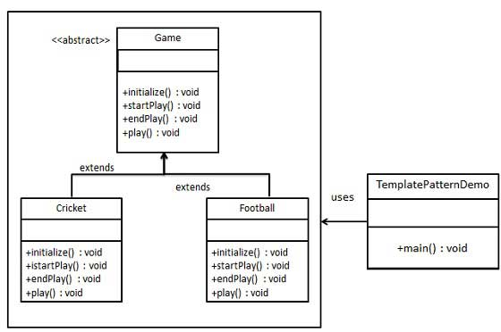
Simple Template Pattern Example
https://www.tutorialspoint.com/design_pattern/template_pattern.htm
CSCI 2600 Spring 2021
65
Notes:
65

Slide 66
public abstract class Game {
abstract void initialize();
abstract void startPlay();
abstract void endPlay();
//template method
public final void play(){
//initialize the game
initialize();
//start game
startPlay();
//end game
endPlay();
}
}
CSCI 2600 Spring 2021
66
Notes:
66

Slide 67
public class Cricket extends Game {
@Override
void endPlay() {
System.out.println("Cricket Game Finished!");
}
@Override
void initialize() {
System.out.println("Cricket Game Initialized! Start playing.");
}
@Override
void startPlay() {
System.out.println("Cricket Game Started. Enjoy the game!");
}
}
CSCI 2600 Spring 2021
67
Notes:
67

Slide 68
public class Football extends Game {
@Override
void endPlay() {
System.out.println("Football Game Finished!");
}
@Override
void initialize() {
System.out.println("Football Game Initialized! Start playing.");
}
@Override
void startPlay() {
System.out.println("Football Game Started. Enjoy the game!");
}
}
CSCI 2600 Spring 2021
68
Notes:
68

Slide 69
public class TemplatePatternDemo {
public static void main(String[] args) {
Game game = new Cricket();
game.play();
System.out.println();
game = new Football();
game.play();
}
}
Output:
Cricket Game Initialized! Start playing.
Cricket Game Started. Enjoy the game!
Cricket Game Finished!
Football Game Initialized! Start playing.
Football Game Started. Enjoy the game!
Football Game Finished!
CSCI 2600 Spring 2021
69
Notes:
69

Slide 70
The Form Template Method Refactoring
Before refactoring TextStatement.value and HtmlStatement.value are very similar
The “duplicate code” smell
Refactor to form a template method
Eliminates the “duplicate code” smell
CSCI 2600 Spring 2021
70
Notes:
70

Slide 71
The Form Template Method Refactoring
Decompose the methods using Extract Method so that all extracted methods are either identical among the different subclasses, or completely different
Use Pull Up Method (another refactoring!) to pull the identical methods, from one subclass, into the superclass
For the different methods use Rename Method
Make sure that each one has the same signature
Declare them as abstract in the superclass
Compile and test after the signature changes
Remove the other identical methods, compile and test after each removal
CSCI 2600 Spring 2021
71
Notes:
71

Slide 72
Form Template Method step 1: Extract Method
class TextStatement extends Statement { …
public String value(Customer c) {
Iterator<Rental> rentals = c.getRentals(); String result = “Rental Record for “ + getName()+ \n”; // new code (after Extract Method):
String result = headerString(c);
while (rentals.hasNext()) { Rental each = rentals.next(); result += …+each.getCharge()+…+“\n”;
new code: result += eachRentalString(each);
}
result +=… +getTotalCharge()+…+getFrequentRenterPoints();
new code: result += footerString(c);
return result;
}
CSCI 2600 Spring 2021
72
Notes:
The red parts are different for HtmlStatement.value(). Black are same. Key point: each extraction is done one by one: header, loop, footer
72

Slide 73
From Template Method, step 2: Pull Up Method
Now, pull up value(Customer) from TextStatement into Statement:
abstract class Statement {
public String value(Customer c) {
Iterator<Rental> rentals = c.getRentals(); String result = headerString(c);
while (rentals.hasNext()) { Rental each = rentals.next (); result += eachRentalString(each);
}
result += footerString(c);
return result;
}
}
CSCI 2600 Spring 2021
73
Notes:
Pull up common code to superclass
73

Slide 74
Form Template Method
Step 3: Make the hooks abstract in Statement
abstract String headerString(Customer c); abstract String eachRentalString(Rental each); abstract String footerString(Customer c);
Step 4: Compile and test!
Step 5: Remove value(Customer) from HtmlStatement. Compile and test!
CSCI 2600 Spring 2021
74
Notes:
74

Slide 75
There is coupling from Statement to Customer,
as value needs rentals and name from Customer
Statement
+ value(Customer) - headerString(…) - eachRentalString(…) - footerString(…)
Customer
+ statement() + htmlStatement() - getTotalCharge() - getTotalFreqRenterPoints()
1
TextStatement
headerString(…) eachRentalString(…) footerString(…)
HtmlStatement
headerString(…) eachRentalString(…) footerString(…)
*
Rental
+ getCharge() + getFreqRenterPoints()
CSCI 2600 Spring 2021
75
Notes:
75

Slide 76
One last refactoring. Back to getCharge(int)
class Regular extends Price { double getCharge(int daysRented) { double result = 2; if (daysRented > 2) result += (daysRented - 2)*1.5; return result; }
}
CSCI 2600 Spring 2021
76
Notes:
76

Slide 77
Replace Magic Number with Symbolic Constant
class Regular extends Price { final static double INTRO_DAYS = 2;
final static double INTRO_RATE = 1;
final static double REGULAR_RATE = 1.5;
double getCharge(int daysRented) { double result = INTRO_DAYS * INTRO_RATE; if (daysRented > INTRO_DAYS) result += (daysRented - INTRO_DAYS)*REGULAR_RATE; return result; }
}
CSCI 2600 Spring 2021
77
Notes:
77

