Slide 1
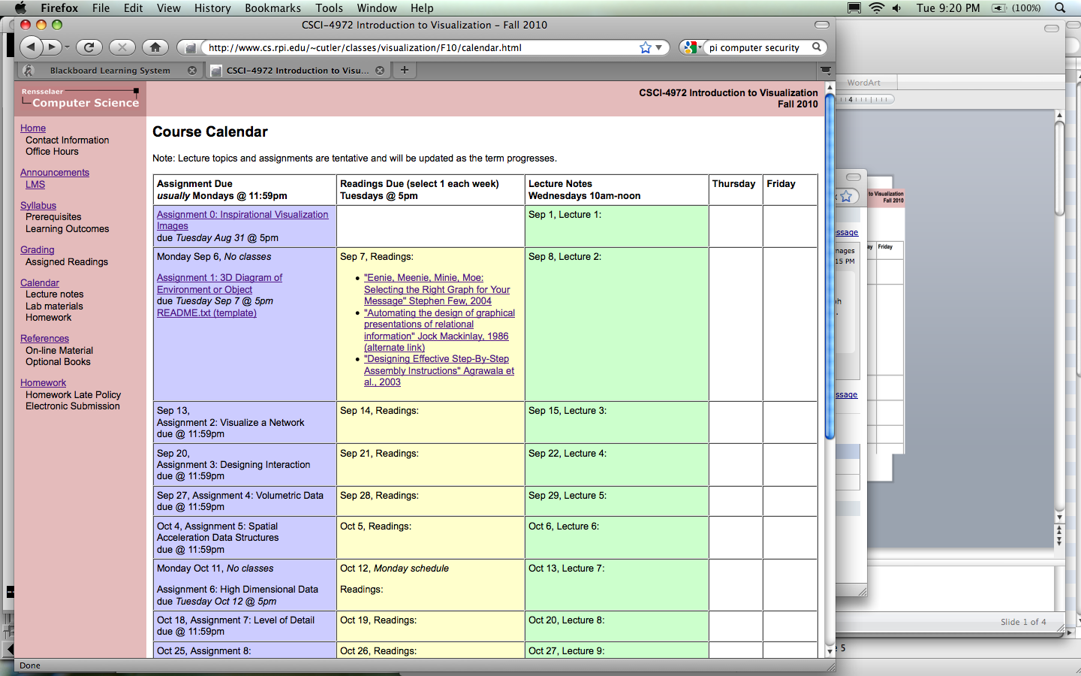
CSCI 4972 Introduction to Visualization Fall 2010
http://www.cs.rpi.edu/~cutler/classes/visualization/F10/

Slide 2
“Introduction” to Visualization: Where do we start?
Technology
Computer Graphics
how?
User Interface Design
Computation
Layout
Visualization
Simulation
Art
Graphic Design
Perception
what?
Color Theory
Science
Human Vision
why?

Slide 3
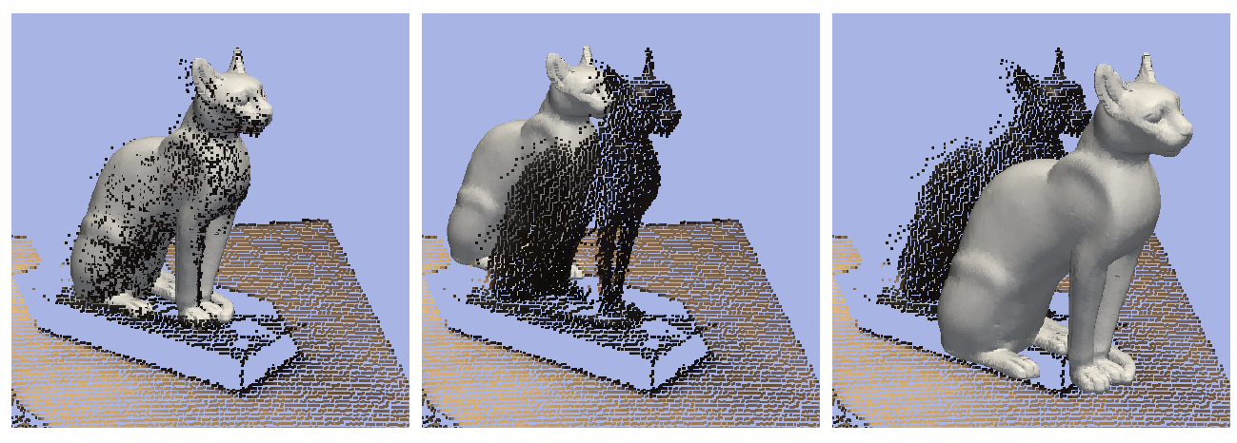
Introductions of People
Barb Cutler
Faculty in Computer Science
Computer Graphics & Computational Geometry & Architectural Design Tools
David Doria
PhD student in Electrical, Computer, & Systems Engineering
Research in Computer Vision & Point Cloud Data
VTK contributer
And you?
Major/Research Area
Skills & Strengths

Slide 4
Course Structure
Homework Assignments in VTK
Design Critiques
Final Project Presentation in EMPAC
Readings
Online Posts & Discussions
Application to your area of interest/study/research

Slide 5
Readings (20%)
Several readings (typically academic research papers in visualization) assigned each week
Select one paper and read it carefully
If the paper is too advanced, pick one concept from the paper and use Google/Wikipedia/etc. to read more about that concept
Make a post about the paper on LMS focusing on what you learned by Tuesday @5pm
Join the online discussion of the papers

Slide 6
Participation & Presentations (15%)
Contribute to in-class & online discussions ☺
Each student will do a 3 minute presentation of one of the readings during the semester
Focus on the contributions of the paper
Summarize the online discussion

Slide 7
Homework Assignments (35%)
Weekly programming assignments
In C++ using the VTK libraries
We’ll start working on the homework during the last half of each Wednesday class period (bring your laptop to class)
Generally due on Mondays @ 11pm
Individual & team-based assignments
Creativity & thoughtful design encouraged and will be rewarded

Slide 8
Final Project (20%)
Topic of your choice
Team projects *highly* encouraged
Last 5 weeks of the semester
Presentation/Demonstration in EMPAC Studio 2

Slide 9
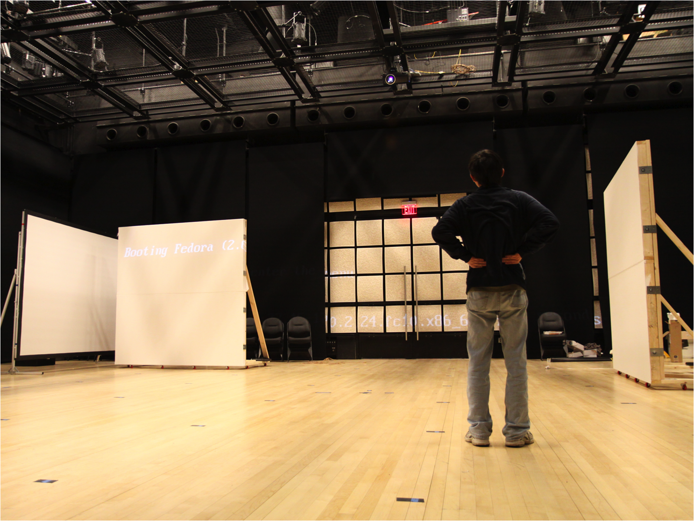
EMPAC Studio 2

Slide 10
Today’s Class
Webpage, Syllabus, Course Structure, etc.
Learning Outcomes
Highlights from Assignment #0
Readings for Next Week
VTK Overview
Using Transformations

Slide 11
Learning Outcomes
Analyze, interpret, and evaluate a specific visualization example and discuss how the visualization might be improved for more accurate interpretation or communication of patterns in the data.
Select or design an effective visualization strategy for a variety of different types of data.
Create a visualization of a new dataset using available open-source visualization resources.
Use visualization to communicate results of experiments and research in their field of study.
Incorporate visualization for debugging and improved program development or experimental data analysis in their field of study.

Slide 12
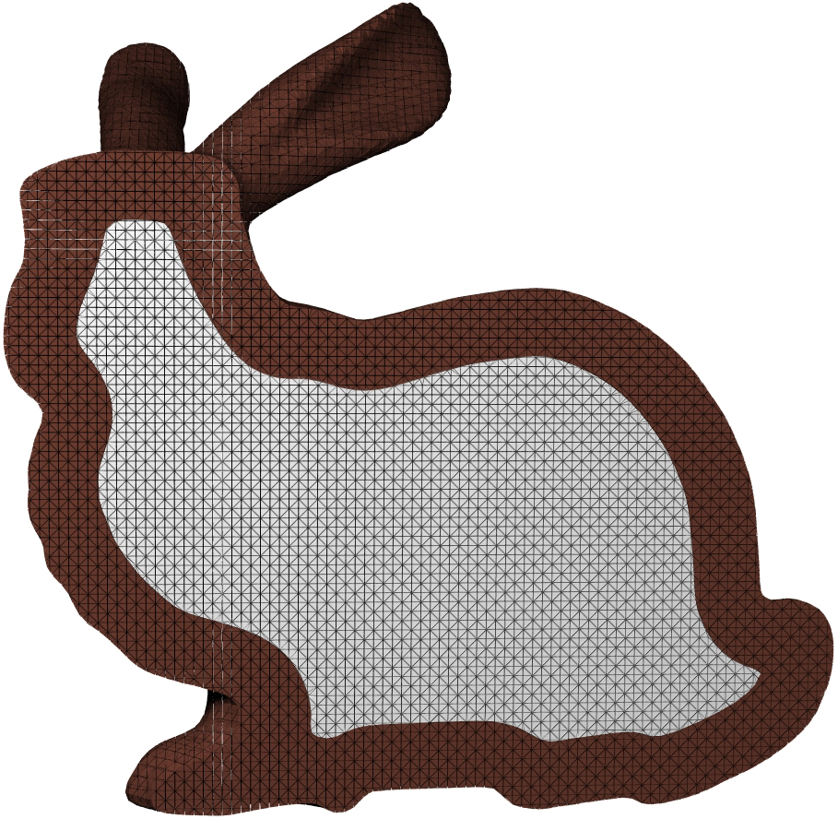
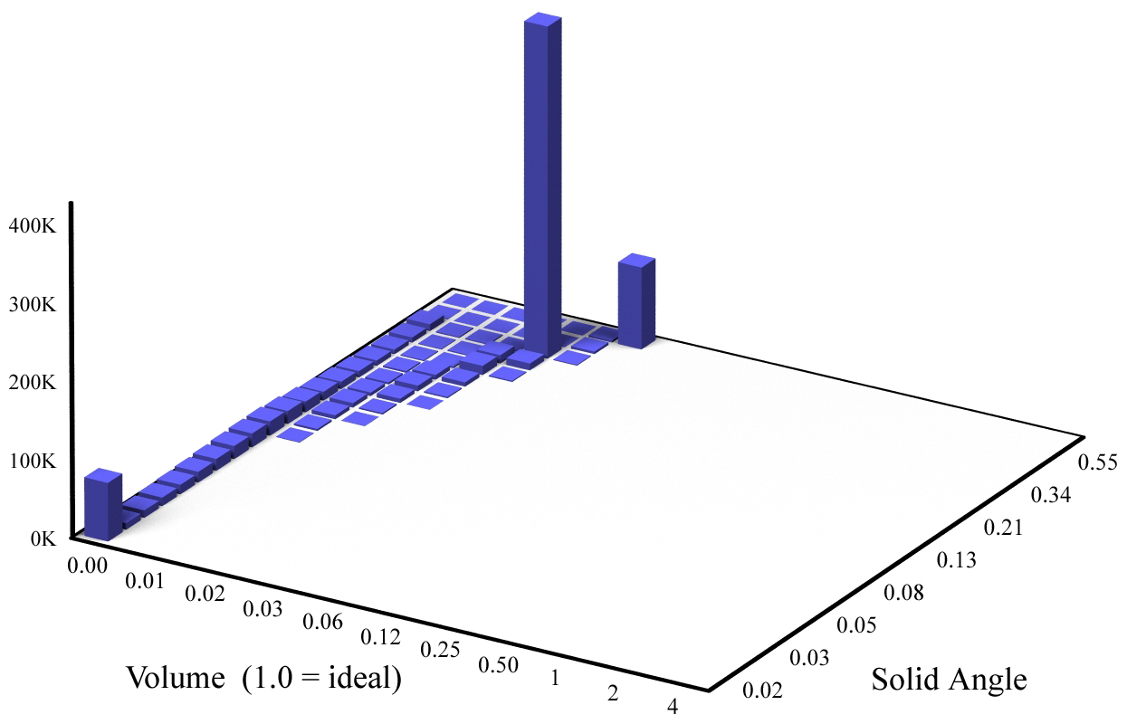
Visualization of Tetrahedra Quality
good angle, but small-volume
1,050K tetras (133K faces)
zero-angle & zero-volume
near-equilateral & ideal-volume

Slide 13
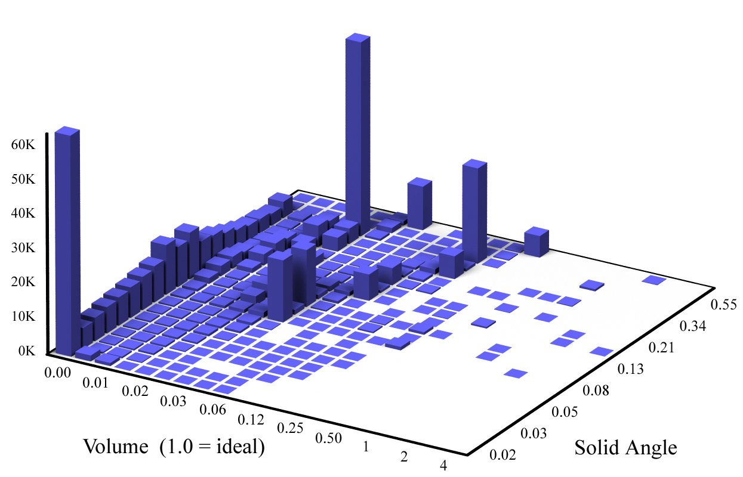
Visualization of Tetrahedra Quality
Octree or Adaptive Distance Field (ADF)
461K tetras (108K faces)

Slide 14
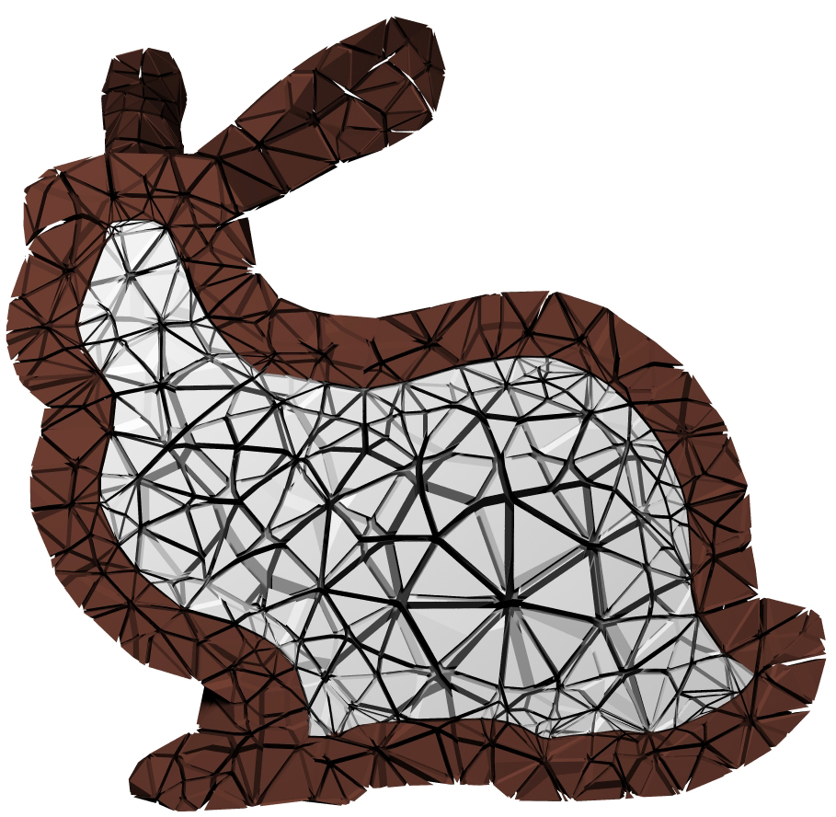
Visualization of Tetrahedra Quality
After Simplification & Mesh Improvement
10K tetras (3K faces)

Slide 15
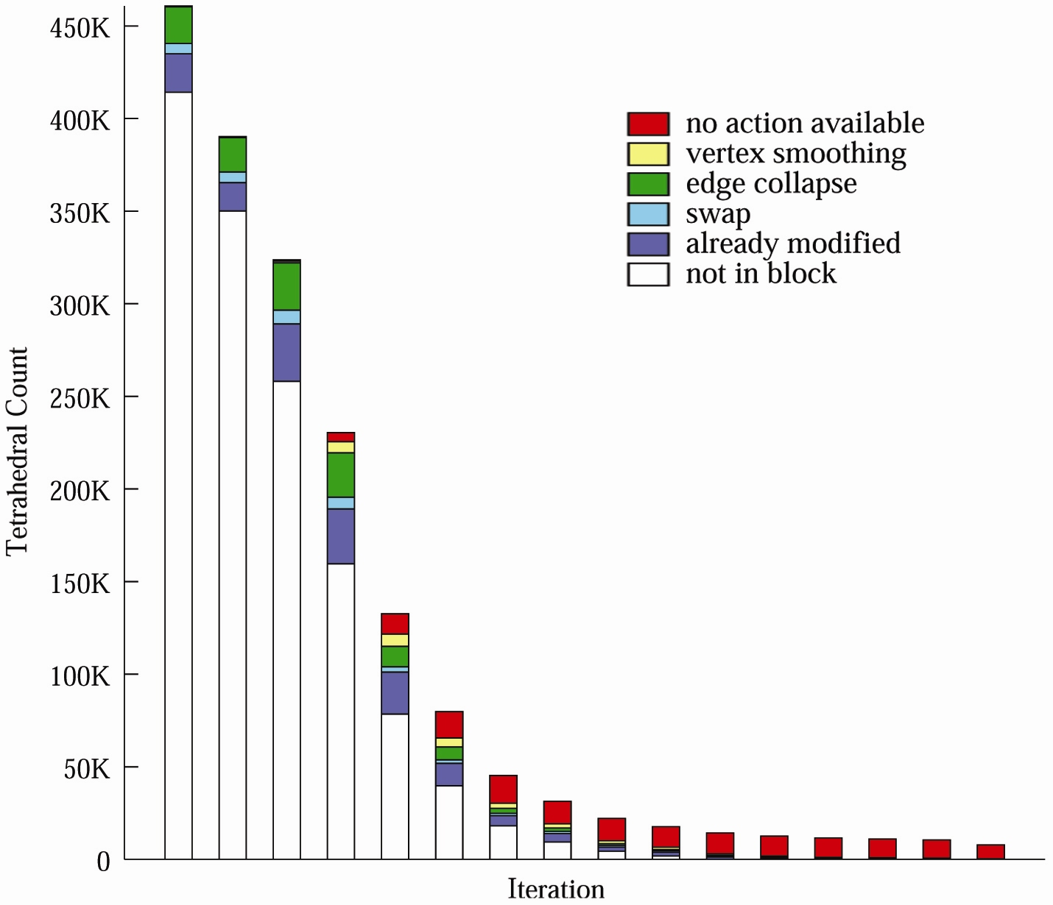
Visualization of Simplification Algorithm

Slide 16
Today’s Class
Webpage, Syllabus, Course Structure, etc.
Learning Outcomes
Highlights from Assignment #0
Readings for Next Week
VTK Overview
Using Transformations

Slide 17
Visualization Design Principles
Scientific Visualization vs. Information Visualization
Simple clean design vs. “Chart Junk”
Managing & leveraging huge amounts of data
Understanding your Audience
E.g., Visualization for Science, Communication, Education, Debugging, etc.
Importance of companion text (title, axis labels, legend, caption)
Targeting visualization design to human perception & low-level vision processing

Slide 18
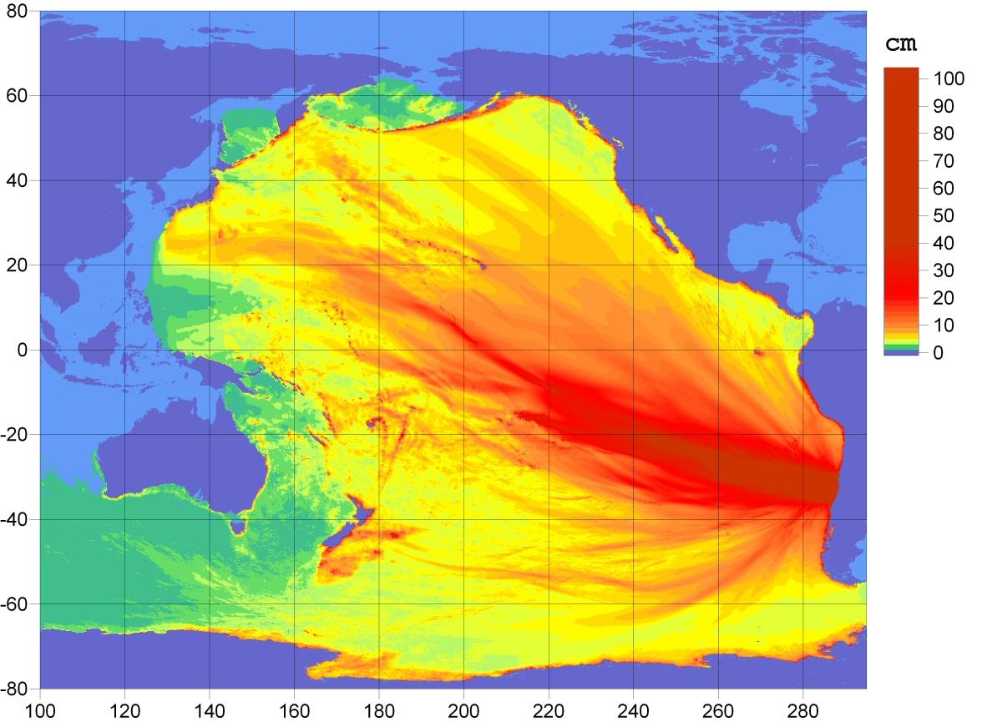

Slide 19
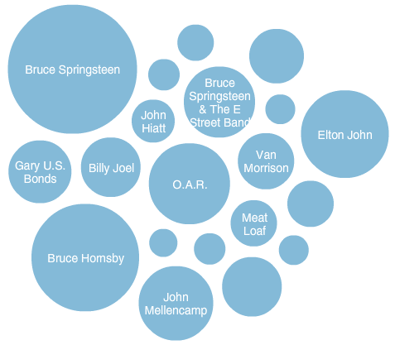

Slide 20
Visualization Design Principles
Scientific Visualization vs. Information Visualization
Simple clean design vs. “Chart Junk”
Managing & leveraging huge amounts of data
Understanding your Audience
E.g., Visualization for Science, Communication, Education, Debugging, etc.
Importance of companion text (title, axis labels, legend, caption)
Targeting visualization design to human perception & low-level vision processing

Slide 21
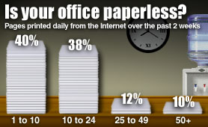

Slide 22
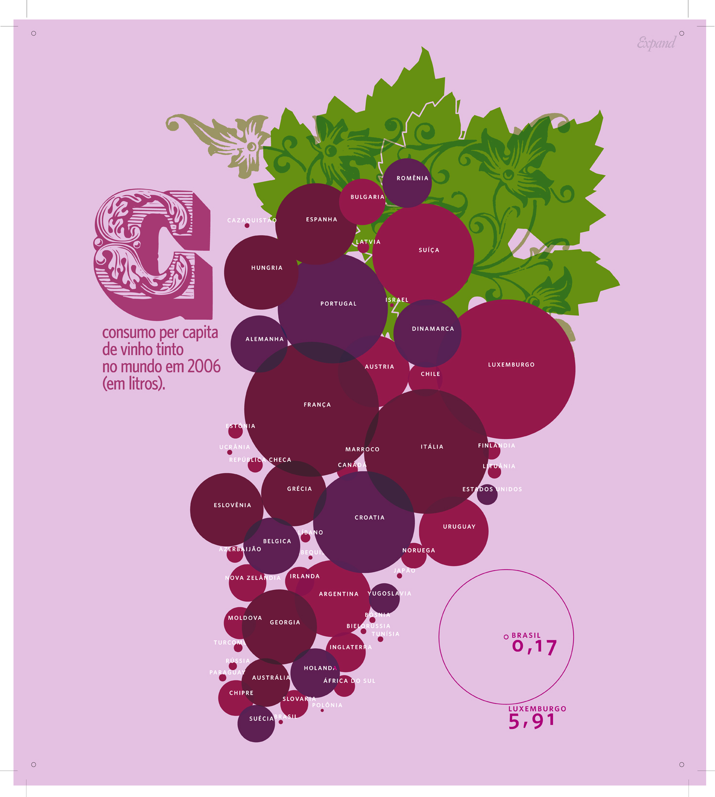

Slide 23
Visualization Design Principles
Scientific Visualization vs. Information Visualization
Simple clean design vs. “Chart Junk”
Managing & leveraging huge amounts of data
Understanding your Audience
E.g., Visualization for Science, Communication, Education, Debugging, etc.
Importance of companion text (title, axis labels, legend, caption)
Targeting visualization design to human perception & low-level vision processing

Slide 24
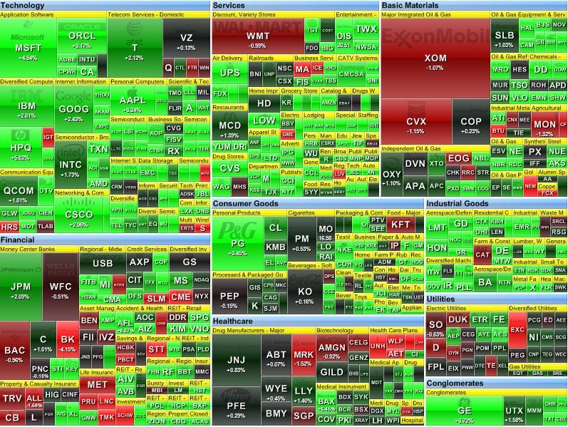

Slide 25
Visualization Design Principles
Scientific Visualization vs. Information Visualization
Simple clean design vs. “Chart Junk”
Managing & leveraging huge amounts of data
Understanding your Audience
E.g., Visualization for Science, Communication, Education, Debugging, etc.
Importance of companion text (title, axis labels, legend, caption)
Targeting visualization design to human perception & low-level vision processing

Slide 26
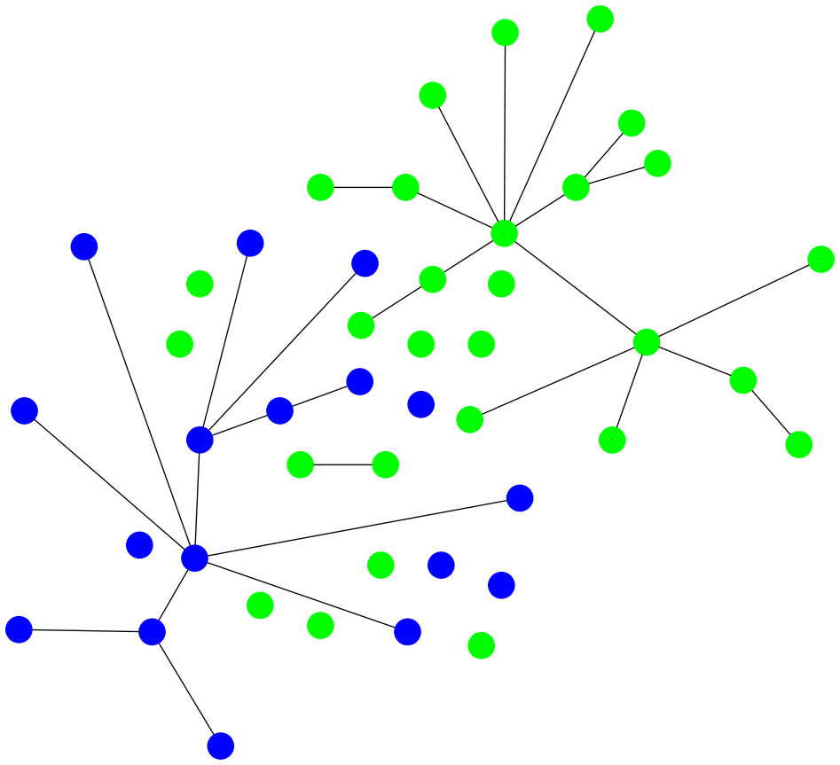

Slide 27
Visualization Design Principles
Scientific Visualization vs. Information Visualization
Simple clean design vs. “Chart Junk”
Managing & leveraging huge amounts of data
Understanding your Audience
E.g., Visualization for Science, Communication, Education, Debugging, etc.
Importance of Companion text (title, axis labels, legend, caption)
Targeting visualization design to human perception & low-level vision processing

Slide 28
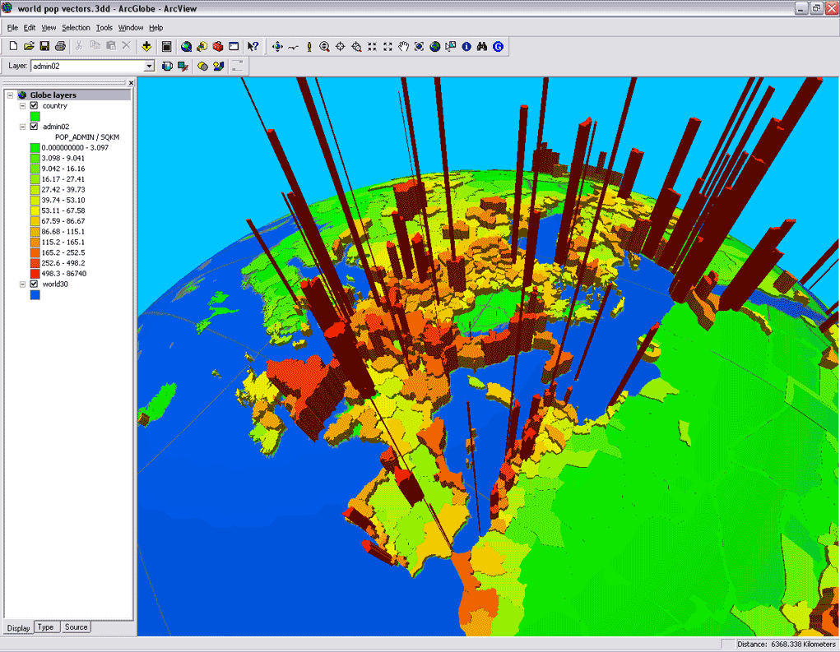

Slide 29
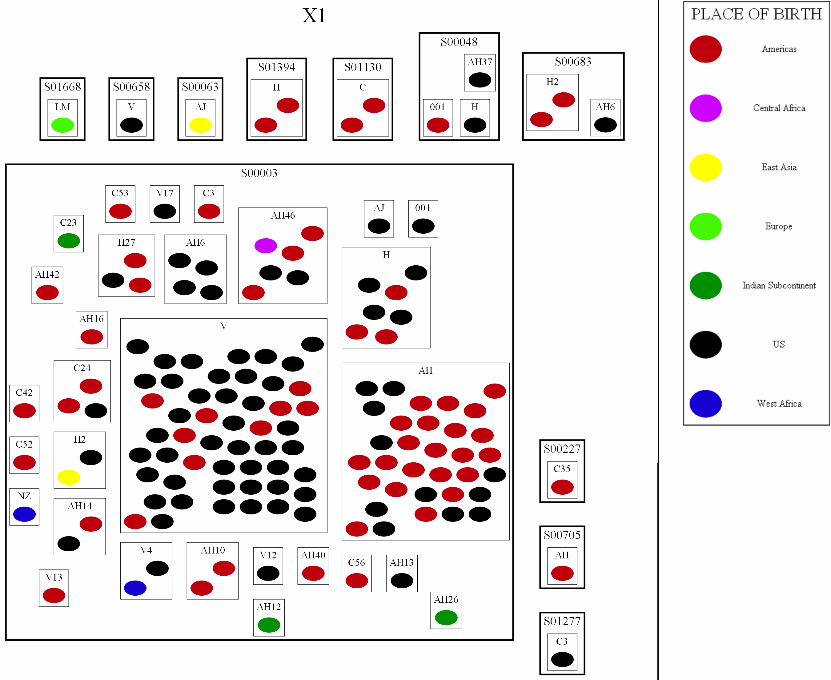

Slide 30
Visualization Design Principles
Scientific Visualization vs. Information Visualization
Simple clean design vs. “Chart Junk”
Managing & leveraging huge amounts of data
Understanding your Audience
E.g., Visualization for Science, Communication, Education, Debugging, etc.
Importance of companion text (title, axis labels, legend, caption)
Targeting visualization design to human perception & low-level vision processing

Slide 31
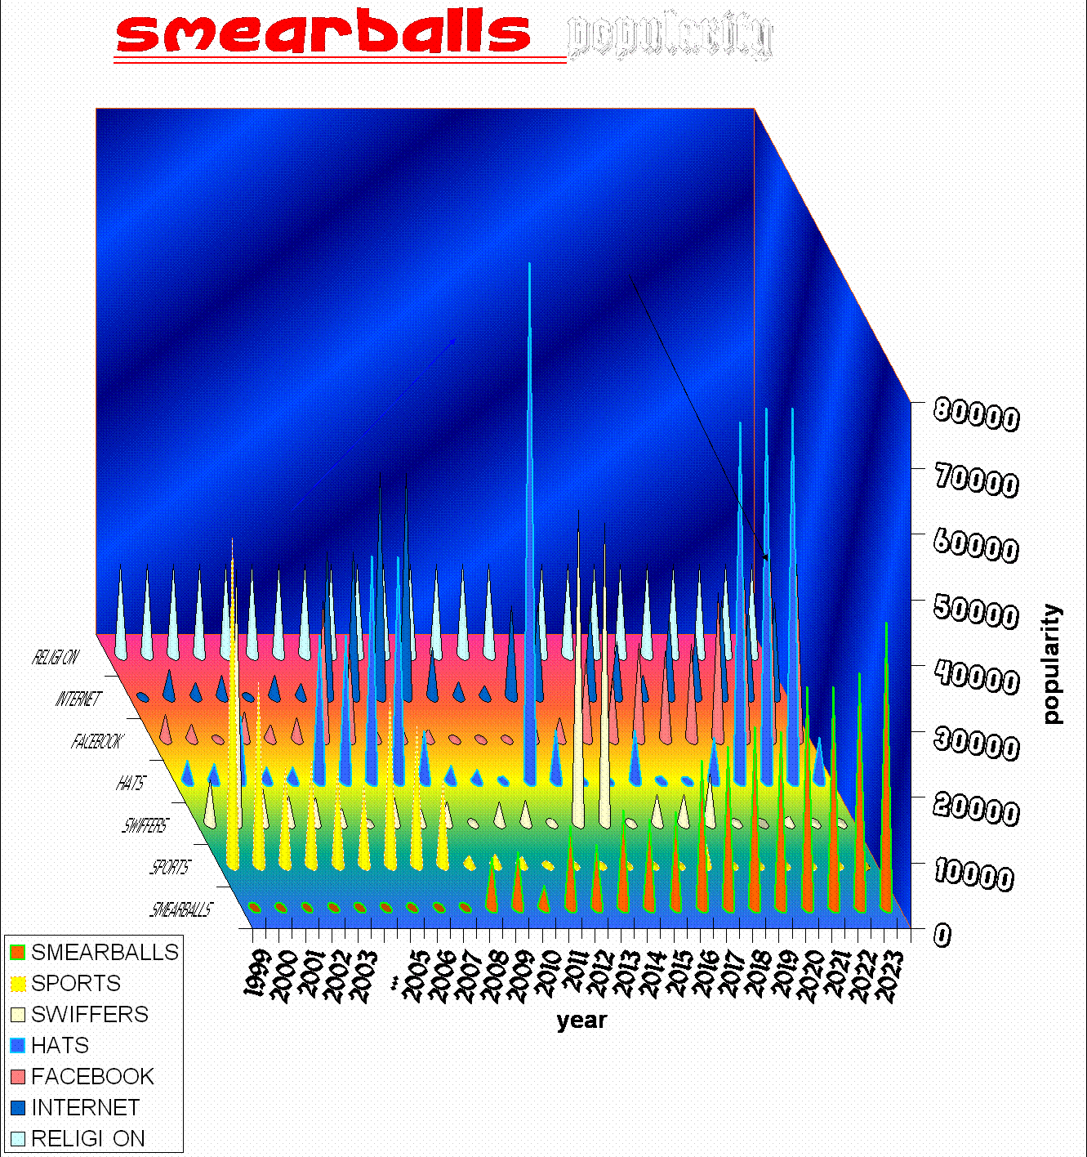

Slide 32
Today’s Class
Webpage, Syllabus, Course Structure, etc.
Learning Outcomes
Highlights from Assignment #0
Readings for Next Week
VTK Overview
Using Transformations

Slide 33
Readings for Next Week:
"Eenie, Meenie, Minie, Moe: Selecting the Right Graph for Your Message" Stephen Few, 2004

Slide 34
Readings for Next Week:
"Automating the design of graphical presentations of relational information" Jock Mackinlay, 1986

Slide 35
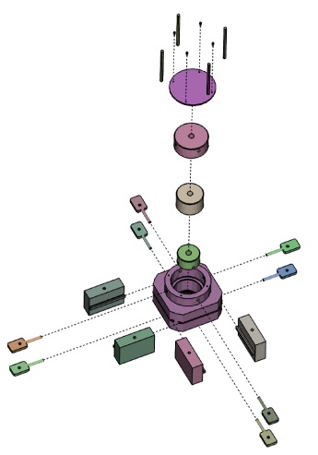
Readings for Next Week:
"Designing Effective Step-By-Step Assembly Instructions" Agrawala et al., 2003

Slide 36
Today’s Class
Webpage, Syllabus, Course Structure, etc.
Learning Outcomes
Highlights from Assignment #0
Readings for Next Week
VTK Overview
Using Transformations

Slide 37
Introduction To VTK: Overview

Slide 38
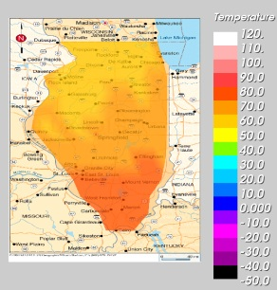
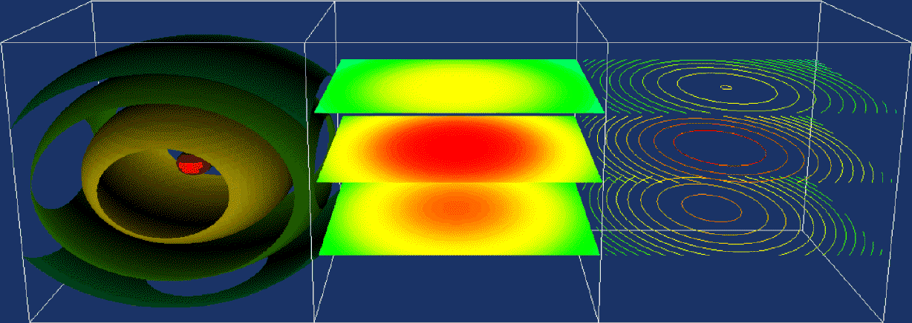
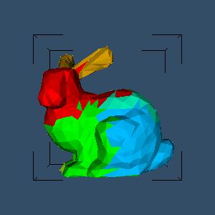
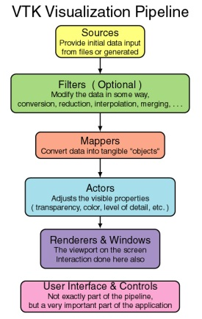
Outline
What is VTK?
What can it do?
Typical workflow – (the “pipeline”)

Slide 39
Visualization ToolKit
Scientific visualization
Information visualization
Written in c++
C++, Java, Python, Tcl API’s
Much more than that:
Excellent framework for scientific programming

Slide 40
Basic Terminology
Taken from: http://www.cs.uic.edu/~jbell/CS526/Tutorial/Tutorial.html

Slide 41
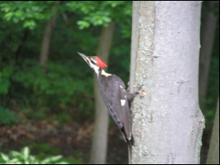
Sources
The source of data flowing through the visualization pipeline
Two types (not distinguished)
Readers: read data out of files in a wide variety of formats (images, 3D data, just about anything you can think of)
Generative sources: generate data based on input parameters. (E.g. a cone source, which generates information describing a cone, given its radius and height.)
Source
To pipeline…

Slide 42
Filters
Components that receive data from other components
Modify the data in some way
Deliver the modified data as output to be used by other components
Source
Triangulate filter

Slide 43
Filter Connections
Can have multiple input and output connections
Filter
Input 0
Output 0
…
…
Input N
Output N
Set/get outputs with:
filter->SetInputConnection(someFilter->GetOutputPort());
If the input is an object, not a filter, use:
filter->SetInputConnection(someObject->GetProducerPort());

Slide 44
Mappers
VTK conceptually divides the pipeline into two segments
Data processing – consists of sources and filters
Rendering – consists of actors, renderers, and windows (OpenGL and OS style things)
Mappers serve as the transition between the two segments
Data
Actor
Mapper

Slide 45
Actors
Components that allow for the adjustment and control of the appearance properties (color, thickness, etc) of objects rendered onto the screen
Source
Mapper/actor
Notes:
The term "actor" comes from analogy with the stage - The actor is a physical representation of the data, "standing" on the "stage" ( appearing in the rendering window ), whose appearance can be modified through lighting, makeup, costumes, etc. )

Slide 46
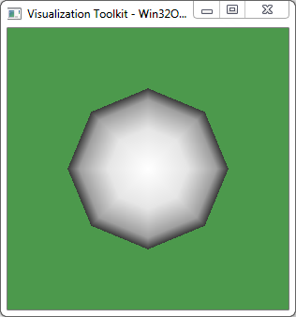
Renderer and RenderWindow
The end of the pipeline – display your work on the screen
Renderer
World to Screen coordinate conversions
Lighting
RenderWindow
“Contains” a renderer
Set the window size/title/etc
Source
Mapper/actor
Renderer/RenderWindow

Slide 47
RenderWindowInteractor
Determine how user actions affect the scene
Right now, you just need to call Start() to display the RenderWindow
More on this in a later class…

Slide 48
Updating the Pipeline
VTK components do not normally generate their output until requested to do so
To update the pipeline, call Update() on the object that you want to update!
This will cause the pipeline to issue an Update() request to all if its inputs, which will in turn issue Update() requests to all of their inputs, and so on

Slide 49
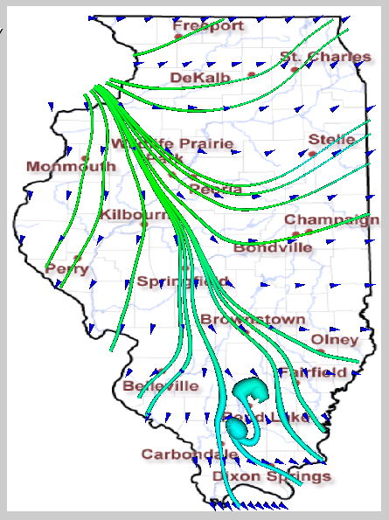
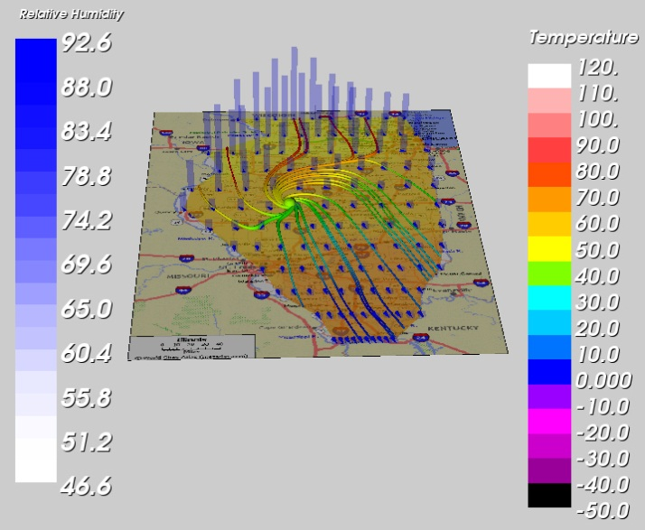
Examples: Weather

Slide 50
Examples: Mathematics
F(x,y,z) = a₀x² + a₁y² + a₂z² + a₃xy + a₄yz + a₅xz + a₆x + a₇y + a₈z + a₉

Slide 51
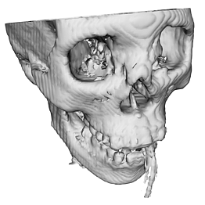
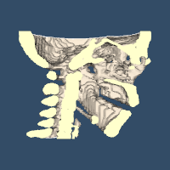
Examples: Medical Data

Slide 52
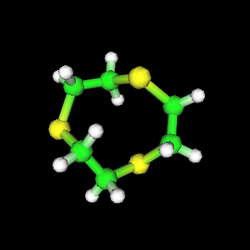
Examples: Chemistry

Slide 53
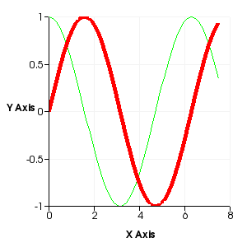
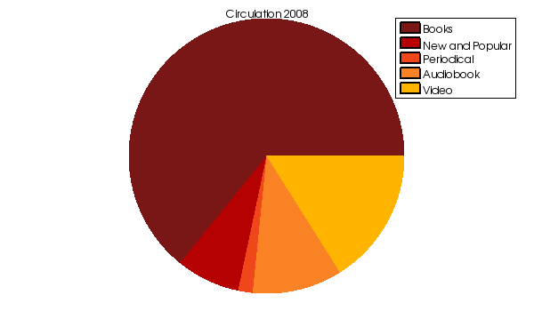
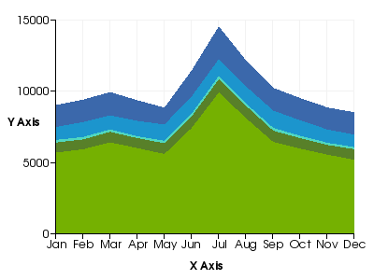
Examples: “Excel style” plots

Slide 54
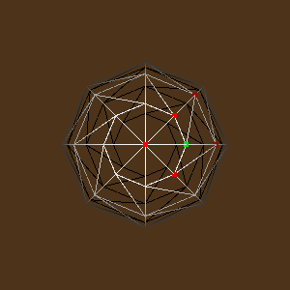
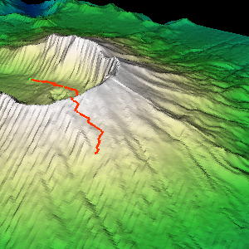
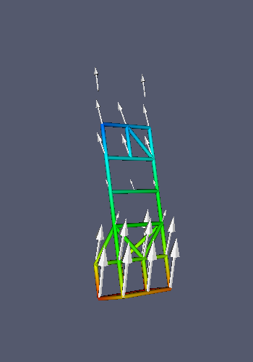
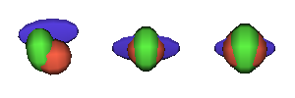
Examples: Generic data visualization

Slide 55
What does the code look like?
#include <vtkSphereSource.h>
#include <vtkPolyData.h>
#include <vtkSmartPointer.h>
#include <vtkPolyDataMapper.h>
#include <vtkActor.h>
#include <vtkRenderWindow.h>
#include <vtkRenderer.h>
#include <vtkRenderWindowInteractor.h>
int main(int , char *[])
{
//Create a sphere
vtkSmartPointer<vtkSphereSource> sphereSource =
vtkSmartPointer<vtkSphereSource>::New();
sphereSource->SetCenter(0.0, 0.0, 0.0);
sphereSource->SetRadius(5.0);
//Create a mapper and actor
vtkSmartPointer<vtkPolyDataMapper> mapper =
vtkSmartPointer<vtkPolyDataMapper>::New();
mapper->SetInputConnection(sphereSource->GetOutputPort());
vtkSmartPointer<vtkActor> actor =
vtkSmartPointer<vtkActor>::New();
actor->SetMapper(mapper);
//Create a renderer, render window, and interactor
vtkSmartPointer<vtkRenderer> renderer =
vtkSmartPointer<vtkRenderer>::New();
vtkSmartPointer<vtkRenderWindow> renderWindow =
vtkSmartPointer<vtkRenderWindow>::New();
renderWindow->AddRenderer(renderer);
vtkSmartPointer<vtkRenderWindowInteractor> renderWindowInteractor =
vtkSmartPointer<vtkRenderWindowInteractor>::New();
renderWindowInteractor->SetRenderWindow(renderWindow);
//Add the actor to the scene
renderer->AddActor(actor);
renderer->SetBackground(.3, .6, .3); // Background color green
//Render and interact
renderWindow->Render();
renderWindowInteractor->Start();
return EXIT_SUCCESS;
}

Slide 56
Code Breakdown: Includes
Get used to seeing long lists of includes. This is about the minimal set.
#include <vtkSphereSource.h>
#include <vtkPolyData.h>
#include <vtkSmartPointer.h>
#include <vtkPolyDataMapper.h>
#include <vtkActor.h>
#include <vtkRenderWindow.h>
#include <vtkRenderer.h>
#include <vtkRenderWindowInteractor.h>

Slide 57
Code Breakdown: Objects
//Create a sphere
vtkSphereSource* sphereSource =
vtkSphereSource::New();
sphereSource->SetCenter(0.0, 0.0, 0.0);
sphereSource->SetRadius(5.0);
sphereSource->Update();
//Equivalent using smart pointers
vtkSmartPointer<vtkSphereSource> sphereSource =
vtkSmartPointer<vtkSphereSource>::New();
sphereSource->SetCenter(0.0, 0.0, 0.0);
sphereSource->SetRadius(5.0);
sphereSource->Update();

Slide 58
Code Breakdown: Rendering “Stuff”
(Luckily, this is usually a “copy/paste” with a few name replacements!)
//Create a mapper and actor
vtkSmartPointer<vtkPolyDataMapper> mapper =
vtkSmartPointer<vtkPolyDataMapper>::New();
mapper->SetInputConnection(sphereSource->GetOutputPort());
vtkSmartPointer<vtkActor> actor =
vtkSmartPointer<vtkActor>::New();
actor->SetMapper(mapper);
//Create a renderer, render window, and interactor
vtkSmartPointer<vtkRenderer> renderer =
vtkSmartPointer<vtkRenderer>::New();
vtkSmartPointer<vtkRenderWindow> renderWindow =
vtkSmartPointer<vtkRenderWindow>::New();
renderWindow->AddRenderer(renderer);
vtkSmartPointer<vtkRenderWindowInteractor> renderWindowInteractor =
vtkSmartPointer<vtkRenderWindowInteractor>::New();
renderWindowInteractor->SetRenderWindow(renderWindow);
//Add the actor to the scene
renderer->AddActor(actor);
renderer->SetBackground(.3, .6, .3); // Background color green
//Render and interact
renderWindow->Render();
renderWindowInteractor->Start();

Slide 59
Today’s Class
Webpage, Syllabus, Course Structure, etc.
Learning Outcomes
Highlights from Assignment #0
Readings for Next Week
VTK Overview
Using Transformations

Slide 60
Introduction to VTK: Transforms

Slide 61
Types of Transforms
Basic transforms include:
“Rigid” transforms
Translation
Rotation
“Similarity” transformations
Scale

Slide 62
Translation

Slide 63
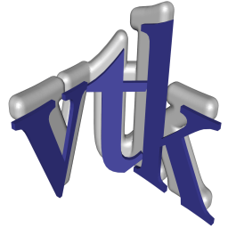
Rotation

Slide 64
Scale

Slide 65
Order is Important!
A translation followed by a rotation typically does not produce the same result as a rotation followed by a translation
This is because the rotation is performed on the whole space around the world origin
transform->PostMultiply() makes operations behave in the order that you specify them

Slide 66
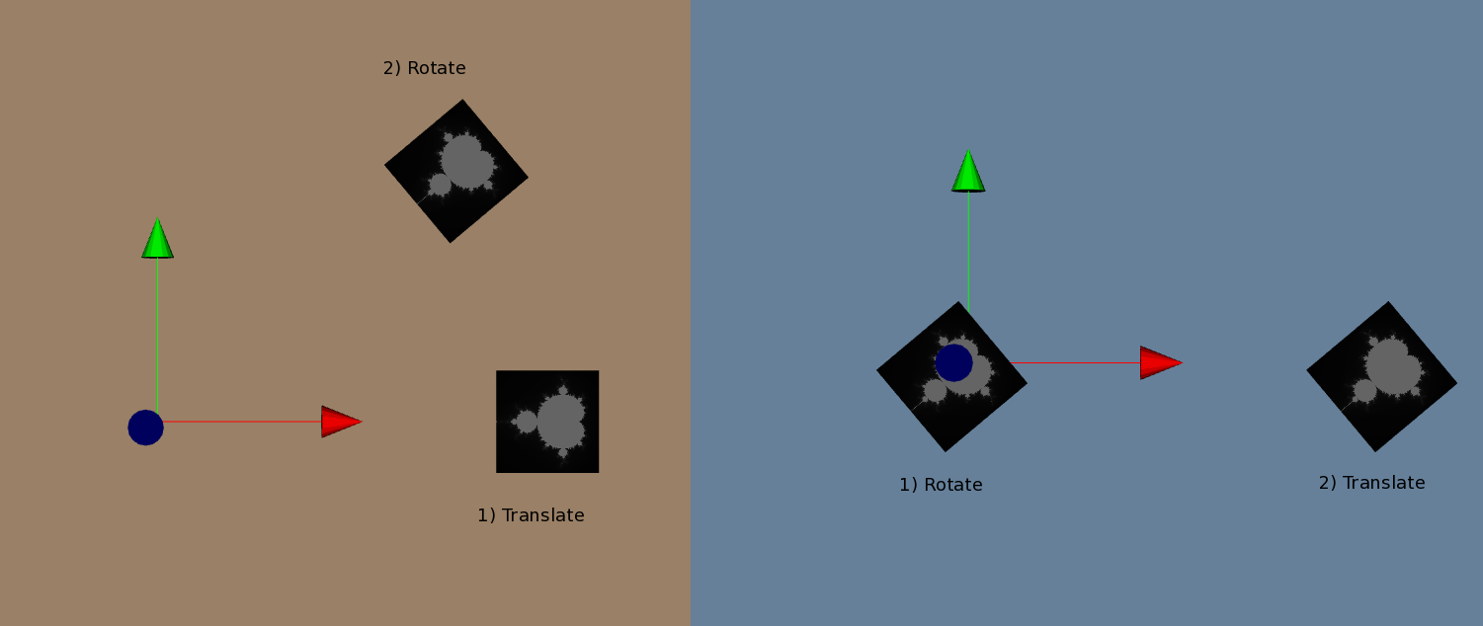
Order is Important Demo
Translation Then Rotation
Rotation Then Translation
http://www.vtk.org/Wiki/VTK/Examples/Cxx/PolyData/TransformOrder

Slide 67
Transformations in VTK
Can apply transformation either to the data itself (before Mapper) or to an Actor
Why transform data?
You have access to the numerical result
Why transform actor?
Faster
Can have multiple instances of the same data
In either case, there is no reason to ever look at a transformation matrix

Slide 68
Transforming Data
Construct a vtkTransform and then apply it with vtkTransformPolyDataFilter
vtkSmartPointer<vtkTransform> transformation=
vtkSmartPointer<vtkTransform>::New();
transformation >Translate(double x, double y, double z);
transformation ->RotateX(double angle);
transformation ->Scale(double x, double y, double z);
vtkSmartPointer<vtkTransformPolyDataFilter> transformFilter =
vtkSmartPointer<vtkTransformPolyDataFilter>::New();
transformFilter->SetInputConnection(sphereSource->GetOutputPort()); transformFilter->SetTransform(translation);
transformFilter->Update();

Slide 69
Transforming Actor
Construct a vtkTransform and then apply it directly to an actor
vtkSmartPointer<vtkTransform> transform =
vtkSmartPointer<vtkTransform>::New();
transform->RotateZ(90.0);
actor->SetUserTransform(transform);

