Slide 1
VTK Graphs Cmake & Git

Slide 2
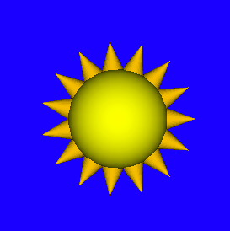
Today’s Class
Highlights from HW #1
This Week’s Readings
Next Week’s Readings
VTK Graphs
Intro to Cmake
Intro to Git

Slide 3
Collision detection: Is it easy to do? Is it necessary?

Slide 4
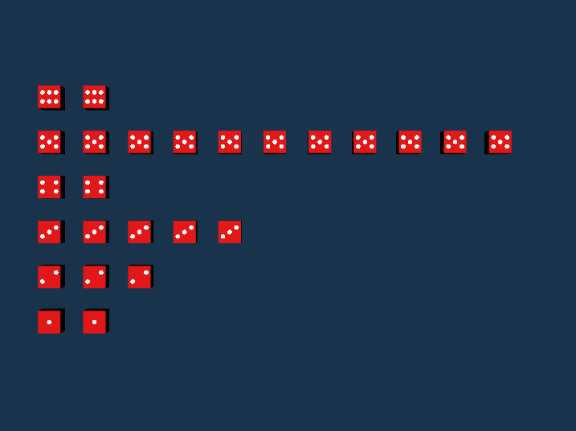
Do you like VTK’s automatic camera placement?
What else does make easy?

Slide 5
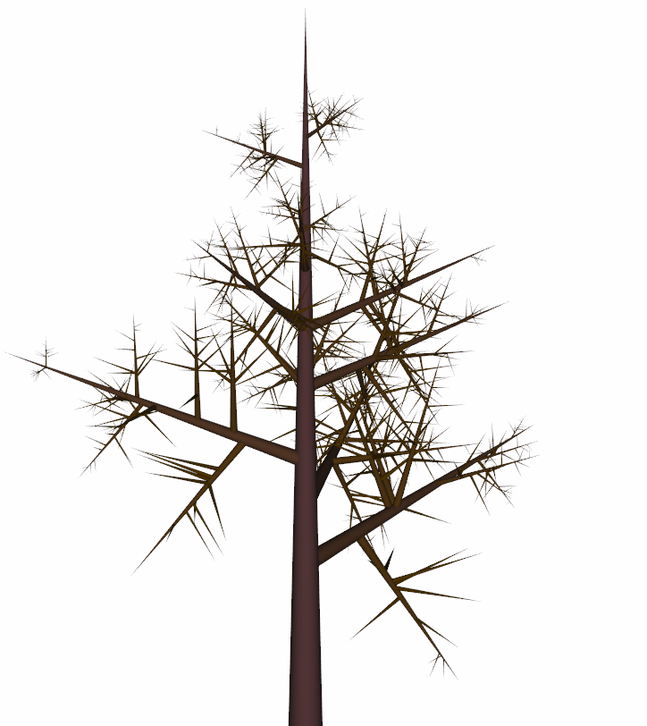
Hierarchy of Transformation?
Any VTK Tips/Tricks?

Slide 6
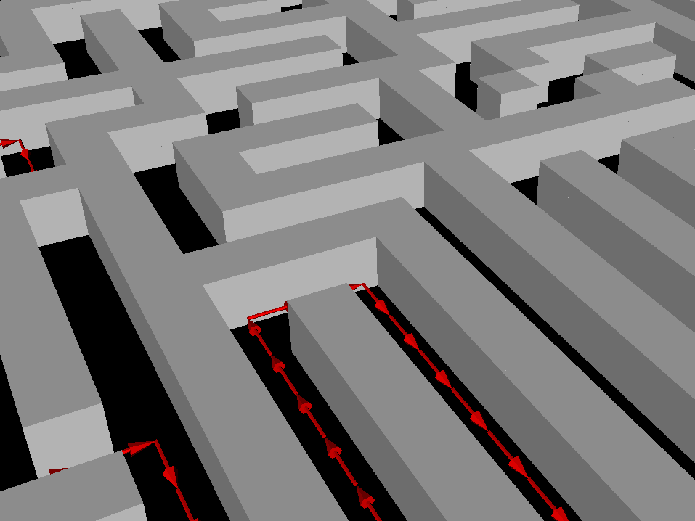
Visualization for Debugging: Would this help you study & debug a maze solving algorithm?

Slide 7
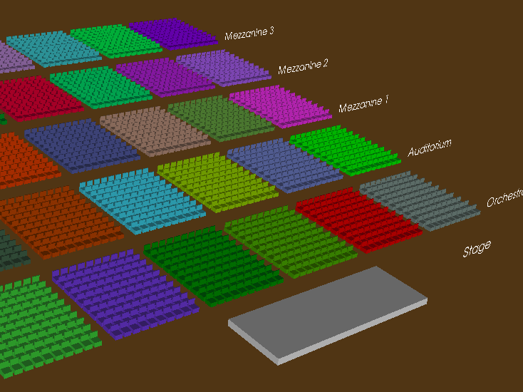
How did performance scale with this much geometry?

Slide 8
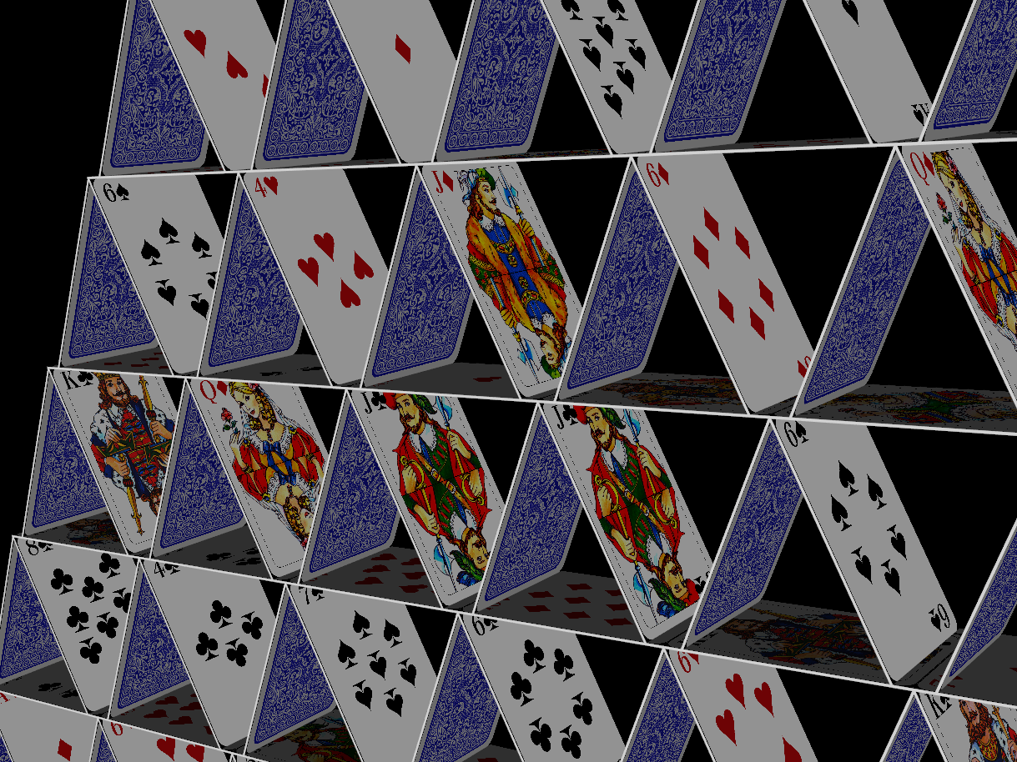
How do you do textures? What was most challenging technical detail?

Slide 9
Today’s Class
Highlights from HW #1
This Week’s Readings
Next Week’s Readings
VTK Graphs
Intro to Cmake
Intro to Git

Slide 10
Readings for This Week:
"Eenie, Meenie, Minie, Moe: Selecting the Right Graph for Your Message" Stephen Few, 2004

Slide 11
Readings for This Week:
"Automating the design of graphical presentations of relational information" Jock Mackinlay, 1986

Slide 12
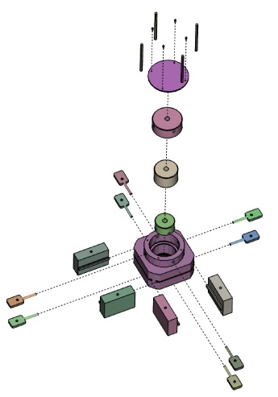
Readings for This Week:
"Designing Effective Step-By-Step Assembly Instructions" Agrawala et al., 2003

Slide 13
Today’s Class
Highlights from HW #1
This Week’s Readings
Next Week’s Readings
VTK Graphs
Intro to Cmake
Intro to Git

Slide 14
Readings for Next Week:
"Graph drawing by force-directed placement", Fruchterman & Reingold, 1991

Slide 15
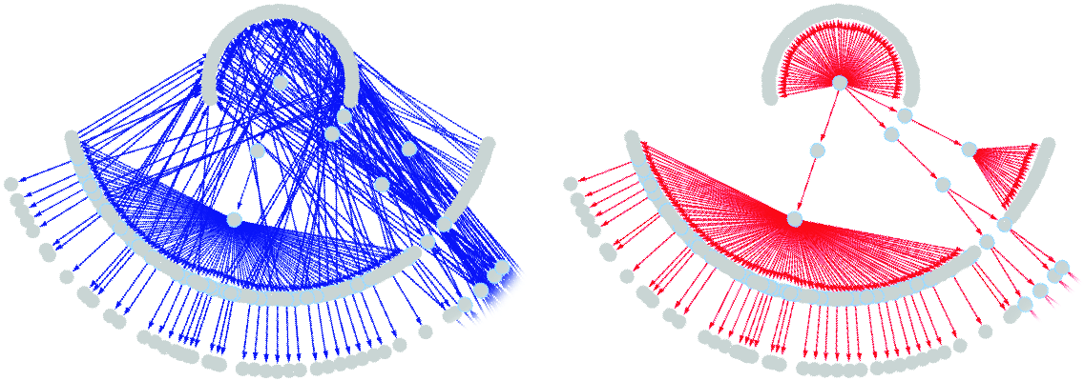
Readings for Next Week:
"Heapviz: Interactive Heap Visualization for Program Understanding and Debugging” Aftandilian, Kelley, Gramazio, Ricci, Su, & Guyer, 2010

Slide 16
Today’s Class
Highlights from HW #1
This Week’s Readings
Next Week’s Readings
VTK Graphs
Intro to Cmake
Intro to Git

Slide 17
Introduction to VTK: Graphs

Slide 18
Graph Theory 101
A graph consists of:
Edges – the “points”
Vertices – the “lines”

Slide 19
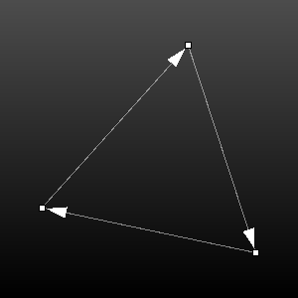
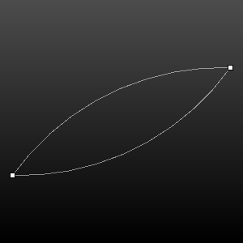
Types of Graphs
Directed
One vertex “points” to another
Undirected
Two vertices are connected (they both point to each other)

Slide 20
Graphs in VTK
http://www.vtk.org/Wiki/VTK/Examples/Cxx#Graphs

Slide 21
Constructing Graphs
http://www.vtk.org/Wiki/VTK/Examples/Cxx/Graphs/VisualizeGraph
Use these to construct graphs
vtkMutableUndirectedGraph
vtkMutableDirectedGraph
vtkSmartPointer<vtkMutableUndirectedGraph> g =
vtkSmartPointer<vtkMutableUndirectedGraph>::New();
vtkIdType v1 = g->AddVertex();
vtkIdType v2 = g->AddVertex();
g->AddEdge ( v1, v2 );

Slide 22
Graph Data
VertexData
You can store data for every vertex
Colors, ids, names, etc
graph->GetVertexData()->AddArray(yourFavoriteArray);
EdgeData
You can store data for every edge
Edge weights, colors, etc
graph->GetEdgeData()->AddArray(yourFavoriteArray);
http://www.vtk.org/Wiki/VTK/Examples/Cxx/Graphs/EdgeWeights

Slide 23
Graph Data: Example
… Create a graph with 3 vertices and 3 edges …
// Create the edge weight array
vtkSmartPointer<vtkDoubleArray> weights =
vtkSmartPointer<vtkDoubleArray>::New();
weights->SetNumberOfComponents(1);
weights->SetName("Weights");
// Set the edge weights
weights->InsertNextValue(1.0);
weights->InsertNextValue(1.0);
weights->InsertNextValue(2.0);
// Create the vertex id array
vtkSmartPointer<vtkIntArray> vertexIDs =
vtkSmartPointer<vtkIntArray>::New();
vertexIDs->SetNumberOfComponents(1);
vertexIDs->SetName("VertexIDs");
// Set the vertex ids
vertexIDs->InsertNextValue(0);
vertexIDs->InsertNextValue(1);
vertexIDs->InsertNextValue(2);
// Add the edge weight array to the graph
g->GetEdgeData()->AddArray(weights);
g->GetVertexData()->AddArray(vertexIDs);

Slide 24
Displaying Graphs
http://www.vtk.org/Wiki/VTK/Examples/Cxx/Graphs/VisualizeGraph
vtkSmartPointer<vtkGraphLayoutView> graphLayoutView =
vtkSmartPointer<vtkGraphLayoutView>::New();
graphLayoutView->AddRepresentationFromInput(g); graphLayoutView->ResetCamera();
graphLayoutView->Render();
graphLayoutView->GetInteractor()->Start();

Slide 25
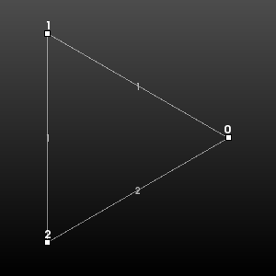
Displaying Vertex and Edge Labels
graphLayoutView->SetVertexLabelVisibility(true); graphLayoutView->SetEdgeLabelVisibility(true); graphLayoutView->SetEdgeLabelArrayName("Weights"); graphLayoutView->SetVertexLabelArrayName("VertexIDs");

Slide 26
Layout Strategies
graphLayoutView->SetLayoutStrategy(“Strategy Name");
"Random“ - Randomly places vertices in a box
"Force Directed“ - Simulating forces (springs) on edges
"Simple 2D“ - A simple 2D force directed layout
"Clustering 2D“ - Just like simple 2D but uses some techniques to cluster better
"Fast 2D“ - A linear-time 2D layout.
"Circular"

Slide 27
Vertex Coodinates
You can also specify the “Pass Through” layout strategy
This allows you to set the coordinates of the vertices manually:
vtkSmartPointer<vtkPoints> points =
vtkSmartPointer<vtkPoints>::New();
points->InsertNextPoint(0.0, 0.0, 0.0);
points->InsertNextPoint(1.0, 0.0, 0.0);
points->InsertNextPoint(0.0, 1.0, 0.0);
g->SetPoints(points);

Slide 28
Neighboring Vertices
vtkAdjacentVertexIterator
vtkSmartPointer<vtkAdjacentVertexIterator> iterator =
vtkSmartPointer<vtkAdjacentVertexIterator>::New();
g->GetAdjacentVertices(0, iterator);
while(iterator->HasNext())
{
vtkIdType nextVertex = iterator->Next();
std::cout << "Next vertex: " << nextVertex << std::endl;
}

Slide 29
Lookup Tables
Automatic map from a range to all colors:
Manually specify colors in the table:
vtkLookupTable* lookupTable =
vtkLookupTable::New();
lookupTable->SetTableRange(0.0, 10.0);
lookupTable->Build();
vtkSmartPointer<vtkLookupTable> lookupTable =
vtkSmartPointer<vtkLookupTable>::New();
lookupTable->SetNumberOfTableValues(2);
lookupTable->SetTableValue(0, 1.0, 0.0, 0.0); // red
lookupTable->SetTableValue(1, 0.0, 1.0, 0.0); // green
lookupTable->Build();

Slide 30
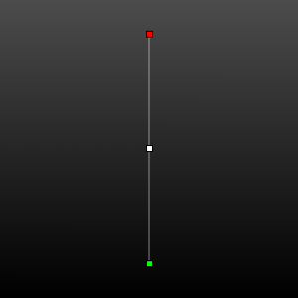
Color Vertices
http://www.vtk.org/Wiki/VTK/Examples/Cxx/Graphs/ColorVertices
// Create the color array
vtkIntArray* vertexColors =
vtkIntArray::New();
vertexColors->SetName(“VertexColors”);
vertexColors->SetNumberOfComponents(1);
vertexColors->InsertNextValue(1);
vertexColors->InsertNextValue(2);
…
… Create a lookup table …
// Add the color array to the graph
graph->GetVertexData()->AddArray(vertexColors);
vtkViewTheme* theme =
vtkViewTheme::New();
theme->SetPointLookupTable(lookupTable);
graphLayoutView->ApplyViewTheme(theme);
graphLayoutView->SetVertexColorArrayName(“VertexColors");
graphLayoutView->ColorVerticesOn();

Slide 31
Color Edges
// Create the color array
vtkIntArray* edgeColors =
vtkIntArray::New();
edgeColors->SetName(“EdgeColors”);
edgeColors->SetNumberOfComponents(1);
edgeColors->InsertNextValue(1);
edgeColors->InsertNextValue(2);
…
… Create a lookup table …
// Add the color array to the graph
graph->GetEdgeData()->AddArray(edgeColors);
vtkViewTheme* theme =
vtkViewTheme::New();
theme->SetCellLookupTable(lookupTable);
graphLayoutView->ApplyViewTheme(theme);
graphLayoutView->SetVertexColorArrayName(“EdgeColors");
graphLayoutView->ColorEdgesOn();

Slide 32
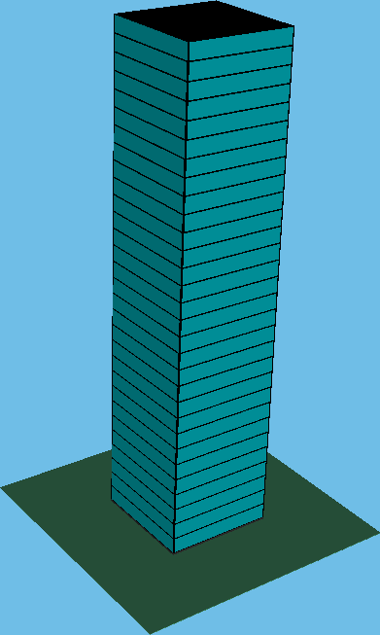
Today’s Class
Highlights from HW #1
This Week’s Readings
Next Week’s Readings
VTK Graphs
Intro to Cmake
Intro to Git

Slide 33
Introduction to VTK: CMake

Slide 34
What is CMake?
Cross platform Make
Allows the same source code to be compiled on many different operating systems and IDEs (Integrated Development Environment)
Visual Studio
Code Blocks
KDevelop
Eclipse
Traditional Unix Makefile
Etc.

Slide 35
The Idea
Software used to ship with a Makefile
The settings for library paths, which options you wanted to use for the compilation and installation were hard coded into the Makefile
Autoconf and similar packages attempted to make this a little easier
CMake makes it VERY easy

Slide 36
Single Person Project
The Code
The Compiler/IDE

Slide 37
Collaborative (“Real”) Project
The Code
YIKES!!
Person A’s Compiler/IDE
Person N’s Compiler/IDE

Slide 38
Collaborative (“Real”) Project
The Code
CMake
Person A’s Compiler/IDE
Person N’s Compiler/IDE

Slide 39
The Magic File – CMakeLists.txt
PROJECT(YourExampleProject)
FIND_PACKAGE(VTK REQUIRED)
INCLUDE(${VTK_USE_FILE})
ADD_EXECUTABLE(ExampleExecutable ExampleCode.cxx) TARGET_LINK_LIBRARIES(ExampleExecutable vtkHybrid)

Slide 40
Line-by-line
PROJECT(YourExampleProject)
Tell CMake you are starting a new project

Slide 41
Line-by-line
FIND_PACKAGE(VTK REQUIRED)
INCLUDE(${VTK_USE_FILE})
Tell CMake you want to use VTK in your new project
If you have the environment variable VTK_BIN set, CMake will find VTK automatically
If not, when you configure your project using CMake it will ask you where you have VTK installed

Slide 42
Line-by-line
ADD_EXECUTABLE(ExampleExecutable ExampleCode.cxx)
Tell CMake you want to create an executable called ExampleExecutable from ExampleCode.cxx
TARGET_LINK_LIBRARIES(ExampleExecutable vtkHybrid)
Tell CMake that ExampleCode.cxx uses functions defined in the library vtkHybrid. You can list as many libraries as you need.
TARGET_LINK_LIBRARIES(ExampleExecutable vtkHybrid vtkInfovis OtherLibrary)

Slide 43
Windows Interface
Download from here: http://www.cmake.org/cmake/resources/software.html
You will use a GUI interface

Slide 44
Windows Process
Run CMake
Point it to your source directory
Point it the build directory of your choice
Set an options that you would like
Click “configure” (you may have to do this twice (until the “generate” button is not greyed out) )
Choose your generator (which IDE you are going to use to build the project)
Click “Generate”

Slide 45
Linux
Should already have CMake installed
Test by typing ‘cmake’ in a terminal
If you don’t get “command not found”, you’re in good shape
If you do, most distributions have a CMake package
sudo yum install cmake
sudo apt-get install cmake
Or equivalent

Slide 46
Linux Interface
ccmake – Curses Cmake (http://en.wikipedia.org/wiki/Curses_(programming_library) )
Allows you to set many options before generating a project

Slide 47
Linux Process
Linux - Makefile
Create a build directory (wherever you want)
From the build directory, run ‘ccmake’ on the source directory
Example:
Your source code is in ~/src/VTK
Create a build directory: mkdir ~/bin/VTK
cd ~/bin/VTK
ccmake ~/src/VTK
Set any options you would like
Hit ‘c’ for ‘configure’. You may have to do this twice
Hit ‘g’ for generate

Slide 48
Linux Process
Linux – Other IDE
ccmake ~/src/VTK –G YourGenerator
More info at http://www.vtk.org/Wiki/CMake_Generator_Specific_Information
Generators include
Eclipse
KDevelop3
CodeBlocks
NMake

Slide 49
First Time VTK Programming
Step 1 – Download the VTK source code
Step 2 – Use CMake to create a project for the IDE you want to use to compile VTK
Step 3 – Use the IDE you selected in Step 2 to build VTK
Step 4 – Obtain an example program and associated CMakeLists.txt file from the Examples Wiki
Step 5 – Use CMake to create a project for the IDE you want to use to compile the example program
Step 6 – Use the IDE you selected in Step 5 to build the example program

Slide 50
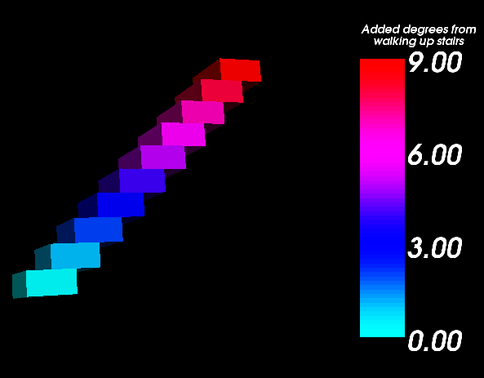
Today’s Class
Highlights from HW #1
This Week’s Readings
Next Week’s Readings
VTK Graphs
Intro to Cmake
Intro to Git

Slide 51
Introduction to VTK: Git

Slide 52
What is Git?
The latest and greatest version control system
Makes large projects easier to manage
Written by Linus Torvalds (the Linux guy) to help with the massive Linux project

Slide 53
Version Control Systems – A Brief History
Patches
CVS/SVN
Git

Slide 54
The Olden Days
In the “olden days”, people would send patches back and forth to each other via email
This was terribly inefficient
The patch would only work with the exact file that it was created for
No version control

Slide 55
CVS/SVN
CVS: Concurrent Versions System
SVN: Subversion – a re-write of CVS
Users can “publish” code to a central repository
Users can get the code from the central repository

Slide 56
CVS/SVN
Central Repository
User A
User B

Slide 57
Git
There is no “central repository” to speak of
Typically one computer is designated as the “official” computer, but it is no different than any other user

Slide 58
Git
“Central Repository”
User A
User B
New link!

Slide 59
Branches
Work on different “projects” without affecting other “projects” in the works
Submit a branch for easy code review
Github.com gitorious.com, etc.

