Slide 1
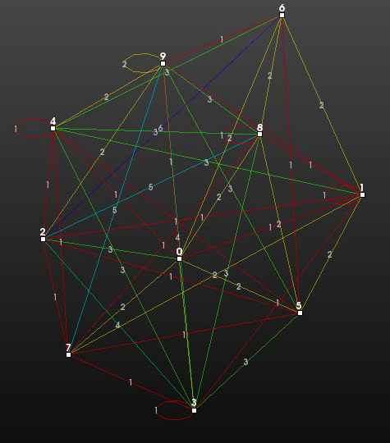
Interaction
& Picking
Mary DeVarney

Slide 2
Today’s Class
Highlights from HW #2
This Week’s Readings
Next Week’s Readings
Immersive Interactive Environments in EMPAC
VTK Interaction
  Callbacks
  Subclassing Interactors
  Mouse & Key Events
  Picking

Slide 3
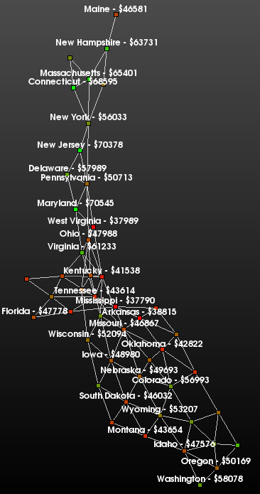
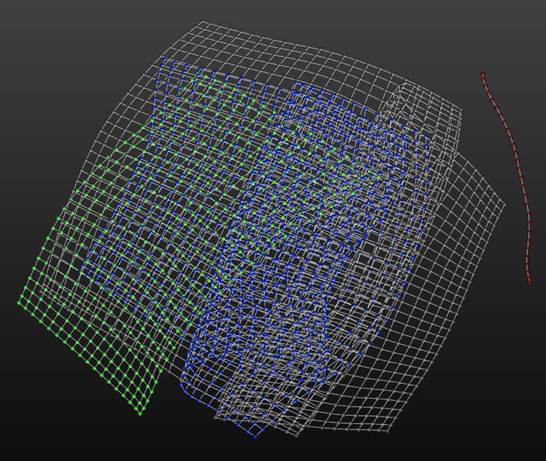
Real 3D Coordinates
Chris Stuetzle
Evan Sullivan

Slide 4
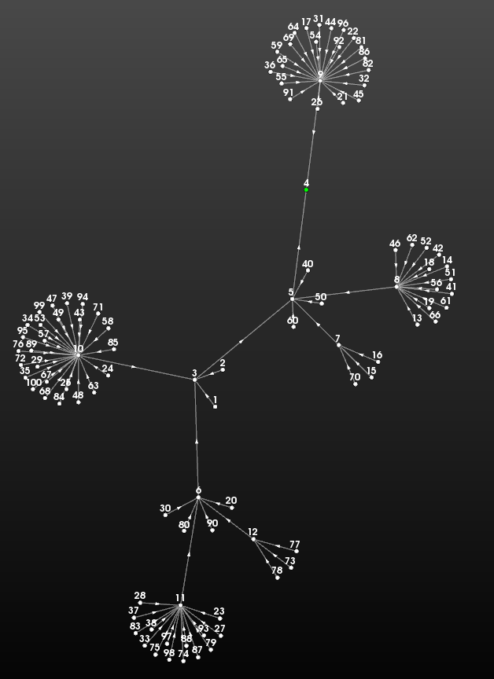
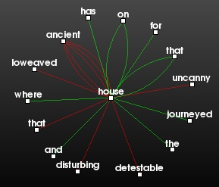
Simplicity
William Fergus
Andrew Dolce

Slide 5
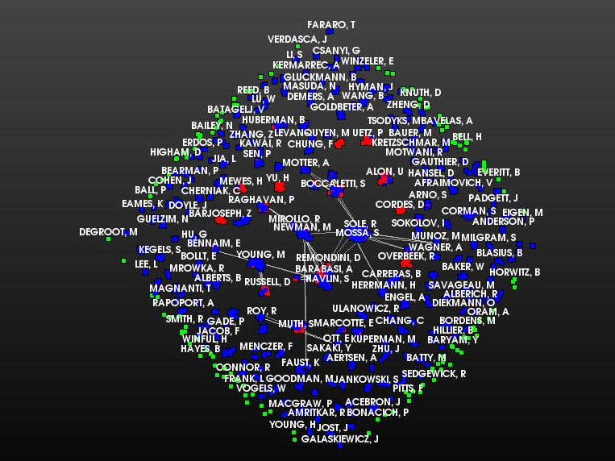
Density of Information?
Importance of Labels?
Cagri Ozcaglar

Slide 6
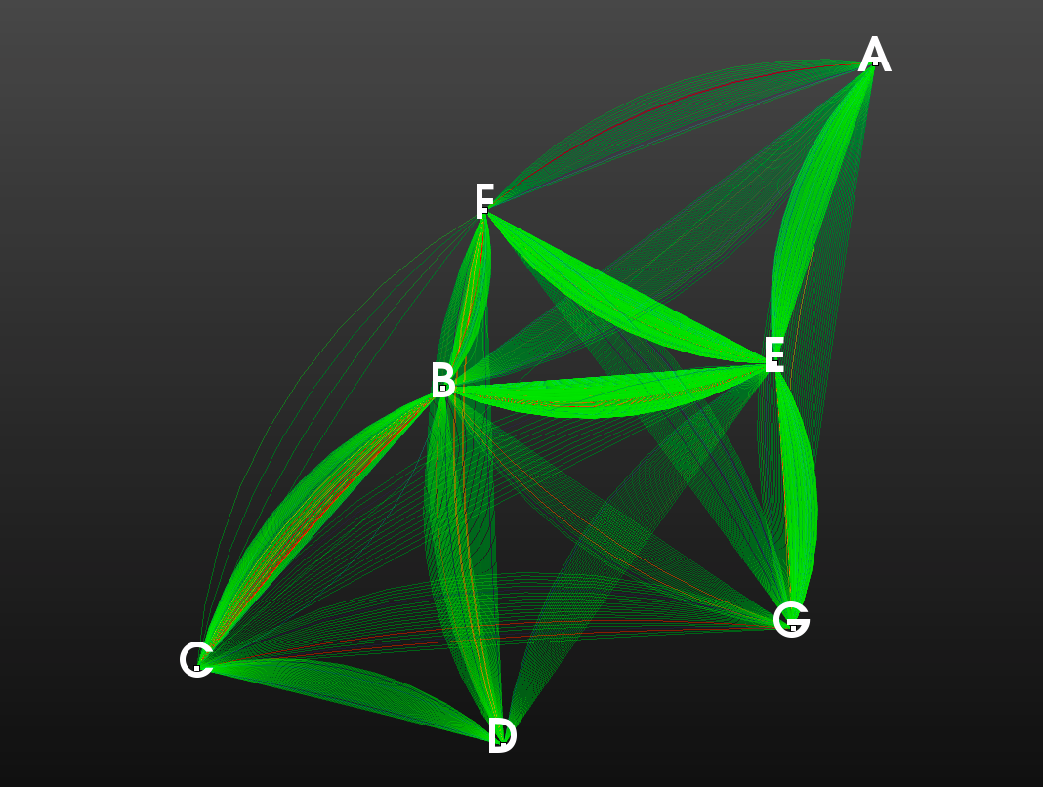
Tricks to Visualizing Multiple Edges?
Gregory White

Slide 7
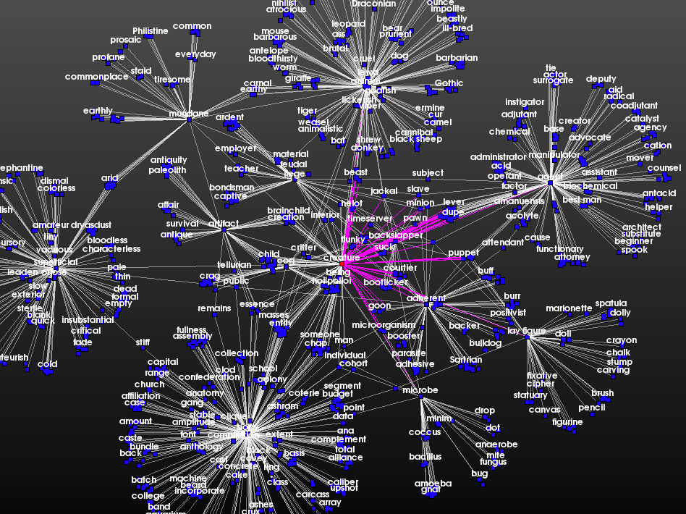
Any Surprising
Patterns or Discoveries?
Daniel Souza

Slide 8
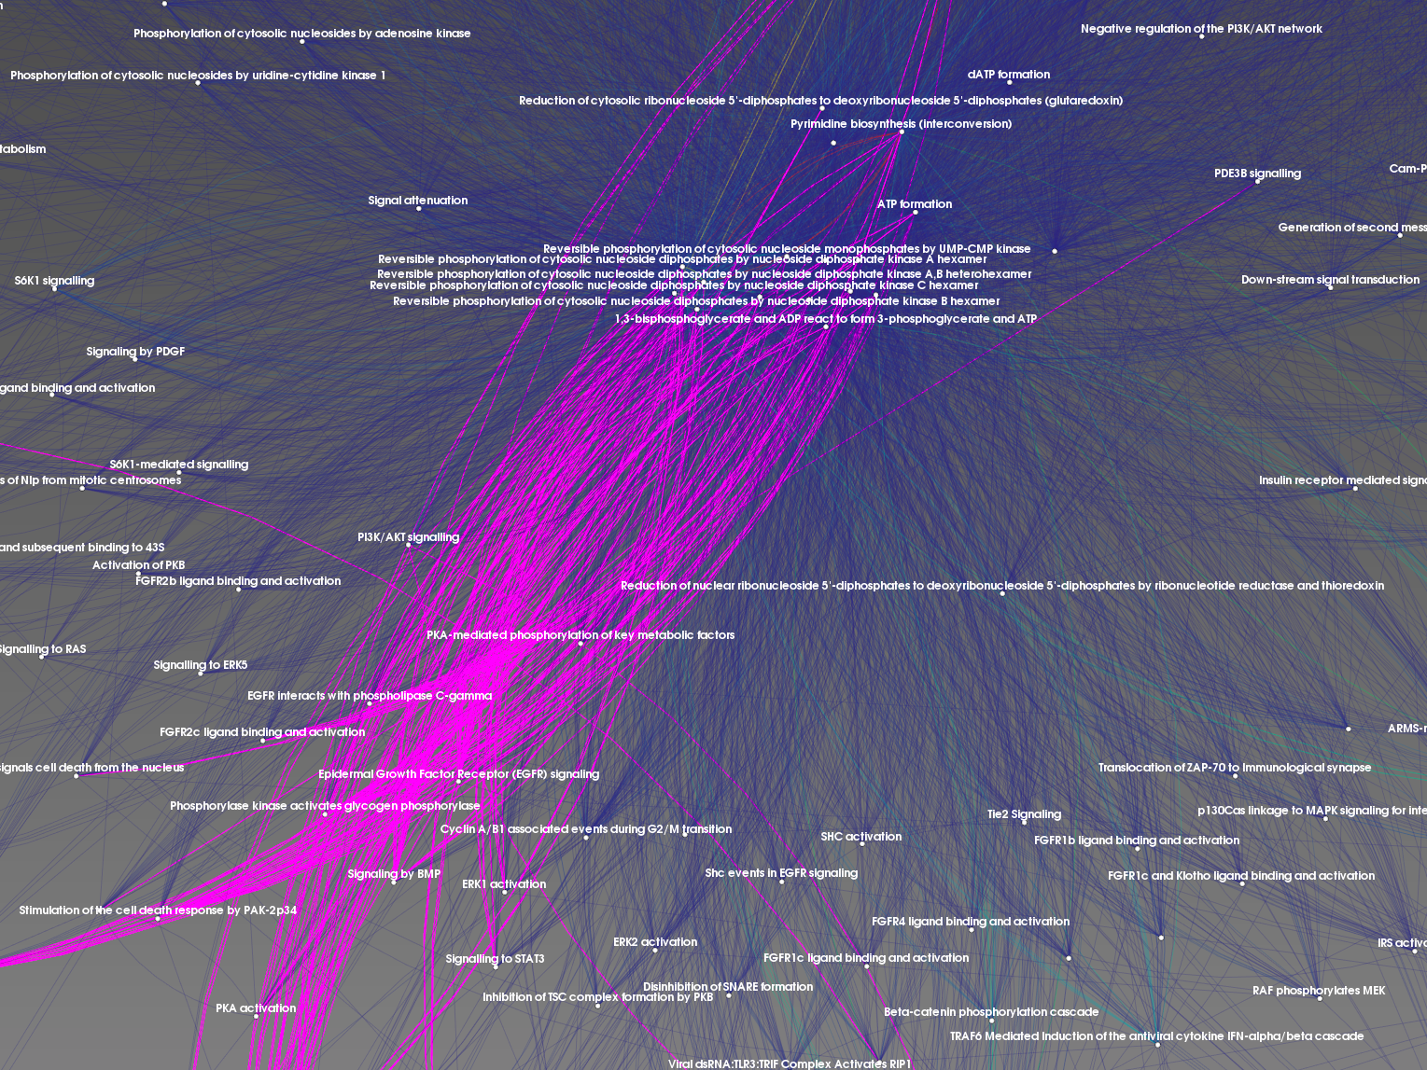
James McCusker
Strategies for Managing
Data Complexity?

Slide 9
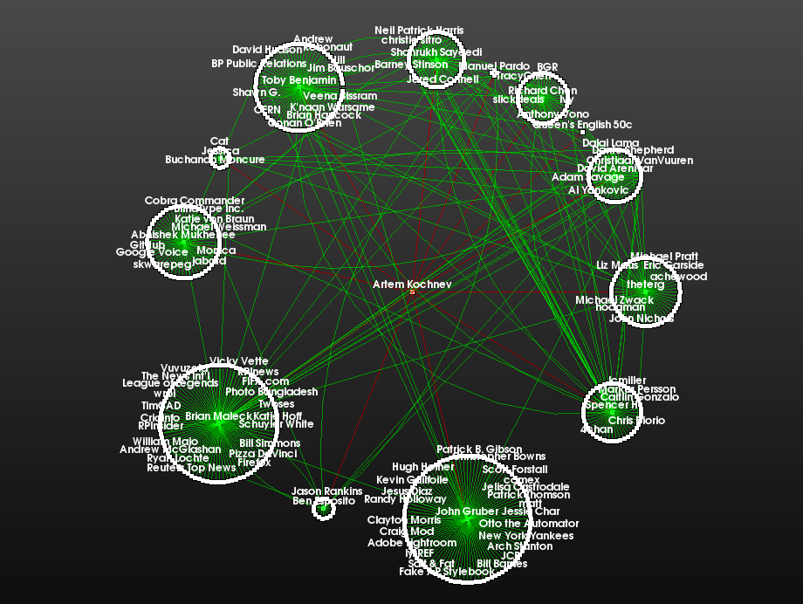
Hierarchy of Layouts?
Artem Kochnev

Slide 10
Today’s Class
Highlights from HW #2
This Week’s Readings
Next Week’s Readings
Immersive Interactive Environments in EMPAC
VTK Interaction
  Callbacks
  Subclassing Interactors
  Mouse & Key Events
  Picking

Slide 11
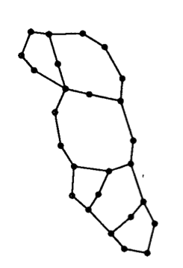
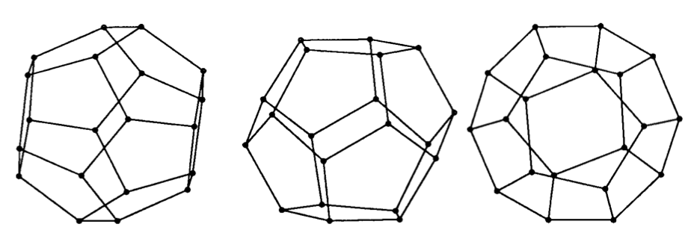
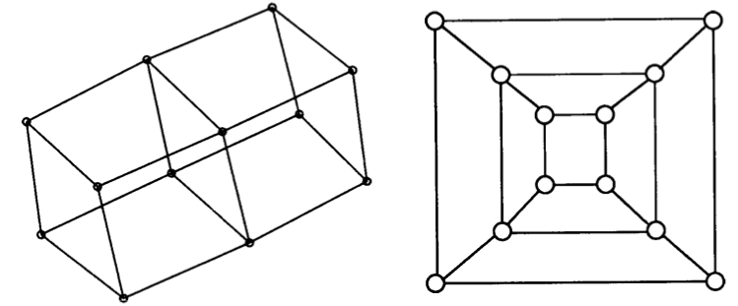
Readings for This Week:
"Graph drawing by force-directed placement", Fruchterman & Reingold, 1991

Slide 12
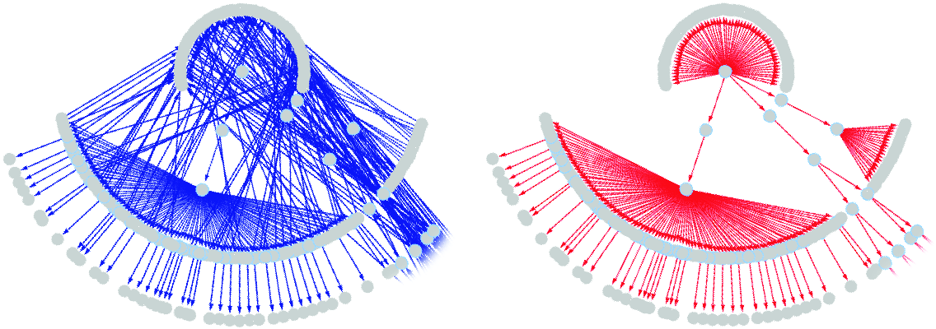
Readings for This Week:
"Heapviz: Interactive Heap Visualization for Program Understanding and Debugging” Aftandilian, Kelley, Gramazio, Ricci, Su, & Guyer, 2010

Slide 13
Today’s Class
Highlights from HW #2
This Week’s Readings
Next Week’s Readings
Immersive Interactive Environments in EMPAC
VTK Interaction
  Callbacks
  Subclassing Interactors
  Mouse & Key Events
  Picking

Slide 14
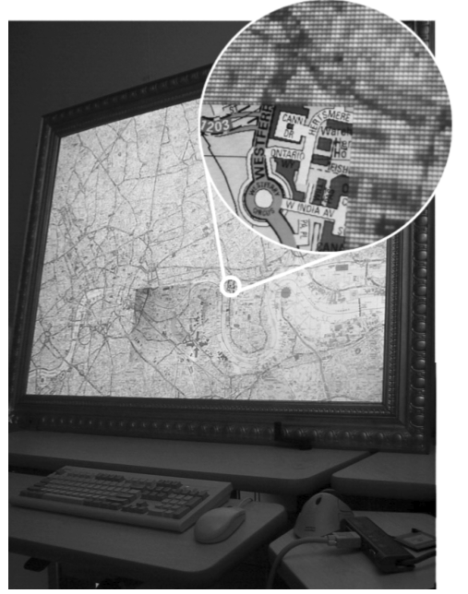
Readings for
Next Week:
“Focus Plus Context Screens: Combining Display Technology with Visualization Techniques”,
Baudisch, Good,
& Stewart,
UIST 2001

Slide 15
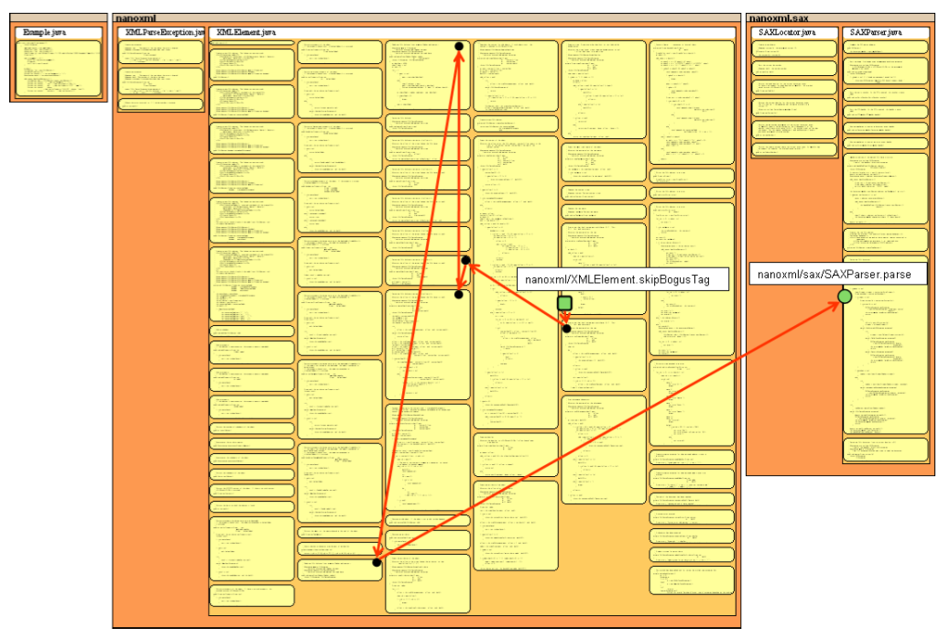
Readings for Next Week:
“Visualization of Exception Handling Constructs
to Support Program Understanding”,
Shah, Gorg, & Harrod, Software Visualization 2008

Slide 16
Today’s Class
Highlights from HW #2
This Week’s Readings
Next Week’s Readings
Immersive Interactive Environments in EMPAC
VTK Interaction
  Callbacks
  Subclassing Interactors
  Mouse & Key Events
  Picking

Slide 17

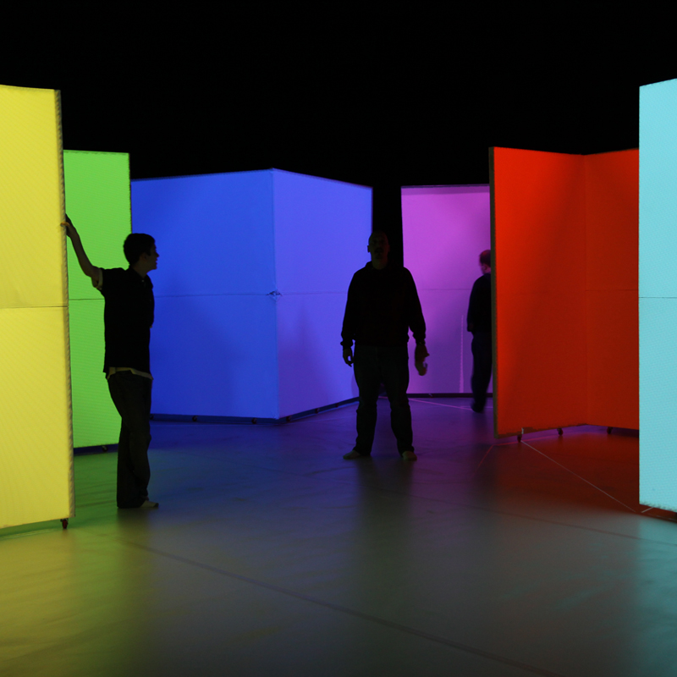
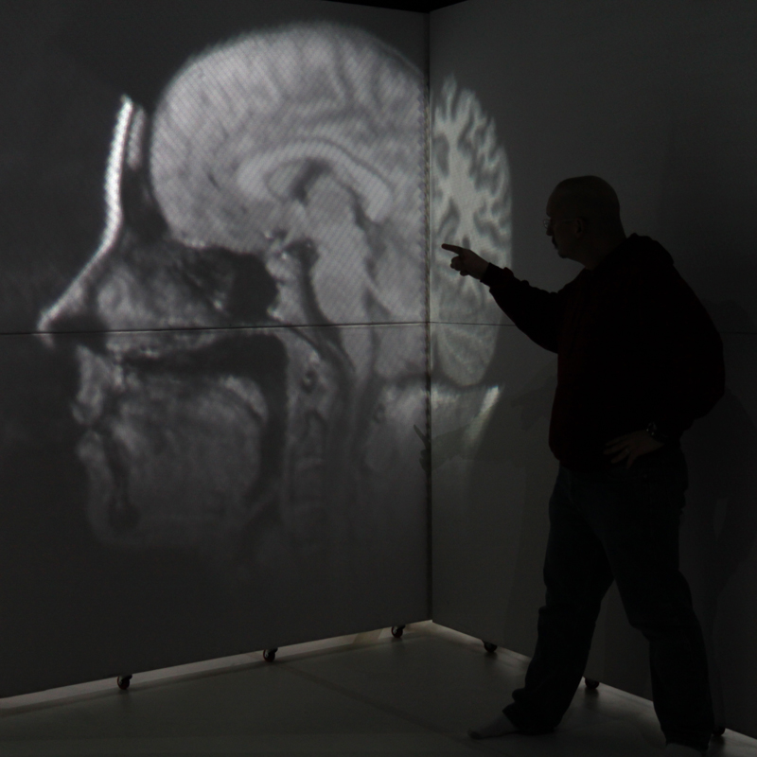
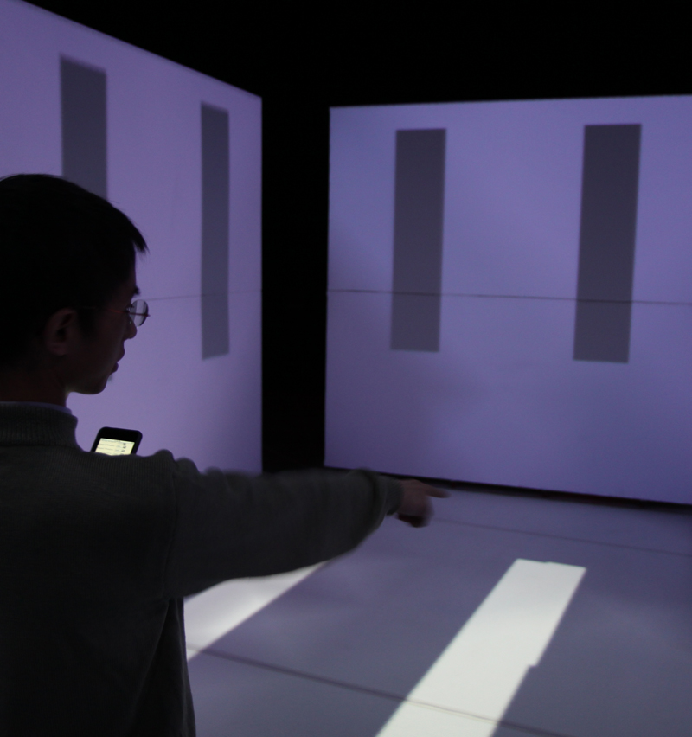
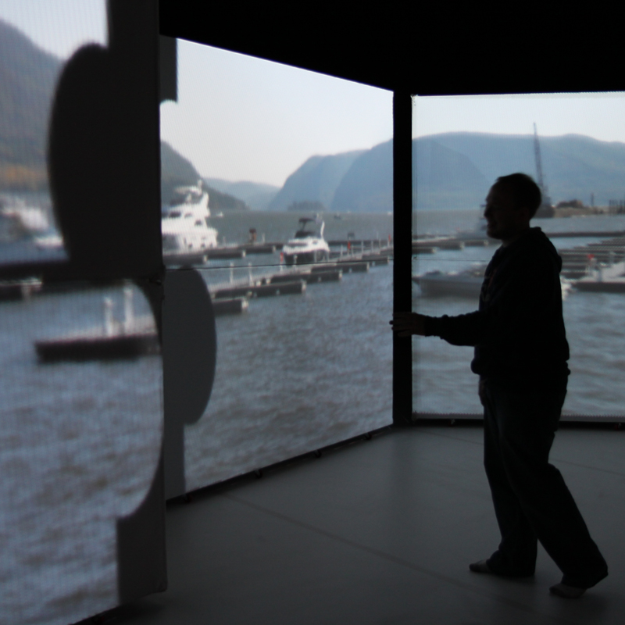
Dynamic Projection Surfaces for Immersive Visualization
Theodore C. Yapo, Yu Sheng, Joshua Nasman,
Andrew Dolce, Eric Li, and Barbara Cutler
PROCAMS 2010 IEEE International Workshop
on Projector-Camera Systems, June 2010

Slide 18
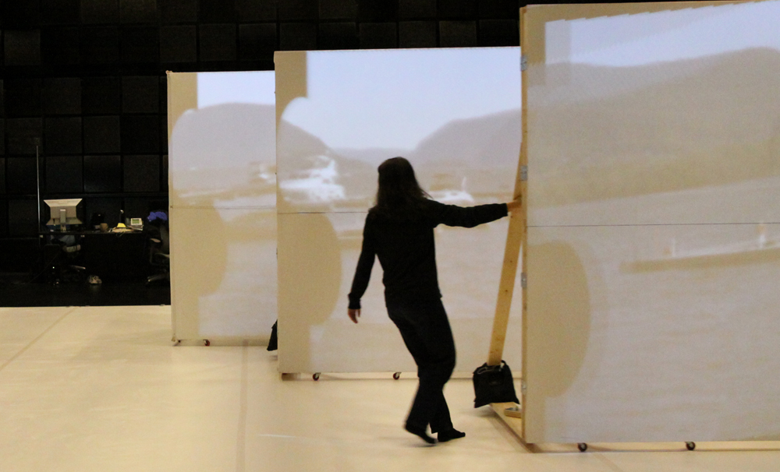
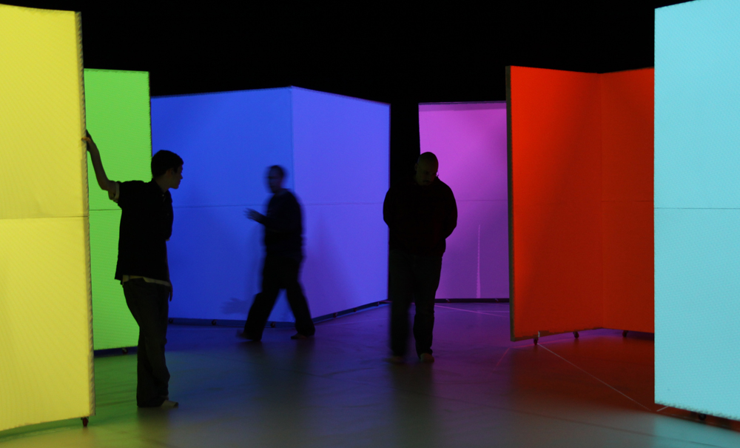
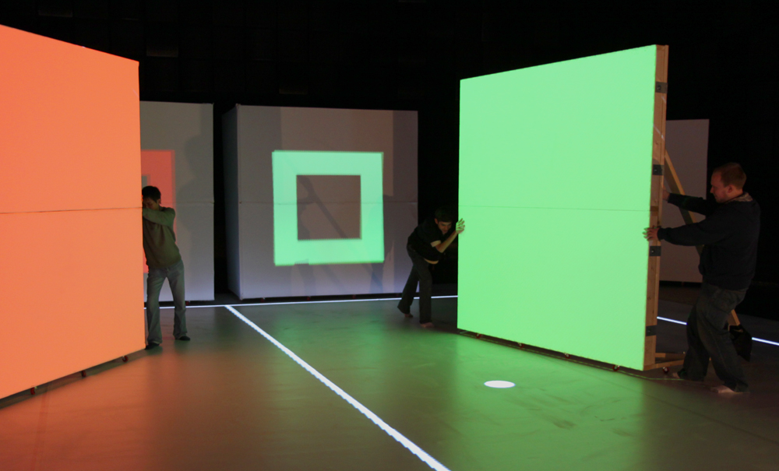
Our System Goals/Requirements
Large, human-scale
projection environment
People move freely
within the space
Projection surfaces can
be moved interactively
Varying illumination
conditions
Robust & real-time
tracking and display

Slide 19
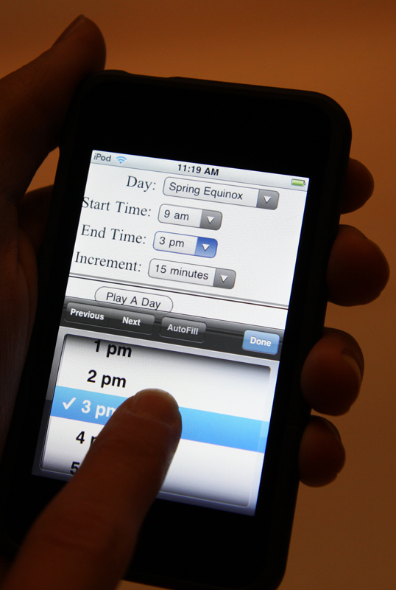
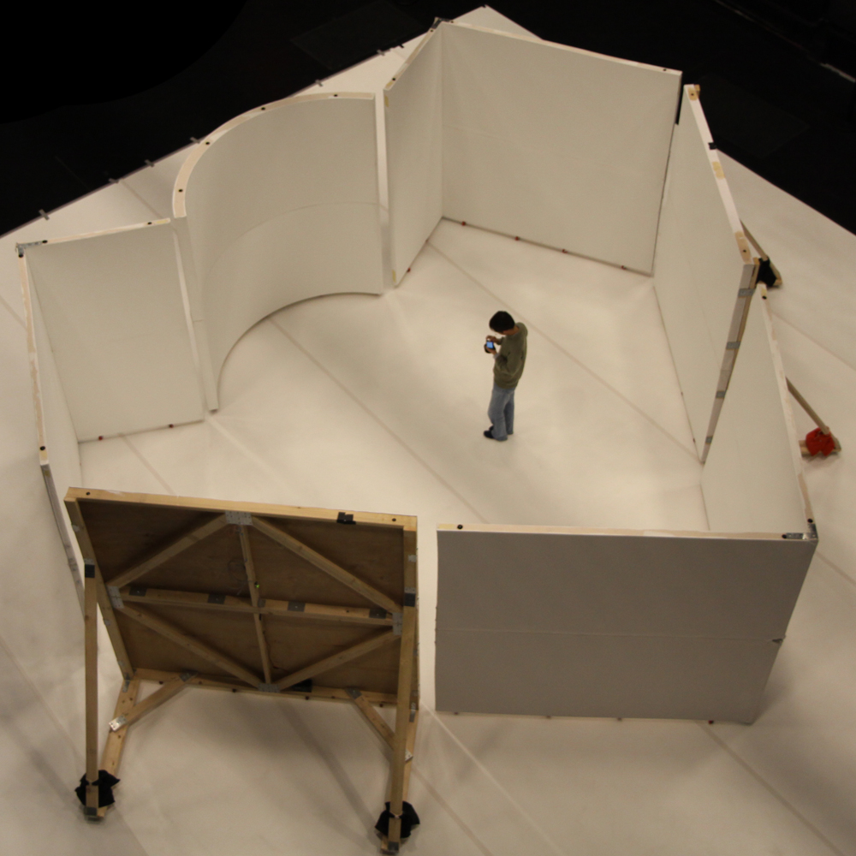
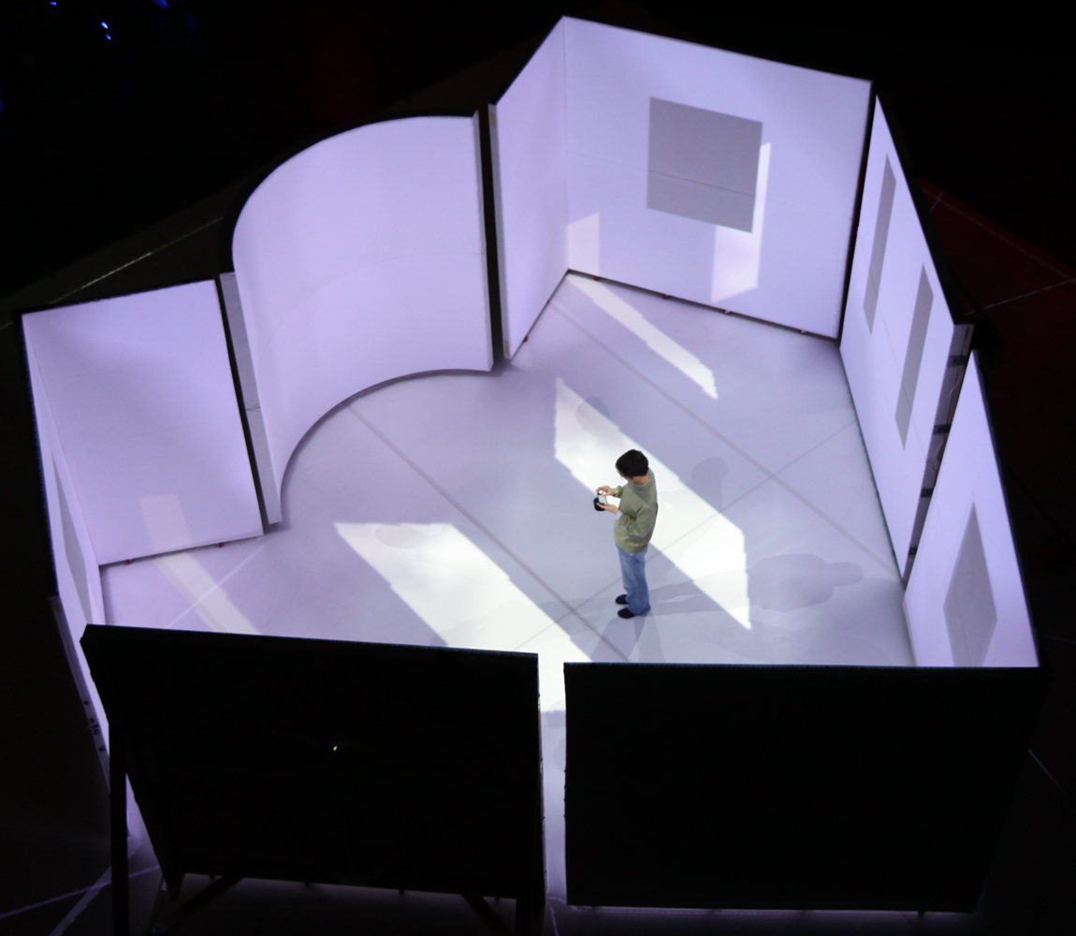
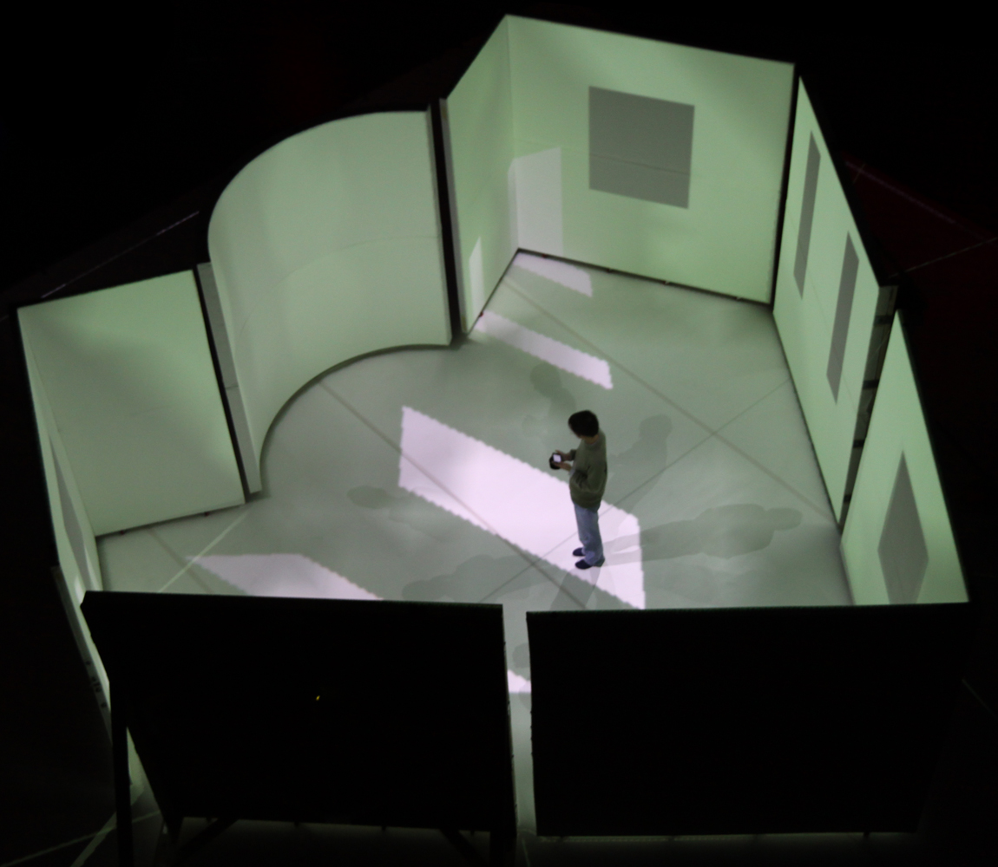
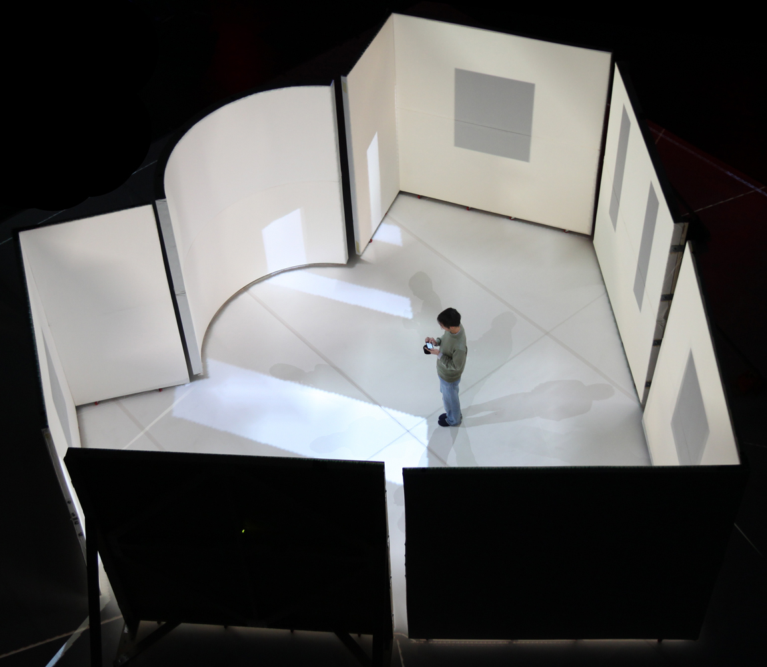
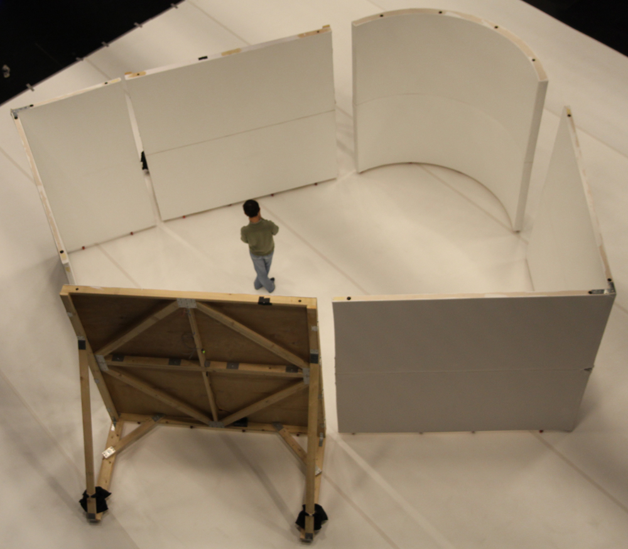
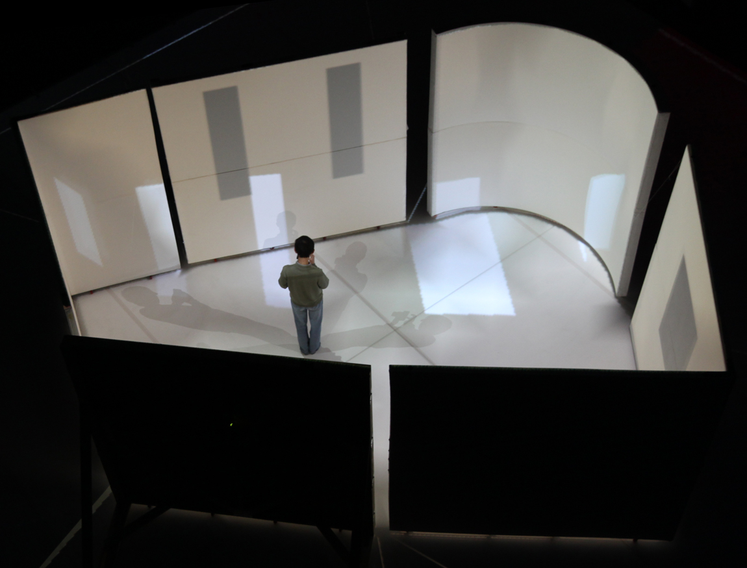
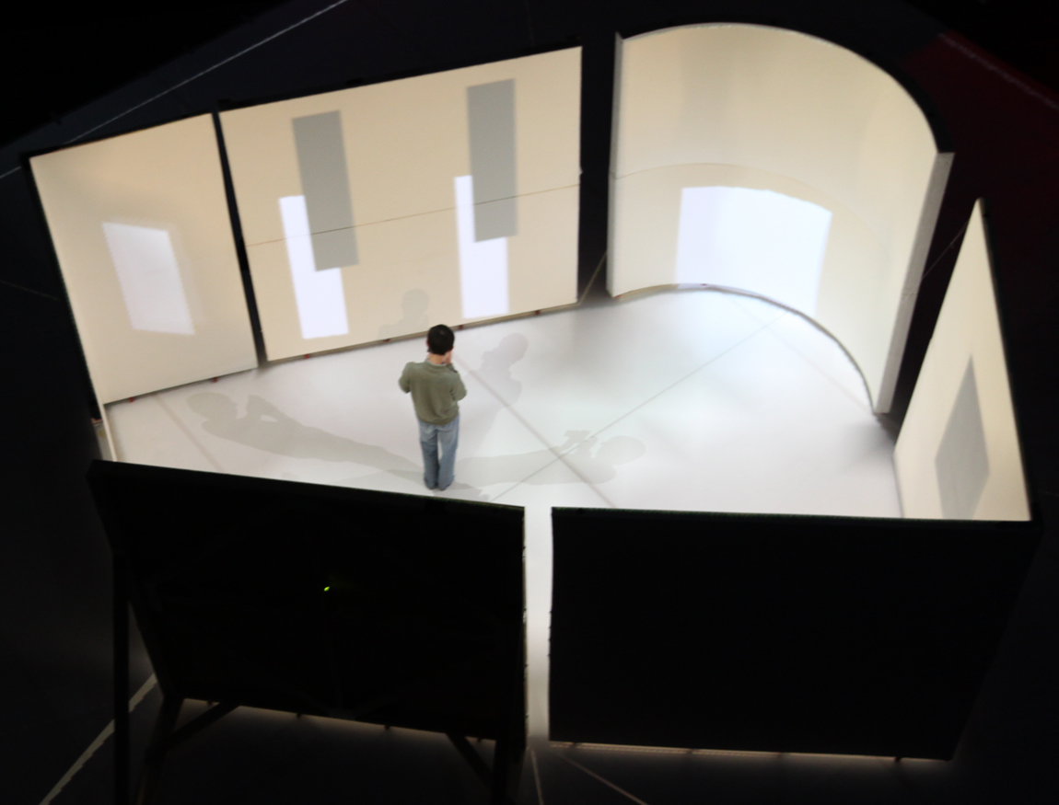
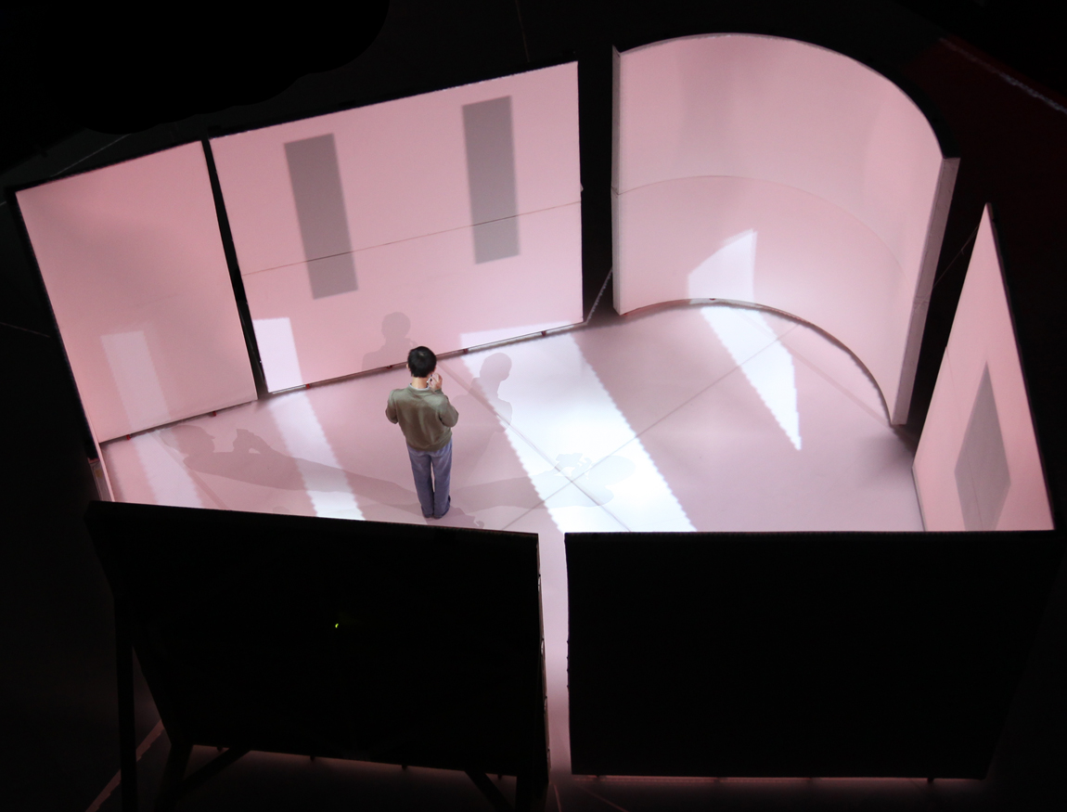
Architectural
Daylighting Design
Windows, wall colors, & time of day
controlled through iTouch interface

Slide 20
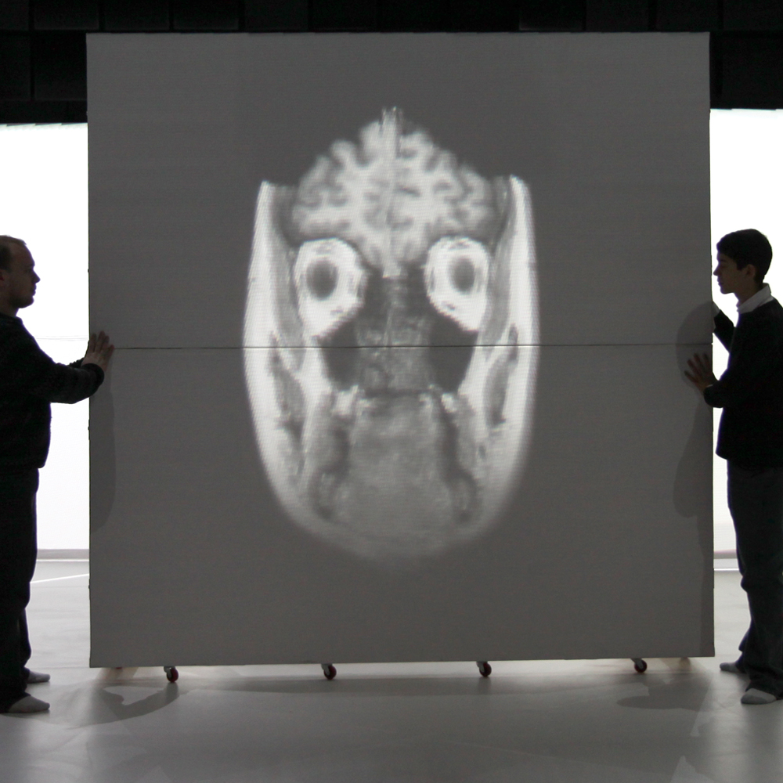
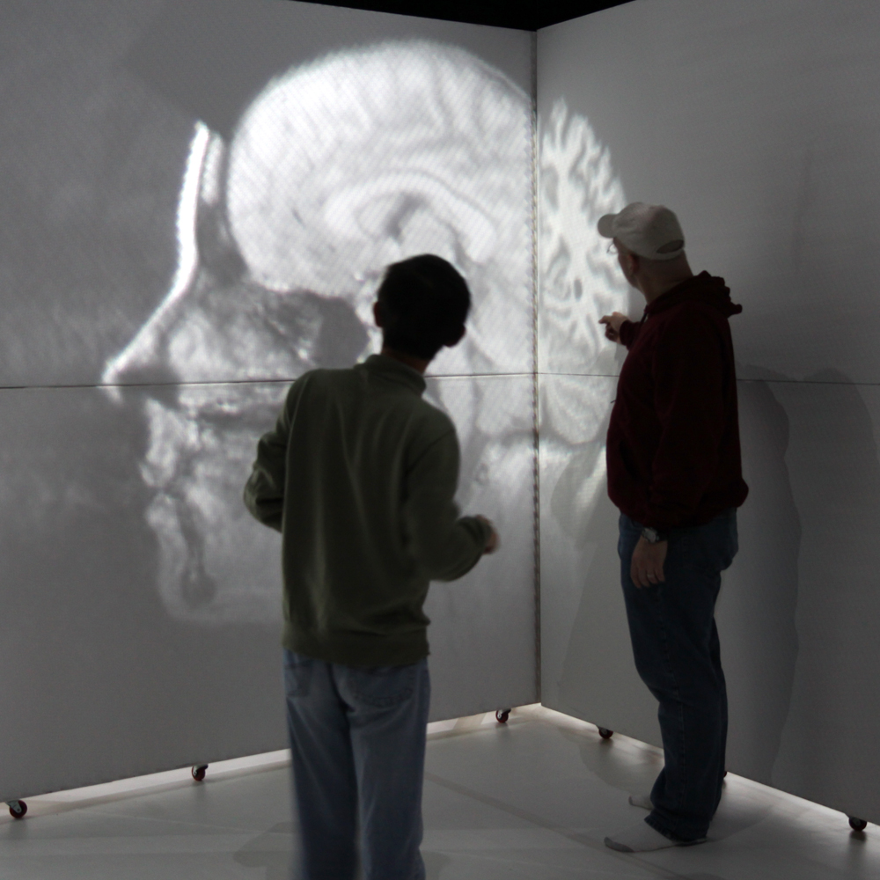
Volumetric Visualization
Cross sections of a 3D medical dataset
virtually placed within the projection volume

Slide 21
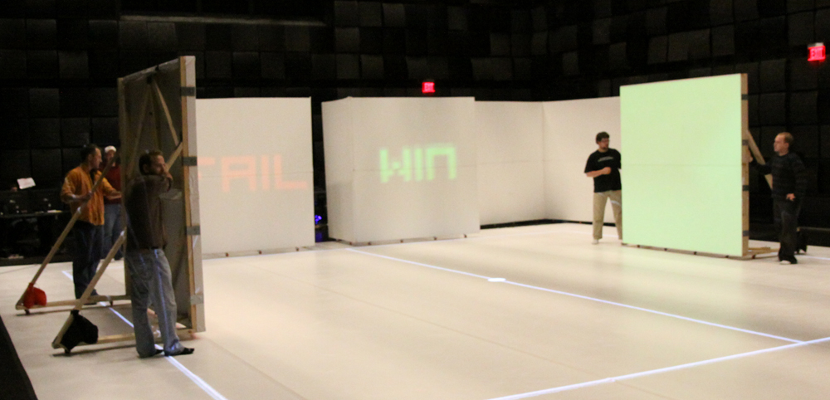
General User Interface Elements
Projection surfaces as input devices
No instruction necessary to play the game!

Slide 22
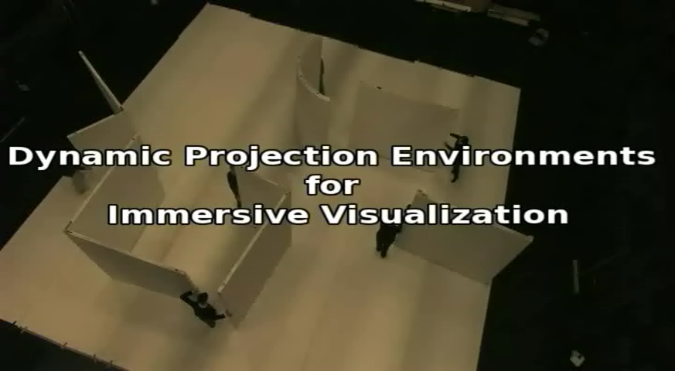
Panorama from Gehua Yang, DualAlign

Slide 23
Today’s Class
Highlights from HW #2
This Week’s Readings
Next Week’s Readings
Immersive Interactive Environments in EMPAC
VTK Interaction
  Callbacks
  Subclassing Interactors
  Mouse & Key Events
  Picking

Slide 24
Introduction to VTK: Interaction

Slide 25
What is Interaction?
Manipulating the objects in a scene
  Moving
  Rotating
  Selecting
  Deleting
Manipulating your view of the scene (manipulating the camera)
  Pan
  Tilt
  Zoom

Slide 26
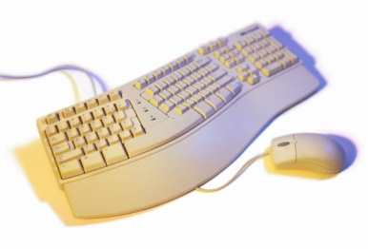

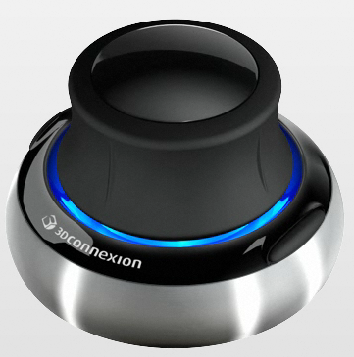
Interaction Devices
Keyboard
  Press a key
  Hold a key
Mouse
  Left button
  Middle button
  Right button
  Single click
  Double click
Joystick
3D mouse (3D Connexions Space Navigator)

Slide 27
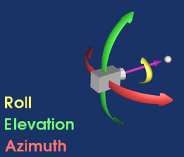
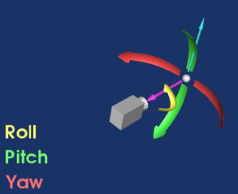
Manipulating the Camera

Slide 28
Interaction in VTK
Callback functions
  Less overhead
  Less powerful
Subclass an existing vtkInteractorStyle
  Preferred method

Slide 29
Callback Functions
void ClickCallbackFunction ( vtkObject* caller,
long unsigned int eventId,
void* clientData,
void* callData )
caller – The object that called the callback.
eventId – What happened to trigger this function?
clientData – Give the callback access to an object.
callData – Additional information specific to this particular call.

Slide 30
Callback Functions (cont.)
void RefreshCallback( vtkObject* caller, long unsigned int eventId, void* clientData, void* callData)
{
// Get the object that called the callback
vtkRenderWindowInteractor *iren =
static_cast<vtkRenderWindowInteractor*>(caller);
// Access anything you put in clientData
vtkActor* actor = static_cast<vtkActor*>(clientData);
}

Slide 31
Connecting the Callback
vtkCallbackCommand* refreshCallback =
vtkCallbackCommand::New();
refreshCallback->SetCallback(RefreshCallback); // The name of the function you have defined above
refreshCallback->SetClientData(actor);
renderWindow->AddObserver(vtkCommand::ModifiedEvent,refreshCallback);

Slide 32
Observable Events in VTK
LeftButtonPressEvent
LeftButtonReleaseEvent
MiddleButtonPressEvent
MiddleButtonReleaseEvent,
RightButtonPressEvent
RightButtonReleaseEvent
KeyPressEvent
KeyReleaseEvent
MouseMoveEvent
Many more (see EventIds enum here http://www.vtk.org/doc/nightly/html/classvtkCommand.html )

Slide 33
Callback Functions Examples
http://www.vtk.org/Wiki/VTK/Examples/Cxx/Interaction/KeypressObserver
http://www.vtk.org/Wiki/VTK/Examples/Cxx/Interaction/MouseEventsObserver

Slide 34
vtkInteractorStyle
Abstract class to catch user actions
Subclasses implement particular functionalities
Subclasses included in VTK:
  vtkInteractorStyleTrackballActor
  vtkInteractorStyleTrackballCamera
  vtkInteractorStyleRubberBand2D
  Many more (see http://www.vtk.org/doc/nightly/html/classes.html)

Slide 35
Existing InteractorStyle Examples
vtkInteractorStyleTrackballActor
http://www.vtk.org/Wiki/VTK/Examples/Cxx/Visualization/MoveActor
vtkInteractorStyleTrackballCamera
http://www.vtk.org/Wiki/VTK/Examples/Cxx/Visualization/MoveCamera

Slide 36
Custom Interaction -Subclassing InteractorStyles
The idea is to simply re-implement functions like OnKeyPress, OnLeftButtonDown, etc with your own functionality
There is some overhead because of VTK’s structure

Slide 37
Custom Interaction -Subclassing InteractorStyles (cont.)
class CustomStyle : public vtkInteractorStyleTrackballCamera
{
public:
static CustomStyle* New();
vtkTypeMacro(CustomStyle, vtkInteractorStyleTrackballCamera);
virtual void OnLeftButtonDown()
{
std::cout << "Pressed left mouse button." << std::endl;
// Forward events
vtkInteractorStyleTrackballCamera::OnLeftButtonDown();
}
};
vtkStandardNewMacro(CustomStyle);

Slide 38
Using Your New Interactor
Just like before!
vtkRenderWindowInteractor* renderWindowInteractor =
vtkRenderWindowInteractor::New();
renderWindowInteractor->SetRenderWindow(renderWindow);
CustomStyle* style = CustomStyle::New();
renderWindowInteractor->SetInteractorStyle(style);

Slide 39
Custom InteractorStyle Examples
Keypress events
http://www.vtk.org/Wiki/VTK/Examples/Cxx/Interaction/KeypressEvents
Mouse events
http://www.vtk.org/Wiki/VTK/Examples/Cxx/Interaction/MouseEvents

Slide 40
Picking
Get the world coordinates of a mouse click
vtkPropPicker

Slide 41
Picking (cont.)
virtual void OnLeftButtonDown()
{
// Get the screen/window/pixel coordinates
int* clickPos = this->GetInteractor()->GetEventPosition();
// Pick from this location
vtkSmartPointer<vtkPropPicker> picker =
vtkSmartPointer<vtkPropPicker>::New();
picker->Pick(clickPos[0], clickPos[1], 0, this->GetDefaultRenderer());
// Get the world coordinates
double* pos = picker->GetPickPosition();
std::cout << "Pick position (world coordinates) is: "
<< pos[0] << " " << pos[1] << " " << pos[2] << std::endl;

Slide 42
Picking Example
http://www.vtk.org/Wiki/VTK/Examples/Cxx/Interaction/Picking

Slide 43
Object Intersection
VTK does not have much to offer
There is a nice “add on” (http://www.midasjournal.org/browse/publication/726) that wraps GTS (GNU Triangulated Surface Library)
What you can do is “Point inside object” testing

Slide 44
Point Inside Object
vtkSelectEnclosedPoints* selectEnclosedPoints =
vtkSelectEnclosedPoints*::New();
selectEnclosedPoints->SetInput(transformPolyData->GetOutput());
selectEnclosedPoints->SetSurface(this->Sphere);
selectEnclosedPoints->Update();
vtkDataArray* insideArray =
vtkDataArray::SafeDownCast(
selectEnclosedPoints->GetOutput()->GetPointData()->GetArray("SelectedPoints"));

Slide 45
Point Inside Object (cont.)
bool inside = false;
for(vtkIdType i = 0; i < insideArray->GetNumberOfTuples(); i++)
{
if(insideArray->GetComponent(i,0) == 1)
{
inside = true; break;
}
}

Slide 46
Positioning an Actor (round 2)
In a previous class we learned about vtkActor::SetUserTransform
However, when you interact with an actor, other internal stat variables (Position and Orientation) are modified.
The UserTransform is generated from the Position and Orientation, so if you REALLY want to set the position/orientation, use:
this->CubeActor->SetPosition(0,0,0);
this->CubeActor->SetOrientation(0,0,0);

Slide 47
Intersection Example
http://www.vtk.org/Wiki/VTK/Examples/Cxx/Interaction/Game

