Slide 1
CSCI 2200
Foundations of Computer Science

Slide 2

CSCI 2200
Foundations of Computer Science

Slide 3
Agenda
Course motivation
Your instructional team
Course structure & admin details
Actual course content

Slide 4
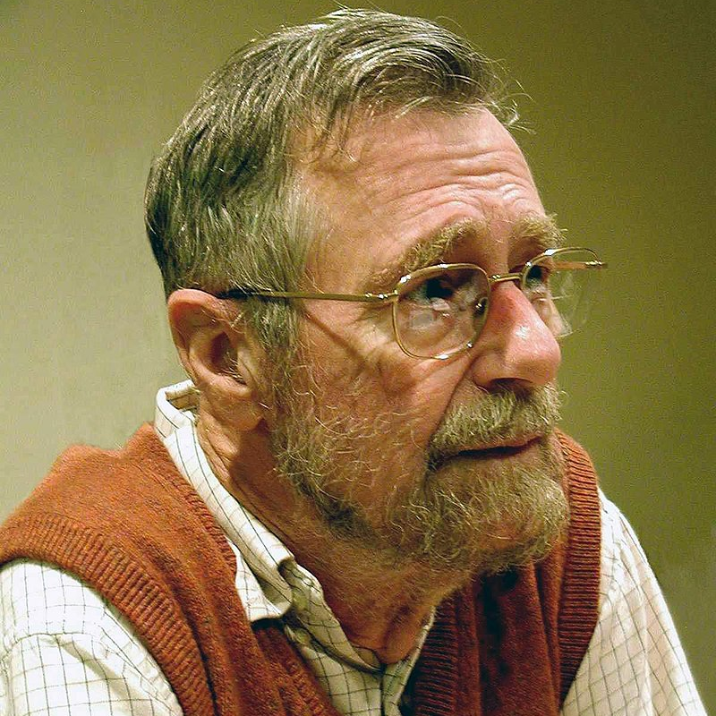

“Computer science is as much about computers as astronomy is about telescopes.” –Edsger Dijkstra

Slide 5
So what is computer science, then?
Computer science:
is a mathematical discipline.
is device agnostic.
is NOT merely software engineering or programming.

Slide 6
The big goal: Computability & complexity
Explore these questions:
What can be calculated? Are there mathematical questions to which an answer cannot be computed at all?
How efficiently can these computations be done? How do we measure this?

Slide 7
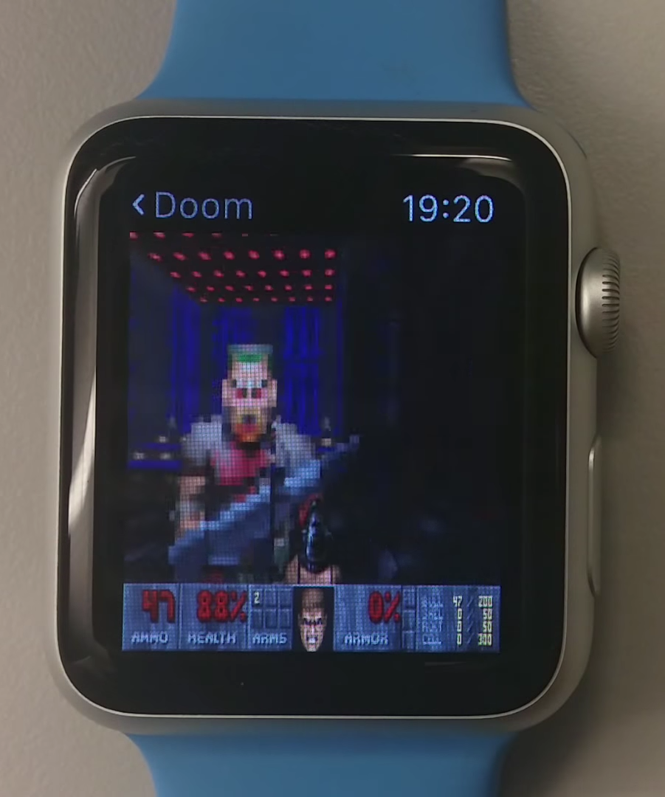
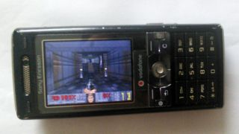
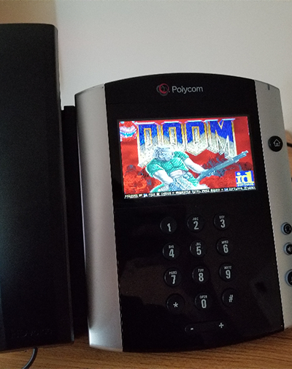
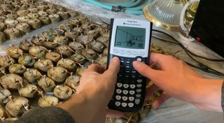
“Anything” can play Doom…
(photo credit gamesradar.com)

Slide 8
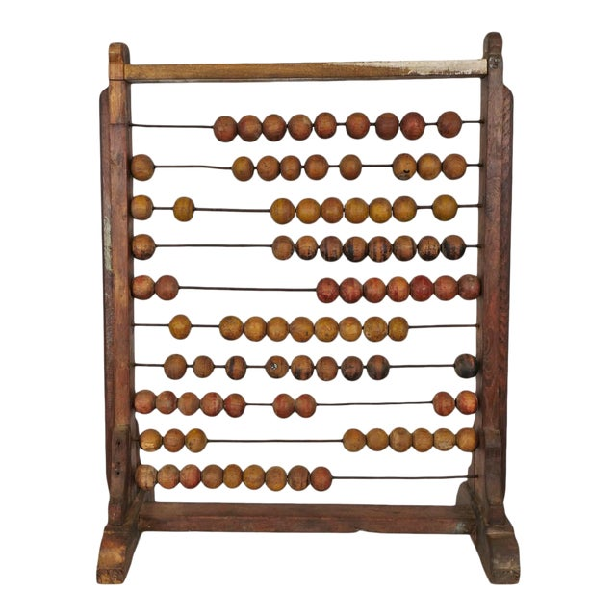
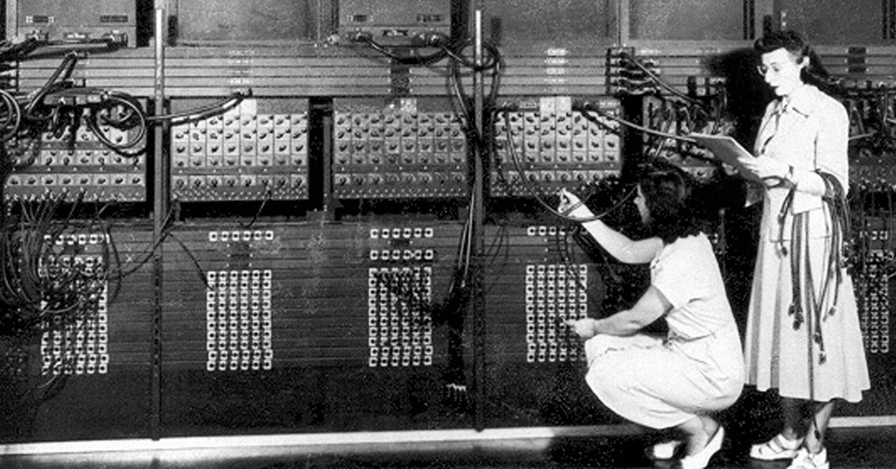
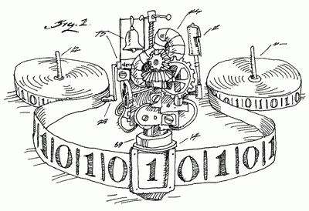
… but what’s the simplest such device?

Slide 9

En route…
Discrete structures
Sets, sequences, and graphs
Combinatorics
Careful counting & probability
Automata
Basic computing machines
Mathematical discipline
Building precision in writing and dialogue

Slide 10
En route…
Discrete structures
Sets, sequences, and graphs
Combinatorics
Careful counting & probability
Automata
Basic computing machines
Mathematical discipline
Building precision in writing and dialogue (yes, that means proofs)

Slide 11
Back to Dijkstra…
“The required techniques of effective reasoning are pretty formal, but as long as programming is done by people that don't master them, the software crisis will remain with us and will be considered an incurable disease. And you know what incurable diseases do: they invite the quacks and charlatans in, who in this case take the form of Software Engineering gurus.”

Slide 12
Instructional team

Slide 13
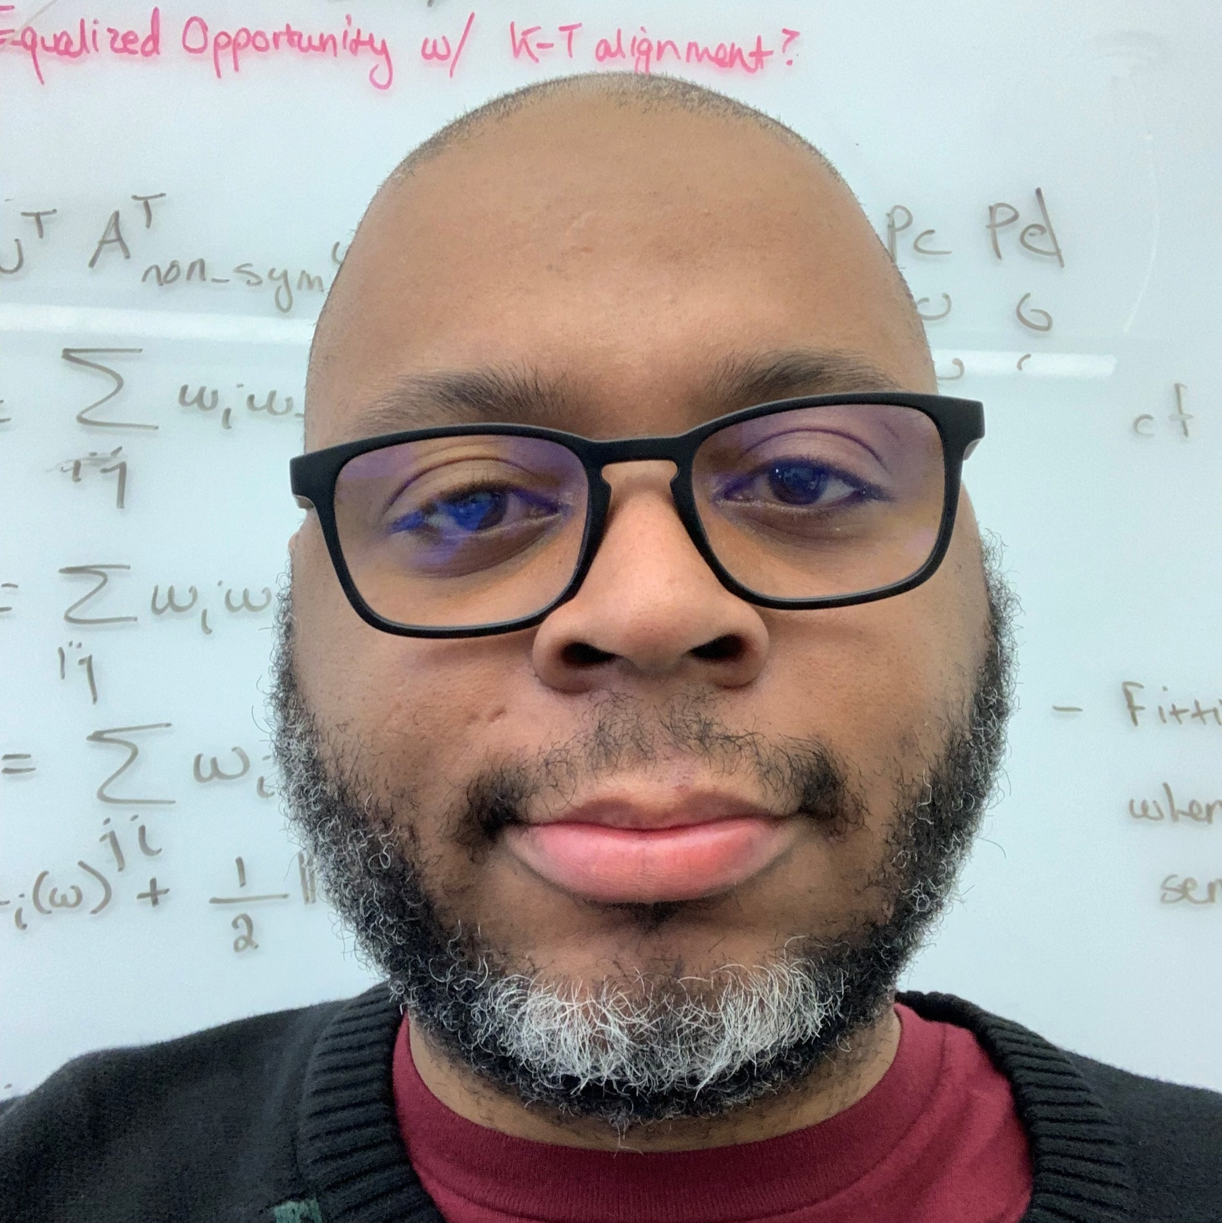
Dr. Alex Gittens
Office: Lally 316
Office hours: Mon. & Thu. 10-11am
E-mail: gittea@rpi.edu

Slide 14
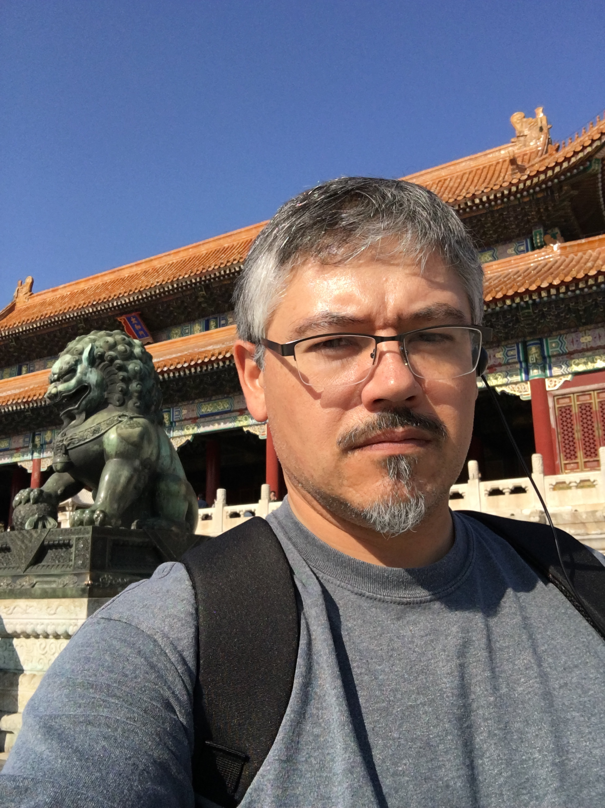
Dr. Dan DiTursi ’98 ’02
Office: Amos Eaton 123A (first one on the right side)
Office hours: Tuesdays 9:30 – 12:00
Thursdays 14:00 – 16:30
E-mail: ditursi@rpi.edu

Slide 15

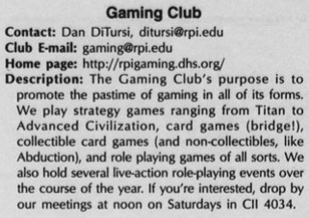

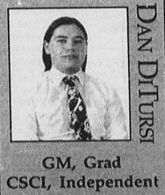


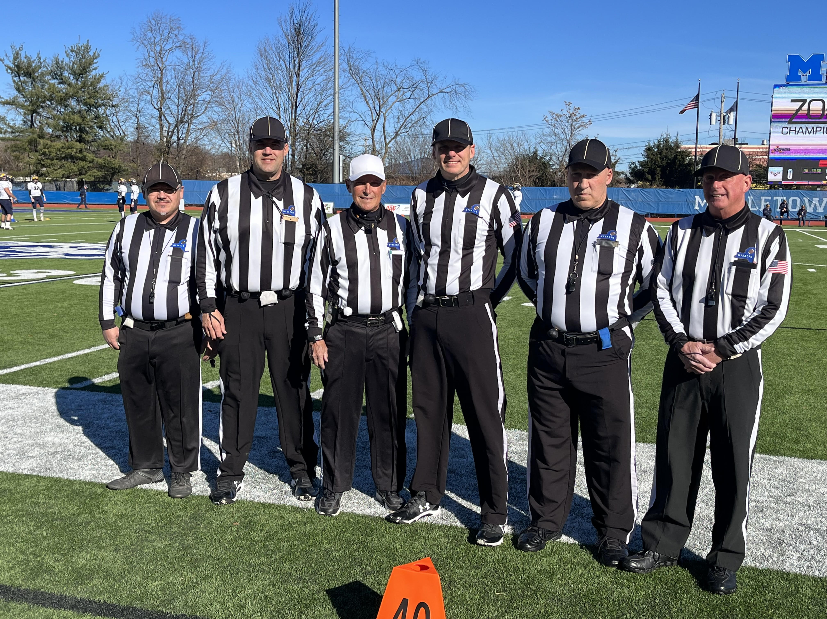


About me

Slide 16
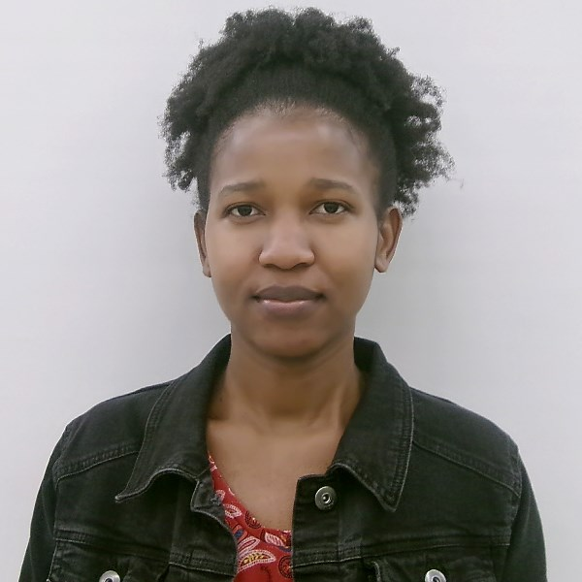
Lead Teaching Assistant
Lilian Ngweta
Office hours: F 14:00-16:00, AE 127
Lilian will handle much of the admin work (e.g. updating Submitty), posting grades, etc.

Slide 17
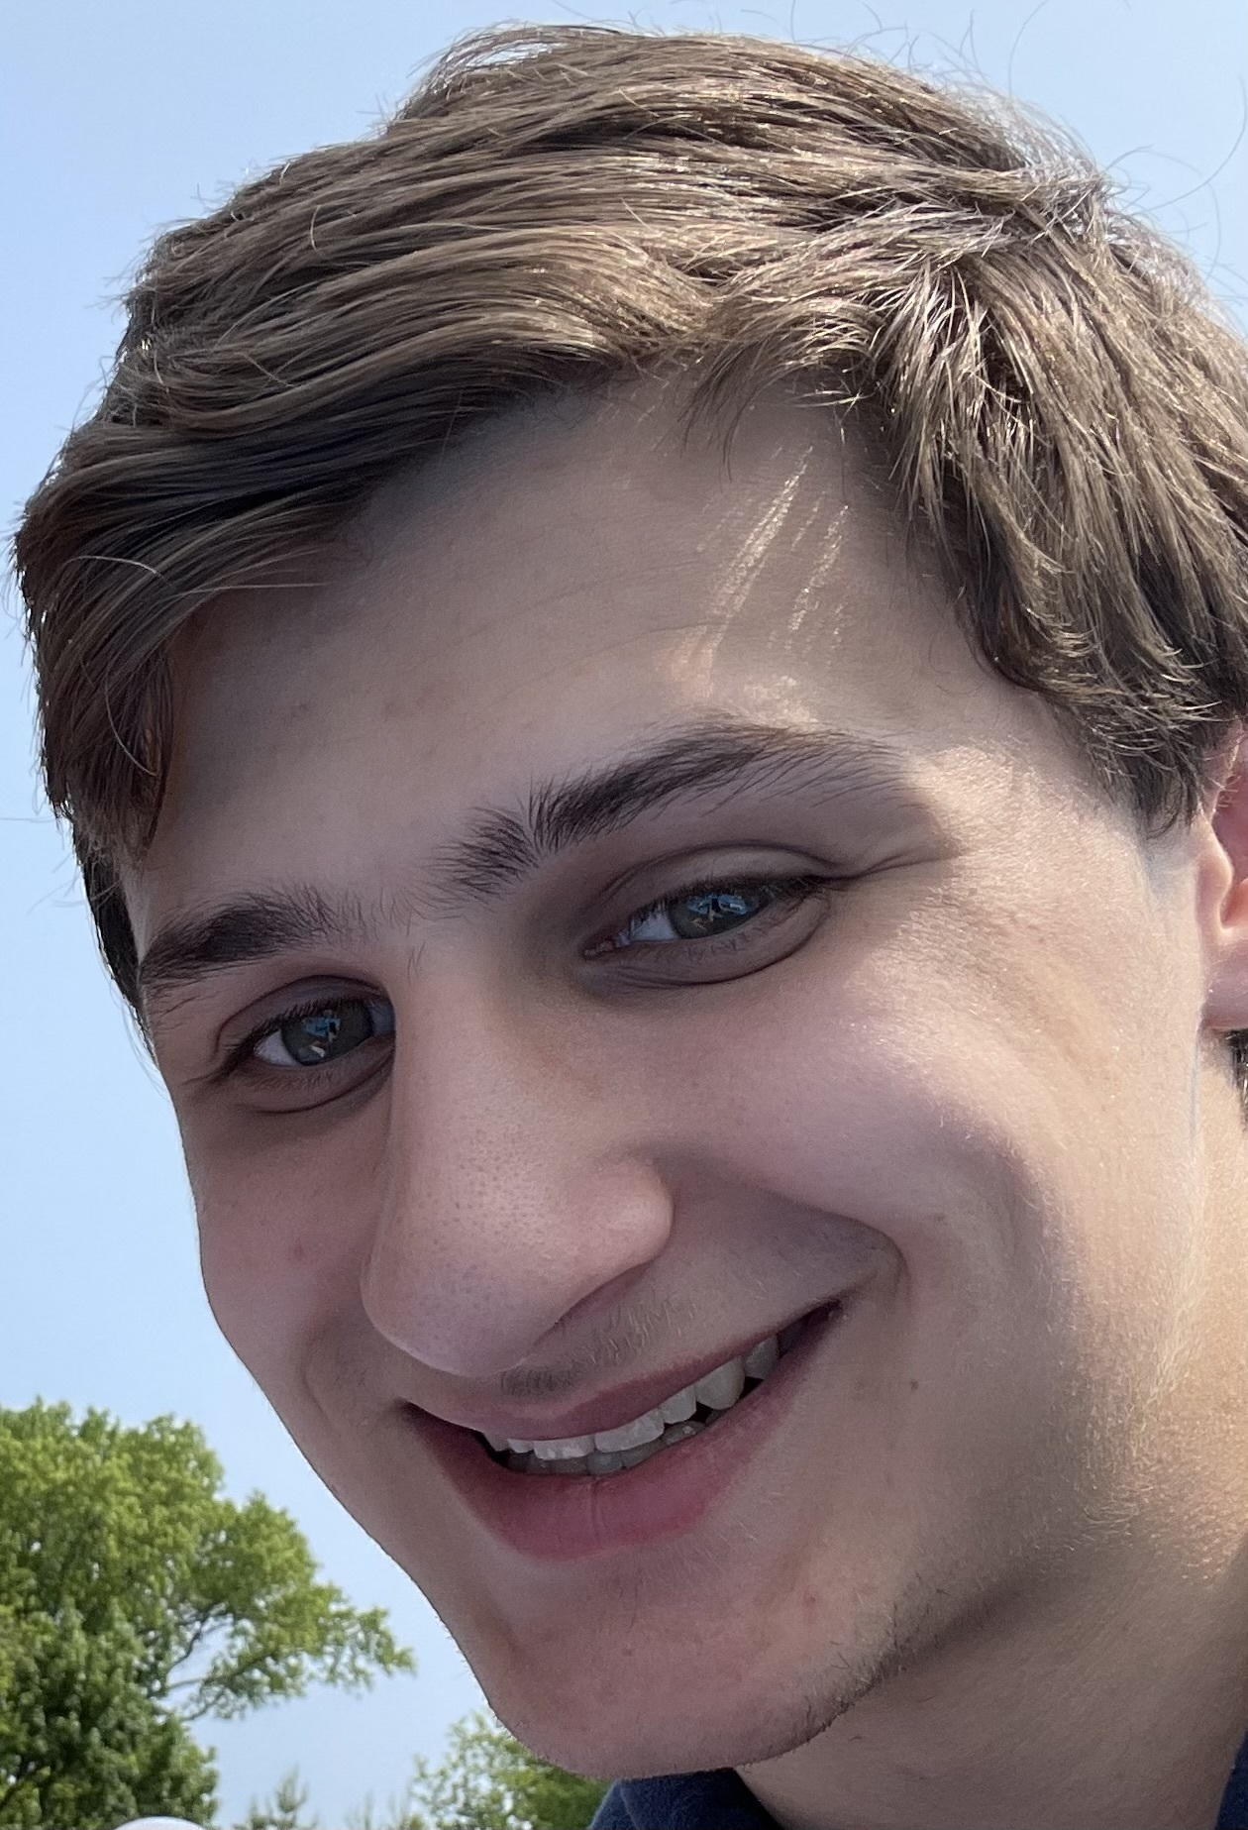
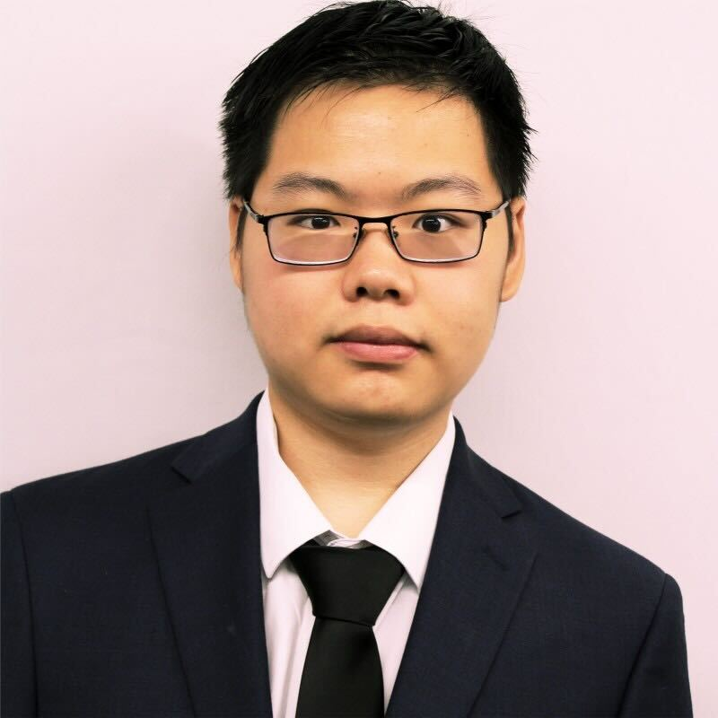
Section TAs/Cas (all recitations in Troy 2018)
Section 1 – Eric Scheer
Recitation: W 10:00 – 12:00
Office hours: Tu 10:00 – 12:00, AE 127
Section 2 – Mei Huang
Recitation: W 12:00 – 14:00
Office hours: M 12:00-14:00, AE 127

Slide 18
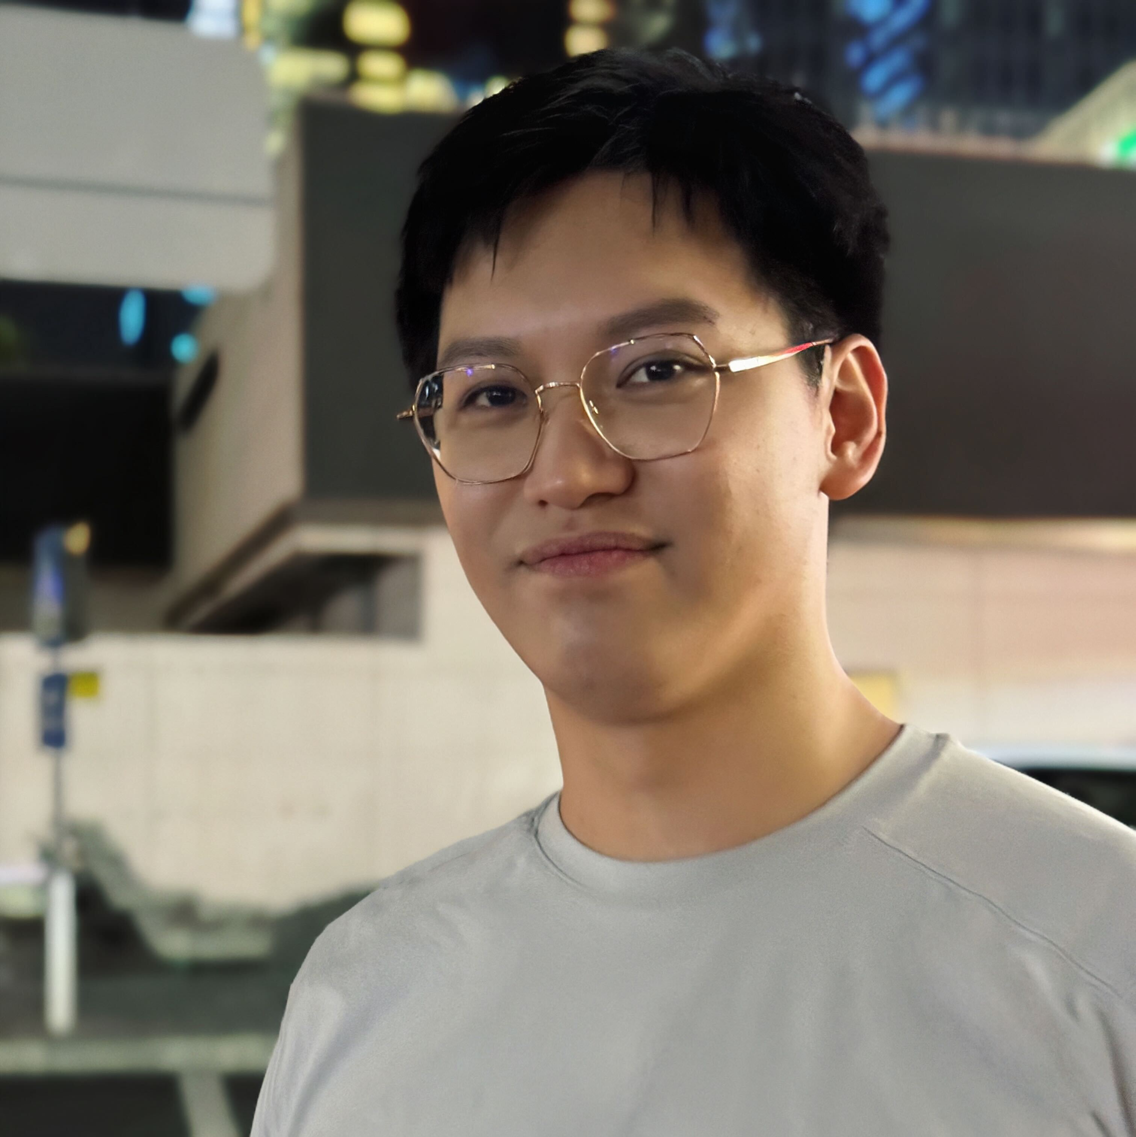
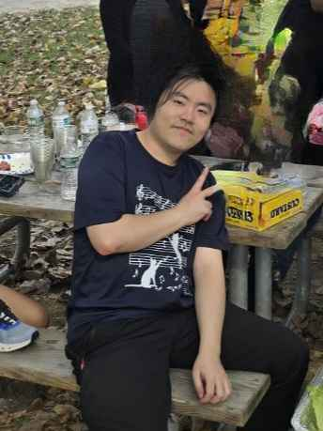
Section TAs/Cas (all recitations in Troy 2018)
Section 3 – Xingjian Zhao
Recitation: W 14:00 – 16:00
Office hours: M 14:00-16:00, AE 127
Section 5 – Jun Kim
Recitation: W 16:00 – 18:00
Office hours: Th 14:00 – 16:00, AE 127

Slide 19
Undergraduate mentors
Angelo Arrandale (arrana2)
Brian Diep (diepb)
Catherine Li (lic26)
Sophia Lin (lins12)
Ronin Silvestre (silver3)
William Young (youngw)
Justin Zhang (zhangj50)

Slide 20
Course structure and details
Syllabus stuff

Slide 21
Course website & schedule of topics
https://www.cs.rpi.edu/~gittea/old-site/teaching/spring2025/focs.html
  Includes syllabus & links to all other items
Schedule of topics: https://www.cs.rpi.edu/~ditursi/FOCS/S25_Course_Schedule.pdf

Slide 22
Submitty
CS department’s LMS (learning management system)
Homework submitted here
Grades posted here
https://submitty.cs.rpi.edu
However, do not use the Discussion Forum feature. For that we have…

Slide 23
Piazza
This is the place for discussion of course concepts, homework assignments, etc.
Wiki-style editing
Permits anonymous posting
https://piazza.com/rpi/spring2025/csci2200

Slide 24
Attendance
Lecture & Recitation: Attendance will not be tracked. However, we are likely to have MUCH more sympathy for students who attend regularly.
Exams: Excused absences must be arranged one week in advance. Unexcused absences will be a zero.

Slide 25
A note about final exams
The instructors have NO control over when during exam week the final will take place.
Therefore, you must ensure that you can be on campus through the end of exam week.
In particular, end-of-semester travel is NOT considered a valid reason to miss your final exam, and makeups will not be given for this reason.

Slide 26
Academic Integrity
Any instance of academic dishonesty is grounds for immediate failure of the course. You have been warned.

Slide 27
Academic Integrity – Specifics
Chegg, StackOverflow, and similar sites are NOT ALLOWED.
ChatGPT, CoPilot, and any other so-called “AI” model are NOT ALLOWED.
No collaboration during exams.
Homework answers must be your own, but you may help each other out.

Slide 28
Grading
Homework: 22%
2% each
13 assignments, 2 dropped
In-semester exams: 51%
17% each; exam dates are Jan. 29, Feb. 26, and Apr. 9
Final exam: 27%
Cumulative
End of semester travel is NOT AN EXCUSE for missing the exam.

Slide 29
Partial credit
All problems on homeworks and exams require you to show your work. For each problem, students receive:
  100% for a correct solution with work shown
  80% for significant progress with work shown
  50% for demonstrating that you understand the problem and making a reasonable attempt that failed
  0% for a serious error or lack of understanding

Slide 30
Deadlines…
… are firm!
Homeworks are due at 8:59pm on Thursdays. There will be no extensions.
(However, the two lowest HW scores will be dropped.)

Slide 31
Self-care
No course is worth damaging your health.
Take care of yourself: Eat, sleep, shower, take breaks, exercise, socialize, etc.
Take care of each other: Check in, say hello, don’t let someone suffer in silence.
Don’t be afraid to ask for help: We are more than happy to work with you, but YOU need to communicate.

Slide 32
Appetizer problems

Slide 33
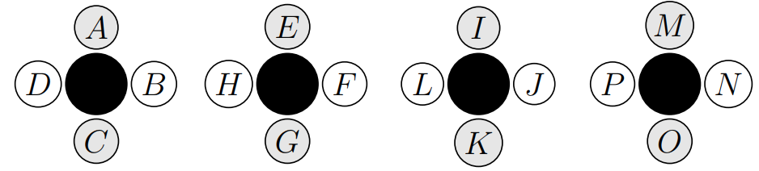
Lab groups
A science class has 16 students in a lab section, and they need to be put in groups of four students for each lab. You want students to work with many different students as quickly as possible.
One person (e.g. Student P) could work with all 15 other students after five labs. Can EVERYBODY do so? If not, what’s the minimum number of labs needed?

Slide 34
You have to PLAY with your food math.
As Malik says in the text, mathematics is NOT a spectator sport.
It’s not enough to listen, to read, or to study. (Though those things are useful, too.) You have to actually DO it.

Slide 35
Lab groups – try it!
A science class has 16 students in a lab section, and they need to be put in groups of four students for each lab. You want students to work with many different students as quickly as possible.
DO NOW: Find an arrangement of the first two labs that allows every student to work with six different students.
If you finish quickly, extend it to the third lab, where every student works with NINE different students.

Slide 36
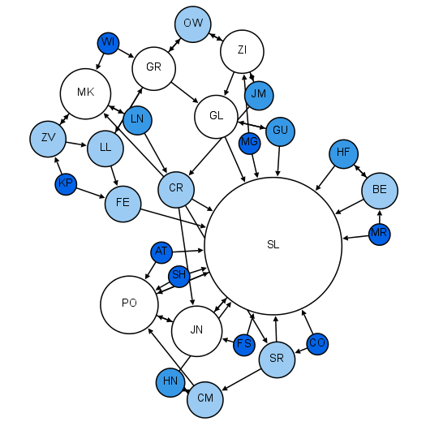
Contact tracing
If you could construct a network of who everyone came into contact with on a regular basis, could you develop a vaccine priority strategy that minimized disease spread?
DO NOW: Talk with your classmates. What would be a good way to measure “importance” in this network?

Slide 37

Tile the plane
Imagine a sheet of square-grid graph paper. If you had a whole bunch of copies of the tiles shown at left (without rotating them), could you fill the graph paper such that every edge had the same color on either side?
How would you go about solving this?

Slide 38
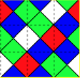

Slide 39
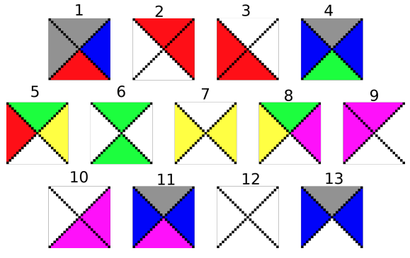
Tile the plane
Imagine a sheet of square-grid graph paper. If you had a whole bunch of copies of the tiles shown at left (without rotating them), could you fill the graph paper such that every edge had the same color on either side?
Could you write a computer program to solve this?

Slide 40
Working the problem
Model the problem using a discrete structure.
Play with a small version of the problem – look for a pattern.
Guess what the general solution might be, based on your pattern.
Prove your solution is correct!

