Slide 1
Lecture 3: Propositional and Predicate Logic
CSCI 2200 Foundations of Computer Science

Slide 2

Lecture 3: Propositional and Predicate Logic
CSCI 2200 Foundations of Computer Science
“Secret Course” from Super Mario Sunshine, Koji Kondo

Slide 3
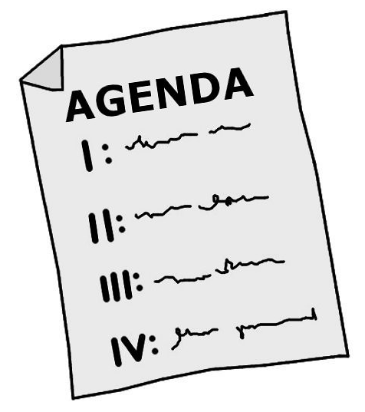
Plan for today
Questions from HW
Mathematical / logical statements: propositional logic
Adding functions and variables: predicate logic

Slide 4
HW questions?

Slide 5
Propositional Logic

Slide 6
Propositions
The most basic type of logical statement is a proposition. This is an unambiguous sentence that can be assigned a truth value: True or False.
There are exactly 137 people in this room.
Dan’s car is silver.
Leicester City has won a Premier League trophy.
Note: We might not know whether or not it’s true or false. But it must be one or the other; there is no third option. This is known as the Law of the Excluded Middle.

Slide 7
Operations with logical statements
We’ll use lowercase letters (often p & q) to represent individual propositions.
p: “Dan is taking Web Systems Development.” q: “Dan is taking Database Systems.”
The primary logical operations are:
NOT (¬, !, ~, −)
¬p = “Dan is not taking Web.”
AND (∧, &, &&, *, ⋅)
p ∧ q = “Dan is taking Web and Dan is taking DB.”
OR (∨, |, ||, +)
p ∨ q = “Dan is taking Web or Dan is taking DB.”

Slide 8
Inclusive vs. exclusive OR
p: “Dan is taking Web Systems Development.” q: “Dan is taking Database Systems.”
OR is inclusive – it allows for the possibility of both halves being true.
p ∨ q = “Dan is taking only Web, DB, or both.”
XOR is exclusive – it is False when both halves are true.
p ⊕ q = “Dan is taking Web without DB, or Dan is taking DB without Web.”

Slide 9
Quick practice
p: “Dan is taking Web Systems Development.” q: “Dan is taking Database Systems.”
What do the following statements say?
p ∨ ¬ q
¬ p ∧ ¬ q
¬ (p ∧ q)

Slide 10
Quick practice
p: “Dan is taking Web Systems Development.” q: “Dan is taking Database Systems.”
What do the following statements say?
p ∨ ¬ q
Dan is taking Web or he is not taking DB.
¬ p ∧ ¬ q
Dan is not taking Web and he is not taking DB.
¬ (p ∧ q)
Dan is not taking both Web and DB together.

Slide 11
DeMorgan’s Laws (redux)
Once again, to distribute a NOT through an AND or an OR:
First, negate each piece of the compound statement.
Then swap AND for OR and vice versa.
¬ (p ∧ q) = ¬p ∨ ¬q = NOT BOTH
¬ (p ∨ q) = ¬p ∧ ¬q = NEITHER

Slide 12
DeMorgan’s Laws (redux)
p: “Dan is taking Web Systems Development.” q: “Dan is taking Database Systems.”
¬ (p ∧ q) = ¬p ∨ ¬q = NOT BOTH
Dan is not taking both Web and DB together.
Dan is not taking Web OR Dan is not taking DB.
¬ (p ∨ q) = ¬p ∧ ¬q = NEITHER
Dan is taking neither Web nor DB.
Dan is not taking Web AND Dan is not taking DB.

Slide 13
Implications
“If … then” statements are critical in both natural and computer languages, and also in propositional logic. Consider:
“If you go to every class session, then you will pass the course.”
How can we evaluate the truth of this statement? What information do we need?
How many individual propositions are contained in that statement?

Slide 14
Implications, cont’d.
“If you go to every class session, then you will pass the course.”
p = “You go to every class session.” q = “You will pass the course.” We represent the full statement as p ⇒ q (“if p, then q” or “p implies q”)

Slide 15
Implications, cont’d.
“If you go to every class session, then you will pass the course.”
p = “You go to every class session.” q = “You will pass the course.”
When is this false?
When you miss class?
When you pass the course?
When you fail the course?

Slide 16
Implications, cont’d.
“If you go to every class session, then you will pass the course.”
p = “You go to every class session.” q = “You will pass the course.”
The only way an implication becomes false is when the first part (the antecedent) is true and the second part (the consequence) is false.
Here, that would mean you go to every class session and still fail. If I’d put the top sentence in the syllabus and that happened, you’d have grounds to be mad.
Thus, in all other situation, the implication is TRUE.

Slide 17
More implications
If it is raining, then it is cloudy.
Suppose it is cloudy. Do you learn anything else?
Under what circumstances do you gain information?
“If you are a Scottish lord, then I am Mickey Mouse!”
In this quote from Indiana Jones and the Last Crusade, what is the butler trying to convey?
As a general note, implications in propositional logic feel a bit… weird. They make much more sense once we are talking about quantifiers (in a few slides).

Slide 18
Reversing implications
HUGELY IMPORTANT: p ⇒ q and q ⇒ p are not the same thing!!
“If you go to every class session, then you will pass the course.”
This does not mean that everyone who passes has gone to every class session!
… but what about everyone who fails the class? Can we conclude anything about them?

Slide 19
The contrapositive
p ⇒ q: “If you go to every class session, then you will pass the course.”
If the above is true, then if someone fails the course, they must not have gone to every class.
Symbolically p ⇒ q is logically equivalent to ¬ q ⇒ ¬ p; anytime one is true, the other is true and vice versa.

Slide 20
Rules of inference (syllogisms)
Given an implication p ⇒ q, if you also know…
p, then you may conclude q. This rule is called modus ponens.
“If you go to every class session, you will pass the course.” “You have gone to every class session.” Therefore: “You pass the course.”
¬q, then you may conclude ¬p. This is called modus tollens.
“If you are a Scottish lord, then I am Mickey Mouse!” “I am not Mickey Mouse.” Therefore: “You are not a Scottish lord.”

Slide 21
Truth tables
Truth tables are an exhaustive approach to breaking down compound logical statements into the basic propositions. For example:
p | q | p ∧ q
T | T | T
T | F | F
F | T | F
F | F | F
p | q | p ⇒ q
T | T | T
T | F | F
F | T | T
F | F | T

Slide 22
Quick practice
Make truth tables for the following:
¬ p ∨ q
¬ p ⇒ q
(p ∧ ¬ q) ∨ r (note: 8 rows needed)
(¬ p ∨ q) ⇒ p (note: you may want an extra column)

Slide 23
Quick practice
Make truth tables for the following:
¬ p ∨ q
(¬ p) ⇒ q
p | q | ¬ p ∨ q
T | T | T
T | F | F
F | T | T
F | F | T
p | q | (¬ p) ⇒ q
T | T | T
T | F | T
F | T | T
F | F | F

Slide 24
Quick practice
Make truth tables for the following:
(p ∧ ¬ q) ∨ r
p | q | r | (p ∧ ¬ q) ∨ r
T | T | T | T
T | T | F | F
T | F | T | T
T | F | F | T
F | T | T | T
F | T | F | F
F | F | T | T
F | F | F | F

Slide 25
Quick practice
Make truth tables for the following:
(¬ p ∨ q) ⇒ p (note: you may want an extra column)
p | q | ¬ p ∨ q | (¬ p ∨ q) ⇒ p
T | T | T | T
T | F | F | T
F | T | T | F
F | F | T | F

Slide 26
Predicate Logic

Slide 27
Dealing with large sets in logic
“Every student in section 3 is a computer science major.”
Could that be a proposition?
Sure.
But it’s a bit… unwieldy. There’s no granularity, no way to put this in terms of individual students unless we do something like: p₁ = “Kai is a CS major.” p₂ = “Carina is a CS major.” … p₂₉ = “Kelton is a CS major.” And then do p₁∧ p₂ ∧ p₃ ∧ … ∧ p₂₉

Slide 28
Too much writing…
It would be nice to not need to lay out all of these propositions individually.
As programmers, we try to automate repetitive tasks. How might we handle this sort of thing in Python?

Slide 29

Python Break!
You have a string S. You want to check if that string represents a number; that is, you need to ensure every character is a digit.
if S[0] >= ‘0’ and S[0] <= ‘9’ and S[1] >= ‘0’ and S[1] <= ‘9’ and S[2] >= ‘0’ and S[2] <= ‘9’ and ...
Of course not! You would use a variable, a binary function, and a loop!
for c in S: if !isdigit(c): return False return True

Slide 30
Predicates
A predicate is a Boolean function whose input(s) are elements of U (the universe of discourse).
C(x) = x is a computer science major.
p₁ = C(Kwasi) p₂ = C(Barbara) … p₆₄ = C(Demetrios)
Well, it’s shorter. But we still need some way to “loop” to really improve things…

Slide 31
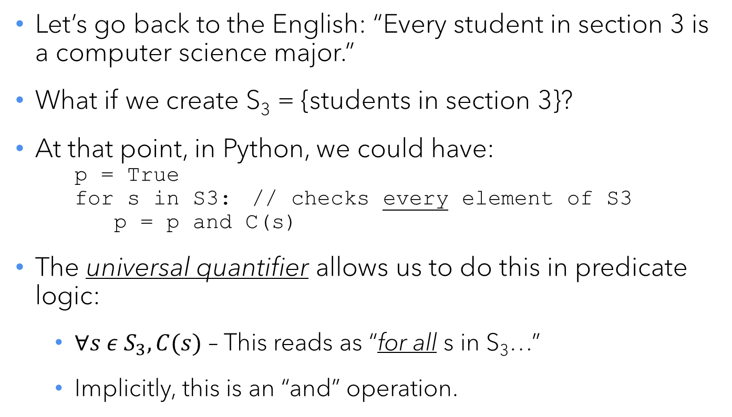
The universal quantifier
Let’s go back to the English: “Every student in section 3 is a computer science major.”
What if we create S₃ = {students in section 3}?
At that point, in Python, we could have: p = True for s in S3: // checks every element of S3 p = p and C(s)
The universal quantifier allows us to do this in predicate logic:
$∀s ε S_{3}, C(s)$ – This reads as “for all s in S₃…”
Implicitly, this is an “and” operation.

Slide 32

Questions of existence…
q = “One among us is an Impostor.”
Without quantifiers: q₁ = “Green is an Impostor.” … q₈ = “Cyan is an Impostor.” q = q₁ ∨ q₂ ∨ q₃ ∨ … ∨ q₈
(Note the or operation here…)

Slide 33
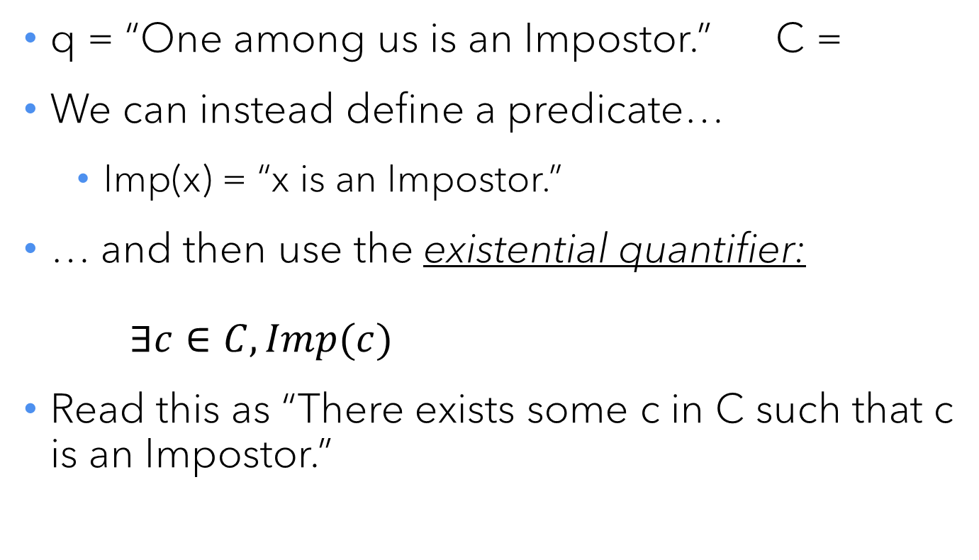
The existential quantifier
q = “One among us is an Impostor.” C =
We can instead define a predicate…
Imp(x) = “x is an Impostor.”
… and then use the existential quantifier: $∃c∈C, Imp(c)$
Read this as “There exists some c in C such that c is an Impostor.”

Slide 34
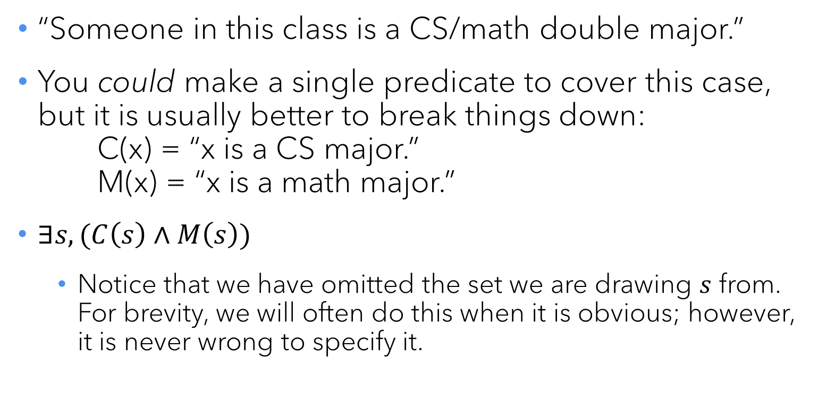
Quantified compound statements
“Someone in this class is a CS/math double major.”
You could make a single predicate to cover this case, but it is usually better to break things down: C(x) = “x is a CS major.” M(x) = “x is a math major.”
$∃s, (C\left(s\right)∧M\left(s\right))$
Notice that we have omitted the set we are drawing $s$ from. For brevity, we will often do this when it is obvious; however, it is never wrong to specify it.

Slide 35
Negating quantifiers
“There is no such thing as a flying horse.”
Given H(x) = “x is a horse” and F(x) is “x can fly”, how would you write this?

Slide 36
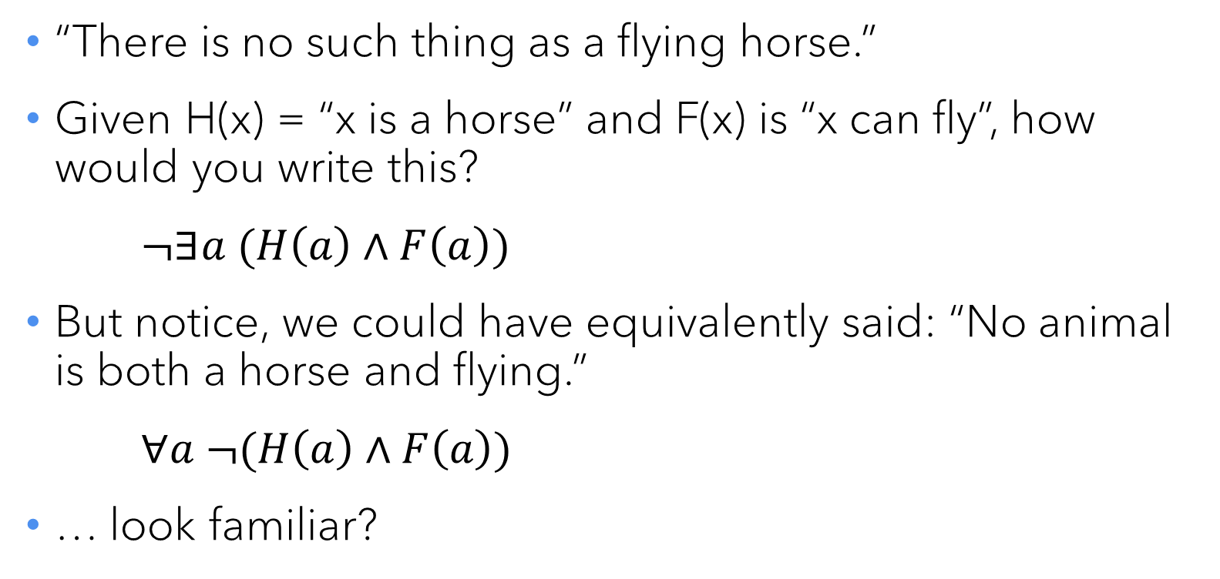
Negating quantifiers
“There is no such thing as a flying horse.”
Given H(x) = “x is a horse” and F(x) is “x can fly”, how would you write this?
$¬∃a (H\left(a\right)∧F\left(a\right))$
But notice, we could have equivalently said: “No animal is both a horse and flying.”
$∀a ¬(H\left(a\right)∧F\left(a\right))$
… look familiar?

Slide 37
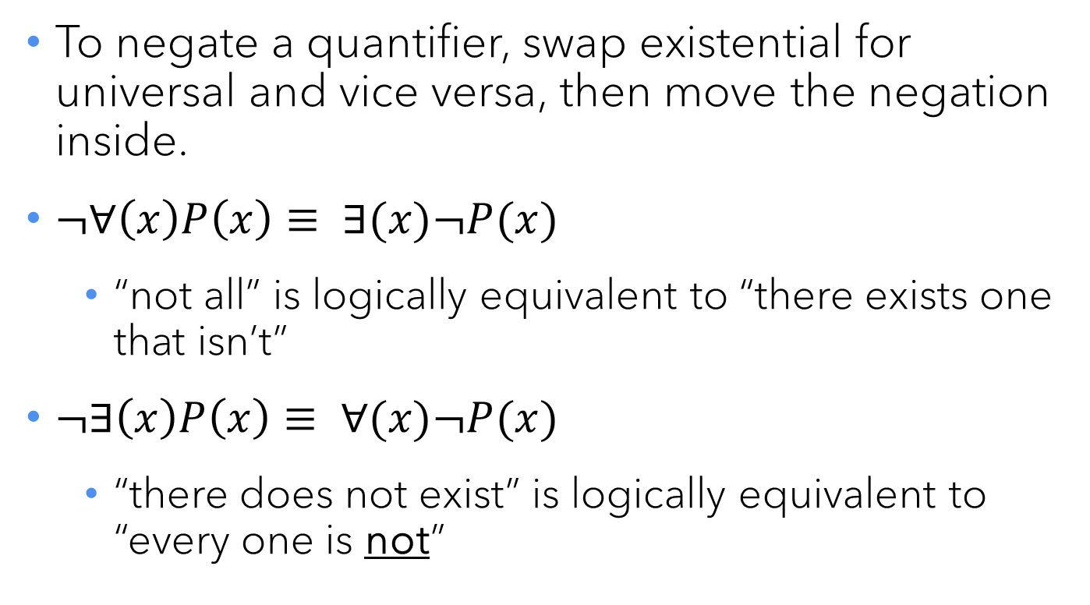
DeMorgan’s Laws (yet again!)
To negate a quantifier, swap existential for universal and vice versa, then move the negation inside.
$¬∀\left(x\right)P\left(x\right)≡ ∃(x)¬P(x)$
“not all” is logically equivalent to “there exists one that isn’t”
$¬∃\left(x\right)P\left(x\right)≡ ∀(x)¬P(x)$
“there does not exist” is logically equivalent to “every one is not”

Slide 38
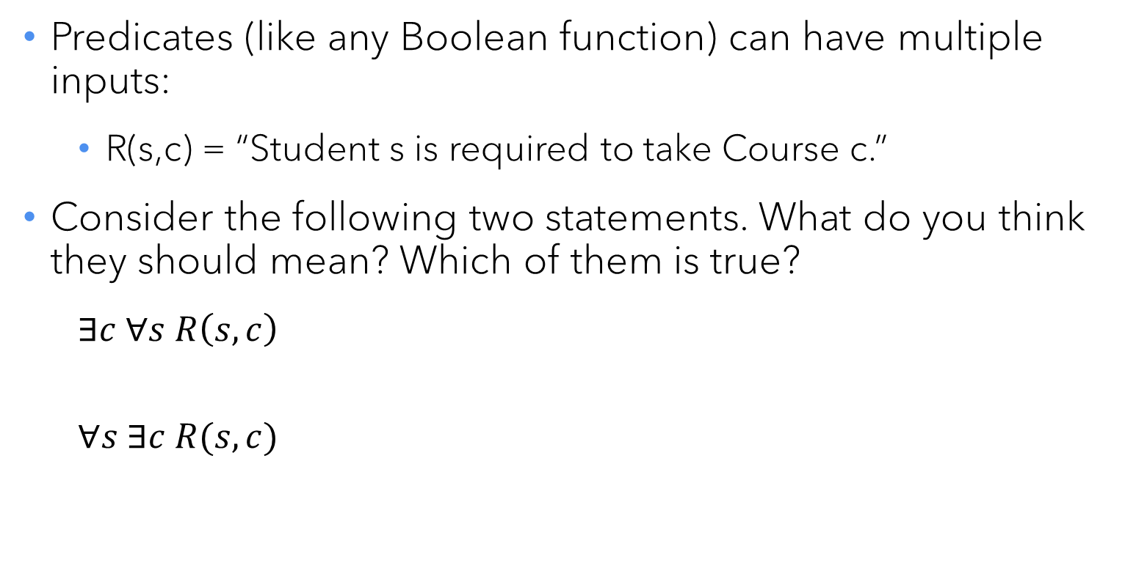
Multiple variables and mixing quantifiers
Predicates (like any Boolean function) can have multiple inputs:
R(s,c) = “Student s is required to take Course c.”
Consider the following two statements. What do you think they should mean? Which of them is true?
$∃c ∀s R\left(s,c\right)$
$$∀s ∃c R(s,c)$$

Slide 39
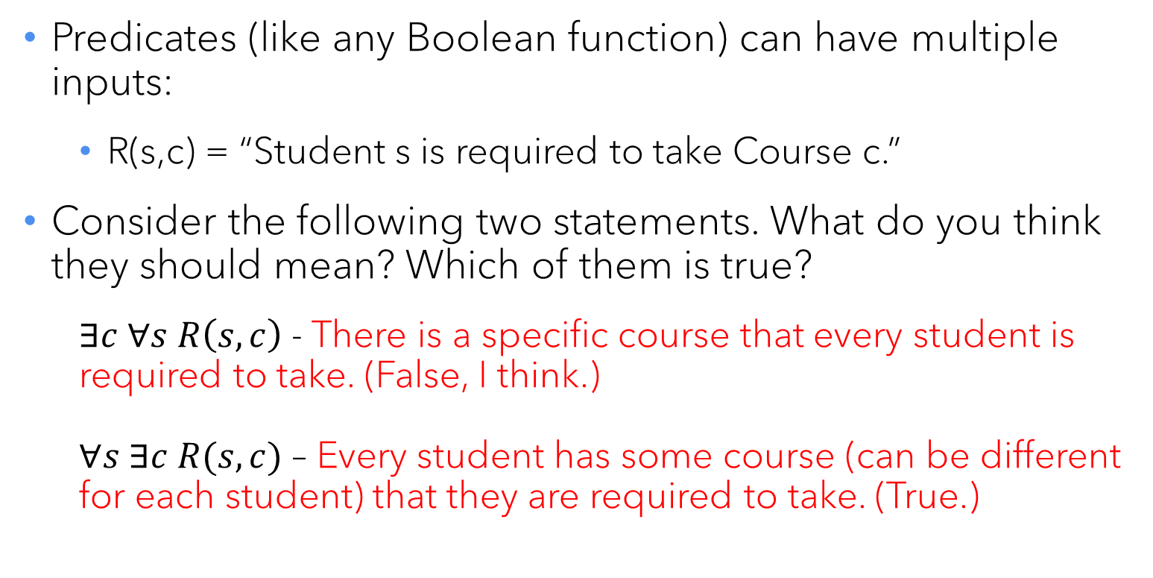
Multiple variables and mixing quantifiers
Predicates (like any Boolean function) can have multiple inputs:
R(s,c) = “Student s is required to take Course c.”
Consider the following two statements. What do you think they should mean? Which of them is true?
$∃c ∀s R\left(s,c\right)$ - There is a specific course that every student is required to take. (False, I think.) $∀s ∃c R(s,c)$ – Every student has some course (can be different for each student) that they are required to take. (True.)

Slide 40
Quick practice
C(s) = “s is a computer science major.” M(s) = “s is a math major.” Ph(c) = “c is a philosophy course.” R(s,c) = “s is required to take c.”
Write the following English sentences in predicate logic.
“No students are CS/math double majors.”
“There is at least one course that every CS major and every math major must take.”
“No CS major has a required philosophy course.”
“Every math major must take some philosophy course.”
“There is a specific philosophy course that every math major must take.

Slide 41
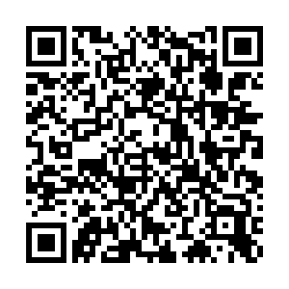
Today’s class survey
Please complete the class survey now.
Recitations on Wednesday – you are encouraged to attend.
Submissions for Problem Set 1 due Thursday.

