Slide 1
Lecture 4: Proof Techniques
CSCI 2200 Foundations of Computer Science

Slide 2

Lecture 4: Proof Techniques
CSCI 2200 Foundations of Computer Science
“Mute City” by Yumiko Kanki (from F-Zero)

Slide 3
Announcements & reminders
Dr. DiTursi’s office hours for this week and next week:
Tuesday 9:30 – 12:00 and Friday 12:00 – 14:30
TA Eric’s office hours for the rest of the semester:
Thursday 12:00 – 14:00
HW1 due tonight before 9pm. HW2 posted after class today.
No class on Monday; Monday is also the add/drop deadline.
Exam 1 is in less than two weeks. (Wed. 1/29)

Slide 4

Plan for today
Proving a quantified statement
Proving & disproving implications
Proving “if and only if”
Indirect proofs (proofs by contradiction)
Proofs about sets

Slide 5

But first, a word from our sponsor textbook author…
A proof is a mathematical essay.
The goal of a proof is to convince a reader of a theorem.
A proof that leaves a reader with some doubts has failed.
Therefore, a proof must be well written, so that the reader can follow the chain of reasoning.
Among other things, that means you should… proofread!

Slide 6

Which of these are hard/easy to prove?
$∀x P\left(x\right)$
$∃x P\left(x\right)$
$¬∀x P\left(x\right)$
$¬∃x P\left(x\right)$

Slide 7
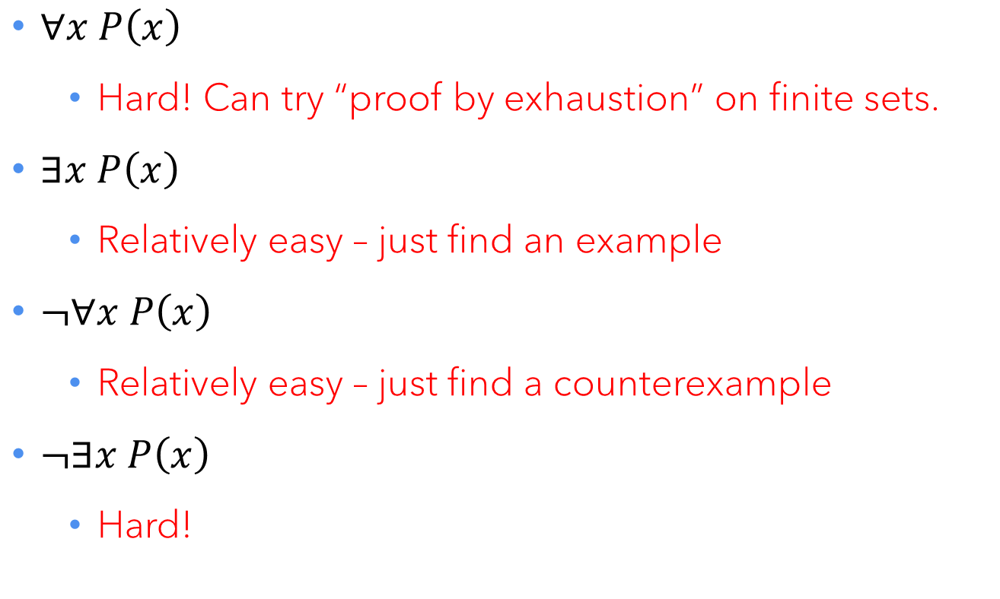
Which of these are hard/easy to prove?
$∀x P\left(x\right)$
Hard! Can try “proof by exhaustion” on finite sets.
$∃x P\left(x\right)$
Relatively easy – just find an example
$¬∀x P\left(x\right)$
Relatively easy – just find a counterexample
$¬∃x P\left(x\right)$
Hard!

Slide 8
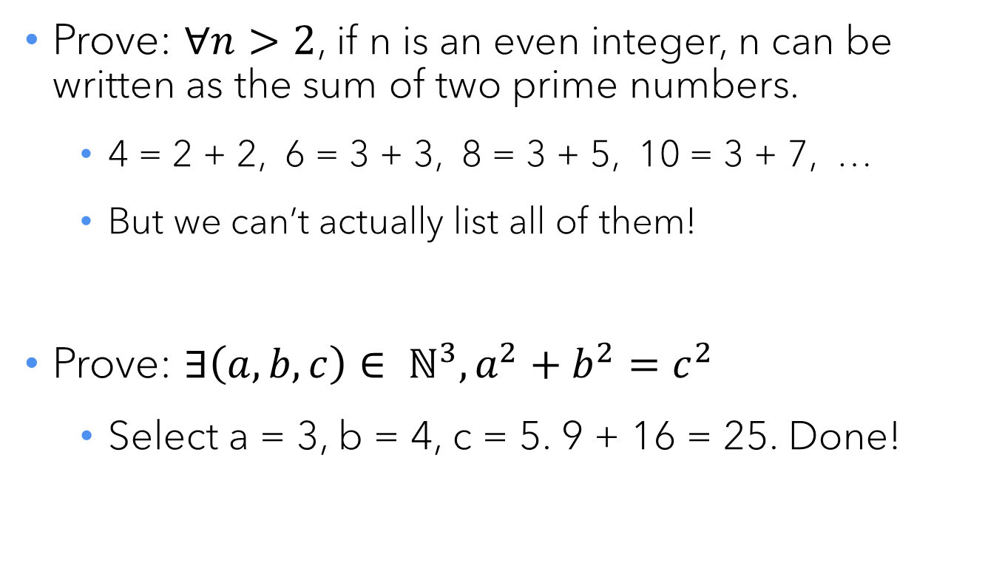
Concrete examples
Prove: $∀n>2$, if n is an even integer, n can be written as the sum of two prime numbers.
4 = 2 + 2, 6 = 3 + 3, 8 = 3 + 5, 10 = 3 + 7, …
But we can’t actually list all of them!
Prove: $∃\left(a,b,c\right)∈ ℕ^{3}, a^{2}+b^{2}=c^{2}$
Select a = 3, b = 4, c = 5. 9 + 16 = 25. Done!

Slide 9
A few number theory facts

Slide 10

Divisibility and remainders
What does “n is divisible by 3” mean?
n = 3k, for some integer k (yes, this includes zero)
“n is odd” means n = 2k + 1
“n mod 4 = 3” means n = 4k + 3
“n is composite” means n = pq, for integers p,q > 1 “n is prime” means n > 1 and not composite
$n∈ℚ$ means n = p / q, for integers p,q ≠ 0

Slide 11
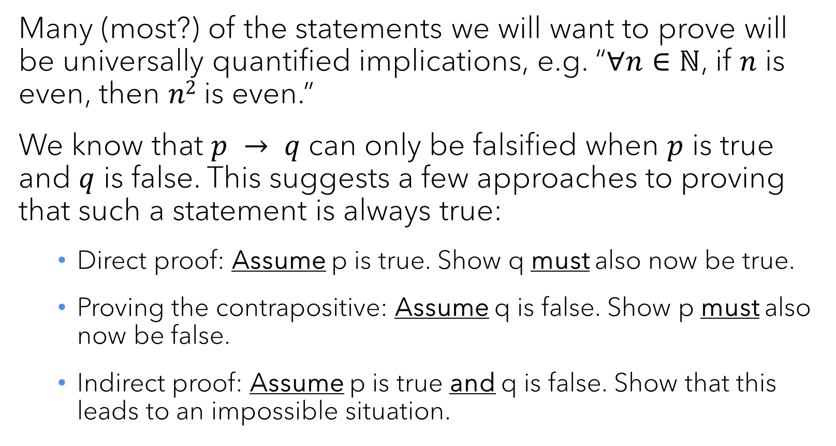
Reasoning about implications
Many (most?) of the statements we will want to prove will be universally quantified implications, e.g. “$∀n∈ℕ$, if $n$ is even, then $n2$ is even.”
We know that $p → q$ can only be falsified when $p$ is true and $q$ is false. This suggests a few approaches to proving that such a statement is always true:
Direct proof: Assume p is true. Show q must also now be true.
Proving the contrapositive: Assume q is false. Show p must also now be false.
Indirect proof: Assume p is true and q is false. Show that this leads to an impossible situation.

Slide 12
Direct proofs

Slide 13
Direct proof – steps
Clearly state your claim. (“If p, then q.”)
Assume the antecedent. (“Assume p is true.”)
Use known mathematical facts to create a chain of true statements that ends at the consequence. (“Because p, we know …, which then means that …, which in turn implies … q!”)
State that you have proven the claim. (“Therefore, we have proven that p implies q.”)
Use an end-of-proof marker. (“QED” or ∎)

Slide 14
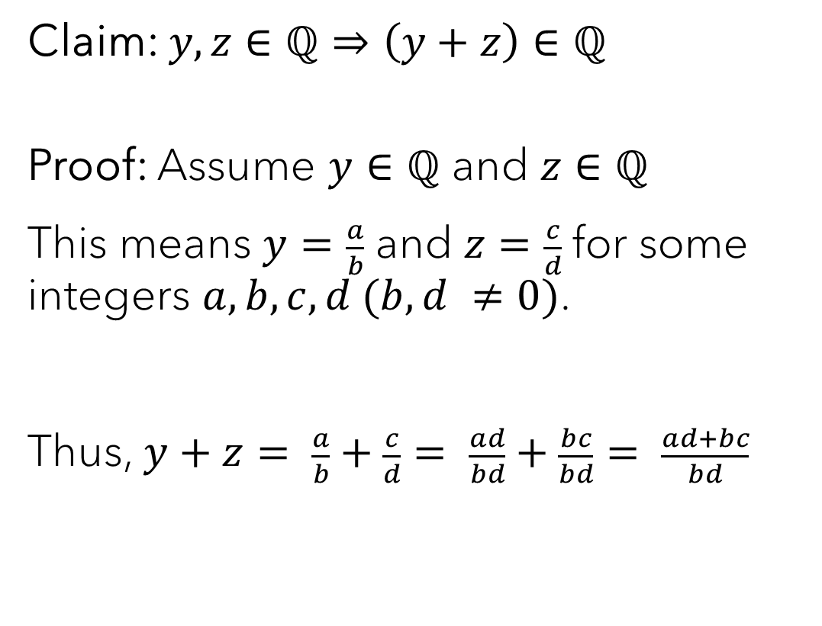
Direct proof – example #1
Claim: $y,z∈ℚ⇒\left(y+z\right)∈ℚ$
Proof: Assume $y∈ℚ$ and $z∈ℚ$
This means $y=\frac{a}{b}$ and $z=\frac{c}{d}$for some integers $a,b,c,d (b,d ≠0)$.
Thus, $y+z= \frac{a}{b}+\frac{c}{d}= \frac{ad}{bd}+\frac{bc}{bd}= \frac{ad+bc}{bd}$
State the claim you wish to prove. (p ⇒ q)
Assume p.
Use the definition of rational number.
Often, algebra required.

Slide 15
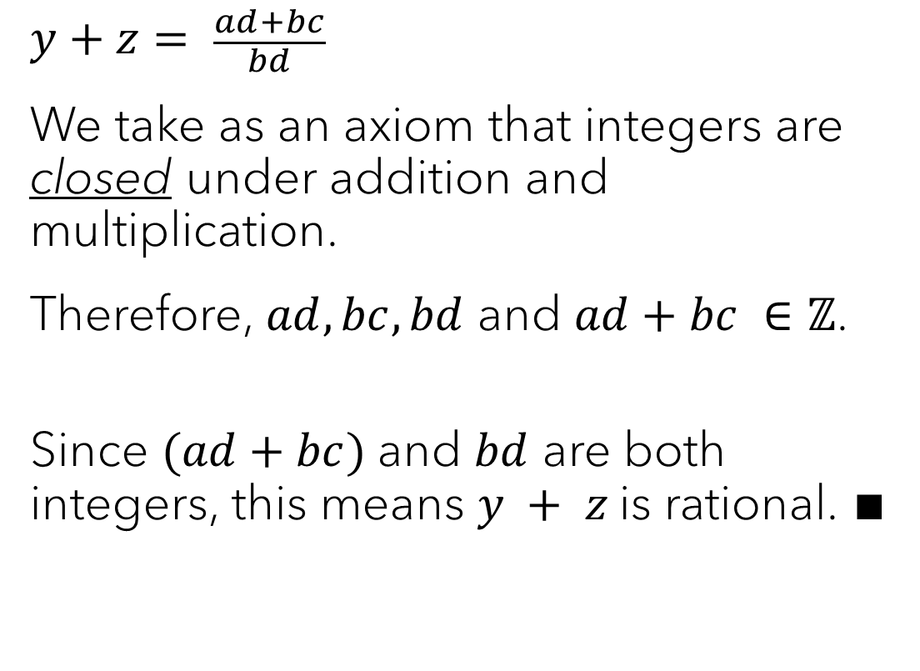
Direct proof – example #1
$$y+z= \frac{ad+bc}{bd}$$
We take as an axiom that integers are closed under addition and multiplication.
Therefore, $ad, bc, bd$ and $ad+bc ∈ℤ$.
Since $(ad+bc)$and $bd$ are both integers, this means $y + z$is rational. ∎
“Axiom” is often code for “this is obvious and I don’t want to prove it.”
Moving back towards the definition of rational.

Slide 16
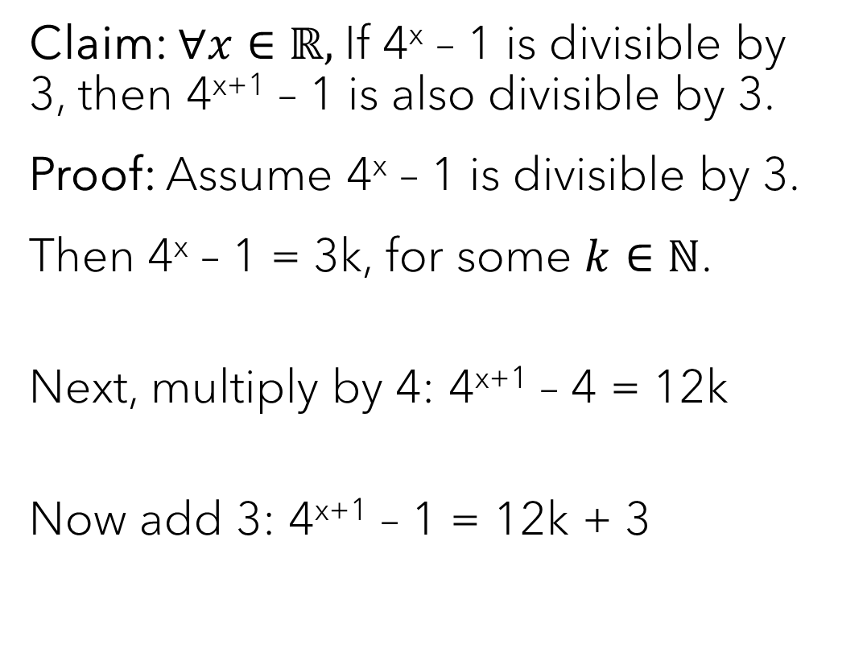
Direct proof – example #2
Claim: $∀x∈ℝ,$If 4^{x} – 1 is divisible by 3, then 4^{x+1} – 1 is also divisible by 3.
Proof: Assume 4^{x} – 1 is divisible by 3.
Then 4^{x} – 1 = 3k, for some $k∈ℕ$.
Next, multiply by 4: 4^{x+1} – 4 = 12k
Now add 3: 4^{x+1} – 1 = 12k + 3
State the claim you wish to prove. (p ⇒ q)
Assume p.
Use the definition of “divisible by 3”.
How do we get to 4^{x+1}?
Continue the process of making it look like q.

Slide 17
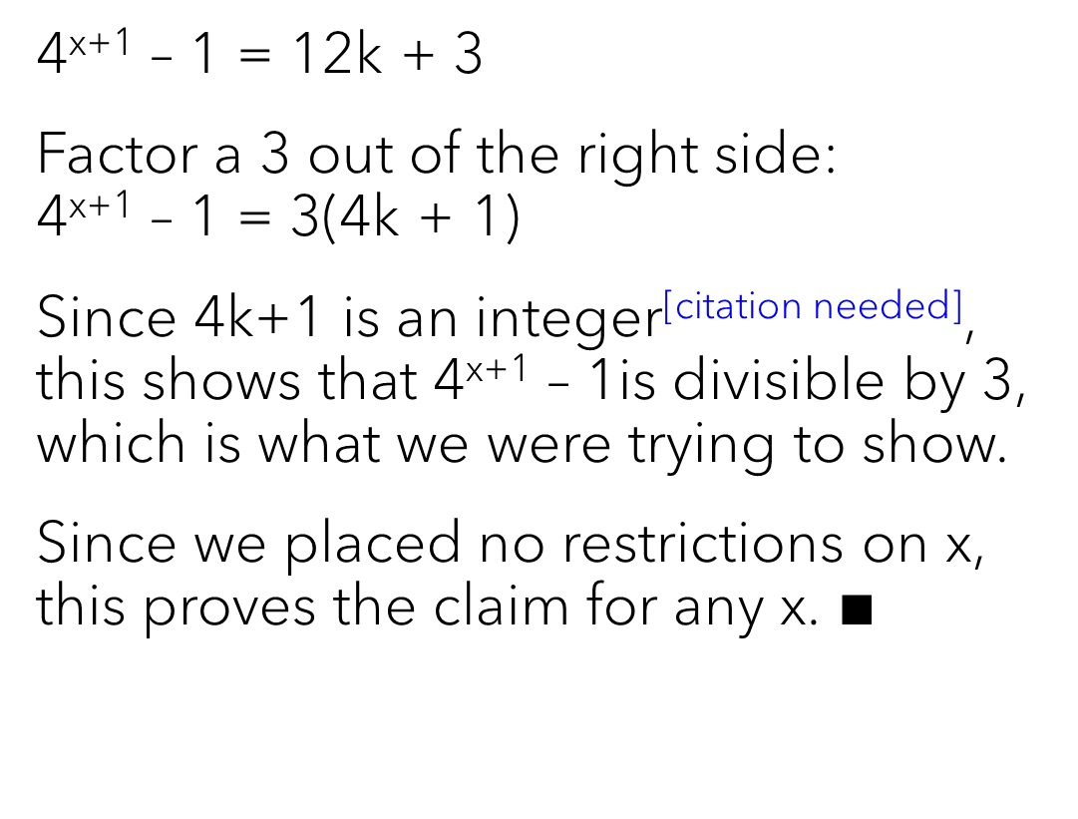
Direct proof – example #2
4^{x+1} – 1 = 12k + 3
Factor a 3 out of the right side: 4^{x+1} – 1 = 3(4k + 1)
Since 4k+1 is an integer^{[citation needed]}, this shows that 4^{x+1} – 1is divisible by 3, which is what we were trying to show.
Since we placed no restrictions on x, this proves the claim for any x. $∎$
Remember, we need to show divisibility by 3.
Use the definition of “divisible by 3” again.
This is a key idea: we said nothing about x as part of proof, so it could have been anything!

Slide 18
Your turn!
Claim: If a and b are even, then a+b is even.

Slide 19
Your turn!
Claim: If a and b are even, then a+b is even.
Proof: Assume a and b are even.
Then a = 2j and b = 2k, where j & k are integers.
a + b = 2j + 2k = 2(j + k)
Since (j + k) is also an integer, (a + b) also meets the definition of even. ∎

Slide 20
Proof by contraposition

Slide 21
Proving the contrapositive – steps
Clearly state your claim. (“If p, then q.”)
Assume the consequence is false. (“Assume ¬q.”)
Use known mathematical facts to create a chain of true statements that ends at the opposite of the antecedent. (“… therefore p must be false.”)
State that you have proven the claim. (“Since we have shown ¬q ⇒ ¬p, we have proven that p implies q.”)
Use an end-of-proof marker. (“QED” or ∎)

Slide 22
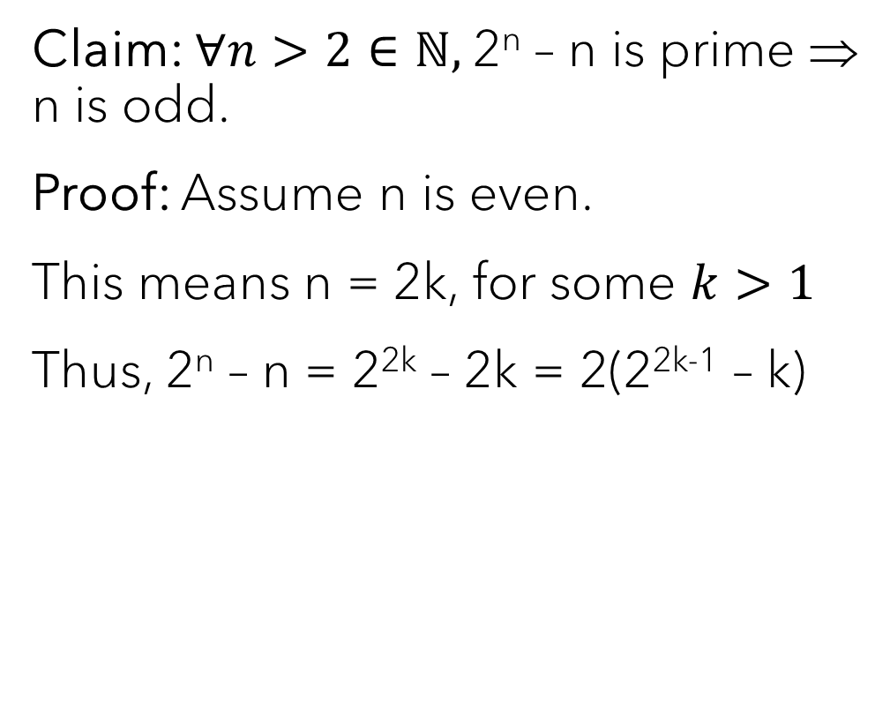
Contrapositive proof – example
Claim: $∀n>2∈ℕ,$2^{n} – n is prime ⇒ n is odd.
Proof: Assume n is even.
This means n = 2k, for some $k>1$
Thus, 2^{n} – n = 2^{2k} – 2k = 2(2^{2k-1} – k)
State the claim you wish to prove. (p ⇒ q)
Assume ¬q.
Definition of even
Work towards the other side of the implication

Slide 23
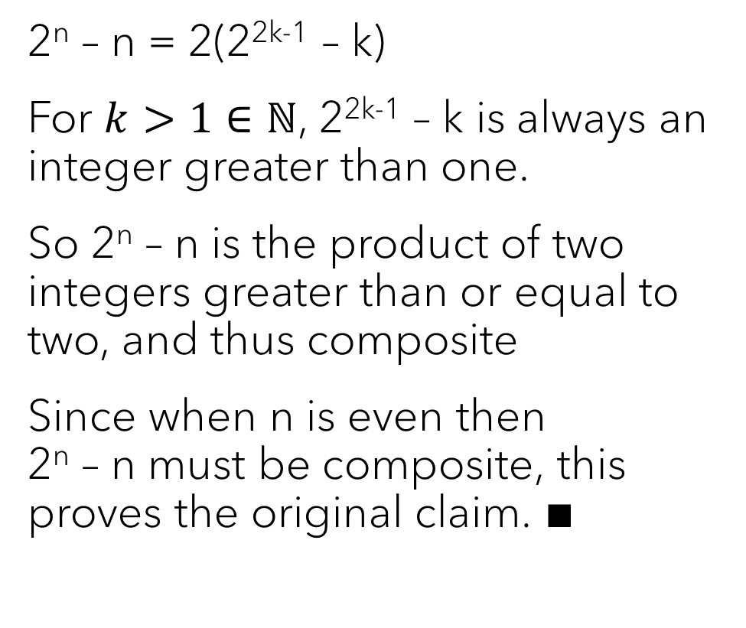
Contrapositive proof – example
2^{n} – n = 2(2^{2k-1} – k)
For $k>1∈ℕ$, 2^{2k-1} – k is always an integer greater than one.
So 2^{n} – n is the product of two integers greater than or equal to two, and thus composite
Since when n is even then 2^{n} – n must be composite, this proves the original claim. ∎
Move towards the definition of “not prime”
Definition of composite
Contrapositive and implication are equivalent

Slide 24
Your turn!
Claim: If n² is not divisible by 4, then n is odd.

Slide 25
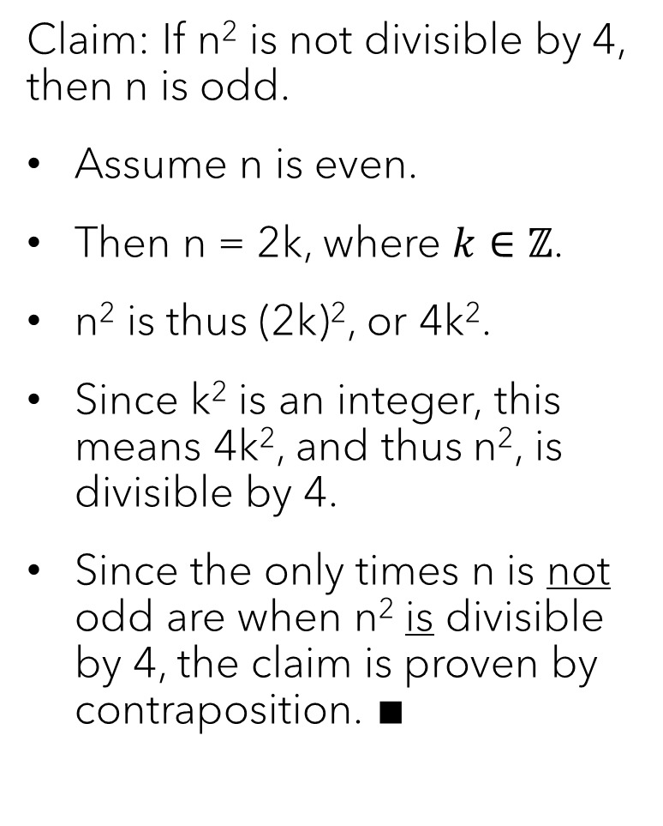
Your turn!
Claim: If n² is not divisible by 4, then n is odd.
Assume n is even.
Then n = 2k, where $k∈ℤ$.
n² is thus (2k)², or 4k².
Since k² is an integer, this means 4k², and thus n², is divisible by 4.
Since the only times n is not odd are when n² is divisible by 4, the claim is proven by contraposition. ∎

Slide 26
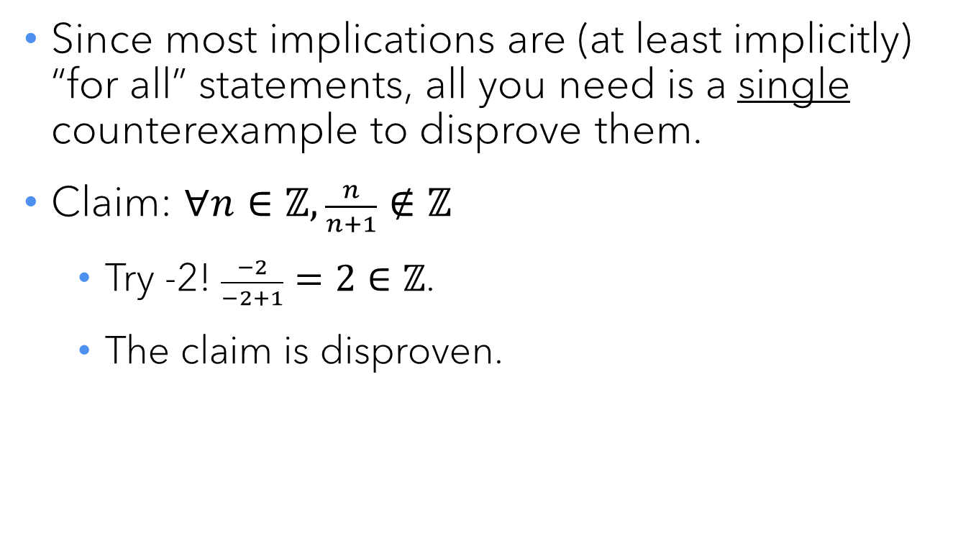
Disproving an implication
Since most implications are (at least implicitly) “for all” statements, all you need is a single counterexample to disprove them.
Claim: $∀n∈ℤ, \frac{n}{n+1}∉ℤ$
Try -2! $\frac{−2}{−2+1}=2∈ℤ$.
The claim is disproven.

Slide 27
Logical equivalence – “if and only if”
Written several different ways:
p ⇔ q
p if and only if q
p iff q
They all mean the same thing:
p ⇒ q ∧ q ⇒ p
To prove an “if and only if”, you must prove both implications.

Slide 28
Proof by contradiction (indirect proof)

Slide 29
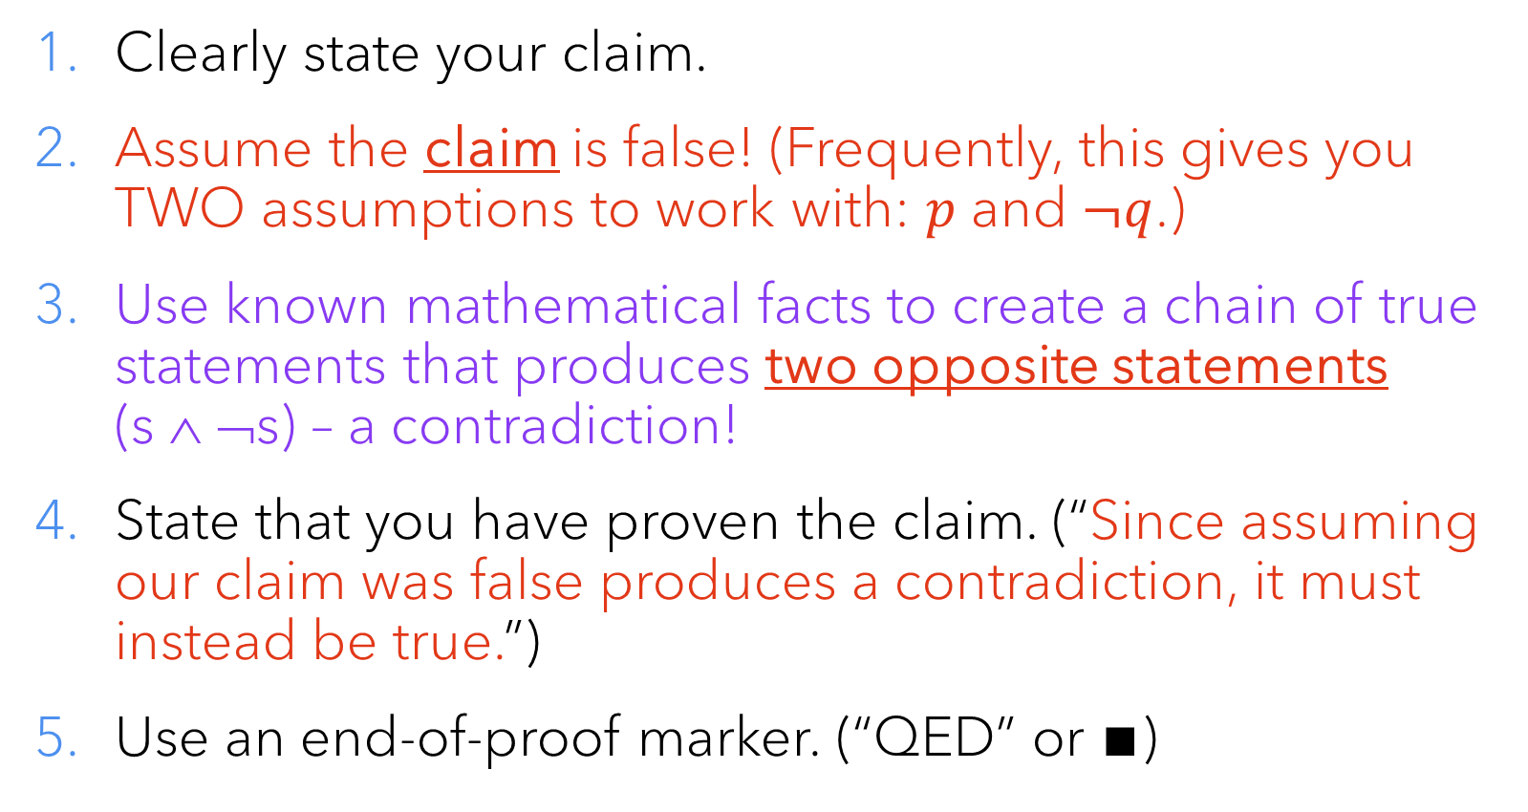
Indirect proof (“reductio ad absurdum”)
Clearly state your claim.
Assume the claim is false! (Frequently, this gives you TWO assumptions to work with: $p$ and $¬q$.)
Use known mathematical facts to create a chain of true statements that produces two opposite statements (s ∧ ¬s) – a contradiction!
State that you have proven the claim. (“Since assuming our claim was false produces a contradiction, it must instead be true.”)
Use an end-of-proof marker. (“QED” or ∎)

Slide 30
The infinitude of the primes
From Euclid’s Elements, Book IX, Proposition 20:
“Prime numbers are more than any assigned multitude of prime numbers.”
This is more commonly stated these days as “There are an infinite number of prime numbers.”

Slide 31
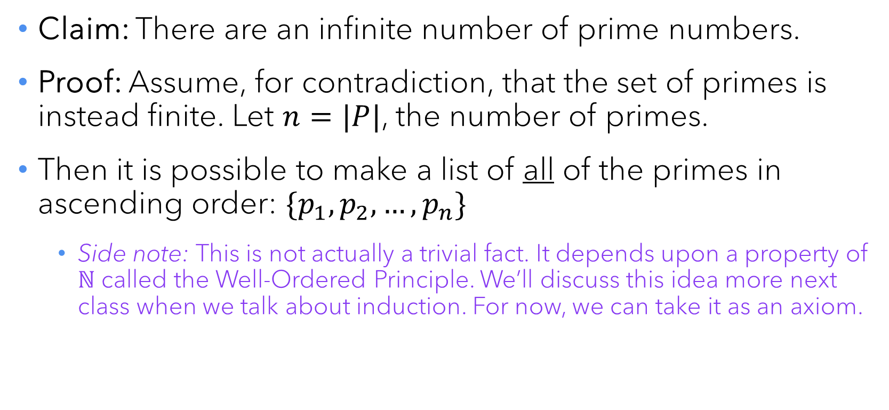
A classic proof by contradiction
Claim: There are an infinite number of prime numbers.
Proof: Assume, for contradiction, that the set of primes is instead finite. Let $n=|P|$, the number of primes.
Then it is possible to make a list of all of the primes in ascending order: $\{p_{1},p_{2},…,p_{n}\}$
Side note: This is not actually a trivial fact. It depends upon a property of $ℕ$ called the Well-Ordered Principle. We’ll discuss this idea more next class when we talk about induction. For now, we can take it as an axiom.

Slide 32
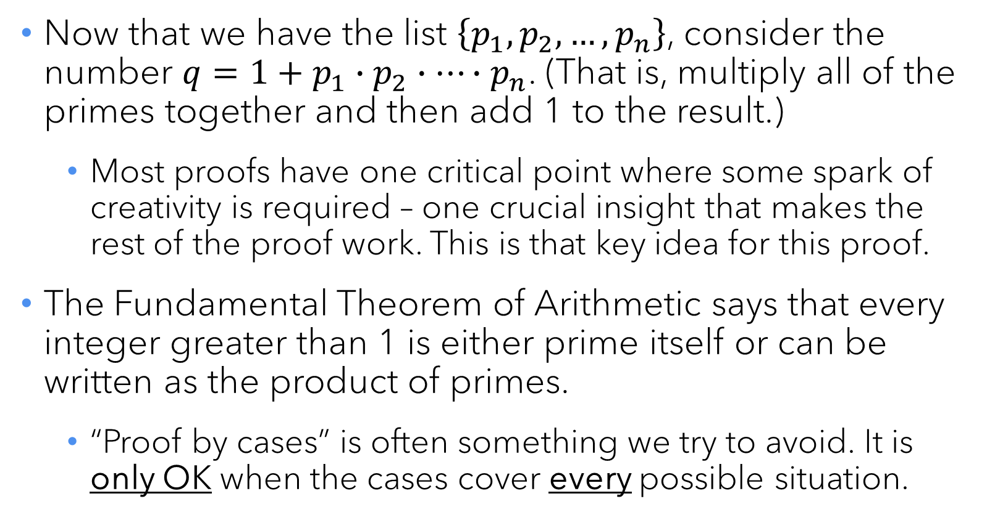
A classic proof by contradiction
Now that we have the list $\left\{p_{1},p_{2},…,p_{n}\right\}$, consider the number $q=1+p_{1}∙p_{2}∙⋯∙p_{n}$. (That is, multiply all of the primes together and then add 1 to the result.)
Most proofs have one critical point where some spark of creativity is required – one crucial insight that makes the rest of the proof work. This is that key idea for this proof.
The Fundamental Theorem of Arithmetic says that every integer greater than 1 is either prime itself or can be written as the product of primes.
“Proof by cases” is often something we try to avoid. It is only OK when the cases cover every possible situation.

Slide 33
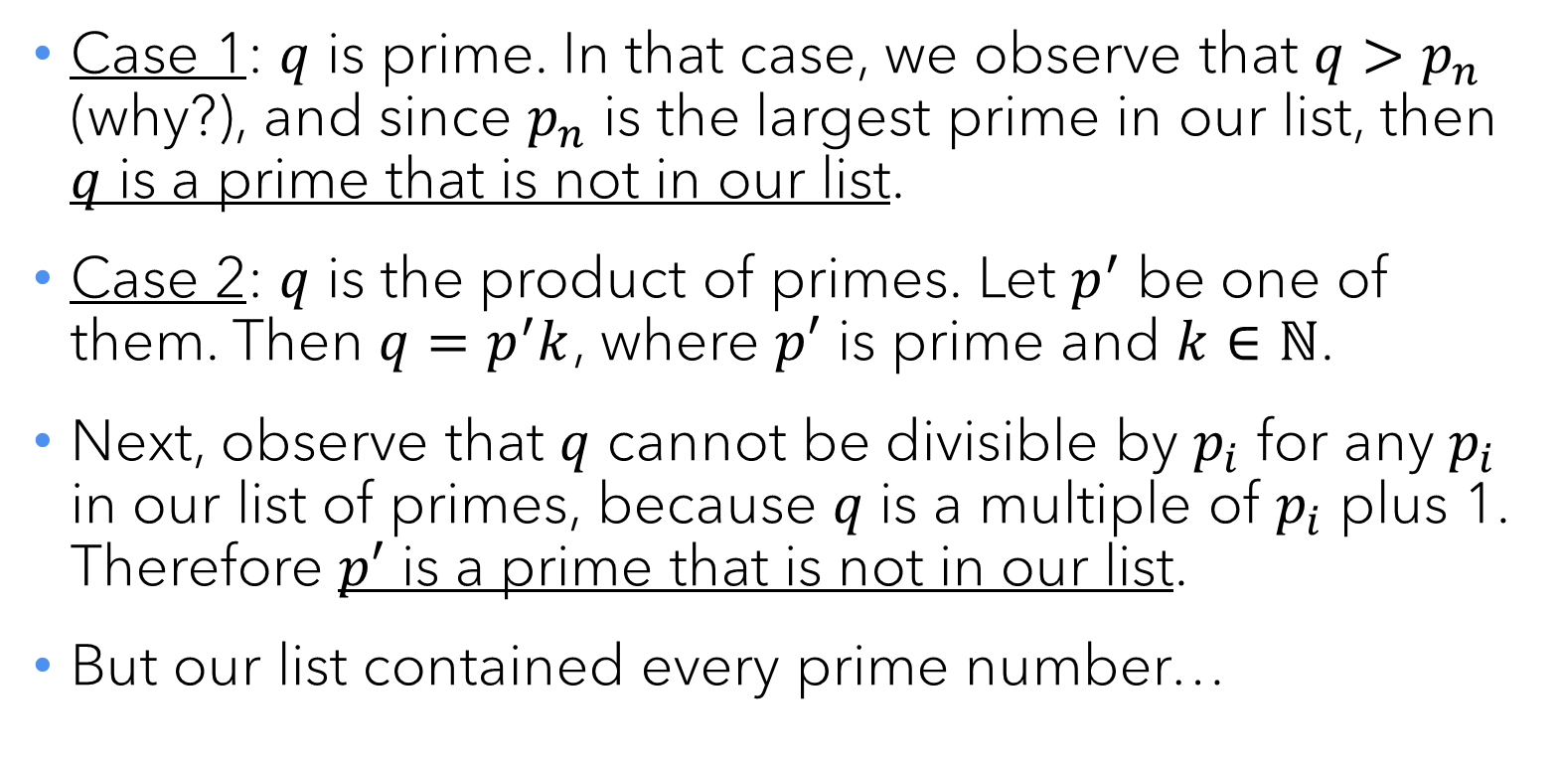
A classic proof by contradiction
Case 1: $q$ is prime. In that case, we observe that $q>p_{n}$ (why?), and since $p_{n}$ is the largest prime in our list, then $q$ is a prime that is not in our list.
Case 2: $q$ is the product of primes. Let $p^{′}$ be one of them. Then $q=p^{′}k$, where $p′$ is prime and $k∈ℕ$.
Next, observe that $q$ cannot be divisible by $p_{i}$ for any $p_{i}$ in our list of primes, because $q$ is a multiple of $p_{i}$ plus 1. Therefore $p′$ is a prime that is not in our list.
But our list contained every prime number…

Slide 34


Slide 35
A classic proof by contradiction
Our list contained every prime number, but then we found one that wasn’t in the list! This is a CONTRADICTION.
Unless we have made an error in reasoning (which can be pretty easy to do!), the only way we can arrive at a contradiction is if we have made a bad assumption.
The only assumption in our reasoning was the initial one: that the number of primes is finite.
Therefore, that assumption must be false, and we have proven that there are an infinite number of primes. ∎

Slide 36
Proofs about sets

Slide 37
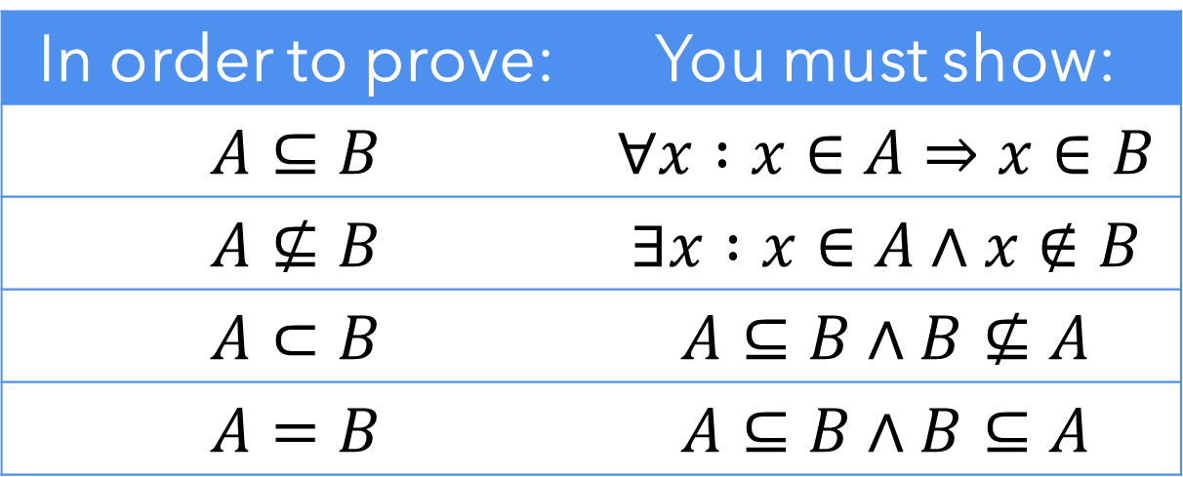
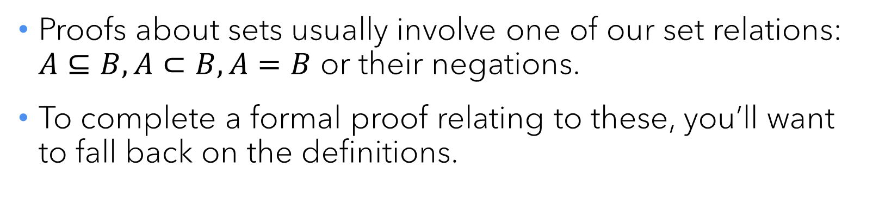
Set relations & formal proofs
Proofs about sets usually involve one of our set relations: $A⊆B, A⊂B, A=B$ or their negations.
To complete a formal proof relating to these, you’ll want to fall back on the definitions.
In order to prove: | You must show:
$$A⊆B$$ | $$∀x :x∈A⇒x∈B$$
$$A⊈B$$ | $$∃x :x∈A∧x∉B$$
$$A⊂B$$ | $$A⊆B∧B⊈A$$
$$A=B$$ | $$A⊆B∧B⊆A$$

Slide 38
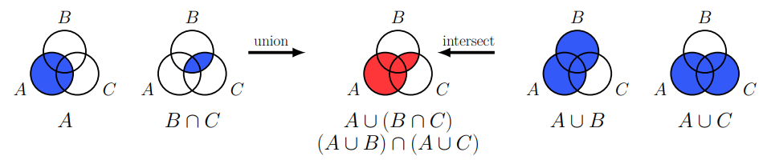

“Proof by picture”
A Venn diagram can be really helpful in conveying what’s going on, especially when more than two sets are involved.
Prove: $A∪\left(B∩C\right)=(A∪B)∩(A∪C)$
If a formal proof is not required, sometimes such a diagram is sufficient. But if a formal proof is needed, you’ll have to fall back on the previous table.

Slide 39
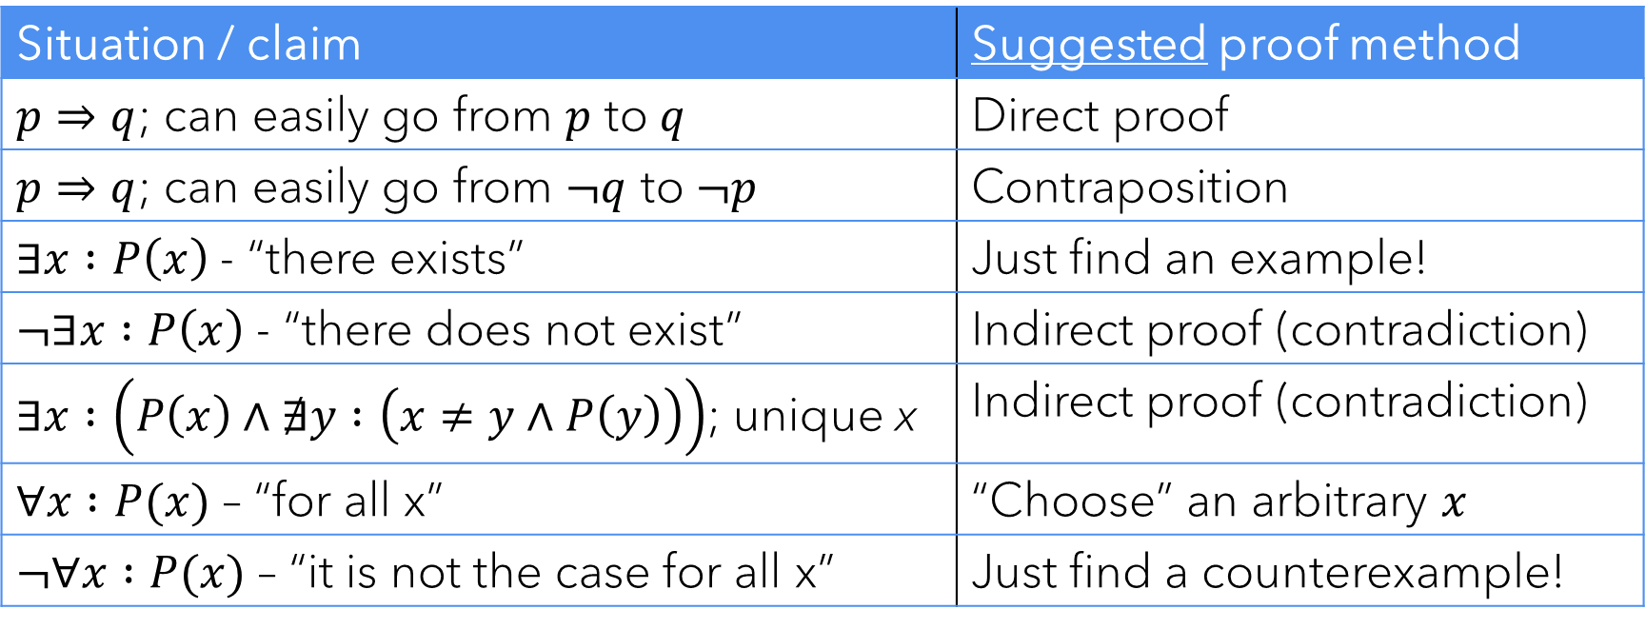
Wrapping up
How do you decide what type of proof to use? Here are some suggestions for where to start. (No promises!)
Situation / claim | Suggested proof method
$p⇒q$; can easily go from $p$ to $q$ | Direct proof
$p⇒q$; can easily go from $¬q$ to $¬p$ | Contraposition
$∃x :P\left(x\right)$ - “there exists” | Just find an example!
$¬∃x :P\left(x\right)$ - “there does not exist” | Indirect proof (contradiction)
$∃x :\left(P\left(x\right)∧∄y :\left(x≠y∧P\left(y\right)\right)\right)$; unique x | Indirect proof (contradiction)
$∀x :P(x)$ – “for all x” | “Choose” an arbitrary $x$
$¬∀x :P(x)$ – “it is not the case for all x” | Just find a counterexample!

Slide 40
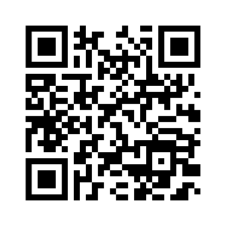
Class survey
Reminders: HW 1 due tonight
No office hours this afternoon (moved to Friday afternoon)
HW 2 posted later today

