Slide 1
Lecture 5: Induction, Part 1
CSCI 2200 Foundations of Computer Science

Slide 2

Lecture 5: Induction, Part 1
CSCI 2200 Foundations of Computer Science
“Tristram” from Diablo by Matt Uelmen

Slide 3
Today’s tasks
Questions from recent problem sets
One more example of proof by contradiction
A few caveats about proofs in general
. . . INDUCTION

Slide 4
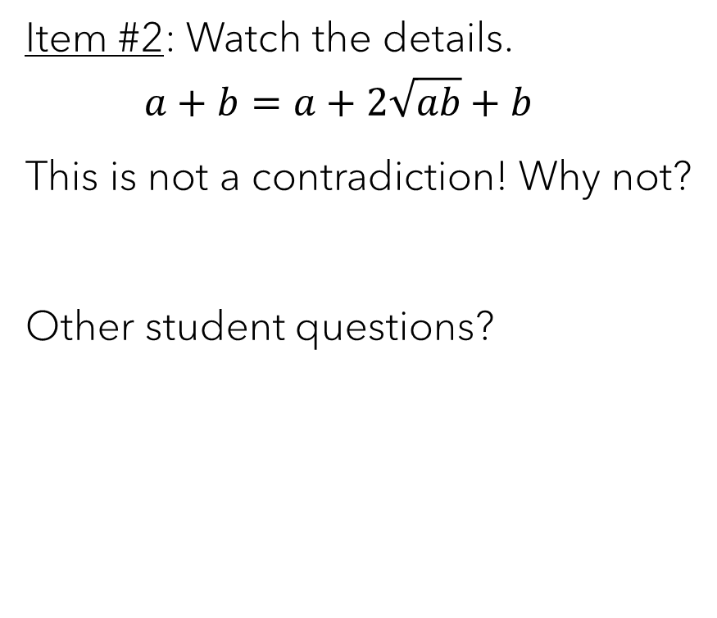
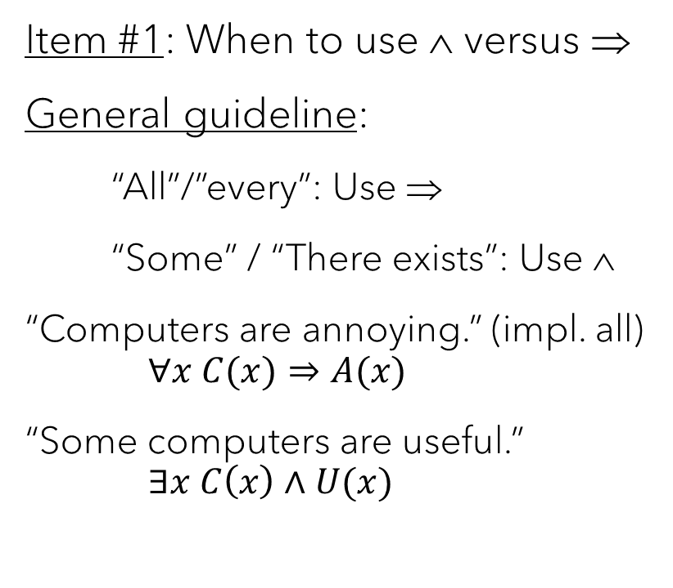
Questions from problem sets
Item #1: When to use ∧ versus ⇒
General guideline:
“All”/”every”: Use ⇒
“Some” / “There exists”: Use ∧
“Computers are annoying.” (impl. all) $∀x C(x)⇒A(x)$
“Some computers are useful.” $∃x C\left(x\right)∧U(x)$
Item #2: Watch the details.
$$a+b=a+2\sqrt{ab}+b$$
This is not a contradiction! Why not?
Other student questions?

Slide 5
General proofs cont’d.

Slide 6
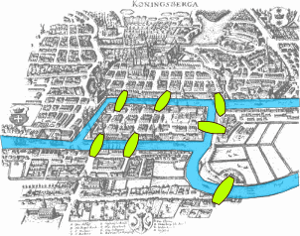
The Seven Bridges of Konigsberg
From Leonhard Euler (1736):
Find a path, starting and ending anywhere (possibly different locations), that crosses each bridge exactly once.

Slide 7
The Seven Bridges of Konigsberg
Observe that we can simplify our visual by constructing a multigraph (allows multiple edges between nodes):
1
1
2
3
2
3
4
4

Slide 8
No such path: proof by contradiction
Assume we can find an Eulerian path.
Then, except for our start and end points, each time we visit a node (landmass), we also must leave it via a different bridge. This means that the number of bridges connected to these intermediate nodes must be even!
1
2
3
4
Since there is only one starting point and one end point, there can be a maximum of two nodes with an odd number of edges. However, all four nodes have an odd number of edges.
This is a contradiction, and thus, our assumption is false – there is no Eulerian path.

Slide 9
Your turn!
Claim: If x is rational and y is irrational, then x+y is irrational.
Give an indirect proof (that is, proof by contradiction).

Slide 10
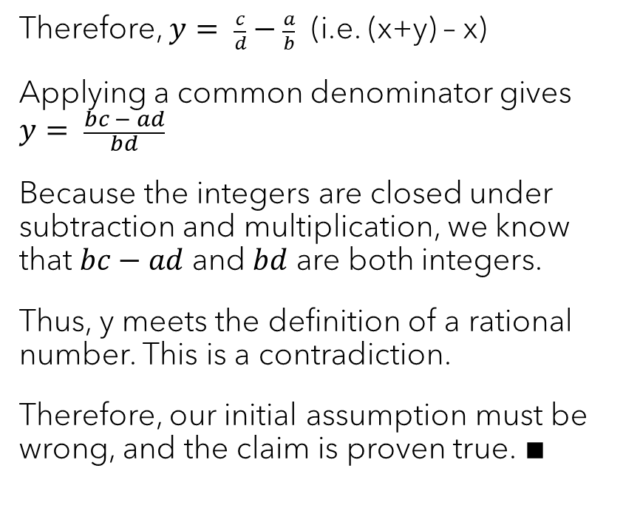
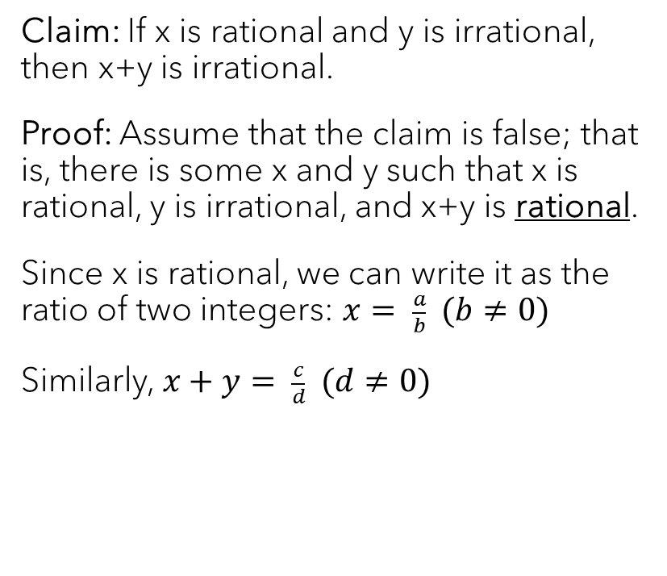
The rational approach…
Claim: If x is rational and y is irrational, then x+y is irrational.
Proof: Assume that the claim is false; that is, there is some x and y such that x is rational, y is irrational, and x+y is rational.
Since x is rational, we can write it as the ratio of two integers: $x= \frac{a}{b} (b≠0)$
Similarly, $x+y= \frac{c}{d} (d≠0)$
Therefore, $y= \frac{c}{d}−\frac{a}{b}$ (i.e. (x+y) – x)
Applying a common denominator gives $$y= \frac{bc − ad}{bd}$$
Because the integers are closed under subtraction and multiplication, we know that $bc−ad$ and $bd$ are both integers.
Thus, y meets the definition of a rational number. This is a contradiction.
Therefore, our initial assumption must be wrong, and the claim is proven true. ∎

Slide 11
Caveat lector…
a = b Take two variables a & b and set them to the same positive number
a² = ab Multiply both sides by a
a² – b² = ab – b² Subtract b² from both sides
(a+b)(a-b) = b(a–b) Factor
a + b = b Divide by (a – b)
b + b = b Because a = b
2b = b Combine like terms
2 = 1 Divide by b

Slide 12

Induction

Slide 13
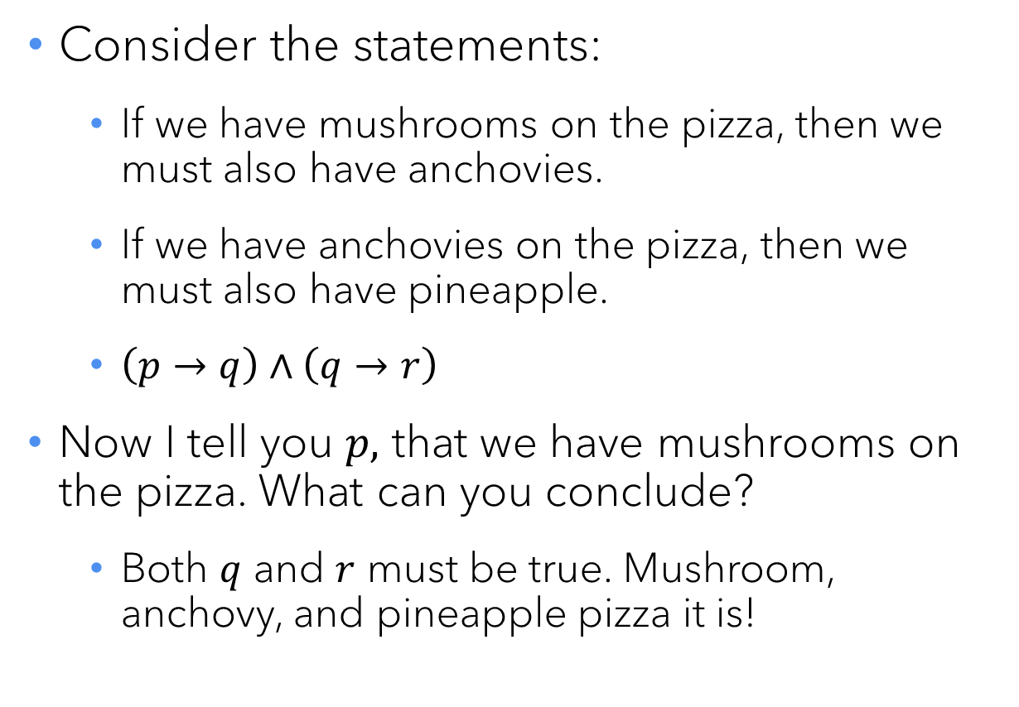
Chains of implications
Consider the statements:
If we have mushrooms on the pizza, then we must also have anchovies.
If we have anchovies on the pizza, then we must also have pineapple.
$\left(p→q\right)∧\left(q→r\right)$
Now I tell you $p,$ that we have mushrooms on the pizza. What can you conclude?
Both $q$ and $r$ must be true. Mushroom, anchovy, and pineapple pizza it is!

Slide 14
Longer chains of implications
Does it still work if I have three chained implications?
Four?
Ten?
…
Infinitely many?
Congratulations! You now understand induction!

Slide 15
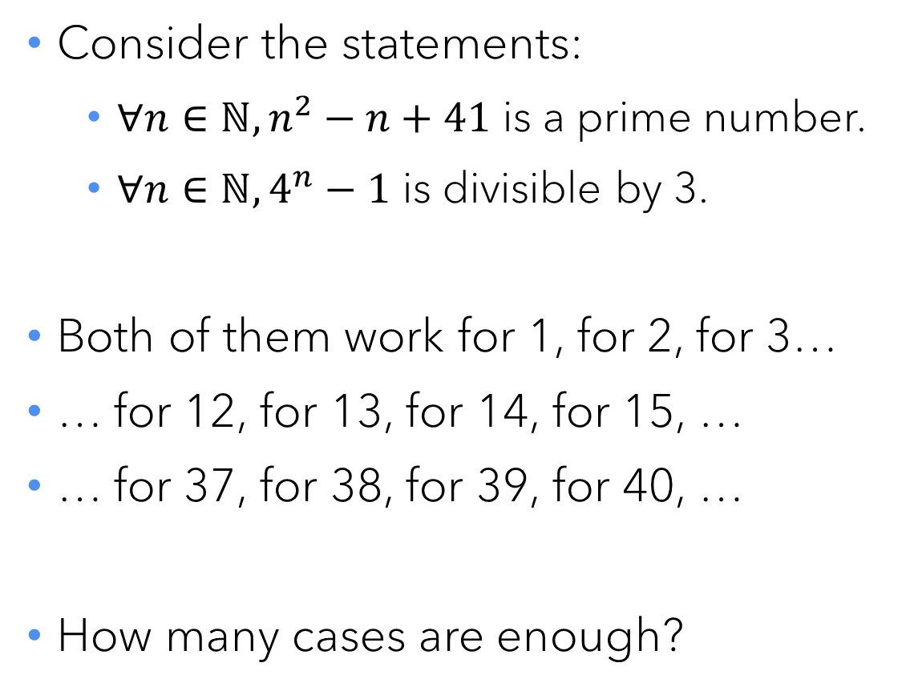
Why do we need induction?
Consider the statements:
$∀n∈ℕ, n^{2}−n+41$ is a prime number.
$∀n∈ℕ, 4^{n}−1$ is divisible by 3.
Both of them work for 1, for 2, for 3…
… for 12, for 13, for 14, for 15, …
… for 37, for 38, for 39, for 40, …
How many cases are enough?
⇐ 41 doesn’t work!
No. Such. Thing.

Slide 16

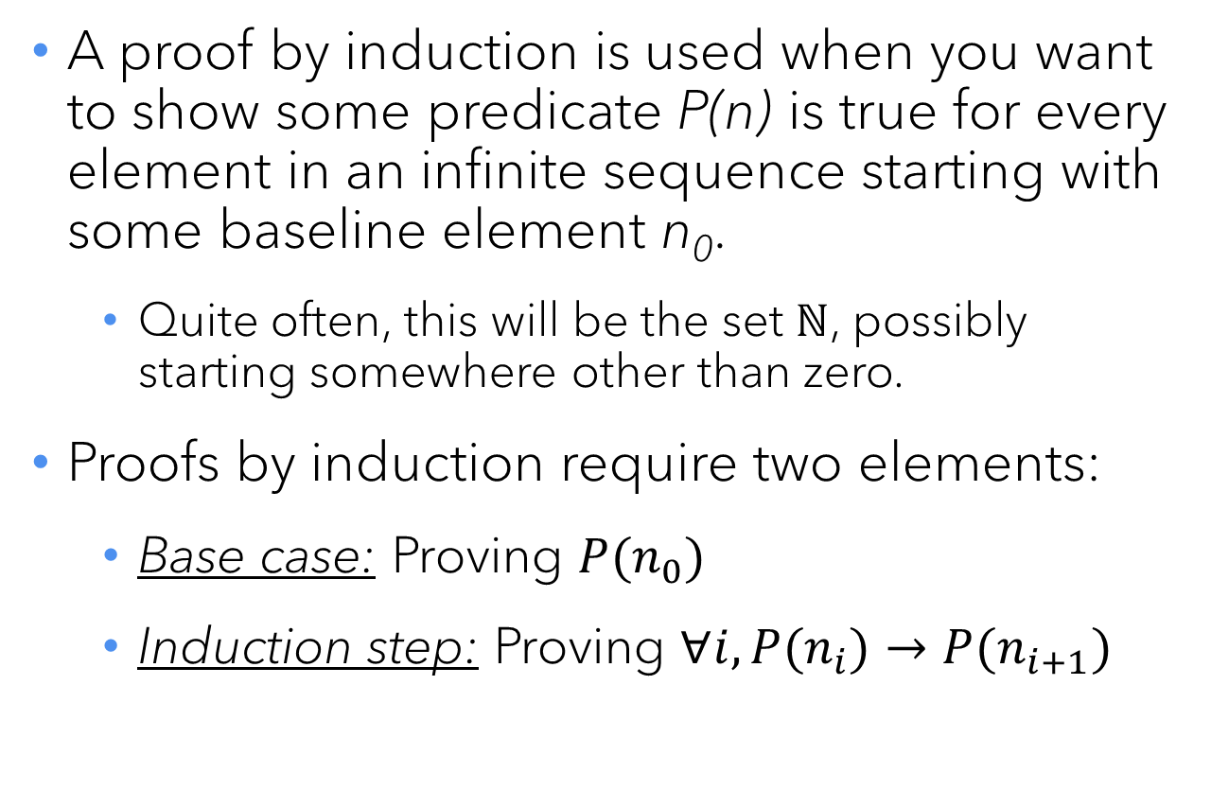
Mathematical induction, basic version
A proof by induction is used when you want to show some predicate P(n) is true for every element in an infinite sequence starting with some baseline element n₀.
Quite often, this will be the set $ℕ$, possibly starting somewhere other than zero.
Proofs by induction require two elements:
Base case: Proving $P(n_{0})$
Induction step: Proving $∀i, P(n_{i})→P(n_{i+1})$

Slide 17
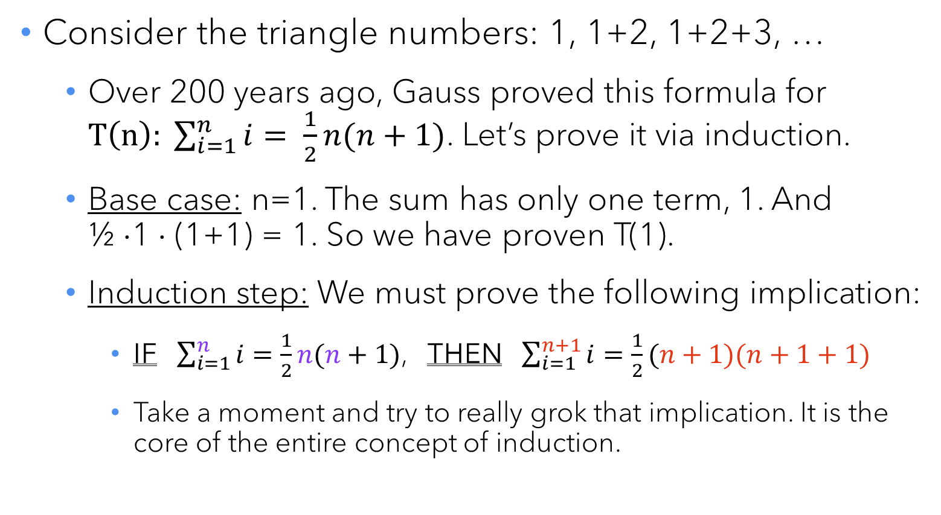
Simple example: Gauss’s formula
Consider the triangle numbers: 1, 1+2, 1+2+3, …
Over 200 years ago, Gauss proved this formula for $T\left(n\right): \sum_{i=1}^{n}{i}= \frac{1}{2}n(n+1)$. Let’s prove it via induction.
Base case: n=1. The sum has only one term, 1. And ½ ⋅1 ⋅ (1+1) = 1. So we have proven T(1).
Induction step: We must prove the following implication:
IF $\sum_{i=1}^{n}{i}=\frac{1}{2}n(n+1)$, THEN $\sum_{i=1}^{n+1}{i}=\frac{1}{2}(n+1)(n+1+1)$
Take a moment and try to really grok that implication. It is the core of the entire concept of induction.

Slide 18
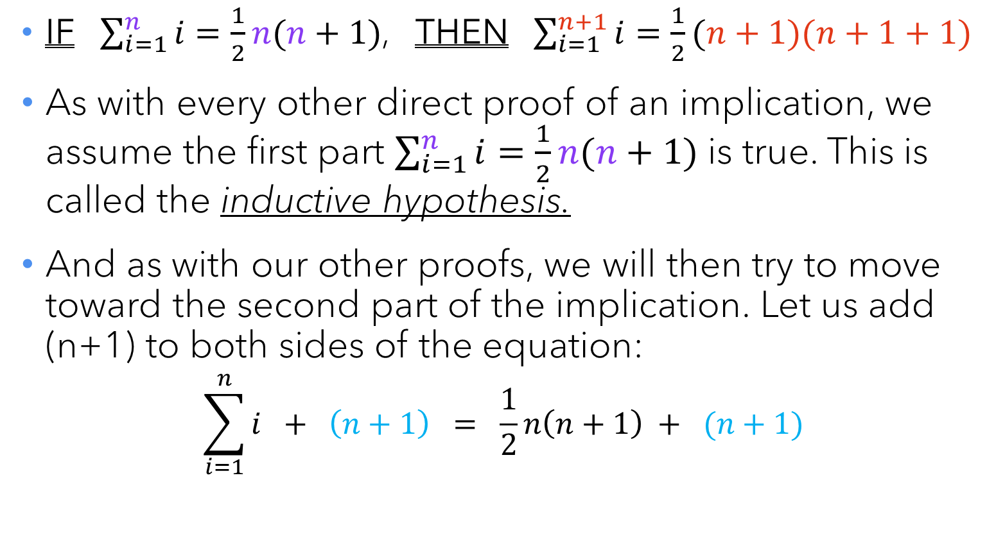
Gauss’s formula, induction step
IF $\sum_{i=1}^{n}{i}=\frac{1}{2}n(n+1)$, THEN $\sum_{i=1}^{n+1}{i}=\frac{1}{2}(n+1)(n+1+1)$
As with every other direct proof of an implication, we assume the first part $\sum_{i=1}^{n}{i}=\frac{1}{2}n(n+1)$ is true. This is called the inductive hypothesis.
And as with our other proofs, we will then try to move toward the second part of the implication. Let us add (n+1) to both sides of the equation:
$$\sum_{i=1}^{n}{i} + \left(n+1\right) = \frac{1}{2}n\left(n+1\right) + (n+1)$$

Slide 19
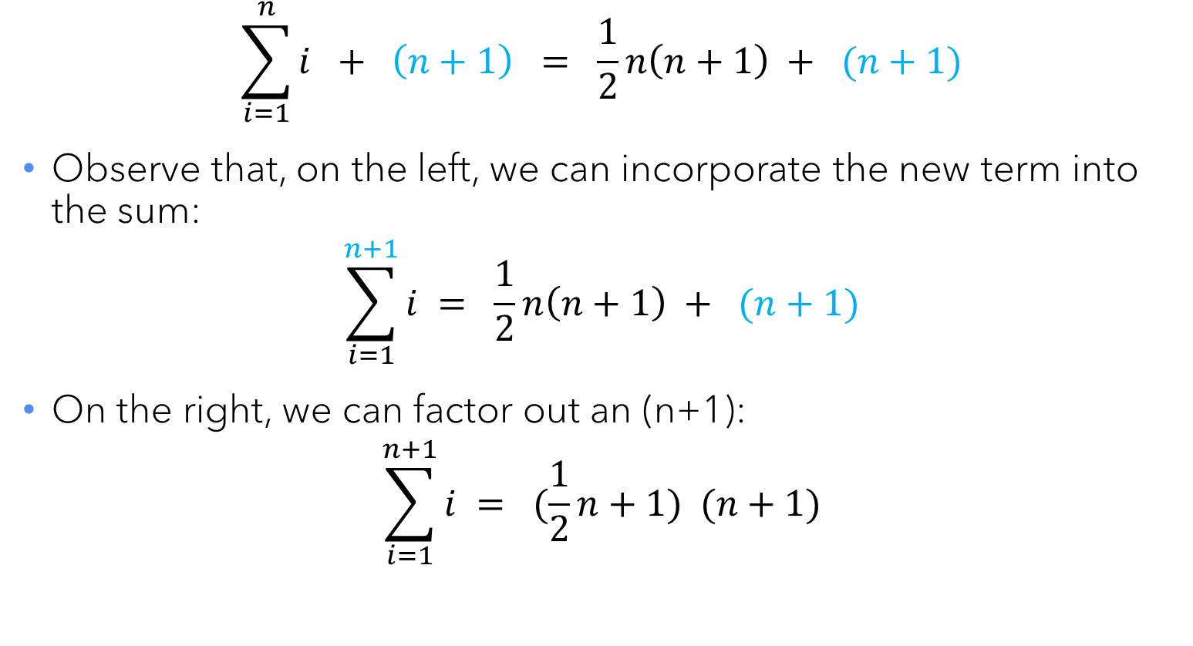
Gauss’s formula, induction step
$$\sum_{i=1}^{n}{i} + \left(n+1\right) = \frac{1}{2}n\left(n+1\right) + (n+1)$$
Observe that, on the left, we can incorporate the new term into the sum:
$$\sum_{i=1}^{n+1}{i} = \frac{1}{2}n\left(n+1\right) + (n+1)$$
On the right, we can factor out an (n+1):
$$\sum_{i=1}^{n+1}{i} = (\frac{1}{2}n+1) (n+1)$$

Slide 20
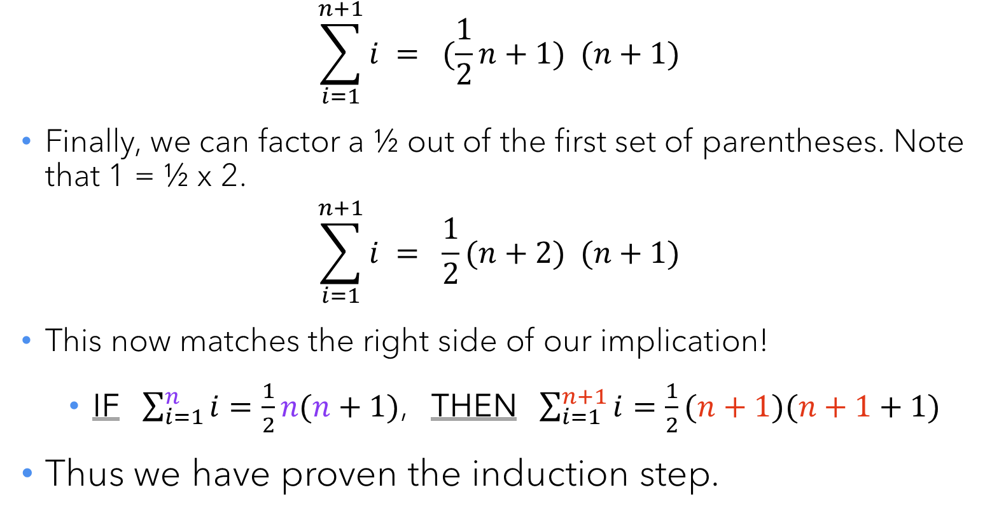
Gauss’s formula, induction step
$$\sum_{i=1}^{n+1}{i} = (\frac{1}{2}n+1) (n+1)$$
Finally, we can factor a ½ out of the first set of parentheses. Note that 1 = ½ x 2.
$$\sum_{i=1}^{n+1}{i} = \frac{1}{2}(n+2) (n+1)$$
This now matches the right side of our implication!
IF $\sum_{i=1}^{n}{i}=\frac{1}{2}n(n+1)$, THEN $\sum_{i=1}^{n+1}{i}=\frac{1}{2}(n+1)(n+1+1)$
Thus we have proven the induction step.

Slide 21
Gauss’s formula, wrapping up
To recap, we have proven:
T(n) ⇒ T(n+1), for all n ≥ 1. (i.e. We have set up a beautiful chain of dominoes…)
T(1). (i.e. We have pushed over the first domino.)
Therefore, by induction, we have proven T(n) for all n ≥ 1.∎

Slide 22
Next example: Polygons
A convex polygon is one where all of the interior angles are less than 180 degrees.
Claim: In a convex polygon with n sides, the sum of the interior angles is (n-2) ⋅ 180°.
Proof: We will use induction.
Base case: n=3 (Why?). This is a triangle. As an axiom, the sum of the interior angles of a triangle is 180°.

Slide 23
Polygons, induction step
Induction step: We need to prove that
If the angles in a polygon with n sides adds up to (n-2) ⋅ 180°, then the angles in a polygon with n+1 sides adds up to ((n+1)-2) ⋅ 180°.
Inductive hypothesis: Assume that the angles in a polygon with n sides DO add up to (n-2) ⋅ 180°
Consider a polygon with n+1 sides:
We can look at three adjacent vertices, and draw a line connecting the two outer ones.

Slide 24
Polygons, induction step
Observe that the line divides the (n+1)-gon into two sections: a triangle and an n-gon.
By axiom, the triangle’s angles add up to 180°.
By the inductive hypothesis, the n-gon’s angles add up to (n-2) ⋅ 180°.
Adding these together, we get (n-1) ⋅ 180°, which is the value we are trying to show.
Since we have proven the base case and the induction step, we have proven the claim for all n ≥ 3.∎

Slide 25

Your turn!
Claim: The sum of the first $n$ perfect squares equals $\frac{1}{6}n\left(n+1\right)\left(2n+1\right)$
Prove using induction.

Slide 26
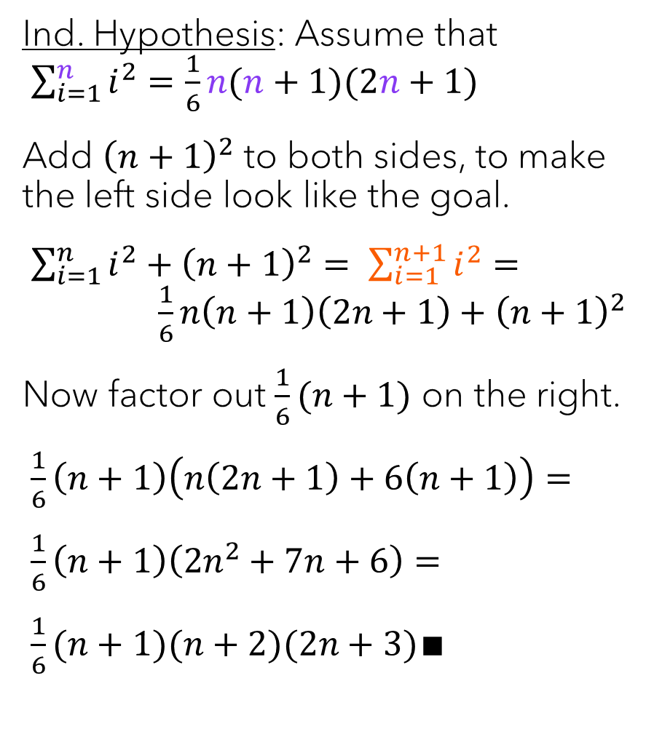
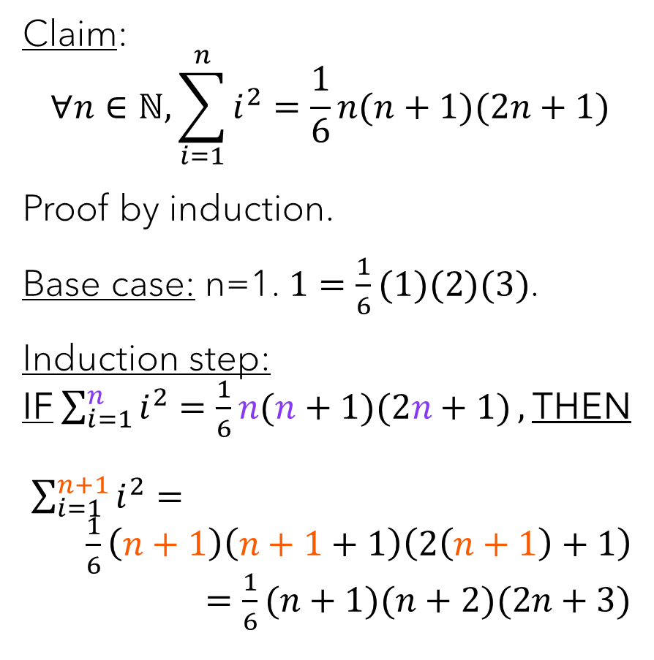
Claim: $$∀n∈ℕ, \sum_{i=1}^{n}{i^{2}=\frac{1}{6}n(n+1)(2n+1)}$$
Proof by induction.
Base case: n=1. $1=\frac{1}{6}(1)(2)(3)$.
Induction step: IF $\sum_{i=1}^{n}{i^{2}=\frac{1}{6}n(n+1)(2n+1)},$THEN $\sum_{i=1}^{n+1}{i^{2}}=$ $\frac{1}{6}\left(n+1\right)\left(n+1+1\right)\left(2\left(n+1\right)+1\right)$ $=\frac{1}{6}(n+1)(n+2)(2n+3)$
Ind. Hypothesis: Assume that $\sum_{i=1}^{n}{i^{2}=\frac{1}{6}n(n+1)(2n+1)}$
Add ${\left(n+1\right)}^{2}$ to both sides, to make the left side look like the goal.
$\sum_{i=1}^{n}{i^{2}}+{\left(n+1\right)}^{2}= \sum_{i=1}^{n+1}{i^{2}}=$ $\frac{1}{6}n\left(n+1\right)\left(2n+1\right)+{\left(n+1\right)}^{2}$
Now factor out $\frac{1}{6}(n+1)$ on the right.
$\frac{1}{6}\left(n+1\right)\left(n\left(2n+1\right)+6\left(n+1\right)\right)=$
$\frac{1}{6}\left(n+1\right)\left(2n^{2}+7n+6\right)=$
$\frac{1}{6}(n+1)(n+2)(2n+3)$∎

Slide 27

Your turn again!
Claim: $∀n∈ℕ, n^{3}−n$ is divisible by 6.
Prove using induction.

Slide 28
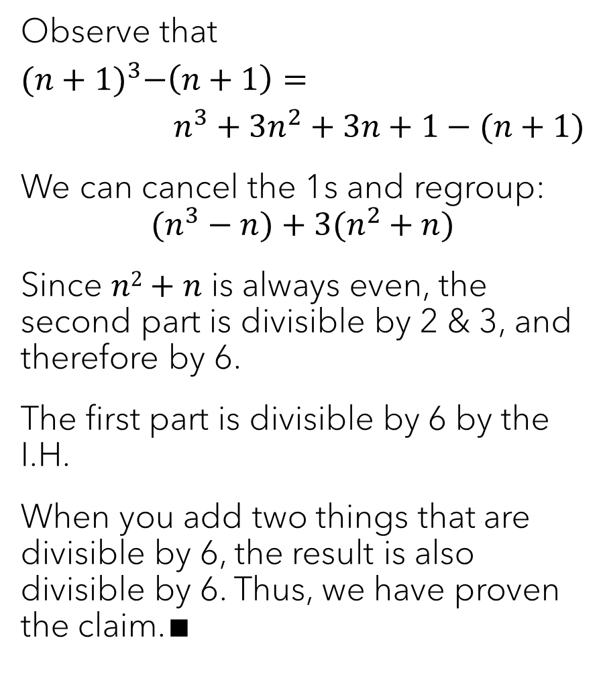
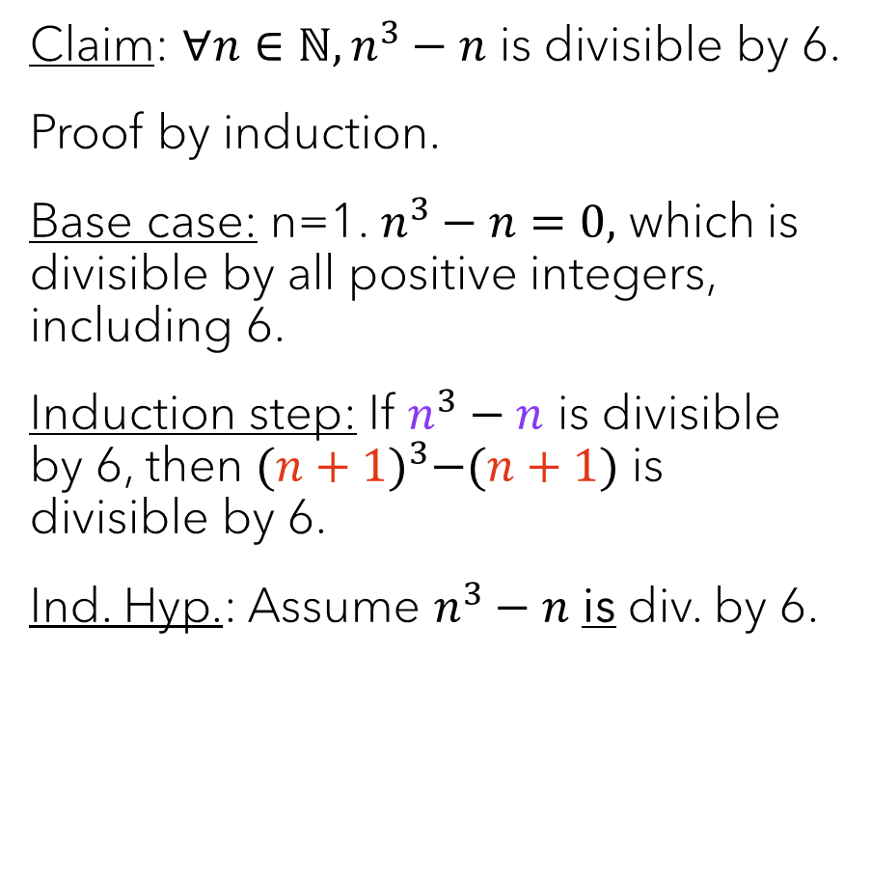
Claim: $∀n∈ℕ, n^{3}−n$ is divisible by 6.
Proof by induction.
Base case: n=1. $n^{3}−n=0,$ which is divisible by all positive integers, including 6.
Induction step: If $n^{3}−n$ is divisible by 6, then ${(n+1)}^{3}−(n+1)$ is divisible by 6.
Ind. Hyp.: Assume $n^{3}−n$ is div. by 6.
Observe that
$${(n+1)}^{3}−\left(n+1\right)=$$
$$n^{3}+3n^{2}+3n+1−(n+1)$$
We can cancel the 1s and regroup: $$(n^{3}−n)+3(n^{2}+n)$$
Since $n2+n$ is always even, the second part is divisible by 2 & 3, and therefore by 6.
The first part is divisible by 6 by the I.H.
When you add two things that are divisible by 6, the result is also divisible by 6. Thus, we have proven the claim.∎

Slide 29
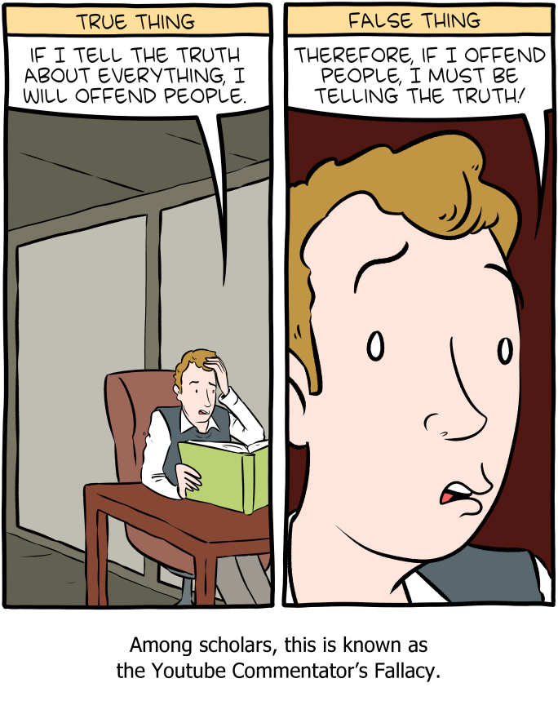
Common error #1
Recall that to directly prove p ⇒ q, we begin by assuming that p is true, and then work our way to q. If we instead begin by assuming q is true, we have committed a logical fallacy.
So, if you start by assuming that the n+1 case is true, your proof is broken before you even take it out of the box.

Slide 30
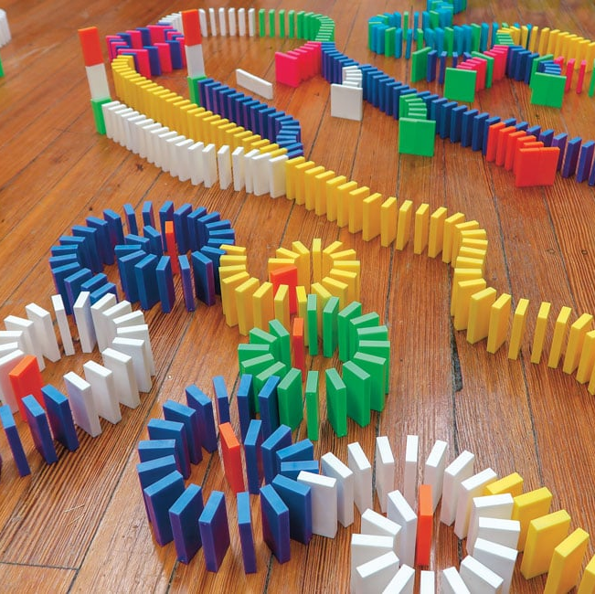
Common error #2
Forgetting the base case!

Slide 31
Common Error #3 – “There’s no such thing as a horse of a different color.”
Claim: In any set of n≥1 horses, all n horses are the same color. Proof: By induction on n.
Base case: n=1; trivial.
Induction step: If every set of n horses are all the same color, then every set of n+1 horses are the same color.
Consider a set H of n+1 horses. Select two of them (h₁ ≠ h₂). Consider the sets H – {h₁} and H – {h₂}. By the I.H., each of them only contains one color of horse. Furthermore, since they only differ by one horse, they have a horse in common, so those colors must be the same. Thus all of the horses in H are also that color. ∎
DON’T BREAK THE CHAIN!

Slide 32

Class survey & reminders
HW 2 due tonight
No office hours this afternoon (moved to Friday afternoon)
HW 3 posted later today
Exam 1 next week! Wed. 1/29, 8-10am DCC 318 (Last names A-K) DCC 324 (Last names L-Z)

