Slide 1
Lecture 6:
Induction, Part 2
CSCI 2200
Foundations of Computer Science

Slide 2

Lecture 6:
Induction, Part 2
CSCI 2200
Foundations of Computer Science
“Bloody Tears” by Kenichi Matsubara,
from Castlevania II: Simon’s Quest

Slide 3
Today’s tasks
Exam reminder
More basic induction practice
Variations on mathematical induction
  “Upgrading” your claim
  Leaping induction
  Strong induction
HW questions / exam review

Slide 4
Exam #1
Wed. 1/29, 8-10am
DCC 318 (last name A-K)
DCC 324 (last name L-Z)
Bring your ID card!
Crib sheet: One letter-size piece of paper. Put your name and RIN on it. It will be collected with your exam.
Covers Lectures 1-5 plus leaping induction from today’s class.

Slide 5

Another basic induction example
Proof the following by induction:
  $$\sum_{i=1}^{2n}{(3i+1)}=6n^{2}+5n$$

Slide 6
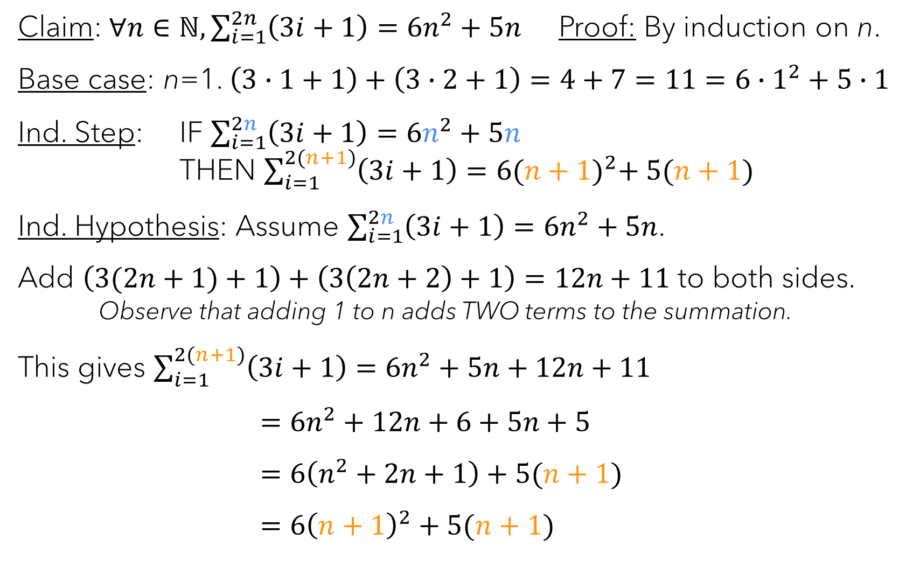
Claim:$∀n∈ℕ,\sum_{i=1}^{2n}{\left(3i+1\right)}=6n^{2}+5n$ Proof: By induction on n.
Base case: n=1. $\left(3∙1+1\right)+\left(3∙2+1\right)=4+7=11=6∙1^{2}+5∙1$
Ind. Step: IF $\sum_{i=1}^{2n}{\left(3i+1\right)}=6n^{2}+5n$
THEN $\sum_{i=1}^{2(n+1)}{\left(3i+1\right)}=6{(n+1)}^{2}+ 5(n+1)$
Ind. Hypothesis: Assume $\sum_{i=1}^{2n}{\left(3i+1\right)}=6n^{2}+5n$.
Add $\left(3(2n+1)+1\right)+\left(3\left(2n+2\right)+1\right)=12n+11$ to both sides.
Observe that adding 1 to n adds TWO terms to the summation.
This gives $\sum_{i=1}^{2(n+1)}{\left(3i+1\right)}=6n^{2}+5n+12n+11$
$=6n^{2}+12n+6+5n+5$
$=6\left(n^{2}+2n+1\right)+5(n+1)$
$=6{\left(n+1\right)}^{2}+5(n+1)$

Slide 7
Induction variations

Slide 8
Upgrading the claim
“Making the proof easier by making it harder”
Recall that proof by contradiction gets us TWO assumptions (p and ¬q), which gives us more material to work with in crafting our proof.
We can do something similar with induction. Instead of proving $∀n F(n)$, we can instead show $∀n \left(F\left(n\right)∧G\left(n\right)\right)$, for some useful $G(n)$.
We can do something similar with induction. Instead of proving ∀𝑛 𝐹(𝑛), we can instead show ∀𝑛 (𝐹(𝑛)∧𝐺(𝑛)), for some useful 𝐺(𝑛).

Slide 9
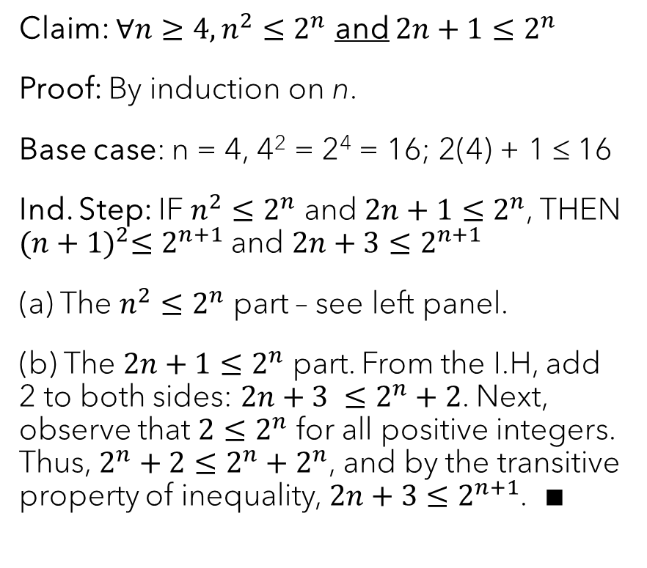
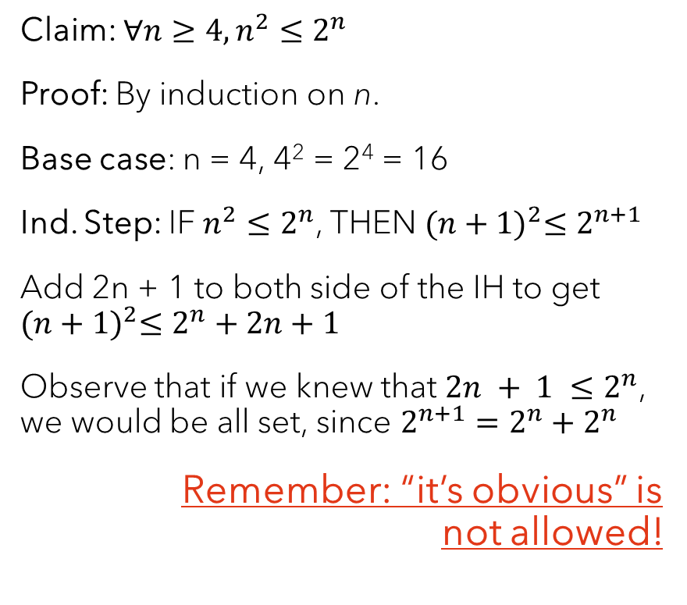
An “upgrade” example
Claim: $∀n≥4, n^{2}≤2^{n}$
Proof: By induction on n.
Base case: n = 4, 4² = 2⁴ = 16
Ind. Step: IF $n^{2}≤2^{n}$, THEN ${(n+1)}^{2}≤2^{n+1}$
Add 2n + 1 to both side of the IH to get ${(n+1)}^{2}≤2^{n}+2n+1$
Observe that if we knew that $2n + 1 ≤2^{n}$, we would be all set, since $2^{n+1}=2^{n}+2^{n}$
Remember: “it’s obvious” is
not allowed!
Claim: $∀n≥4, n^{2}≤2^{n}$ and $2n+1≤2^{n}$
Proof: By induction on n.
Base case: n = 4, 4² = 2⁴ = 16; 2(4) + 1 ≤ 16
Ind. Step: IF $n^{2}≤2^{n}$ and $2n+1≤2^{n}$, THEN ${(n+1)}^{2}≤2^{n+1}$ and $2n+3≤2^{n+1}$
(a) The $n^{2}≤2^{n}$ part – see left panel.
(b) The $2n+1≤2^{n}$ part. From the I.H, add 2 to both sides: $2n+3 ≤2^{n}+2$. Next, observe that $2≤2^{n}$ for all positive integers. Thus, $2^{n}+2≤2^{n}+2^{n}$, and by the transitive property of inequality, $2n+3≤2^{n+1}$. ∎

Slide 10
Upgrading vs. using a lemma
The previous proof could also have been constructed by using a lemma – a “helper” statement that you prove on the way to your main result.
  Lemmas can help you organize your proof, but they can also make it harder to follow if you’re not careful. It is often best to put all of the lemmas and their proofs FIRST, before starting the main proof, and then refer back to them as needed.
The upgrade technique is most useful when the two parts of the claim depend upon each other – that is, you can’t prove EITHER of the parts without using BOTH halves of the I.H.

Slide 11
Leaping induction
Nothing forces us to go from n to n + 1…
In football, teams usually score 3 or 7 points at a time. For this problem, assume those are the ONLY possibilities. Under those circumstances, some total scores are impossible, e.g. 5 or 8.
What’s the largest score that is impossible to make?
11
Prove it!

Slide 12
Leaping induction
Key idea: we have no mechanism to get from n to n+1… but we can get from n to n+3!
Induction step: IF the value n can be made from 3- and 7-point scores, THEN so can the value n+3.
  Argument is pretty trivial: I.H. gets you to n, one field goal gets you to n+3.
Base case: n = 12. Can be made as 3 + 3 + 3 + 3. Done?
NO! We can’t get to everything from 12…
  n = 13: 3 + 3 + 7; n = 14: 7 + 7
  NOW we can get everywhere.

Slide 13

Your turn!
Claim: Any square can be divided into any number $n$ of smaller squares (not necessarily the same size), for any $n≥6$.
Give a proof using leaping induction (you’ll need a size 3 leap).

Slide 14
Dividing squares
If our “leap” is 3, what does our induction step look like? How many base cases do we need? What are they?
Induction step:
3 base cases (n=6, n=7, n=8):

Slide 15
Strong induction

Slide 16

The chain(s) of implications
Standard induction:
$$P\left(1\right)→P\left(2\right)→P\left(3\right)→P\left(4\right)→P\left(5\right)→P\left(6\right)→P(7)→P(8)→…$$
Leaping induction (k=3):
$$P\left(1\right) P\left(2\right) P\left(3\right) P\left(4\right) P\left(5\right) P\left(6\right) P\left(7\right) P\left(8\right) …$$
Strong induction – use everything:
$$P\left(1\right)→P\left(2\right)→P\left(3\right)→P\left(4\right)→P\left(5\right)→P\left(6\right)→P(7)→P(8)→…$$

Slide 17
Strong induction – core idea
Basic induction uses P(n) to prove P(n+1).
  Induction step: P(n) ⇒ P(n+1)
However, by the time we get to P(n+1), what do we already know?
  P(1) ∧ P(2) ∧ P(3) ∧ … P(n)! So let’s use them all!
  Induction step: (P(1) ∧ P(2) ∧ P(3) ∧ … P(n)) ⇒ P(n+1)
  Gives us LOTS to work with in the I.H.

Slide 18

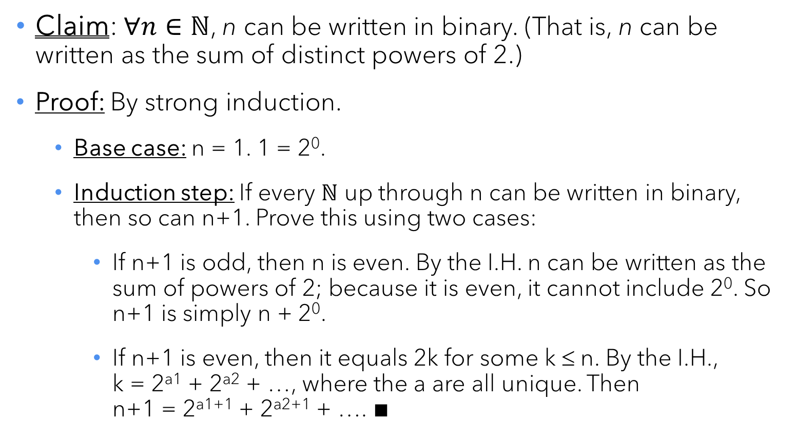
Binary representation
Claim: $∀n∈ℕ$, n can be written in binary. (That is, n can be written as the sum of distinct powers of 2.)
Proof: By strong induction.
  Base case: n = 1. 1 = 2⁰.
  Induction step: If every $ℕ$ up through n can be written in binary, then so can n+1. Prove this using two cases:
    If n+1 is odd, then n is even. By the I.H. n can be written as the sum of powers of 2; because it is even, it cannot include 2⁰. So n+1 is simply n + 2⁰.
    If n+1 is even, then it equals 2k for some k ≤ n. By the I.H.,
    k = 2^{a1} + 2^{a2} + …, where the a are all unique. Then
    n+1 = 2^{a1+1} + 2^{a2+1} + …. ∎

Slide 19
The game of Nim
There are coins laid out in rows.
Two players (green & purple) take turns.
A turn consists of selecting a row, and then removing any number of coins from that row.
The goal is to not take the last coin. (Green loses in this example.)

Slide 20
Your turn!
Claim: In any game of Nim that has two rows with n ≥ 2 coins each, the second player can force a win.
Give a proof using strong induction.

Slide 21
Nimble proof
Base case (n = 2): Need two cases, for green’s two possible moves. Top right.
Induction step: If winnable for all lengths 2 through n, then winnable for n+1.
Three cases: green leaves (a) zero, (b) one, or (c) more than one coin in the row. In (c), take the same number from the other row and then the smaller game is winnable per the I.H.

Slide 22

The Fundamental Theorem of Arithmetic
$∀n∈ℕ,n≥2$, one of these two things is true:
  $n$ is prime itself.
  $n$ is the product of two or more (possibly repeated) primes.
How could you prove such a thing?
  Strong induction!

Slide 23

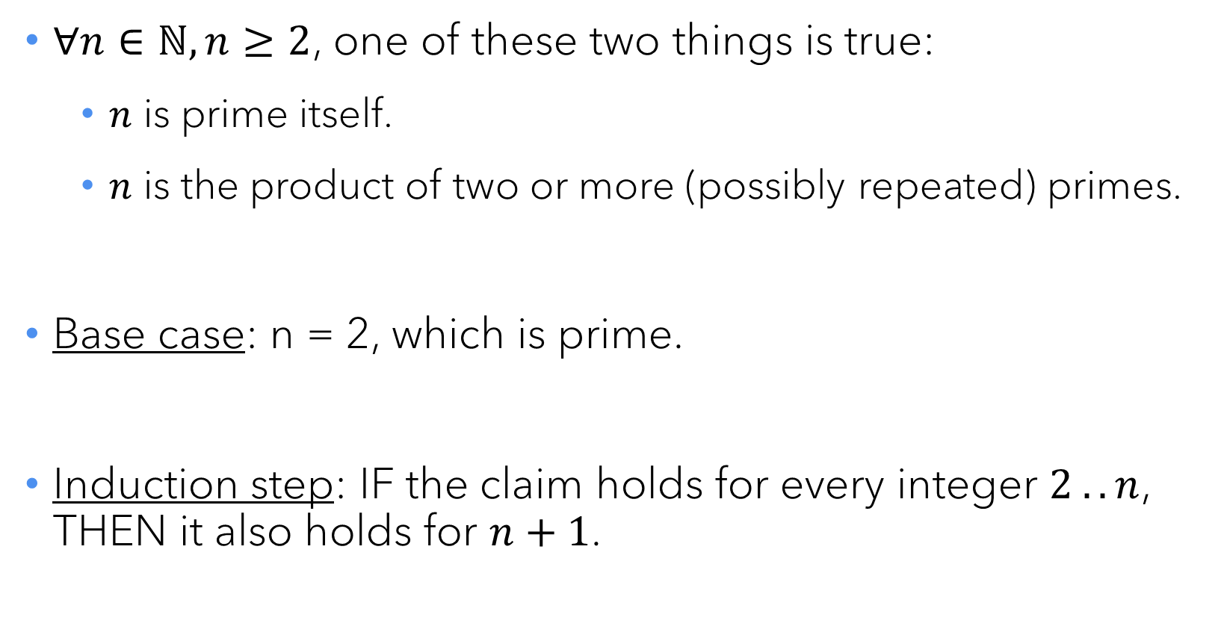
The Fundamental Theorem of Arithmetic
$∀n∈ℕ,n≥2$, one of these two things is true:
  $n$ is prime itself.
  $n$ is the product of two or more (possibly repeated) primes.
Base case: n = 2, which is prime.
Induction step: IF the claim holds for every integer $2 .. n$,
THEN it also holds for $n+1$.

Slide 24
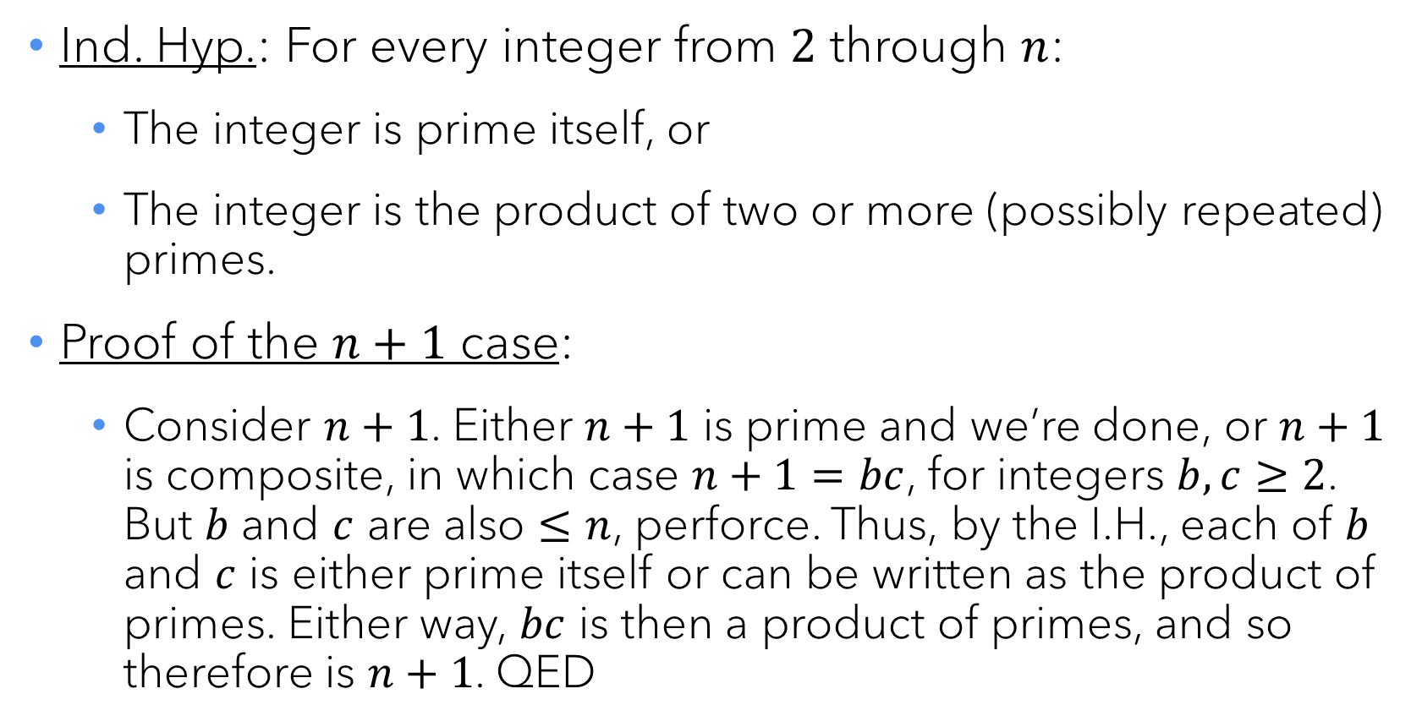
The Fundamental Theorem of Arithmetic
Ind. Hyp.: For every integer from $2$ through $n$:
  The integer is prime itself, or
  The integer is the product of two or more (possibly repeated) primes.
Proof of the $n+1$ case:
  Consider $n+1$. Either $n+1$ is prime and we’re done, or $n+1$ is composite, in which case $n+1=bc$, for integers $b,c≥2$. But $b$ and $c$ are also $≤n$, perforce. Thus, by the I.H., each of $b$ and $c$ is either prime itself or can be written as the product of primes. Either way, $bc$ is then a product of primes, and so therefore is $n+1$. QED

Slide 25

Questions?
Exam 1 Wed. 1/29, 8-10am
DCC 318 (Last names A-K)
DCC 324 (Last names L-Z)

