Slide 1
Lecture 7: Recursion
CSCI 2200 Foundations of Computer Science

Slide 2


Slide 3

Agenda
Overview of recursion
Recursive sets
Recursive structures
Recursive functions

Slide 4
Reminder: This course is not easy!
Ask John von Neumann!
“It is exceptional that one should be able to acquire the understanding of a process without having previously acquired a deep familiarity with running it, with using it, before one has assimilated it in an instinctive and empirical way.”
“In mathematics, you do not understand things. You just get used to them.”

Slide 5
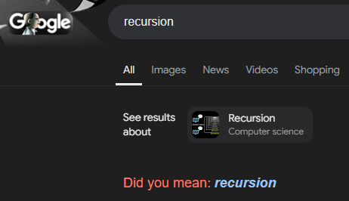

Slide 6
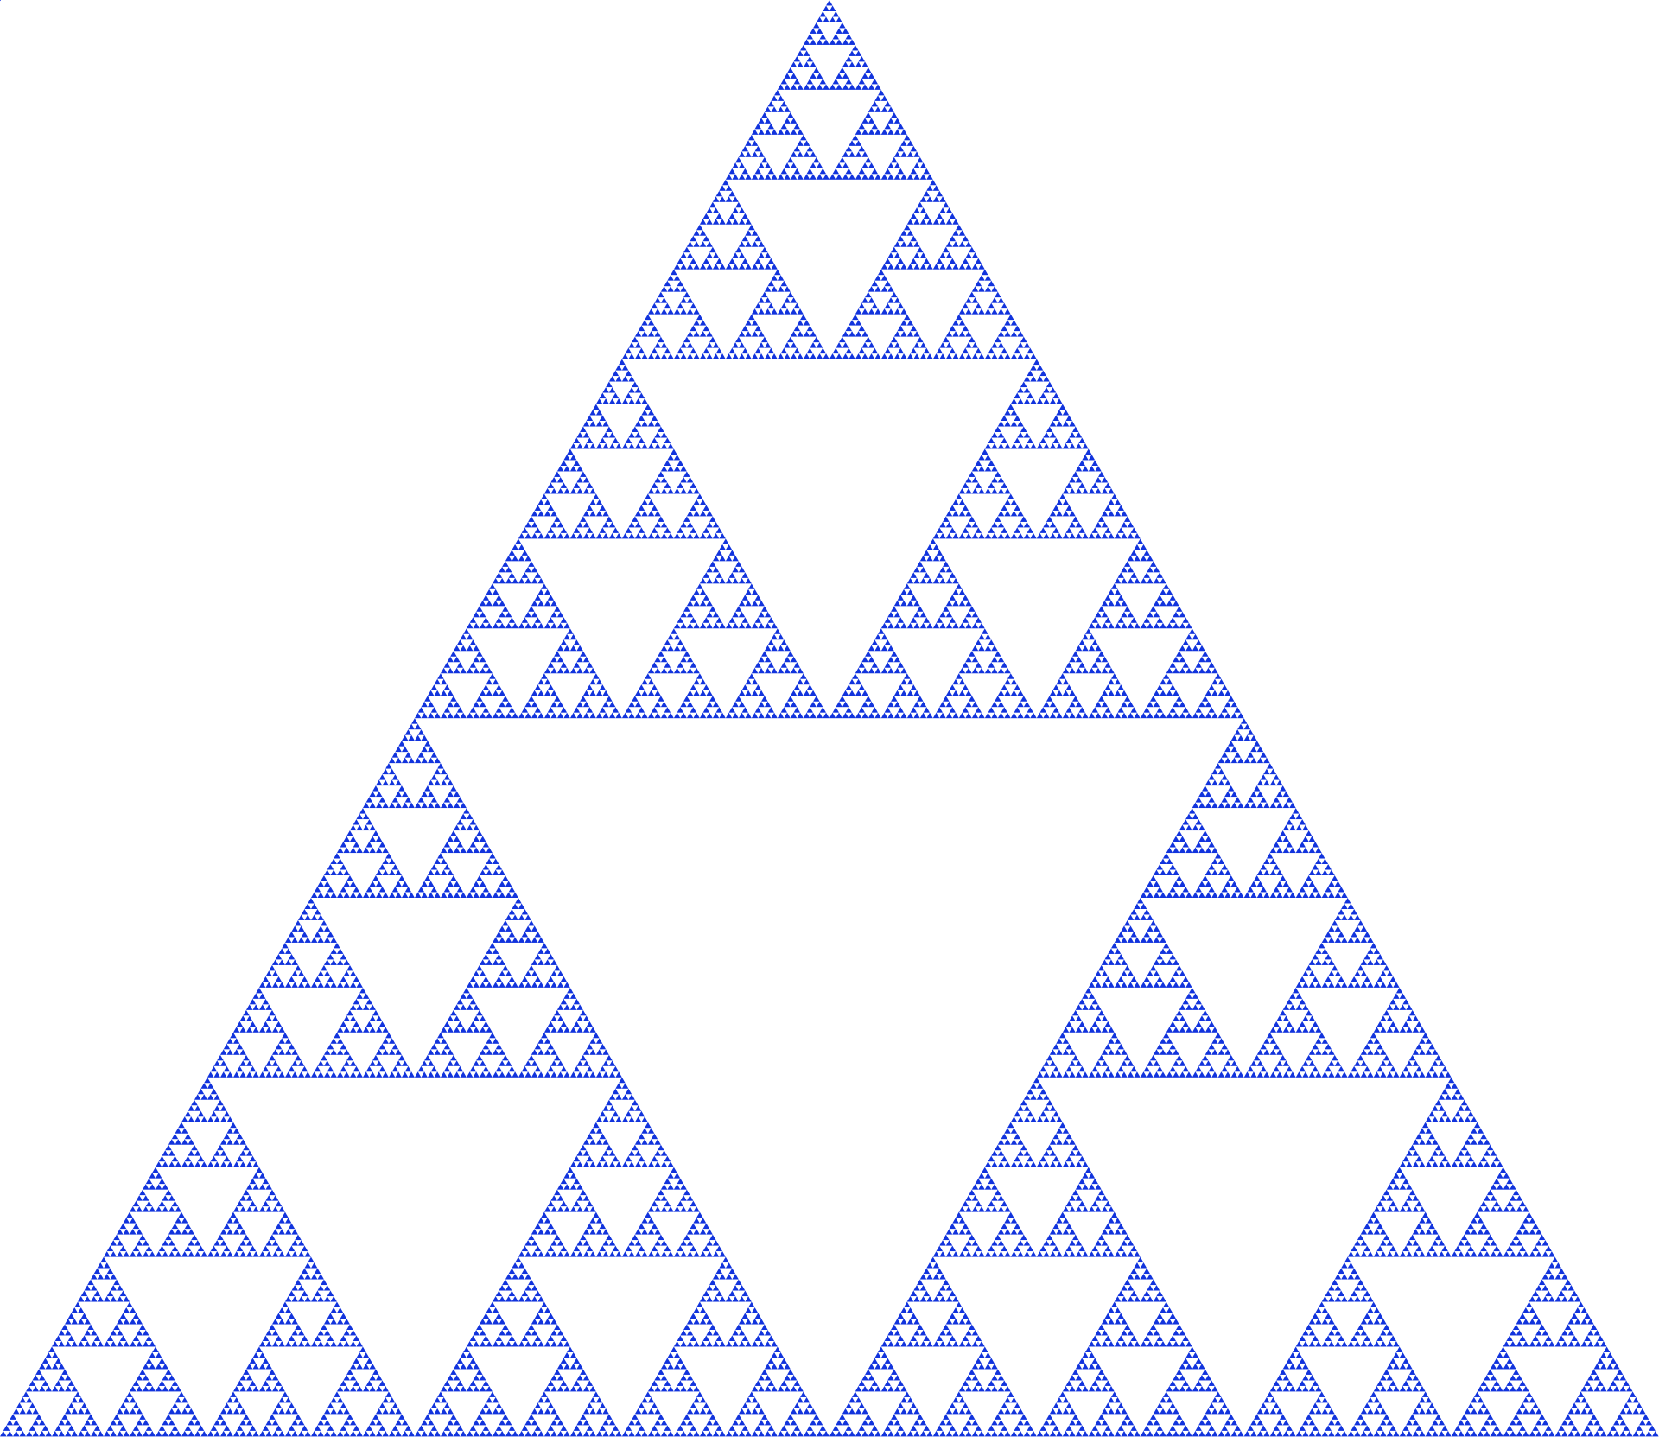
Sierpinski gasket
The Sierpinski triangle (or gasket) is an example of a fractal: a self-similar structure in which the entire structure is contained in a smaller component of the structure.
If you zoom in on one of the three subsections, it’s identical to the whole thing.
How do you draw a Sierpinski triangle of size S? First, draw three Sierpinski triangles of size S/2…

Slide 7
Recursion
More generally, recursion refers to any situation where we use an object in its own definition. The objects in question can be functions, structures, computer programs, what have you.
Recursion is one of the fundamental concepts in computer science, and one that you’re going to have to get comfortable with.

Slide 8
A familiar example
Fibonacci numbers!
How do you calculate the 20th Fibonacci number?
Add the 18th and 19th!
More generally, F(n) = F(n-1) + F(n-2).
Notice: the definition of F involves F.
What’s the catch?

Slide 9
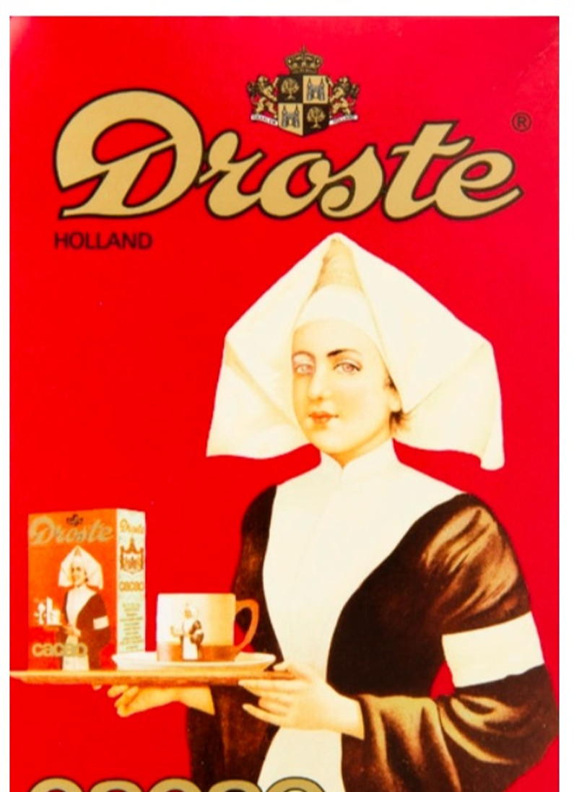
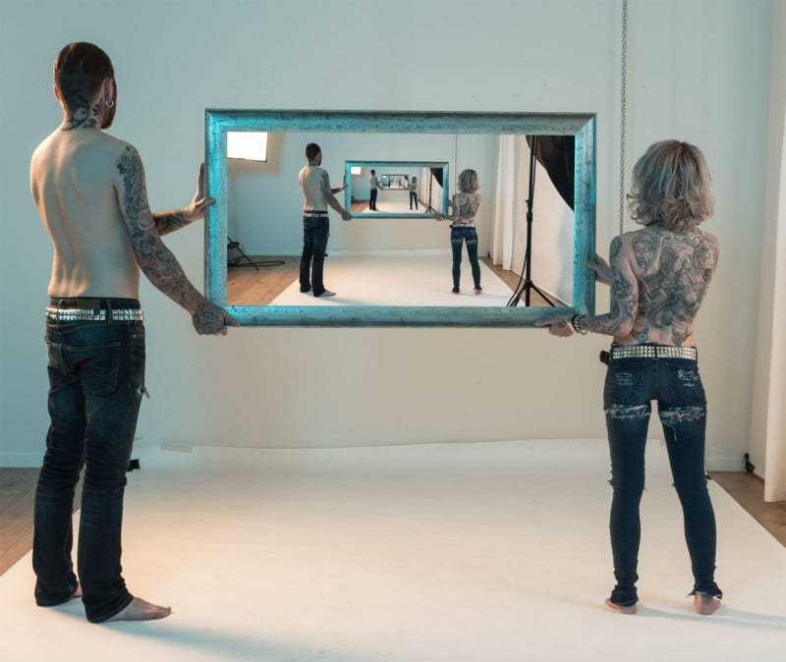
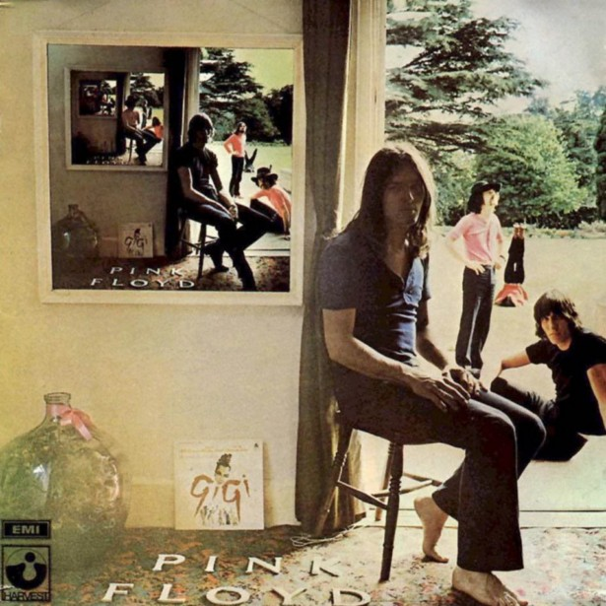
The Droste effect

Slide 10
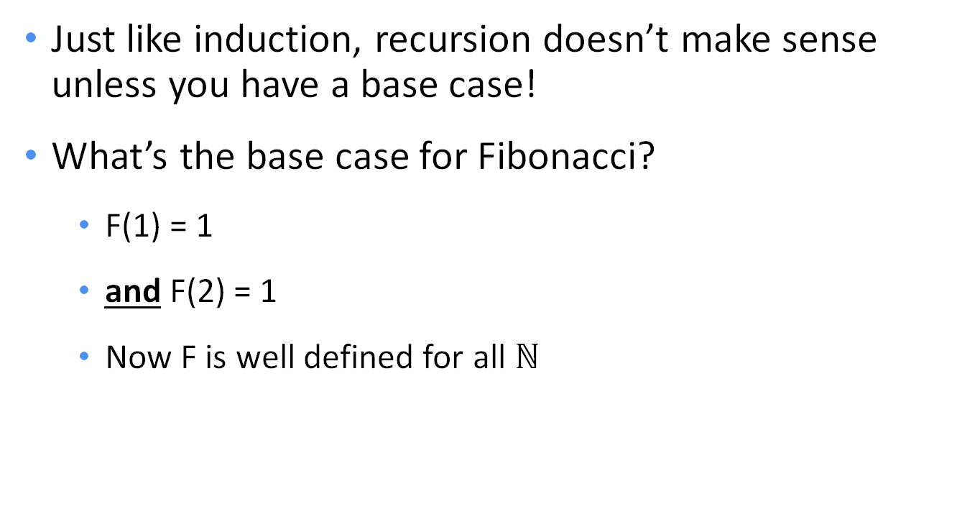
Where does it end? (Or begin?)
Just like induction, recursion doesn’t make sense unless you have a base case!
What’s the base case for Fibonacci?
F(1) = 1
and F(2) = 1
Now F is well defined for all $ℕ$

Slide 11
Using it in a program
def fib(n): return fib(n-1) + fib(n-2)
def fib(n): if n <= 2: return 1 return fib(n-1) + fib(n-2)

Slide 12

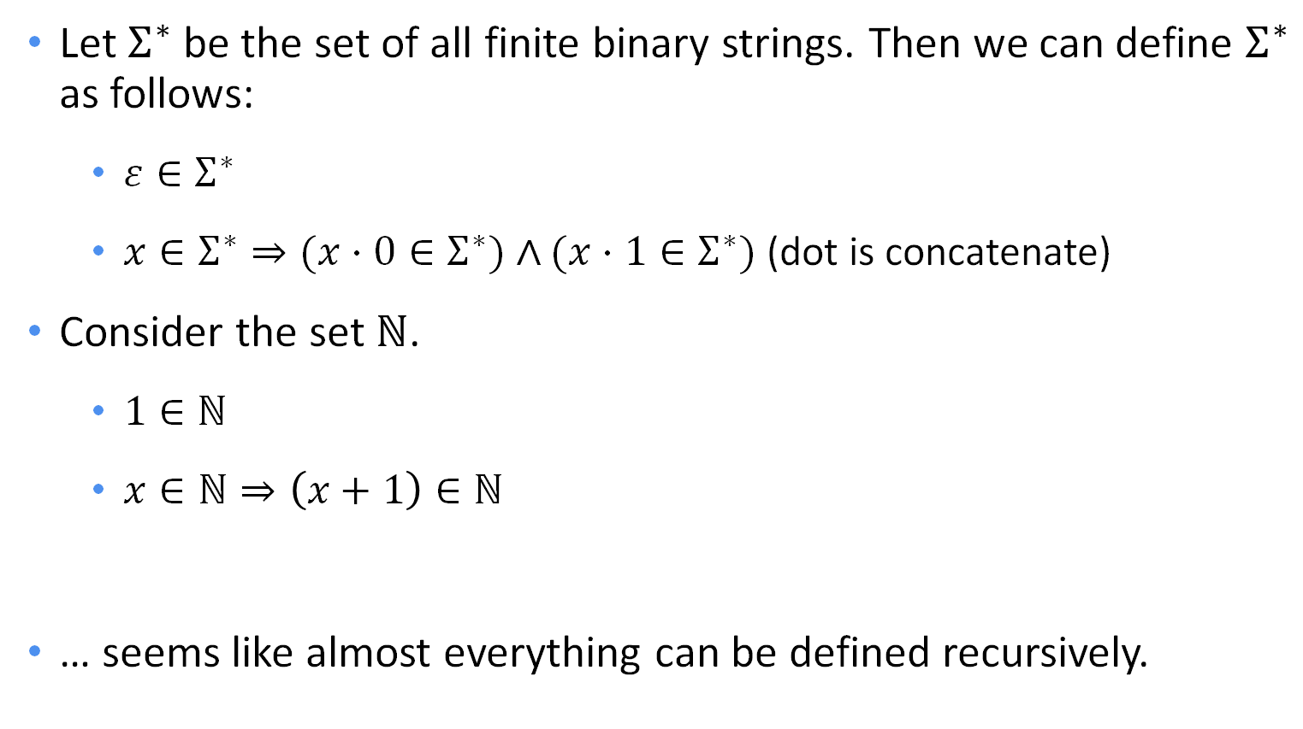
Recursive sets
Let $Σ^{∗}$ be the set of all finite binary strings. Then we can define $Σ^{∗}$ as follows:
$ε∈Σ^{∗}$
$x∈Σ^{∗}⇒(x⋅0∈Σ^{∗})∧(x⋅1∈Σ^{∗})$ (dot is concatenate)
Consider the set $ℕ$.
$1∈ℕ$
$x∈ℕ⇒\left(x+1\right)∈ℕ$
… seems like almost everything can be defined recursively.

Slide 13
Your turn!
Write a recursive definition for the set of all binary palindromes (that is, the set of all binary strings that read the same forwards and backwards).
Hint: Multiple base cases!

Slide 14
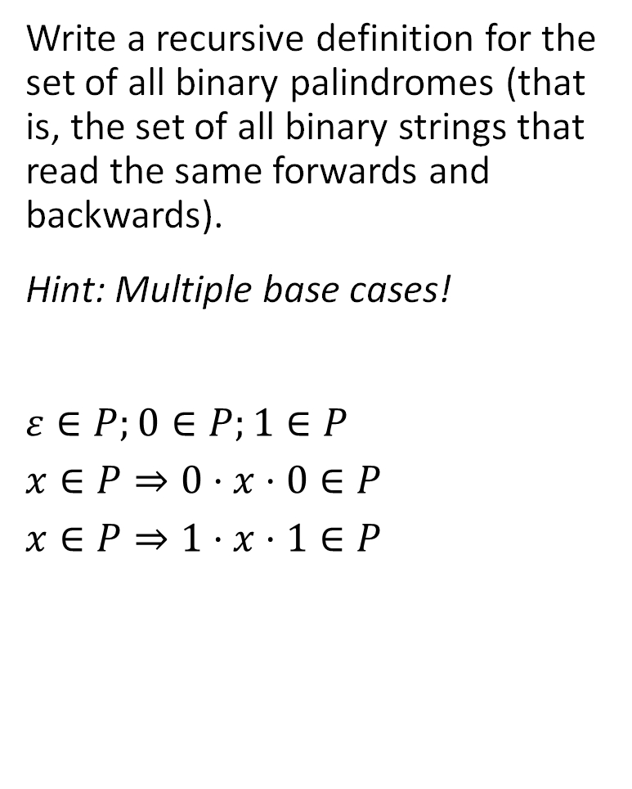
Your turn!
Write a recursive definition for the set of all binary palindromes (that is, the set of all binary strings that read the same forwards and backwards).
Hint: Multiple base cases!
$$ε∈P;0∈P;1∈P$$
$$x∈P⇒0⋅x⋅0∈P$$
$$x∈P⇒1⋅x⋅1∈P$$

Slide 15
Recursive structures
Linked lists:
An empty list is a LL.
Anything consisting of a single node followed by a LL is itself a LL.
Binary trees:
An empty tree is a BT. A single node (root) is a BT.
Anything consisting of a single node (root) with BTs as left and right children is itself a BT.
… seems like almost everything can be defined recursively.
List
T
T

Slide 16

Recursive functions (aka recurrence relations)
Consider this function:
f(0) = 0
f(n) = f(n-1) + 2n – 1, for all $n≥1$
What does this function calculate?
How do you prove it?

Slide 17

Unrolling a recursion
We can “stack” our recursive steps…
$f(n)$ = $f\left(n−1\right)+2n−1$
$f(n−1)$ = $f\left(n−2\right)+2n−3$
$f(n−2)$ = $f\left(n−3\right)+2n−5$
…
$f(2)$ = $f\left(1\right) +3$
$f(1)$ = $f\left(0\right) +1$
Looks like $f\left(n\right)= \sum_{i=1}^{n}{2i−1}$ - can prove via induction.

Slide 18
Your turn!
(a) Write a recursive definition for the Fibonacci sequence.
(b) Prove via induction that F₁ + F₂ + … + F_{n} = F_{n+2} – 1 for all n ≥ 1.

Slide 19
Your turn!
(a) Write a recursive definition for the Fibonacci sequence.
(b) Prove via induction that F₁ + F₂ + … + F_{n} = F_{n+2} – 1 for all n ≥ 1.
F₁ = 1; F₂ = 1
F_{n} = F_{n-1} + F_{n-2}, for n ≥ 3.

Slide 20
Your turn!
(a) Write a recursive definition for the Fibonacci sequence.
(b) Prove via induction that F₁ + F₂ + … + F_{n} = F_{n+2} – 1 for all n ≥ 1.
F₁ = 1; F₂ = 1
F_{n} = F_{n-1} + F_{n-2}, for n ≥ 3.
Assume F₁ + … + F_{n} = F_{n+2} – 1
F_{n+3} = F_{n+2} + F_{n+1} (by def.)
F_{n+3} = F₁ + … + F_{n} + 1 + F_{n+1} (by I.H.)
F_{n+3} – 1 = F₁ + … + F_{n} + F_{n+1} ∎

Slide 21
Other ways to “solve” recurrences
Some styles of recurrences have well-known closed-form solutions.
Geometric series (e.g. compound interest)
There is a “Master Theorem” that gives a closed-form solution for MANY recurrence relations.
…
… and we’re not covering it here. (Algo or Big Algo?)

Slide 22
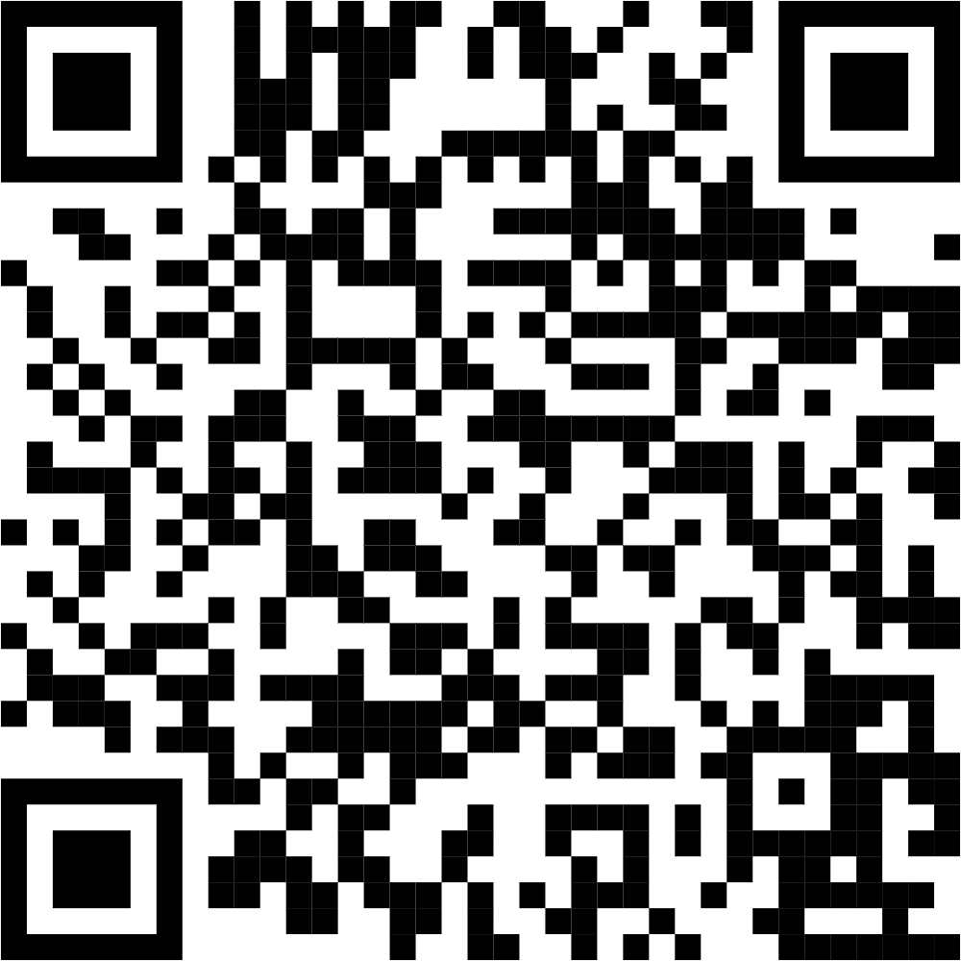
Class survey & reminders
HW 3 due tonight & HW 4 posted today

