Slide 1
Lecture 8: Structural Induction
CSCI 2200 Foundations of Computer Science

Slide 2

Lecture 8: Structural Induction
CSCI 2200 Foundations of Computer Science
“Bloody Tears” by Kenichi Matsubara, from Castlevania II: Simon’s Quest

Slide 3
Today’s tasks
HW questions
Structural induction

Slide 4
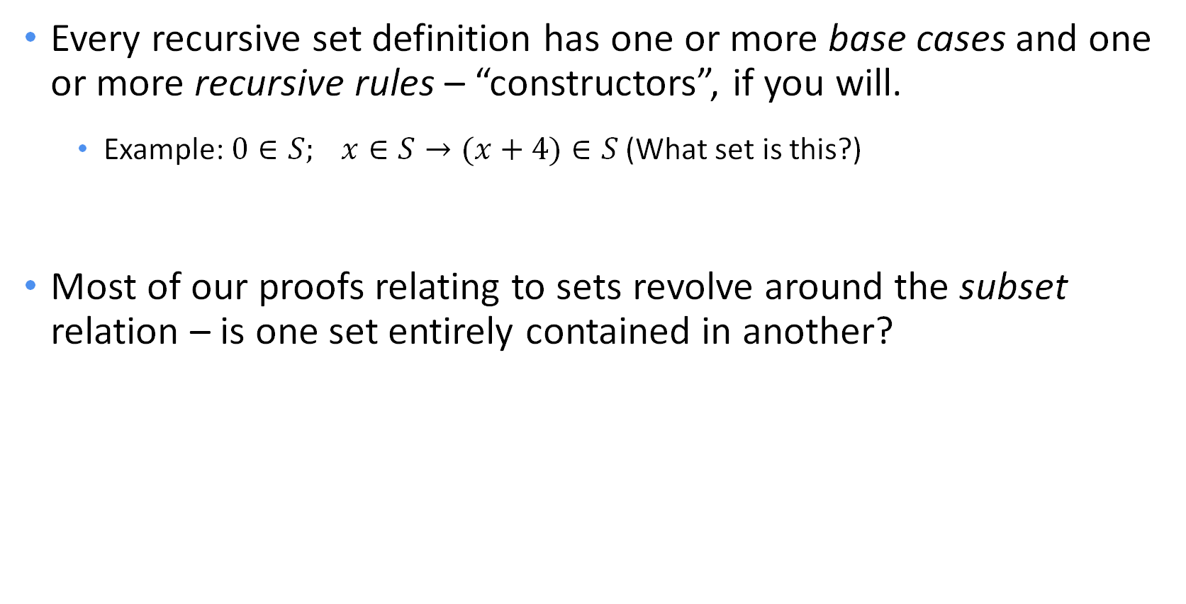
Two reminders
Every recursive set definition has one or more base cases and one or more recursive rules – “constructors”, if you will.
Example: $0∈S; x∈S→(x+4)∈S$ (What set is this?)
Most of our proofs relating to sets revolve around the subset relation – is one set entirely contained in another?

Slide 5

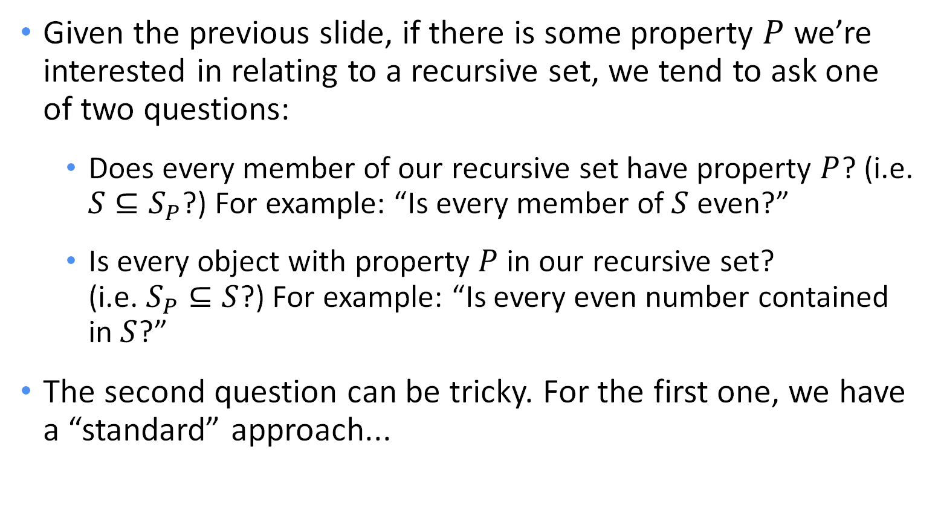
Two questions
$$0∈S; x∈S→(x+4)∈S$$
Given the previous slide, if there is some property $P$ we’re interested in relating to a recursive set, we tend to ask one of two questions:
Does every member of our recursive set have property $P$? (i.e. $S⊆S_{P}$?) For example: “Is every member of $S$ even?”
Is every object with property $P$ in our recursive set? (i.e. $S_{P}⊆S$?) For example: “Is every even number contained in $S$?”
The second question can be tricky. For the first one, we have a “standard” approach...

Slide 6
... more induction!
To get the intuition:
The first two orks had blue eyes. Whenever two blue-eyed orks mate, the offspring always have blue eyes.
Can you conclude that all orks have blue eyes?
Sure – where would any other color come from?
Your textbook author refers to this sort of reasoning as “structural induction.”
Really, this is just a special case of strong induction.

Slide 7
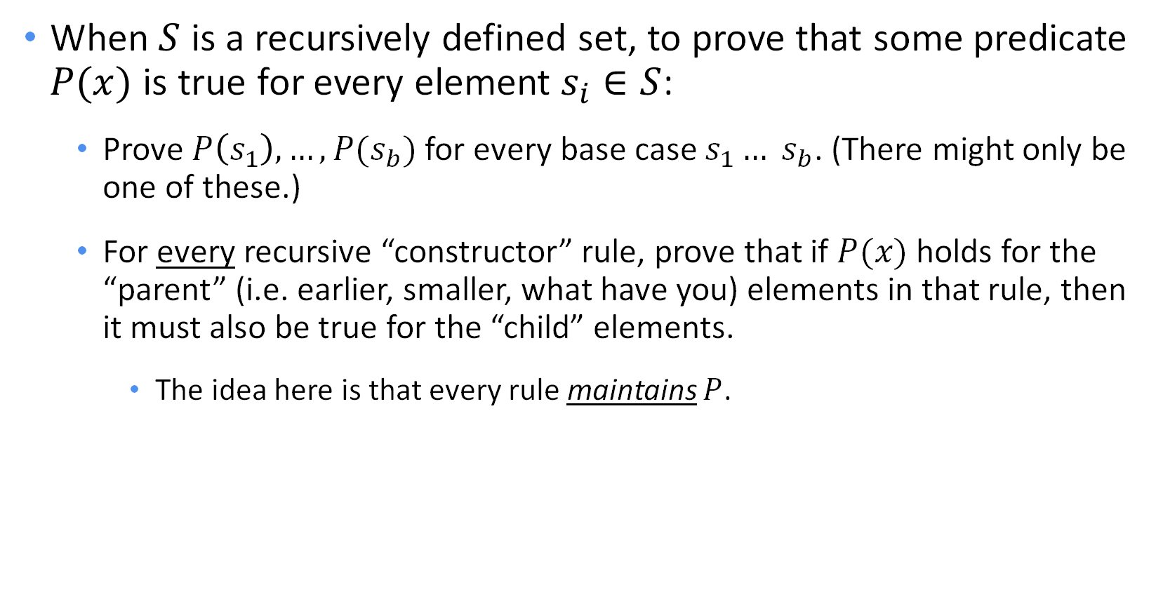
Structural induction
When $S$ is a recursively defined set, to prove that some predicate $P(x)$ is true for every element $s_{i}∈S$:
Prove $P\left(s_{1}\right),…,P(s_{b})$ for every base case $s_{1}… s_{b}$. (There might only be one of these.)
For every recursive “constructor” rule, prove that if $P(x)$ holds for the “parent” (i.e. earlier, smaller, what have you) elements in that rule, then it must also be true for the “child” elements.
The idea here is that every rule maintains $P$.

Slide 8
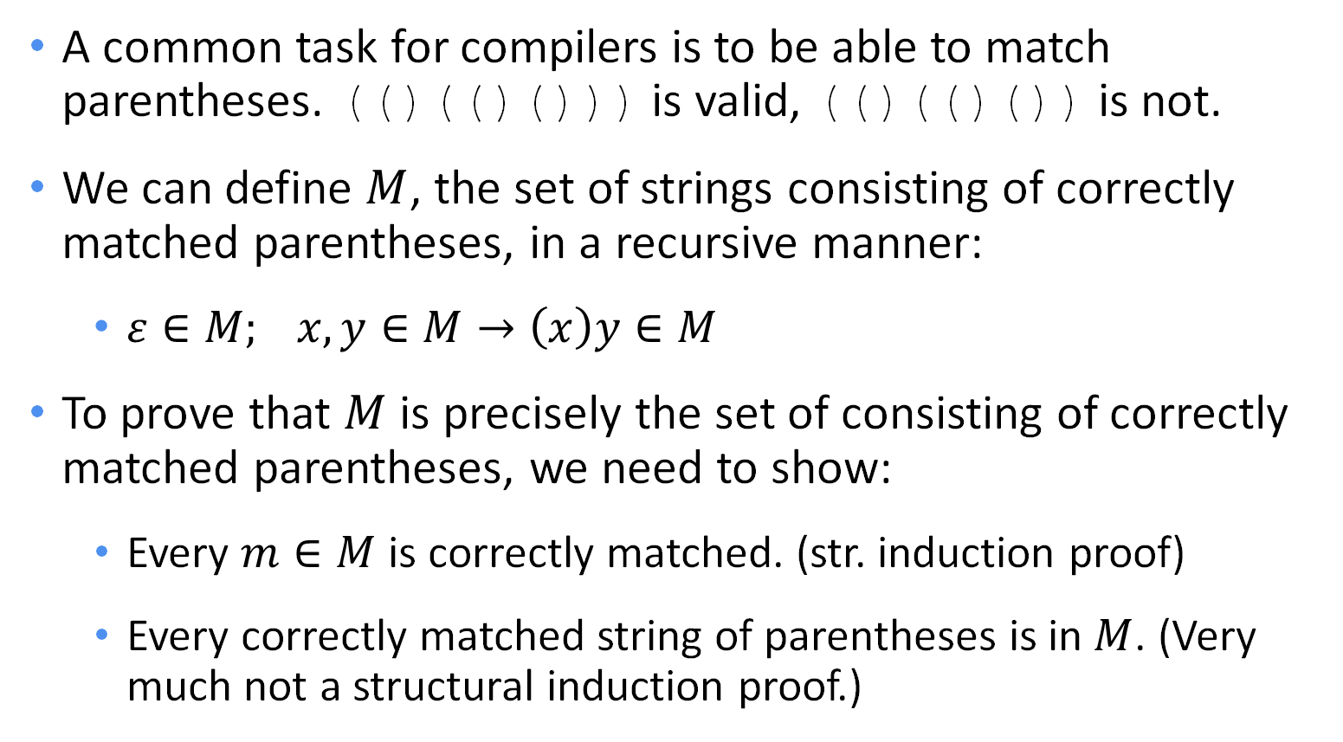
Example structural induction proof
A common task for compilers is to be able to match parentheses. (()(()())) is valid, (()(()()) is not.
We can define $M$, the set of strings consisting of correctly matched parentheses, in a recursive manner:
$ε∈M; x,y∈M→\left(x\right)y∈M$
To prove that $M$ is precisely the set of consisting of correctly matched parentheses, we need to show:
Every $m∈M$ is correctly matched. (str. induction proof)
Every correctly matched string of parentheses is in $M$. (Very much not a structural induction proof.)

Slide 9
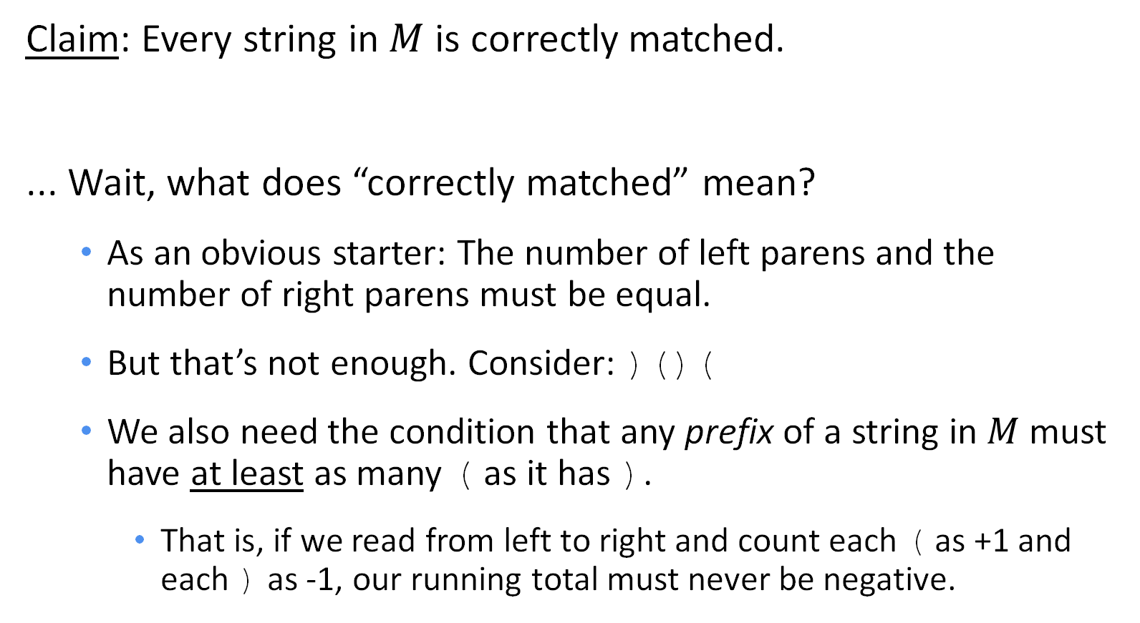
Example S.I. proof
$$ε∈M; x,y∈M→\left(x\right)y∈M$$
Claim: Every string in $M$ is correctly matched.
... Wait, what does “correctly matched” mean?
As an obvious starter: The number of left parens and the number of right parens must be equal.
But that’s not enough. Consider: )()(
We also need the condition that any prefix of a string in $M$ must have at least as many ( as it has ).
That is, if we read from left to right and count each ( as +1 and each ) as -1, our running total must never be negative.

Slide 10
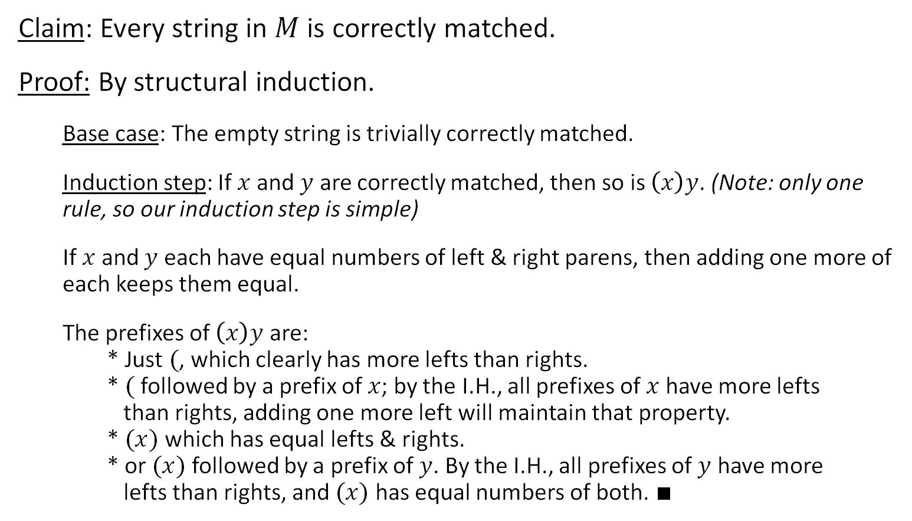
Example S.I. proof
$$ε∈M; x,y∈M→\left(x\right)y∈M$$
Claim: Every string in $M$ is correctly matched.
Proof: By structural induction.
Base case: The empty string is trivially correctly matched.
Induction step: If $x$ and $y$ are correctly matched, then so is $\left(x\right)y$. (Note: only one rule, so our induction step is simple)
If $x$ and $y$ each have equal numbers of left & right parens, then adding one more of each keeps them equal.
The prefixes of $\left(x\right)y$ are: * Just $($, which clearly has more lefts than rights. * $($ followed by a prefix of $x$; by the I.H., all prefixes of $x$ have more lefts than rights, adding one more left will maintain that property. * $(x)$ which has equal lefts & rights. * or $(x)$ followed by a prefix of $y$. By the I.H., all prefixes of $y$ have more lefts than rights, and $(x)$ has equal numbers of both. $∎$

Slide 11
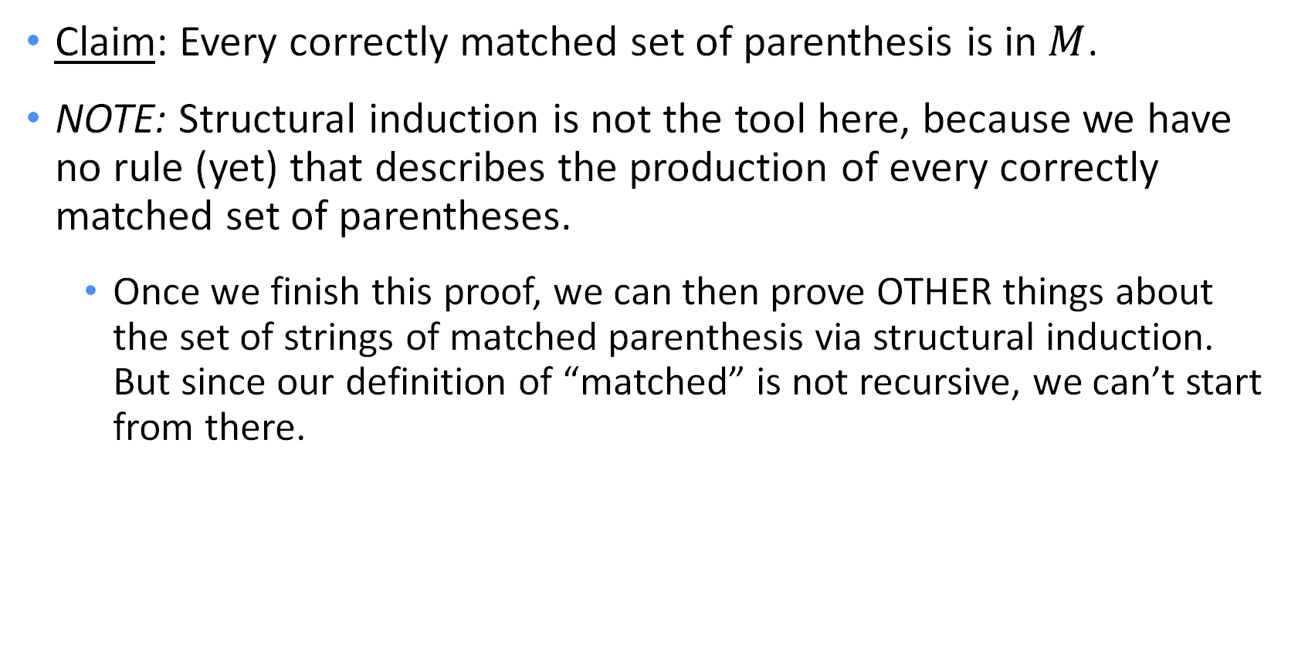
NOT structural induction
$$ε∈M; x,y∈M→\left(x\right)y∈M$$
Claim: Every correctly matched set of parenthesis is in $M$.
NOTE: Structural induction is not the tool here, because we have no rule (yet) that describes the production of every correctly matched set of parentheses.
Once we finish this proof, we can then prove OTHER things about the set of strings of matched parenthesis via structural induction. But since our definition of “matched” is not recursive, we can’t start from there.

Slide 12
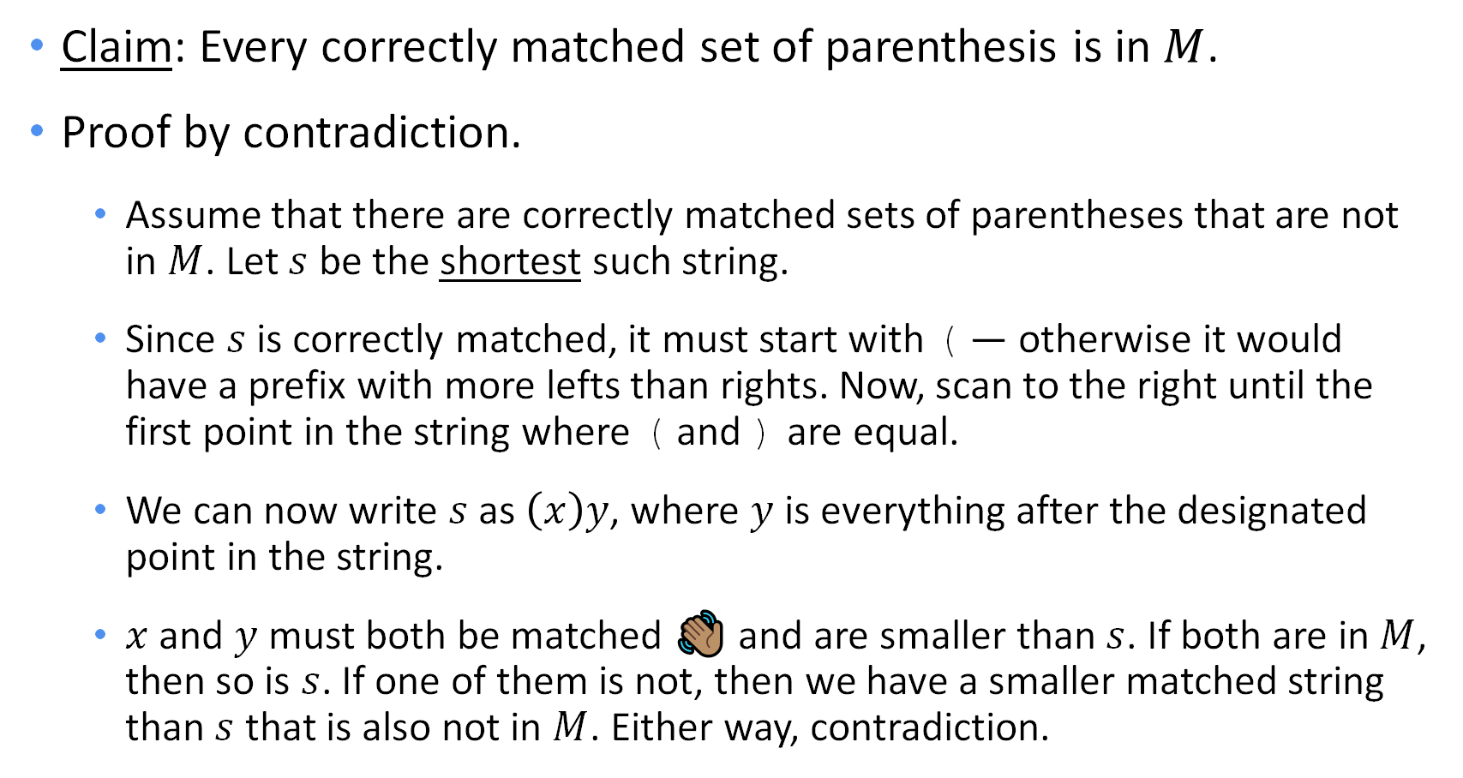
NOT structural induction
$$ε∈M; x,y∈M→\left(x\right)y∈M$$
Claim: Every correctly matched set of parenthesis is in $M$.
Proof by contradiction.
Assume that there are correctly matched sets of parentheses that are not in $M$. Let $s$ be the shortest such string.
Since $s$ is correctly matched, it must start with ( — otherwise it would have a prefix with more lefts than rights. Now, scan to the right until the first point in the string where ( and ) are equal.
We can now write $s$ as $\left(x\right)y$, where $y$ is everything after the designated point in the string.
$x$ and $y$ must both be matched 👋🏽 and are smaller than $s$. If both are in $M$, then so is $s$. If one of them is not, then we have a smaller matched string than $s$ that is also not in $M$. Either way, contradiction.

Slide 13
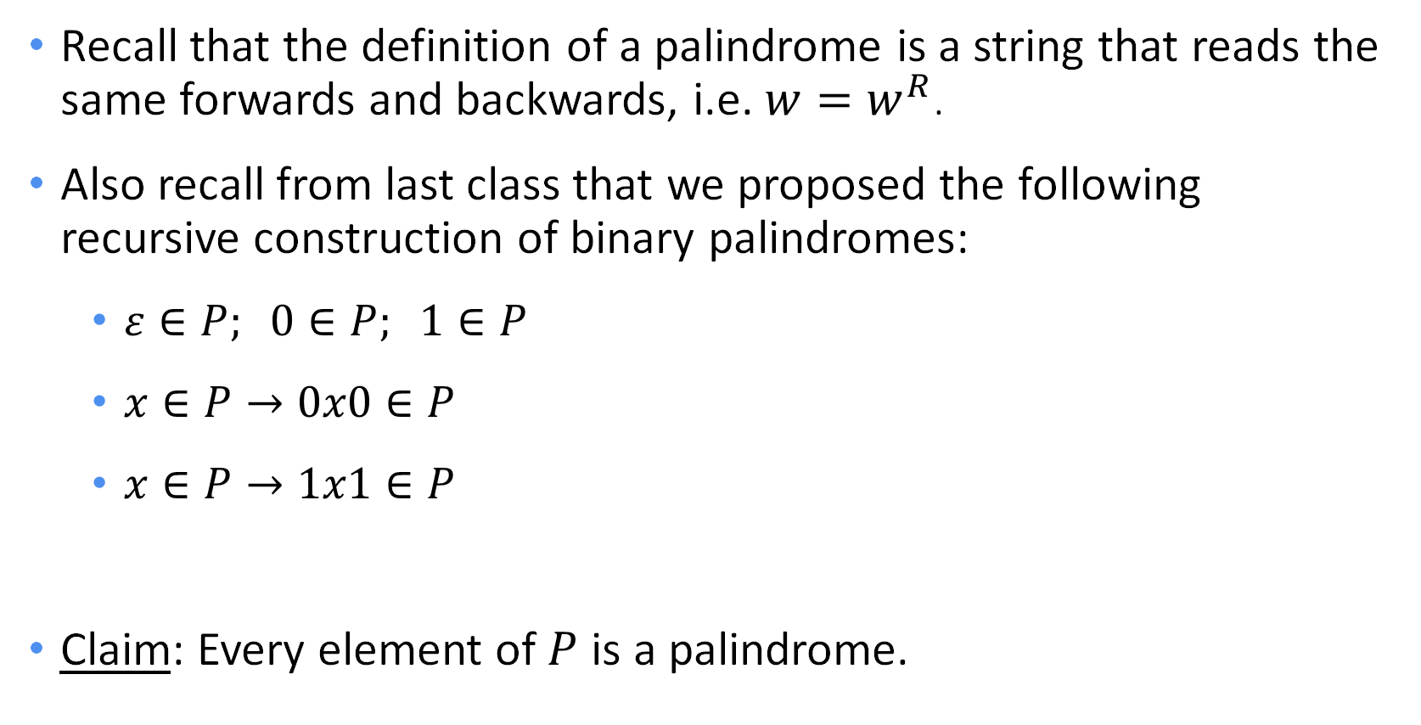
Palindromes
Recall that the definition of a palindrome is a string that reads the same forwards and backwards, i.e. $w=w^{R}$.
Also recall from last class that we proposed the following recursive construction of binary palindromes:
$ε∈P; 0∈P; 1∈P$
$x∈P→0x0∈P$
$x∈P→1x1∈P$
Claim: Every element of $P$ is a palindrome.

Slide 14
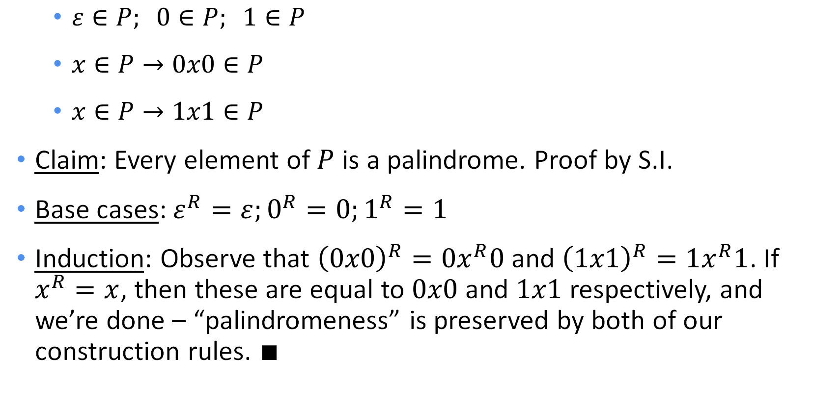
Palindromes – structural induction proof
$ε∈P; 0∈P; 1∈P$
$x∈P→0x0∈P$
$x∈P→1x1∈P$
Claim: Every element of $P$ is a palindrome. Proof by S.I.
Base cases: $ε^{R}=ε;0^{R}=0;1^{R}=1$
Induction: Observe that ${\left(0x0\right)}^{R}=0x^{R}0$ and ${\left(1x1\right)}^{R}=1x^{R}1$. If $x^{R}=x$, then these are equal to $0x0$ and $1x1$ respectively, and we’re done – “palindromeness” is preserved by both of our construction rules. $∎$

Slide 15
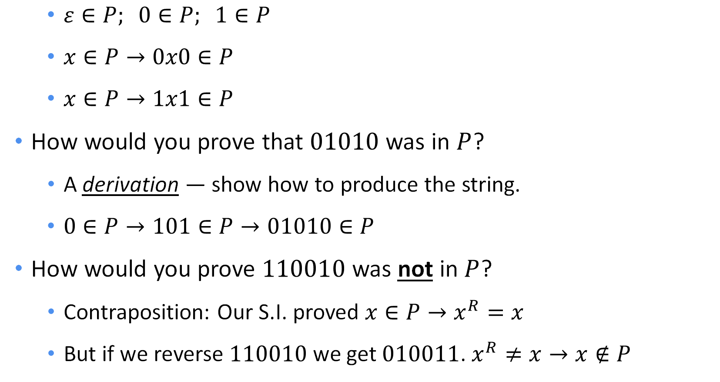
An observation
$ε∈P; 0∈P; 1∈P$
$x∈P→0x0∈P$
$x∈P→1x1∈P$
How would you prove that $01010$ was in $P$?
A derivation — show how to produce the string.
$0∈P→101∈P→01010∈P$
How would you prove $110010$ was not in $P$?
Contraposition: Our S.I. proved $x∈P→x^{R}=x$
But if we reverse $110010$ we get $010011$. $x^{R}≠x→x∉P$

Slide 16
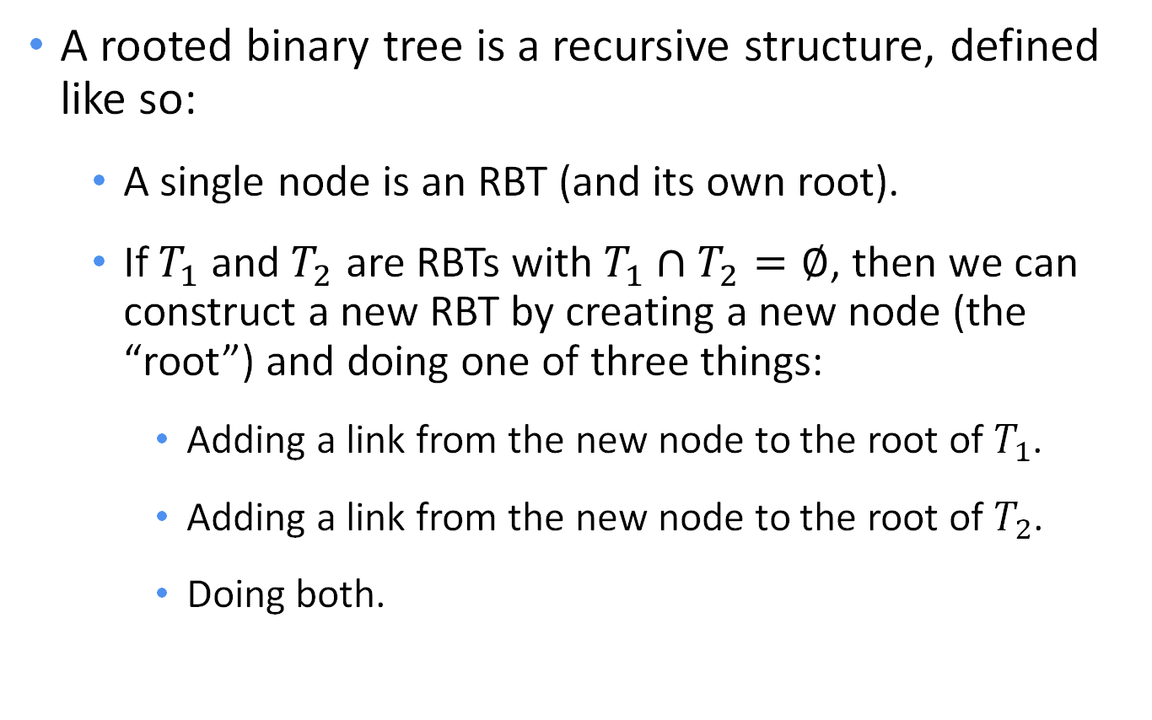
Rooted binary trees
T₁
T₂
A rooted binary tree is a recursive structure, defined like so:
A single node is an RBT (and its own root).
If $T_{1}$ and $T_{2}$ are RBTs with $T_{1}∩T_{2}=∅$, then we can construct a new RBT by creating a new node (the “root”) and doing one of three things:
Adding a link from the new node to the root of $T_{1}$.
Adding a link from the new node to the root of $T_{2}$.
Doing both.
T₁
T₂
T₁
T₂

Slide 17

Putting the “structure” in structural induction
T₁
T₂
Claim: Every rooted binary tree with $n$ nodes has exactly $n−1$ links.
Prove the above claim by structural induction.
T₁
T₂
T₁
T₂

Slide 18
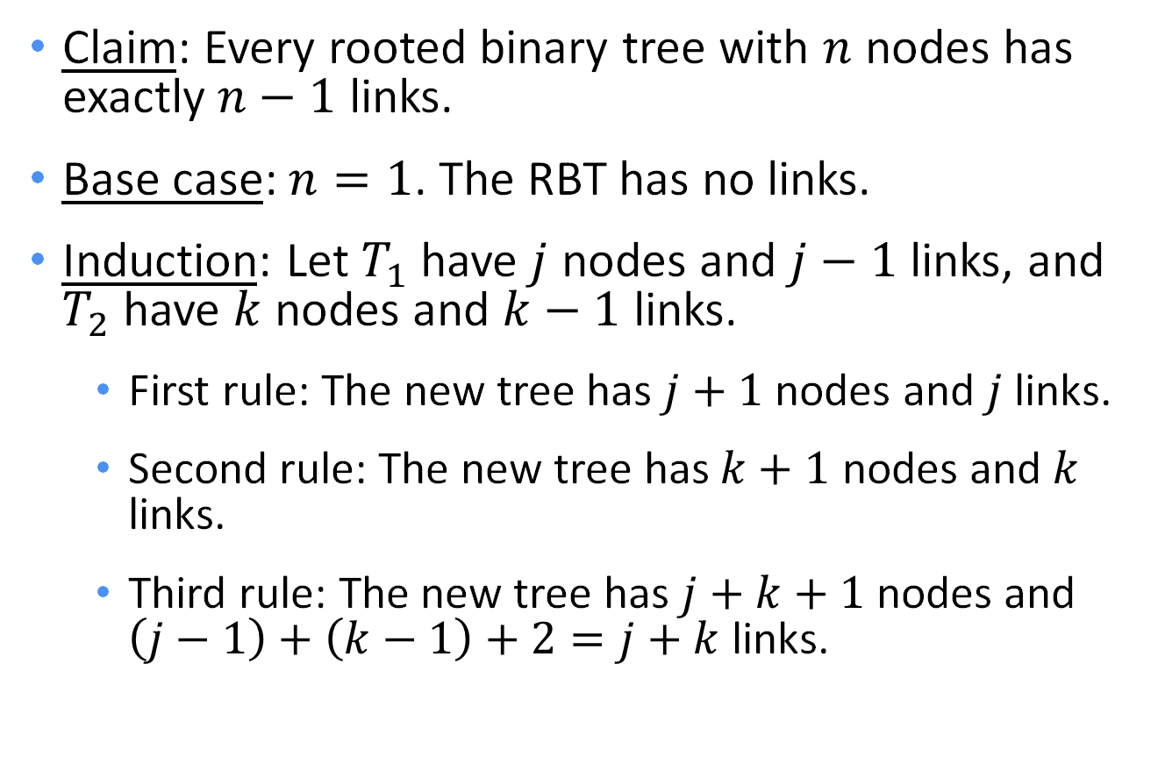
Putting the “structure” in structural induction
T₁
T₂
Claim: Every rooted binary tree with $n$ nodes has exactly $n−1$ links.
Base case: $n=1$. The RBT has no links.
Induction: Let $T_{1}$ have $j$ nodes and $j−1$ links, and $T_{2}$ have $k$ nodes and $k−1$ links.
First rule: The new tree has $j+1$ nodes and $j$ links.
Second rule: The new tree has $k+1$ nodes and $k$ links.
Third rule: The new tree has $j+k+1$ nodes and $\left(j−1\right)+\left(k−1\right)+2=j+k$ links.
T₁
T₂
T₁
T₂

Slide 19
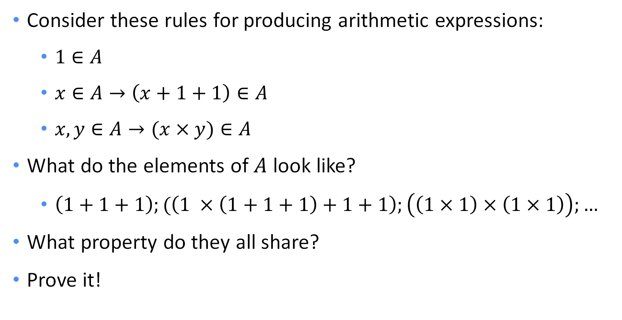
A final example
Consider these rules for producing arithmetic expressions:
$1∈A$
$x∈A→\left(x+1+1\right)∈A$
$x,y∈A→(x×y)∈A$
What do the elements of $A$ look like?
$\left(1+1+1\right);(\left(1 ×\left(1+1+1\right)+1+1\right);\left(\left(1×1\right)×\left(1×1\right)\right);…$
What property do they all share?
Prove it!

Slide 20
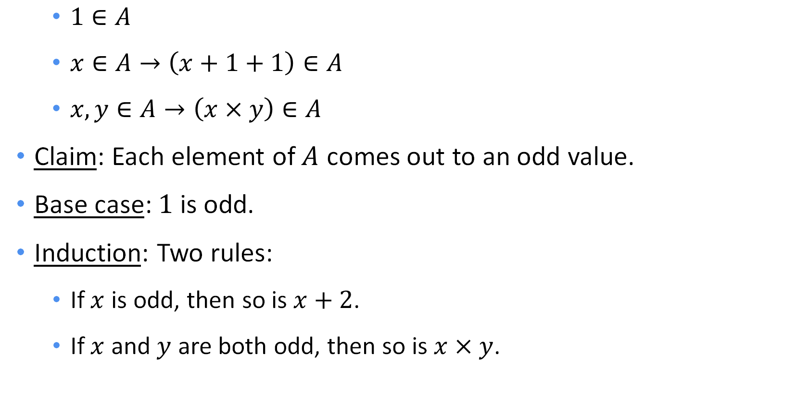
A final example
$1∈A$
$x∈A→\left(x+1+1\right)∈A$
$x,y∈A→\left(x×y\right)∈A$
Claim: Each element of $A$ comes out to an odd value.
Base case: $1$ is odd.
Induction: Two rules:
If $x$ is odd, then so is $x+2$.
If $x$ and $y$ are both odd, then so is $x×y$.

Slide 21
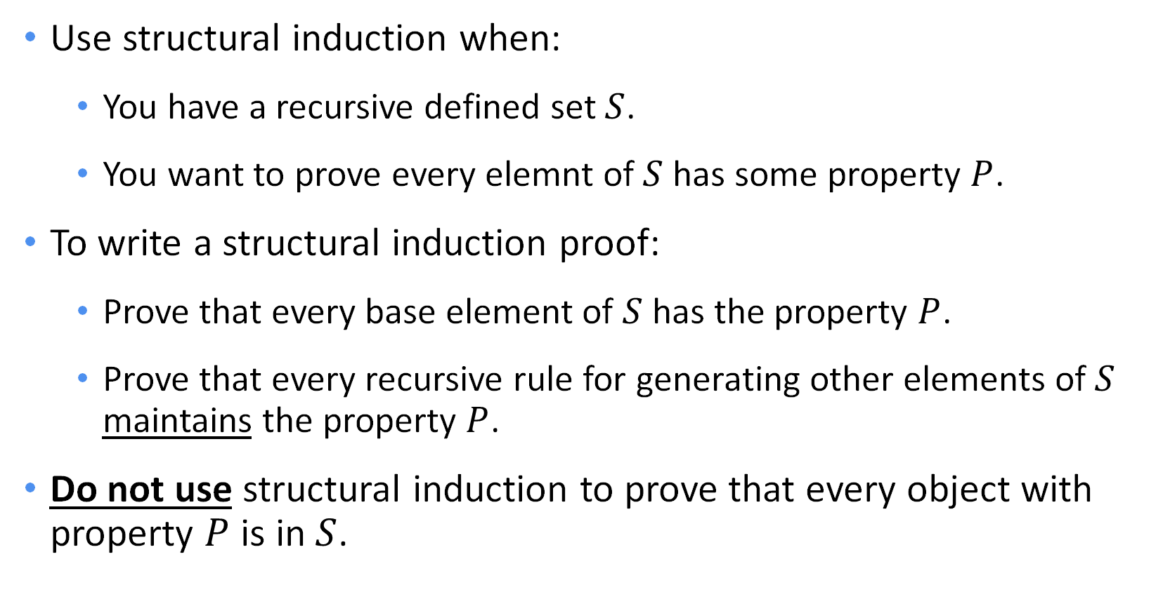
Summing up
Use structural induction when:
You have a recursive defined set $S$.
You want to prove every elemnt of $S$ has some property $P$.
To write a structural induction proof:
Prove that every base element of $S$ has the property $P$.
Prove that every recursive rule for generating other elements of $S$ maintains the property $P$.
Do not use structural induction to prove that every object with property $P$ is in $S$.

Slide 22
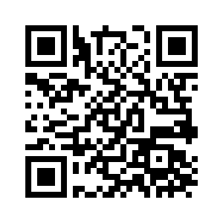
Questions?

