Slide 1
Lecture 9:
Sums and Asymptotics
CSCI 2200
Foundations of Computer Science

Slide 2

Lecture 9:
Sums and Asymptotics
CSCI 2200
Foundations of Computer Science
“Katamari on the Rocks” performed by Masayuki Tanaka
and Tomomi Suzuki, composed by Yuu Miyake

Slide 3
Today’s tasks
HW questions
Methods for dealing with summations
Asymptotic notation: big-O and its cousins
Shameless plug: My friend P.D. Magnus recent published a paper titled On Trusting Chatbots. Worth reading.

Slide 4
An example problem: Subsequence sum
Given a list of integers...
1 -1 -1 2 3 4 -1 -1 2 3 -4 1 2 -1 -2 1
... find the run of consecutive values that produces the largest sum.
How would you accomplish this?
max = -sys.maxsize - 1
for i in range(N):
for j in range(i+1,N):
total = sum(A[i:j])
if total > max:
max = total

Slide 5
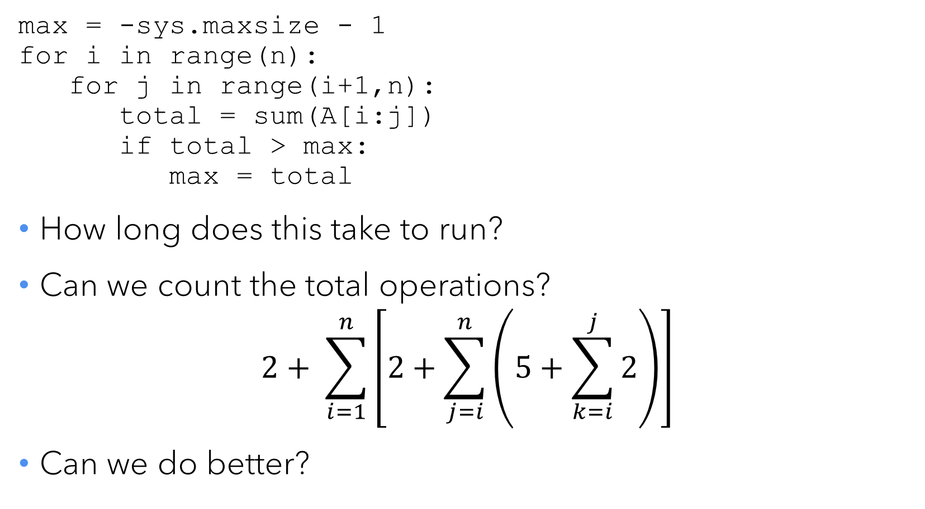
Calculating runtime
max = -sys.maxsize - 1
for i in range(n):
for j in range(i+1,n):
total = sum(A[i:j])
if total > max:
max = total
How long does this take to run?
Can we count the total operations?
$$2+ \sum_{i=1}^{n}{\left[2+\sum_{j=i}^{n}{\left(5+\sum_{k=i}^{j}{2}\right)}\right]}$$
Can we do better?

Slide 6
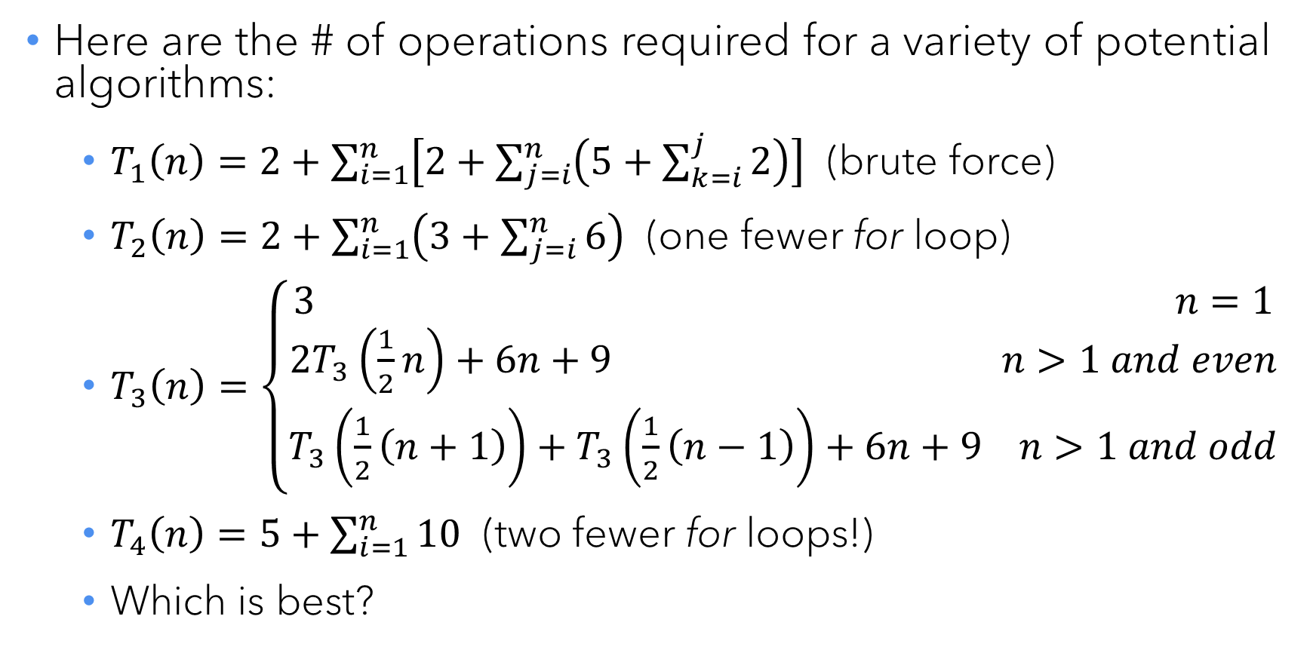
Other possibilities
Here are the # of operations required for a variety of potential algorithms:
  $T_{1}\left(n\right)=2+\sum_{i=1}^{n}{\left[2+\sum_{j=i}^{n}{\left(5+\sum_{k=i}^{j}{2}\right)}\right]}$ (brute force)
  $T_{2}\left(n\right)=2+\sum_{i=1}^{n}{\left(3+\sum_{j=i}^{n}{6}\right)}$ (one fewer for loop)
  $T_{3}\left(n\right)=\left\{\begin{aligned}3 n=1 \\ 2T_{3}\left(\frac{1}{2}n\right)+6n+9 n>1 and even \\ T_{3}\left(\frac{1}{2}\left(n+1\right)\right)+T_{3}\left(\frac{1}{2}\left(n−1\right)\right)+6n+9 n>1 and odd\end{aligned}\right.$
  $T_{4}\left(n\right)=5+\sum_{i=1}^{n}{10}$ (two fewer for loops!)
  Which is best?

Slide 7
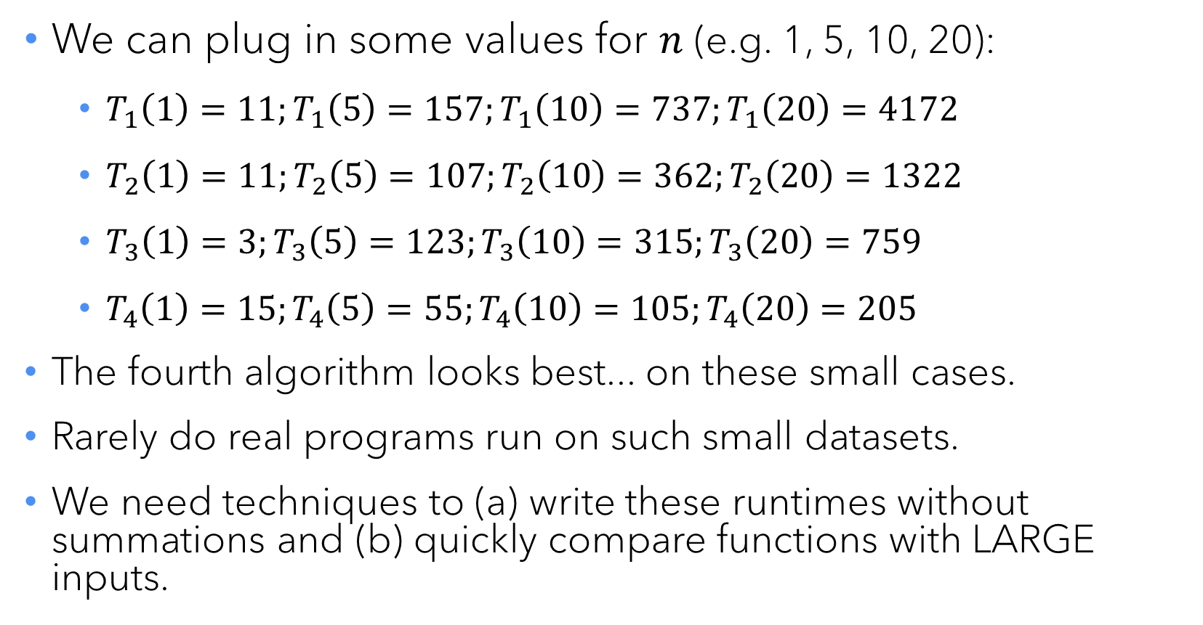
Small cases
We can plug in some values for $n$ (e.g. 1, 5, 10, 20):
  $T_{1}\left(1\right)=11;T_{1}\left(5\right)=157;T_{1}\left(10\right)=737;T_{1}\left(20\right)=4172$
  $T_{2}\left(1\right)=11;T_{2}\left(5\right)=107;T_{2}\left(10\right)=362;T_{2}\left(20\right)=1322$
  $T_{3}\left(1\right)=3;T_{3}\left(5\right)=123;T_{3}\left(10\right)=315;T_{3}\left(20\right)=759$
  $T_{4}\left(1\right)=15;T_{4}\left(5\right)=55;T_{4}\left(10\right)=105;T_{4}\left(20\right)=205$
The fourth algorithm looks best... on these small cases.
Rarely do real programs run on such small datasets.
We need techniques to (a) write these runtimes without summations and (b) quickly compare functions with LARGE inputs.

Slide 8
Dealing with summations

Slide 9
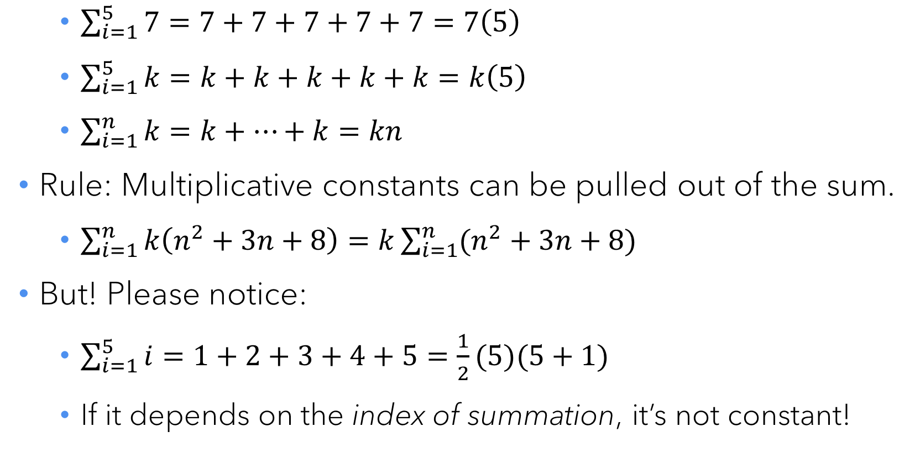
Rule 1: The Constant Rule
  $\sum_{i=1}^{5}{7}=7+7+7+7+7=7\left(5\right)$
  $\sum_{i=1}^{5}{k}=k+k+k+k+k=k\left(5\right)$
  $\sum_{i=1}^{n}{k}=k+…+k=kn$
Rule: Multiplicative constants can be pulled out of the sum.
  $\sum_{i=1}^{n}{k\left(n^{2}+3n+8\right)=k\sum_{i=1}^{n}{(n^{2}+3n+8)}}$
But! Please notice:
  $\sum_{i=1}^{5}{i}=1+2+3+4+5=\frac{1}{2}(5)(5+1)$
  If it depends on the index of summation, it’s not constant!

Slide 10
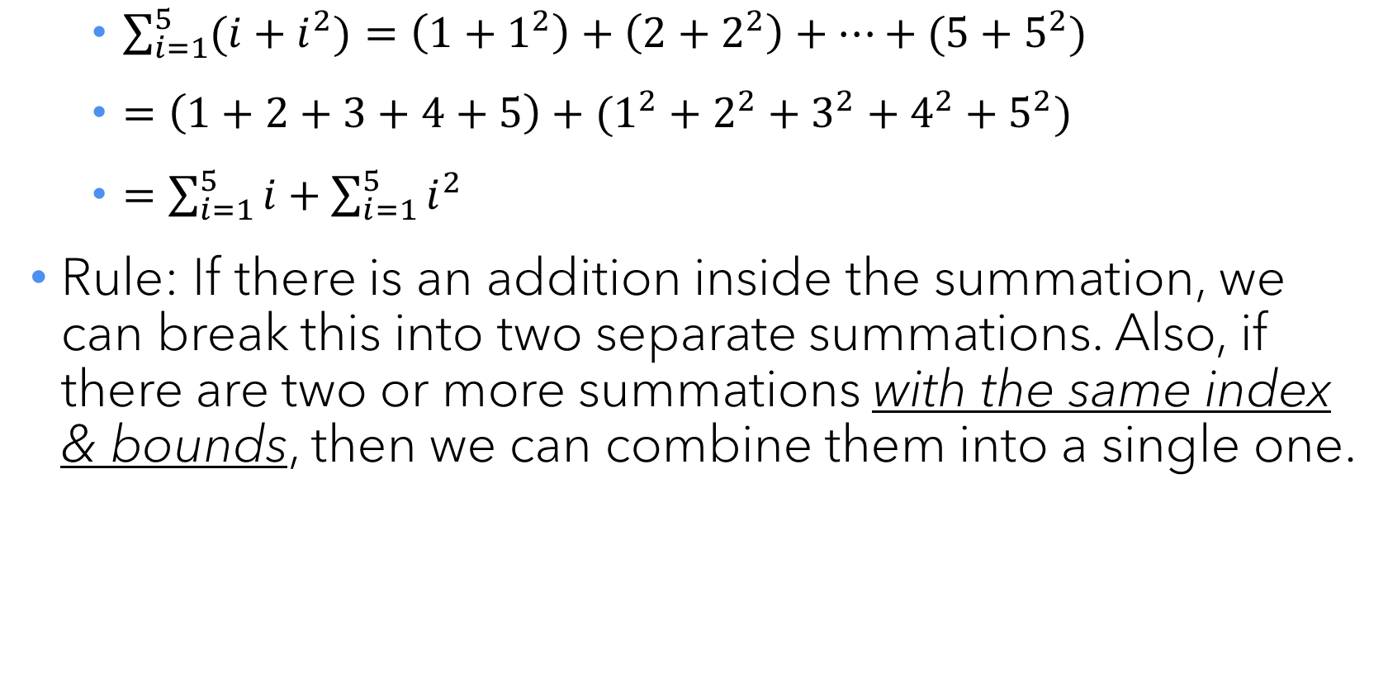
Rule 2: The Addition Rule
  $\sum_{i=1}^{5}{(i+i^{2})}=\left(1+1^{2}\right)+\left(2+2^{2}\right)+…+(5+5^{2})$
  $=\left(1+2+3+4+5\right)+(1^{2}+2^{2}+3^{2}+4^{2}+5^{2})$
  $=\sum_{i=1}^{5}{i}+\sum_{i=1}^{5}{i^{2}}$
Rule: If there is an addition inside the summation, we can break this into two separate summations. Also, if there are two or more summations with the same index & bounds, then we can combine them into a single one.

Slide 11
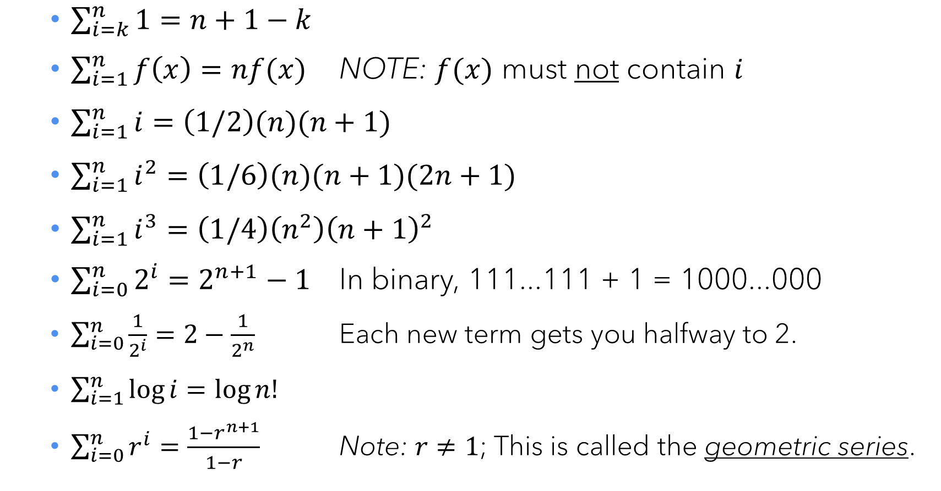
Crib sheet material: Common summations
  $\sum_{i=k}^{n}{1}=n+1−k$
  $\sum_{i=1}^{n}{f\left(x\right)=nf(x)}$ NOTE: $f(x)$ must not contain $i$
  $\sum_{i=1}^{n}{i}=\left(1/2\right)(n)(n+1)$
  $\sum_{i=1}^{n}{i^{2}}=\left(1/6\right)(n)(n+1)(2n+1)$
  $\sum_{i=1}^{n}{i^{3}}=\left(1/4\right)\left(n^{2}\right){\left(n+1\right)}^{2}$
  $\sum_{i=0}^{n}{2^{i}}=2^{n+1}−1$ In binary, 111...111 + 1 = 1000...000
  $\sum_{i=0}^{n}{\frac{1}{2^{i}}}=2−\frac{1}{2^{n}}$ Each new term gets you halfway to 2.
  $\sum_{i=1}^{n}{\log{i}}=\log{n! }$
  $\sum_{i=0}^{n}{r^{i}}=\frac{1−r^{n+1}}{1−r}$ Note: $r≠1$; This is called the geometric series.

Slide 12
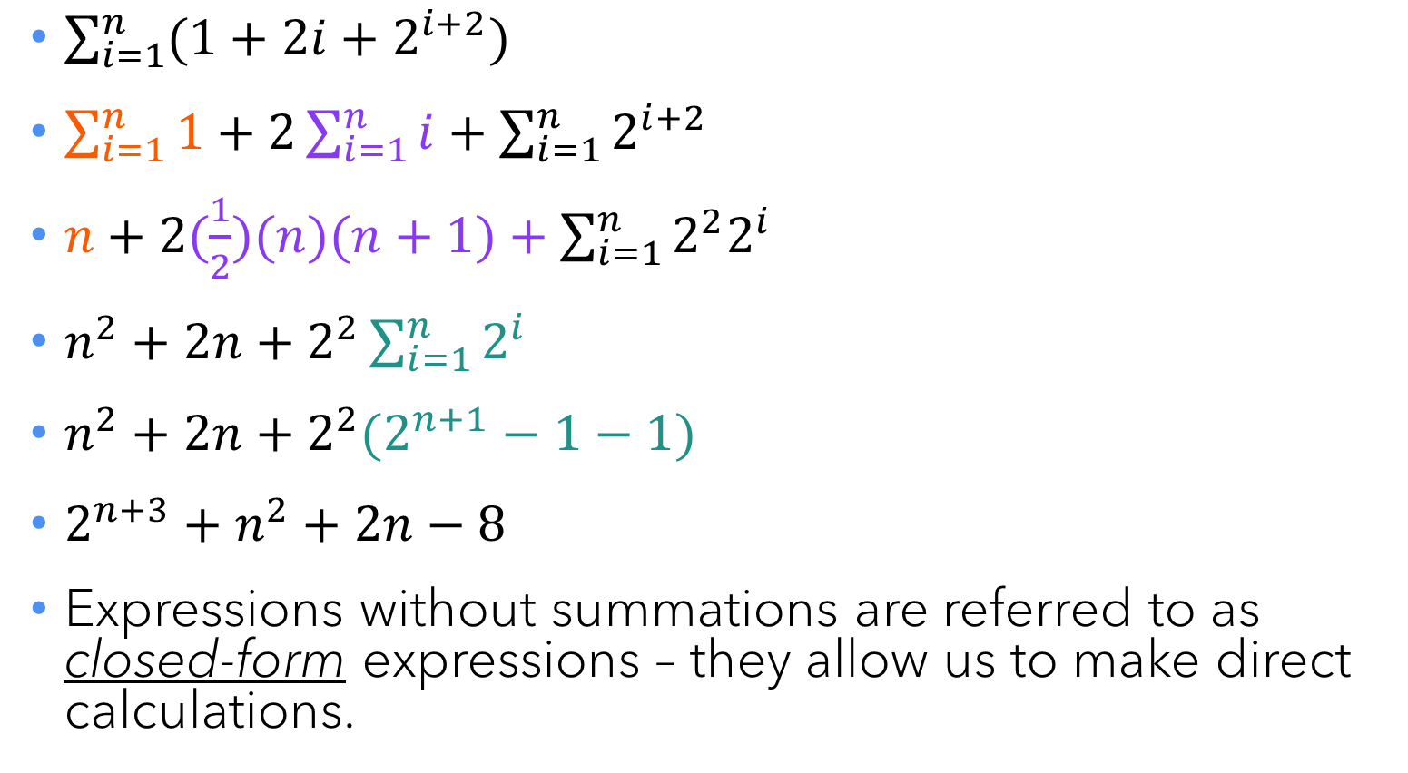
Example summation breakdown
$\sum_{i=1}^{n}{(1+2i+2^{i+2})}$
$\sum_{i=1}^{n}{1}+2\sum_{i=1}^{n}{i}+\sum_{i=1}^{n}{2^{i+2}}$
$n+2(\frac{1}{2})(n)(n+1)+\sum_{i=1}^{n}{2^{2}2^{i}}$
$n^{2}+2n+2^{2}\sum_{i=1}^{n}{2^{i}}$
$n^{2}+2n+2^{2}(2^{n+1}−1−1)$
$2^{n+3}+n^{2}+2n−8$
Expressions without summations are referred to as closed-form expressions – they allow us to make direct calculations.

Slide 13

You try it!
$\sum_{i=1}^{n}{(5i+2n)}$
$\sum_{i=1}^{n}{5i}+\sum_{i=1}^{n}{2n}$
$5\sum_{i=1}^{n}{i}+2\sum_{i=1}^{n}{n}$
$5\left(\frac{1}{2}\right)\left(n\right)\left(n+1\right)+2(n)(n)$
$\frac{9}{2}n^{2}+\frac{5}{2}n$

Slide 14

Rule 3: The Nested Sum Rule
To compute a nested summation, start with the innermost sum and work outward.
  $\sum_{i=1}^{5}{\sum_{j=1}^{5}{1}}=\sum_{i=1}^{5}{5}=5\left(5\right)=25$
  $\sum_{i=1}^{5}{\sum_{j=1}^{i}{1}}= …?$
  $\sum_{i=1}^{5}{\sum_{j=1}^{i}{1}}= \sum_{i=1}^{5}{i}=\left(\frac{1}{2}\right)\left(5\right)\left(5+1\right)=15$

Slide 15
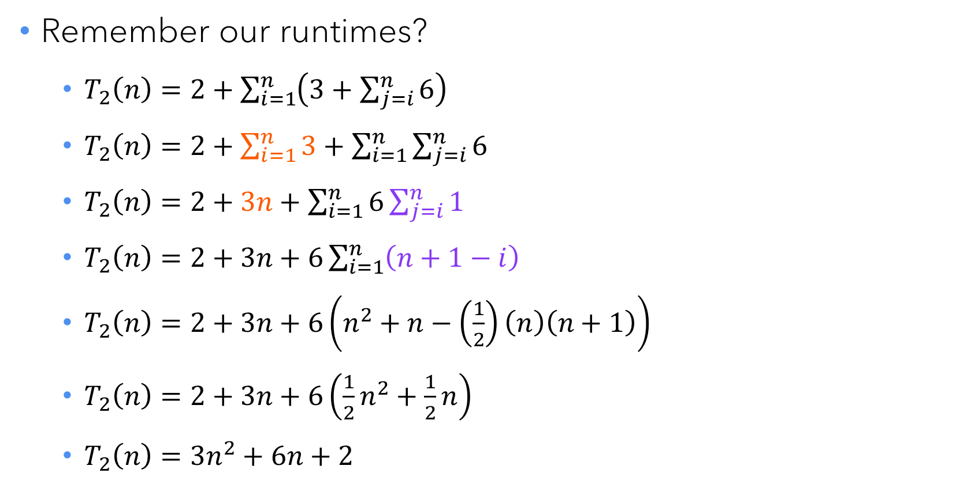
A larger example
Remember our runtimes?
  $T_{2}\left(n\right)=2+\sum_{i=1}^{n}{\left(3+\sum_{j=i}^{n}{6}\right)}$
  $T_{2}\left(n\right)=2+\sum_{i=1}^{n}{3}+\sum_{i=1}^{n}{\sum_{j=i}^{n}{6}}$
  $T_{2}\left(n\right)=2+3n+\sum_{i=1}^{n}{6\sum_{j=i}^{n}{1}}$
  $T_{2}\left(n\right)=2+3n+6\sum_{i=1}^{n}{\left(n+1−i\right)}$
  $T_{2}\left(n\right)=2+3n+6\left(n^{2}+n−\left(\frac{1}{2}\right)\left(n\right)\left(n+1\right)\right)$
  $T_{2}\left(n\right)=2+3n+6\left(\frac{1}{2}n^{2}+\frac{1}{2}n\right)$
  $T_{2}\left(n\right)=3n^{2}+6n+2$

Slide 16
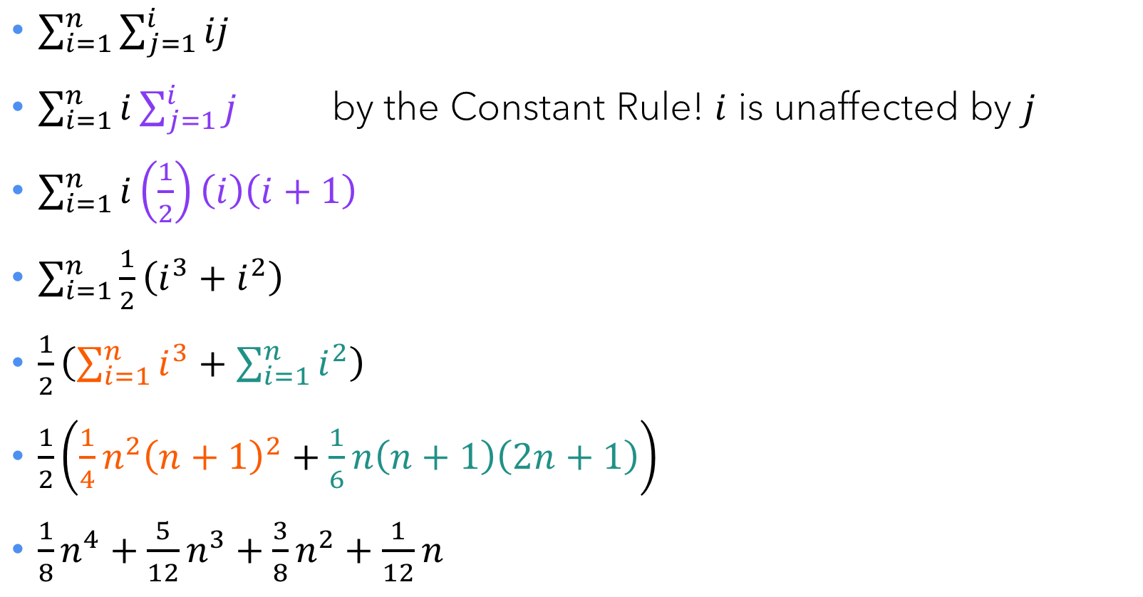
You try it!
$\sum_{i=1}^{n}{\sum_{j=1}^{i}{ij}}$
$\sum_{i=1}^{n}{i\sum_{j=1}^{i}{j}}$ by the Constant Rule! $i$ is unaffected by $j$
$\sum_{i=1}^{n}{i}\left(\frac{1}{2}\right)\left(i\right)\left(i+1\right)$
$\sum_{i=1}^{n}{\frac{1}{2}\left(i^{3}+i^{2}\right)}$
$\frac{1}{2}\left(\sum_{i=1}^{n}{i^{3}}+\sum_{i=1}^{n}{i^{2}}\right)$
$\frac{1}{2}\left(\frac{1}{4}n^{2}{\left(n+1\right)}^{2}+\frac{1}{6}n\left(n+1\right)\left(2n+1\right)\right)$
$\frac{1}{8}n^{4}+\frac{5}{12}n^{3}+\frac{3}{8}n^{2}+\frac{1}{12}n$

Slide 17
Asymptotic analysis (i.e. big-O notation)

Slide 18
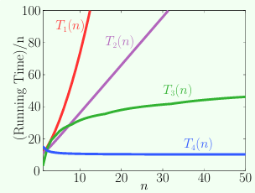
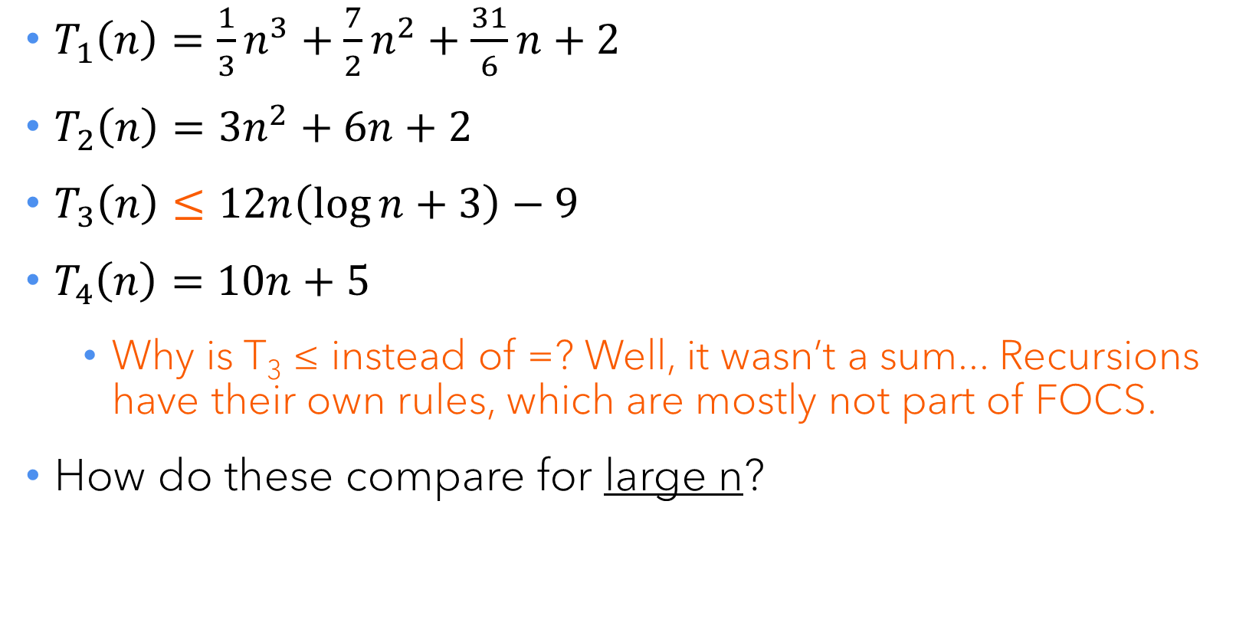
Back to our runtimes
$T_{1}\left(n\right)=\frac{1}{3}n^{3}+\frac{7}{2}n^{2}+\frac{31}{6}n+2$
$T_{2}\left(n\right)=3n^{2}+6n+2$
$T_{3}\left(n\right)≤12n\left(\log{n}+3\right)−9$
$T_{4}\left(n\right)=10n+5$
  Why is T₃ ≤ instead of =? Well, it wasn’t a sum... Recursions have their own rules, which are mostly not part of FOCS.
How do these compare for large n?

Slide 19
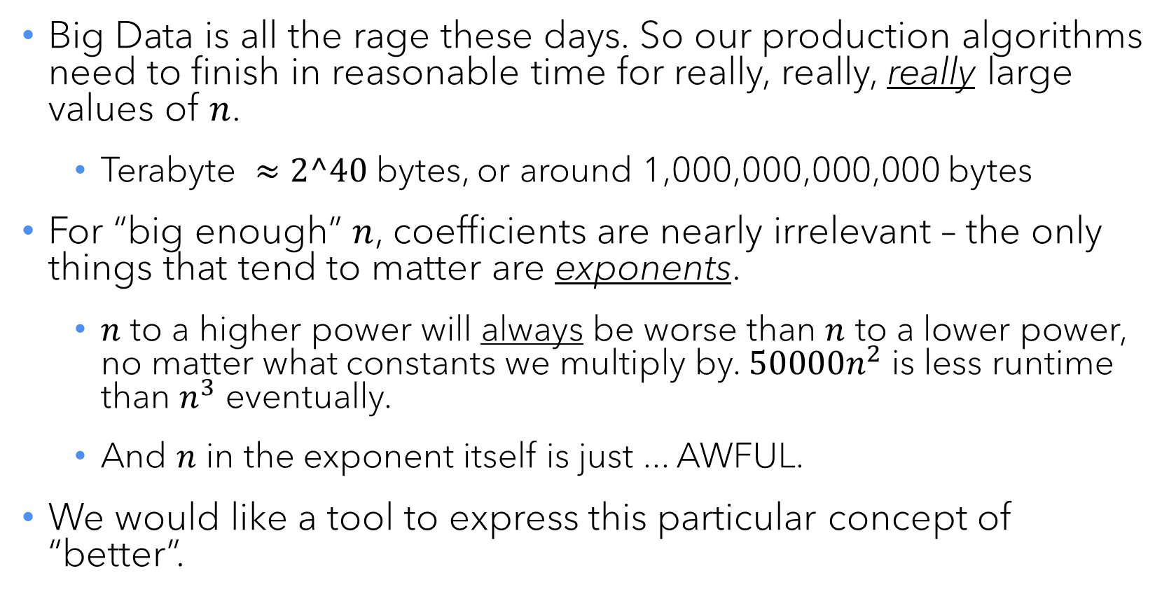
The big BIG idea
Big Data is all the rage these days. So our production algorithms need to finish in reasonable time for really, really, really large values of $n$.
  Terabyte $≈2^40$ bytes, or around 1,000,000,000,000 bytes
For “big enough” $n$, coefficients are nearly irrelevant – the only things that tend to matter are exponents.
  $n$ to a higher power will always be worse than $n$ to a lower power, no matter what constants we multiply by. $50000n^{2}$ is less runtime than $n^{3}$ eventually.
  And $n$ in the exponent itself is just ... AWFUL.
We would like a tool to express this particular concept of “better”.

Slide 20
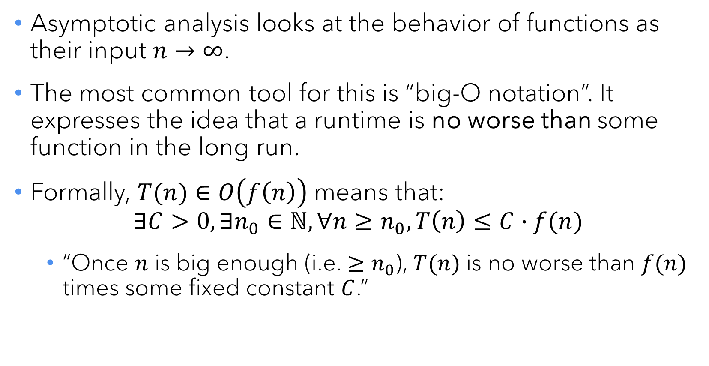
Asymptotic analysis
Asymptotic analysis looks at the behavior of functions as their input $n→∞$.
The most common tool for this is “big-O notation”. It expresses the idea that a runtime is no worse than some function in the long run.
Formally, $T(n)∈O\left(f\left(n\right)\right)$ means that:
$∃C>0, ∃n_{0}∈ℕ,∀n≥n_{0}, T\left(n\right)≤C∙f(n)$
  “Once $n$ is big enough (i.e. $≥n_{0}$), $T(n)$ is no worse than $f(n)$ times some fixed constant $C$.”

Slide 21
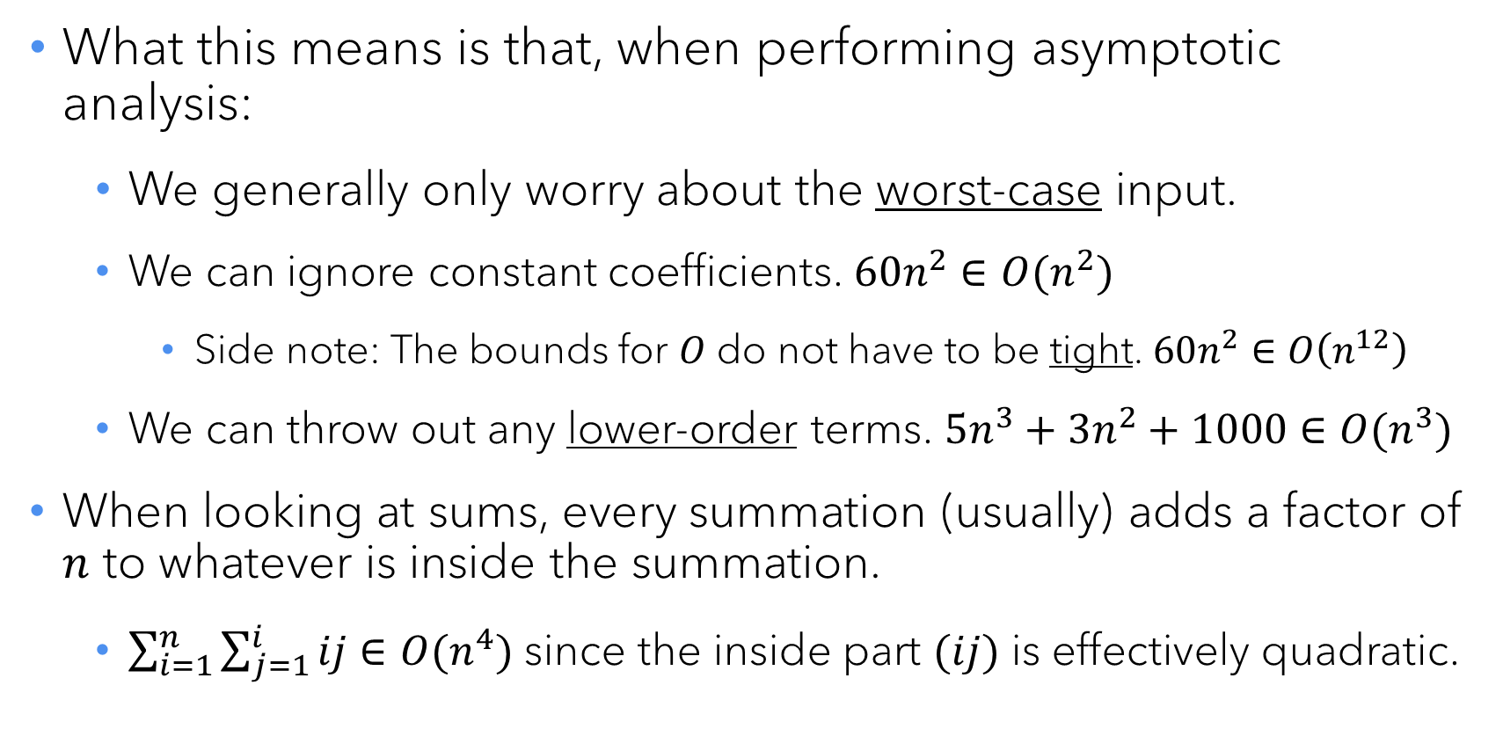
Practical application
What this means is that, when performing asymptotic analysis:
  We generally only worry about the worst-case input.
  We can ignore constant coefficients. $60n^{2}∈O(n^{2})$
    Side note: The bounds for $O$ do not have to be tight. $60n^{2}∈O\left(n^{12}\right)$
  We can throw out any lower-order terms. $5n^{3}+3n^{2}+1000∈O(n^{3})$
When looking at sums, every summation (usually) adds a factor of $n$ to whatever is inside the summation.
  $\sum_{i=1}^{n}{\sum_{j=1}^{i}{ij}}∈O(n^{4})$ since the inside part $(ij)$ is effectively quadratic.

Slide 22
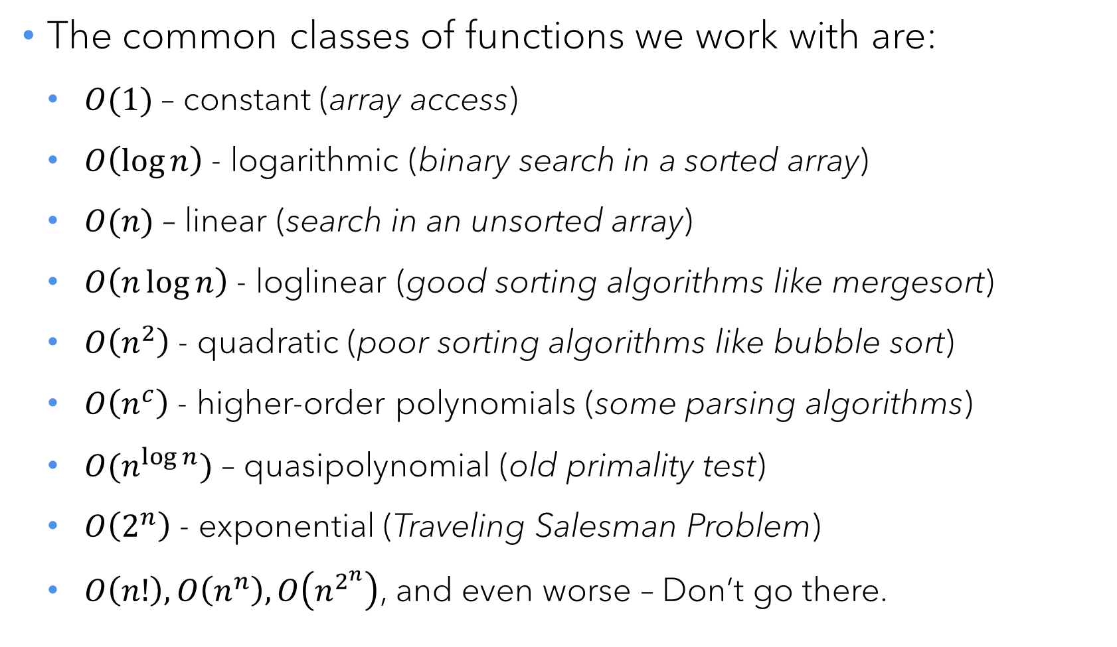
The big-O menagerie
The common classes of functions we work with are:
  $O(1)$ – constant (array access)
  $O\left(\log{n}\right)$ - logarithmic (binary search in a sorted array)
  $O(n)$ – linear (search in an unsorted array)
  $O\left(n\log{n}\right)$ - loglinear (good sorting algorithms like mergesort)
  $O\left(n^{2}\right)$ - quadratic (poor sorting algorithms like bubble sort)
  $O\left(n^{c}\right)$ - higher-order polynomials (some parsing algorithms)
  $O(n^{\log{n}})$ – quasipolynomial (old primality test)
  $O\left(2^{n}\right)$ - exponential (Traveling Salesman Problem)
  $O\left(n!\right), O\left(n^{n}\right), O\left(n^{2^{n}}\right)$, and even worse – Don’t go there.

Slide 23
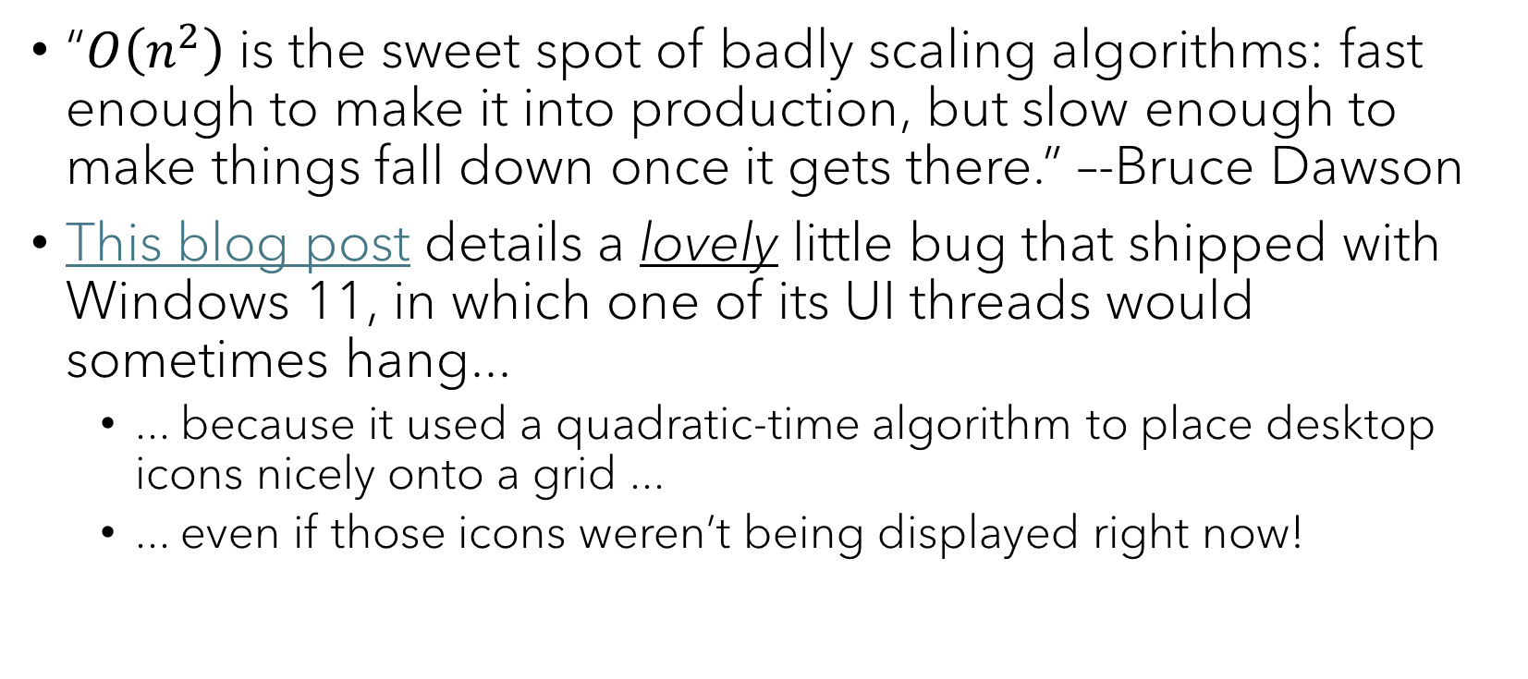
Thought for the day
“$O\left(n^{2}\right)$ is the sweet spot of badly scaling algorithms: fast enough to make it into production, but slow enough to make things fall down once it gets there.” –-Bruce Dawson
This blog post details a lovely little bug that shipped with Windows 11, in which one of its UI threads would sometimes hang...
  ... because it used a quadratic-time algorithm to place desktop icons nicely onto a grid ...
  ... even if those icons weren’t being displayed right now!

Slide 24
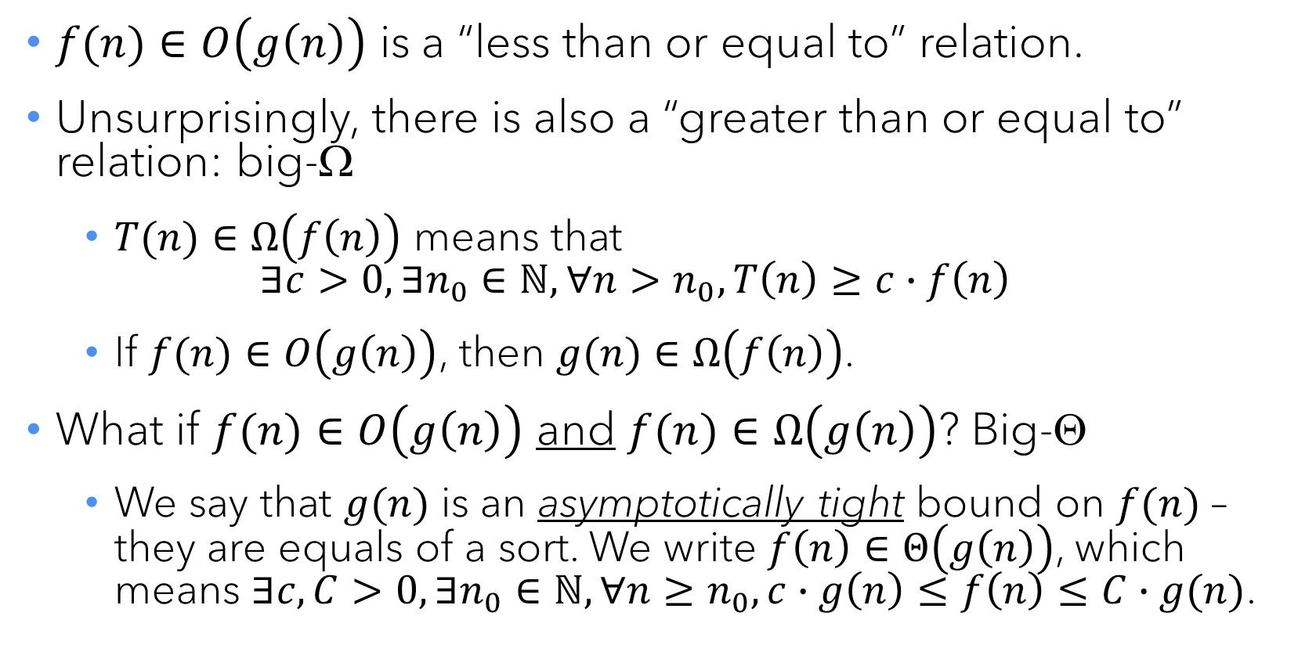
Siblings of big-O...
$f(n)∈O\left(g\left(n\right)\right)$ is a “less than or equal to” relation.
Unsurprisingly, there is also a “greater than or equal to” relation: big-Ω
  $T(n)∈Ω\left(f\left(n\right)\right)$ means that
  $∃c>0,∃n_{0}∈ℕ,∀n>n_{0}, T\left(n\right)≥c∙f\left(n\right)$
  If $f(n)∈O\left(g\left(n\right)\right)$, then $g(n)∈Ω\left(f\left(n\right)\right)$.
What if $f(n)∈O\left(g\left(n\right)\right)$ and $f(n)∈Ω\left(g\left(n\right)\right)$? Big-Θ
  We say that $g(n)$ is an asymptotically tight bound on $f(n)$ – they are equals of a sort. We write $f\left(n\right)∈Θ\left(g\left(n\right)\right)$, which means $∃c,C>0,∃n_{0}∈ℕ,∀n≥n_{0}, c∙g\left(n\right)≤f\left(n\right)≤C∙g(n)$.

Slide 25
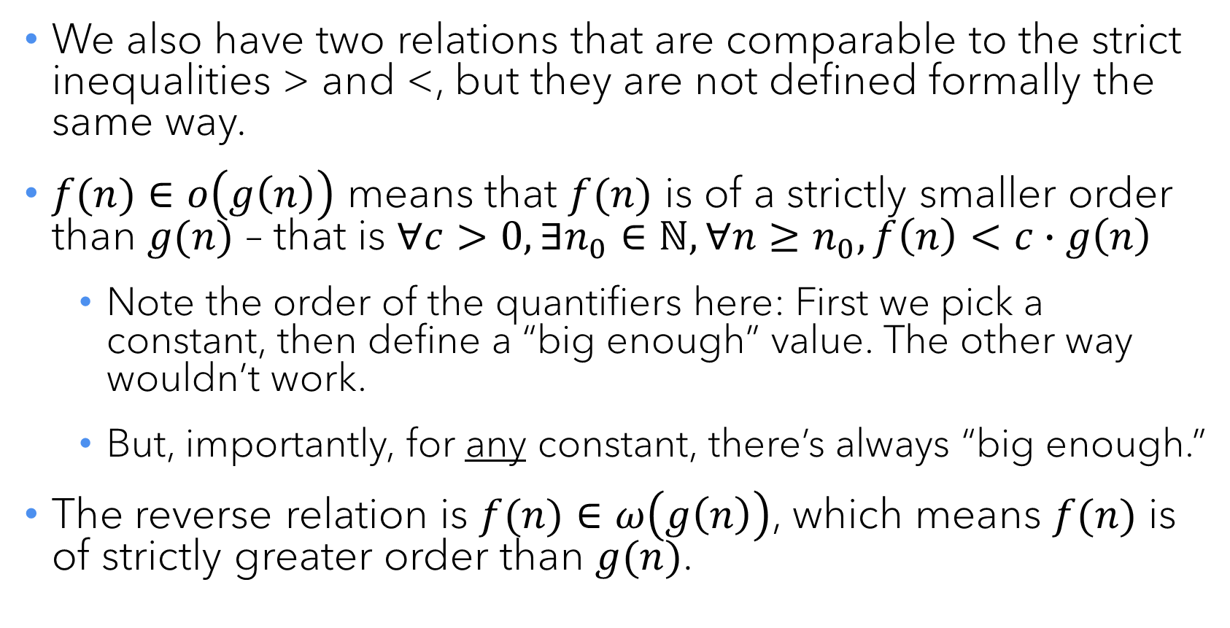
... and their little cousins
We also have two relations that are comparable to the strict inequalities > and <, but they are not defined formally the same way.
$f(n)∈o\left(g\left(n\right)\right)$ means that $f(n)$ is of a strictly smaller order than $g(n)$ – that is $∀c>0,∃n_{0}∈ℕ,∀n≥n_{0},f\left(n\right)<c∙g\left(n\right)$
  Note the order of the quantifiers here: First we pick a constant, then define a “big enough” value. The other way wouldn’t work.
  But, importantly, for any constant, there’s always “big enough.”
The reverse relation is $f(n)∈ω\left(g\left(n\right)\right)$, which means $f(n)$ is of strictly greater order than $g(n)$.

Slide 26
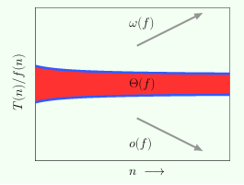

Using limits to express the same ideas
$$\lim_{n→∞}{\frac{T\left(n\right)}{f\left(n\right)}=…}$$
... $0$, then $T(n)∈o\left(f\left(n\right)\right)$.
... any $c>0$, then $T(n)∈Θ\left(f\left(n\right)\right)$.
... $∞$, then $T(n)∈ω\left(f\left(n\right)\right)$.
In practice, we nearly always just use big-O.

Slide 27

Questions?

