Slide 1
Lecture 10: A Taste of Number Theory
CSCI 2200 Foundations of Computer Science

Slide 2

Lecture 10: A Taste of Number Theory
CSCI 2200 Foundations of Computer Science
“Baba Yetu” performed by Ron Ragin & the Stanford Talisman, composed by Christopher Tin for Civilization IV

Slide 3
Today’s tasks
Gentle reminder: Exam 2 on Wed. 2/26
HW questions
Divisibility & GCD
Modular arithmetic
Primes & cryptography

Slide 4
But first: What is number theory?
“Number theory is the queen of mathematics.” --Carl Friedrich Gauss
Number theory is the branch of pure math that is mostly concerned about integers and elements that can be constructed with them (e.g. rational numbers).
Basically, it’s Discrete Math++
A lot of number theory is concerned with prime numbers.
One of the Millenium Prize Problems (the Riemann-Zeta Hypothesis) is intimately tied to the distribution of primes.

Slide 5
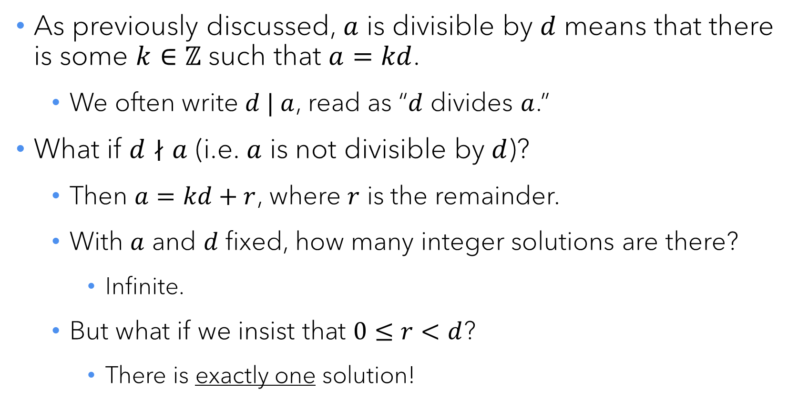
Divisibility, quotients, & remainders
As previously discussed, $a$ is divisible by $d$ means that there is some $k∈ℤ$ such that $a=kd$.
We often write $d | a$, read as “$d$ divides $a$.”
What if $d∤a$ (i.e. $a$ is not divisible by $d$)?
Then $a=kd+r$, where $r$ is the remainder.
With $a$ and $d$ fixed, how many integer solutions are there?
Infinite.
But what if we insist that $0≤r<d$?
There is exactly one solution!

Slide 6

The Quotient-Remainder Theorem
Given $a∈ℤ$ and $d∈ℕ$, then there is exactly one pair of integers $(k,r)$ that satisifies $a=kd+r$ and $0≤r<d$.
Put another way: When you divide an integer by a positive integer, there is one quotient and one remainder. Just like in grade school.

Slide 7

Quick divisibility facts
$∀d∈ℕ, d | 0$
If $d | n$ and $e | n$, then $de | n$.
If $d | m$ and $m | n$, then $d | n$.
If $d | n$ and $d | m$, then $d | (m+n)$.
If $d | (m+n)$ and $d | m$, then $d | n$.
If $d | n$, then $∀k∈ℕ, kd | kn$.

Slide 8
Greatest common divisor
What are the divisors of 30?
{1,2,3,5,6,15,30}
What are the divisors of 42?
{1,2,3,6,7,14,21,42}
6 is the largest number in both lists, so gcd(30,42) = 6.
How can we calculate this in general?

Slide 9
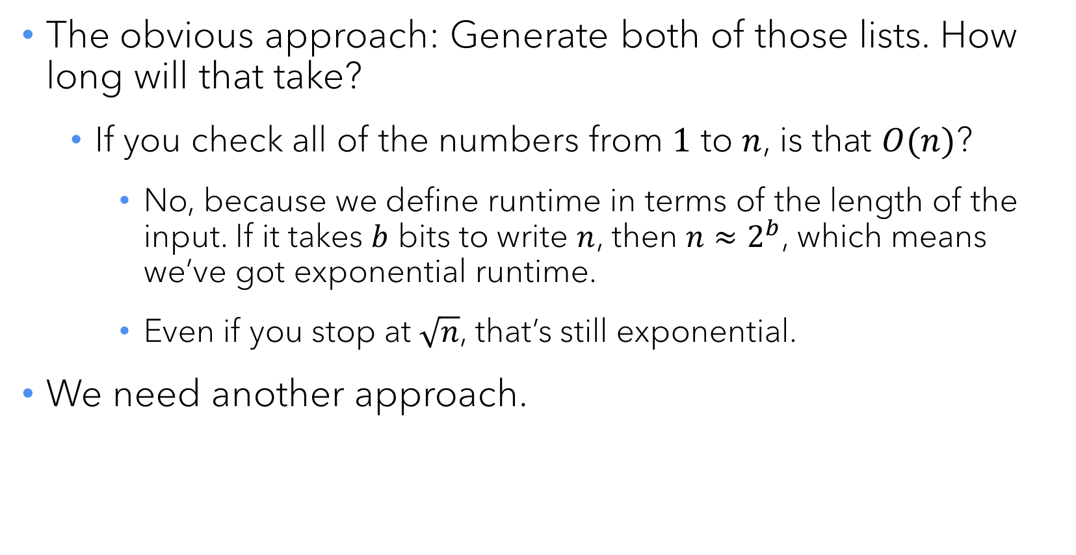
GCD algorithms
The obvious approach: Generate both of those lists. How long will that take?
If you check all of the numbers from $1$ to $n$, is that $O(n)$?
No, because we define runtime in terms of the length of the input. If it takes $b$ bits to write $n$, then $n≈2^{b}$, which means we’ve got exponential runtime.
Even if you stop at $\sqrt{n}$, that’s still exponential.
We need another approach.

Slide 10
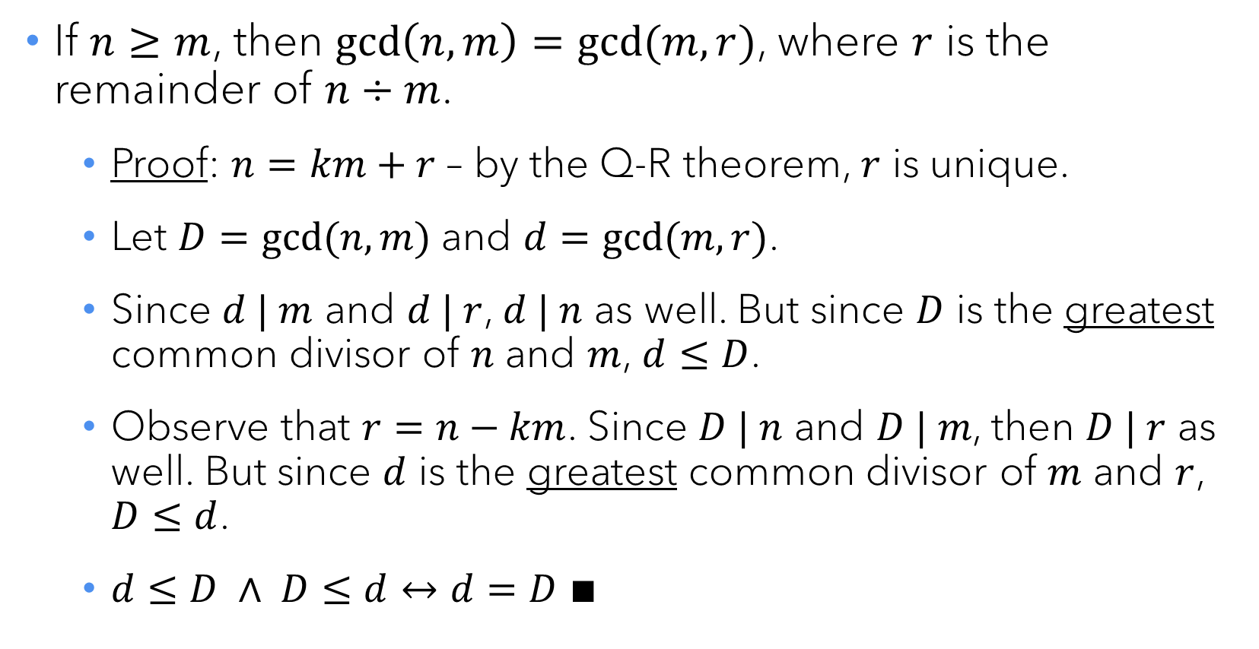
A surprising fact
If $n≥m$, then $\gcd\left(n,m\right)=gcd⁡(m,r)$, where $r$ is the remainder of $n÷m$.
Proof: $n=km+r$ – by the Q-R theorem, $r$ is unique.
Let $D=gcd⁡(n,m)$ and $d=gcd⁡(m,r)$.
Since $d | m$ and $d | r$, $d | n$ as well. But since $D$ is the greatest common divisor of $n$ and $m$, $d≤D$.
Observe that $r=n−km$. Since $D | n$ and $D | m$, then $D | r$ as well. But since $d$ is the greatest common divisor of $m$ and $r$, $D≤d$.
$d≤D ∧ D≤d↔d=D ∎$

Slide 11
Euclid’s GCD Algorithm
def gcd(n,m): # assume n >= m >= 1 if m == 1: return 1 return gcd(m,n%m)
This algorithm is linear in the number of bits of the input.

Slide 12
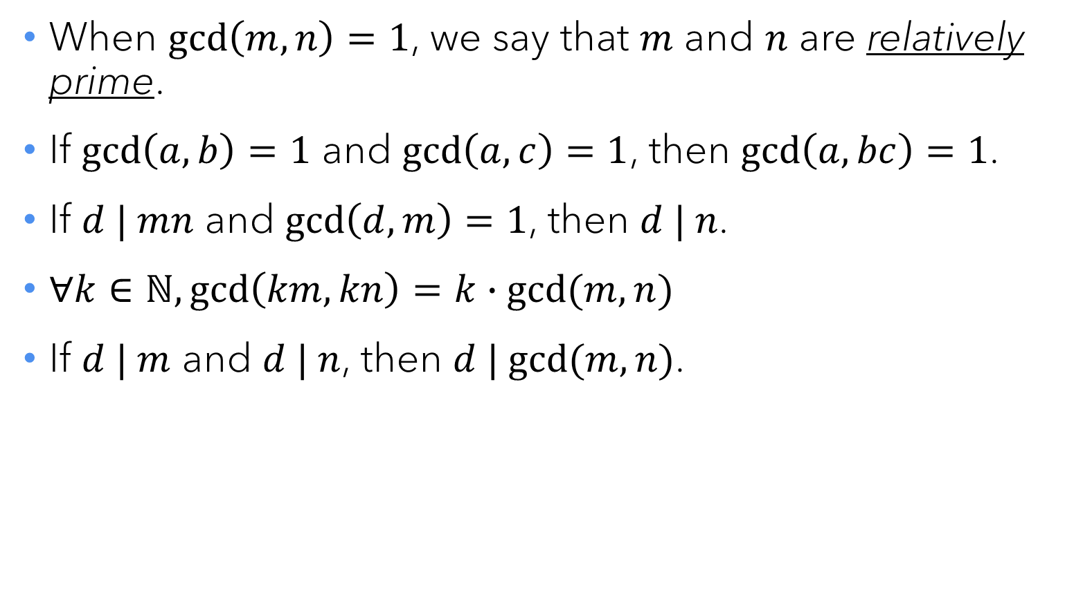
GCD facts
When $\gcd\left(m,n\right)=1$, we say that $m$ and $n$ are relatively prime.
If $\gcd\left(a,b\right)=1$ and $\gcd\left(a,c\right)=1$, then $\gcd\left(a,bc\right)=1$.
If $d | mn$ and $\gcd\left(d,m\right)=1$, then $d | n$.
$∀k∈ℕ,\gcd\left(km,kn\right)=k∙gcd⁡(m,n)$
If $d | m$ and $d | n$, then $d | gcd⁡(m,n)$.

Slide 13

Modular arithmetic

Slide 14
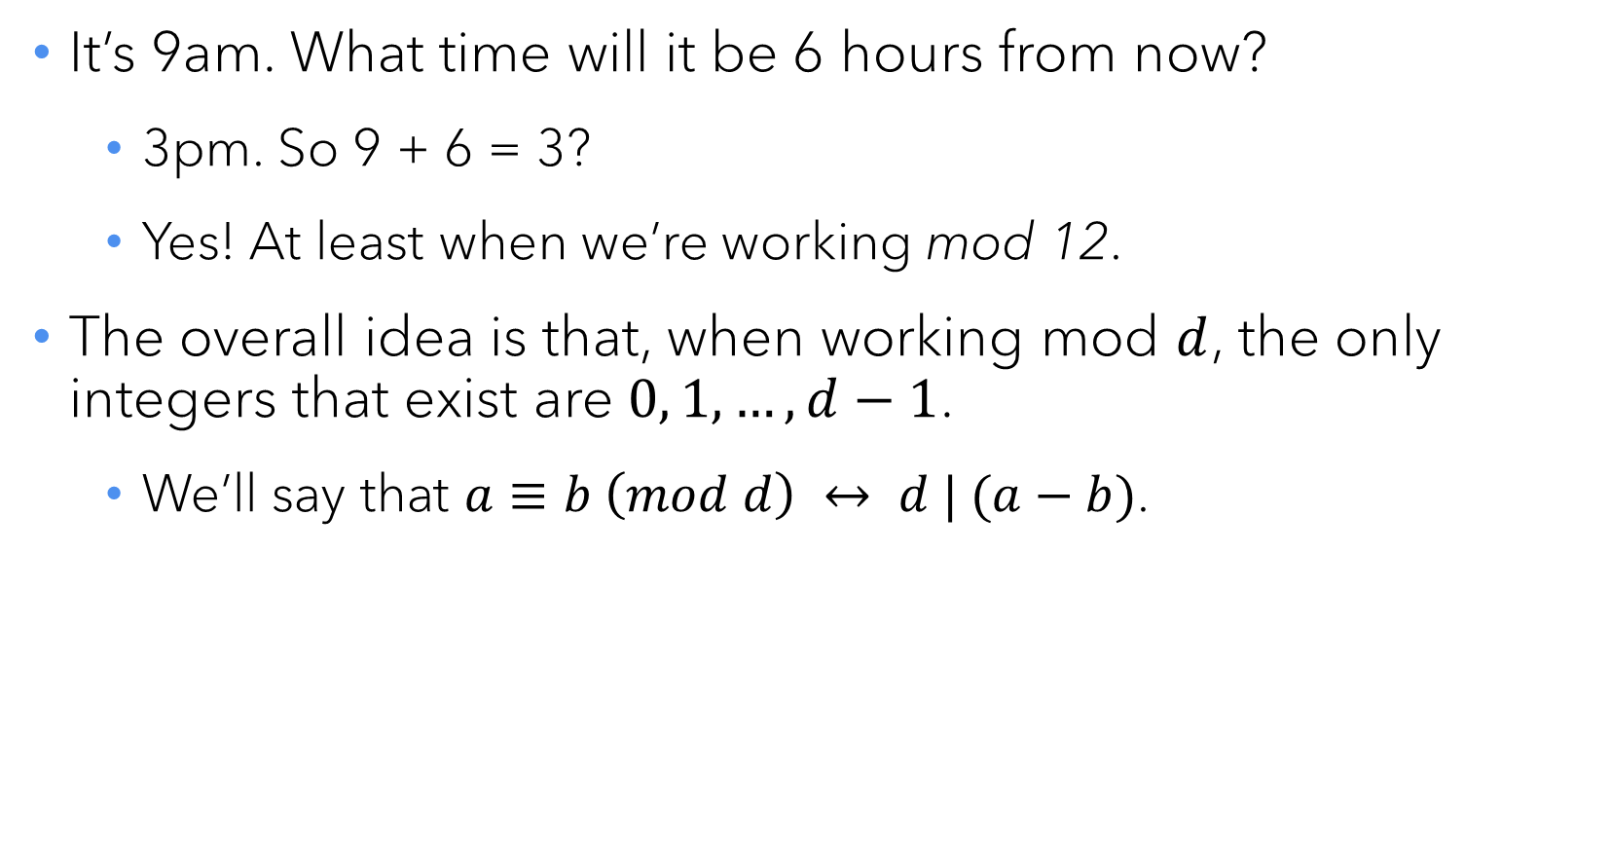
Calculations on a clock
It’s 9am. What time will it be 6 hours from now?
3pm. So 9 + 6 = 3?
Yes! At least when we’re working mod 12.
The overall idea is that, when working mod $d$, the only integers that exist are $0, 1, …, d−1$.
We’ll say that $a≡b \left(mod d\right) ↔ d | (a−b)$.

Slide 15
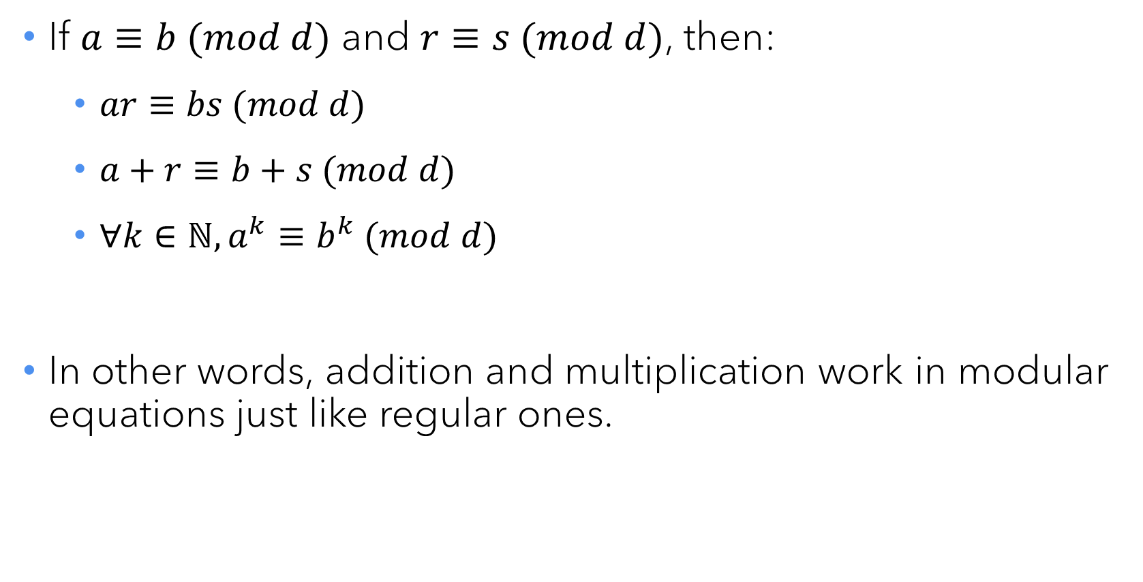
Modular arithmetic identities
If $a≡b (mod d)$ and $r≡s (mod d)$, then:
$ar≡bs (mod d)$
$a+r≡b+s (mod d)$
$∀k∈ℕ, a^{k}≡b^{k} (mod d)$
In other words, addition and multiplication work in modular equations just like regular ones.

Slide 16
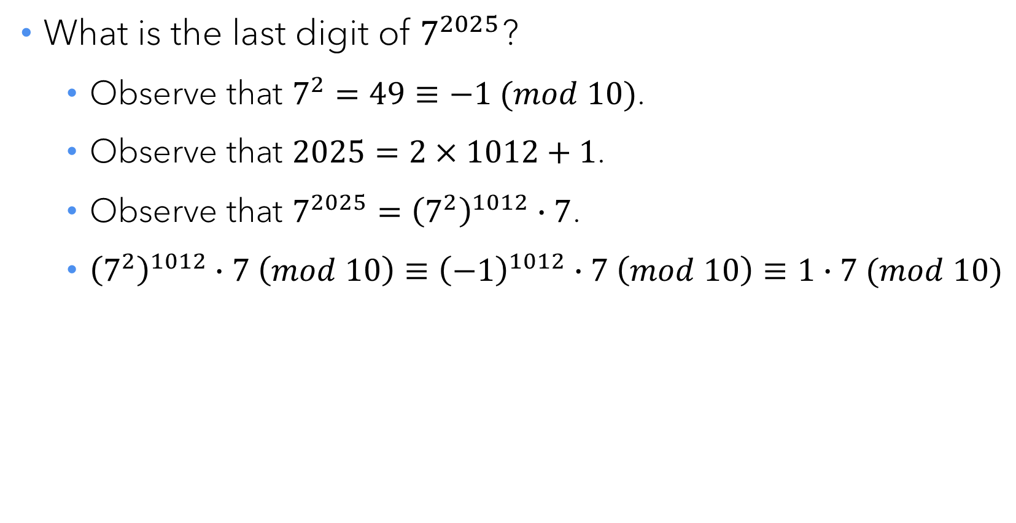
Silly math tricks
What is the last digit of $7^{2025}$?
Observe that $7^{2}=49≡−1 (mod 10)$.
Observe that $2025=2×1012+1$.
Observe that $7^{2025}={\left(7^{2}\right)}^{1012}∙7$.
${\left(7^{2}\right)}^{1012}∙7 \left(mod 10\right)≡{\left(−1\right)}^{1012}∙7 \left(mod 10\right)≡1∙7 (mod 10)$

Slide 17
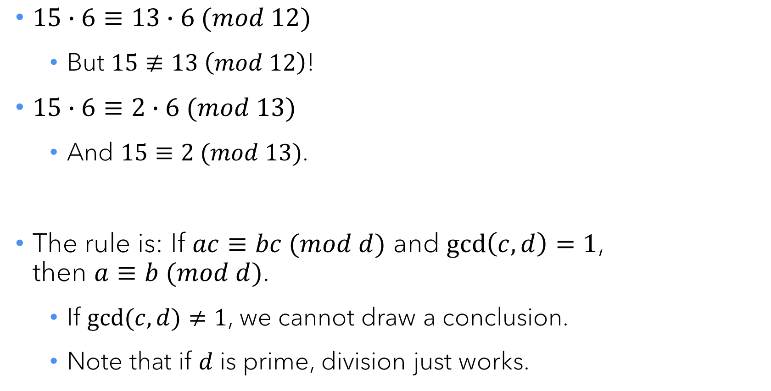
Modular division
$15∙6≡13∙6 (mod 12)$
But $15≢13 \left(mod 12\right)$!
$15∙6≡2∙6 (mod 13)$
And $15≡2 (mod 13)$.
The rule is: If $ac≡bc (mod d)$ and $\gcd\left(c,d\right)=1$, then $a≡b (mod d)$.
If $gcd⁡(c,d)≠1$, we cannot draw a conclusion.
Note that if $d$ is prime, division just works.

Slide 18
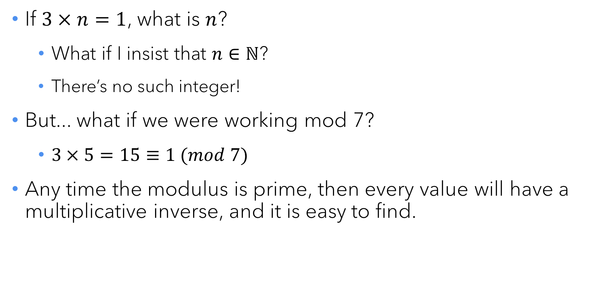
Multiplicative inverses
If $3×n=1$, what is $n$?
What if I insist that $n∈ℕ$?
There’s no such integer!
But... what if we were working mod 7?
$3×5=15≡1 (mod 7)$
Any time the modulus is prime, then every value will have a multiplicative inverse, and it is easy to find.

Slide 19
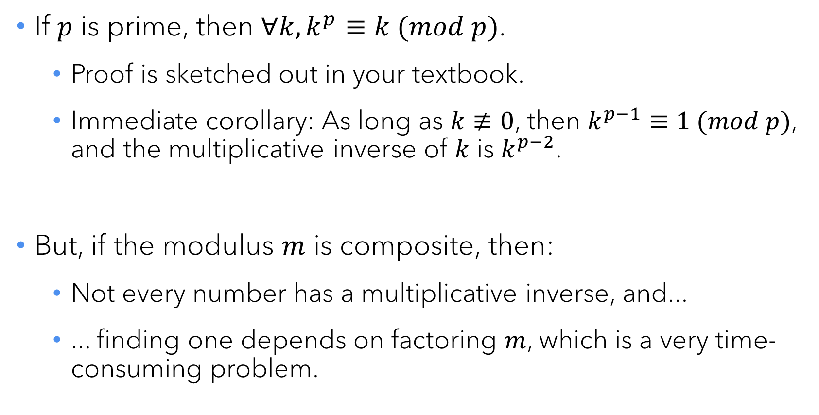
Fermat’s Little Theorem
If $p$ is prime, then $∀k, k^{p}≡k (mod p)$.
Proof is sketched out in your textbook.
Immediate corollary: As long as $k≢0$, then $k^{p−1}≡1 (mod p)$, and the multiplicative inverse of $k$ is $k^{p−2}$.
But, if the modulus $m$ is composite, then:
Not every number has a multiplicative inverse, and...
... finding one depends on factoring $m$, which is a very time-consuming problem.

Slide 20

RSA public-key cryptography

Slide 21
Cryptography: General idea
Send a private message from A to B assuming that a third party E is eavesdropping on the transmission.
The goal is to mathematically transform the message in a way that B can undo but E cannot.
One approach is to agree upon a bitmask ahead of time – you just toggle a set of randomly chosen bits, and then no one can decode it without the bitmask/password.
But you have to agree ahead of time – inconvenient.

Slide 22
Public key cryptography
B publishes a “lock” that anyone can use to encrypt a message.
B maintains the “key” to this lock, and keeps it secret from everyone.
For this to work, the “locking” process needs to be difficult to reverse-engineer without the key.
What might this “lock” and “key” mechanism look like?

Slide 23
Key idea: The power of 1
If you raise a value to the power of 1, what happens?
Right, nothing.
So what if you have two values that multiply together to 1?
And what if you use those values as exponents?

Slide 24
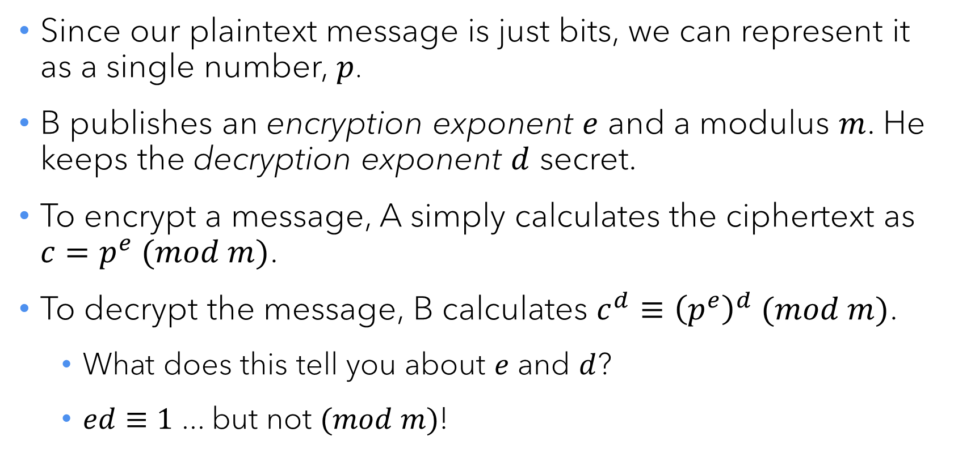
RSA, briefly
Since our plaintext message is just bits, we can represent it as a single number, $p$.
B publishes an encryption exponent $e$ and a modulus $m$. He keeps the decryption exponent $d$ secret.
To encrypt a message, A simply calculates the ciphertext as $c=p^{e} (mod m)$.
To decrypt the message, B calculates $c^{d}≡{\left(p^{e}\right)}^{d} (mod m)$.
What does this tell you about $e$ and $d$?
$ed≡1$ ... but not $(mod m)$!

Slide 25
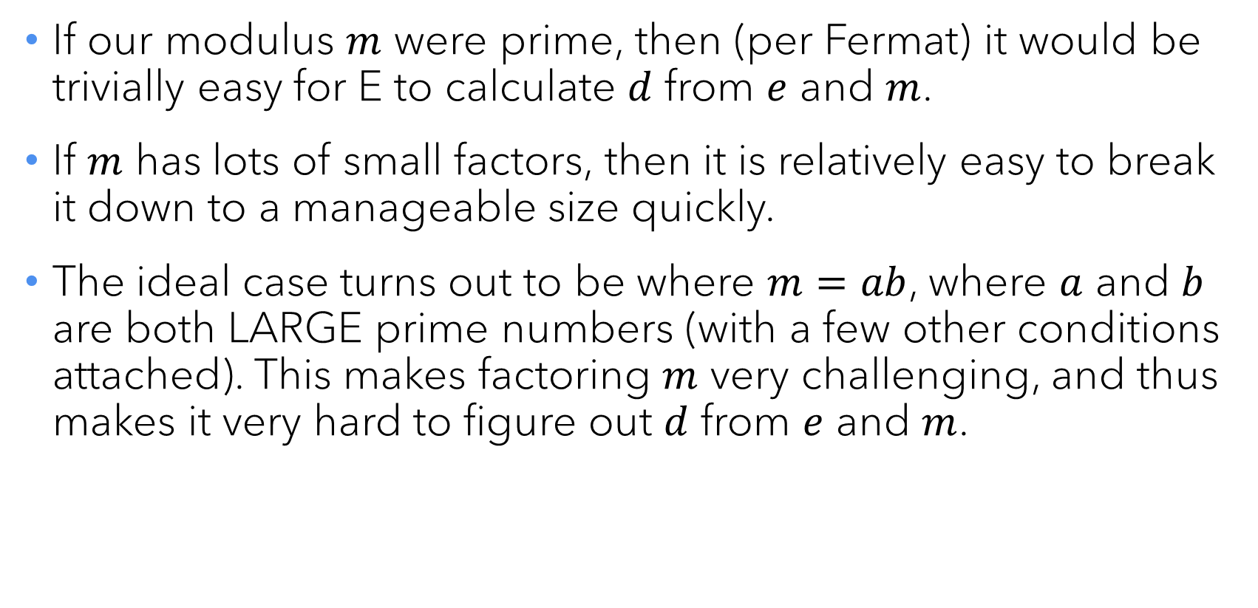
The right modulus
If our modulus $m$ were prime, then (per Fermat) it would be trivially easy for E to calculate $d$ from $e$ and $m$.
If $m$ has lots of small factors, then it is relatively easy to break it down to a manageable size quickly.
The ideal case turns out to be where $m=ab$, where $a$ and $b$ are both LARGE prime numbers (with a few other conditions attached). This makes factoring $m$ very challenging, and thus makes it very hard to figure out $d$ from $e$ and $m$.

Slide 26
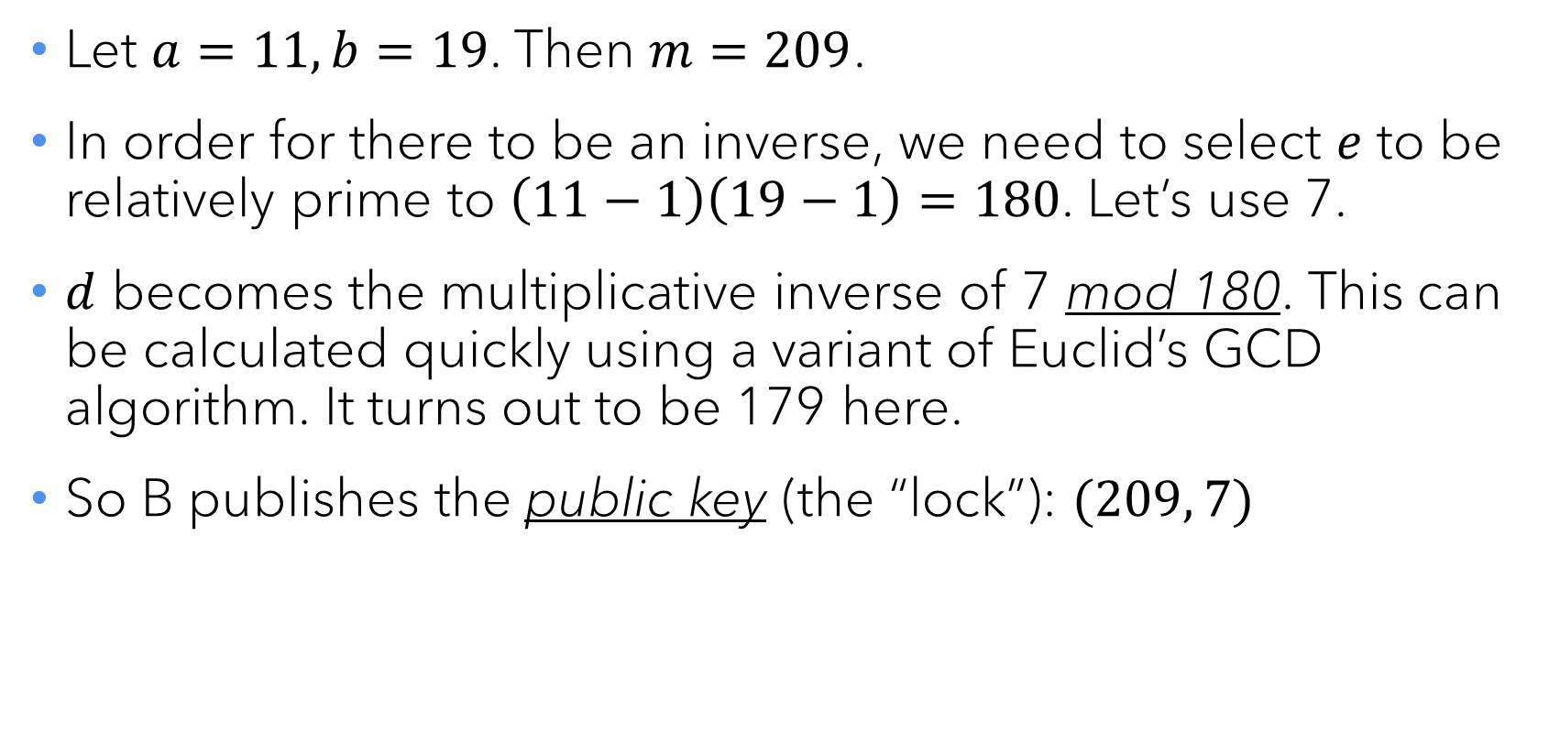
A toy example
Let $a=11, b=19$. Then $m=209$.
In order for there to be an inverse, we need to select $e$ to be relatively prime to $\left(11−1\right)\left(19−1\right)=180$. Let’s use 7.
$d$ becomes the multiplicative inverse of 7 mod 180. This can be calculated quickly using a variant of Euclid’s GCD algorithm. It turns out to be 179 here.
So B publishes the public key (the “lock”): $(209, 7)$

Slide 27
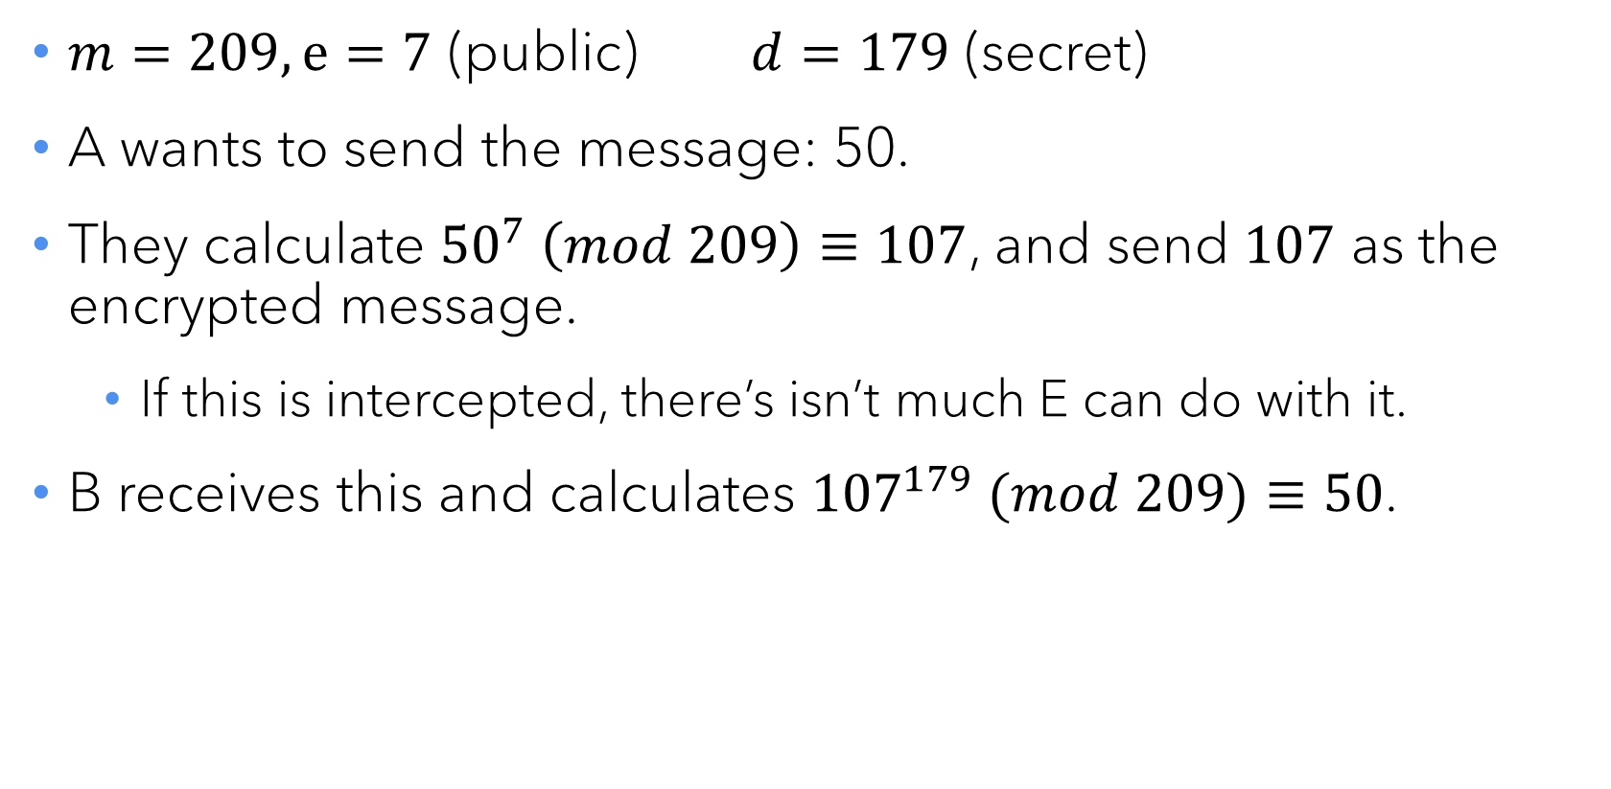
A toy example
$m=209, e=7$ (public) $d=179$ (secret)
A wants to send the message: 50.
They calculate ${50}^{7} \left(mod 209\right)≡107$, and send $107$ as the encrypted message.
If this is intercepted, there’s isn’t much E can do with it.
B receives this and calculates ${107}^{179} (mod 209)≡50$.

Slide 28
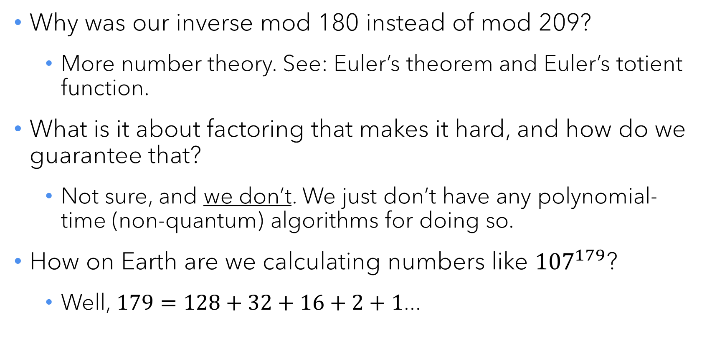
Important ideas we haven’t discussed
Why was our inverse mod 180 instead of mod 209?
More number theory. See: Euler’s theorem and Euler’s totient function.
What is it about factoring that makes it hard, and how do we guarantee that?
Not sure, and we don’t. We just don’t have any polynomial-time (non-quantum) algorithms for doing so.
How on Earth are we calculating numbers like ${107}^{179}$?
Well, $179=128+32+16+2+1$...

Slide 29

Questions?

