Slide 1
Lecture 11: Graphs I
CSCI 2200 Foundations of Computer Science

Slide 2
Lecture 11: Graphs I
CSCI 2200 Foundations of Computer Science

Slide 3
Today’s tasks
Gentle reminder: Exam 2 on Wed. 2/26
More urgent reminder: Next class will be on Tuesday 2/18.
Graphs
Motivation & basic notation / terminology
Programmatic representation
Connectivity properties
Special types of graphs
Modeling & problem solving with graphs

Slide 4
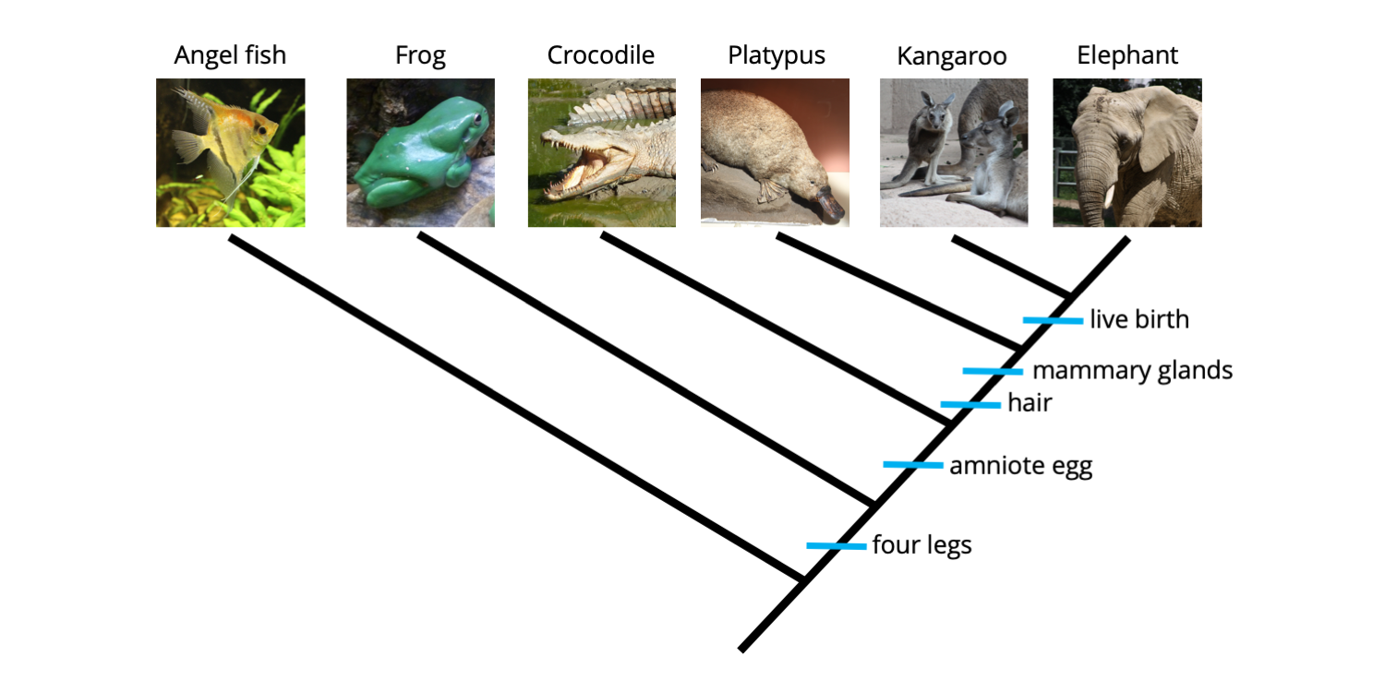
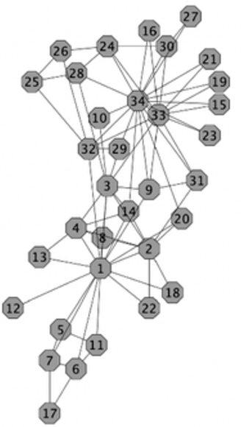
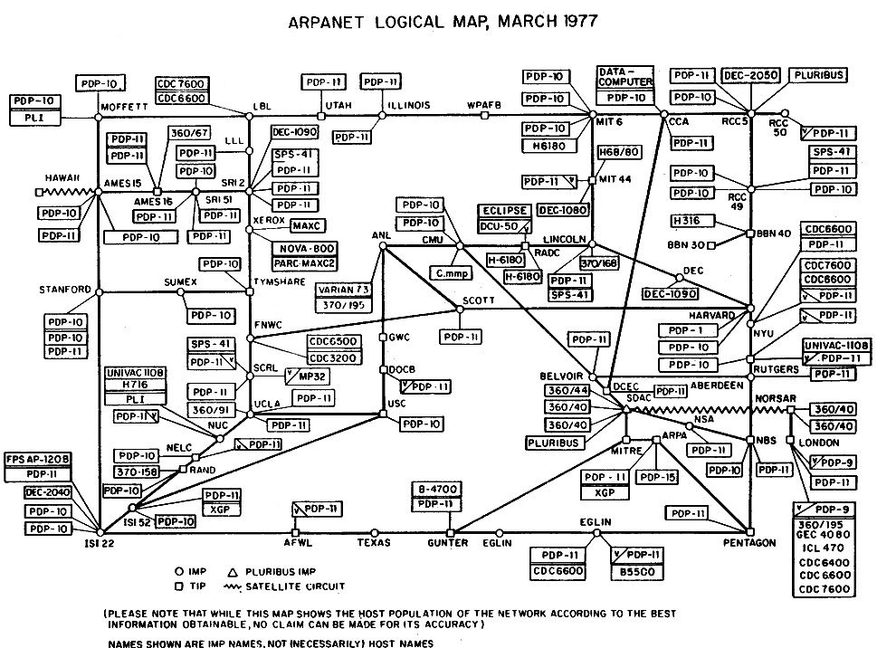
Why graphs?

Slide 5
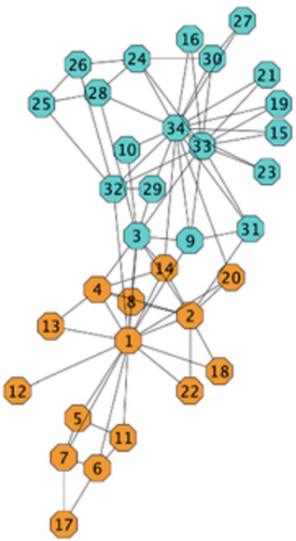
Why graphs?

Slide 6

Graphs model relationships
Graphs are exceedingly common in computer science because so many different situations call for modeling not just some set of objects, but some kind of relationship between those objects.
“Mathematics is the art of giving the same name to different things.” –Henri Poincaré
By distilling a situation down to a graph, we are able to bring our (large) toolbox of graph theorems and properties to bear on the problem.

Slide 7
Vocabulary
You know nodes/vertices and edges/connections. Graphs can be directed (one-way edges) or undirected (two-way).
Degree: The number of edges incident to a node.
When graphs are directed, we talk about indegree and outdegree.
Path: A sequence of edges leading from one vertex to another, where each set of consecutive edges shares one vertex. A simple path does not repeat any vertices.
The length of a path is the number of edges in it. Often we are interested in the shortest path between two vertices.
A cycle is a path that starts and ends at the same vertex.

Slide 8
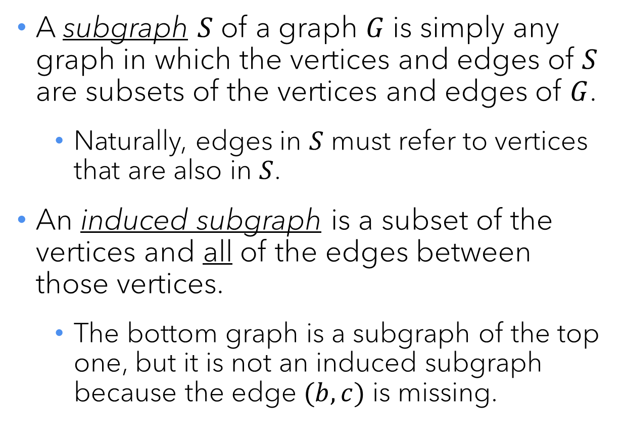
Subgraphs and induced subgraphs
a
A subgraph $S$ of a graph $G$ is simply any graph in which the vertices and edges of $S$ are subsets of the vertices and edges of $G$.
Naturally, edges in $S$ must refer to vertices that are also in $S$.
An induced subgraph is a subset of the vertices and all of the edges between those vertices.
The bottom graph is a subgraph of the top one, but it is not an induced subgraph because the edge $(b,c)$ is missing.
b
c
d
e
a
b
c
d

Slide 9
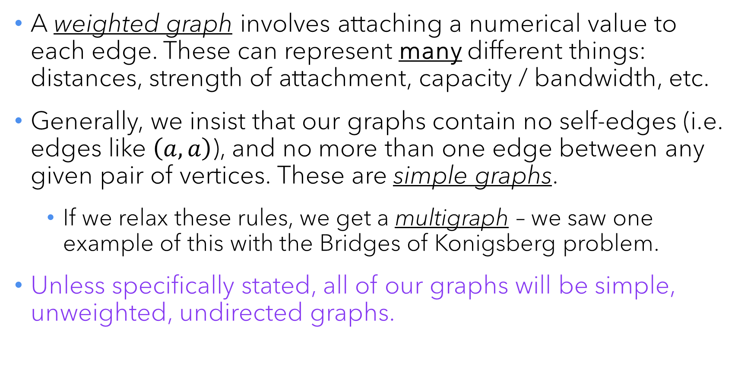
Graph variations
A weighted graph involves attaching a numerical value to each edge. These can represent many different things: distances, strength of attachment, capacity / bandwidth, etc.
Generally, we insist that our graphs contain no self-edges (i.e. edges like $\left(a,a\right)$), and no more than one edge between any given pair of vertices. These are simple graphs.
If we relax these rules, we get a multigraph – we saw one example of this with the Bridges of Konigsberg problem.
Unless specifically stated, all of our graphs will be simple, unweighted, undirected graphs.

Slide 10
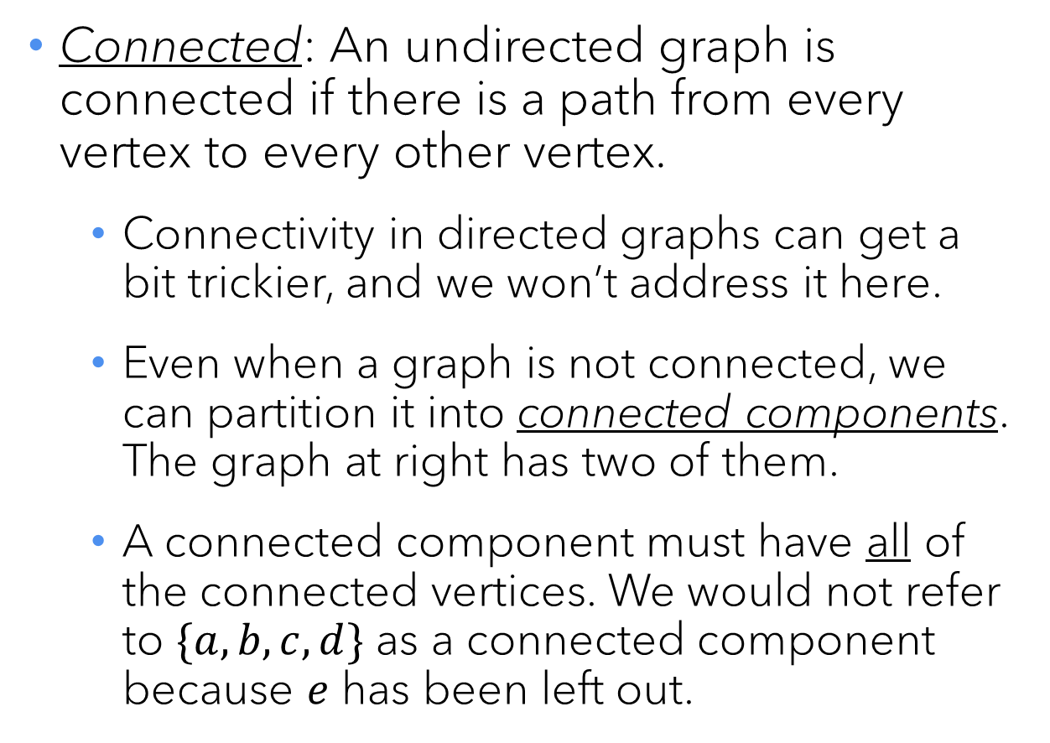
Connectivity
a
Connected: An undirected graph is connected if there is a path from every vertex to every other vertex.
Connectivity in directed graphs can get a bit trickier, and we won’t address it here.
Even when a graph is not connected, we can partition it into connected components. The graph at right has two of them.
A connected component must have all of the connected vertices. We would not refer to $\{a,b,c,d\}$ as a connected component because $e$ has been left out.
f
b
c
g
d
e

Slide 11
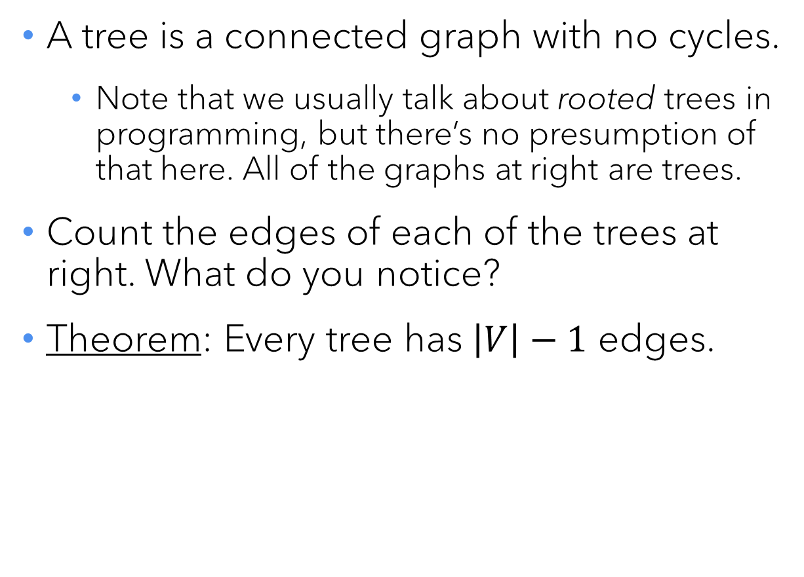
Trees
a
a
A tree is a connected graph with no cycles.
Note that we usually talk about rooted trees in programming, but there’s no presumption of that here. All of the graphs at right are trees.
Count the edges of each of the trees at right. What do you notice?
Theorem: Every tree has $\left|V\right|−1$ edges.
b
b
c
d
e
a
b
f
c
e
d

Slide 12
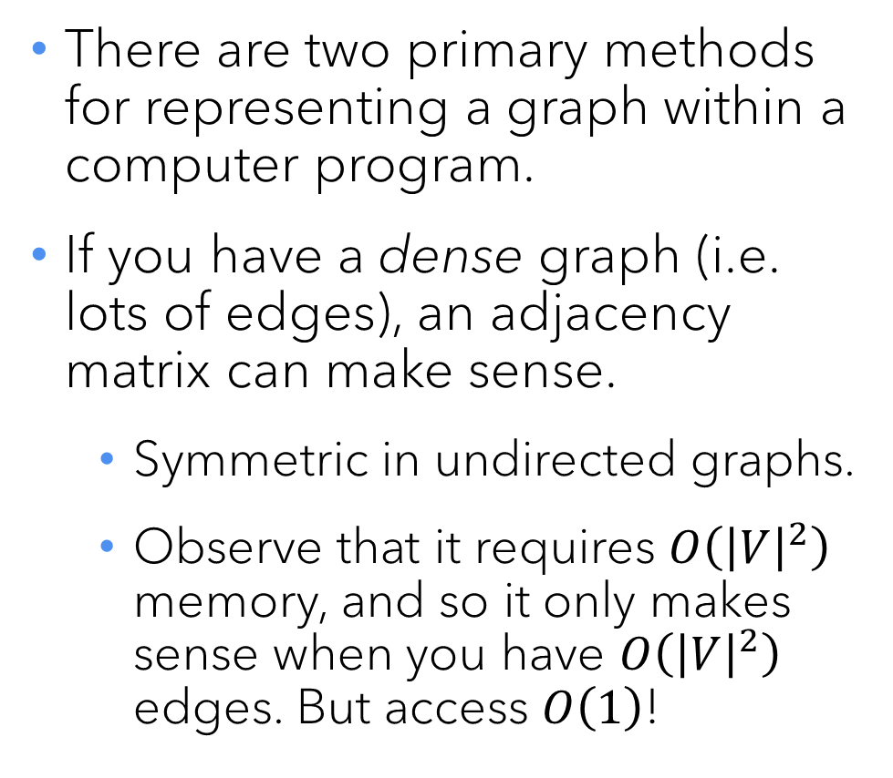
Adjacency matrix vs. adjacency list
a
There are two primary methods for representing a graph within a computer program.
If you have a dense graph (i.e. lots of edges), an adjacency matrix can make sense.
Symmetric in undirected graphs.
Observe that it requires $O\left({\left|V\right|}^{2}\right)$ memory, and so it only makes sense when you have $O\left({\left|V\right|}^{2}\right)$ edges. But access $O\left(1\right)$!
f
b
c
g
d
e
 | a | b | c | d | e | f | g
a | 0 | 1 | 1 | 0 | 0 | 0 | 0
b | 1 | 0 | 1 | 1 | 0 | 0 | 0
c | 1 | 1 | 0 | 1 | 1 | 0 | 0
d | 0 | 1 | 1 | 0 | 1 | 0 | 0
e | 0 | 0 | 1 | 1 | 0 | 0 | 0
f | 0 | 0 | 0 | 0 | 0 | 0 | 1
g | 0 | 0 | 0 | 0 | 0 | 1 | 0

Slide 13
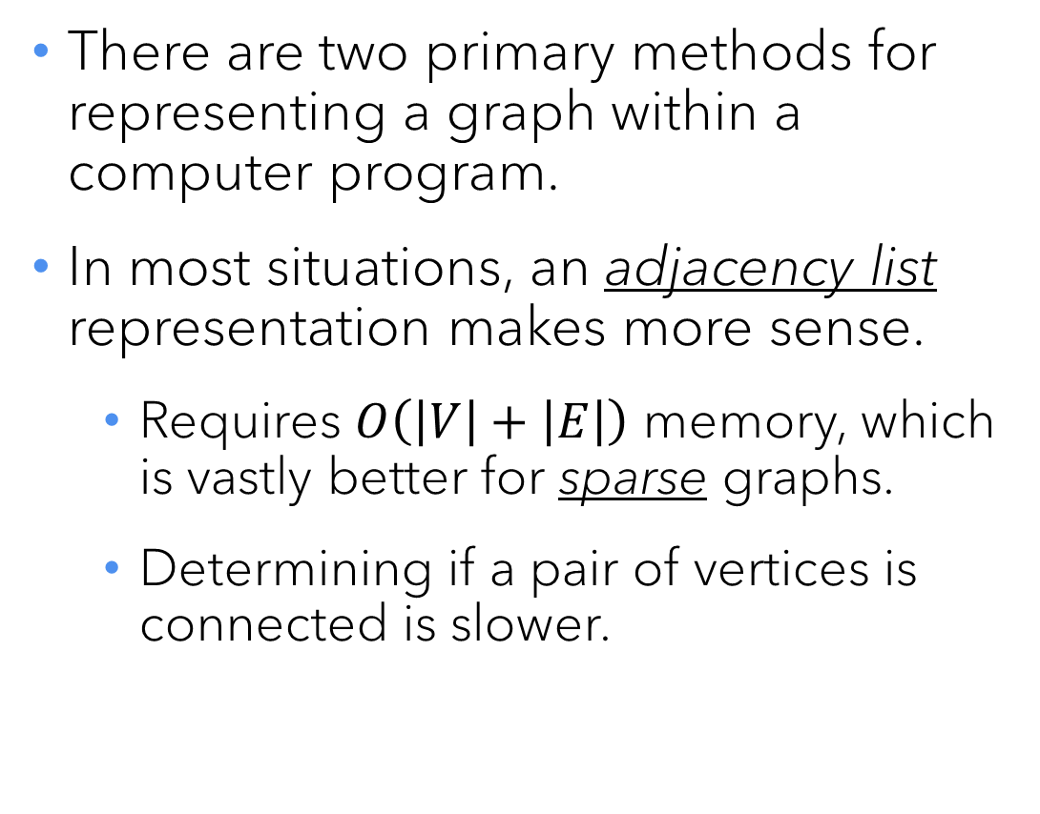
Adjacency matrix vs. adjacency list
a
There are two primary methods for representing a graph within a computer program.
In most situations, an adjacency list representation makes more sense.
Requires $O\left(\left|V\right|+\left|E\right|\right)$ memory, which is vastly better for sparse graphs.
Determining if a pair of vertices is connected is slower.
f
b
c
g
d
e
a: b,c b: a,c,d c: a,b,d,e d: b,c,e e: c,d f: g g: f

Slide 14
Graph isomorphism
a
f
b
c
g
h
As previously discussed, it does not matter how one draws a graph – all that matters are what’s connected to what.
In many situations, it doesn’t even matter how the vertices are labeled.
If we can obtain the exact same list of edges from two different graphs, we say they are isomorphic.
Another way of thinking of this: If you can rearrange rows & columns to get identical adjacency matrices.
d
e
i
j

Slide 15
Bipartite graphs
a
It is a common situation where we have two different types of object that we want to model with vertices, where connections will only occur between vertices of different types.
Example: We want a graph to represent which students have taken courses with each professor.
We call such a graph bipartite.
x
b
c
y
d
z
e

Slide 16



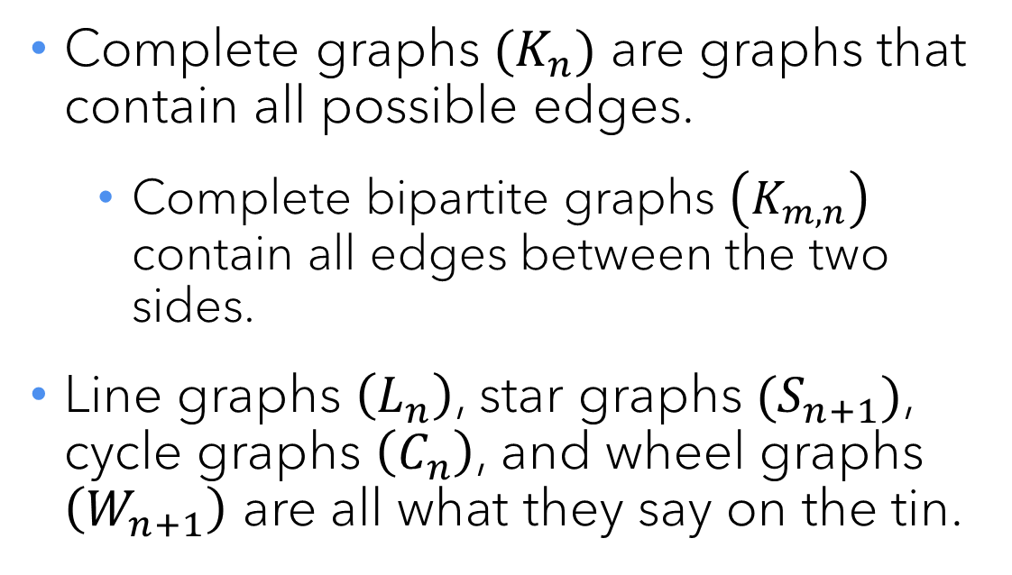




Named graphs
$$K_{5}$$
$$K_{4}$$
a
b
a
Complete graphs $(K_{n})$ are graphs that contain all possible edges.
Complete bipartite graphs $\left(K_{m,n}\right)$ contain all edges between the two sides.
Line graphs $\left(L_{n}\right)$, star graphs $(S_{n+1})$, cycle graphs $\left(C_{n}\right)$, and wheel graphs $\left(W_{n+1}\right)$ are all what they say on the tin.
b
c
c
d
$$K_{3,3}$$
d
e
a
x
b
y
c
z
$$W_{5}$$
a
b
a
b
a
b
a
b
c
d
e
$$C_{3}$$
d
$$S_{4}$$
e
$$L_{5}$$
c
c
c
d

Slide 17
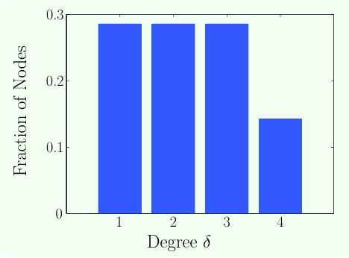
Degree sequences & histograms
a
Sometimes it can be interesting to list the degrees of the vertices in order.
This one is [ 4 3 3 2 2 1 1]. 🤷🏽
We can also plot them on a histogram.
Again, 🤷🏽
But for large graphs...
f
b
c
g
d
e

Slide 18
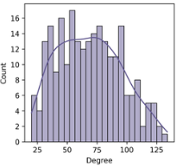
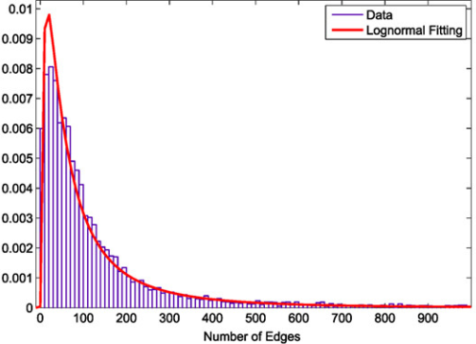
Different degree distributions

Slide 19
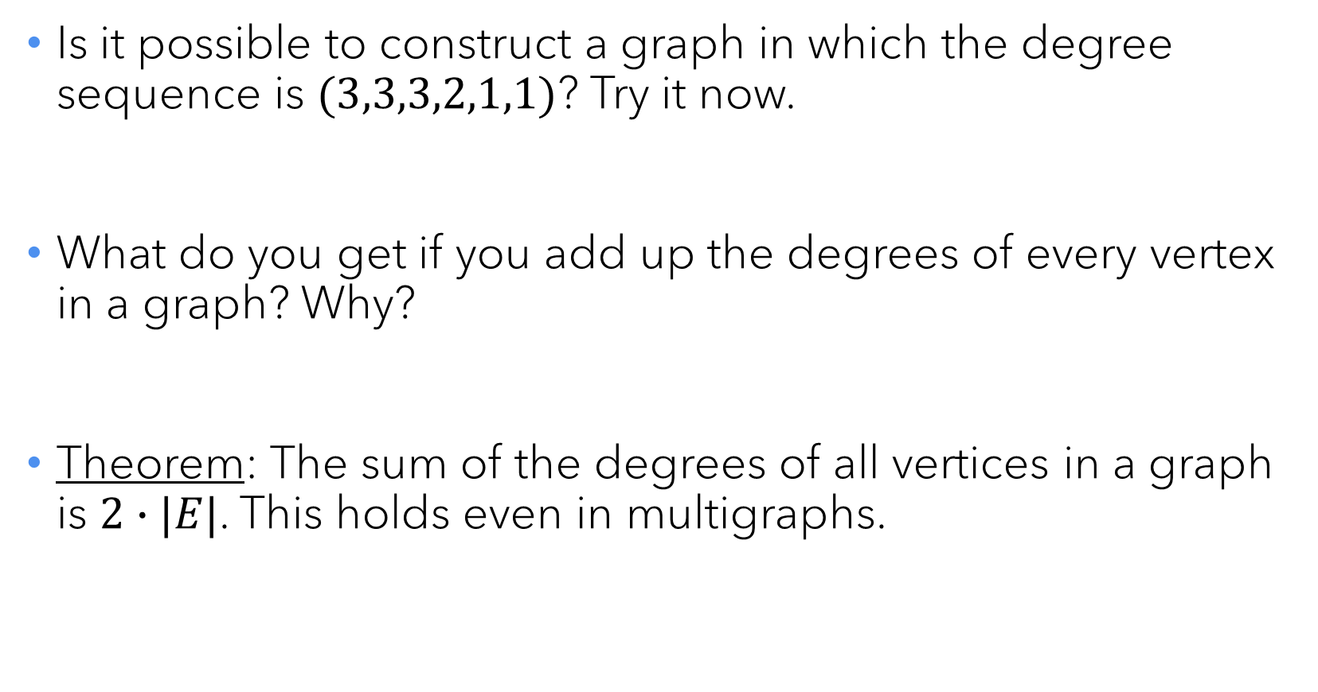
Handshake theorem
Is it possible to construct a graph in which the degree sequence is $(3,3,3,2,1,1)$? Try it now.
What do you get if you add up the degrees of every vertex in a graph? Why?
Theorem: The sum of the degrees of all vertices in a graph is $2∙|E|$. This holds even in multigraphs.

Slide 20




An old riddle
There are three houses and three utilities (water, gas, phone). Each house needs to be connected to each utility. Do so without crossing any lines. Try it now!
Any luck?

Slide 21
Planar graphs
A graph that can be drawn without crossing any lines is called a planar graph. They come up in a variety of situations.
Wiring diagrams: On a circuit board or within one level of a chip, one generally cannot cross wires. (Note: Modern processors are laid out in 3-D, to an extent.)
Maps: Every map of territories corresponds to a planar graph in which neighbors share an edge.

Slide 22

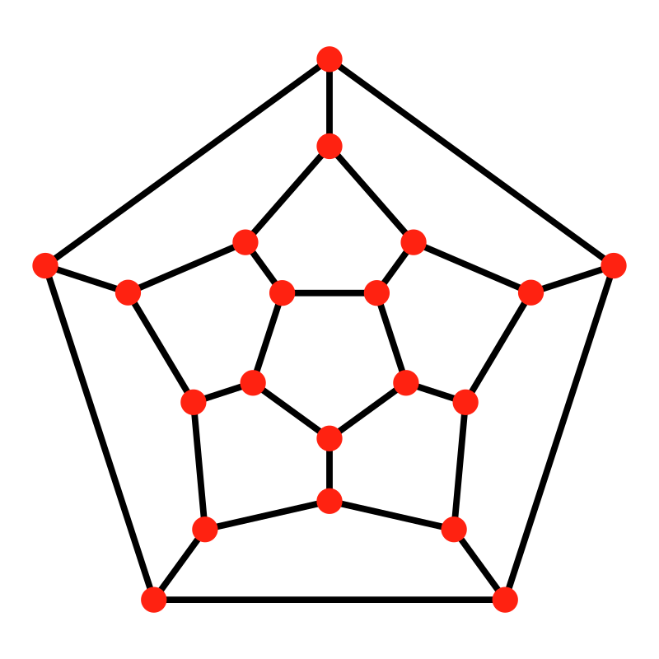
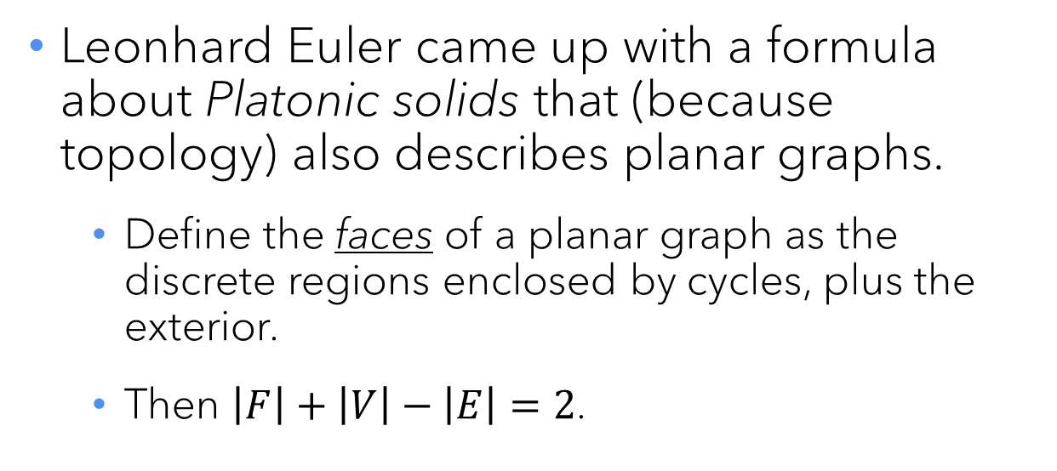
A property of planar graphs
Leonhard Euler came up with a formula about Platonic solids that (because topology) also describes planar graphs.
Define the faces of a planar graph as the discrete regions enclosed by cycles, plus the exterior.
Then $\left|F\right|+\left|V\right|−\left|E\right|=2$.
a
b
6
2
e
3
4
1
5
c
d
Dodecahedron. 12 faces, 20 vertices, 30 edges
5 faces. 5 + 5 – 8 = 2
6 faces. 6 + 7 – 11 = 2

Slide 23
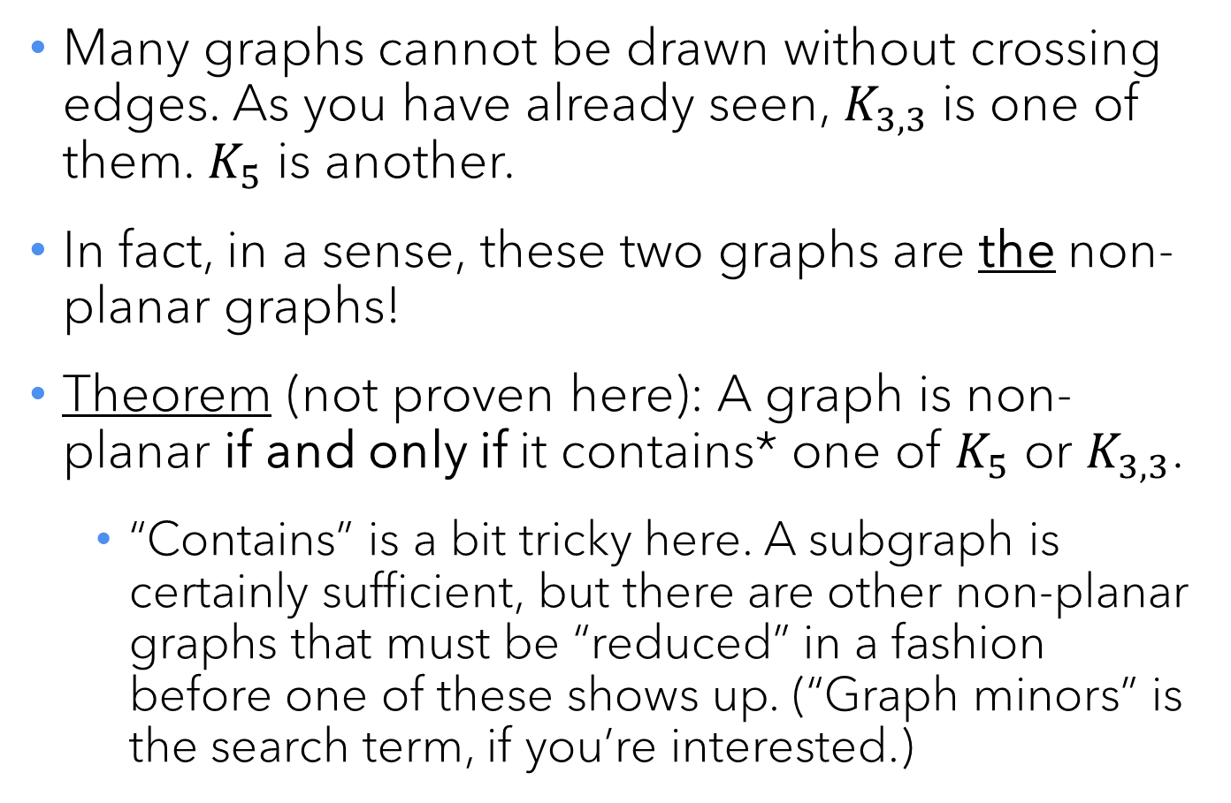

Non-planar graphs
$$K_{5}$$
a
Many graphs cannot be drawn without crossing edges. As you have already seen, $K_{3,3}$ is one of them. $K_{5}$ is another.
In fact, in a sense, these two graphs are the non-planar graphs!
Theorem (not proven here): A graph is non-planar if and only if it contains* one of $K_{5}$ or $K_{3,3}$.
“Contains” is a bit tricky here. A subgraph is certainly sufficient, but there are other non-planar graphs that must be “reduced” in a fashion before one of these shows up. (“Graph minors” is the search term, if you’re interested.)
b
c
d
e
$$K_{3,3}$$
a
x
b
y
c
z

Slide 24
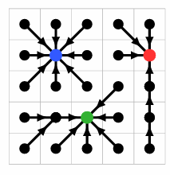
Modeling with graphs
3 | 2 | 7 | 8 | 7
4 | 1 | 8 | 9 | 6
5 | 6 | 7 | 10 | 8
6 | 3 | 2 | 11 | 9
8 | 7 | 8 | 10 | 12
Consider a park where the elevation of the land is as shown in the table.
Water, of course, runs downhill. We can roughly assume that it will take the steepest / fastest path downhill; that is, it will flow to the adjacent spot with the lowest elevation.
Where should we put storm drains, and how much water do they need to handle?
We need three drains, with capacities 9, 9, and 7. Easy to see once we make a graph.

Slide 25

Questions?
Please fill out the survey for today’s lecture:
https://forms.gle/Lrd5mcXNRmrM7c9G6

