Slide 1
Lecture 0x08: Counting, part 1
CSCI 2200 Foundations of Computer Science

Slide 2
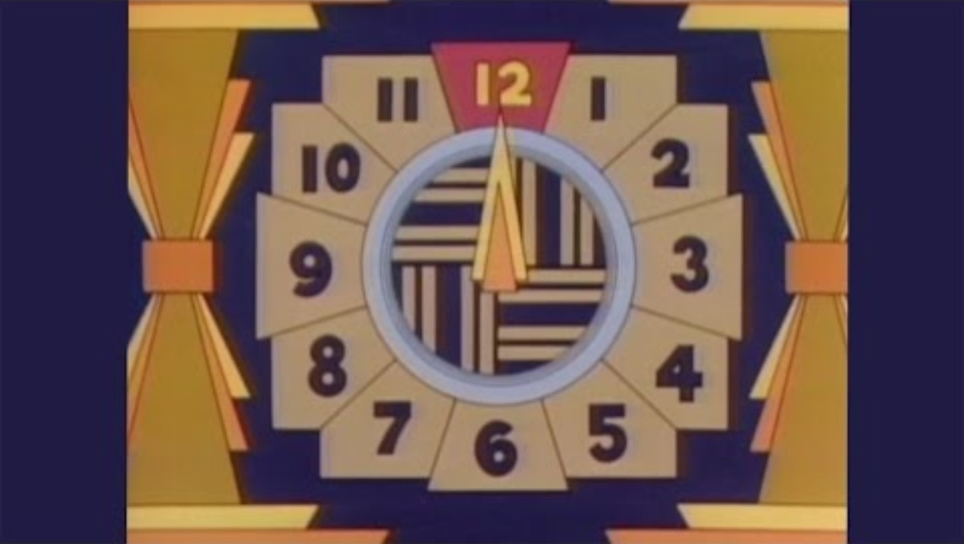
Lecture 0x08: Counting, part 1
CSCI 2200 Foundations of Computer Science
“The Phantom of the Opera” by Andrew Lloyd Weber

Slide 3
Lecture 0x08: Counting, part 1
CSCI 2200 Foundations of Computer Science
“Pinball Number Count” composed by Walt Kraemer performed by The Pointer Sisters

Slide 4
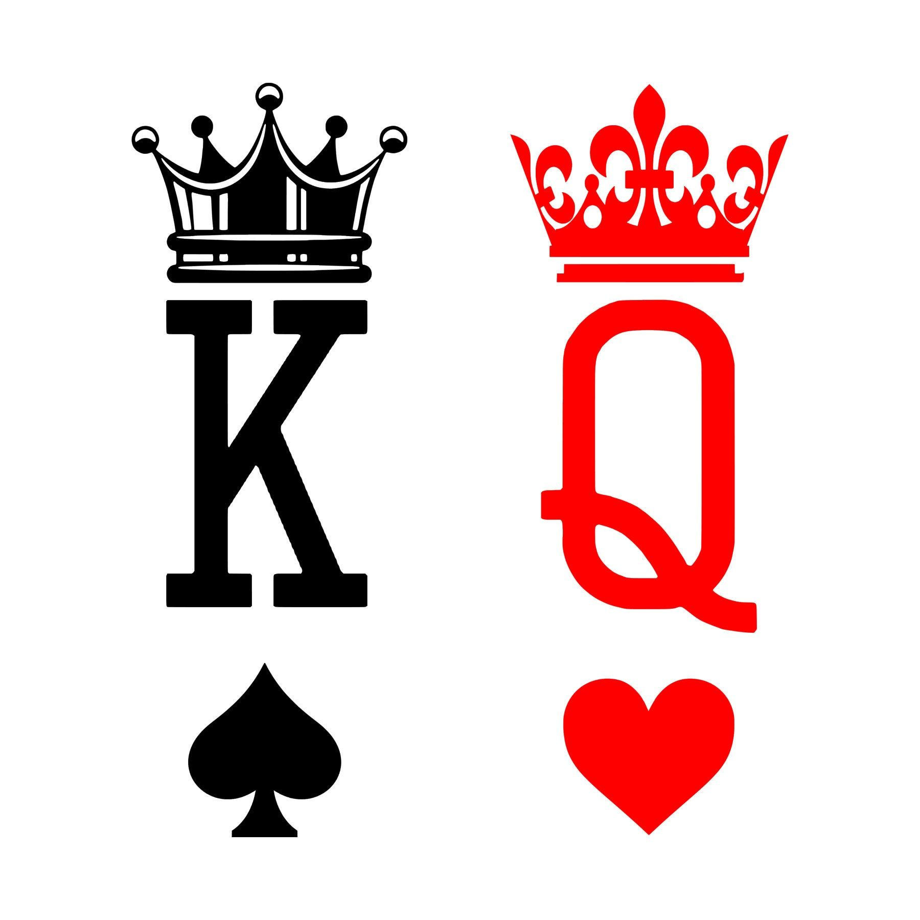
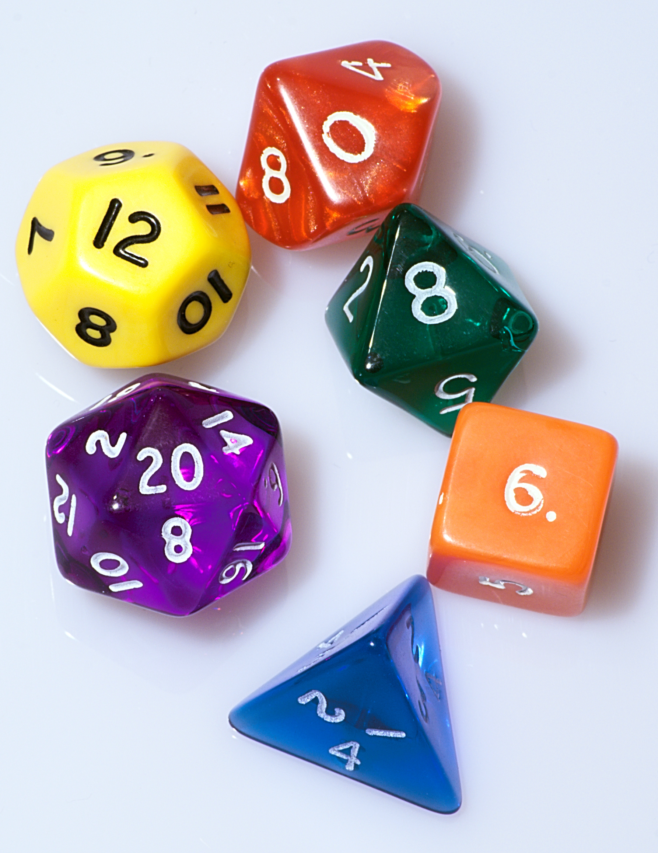
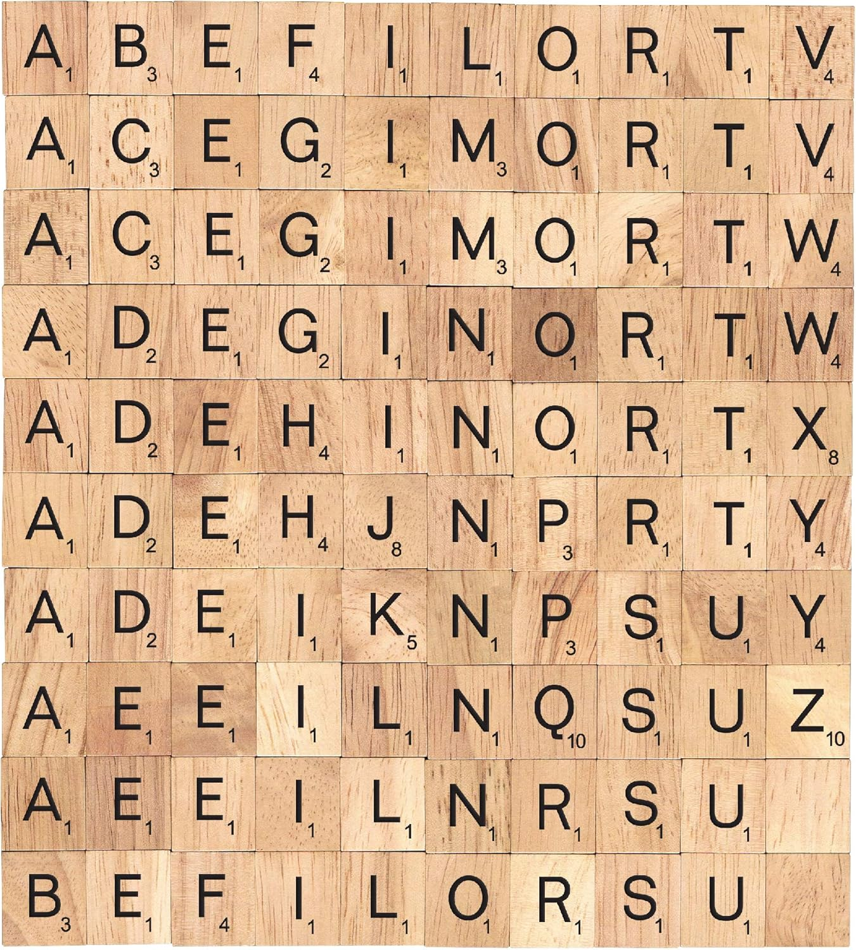
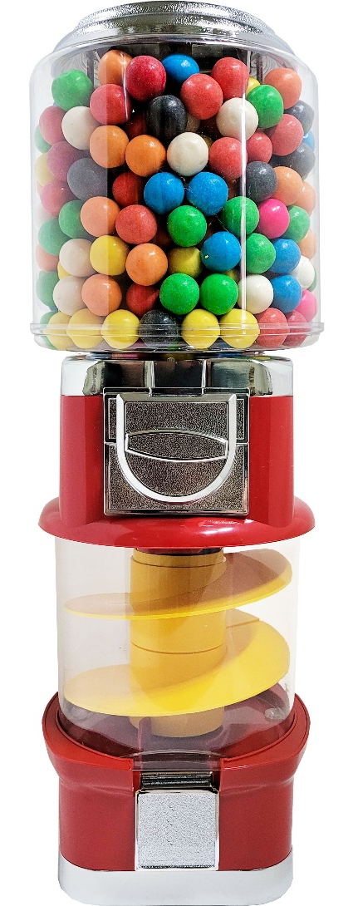
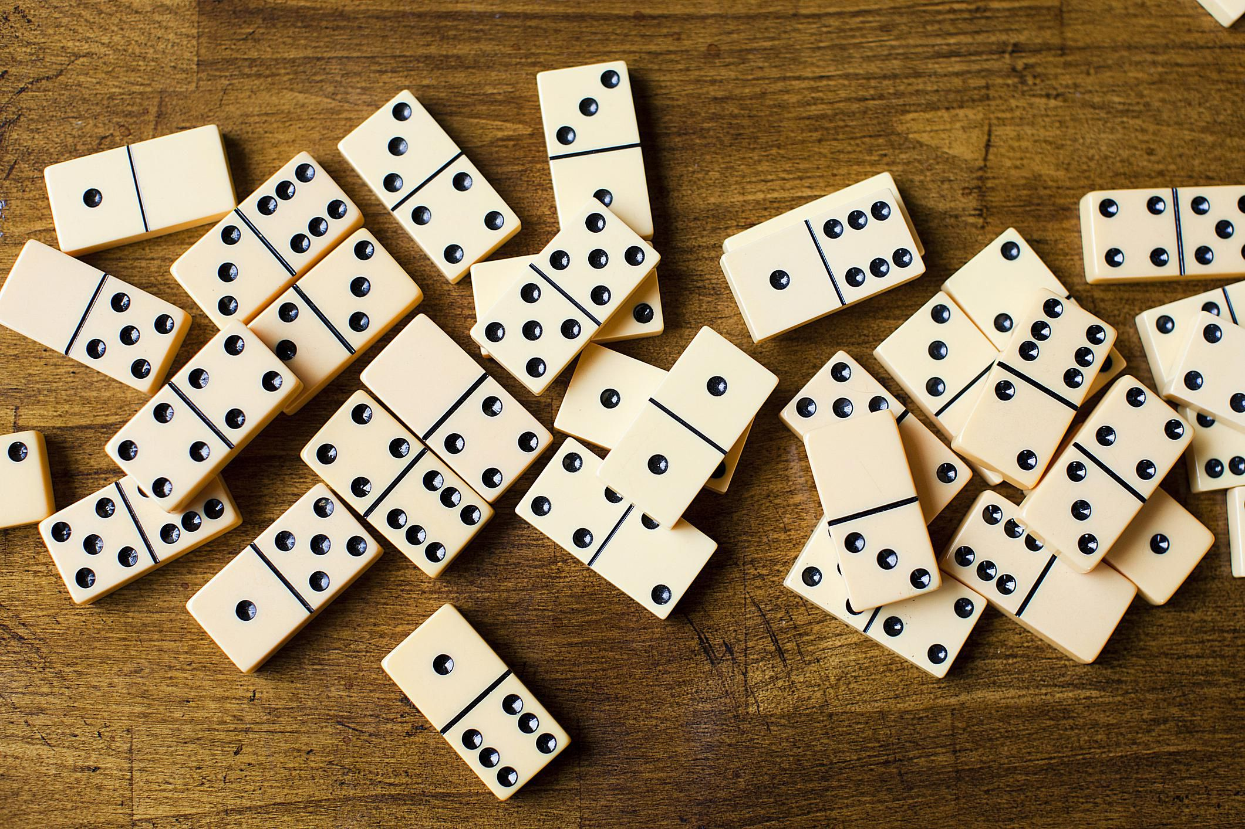
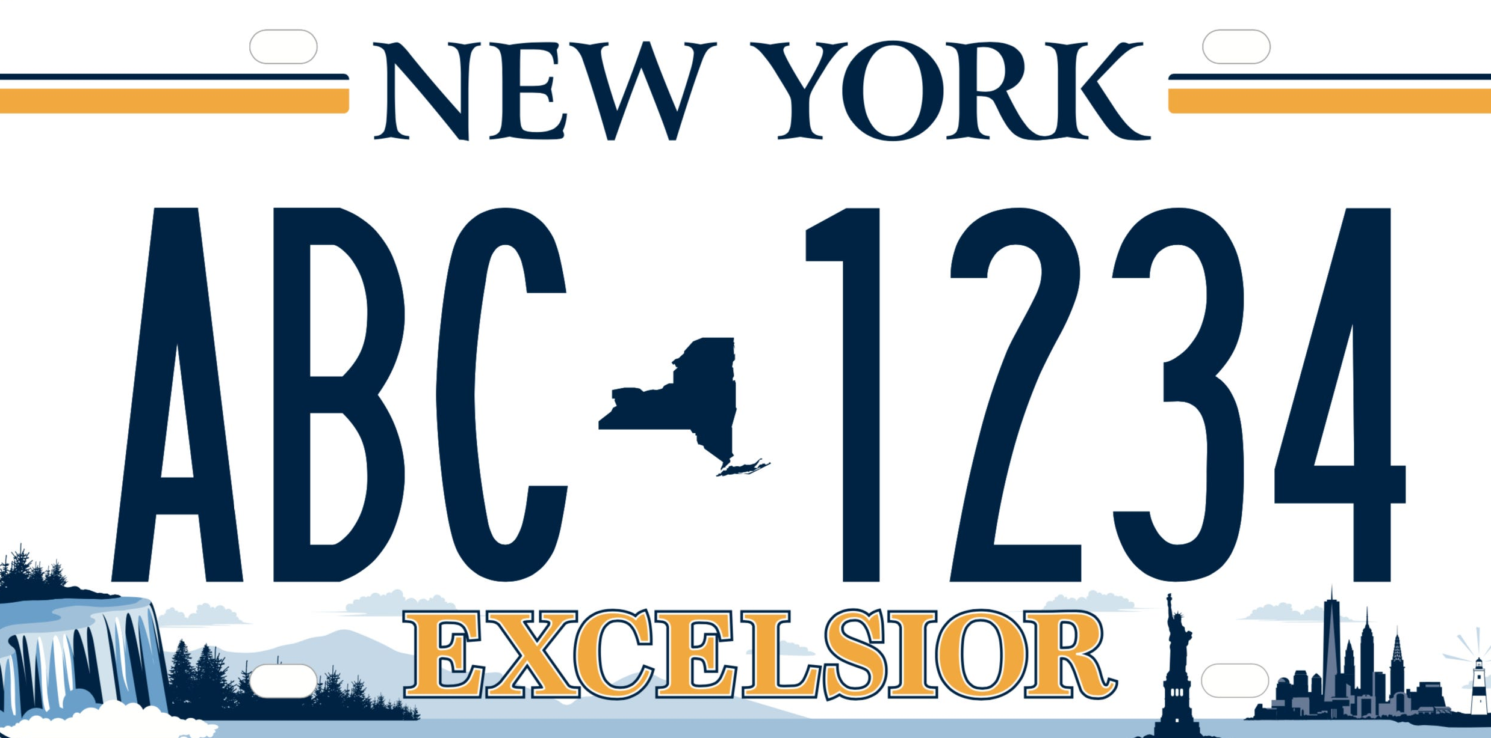
Tools of the trade…

Slide 5
Warm-up…
…01000110010101010101010110111001101100001010101101111101101010101000101001111011000101…
How many bitstrings are there of length n?
Let’s say you didn’t already know the answer. What would you do?
Right – play with it! Try small values of n, see what happens.
n = 1. There are 2: 0, 1
n = 2. There are 4: 00, 01, 10, 11
n = 3. There are 8: 000, 001, 010, 011, 100, 101, 110, 111.
Pattern seems clear – how do we prove it?

Slide 6
Yup. Induction.
…01000110010101010101010110111001101100001010101101111101101010101000101001111011000101…
Base case: n = 0. There is only one way to write the empty string.
Induction step: If there are 2^{n} bitstrings of length n, then there are 2^{n+1} bitstrings of length n+1.
Take any string of length n. We can make a string of length n+1 by adding a 0 or 1.
So there are 2^{n} strings of length n+1 that end in 0, and 2^{n} strings of length n+1 that end in 1. Combined, that’s 2^{n+1}.

Slide 7
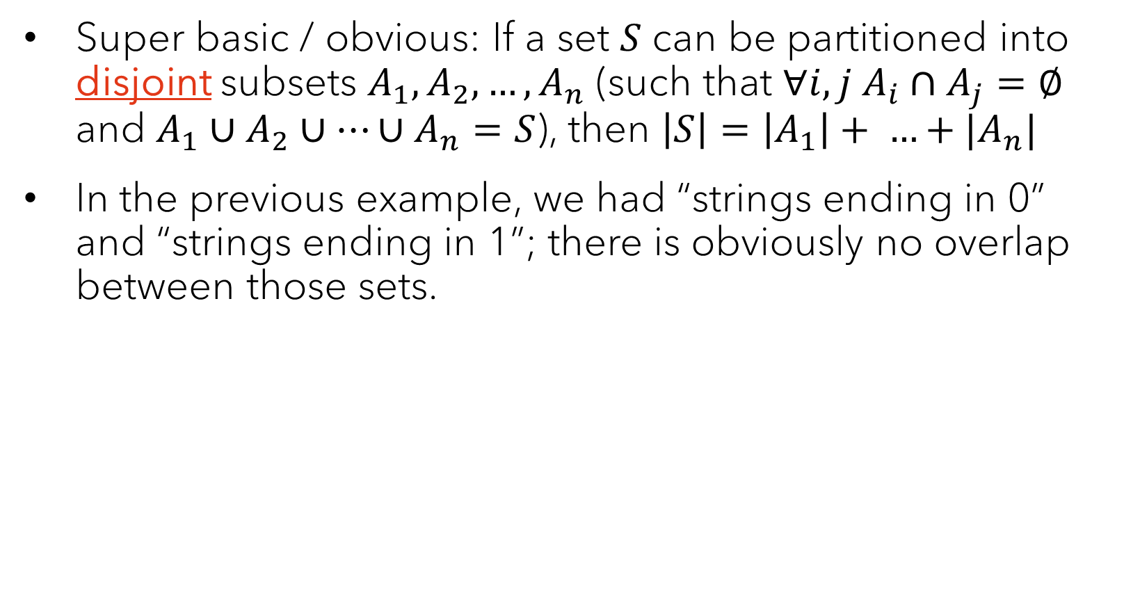
The Sum Rule
Super basic / obvious: If a set $S$ can be partitioned into disjoint subsets $A_{1},A_{2},…, A_{n}$ (such that $∀i,j A_{i}∩A_{j}=∅$ and $A_{1}∪A_{2}∪…∪A_{n}=S$), then $\left|S\right|=\left|A_{1}\right|+ …+|A_{n}|$
In the previous example, we had “strings ending in 0” and “strings ending in 1”; there is obviously no overlap between those sets.

Slide 8
The Product Rule
We can get to the answer another way…
In an n-bit string, how many choices are there for the first bit?
For the second bit?
The third bit?
Do these choices impact each other?
When a set is determined by a series of choices, the number of elements in the set is the number of options for the first choice times the number of options for the second choice after the first choice is made, times the number of options for the third choice after the first two choices are made, etc.

Slide 9
Quick check-in #1
A standard New York license plate has three letters followed by four digits. How many standard license plate numbers are possible?
26 x 26 x 26 x 10 x 10 x 10 x 10 (or 26³ x 10⁴) ≅ 175M
Real-world note: it’s less than this for a variety of reasons. But there are also other possible patterns of letters & digits that are allowed.

Slide 10
Quick check-in #2
A standard deck of cards has four suits (spades, hearts, diamonds, clubs) with 13 cards in each suit (ace, two, three, …, ten, jack, queen, king – these are the ranks).
How many sequences of five cards will have no pairs (i.e. no cards of matching rank)?
52 x 48 x 44 x 40 x 36
Key notion: Once you pick the first card, that reduces the number of possibilities for all future cards by four; the second card similar eliminates four more options for each subsequent card, and so on.

Slide 11
Adding restrictions
How many bitstrings of length 10 are there…
… that have exactly three 1s?
How should we start this problem?
Right: Play with it. Try small cases.
How many bitstrings of length 1 are there with exactly three 1s?
Length 2? Length 3?
Length 4?

Slide 12
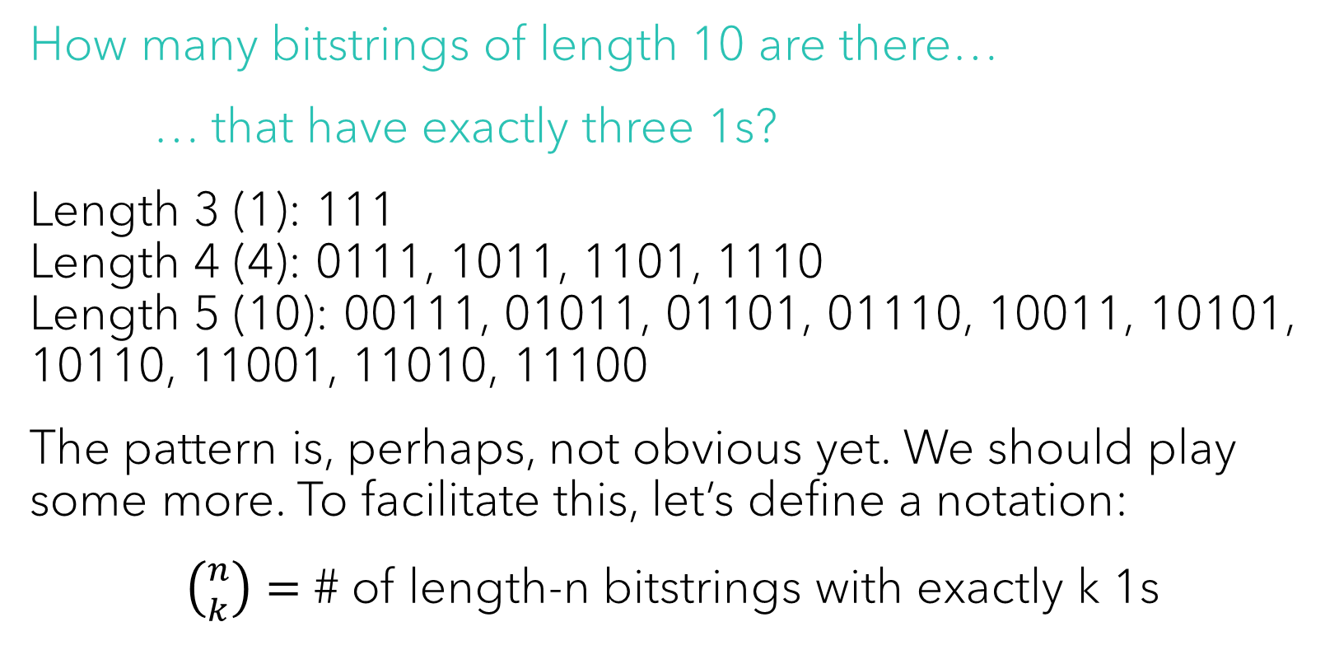
Adding restrictions
How many bitstrings of length 10 are there…
… that have exactly three 1s?
Length 3 (1): 111 Length 4 (4): 0111, 1011, 1101, 1110 Length 5 (10): 00111, 01011, 01101, 01110, 10011, 10101, 10110, 11001, 11010, 11100
The pattern is, perhaps, not obvious yet. We should play some more. To facilitate this, let’s define a notation:
$\left({n \atop k}\right)=$ # of length-n bitstrings with exactly k 1s

Slide 13
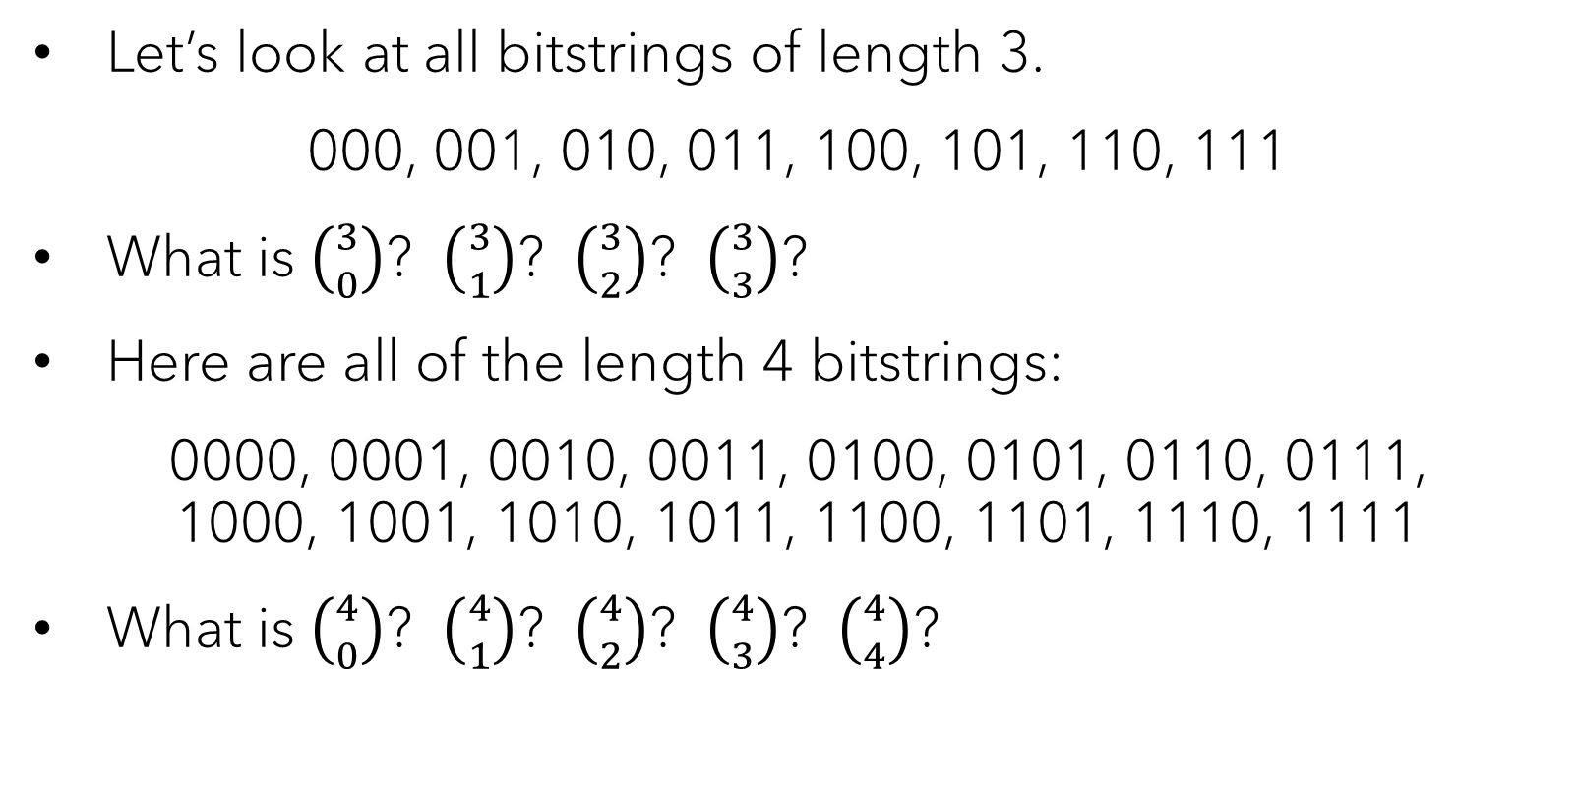
Further play
Let’s look at all bitstrings of length 3.
000, 001, 010, 011, 100, 101, 110, 111
What is $\left({3 \atop 0}\right)$? $\left({3 \atop 1}\right)$? $\left({3 \atop 2}\right)$? $\left({3 \atop 3}\right)$?
Here are all of the length 4 bitstrings:
0000, 0001, 0010, 0011, 0100, 0101, 0110, 0111, 1000, 1001, 1010, 1011, 1100, 1101, 1110, 1111
What is $\left({4 \atop 0}\right)$? $\left({4 \atop 1}\right)$? $\left({4 \atop 2}\right)$? $\left({4 \atop 3}\right)$? $\left({4 \atop 4}\right)$?

Slide 14
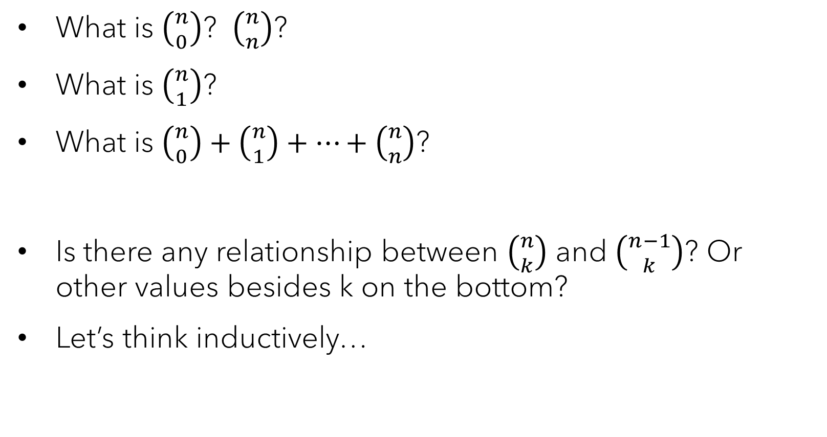
Some observations
What is $\left({n \atop 0}\right)$? $\left({n \atop n}\right)$?
What is $\left({n \atop 1}\right)$?
What is $\left({n \atop 0}\right)+\left({n \atop 1}\right)+…+\left({n \atop n}\right)$?
Is there any relationship between $\left({n \atop k}\right)$ and $\left({n−1 \atop k}\right)$? Or other values besides k on the bottom?
Let’s think inductively…

Slide 15
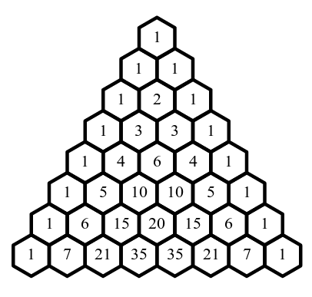
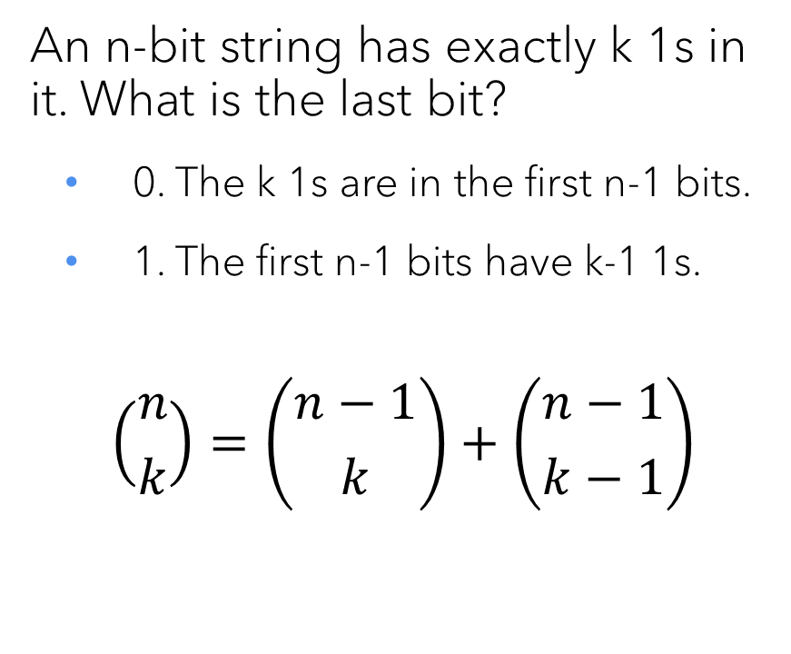
Pascal’s Identity
An n-bit string has exactly k 1s in it. What is the last bit?
0. The k 1s are in the first n-1 bits.
1. The first n-1 bits have k-1 1s.
$$\left({n \atop k}\right)=\left({n−1 \atop k}\right)+\left({n−1 \atop k−1}\right)$$

Slide 16
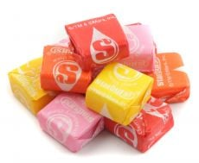
More counting
Starbursts originally had four colors: red, pink, orange, yellow
How many different packages of seven original Starbursts can be constructed?
How should we think about this?

Slide 17




Starburst counting
We could treat this as a base-4 value and enumerate…
… but this presumes we care about order. And it would take forever.

Slide 18

Better model
Four bins/buckets, one per color:

Slide 19
Better model
Four bins/buckets, one per color:
… ok, how does this help? Is this really easier to count?

Slide 20
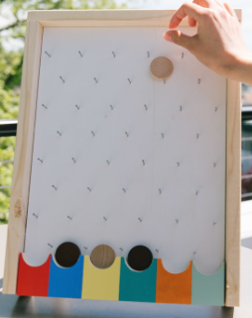
Plinko
Disks are dropped from the top, hit the obstacles along the way, and eventually fall into one of the bins in the bottom.
If we make the bins deep enough to hold multiple disks, they can stand in for our buckets.
Key insight: The important thing is the dividers at the bottom!

Slide 21
An encoding
Our first package had:
2 orange, 3 yellow, 1 red, 1 pink
Our second package had:
3 orange, 0 yellow, 4 red, 0 pink
0 0 1 0 0 0 1 0 1 0
0 0 0 11 0 0 0 0 1
The number of Starbucks packages is precisely the same as the number of 10-bit strings with exactly three 1s!! It’s $\left({10 \atop 3}\right)$

Slide 22
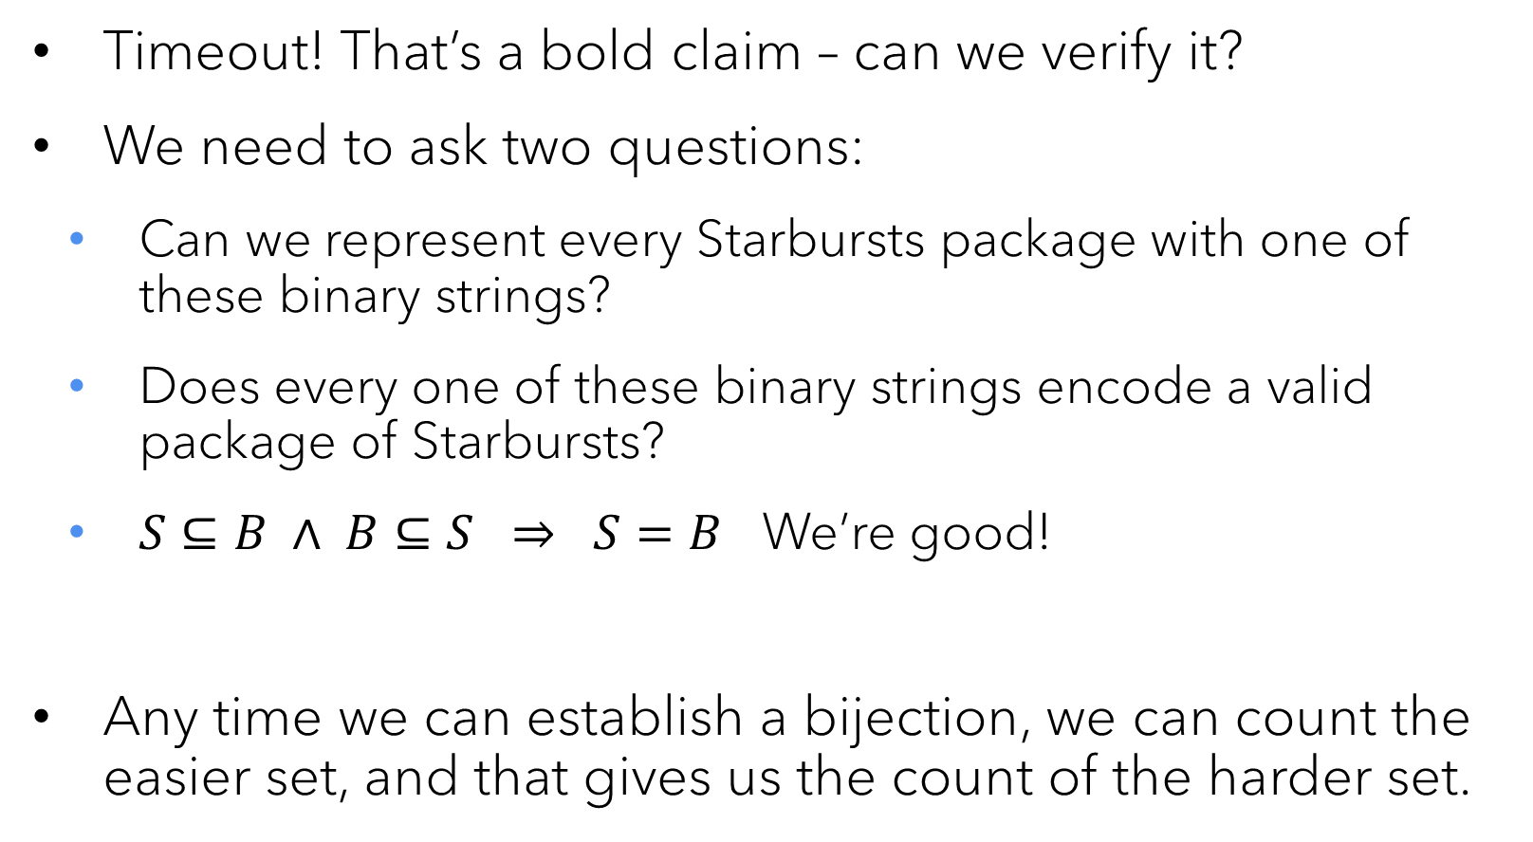
The Bijection Principle
Timeout! That’s a bold claim – can we verify it?
We need to ask two questions:
Can we represent every Starbursts package with one of these binary strings?
Does every one of these binary strings encode a valid package of Starbursts?
$S⊆B ∧ B⊆S ⇒ S=B$ We’re good!
Any time we can establish a bijection, we can count the easier set, and that gives us the count of the harder set.

Slide 23
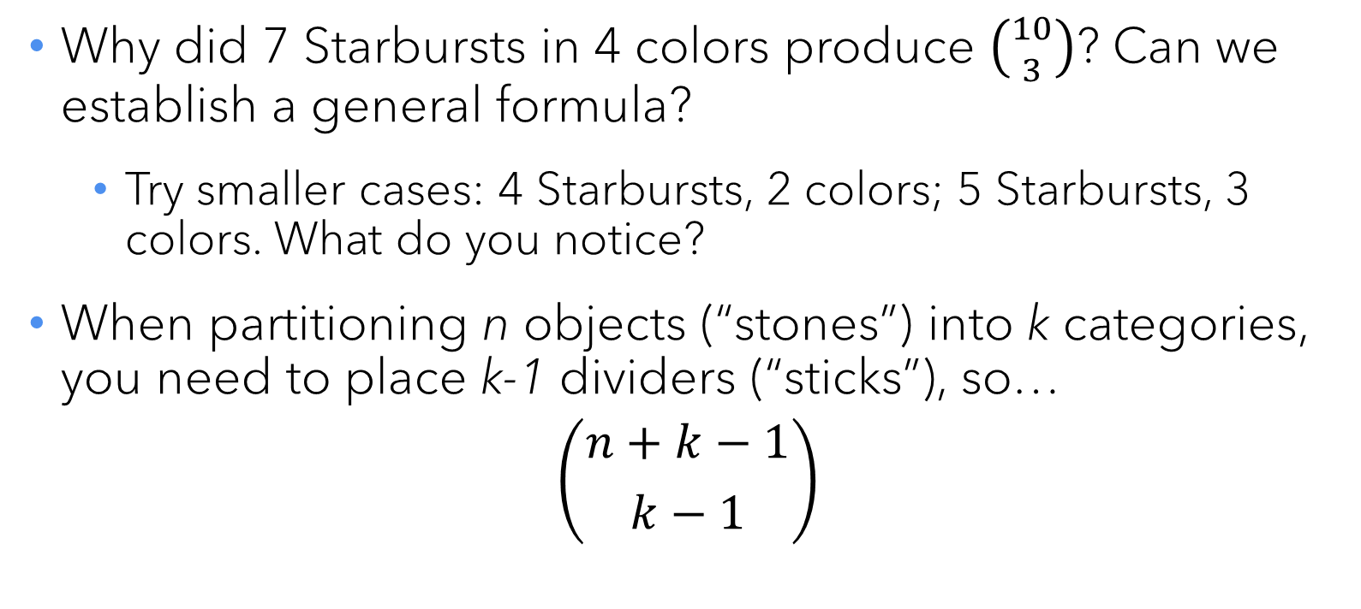
Sticks and stones
Why did 7 Starbursts in 4 colors produce $\left({10 \atop 3}\right)$? Can we establish a general formula?
Try smaller cases: 4 Starbursts, 2 colors; 5 Starbursts, 3 colors. What do you notice?
When partitioning n objects (“stones”) into k categories, you need to place k-1 dividers (“sticks”), so…
$$\left({n+k−1 \atop k−1}\right)$$

Slide 24
Selecting a sequence from a set
How many ways are there to draw a five-card flush in hearts off the top of a deck?
13 x 12 x 11 x 10 x 9
This looks like 13! (factorial), but we’re missing the last 8 factors off the end. Can we write that formulaically?
13 x 12 x 11 x 10 x 9 = 13! ÷ 8!
… where did the 8 come from?
13 (# of objects in the set) – 5 (number of selections)

Slide 25
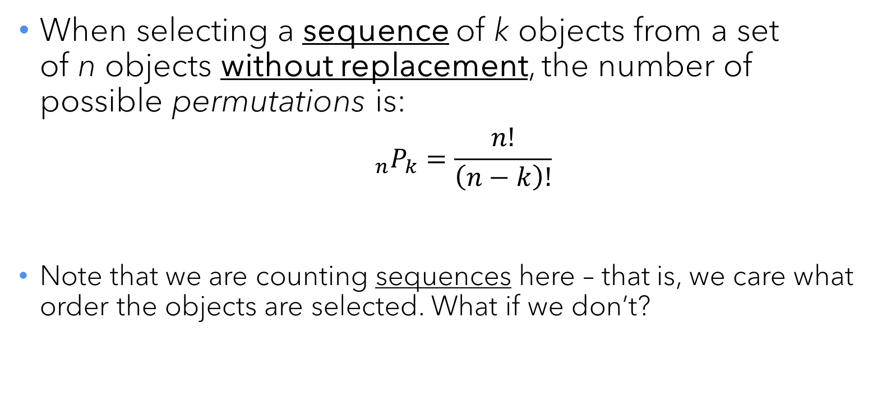
Permutations
When selecting a sequence of k objects from a set of n objects without replacement, the number of possible permutations is:
$${}_{n}P_{k}=\frac{n!}{\left(n−k\right)!}$$
Note that we are counting sequences here – that is, we care what order the objects are selected. What if we don’t?

Slide 26
Selecting a subset from a set
How many ways are there to draw a five-card flush in hearts off the top of a deck?
13 x 12 x 11 x 10 x 9 … but we don’t care what order the cards are drawn in, only that we have five hearts at the end.
In how many different orders can five distinct cards appear?
Apply the Product Rule.
5 x 4 x 3 x 2 x 1 = 5! = 120
So there are 120 flush sequences for every flush subset.

Slide 27
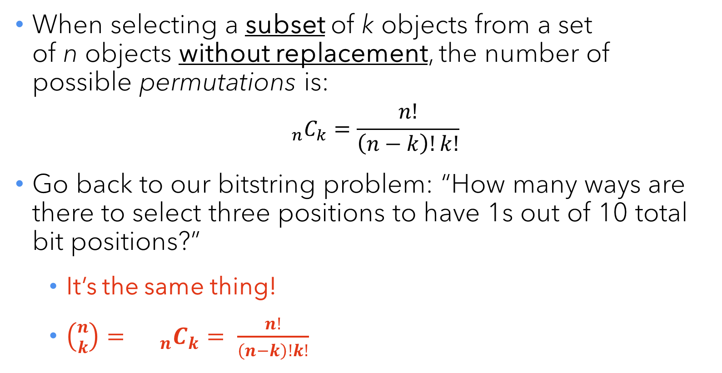
Combinations
When selecting a subset of k objects from a set of n objects without replacement, the number of possible permutations is:
$${}_{n}C_{k}=\frac{n!}{\left(n−k\right)!k!}$$
Go back to our bitstring problem: “How many ways are there to select three positions to have 1s out of 10 total bit positions?”
It’s the same thing!
$\left({n \atop k}\right)= {}_{n}C_{k}= \frac{n!}{\left(n−k\right)!k!}$

Slide 28
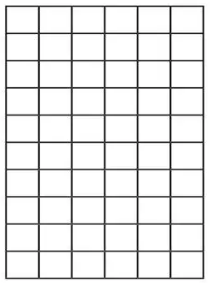
Your turn…
1) An Olympic race has 8 runners. How many different ways can the gold, silver, and bronze medals be awarded? 2) 26136000 factors into primes as 2⁶ x 3³ x 5³ x 11². How many different integers is it divisible by?
3) In a city with a regular grid of streets, you need to travel 10 blocks north and 6 blocks east. If you never turn south or west, how many possible paths are there?

Slide 29
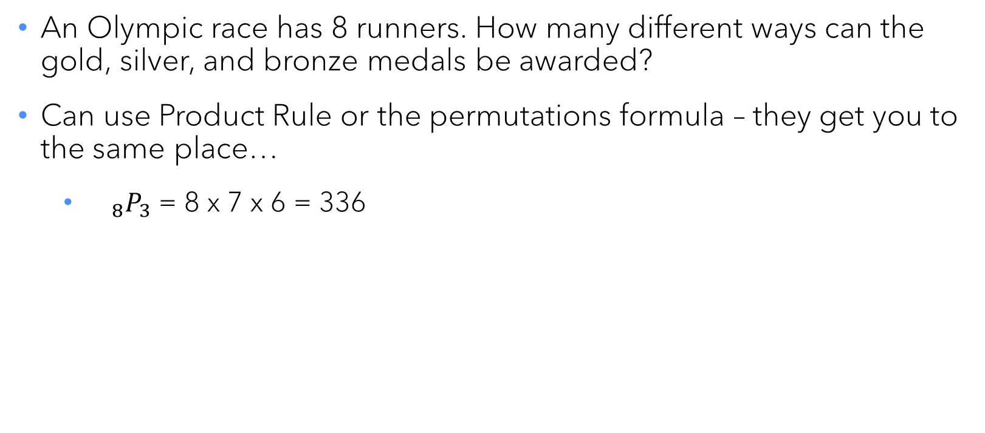
Olympic race
An Olympic race has 8 runners. How many different ways can the gold, silver, and bronze medals be awarded?
Can use Product Rule or the permutations formula – they get you to the same place…
${}_{8}P_{3}$ = 8 x 7 x 6 = 336

Slide 30
Number of divisors
26136000 factors into primes as 2⁶ x 3³ x 5³ x 11². How many different integers is it divisible by?
This is another Product Rule problem. A divisor of 26136000 may contain any or all (or none!) of the prime factors listed above.
How many factors of 2 are in the divisor?
0, 1, 2, 3, 4, 5, or 6
Similarly, there are 4 choices for the quantity of 3s, 4 choices for the quantity of 5s, and 3 choices for the quantity of 11s.
7 x 4 x 4 x 3 = 336 divisors.

Slide 31
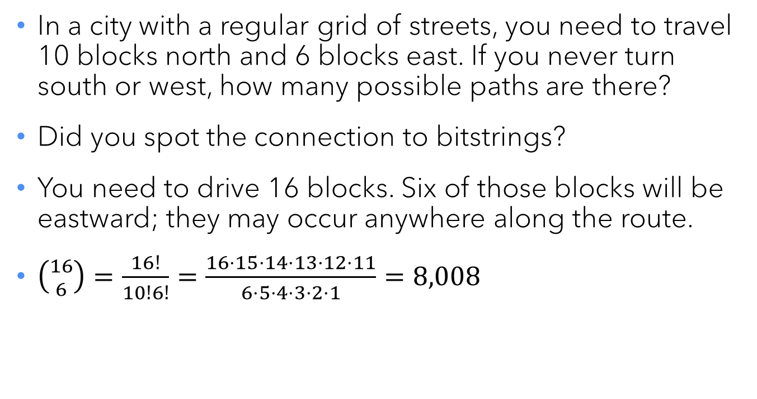
The grid
In a city with a regular grid of streets, you need to travel 10 blocks north and 6 blocks east. If you never turn south or west, how many possible paths are there?
Did you spot the connection to bitstrings?
You need to drive 16 blocks. Six of those blocks will be eastward; they may occur anywhere along the route.
$\left({16 \atop 6}\right)=\frac{16!}{10!6!}=\frac{16⋅15⋅14⋅13⋅12⋅11}{6⋅5⋅4⋅3⋅2⋅1}=8,008$

Slide 32
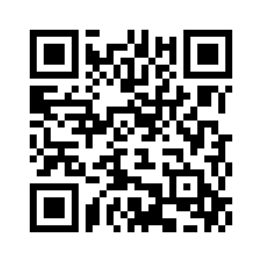
Questions? REMINDER: Exam 2 on W 2/26 Last names A-K: DCC 318 Last names L-Z: DCC 324 Bring your ID card!

