Slide 1
Lecture 14: Counting, part 2
CSCI 2200 Foundations of Computer Science

Slide 2

Lecture 14: Counting, part 2
CSCI 2200 Foundations of Computer Science
“Still Alive” composed by Jonathan Coulton performed by Ellen McLain for Portal

Slide 3
Announcements
Final exam schedule has been posted by the Registrar. We are on M 4/28, 11:30am. (Room(s) TBD.)
Exam 2 is this Wednesday 2/26. No recitations that day.
Last names A-K DCC 318; last names L-Z DCC 324.
One-page (double-sided) crib sheet.
Bring your ID!
Reminder: Prof. Gittens will be taking over lectures starting on Thursday.

Slide 4

Answering a question from last time
What is ${\left(x+y\right)}^{2}$?
$$x^{2}+2xy+y^{2}$$
What is ${\left(x+y\right)}^{3}$?
$$x^{3}+3x^{2}y+3xy^{2}+y^{3}$$
What is ${\left(x+y\right)}^{4}$?
$$x^{4}+4x^{3}y+6x^{2}y^{2}+4xy^{3}+y^{4}$$

Slide 5

Answering a question from last time
What is ${\left(x+y\right)}^{2}$?
$${1x}^{2}+2xy+1y^{2}$$
What is ${\left(x+y\right)}^{3}$?
$${1x}^{3}+3x^{2}y+3xy^{2}+{1y}^{3}$$
What is ${\left(x+y\right)}^{4}$?
$$1x^{4}+4x^{3}y+6x^{2}y^{2}+4xy^{3}+1y^{4}$$
What is ${\left(x+y\right)}^{n}$?
$$\sum_{k=0}^{n}{\left({n \atop k}\right)}x^{k}y^{n−k}$$

Slide 6
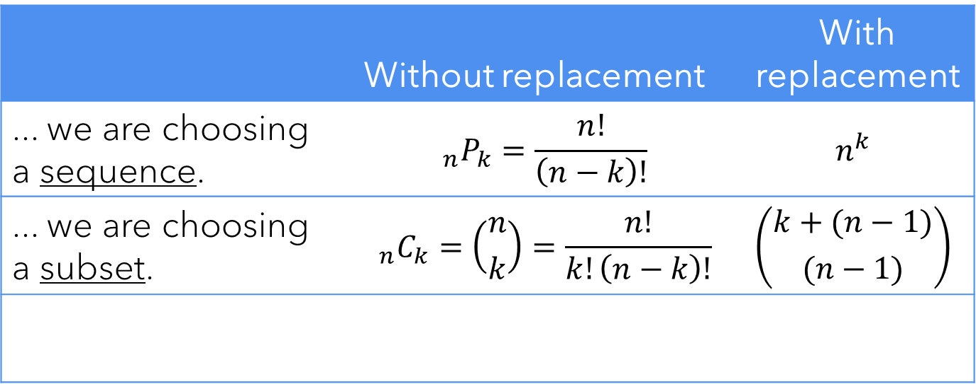
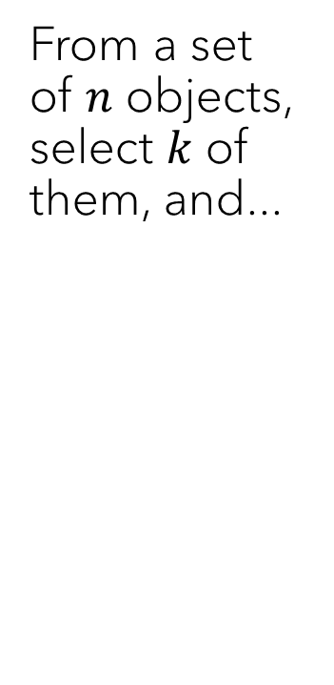
What we know so far
From a set of $n$ objects, select $k$ of them, and...
 | Without replacement | With replacement
... we are choosing a sequence. | $${}_{n}P_{k}=\frac{n!}{\left(n−k\right)!}$$ | $$n^{k}$$
... we are choosing a subset. | $${}_{n}C_{k}=\left({n \atop k}\right)=\frac{n!}{k!\left(n−k\right)!}$$ | $$\left({k+(n−1) \atop (n−1)}\right)$$

Slide 7
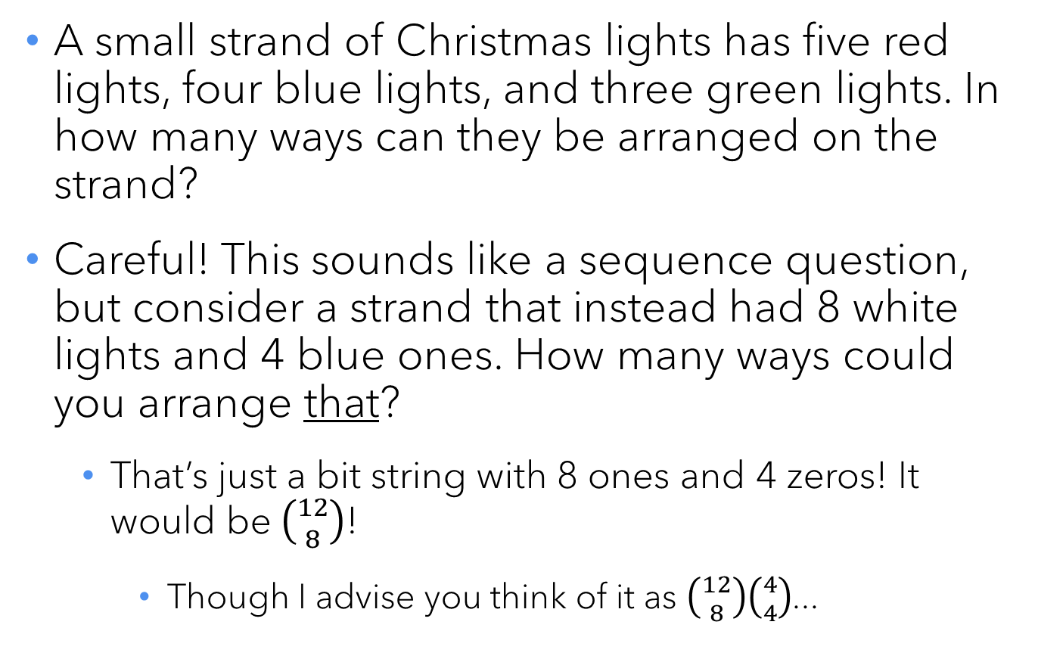
The multinomial coefficient
A small strand of Christmas lights has five red lights, four blue lights, and three green lights. In how many ways can they be arranged on the strand?
Careful! This sounds like a sequence question, but consider a strand that instead had 8 white lights and 4 blue ones. How many ways could you arrange that?
That’s just a bit string with 8 ones and 4 zeros! It would be $\left({12 \atop 8}\right)$!
Though I advise you think of it as $\left({12 \atop 8}\right)\left({4 \atop 4}\right)$...

Slide 8
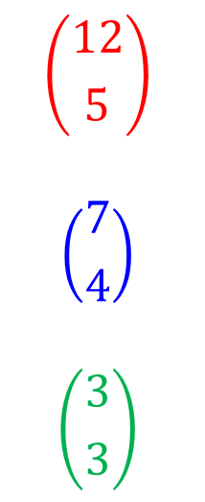
The multinomial coefficient
A small strand of Christmas lights has five red lights, four blue lights, and three green lights. In how many ways can they be arranged on the strand?
Start simple: How many different ways could you select the locations for the red lights?
After placing the red lights, how many ways could you select the locations for the blue lights?
After placing both the red and blue lights, how many ways could you select locations for the green lights?
$$\left({12 \atop 5}\right)$$
$$\left({7 \atop 4}\right)$$
$$\left({3 \atop 3}\right)$$

Slide 9
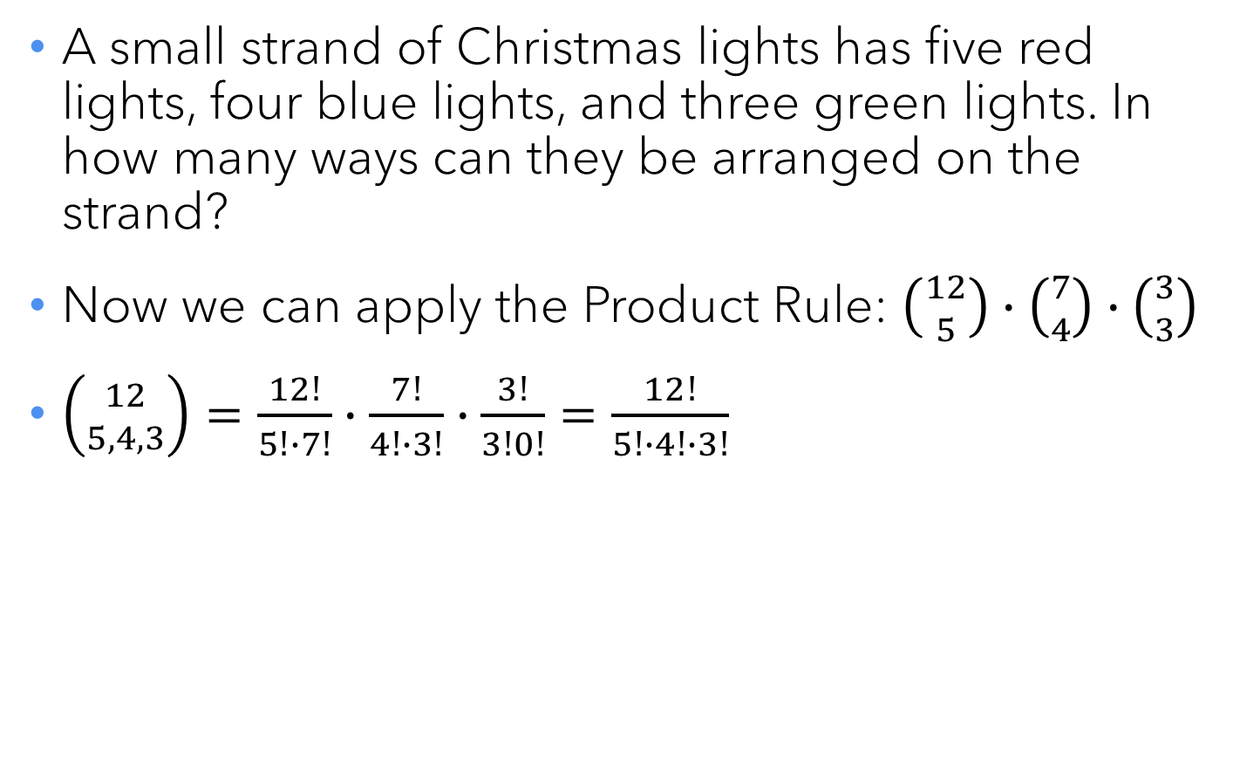
The multinomial coefficient
A small strand of Christmas lights has five red lights, four blue lights, and three green lights. In how many ways can they be arranged on the strand?
Now we can apply the Product Rule: $\left({12 \atop 5}\right)∙\left({7 \atop 4}\right)∙\left({3 \atop 3}\right)$
$\left({12 \atop 5,4,3}\right)=\frac{12!}{5!∙7!}∙\frac{7!}{4!∙3!}∙\frac{3!}{3!0!}=\frac{12!}{5!∙4!∙3!}$

Slide 10

Quick check-in
How many ways are there to rearrange the letters in RENSSELAER?
$\left({10 \atop 3,2,2,1,1,1}\right)=\frac{10!}{3!∙2!∙2!∙1!∙1!∙1!}=151,200$

Slide 11
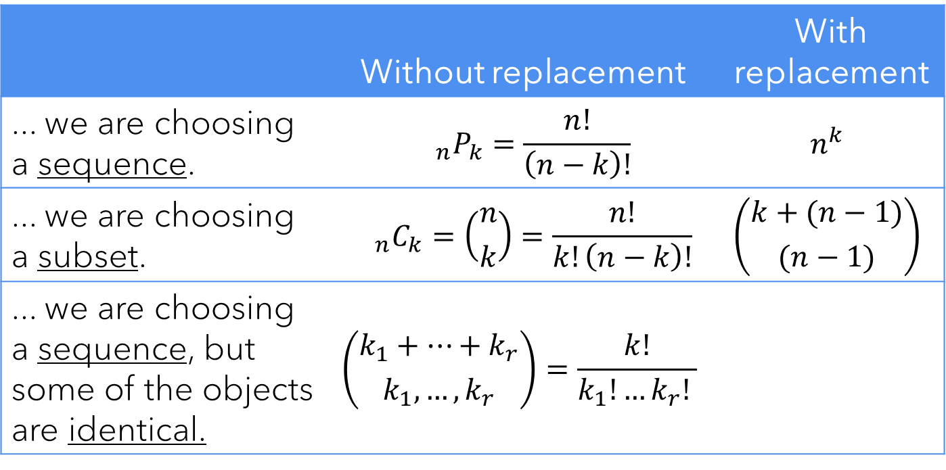
What we know so far
From a set of $n$ objects, select $k$ of them, and...
 | Without replacement | With replacement
... we are choosing a sequence. | $${}_{n}P_{k}=\frac{n!}{\left(n−k\right)!}$$ | $$n^{k}$$
... we are choosing a subset. | $${}_{n}C_{k}=\left({n \atop k}\right)=\frac{n!}{k!\left(n−k\right)!}$$ | $$\left({k+(n−1) \atop (n−1)}\right)$$
... we are choosing a sequence, but some of the objects are identical. | $$\left({k_{1}+…+k_{r} \atop k_{1},…,k_{r}}\right)=\frac{k!}{k_{1}!…k_{r}! }$$

Slide 12
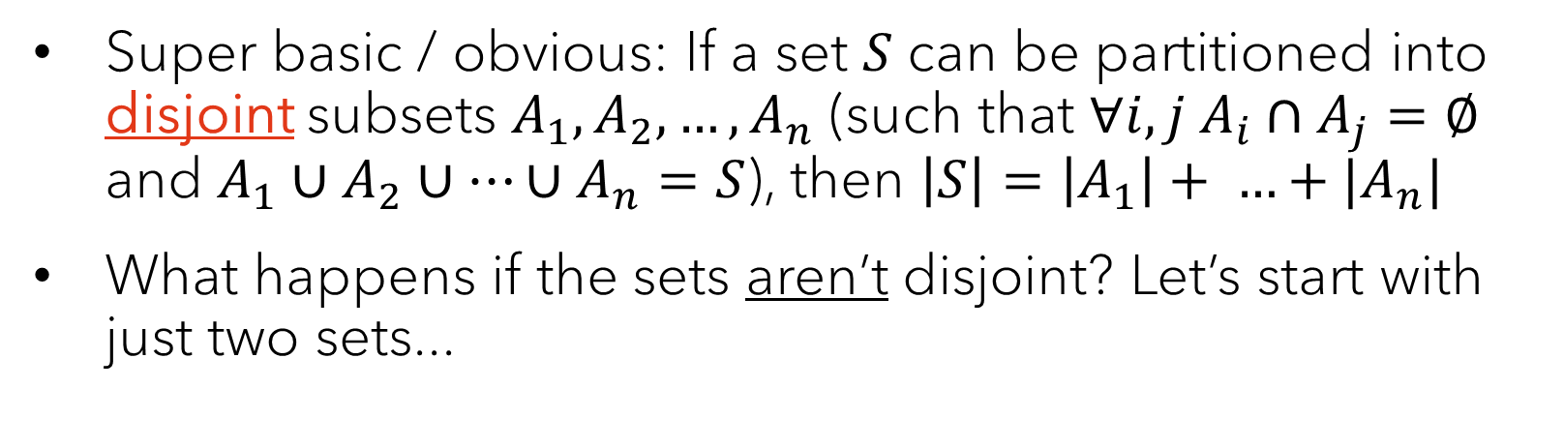
The Sum Rule
Super basic / obvious: If a set $S$ can be partitioned into disjoint subsets $A_{1},A_{2},…, A_{n}$ (such that $∀i,j A_{i}∩A_{j}=∅$ and $A_{1}∪A_{2}∪…∪A_{n}=S$), then $\left|S\right|=\left|A_{1}\right|+ …+|A_{n}|$
What happens if the sets aren’t disjoint? Let’s start with just two sets...
A .
. B

Slide 13
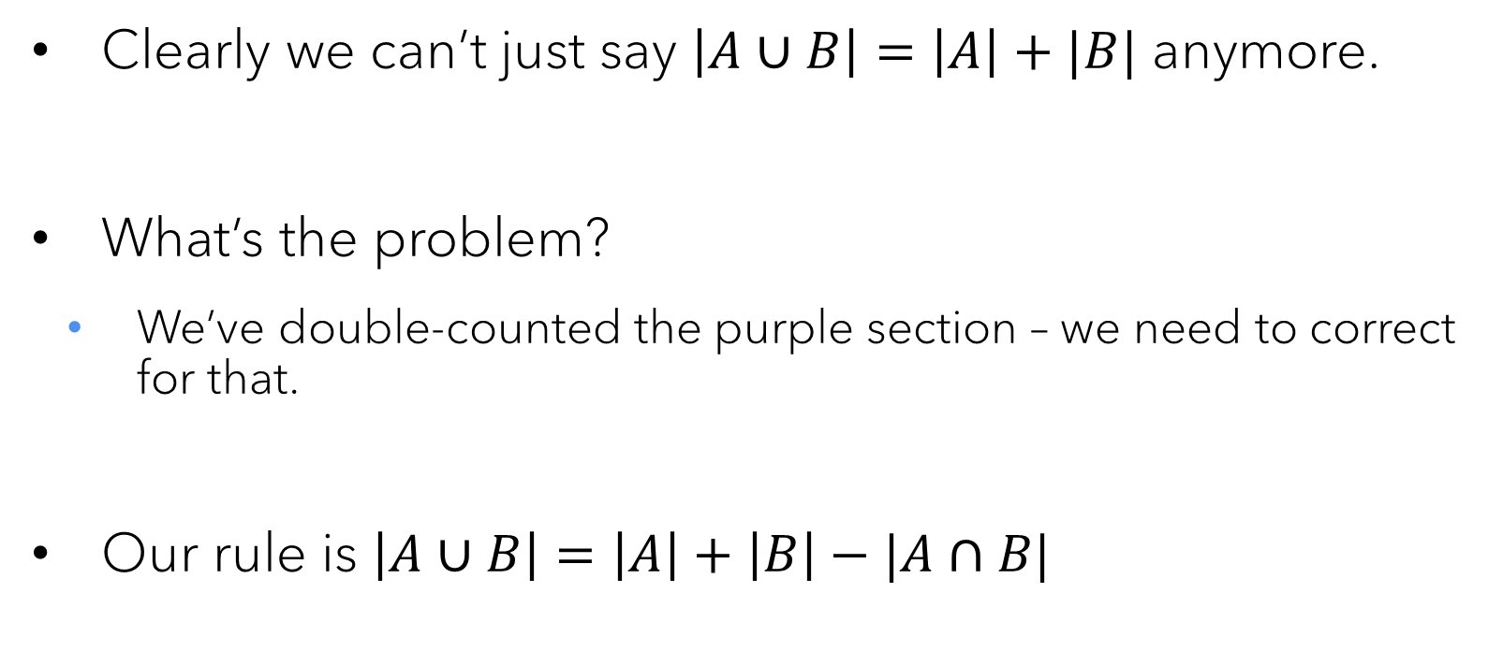
Inclusion-exclusion
A .
. B
Clearly we can’t just say $\left|A∪B\right|=\left|A\right|+|B|$ anymore.
What’s the problem?
We’ve double-counted the purple section – we need to correct for that.
Our rule is $\left|A∪B\right|=\left|A\right|+\left|B\right|−|A∩B|$

Slide 14
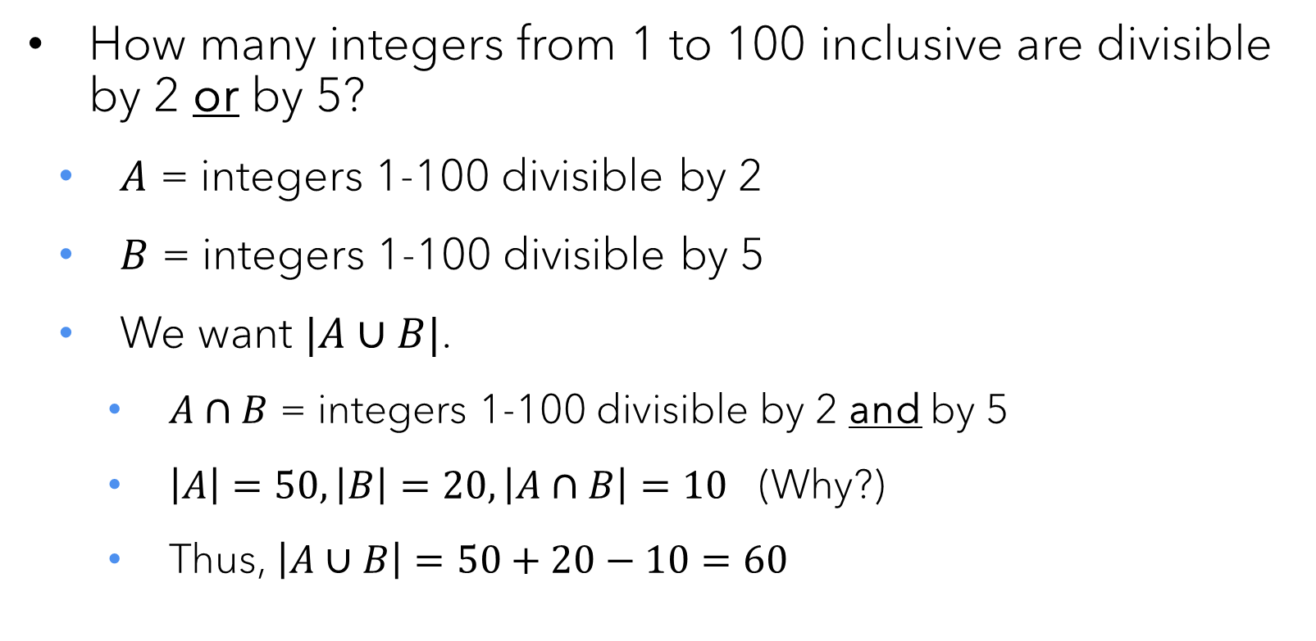
Quick check-in
How many integers from 1 to 100 inclusive are divisible by 2 or by 5?
$A$ = integers 1-100 divisible by 2
$B$ = integers 1-100 divisible by 5
We want $|A∪B|$.
$A∩B$ = integers 1-100 divisible by 2 and by 5
$\left|A\right|=50, \left|B\right|=20, \left|A∩B\right|=10$ (Why?)
Thus, $\left|A∪B\right|=50+20−10=60$

Slide 15
More inclusion-exclusion
What if there are three sets?
Or four sets?
Count the regions, then count how many times each region is covered by one of the main sets.

Slide 16
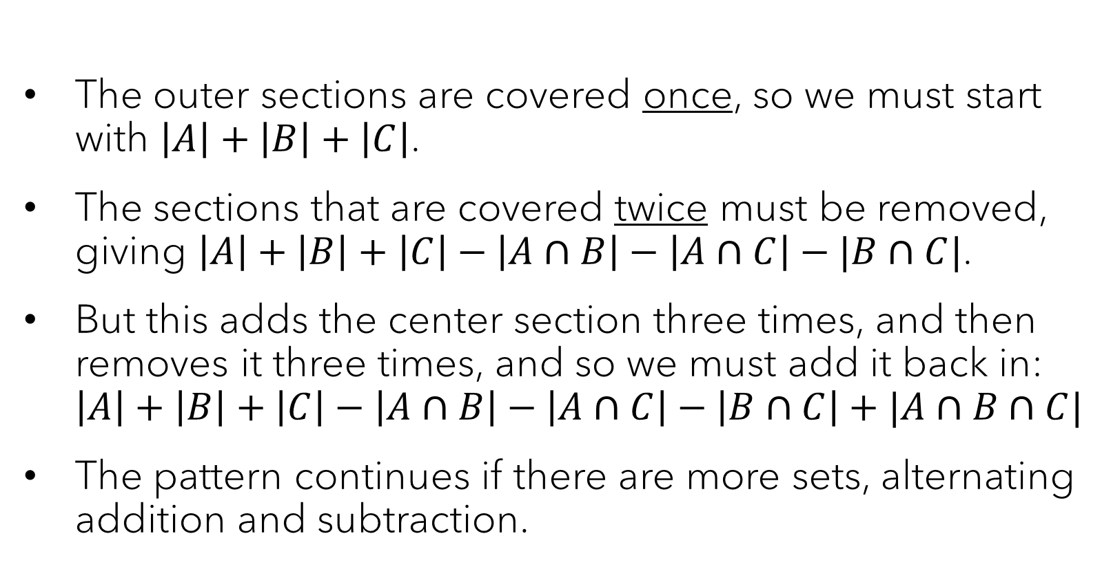
More inclusion-exclusion
1
2
1
3
2
2
1
The outer sections are covered once, so we must start with $\left|A\right|+\left|B\right|+\left|C\right|$.
The sections that are covered twice must be removed, giving $\left|A\right|+\left|B\right|+\left|C\right|−\left|A∩B\right|−\left|A∩C\right|−|B∩C|$.
But this adds the center section three times, and then removes it three times, and so we must add it back in: $\left|A\right|+\left|B\right|+\left|C\right|−\left|A∩B\right|−\left|A∩C\right|−\left|B∩C\right|+|A∩B∩C|$
The pattern continues if there are more sets, alternating addition and subtraction.

Slide 17
Less-quick check in
How many 8-bit strings have four consecutive 0s or four consecutive 1s? (Note: The counting before you get to inclusion-exclusion will take some work.)
Where do the consecutive 0s start?
0000xxxx: 2⁴=16 strings
10000xxx: 2³=8 strings
x10000xx: 2³=8 strings
xx10000x: 2³=8 strings
xxx10000: 2³=8 strings
So there are 48 eight-bit strings with 4+ consecutive zeros.

Slide 18
Less-quick check in
How many 8-bit strings have four consecutive 0s or four consecutive 1s? (Note: The counting before you get to inclusion-exclusion will take some work.)
There are 48 eight-bit strings with 4+ consecutive 0s.
By symmetry, there are 48 eight-bit strings with 4+ consecutive 1s.
How many strings have both?
Just two: 00001111 and 11110000
That makes our final answer 48 + 48 – 2 = 94 strings.

Slide 19
The most obvious theorem in FOCS
The Pigeonhole Principle
If you have more objects than places to put them, then at least one of those places will end up with two or more objects.
That’s it. That’s the whole thing.
It is (almost) a straightforward contraposition of the Bijection Principle.
If you can put two sets into 1:1 correspondence, then they are the same size.
If two sets are not the same size, you cannot put them into 1:1 correspondence.

Slide 20
Some quick Pigeonhole Principle examples
How many people do you need in a room before two of them were born in the same month?
Every graph has a pair of vertices with the same degree.
Any list of one hundred 27-digit positive integers will have two subsets that add up to the same value.

Slide 21
Some quick Pigeonhole Principle examples
How many people do you need in a room to guarantee two of them were born in the same month?
13. Once you have one per month, the next person must duplicate SOMEBODY.

Slide 22
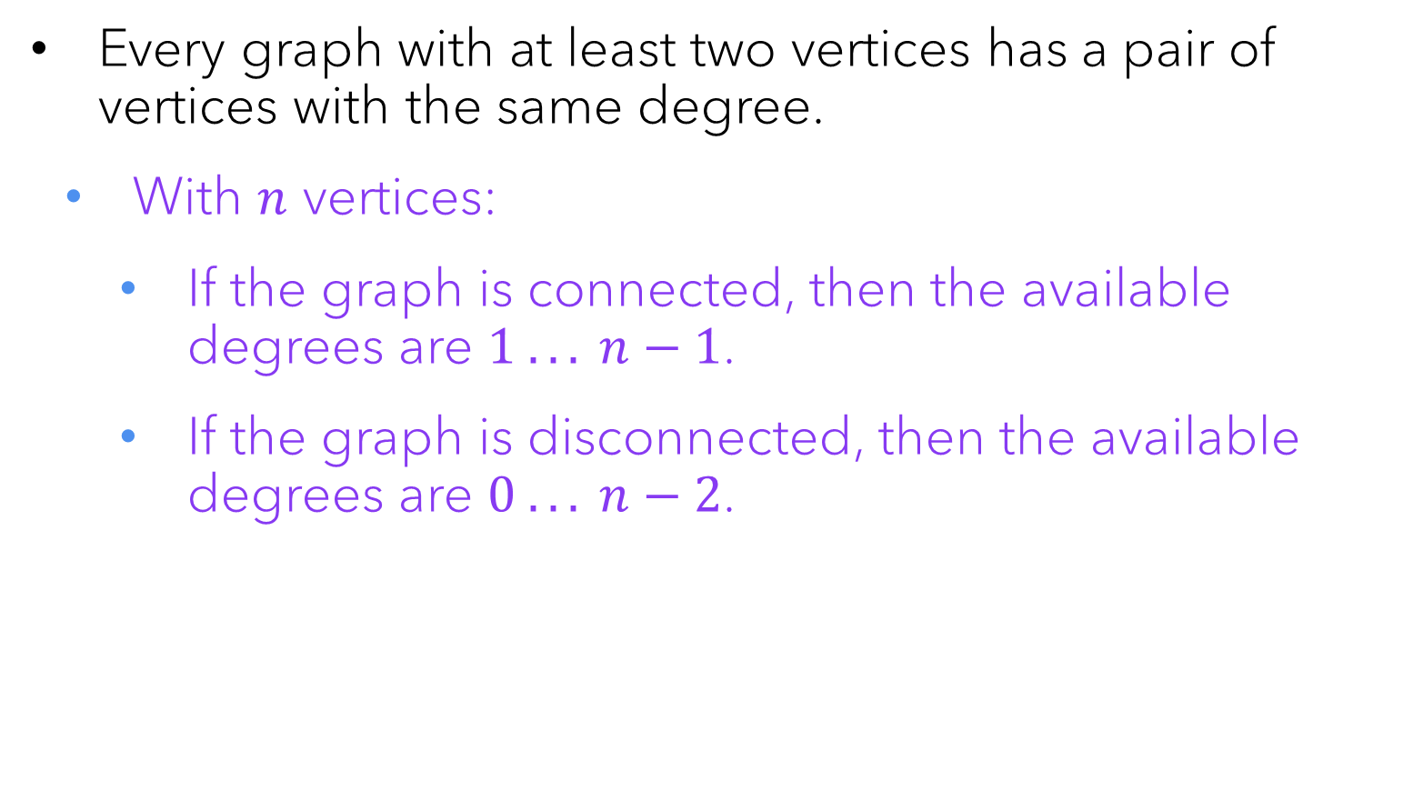
Some quick Pigeonhole Principle examples
Every graph with at least two vertices has a pair of vertices with the same degree.
With $n$ vertices:
If the graph is connected, then the available degrees are $1 .. . n−1$.
If the graph is disconnected, then the available degrees are $0 .. . n−2$.

Slide 23
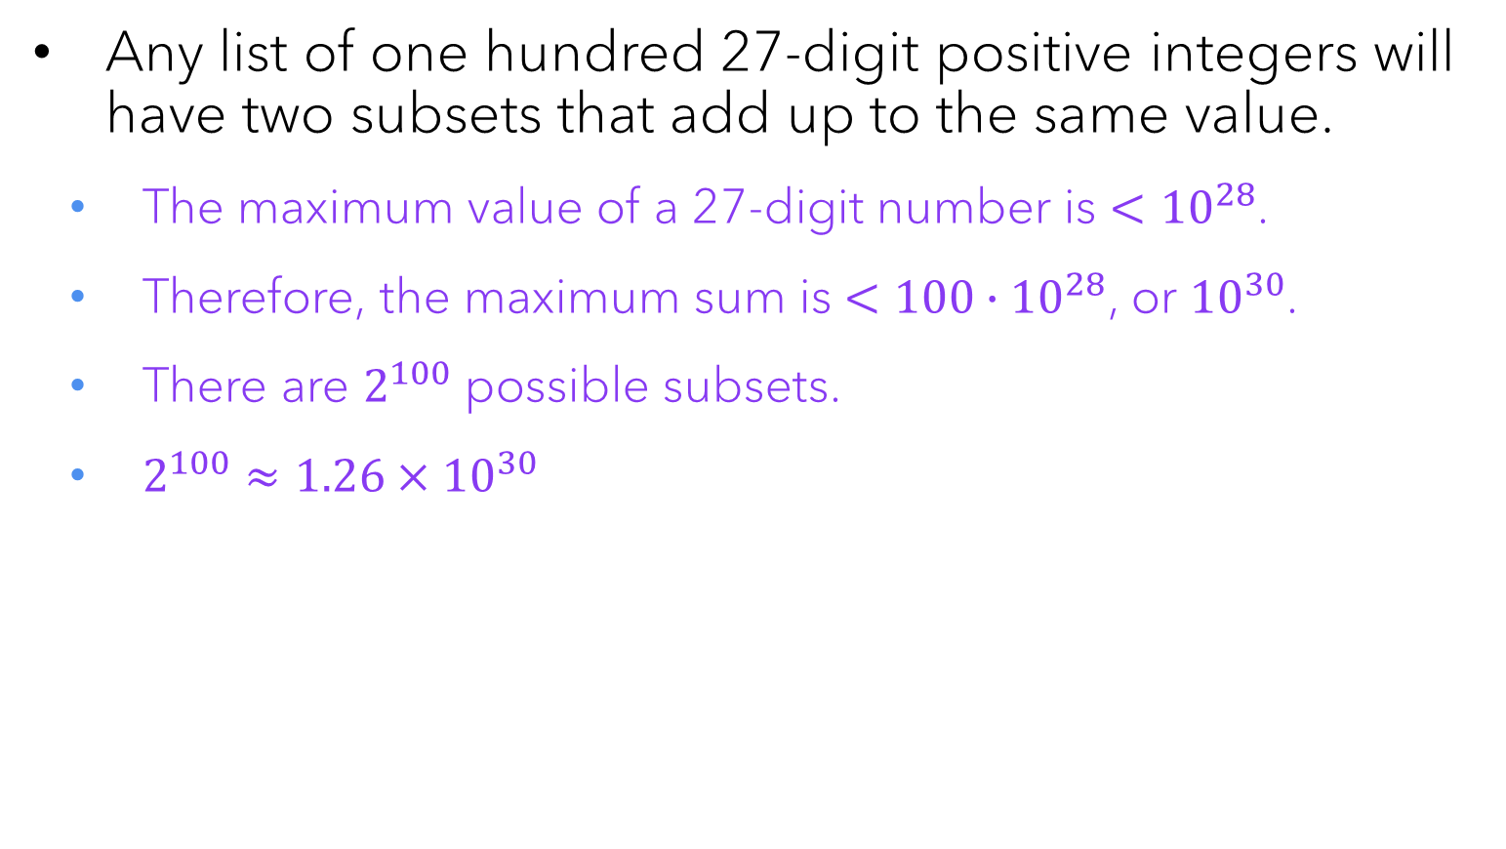
Some quick Pigeonhole Principle examples
Any list of one hundred 27-digit positive integers will have two subsets that add up to the same value.
The maximum value of a 27-digit number is $<{10}^{28}$.
Therefore, the maximum sum is $<100∙{10}^{28}$, or ${10}^{30}$.
There are $2^{100}$ possible subsets.
$2^{100}≈1.26×{10}^{30}$

Slide 24

Questions? REMINDER: Exam 2 on W 2/26 Last names A-K: DCC 318 Last names L-Z: DCC 324 Bring your ID card!

