Slide 1
Operating Systems
{week 01}
Rensselaer Polytechnic Institute
CSCI-4210 – Operating Systems
CSCI-6140 – Computer Operating Systems
David Goldschmidt, Ph.D.

Slide 2
What is an operating system?
What is an Operating System?
  The software interface between
  hardware and its users
Operating systems:
  Execute user and system programs
  Manage and coordinate computer hardware
  Serve as resource allocators
  Provide system security for programs and data

Slide 3
User views of an operating system
System calls (for programmers)
System programs (for general users)
Commands (for superusers)
Filesystem (for all users)
  Includes devices, network connections, etc.

Slide 4
Operating system design goals
From a user’s perspective:
  easy to use
  easy to learn
  reliable
  safe
  fast
  etc.
System goals:
  reliability
  flexibility
  extensibility
  speed(y)
  efficiency
  maintainability
  etc.

Slide 5
Operating system services (i)
An operating system provides services:
  Program execution
    Load programs into memory, run/suspend/halt programs, handle/display errors
  I/O operations
    Seamlessly interact with I/O devices, including
    disks, networks connection, etc.
  Filesystem manipulation
    Read/write/traverse filesystem directories,
    read/write files, enforce permissions, search for files

Slide 6
Operating system services (ii)
Other operating system services:
  Inter-Process Communications (IPC)
    Processes exchange information via shared memory,
    message passing, sockets, pipes, files, etc.
    Often spans multiple computers and networks
  Error detection and recovery
    Detect errors in CPU, memory, I/O devices,
    processes, network connections, etc.
    Recover from errors gracefully,
    ensuring correct and consistent operations

Slide 7
Operating system services (iii)
Other operating system services:
  Resource allocation
    Process scheduling, memory management
  Account and resource protection
    Users, groups, account verification, memory protection, synchronization, etc.
  Usage monitoring
    Processes, users, networks
    Log files

Slide 8
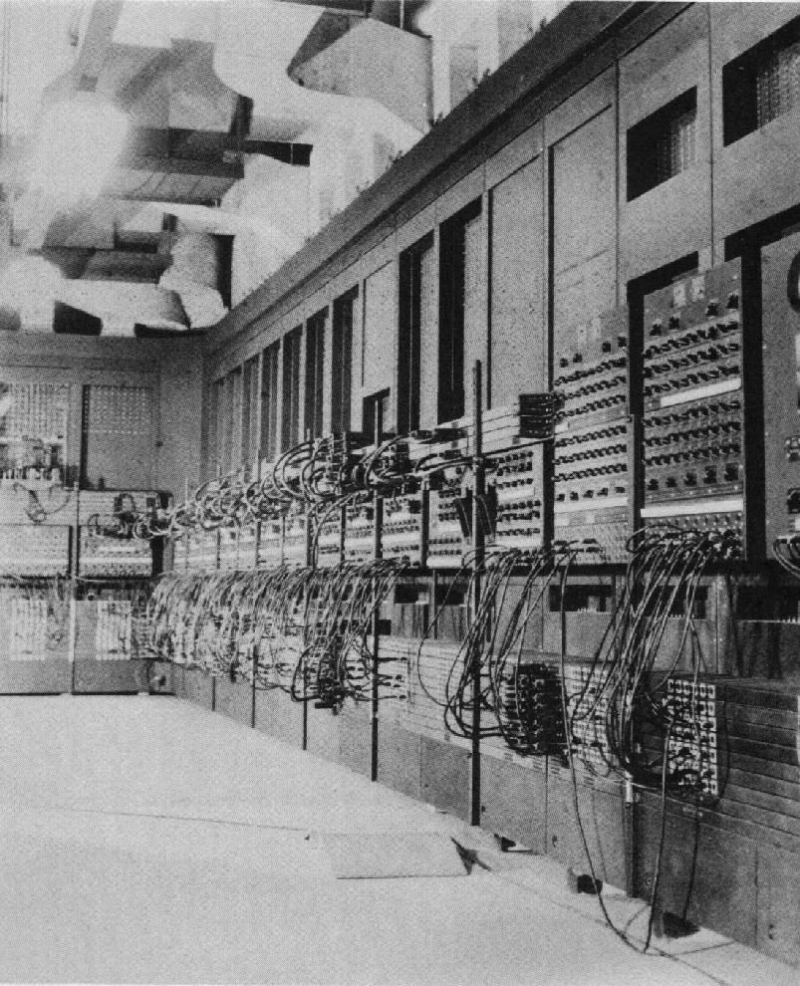
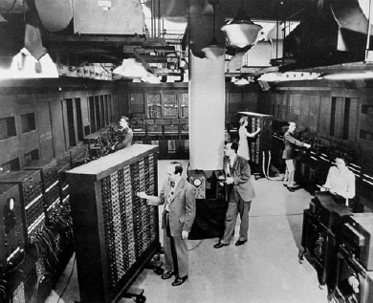
History of operating systems (i)
In the beginning...
...the 1940s

Slide 9

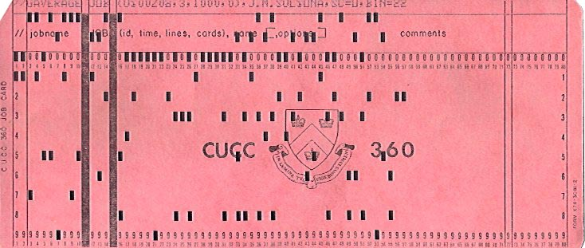
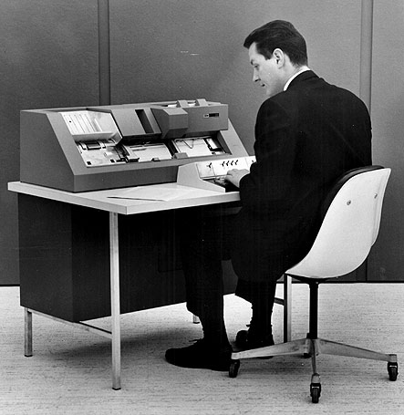
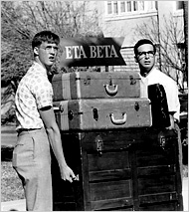
History of operating systems (ii)
Automation in the 1950s with punch cards

Slide 10
Batch jobs
A job is a unit of work submitted by a user
to the operating system
Jobs typically consist of:
  a program either in a
  source language or in
  “executable” binary form
  input data used by the program when it executes
Purpose is to produce output

Slide 11
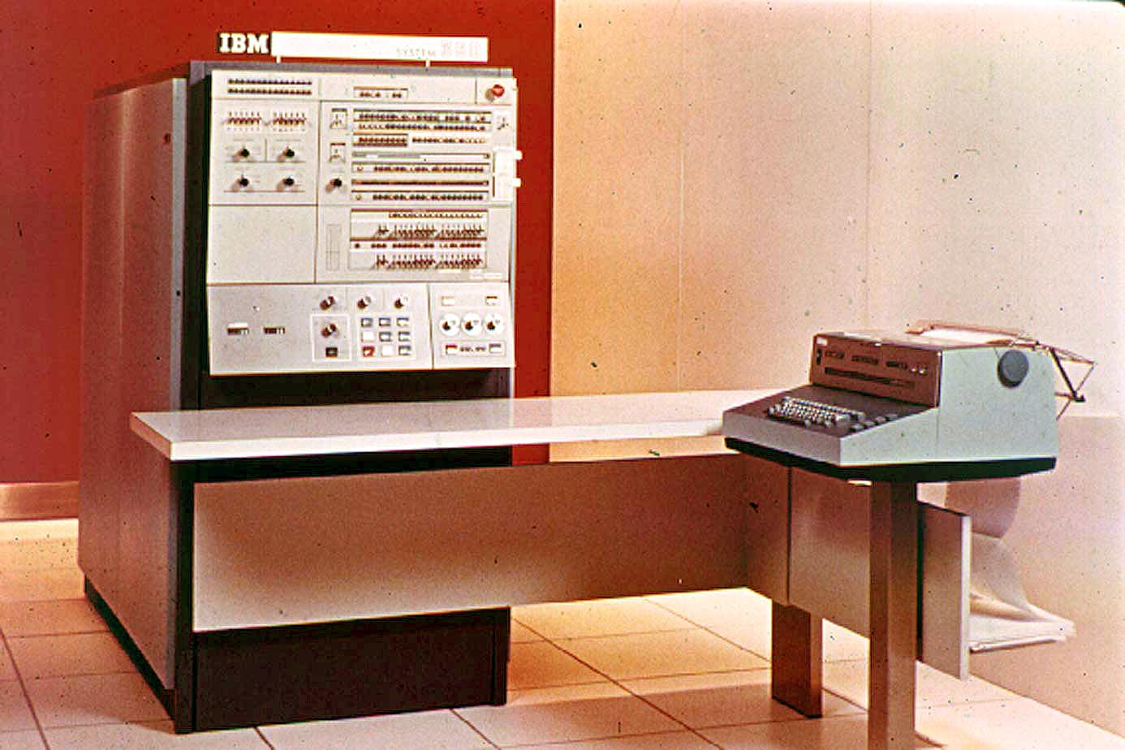
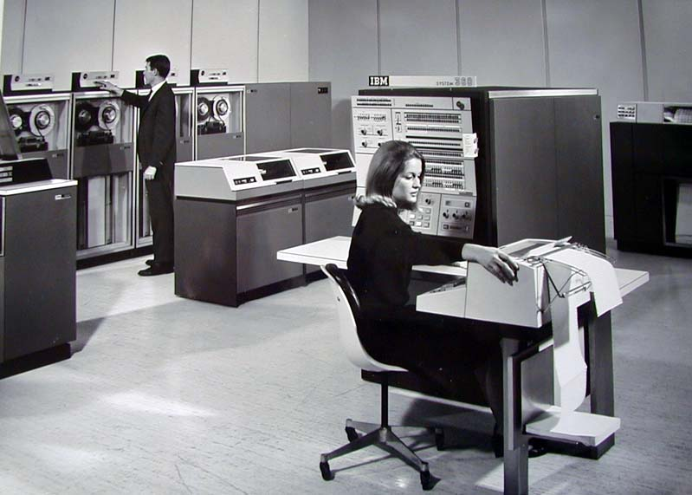
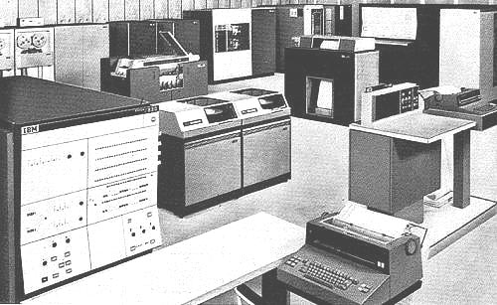
History of operating systems (iii)
IBM 360 introduced
(in 1964)
a computing revolution!
what’s so revolutionary?

Slide 12
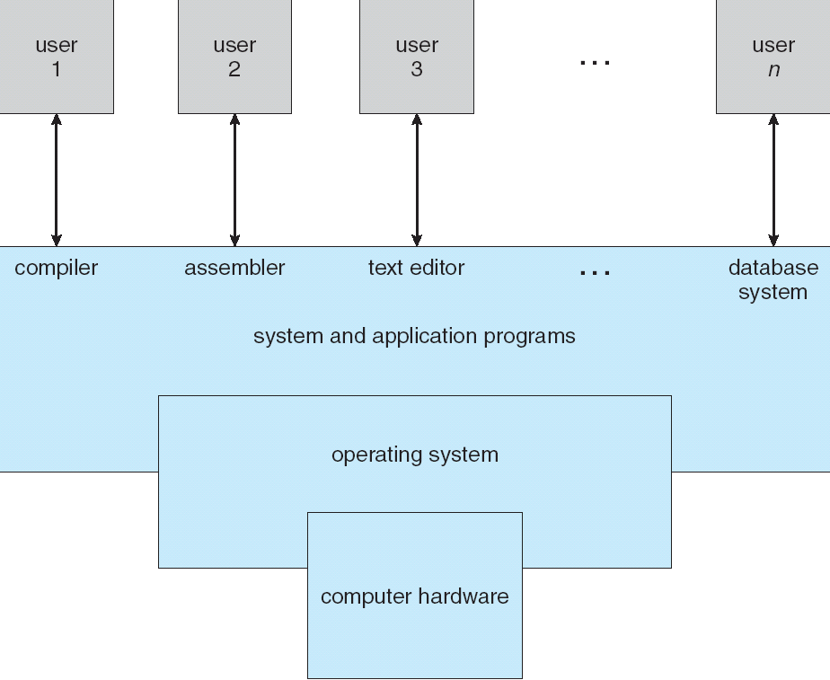
Multiprogramming (i)

Slide 13
Multiprogramming (ii)
In multiprogramming,
several processes reside
in memory at the same
time
  CPU is shared and
  managed by the
  operating system
  Addresses the problem of the CPU
  being underutilized (use context switching)

Slide 14
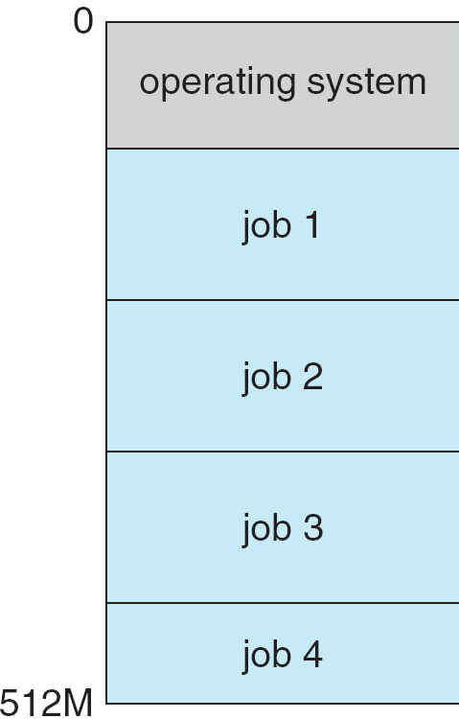
Multiprogramming (iii)
Computer is often idle – why?
  CPU and hardware significantly
  faster than I/O
  When a user or process is
  blocked waiting for I/O, the
  operating system switches
  to another process
  A subset of processes is stored
  in memory, awaiting CPU or I/O

Slide 15
Multiprogramming (iv)
Multiprogramming provides efficient use of the computer (CPU) and its resources (I/O)
  One user cannot keep the CPU and I/O devices busy at all times
  Multiprogramming attempts to organize processes so that the CPU is as busy as possible
By overlapping I/O with computation,
we need interrupts and interrupt handlers

Slide 16
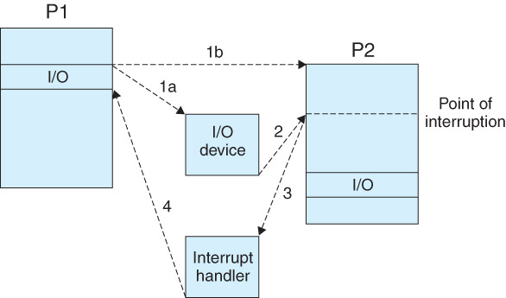
Interrupt mechanism
Interrupts are handled much like calling
a function in a programming language
I/O is typically buffered

Slide 17
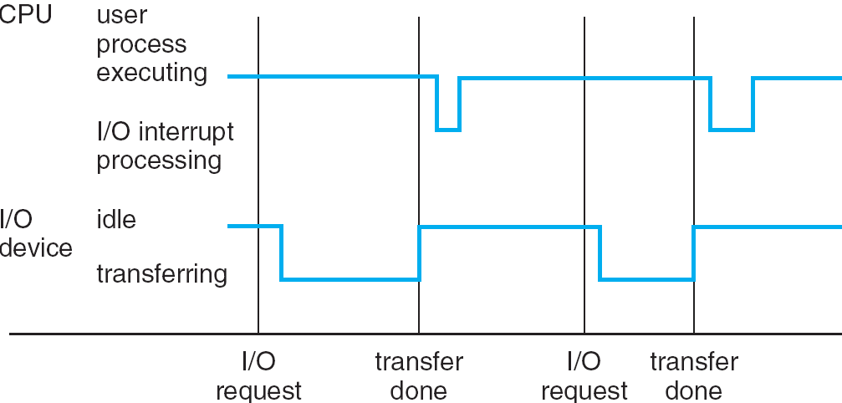
Typical interrupt timeline
interrupt
processing
times vary...
...and so do
I/O transfer times

Slide 18
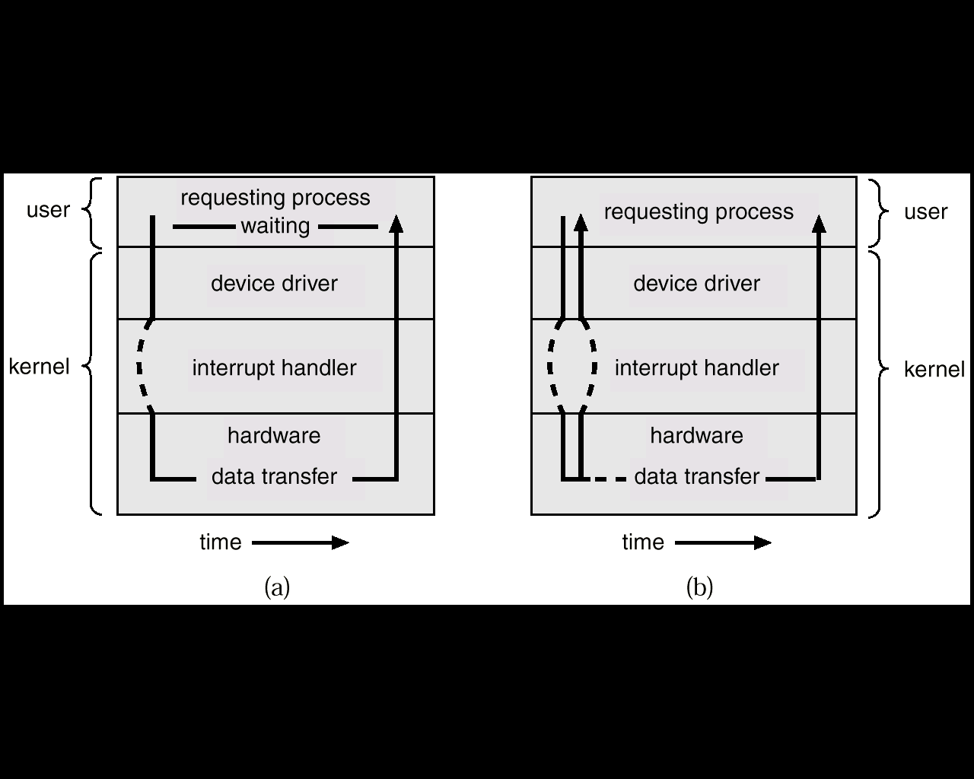
Synchronous and Asynchronous I/O
Synchronous Asynchronous

Slide 19
Timesharing
To ensure fairness, use timesharing in which the CPU cycles through all processes
  Each process is given a fixed amount of CPU time (a CPU burst)
  Switching from one running process to another
  is called a context switch
  A process relinquishes its time
  when requesting I/O

Slide 20
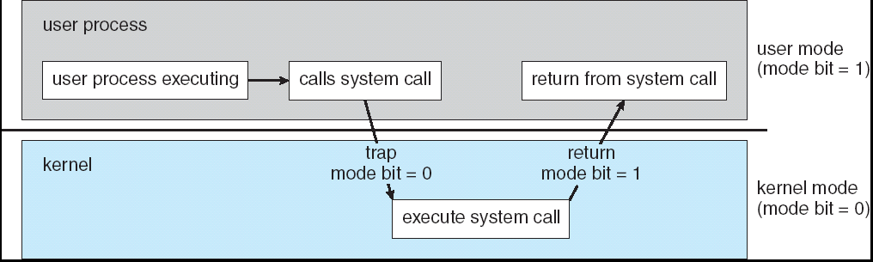
User and kernel modes
Program instructions run either
in user mode or in kernel mode
  Kernel mode allows the operating system
  to protect itself and its system components
switch modes
via system calls

Slide 21
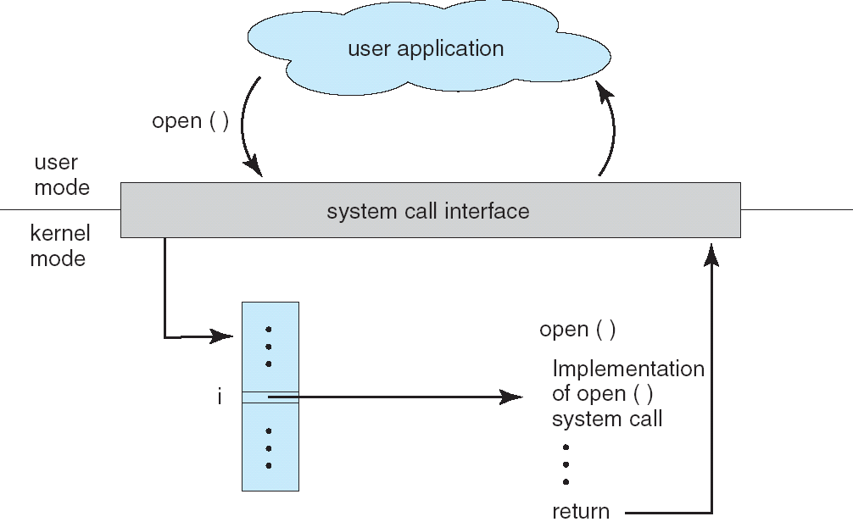
System calls via APIs

Slide 22
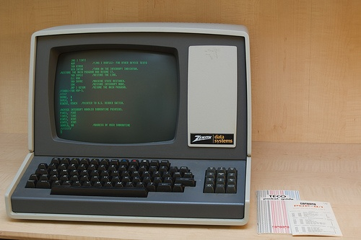
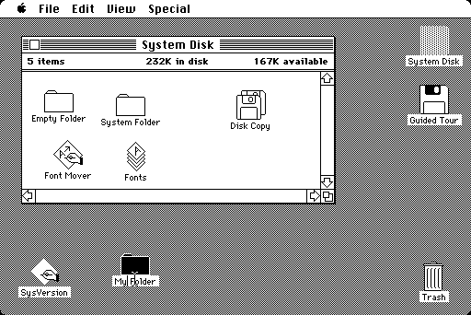
History of operating systems (iv)
Text CRTs (1970s) to an early Mac (1984)

Slide 23
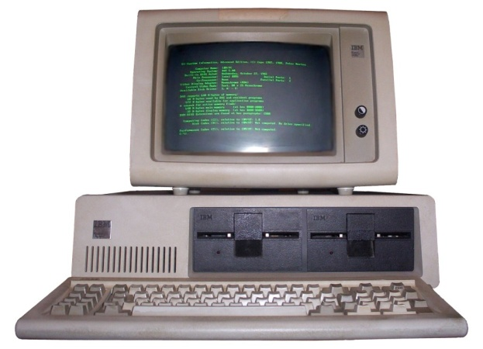
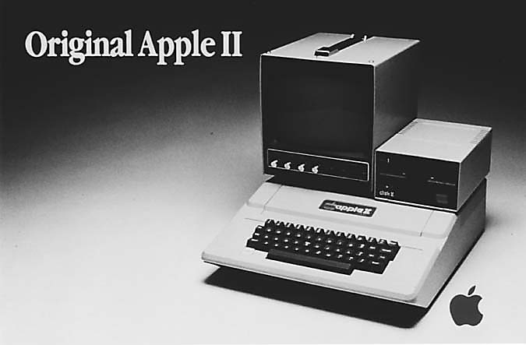
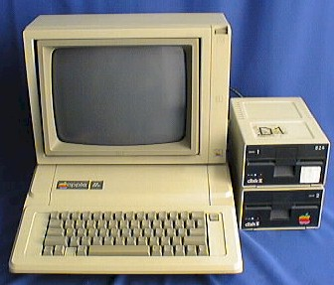
History of operating systems (v)
Personal computer revolution (1970s/80s)

Slide 24
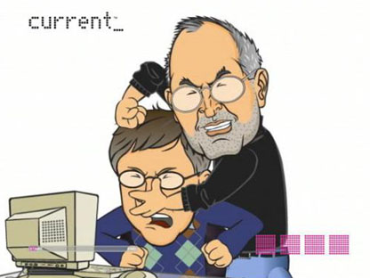
History of operating systems (vi)
The battle begins...

Slide 25
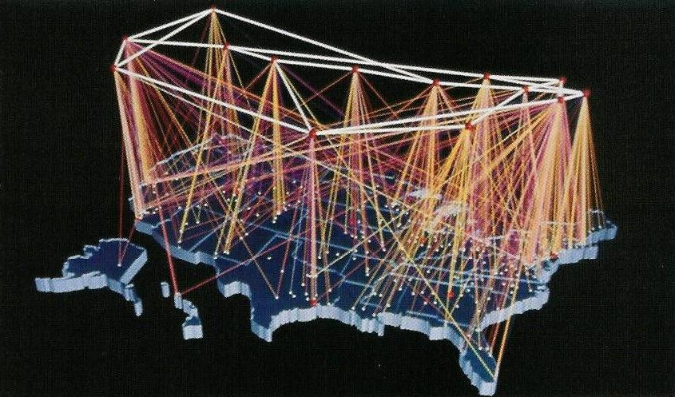
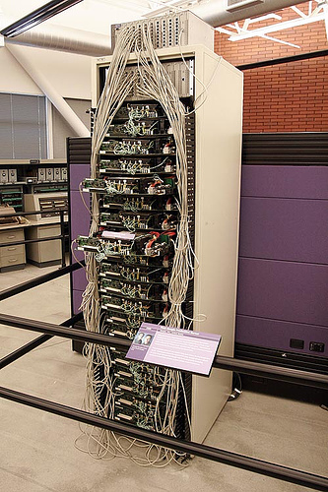
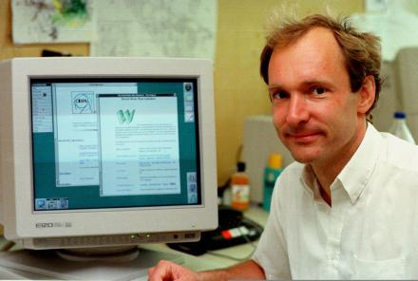
History of operating systems (vii)
World Wide Web and Internet revolution
(1990s/2000s)
  Sir Tim Berners-Lee

Slide 26
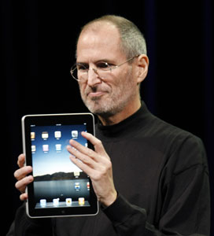
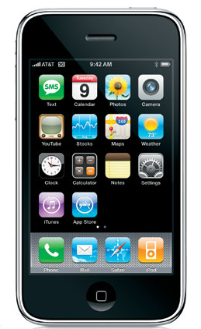
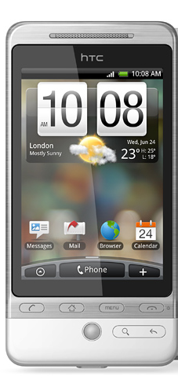

History of operating systems (viii)
Mobile revolution (2010s)

Slide 27
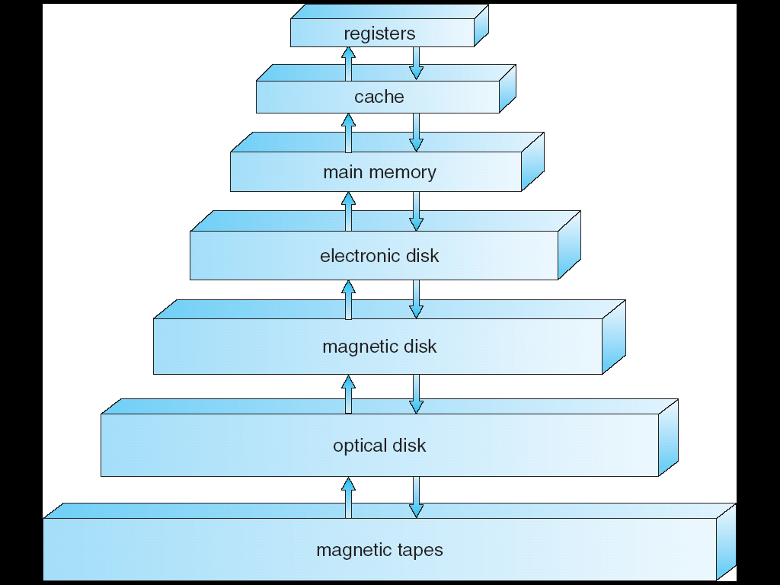
Hierarchical storage architecture
very fast
very small
volatile
non-volatile
very slow
very large

Slide 28
Caching (i)
Caching is a technique in
which data is temporarily
stored in a smaller and
faster memory component
  Why implement caching in an operating system?

Slide 29
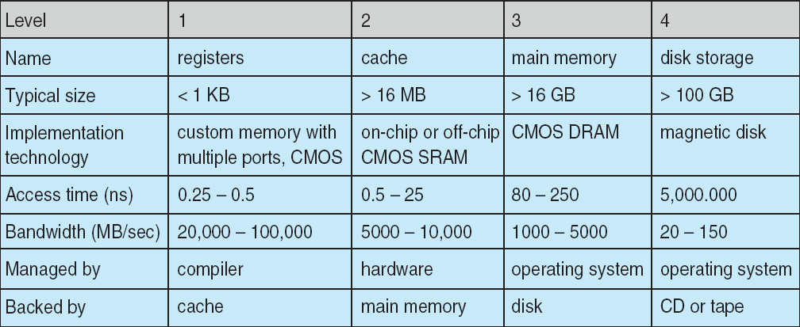
Caching (ii)
A key goal in operating system design is
achieving fast and efficient performance

Slide 30
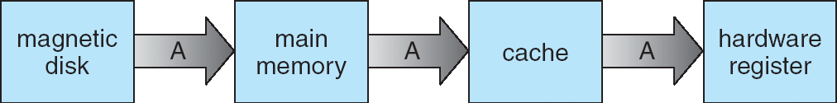
Caching (iii)
What’s the caching algorithm?
  When the operating system attempts to read from memory, check to see if the requested data is already in the cache
  If it is, data is read from the cache (fast!)
  If not, data is copied from memory to the cache
  (maybe next time...)

Slide 31
Principle of locality
When a running program reads from memory location X, the principle of locality predicts that the next memory location requested will be near X
Store pages of data in a cache, where each page is typically the same size (e.g. 16MB)
memory location X

Slide 32
Programming exercise
Implement a program to simulate caching:
  Write a function called calculateAnswer() that takes integer n as input and calculates (and returns)
  the sum (1 + 2 + … + n)
    Pretend this method is computationally costly!
  Initially, the cache (holds only 11 elements) is empty
    Ask the user to input a number in range 1..100
    If the answer is not in the cache, call calculateAnswer() and display the resulting sum; store the result in the cache
    If the answer is in the cache, simply display the answer

