Slide 1
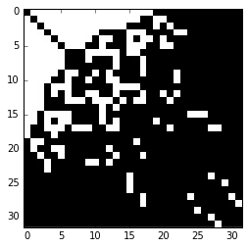
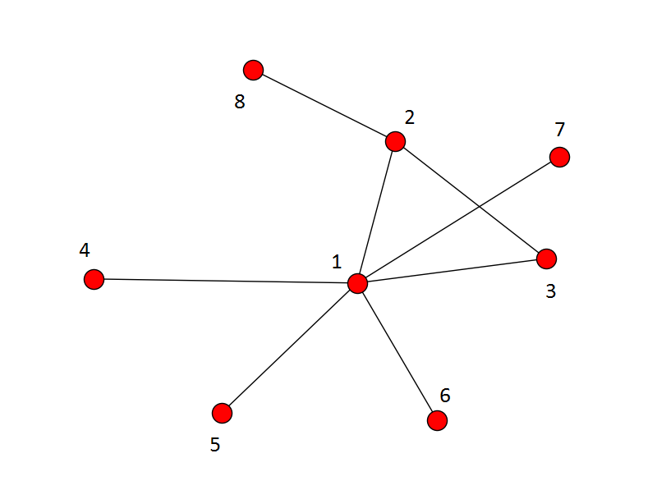
Network Classification Using Adjacency Matrix Embeddings and Deep Learning
Ke (Kevin) Wu^{1,2}, Philip Watters¹, Malik Magdon-Ismail¹
¹Department of Computer Science
Rensselaer Polytechnic Institute
Troy, New York 12180
²Quantcast Corporation
201 3rd Street, #2
San Francisco, California, 94103
kevinwu.work@yahoo.com
magdon@gmail.com

Slide 2
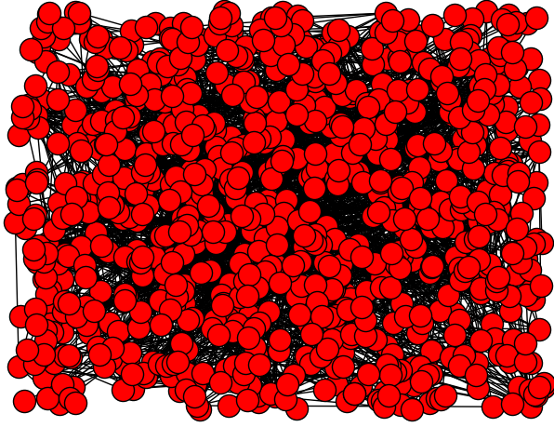
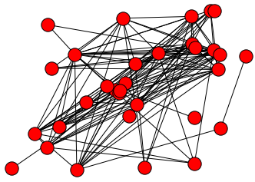
A Natural Problem—Graph Classification
Given a small piece of a large parent network, is it possible to identify the parent network?
To what scale are different types of networks distinguishable? (or “Are all social networks structurally similar?” Hashmi et al. ASONAM 2012)
What is the optimal method and features to do the classification?

Slide 3
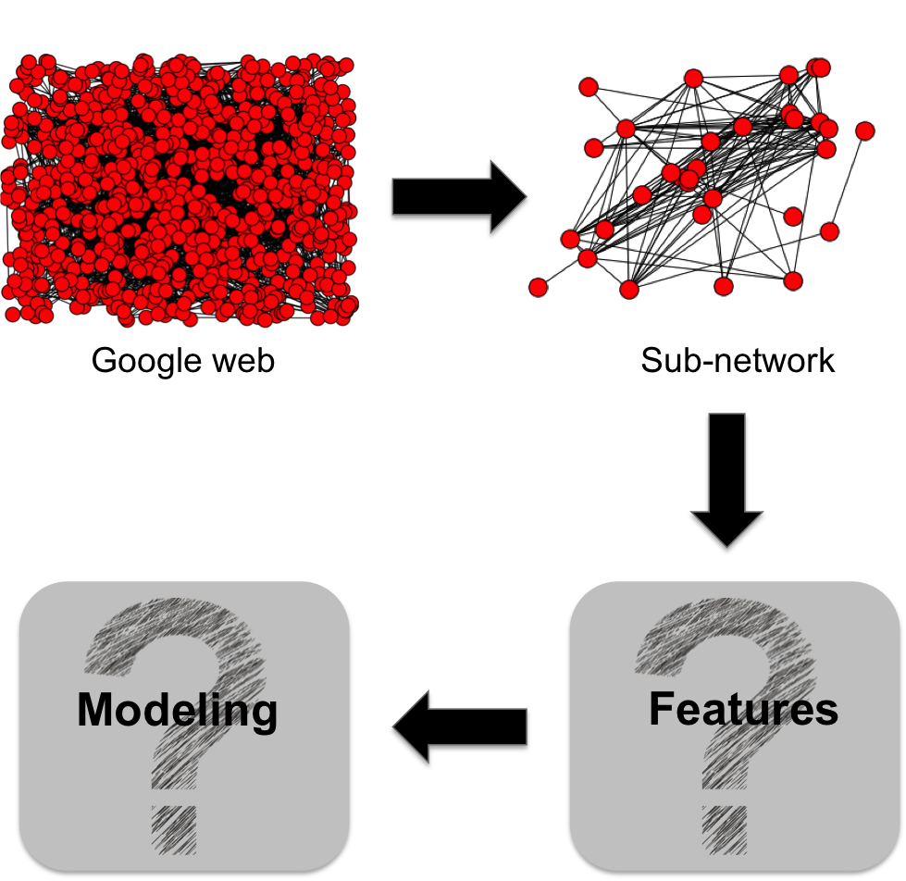
Problem Formulation

Slide 4
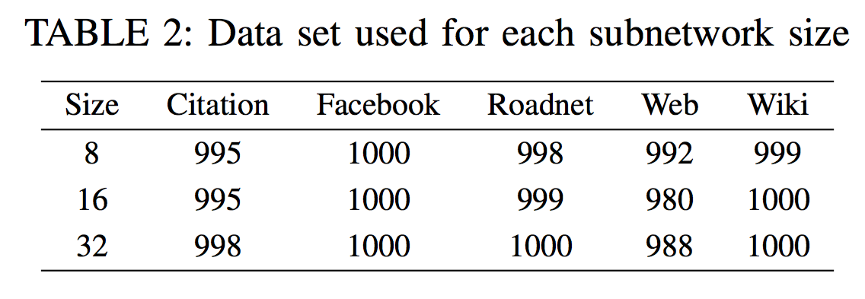
Data
Obtained five real world network graphs from the Stanford Network Analysis Project (SNAP)
The five graph domains we focused on were Social Networks (Facebook), Citation Networks (HEP-PH), Web graphs, Road networks (PA roadNet), and Wikipedia networks (wikipedia)
Sub-network size, obtained by random walk sampling

Slide 5
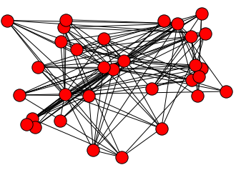
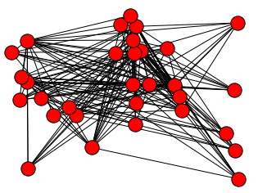
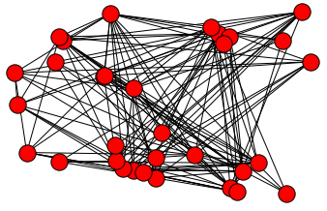
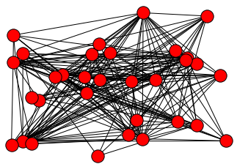
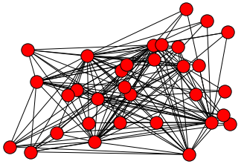
Examples (32 nodes)
Citation
Facebook
Web
Wikipedia
Road Net

Slide 6
Graph Kernel vs Topological Features
Graph kernels are widely used in graph classification, computation time for popular kernel function is from O(d^3) to O(d^6), d is the number of nodes(vertices).
O(n^2) for training using kernel method.
Feature-based method may have better scalability
But topological features requires extra effort to design

Slide 7
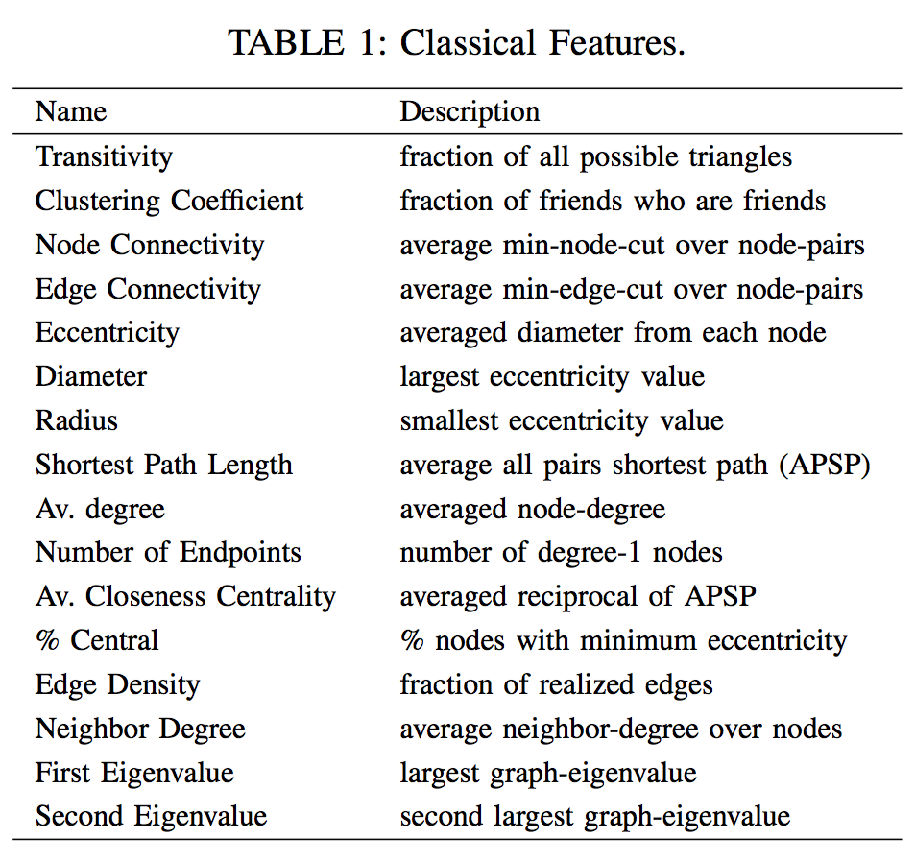
Classic Topological Features

Slide 8
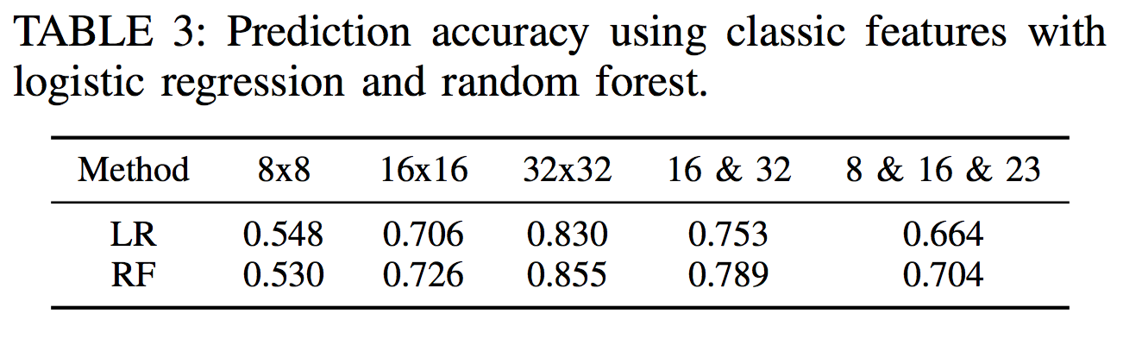
Classic Topological Features
Logistic regression (LR) and random forest (RF) on each data set using classic features
For both methods, we used a fixed set of hyperparameters (For LR, the regularization constant was 1.0 and for RF, 500 trees were used after a convergence test on the number of trees)

Slide 9
“Naïve Feature”—Adjacency Matrix
Adjacency matrix contains all the information related to the network
Contrary to topological features, which provides the “lossy” description of the object (network), adjacency matrix provides a complex but “lossless” description.
It looks just like a picture.
But, there are d! different adjacency matrices for a network.
And networks may have different sizes

Slide 10
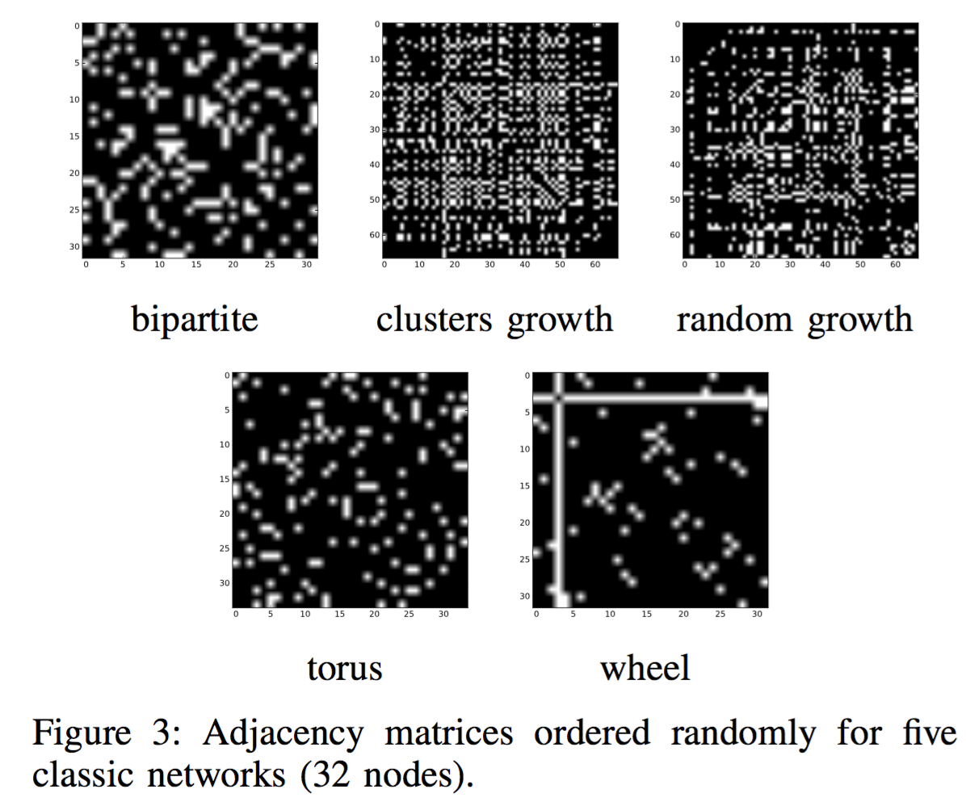
Adjacency matrices

Slide 11
BFS-based Ordering Scheme
To form “better patterns” in an adjacency matrix
Starts with the node with the highest degree, tie broken by the node with the largest k-neighborhood
Once this node is decided, the next node in the ordering is the node with the shortest path to the first already ordered node, tie broken by the shortest path to the second already ordered node, and so on.

Slide 12
Properties of the Ordering Algorithm
Nodes with the same parent must be adjacent in the adjacent matrix.
Parent P and its first child C are separated in the adjacency matrix by a bounded range of [D_{PP} , D_{PP} + D_{P_cousin}], ordered by D_{P} , where D_{P} , D_{PP} and D_{P} cousin are the degrees of P , P ’s parent and P ’s cousins.

Slide 13
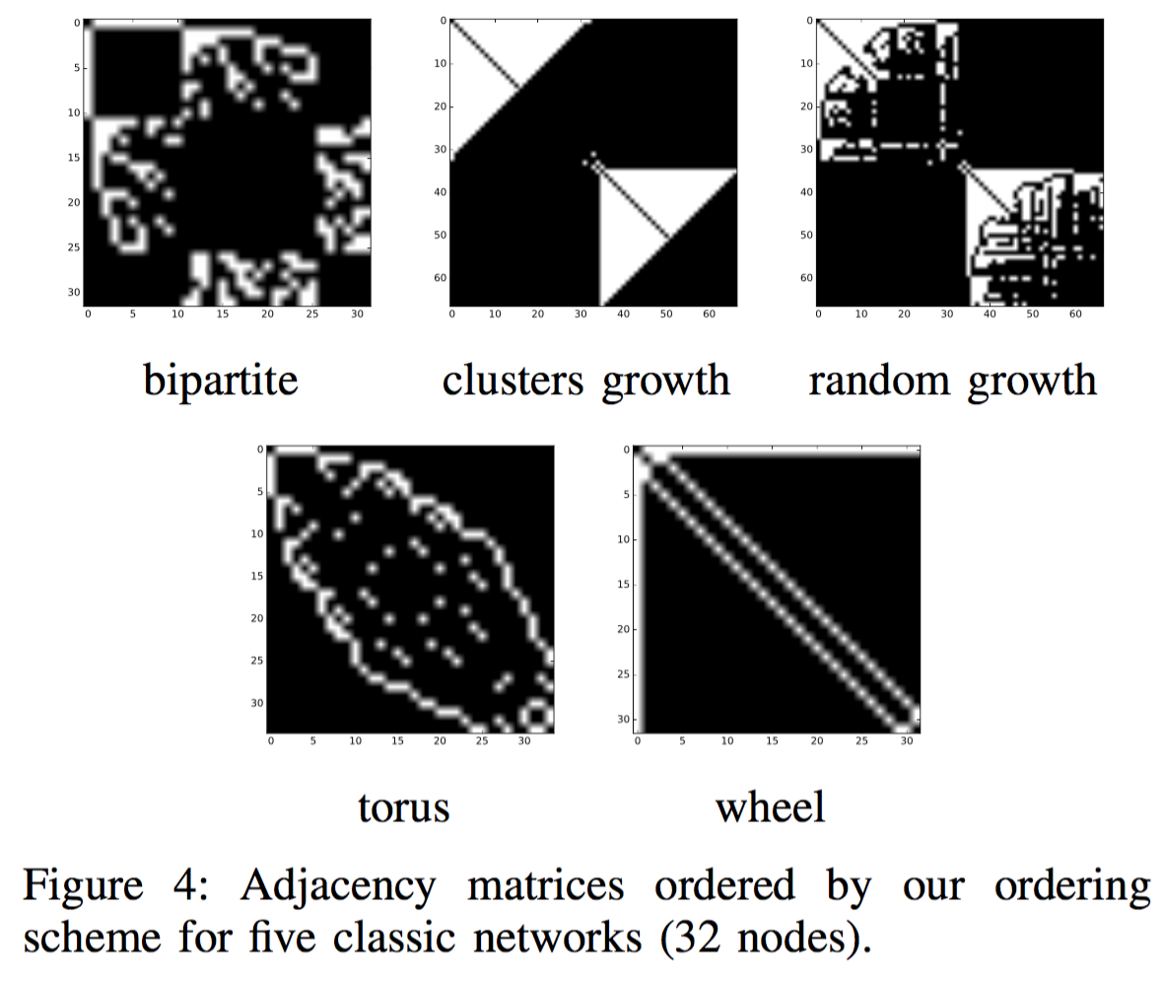
Ordered Adjacency Matrices

Slide 14
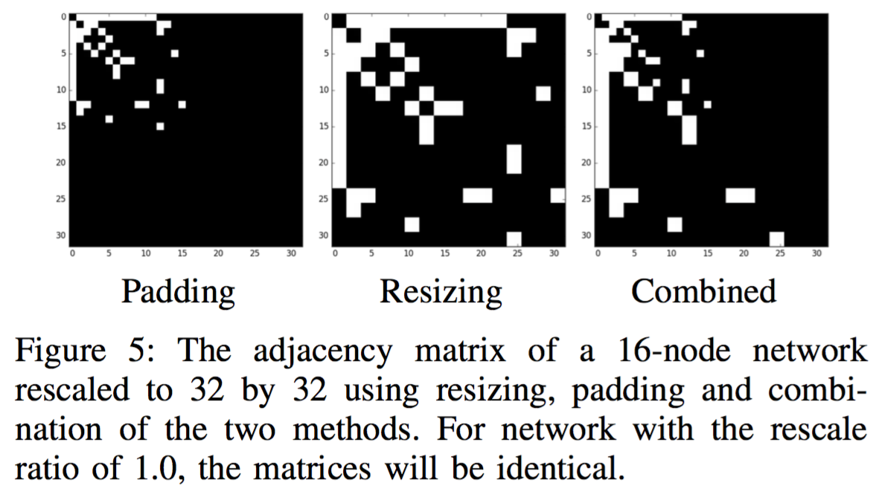
Variable Sized Networks
Topological features are to some extent scale insensitive, but there are no machine learning method so far can deal with different input dimension well.

Slide 15
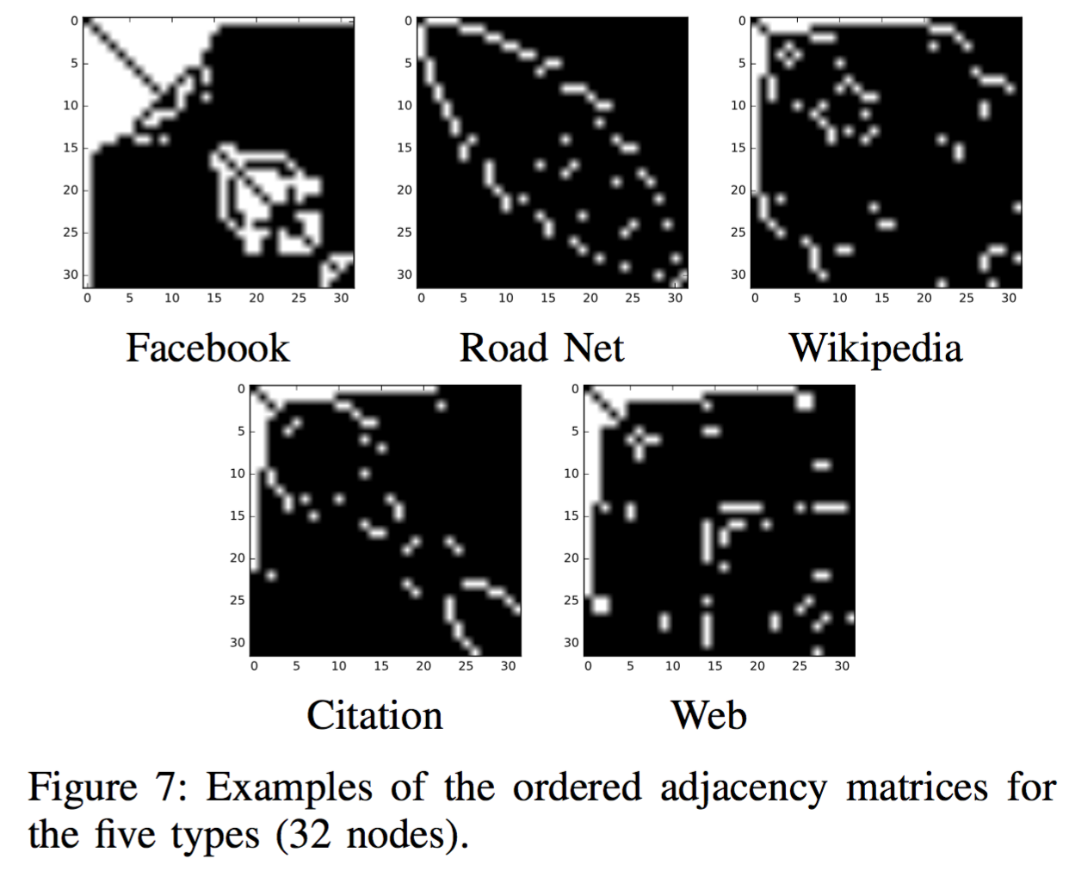
Real World Networks

Slide 16
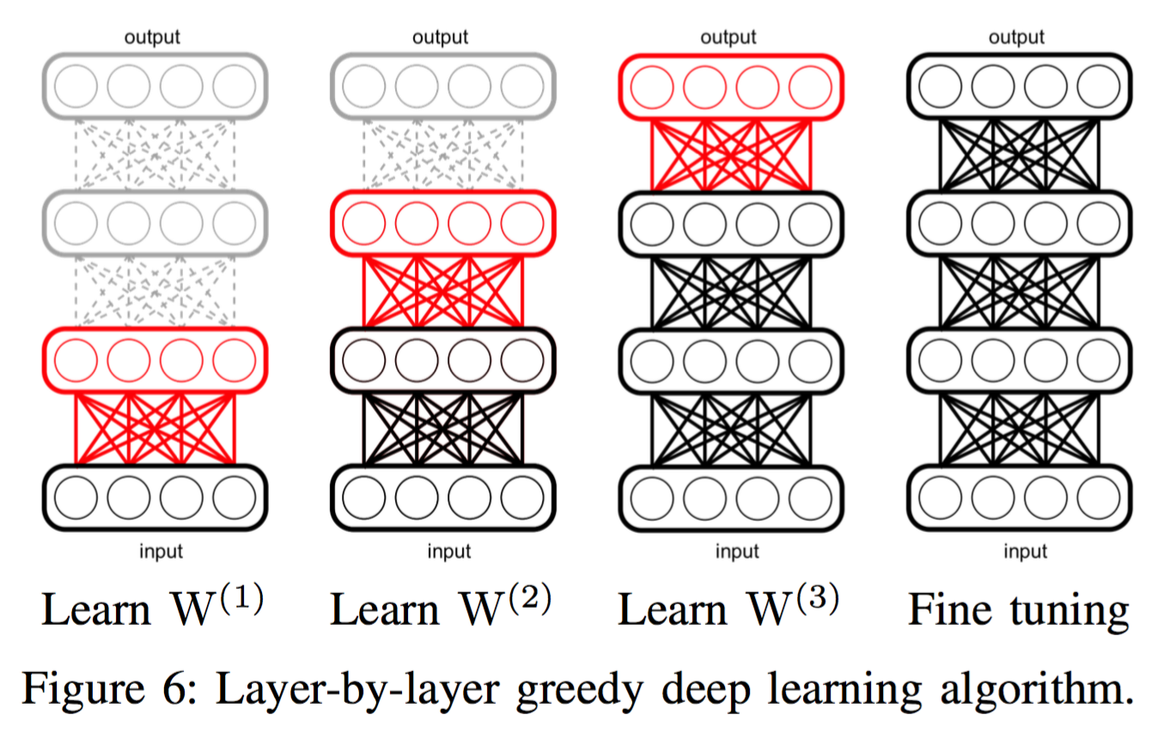
Deep Learning
Stacked Denoising Autoencoder
Use the corrupted input to reconstruct the original one
Pretraining to provide better initial weights and fine-tuning for specialization

Slide 17
Autoencoder
Developed by Bengio(2007) and Vincent(2008). Successfully used for pre-train deep learning and hierarchical feature learning
Neural Network
Autoencoder

Slide 18
Denoising Autoencoder
Developed in 2008 by Vincent et al. Successfully used for deep learning and hierarchical feature learning
Neural Network
Denoising autoencoder

Slide 19
Result
With no corruption rate, the performance of deep learning with adjacency matrix is the highest
Deep learning performs better than classical methods when (1) networks are small (2) different sizes of networks are combined.
Method | Feature | 8x8 | 16x16 | 32x32 | 16&32 (padding) | 16&32 (resizing) | 16&32 (Combined)
DL(0.0) | Adjmat | 0.557 | 0.735 | 0.820 | 0.804 | 0.804 | 0.796
DL(0.2) | Adjmat | 0.527 | 0.728 | 0.800 | 0.793 | 0.799 | 0.801
DL(0.5) | Adjmat | 0.540 | 0.718 | 0.823 | 0.799 | 0.789 | 0.802
LR | Adjmat | 0.542 | 0.705 | 0.780 | 0.771 | 0.768 | 0.798
RF | Adjmat | 0.518 | 0.698 | 0.789 | 0.765 | 0.771 | 0.758
LR | Classic | 0.548 | 0.706 | 0.830 | 0.753
RF | Classic | 0.530 | 0.726 | 0.855 | 0.789

Slide 20
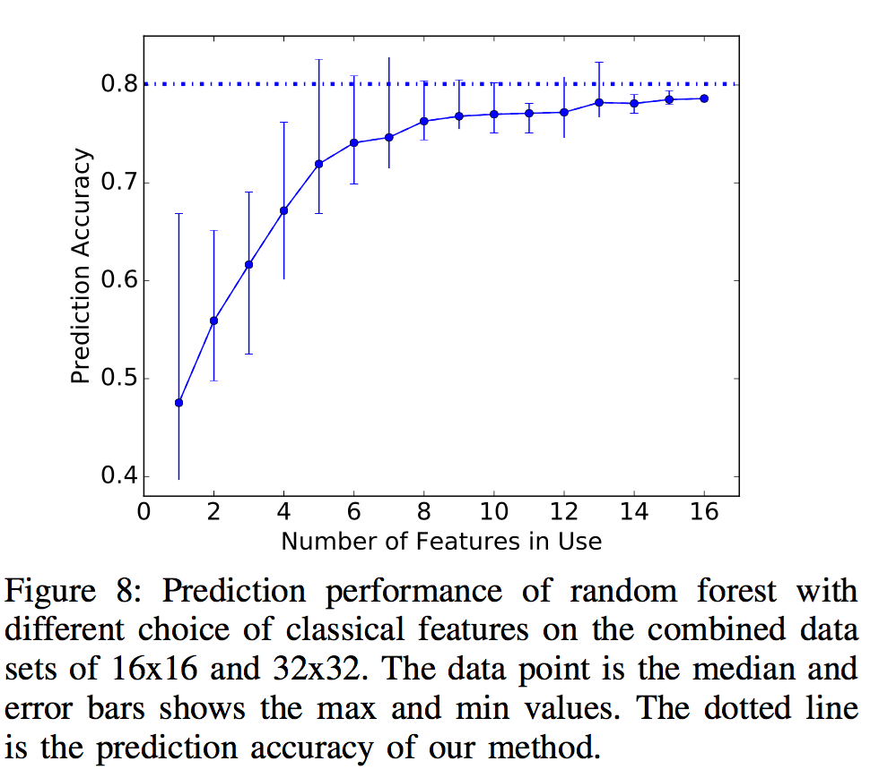
Performance Plateau
Designing topological descriptors requires extra effort, and it is an “endless” process.
New features are needed, but what are they?

Slide 21
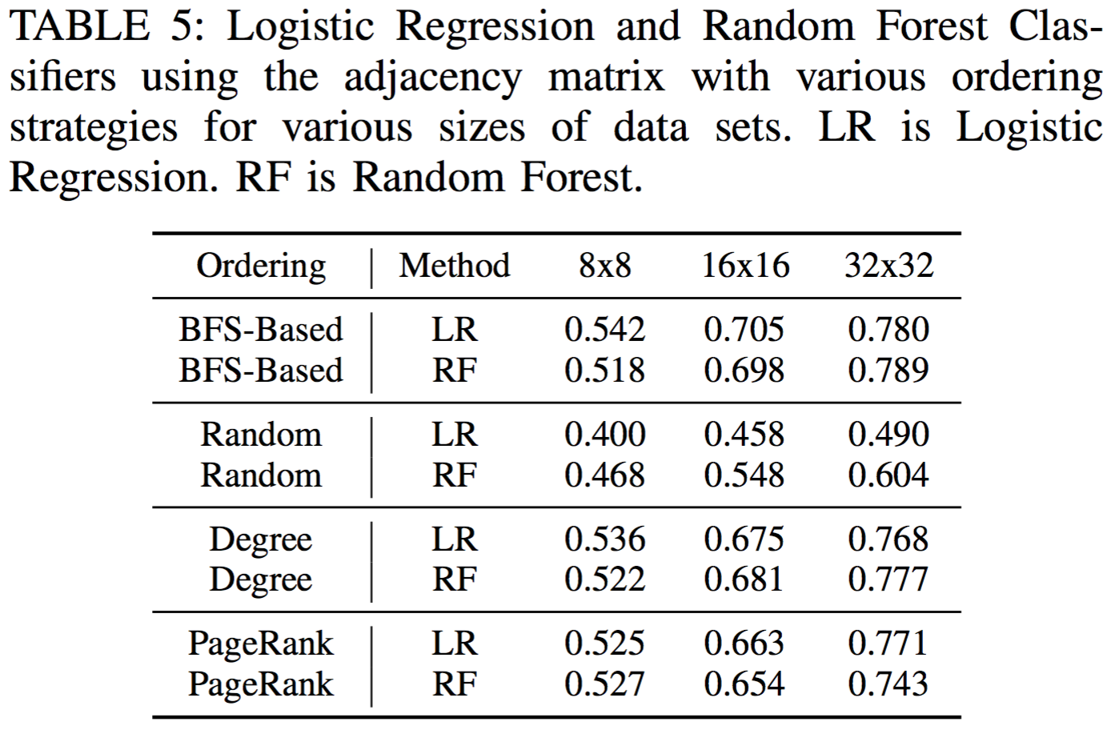
Is this ordering better than others?

Slide 22
Conclusion
We proposed a novel image embedding of adjacency matrices which can accommodate different sized graphs through padding or resizing (or a combination)
Our results indicate that the classical feature approach, rich with domain expertise and the plug and play approach which uses our image embedding of the topology together with deep learning can perform comparably
This is extremely promising for the application of our image embedding to network domains where domain expert features may not be available.

Slide 23
Future Directions
Better ordering?
Theoretic support on what kind(s) of ordering algorithm is/are better.
Other applications (drug discovery/cheminformatics)
Advanced deep learning algorithm
A better denoising mechanism
Corrupt the edge or corrupt the node?
…

Slide 24
8x8 RF, classic feature
C: citation
F: facebook
R: roadnet
W: web
P: wikipedia
Predicted
 | C | F | R | W | P
C | 34 | 11 | 21 | 11 | 23
F | 11 | 62 | 2 | 19 | 6
R | 9 | 1 | 87 | 0 | 3
W | 16 | 17 | 4 | 53 | 9
P | 25 | 10 | 9 | 21 | 35
True

Slide 25
32x32 LR, classic feature
C: citation
F: facebook
R: roadnet
W: web
P: wikipedia
Predicted
 | C | F | R | W | P
C | 72 | 2 | 2 | 1 | 23
F | 2 | 95 | 0 | 3 | 0
R | 0 | 0 | 100 | 0 | 0
W | 11 | 12 | 0 | 69 | 7
P | 13 | 0 | 0 | 4 | 83
True

Slide 26
Thank you

Slide 27
8x8 LR, classic feature
C: citation
F: facebook
R: roadnet
W: web
P: wikipedia
A total of 1044 distinguishable graphs with 8 unlabeled nodes
http://oeis.org/A000088
Predicted
 | C | F | R | W | P
C | 40 | 10 | 24 | 10 | 16
F | 7 | 68 | 4 | 16 | 5
R | 9 | 1 | 89 | 0 | 1
W | 13 | 30 | 4 | 38 | 14
P | 23 | 6 | 14 | 16 | 41
True

Slide 28
32x32 RF, classic feature
C: citation
F: facebook
R: roadnet
W: web
P: wikipedia
Predicted
 | C | F | R | W | P
C | 68 | 3 | 2 | 5 | 22
F | 1 | 96 | 0 | 3 | 0
R | 0 | 0 | 100 | 0 | 0
W | 8 | 4 | 0 | 82 | 5
P | 11 | 1 | 0 | 3 | 85
True

Slide 29
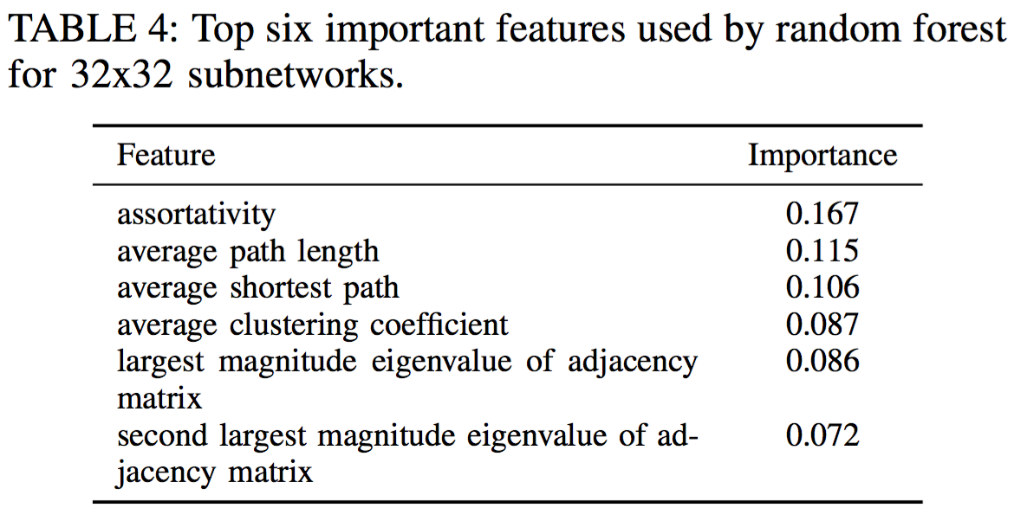
Important Features
Even though each feature is designed with a mathematic definition, for problem with this level of complexity, it is still quite hard to interpret the result.

Slide 30
Adjacency Matrices for Real-World Networks

