Slide 1
Programming Languages CSCI 4430 Fall 2022
www.cs.rpi.edu/~milanova/csci4430/
Instructor: Ana Milanova
Office: Lally 314. Email: milanova@cs.rpi.edu, Webex: https://rensselaer.webex.com/meet/milana2
Course coordinator: Shianne Hulbert
Email: proglang@cs.lists.rpi.edu

Slide 2
Lecture Outline
Introduction: the rules
We are back in the classroom!
Programming language spectrum
Why study programming languages?
Compilation
Read: Scott Chapter 1

Slide 3
Introduction
Course webpage
https://www.cs.rpi.edu/~milanova/csci4430
Schedule, Notes, Reading
Schedule, lecture slides, assigned reading, and homework links
Submitty
Homework and quiz submission and grades (Rainbow grades)
Discussion forum

Slide 4
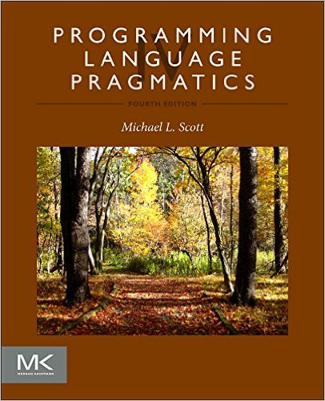
Introduction
Required textbook
Programming Language Pragmatics, 4th Edition, by Michael Scott, Morgan Kaufmann, 2015

Slide 5
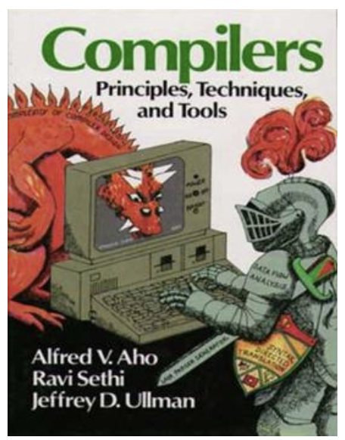
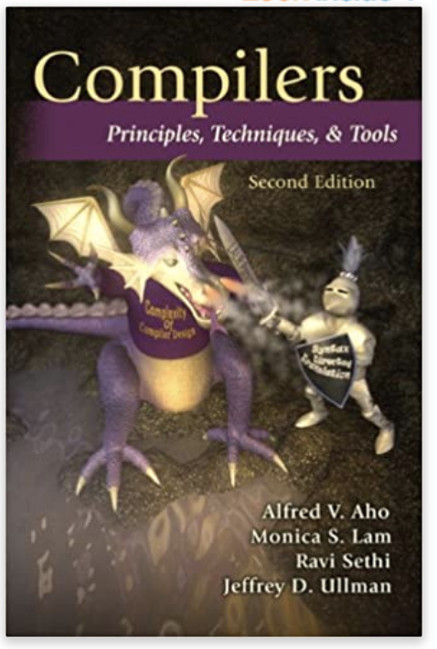
Introduction
Recommended textbook
Compilers: Principles, Techniques, and Tools, 2nd Edition, by A. Aho, M. Lam, R. Sethi and J. Ullman, AW, 2007 (Dragon Book)
Aho and Ullman 2020 Turing Award citation:
For fundamental algorithms and theory underlying programming language implementation and for synthesizing these results and those of others in their highly influential books, which educated generations of computer scientists.

Slide 6
Introduction
Syllabus
https://www.cs.rpi.edu/~milanova/csci4430/syllabus.html
Topics, outcomes, policies, and grading
2 midterm exams and a final exam: 50%
7 homework assignments: 42%
8 quizzes: 8%
1% attendance and participation
Notes:
Each midterm is 12.5%, final is 25%.
Homework is 42%.

Slide 7
Introduction
Lectures are live here in DCC 308 Tuesdays and Fridays 2:00–4:00pm
If you are unable to attend due to medical reasons, please notify us by September 9th
Fall 2020 pre-recorded lectures are available at https://mediasite.mms.rpi.edu/Mediasite5/Channel/ programming_languages
PDF notes: https://www.cs.rpi.edu/~milanova/csci4430/schedule.html

Slide 8
Introduction
Homework is due at 2pm on the due date
Submit typed homework as a PDF electronically in Submitty
Submit programming homework in Submitty for autograding
Homework, including submission instructions, will be posted at
https://www.cs.rpi.edu/~milanova/csci4430/schedule.html

Slide 9
Introduction
Homework is due at 2pm on the due date
6 late days in total
2 late days at most per homework
Extensions only with a formal excuse note from your class dean. See syllabus for details.

Slide 10
Introduction
9 quizzes during scheduled class hours
Quiz dates are marked in Schedule
Will cover material of previous weeks
Quiz will show on Submitty at 2pm, 10-15min
Multiple choice and short answer, upload text file
Work in groups is encouraged (4-5 people)
Physical attendance not required but encouraged
Do not post questions or discussion on public sites/channels!

Slide 11
Introduction
Exams will be in person in DCC 308
If unable to attend due to medical reasons, please notify us by September 9th
Quiz or exam makeup will be arranged only after we have received an excuse note from your class dean. See syllabus for details.

Slide 12
Introduction
We plan for ample office hours on Mondays, Wednesdays and Thursdays. TBD.
Instructor office hours
Mondays 12:30-2:30pm in Lally 314. Please wear a mask
Immediately after class on Tuesdays and Fridays

Slide 13
Other Notes
Asking questions
First, go to Submitty forum
Do not post code on forum
You cannot post code to any website
Second, go to office hours
Sessions are individual, run through Submitty queues
We will not be answering questions coming in late at night or in the morning on day HW is due

Slide 14
Other Notes
Submitty forum
Announcements – check regularly
Ask all non-personal questions on the forum
Check out prior messages before you post a question – the answer is probably already there
Mailing list proglang@cs.lists.rpi.edu (instructors)
Personal questions (extensions, grade disputes, etc.)
Unsolicited debugging emails to instructors or mailing list will likely go unanswered!

Slide 15
Other Notes
Debugging and homework help in office hours
Instructor, TA and mentor office hours will be finalized by beginning of next week

Slide 16
Academic Integrity
In short, do not copy and do not post solutions or code on public forums or repos
Excessive similarities between homework submissions will be considered cheating and handled accordingly
I trust you. Submitty has advanced plagiarism detection tools that course stuff runs regularly

Slide 17
How to Study
Read textbook chapter in advance of lecture
Chapters are announced on Schedule page
Read/listen lecture and read textbook chapter immediately after class
Lecture pdfs will be available shortly before class
Solve exercises in lectures
Form study groups
ASK QUESTIONS – in class, on forum

Slide 18
Course Topics
Programming language syntax: Scanning and parsing
Programming language semantics: Attribute grammars
Naming, binding and scoping
Data abstraction and types
Control abstraction and parameter passing
Concurrency
Logic-oriented language: Prolog
Functional languages: Scheme and Haskell
Imperative languages
An object-oriented language: Java
A dynamic language: Python

Slide 19
Course Topics
Schedule at www.cs.rpi.edu/~milanova/csci4430/schedule.html
Lists major and minor topics
Homework links, dates and due dates
Quiz and exam schedule

Slide 20
Lecture Outline
Introduction to the course
Programming language spectrum
Why study programming languages?
Compilation

Slide 21
The Programming Language Spectrum
Imperative languages
Von Neumann languages: Fortran, C,…
Object-oriented languages: Java, C++, Smalltalk,…
Dynamic languages: Perl, Python, PHP,…
Declarative languages
Functional languages: Scheme/Lisp, ML, Haskell
Logic languages: Prolog
There are other declarative languages: e.g., dataflow languages
Notes:
Programming languages are divided into two broad categories,
imperative and declarative. Imperative languages are “lower-level”
languages, while declarative languages are “higher-level” languages.
Imperative languages require that programmers specify what needs to
be done by setting up how it is done. Declarative languages state
what needs to be done and a “smart” runtime sets up the how.

Slide 22
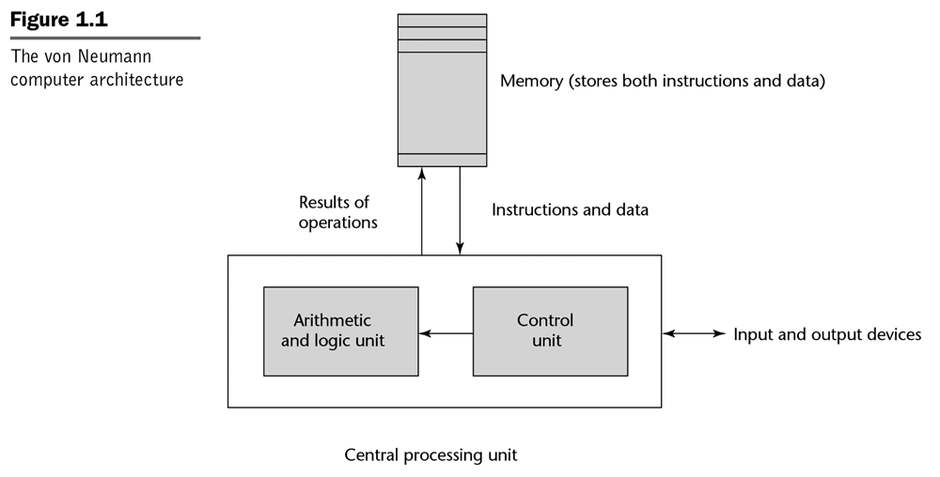
The Programming Language Spectrum
Imperative languages
Evolved from the von Neumann Architecture
Variable
Assignment Statement

Slide 23
The Programming Language Spectrum
Imperative languages
Most widely popular programming style
FORTRAN, C, C++, C#, Java, Python, Visual BASIC, Perl, JavaScript, Ruby, etc.
Variable and assignment statement are central concepts
Program is a sequence of statements:
j := i – j;
k := j * l;
Execution is a sequence of transitions on memory state

Slide 24
The Programming Language Spectrum
FORTRAN was invented in mid-1950
John Backus, the inventor of FORTRAN, wrote the following paper in 1979: “Can programming be liberated from the von Neumann style? A functional style and its algebra of programs”
Problems with imperative languages
Difficult to understand programs
Difficult to reason about correctness of programs
Notes:
John Backus – Turing Award 1977.

Slide 25
The Programming Language Spectrum
John Backus 1977 Turing award citation
… contributions to the design of practical high-level programming systems, notably through his work on FORTRAN, and for seminal publication of formal procedures for the specification of programming languages.
More history…
1969: Hoare logic and program verification
78-79: Enthusiasm cools, Perlis’ paper, Backus’ paper
1980-ties and onward: Functional languages

Slide 26
The Programming Language Spectrum
Functional Programming
Main alternative to imperative programming
Lisp/Scheme, ML/OCaml, Haskell
Program consists of function definitions + evaluation expr
(fun3 (fun2 (fun1 data)))
(fun3 (fun2 data2))
(fun3 data3)
data4
Execution is a sequence of function applications (i.e., reductions)
Logic Programming
Perform queries against knowledge base
Prolog, Datalog, SQL

Slide 27
An Example: Inner Product
Inner product in FORTRAN:
Illustrates state-transition semantics
1. C := 0;
2. for I := 1 step 1 until N do
3. T := a[I]*b[I];
4. C := C + T;

Slide 28
An Example: Inner Product
Inner product in FP:
Def IP = (Insert +) º (ApplyToAll *) º Transpose
IP <<1,2,3>,<6,5,4>> is
(Insert +) ((ApplyToAll *) (Transpose <<1,2,3>,<6,5,4>>))
(Insert +) ((ApplyToAll *) <<1,6>,<2,5>,<3,4>>)
(Insert +) <6,10,12>
28
Illustrates reduction (applicative) semantics
Function composition

Slide 29
Why Study Programming Languages
Goal of the course: learn to analyze programming languages
What are the questions we ask when facing a new programming language
Helps learn new languages, choose the right language for a problem, understand language features, design languages

Slide 30
Lecture Outline
Introduction to the course
The programming language spectrum
Why study programming languages
Compilation

Slide 31
Compilation and Interpretation
Compilation
Compiler
A “high-level” program is translated into executable machine code
Pure interpretation
Interpreter
A program is translated and executed one statement at a time
Hybrid interpretation
Both a compiler and an interpreter
A program is “compiled” into intermediate code; intermediate code is “interpreted”

Slide 32
Compilation
COMPILER
character stream
Scanner (lexical analysis)
Machine-independent code improvement
token stream
Parser (syntax analysis)
parse tree
modified
intermediate form
Semantic analysis and
intermediate code generation
Code Generation
target language
(assember)
abstract syntax tree
and/or intermediate form
Machine-dependent code improvement
modified target language
Notes:
The compiler is a sequence of phases (passes) where the output
of each phase is the input to the next phase.
The Scanner takes as input a character stream (the program code)
and outputs a token stream. The Parser takes the token stream and
outputs a parse tree. The Semantic analysis and intermediate code
generation phase takes the parse tree and outputs the abstract
syntax tree or another intermediate form. And so on.
In our course, we will discuss in detail the Scanner, the Parser and
the Semantic Analysis.
Last, the left side of this picture, namely the Scanner, Parser,
Semantic analyzer and intermediate code generator form the
FRONT END (or machine-independent part) of the COMPILER.
The optimizer and code generator form the BACK END
(machine-dependent part) of the COMPILER.

Slide 33
Compilation
position = initial + rate * 60;
Scanner
Symbol table
position, …
initial, …
3. rate, …
<id,1> <=> <id,2> <+> <id,3> <*> <60>
Parser
Semantic analysis and
intermediate code generation
Notes:
The Scanner breaks the character stream into a sequence of tokens.
id, =, +, *, 60 are all tokens. The sequence of tokens is the input to
the Parser.

Slide 34
Compilation
Semantic analysis and
intermediate code generation
=
<id,1>
+
Abstract Syntax Tree
<id,2> *
<id,3> 60.0
tmp1 = id3 * 60.0
tmp2 = id2 + tmp1
id1 = tmp2
Intermediate form (three-address code)
Notes:
Semantic analysis and intermediate code generation outputs
an abstract syntax tree (AST) and/or intermediate form.
The intermediate form shown here is known as three-address
code. We can perform semantic analysis and optimizations on
the AST and on the three-address code.

Slide 35
Compilation
Machine-independent code improvement
tmp1 = id3 * 60.0
id1 = id2 + tmp1
Improved intermediate form
Code generation
movf id3, R2
mulf #60.0, R2
movf id2, R1
addf R2, R1
movf R1, id1
Target language
Notes:
Code improvement is an optional compilation phase.
However, it is very important. Generating code is easy;
generating good (i.e., efficient) code is hard!

Slide 36
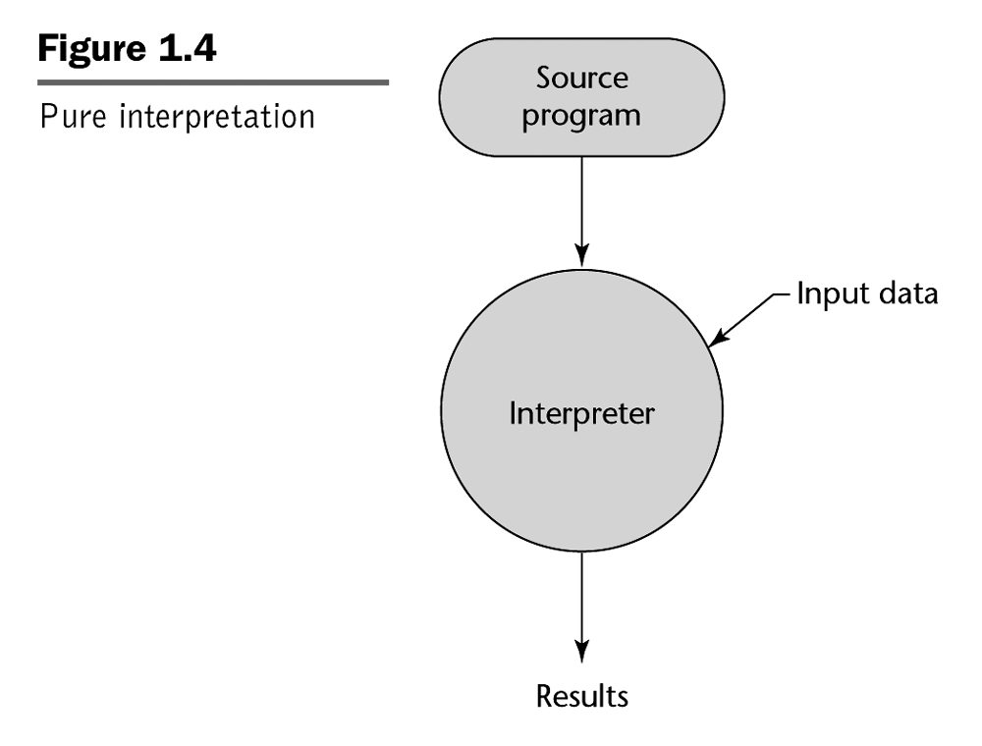
Interpretation
e.g. BASIC
REM COMMENT
LET X = 5
LET Y = 8
PRINT X
PRINT Y
LET Z = X
PRINT Z
...

Slide 37
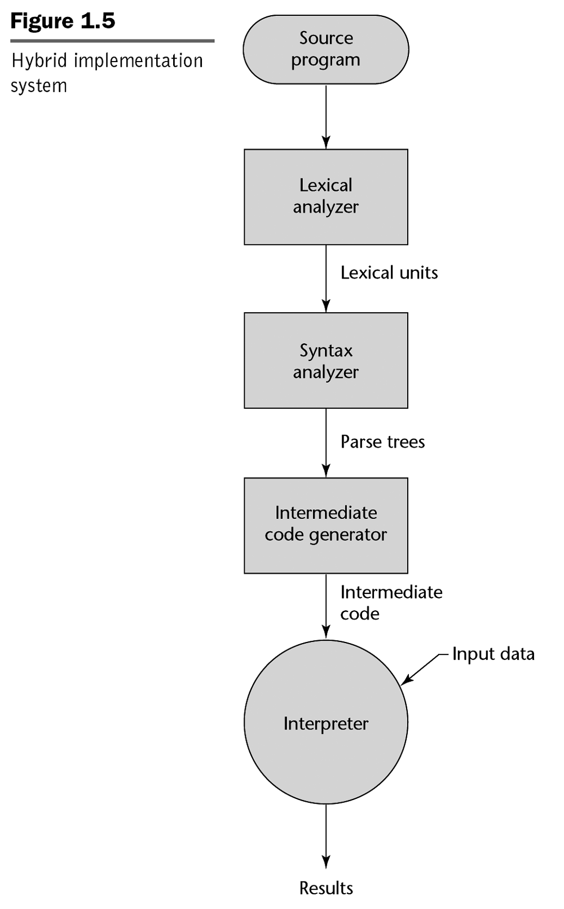
Hybrid Interpretation
09 AB 19 29 99 73 09 AB 19 29 99 73 09 AB 19 29 99 73 09 AB 19 29 99 73 09 AB 19 29 99 73 09
e.g. Java byte code
e.g. Java Virtual Machine (JVM)
Also Perl....
Notes:
Note that Lexical analyzer is another term (often used in texts) for Scanner.
Similarly, Syntax analyzer is another term for Parser.

Slide 38
Compilation vs. Interpretation
Advantages of compilation?
Faster execution
Advantages of interpretation?
Greater flexibility
Dynamic code generation and execution, sandboxing

Slide 39
Compilation vs. Interpretation
A language can be implemented using a compiler or using an interpreter
One can build a compiler for Lisp and one can easily build an interpreter for C or Fortran
However, language features (determined during language design) have significant impact on “compilability” and the decision “compiler vs. interpreter”

Slide 40
Next Class
We will review regular expressions and context free grammars
Read Chapter 2.1 and 2.2 from Scott’s book

Slide 41
The End

