Slide 1
Announcements
Rainbow grades
Quizzes 1-4, Homework 1-2
Exam 1
16% A-range, 27% B-range, 27% C-range, 16% D-r
Median: 91/115, Mean: 88/115
We will release papers on Submitty on Thu. Thanks!
Drop deadline is this Friday, October 21st!
We’ll start grading HW3 next week. Thanks!

Slide 2
Functional Programming with Scheme
Keep reading: Scott, Chapter 11.5-11.6

Slide 3
Lecture Outline
Notes on writing “comments” for homework
Scheme
Equality testing
Higher-order functions
map, foldr, foldl
Tail recursion

Slide 4
Writing “Comments”
Each function should have the following sections:
;; Contract: len : (list a) -> integer
;; Purpose: to compute length of a list lis
;; Example: (len ‘(1 2 3 4)) should return 4
;; Definition:
(define (len lis)
(if (null? lis) 0 (+ 1 (len (cdr lis)))))
Notes:
Definition is the actual function definition (code).

Slide 5
Writing “Comments”
;; Contract:
;; len : (list a) -> number
Has two parts. The first part, to the left of the colon, is the name of the function. The second part, to the right of the colon, states what type of data it consumes and what type of data it produces
We shall use a, b, c, etc. to denote type parameters, and list to denote the list type
Thus, len is a function, which consumes a list whose elements are of some type a, and produces a number

Slide 6
Writing “Comments”
;; Contract:
;; lis : (list integer) -> (list integer)
lis : is a function, which consumes a list of integers, and produces a list of integers (you may assume that the input is a list of integers)
;; Purpose: to compute …

Slide 7
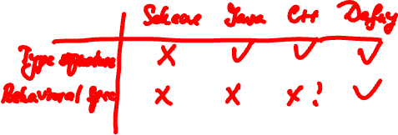
Writing “Comments”
Comments are extremely important in Scheme
Why?
Our “comments” amount to adding an unchecked type signature + an informal behavioral specification
Notes:
Scheme is dynamically typed, unlike Java and C++.
Functions in Scheme have no type signatures to elucidate their purpose.

Slide 8
Lecture Outline
Notes on writing “comments” for homework
Scheme
Equality testing
Higher-order functions
map, foldr, foldl
Tail recursion

Slide 9
Equality Testing
eq?
Built-in predicate that can check atoms for equal values
Does not work on lists in the way you might expect!
eql?
Our predicate that works on lists
(define (eql? x y)
(or (and (atom? x) (atom? y) (eq? x y))
(and (not (atom? x)) (not (atom? y))
(eql? (car x) (car y))
(eql? (cdr x) (cdr y)) )))
equal?
Built-in predicate that works on lists

Slide 10
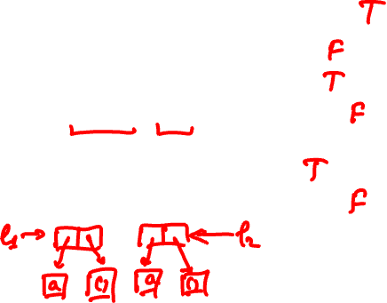
Examples
(eql? ‘(a) ‘(a)) yields what?
(eql? ‘a ‘b) yields what?
(eql? ‘b ‘b) yields what?
(eql? ‘((a)) ‘(a)) yields what?
(eq? ‘a ‘a) yields what?
(eq? ‘(a) ‘(a)) yields what?

Slide 11
Models for Variables
Value model for variables
A variable is a location that holds a value
I.e., a named container for a value
a := b
Reference model for variables
A variable is a reference to a value
Every variable is an l-value
Requires dereference when r-value needed (usually, but not always implicit)
l-value (the location)
r-value (the value held in that location)

Slide 12
Models for Variables: Example
b := 2;
c := b;
a := b + c;
Value model for variables
b := 2 b:
c := b c:
a := b+c a:
Reference model for variables
b := 2 b
c := b c
a := b+c a
2
2
4
2
4

Slide 13
Equality Testing: How does eq? work?
Scheme uses the reference model for variables!
(define (f x y) (list x y))
Call (f ‘a ‘a) yields (a a)
x refers to atom a and y refers to atom a.
eq? checks that x and y both point to the
same place.
Call (f ‘(a) ‘(a)) yields ((a) (a))
x and y do not refer to the same list.
x
y
a
A cons cell
x
y
a
( )
Notes:
note that ( ) or nil is an atom!
nil is actually a polymorphic constant as it stands both the empty list and is an atom as well.
also, note that x and y don’t point to the same list at all so that the eq? comparison will fail.
in the atom: a case, x and y both point to the cell which points to a, so they have the same contents and compare eq.
safest thing to do is to use eql? on all comparisons! this tests that 2 S-exprs are isomorphic, which is what we usually mean by equal.

Slide 14
Models for Variables
C/C++, Pascal, Fortran
Value model
Java
Mixed model: value model for simple types, reference model for class types
JS, Python, R, etc.
Reference model
Scheme
Reference model! eq? is “reference equality” (akin of Java’s ==), equal? is value equality

Slide 15
Equality Testing
In languages with reference model for variables we have two tests for equality
One tests reference equality, whether two references refer to the same object
eq? in Scheme (eq? ‘(a) ‘(a)) yields #f
== in Java
Other tests value equality. Even if the two references do not refer to the same object, they may refer to objects that have the same value
equal? in Scheme (equal? ‘(a) ‘(a)) yields #t
.equals() method in Java

Slide 16
Lecture Outline
Notes on writing “comments” for homework
Scheme
Equality testing
Higher-order functions
map, foldr, foldl
Tail recursion

Slide 17
Higher-order Functions
Functions are first-class values
A function is said to be a higher-order function if it takes a function as an argument or returns a function as a result
Functions as arguments
(define (f g x) (g x))
(f number? 0) yields #t
(f len ‘(1 (2 3))) yields what?
(f (lambda (x) (* 2 x)) 3) yields what?
Notes:
(f len ‘(1 (2 3)) ) yields 2
(f (lambda (x) (* 2 x)) 3) yields 6

Slide 18
Higher-order Functions
Functions as return values
(define (fun)
(lambda (a) (+ 1 a)))
(fun 4) yields what?
((fun) 4) yields what?

Slide 19
Higher-order Functions: map
Higher-order function used to apply another function to every element of a list
Takes 2 arguments: a function f and a list lis and builds a new list by applying the f to each element of lis
(define (my-map f lis)
(if (null? lis) ‘()
(cons (f (car lis)) (my-map f (cdr lis)))))
Notes:
I use mymap because, of course, there is a built-in map in Scheme.
last map application uses a function of 2 args so it uses the cars of each list and builds new list from the result of applying + to these cars.

Slide 20
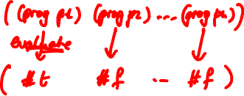
map
(my-map f lis)
( e1 e2 e3 … en )
( r1 r2 r3 … rn )
There is a build-in function map
f
f
f
f

Slide 21
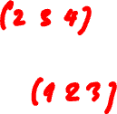
map
(define (my-map f l)
(if (null? l) ‘( )
(cons (f (car l)) (my-map f (cdr l)) )))
(my-map abs ‘(-1 2 -3 -4)) yields (1 2 3 4)
(my-map (lambda (x) (+ 1 x)) ‘(1 2 3)) yields what?
(my-map (lambda (x) (abs x)) ‘(-1 2 -3)) yields what?
Notes:
yields (2 3 4)

Slide 22
map
Remember atomcount, calculates the number of atoms in a list
(define (atomcount s)
(cond ((null? s) 0)
((atom? s) 1)
(else (+ (atomcount (car s)) (atomcount (cdr s))))))
We can write atomcount2, using map:
(define (atomcount2 s)
(cond ((atom? s) 1)
(else (apply + (map atomcount2 s)))))
Notes:
apply is a higher order function as well.
It takes as arguments a function and a list. In our case (apply + (e1 e2 … en)) computes e1+e2+… +en.
For example (apply + (1 2 3)) yields 1+2+3 = 6.
atomcount2 uses map to calculate the number of atoms in a list.
atomcount2 creates a list of the count of atoms in every sublist.
apply of + calculates the sublist sum.

Slide 23
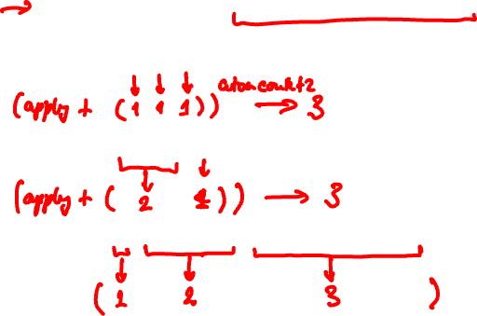
map
(define (atomcount2 s)
(cond ((atom? s) 1)
(else (apply + (map atomcount2 s)))))
(atomcount2 ‘(1 2 3)) yields 3
(atomcount2 ‘((a b) d)) yields 3
(atomcount2 ‘(1 ((2) 3) (((3) (2) 1)))) ?
Notes:
apply is a higher order function as well.
It takes as arguments a function and a list. In our case (apply + (e1 e2 … en)) computes e1+e2+… +en.
For example (apply + (1 2 3)) yields 1+2+3 = 6.
atomcount2 uses map to calculate the number of atoms in a list.
atomcount2 creates a list of the count of atoms in every sublist.
apply of + calculates the sublist sum.

Slide 24
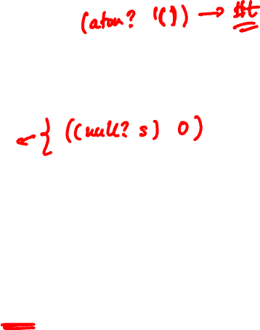
Question
My atomcount2 defined below
(define (atomcount2 s)
(cond ((atom? s) 1)
(else (apply + (map atomcount2 s)))))
has a bug :). Can you find it?
Answer: It counts the null list ‘() as an atom.
E.g., (atomcount2 ‘()) will return 1.
Notes:
apply is a higher order function as well.
It takes as arguments a function and a list. In our case (apply + (e1 e2 … en)) computes e1+e2+… +en.
For example (apply + (1 2 3)) yields 1+2+3 = 6.
atomcount2 uses map to calculate the number of atoms in a list.
atomcount2 creates a list of the count of atoms in every sublist.
apply of + calculates the sublist sum.

Slide 25
Exercise
(define (atomcount2 s)
(cond ((atom? s) 1)
(else (apply + (map atomcount2 s)))))
Now, let’s write flatten2 using map
(flatten2 ‘(1 ((2) 3) (((3) (2) 1)))) yields (1 2 3 3 2 1)
(define (flatten2 s)
…
Hint: you can use (apply append (…
Notes:
append is a build-in function.
(apply append ‘((a) (b c) (d)))
yields (a b c d).

Slide 26
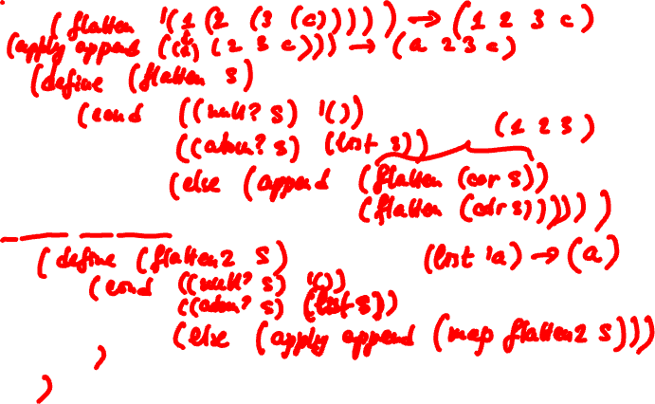
Exercise

Slide 27
foldr
Higher-order function that “folds” (“reduces”) the elements of a list into one, from right-to-left
Takes 3 arguments: a binary operation op, a list lis, and initial value id. forldr “folds” lis
(define (foldr op lis id)
(if (null? lis) id
(op (car lis) (foldr op (cdr lis) id)) ))
(foldr + ‘(10 20 30) 0) yields 60
it is 10 + (20 + (30 + 0))
(foldr - ‘(10 20 30) 0) yields ?
Notes:
The fold (also known as reduce) functions are another class of important higher-order functions.
Note: the id has to be a special preserving constant for calculations associated with the operator.
for + 0, * 1, and true, etc.

Slide 28
foldr
(foldr op lis id)
( e₁ … e_{n-1} e_{n} ) id
( e₁ … e_{n-1} ) res₁
…
( e₁ ) res_{n-1}
res_{n}

Slide 29
Exercise
What does
(foldr append ‘((1 2) (3 4)) ‘()) yield?
Recall that append appends two lists:
(append ‘(1 2) ‘((3) (4 5))) yields (1 2 (3) (4 5))
Now, define a function len2 that computes the length of a list using foldr
(define (len2 lis)
(foldr …
Notes:
(foldr append ‘((1 2) (3 4)) ‘()) yields (1 2 3 4)

Slide 30
foldr
List element
(define (len2 lis) (foldr (lambda (x y) (+ 1 y)) lis 0))
( a b c ) 0
( a b ) 1
( a ) 2
3
Partial result

Slide 31
foldr
foldr is right-associative
E.g., (foldr + ‘(1 2 3) 0) is 1 + (2 + (3 + 0))
Partial results are calculated in order down the else-branch
(define (foldr op lis id)
(if (null? lis) id
(op (car lis) (foldr op (cdr lis) id))))
1 2 3 ()
0
3
5
6

Slide 32
foldl
foldl is left-associative and (as we shall see) more efficient than foldr
E.g., (foldl + ‘(1 2 3) 0) is ((0 + 1) + 2) + 3
Partial results are accumulated in id
(define (foldl op lis id)
(if (null? lis) id
(foldl op (cdr lis) (op id (car lis)))))
0 1 2 3
()
1
3
6
6
Notes:
There are no buildin functions foldr and foldl.

Slide 33
foldl
(foldl op lis id)
id ( e₁ e₂ e₃ … e_{n} )
id₁ ( e₂ e₃ … e_{n} )
id₂ ( e₃ … e_{n} )
…
id_{n-1} ( e_{n} )
id_{n}

Slide 34
Exercise
Define a function rev computing the reverse of a list using foldl E.g., (rev ‘(a b c)) yields (c b a)
(define (rev lis)
(foldl (lambda (x y) (…
(define (foldl op lis id)
(if (null? lis) id
(foldl op (cdr lis) (op id (car lis)))))

Slide 35
foldl
Next element
(define (rev lis) (foldl (lambda (x y) (cons y x)) lis ‘()))
() ( a b c )
(a) ( b c )
(b a) ( c )
(c b a) ()
Partial result

Slide 36
Exercise
(define (foldr op lis id)
(if (null? lis) id
(op (car lis) (foldr op (cdr lis) id)) ))
(define (foldl op lis id)
(if (null? lis) id
(foldl op (cdr lis) (op id (car lis)))) )
Write len, which computes the length of the list, using foldl
Write rev, which reverses the list, using foldr

Slide 37
Exercise
(define (foldl op lis id)
(if (null? lis) id (foldl op (cdr lis) (op id (car lis)))) )
Write len, which computes the length of the list, using foldl
(define (len lis) …

Slide 38
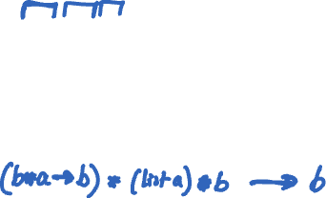
Exercise
Can you write the contract for foldl ?
(define (foldl op lis id)
(if (null? lis) id
(foldl op (cdr lis) (op id (car lis)))))
;; Contract:
;; foldl : (b * a -> b ) * (list a) * b -> b

Slide 39
Exercise
How about the contract for foldr ?
(define (foldr op lis id)
(if (null? lis) id
(op (car lis) (foldr op (cdr lis) id))))
;; Contract:
;; foldr : (a * b -> b ) * (list a) * b -> b

Slide 40
foldr vs. foldl
(define (foldr op lis id)
(if (null? lis) id
(op (car lis) (foldr op (cdr lis) id)) ))
(define (foldl op lis id)
(if (null? lis) id
(foldl op (cdr lis) (op id (car lis))) ))
Compare underlined portions of these 2 functions
foldr contains a recursive call, but it is not the entire return value of the function
foldl returns the value obtained from the recursive call to itself!
Notes:
Foldl is tail-recursive.

Slide 41
Tail Recursion
If the result of a function is computed without a recursive call OR it is the result of an immediate recursive call, then the function is said to be tail recursive
E.g., foldl
Tail recursion can be implemented efficiently
Result is accumulated in one of the arguments, and stack frame creation can be avoided!
Scheme implementations are required to be “properly tail-recursive”
Notes:
Wikstrom’s ML book; explain intuition about stack frames and why tail recursive functions don’t need a stack to store the values of successive copies of the function

Slide 42
Tail Recursion: Two Definitions of Length
(define (len lis)
(if (null? lis)
0
(+ 1 (len (cdr lis)))))
(len '(3 4 5))
(define (lenh lis total)
(if (null? lis)
total
(lenh (cdr lis) (+ 1 total))))
(define (len lis) (lenh lis 0))
(len '(3 4 5))
Lenh is tail recursive. total
accumulates the length
Notes:
On the left is our original definition. On the right is a tail recursive definition
That we build by adding a parameter which accumulates the value we are calculating to return it.
Then len2 is used to call the tail recursive version of length

Slide 43
Tail Recursion: Two Definitions of Factorial
(define (factorial n)
(cond ((zero? n) 1)
((eq? n 1) 1)
(else (* n (factorial (- n 1))))))
(define (fact2 n acc)
(cond ((zero? n) 1) ((eq? n 1) acc)
(else (fact2 (- n 1)
(* n acc)))))
(define (factorial n)
(fact2 n 1))
fact2 is tail recursive
Notes:
???

Slide 44
The End

