Slide 1
Functional Programming with Scheme
Keep reading: Scott, Chapter 11.1-11.3, 11.5-11.6, Scott, 3.6

Slide 2
Lecture Outline
Scheme
Exercises with map, foldl and foldr
Binding with let, let*, and letrec
Scoping in Scheme
Closures
Scoping, revisited

Slide 3
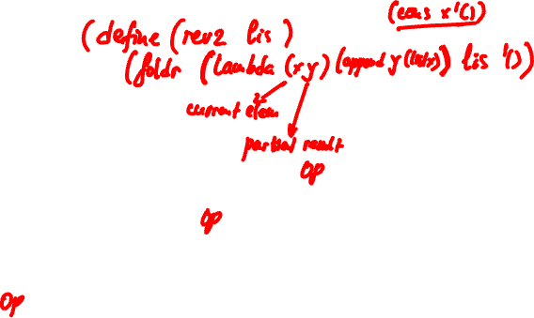
Exercises
(foldr op lis id)
( e₁ … e_{n-1} e_{n} ) id
( e₁ … e_{n-1} ) res₁
…
( e₁ ) res_{n-1}
res_{n}
Write rev2, which reverses a list, using a single call to foldr
(define (rev2 lis) (foldr …) )

Slide 4
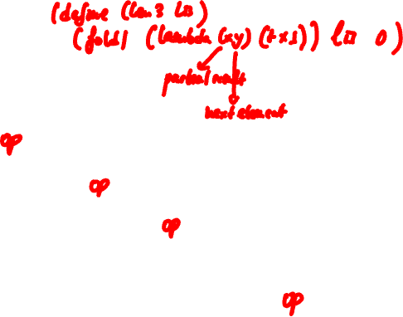
Exercises
(foldl op lis id)
id ( e₁ e₂ e₃ … e_{n} )
id₁ ( e₂ e₃ … e_{n} )
id₂ ( e₃ … e_{n} )
…
id_{n-1} ( e_{n} )
id_{n}
Write len3, which computes
length of list, using a single call to foldl
(define (len3 lis) (foldl …) )

Slide 5
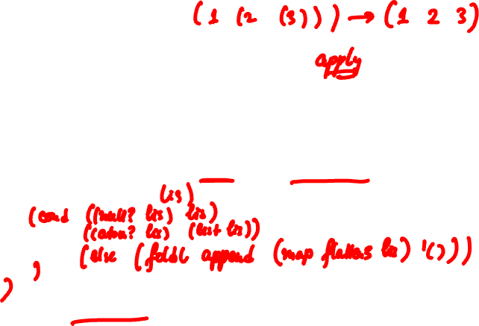
Exercises
(define (foldl op lis id)
(if (null? lis) id
(foldl op (cdr lis) (op id (car lis)))) )
Write flatten3 using map and foldl/foldr
(define (flatten3
Write flatten4 this time using foldl but not map.

Slide 6
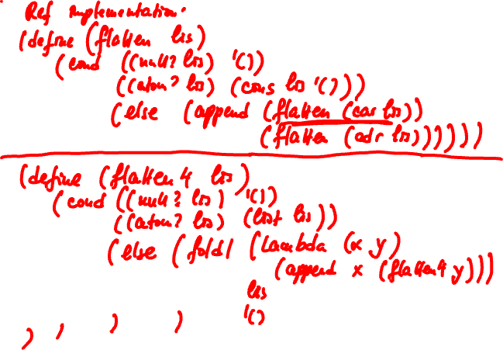

Slide 7
Exercises
Write a function that counts the appearances of symbols a, b and c in a list of flat lists
(count-sym ‘((a b) (c a) (a b d)) yields
((a 3) (b 2) (c 1))
Natural idea: use map and fold
map and fold (or map and reduce), are the foundation of Google’s MapReduce model
Canonical MapReduce example [Dean and Ghemawat OSDI’04] is WordCount

Slide 8
Tail Recursion, A Bit More
A tail expression is an expression that occurs in tail context. Defined inductively as follows:
The body of function is a tail expression
If (if e1 e2 e3) is a tail expression, then e2 and e3 are tail expressions
Examples
(define (foldl op lis id)
(if (null? lis) id
(foldl op (cdr lis) (op id (car lis)))) )

Slide 9
Tail Recursion, A Bit More
A tail call is a tail expression that is a function call. E.g.,
(define (foldl op lis id)
(if (null? lis) id
(foldl op (cdr lis) (op id (car lis)))) )
A tail recursive function is a function whose “leaf” tail expressions are either returns or tail calls to itself (still informal)
Tail calls give rise to efficient implementation of Continuation Passing Style (CPS)

Slide 10
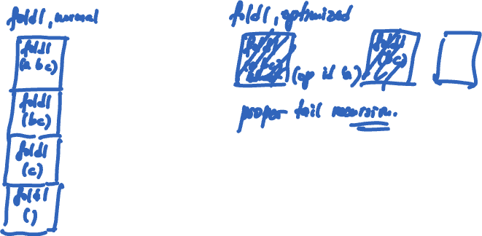
Tail Recursion, A Bit More

Slide 11
Lecture Outline
Scheme
Exercises with map, foldl and foldr
Binding with let, let*, and letrec
Scoping in Scheme
Closures
Scoping, revisited

Slide 12
Let Expressions
Let-expr ::= ( let ( Binding-list ) S-expr1 )
Let*-expr ::= ( let* ( Binding-list ) S-expr1 )
Binding-list ::= ( Var S-expr ) { ( Var S-expr ) }
let and let* expressions define a binding between each Var and the S-expr value, which holds during execution of S-expr1
let evaluates the S-exprs in Binding-list in current environment “in parallel”
let* evaluates the S-exprs from left to right
Associate values with variables for the local computation

Slide 13
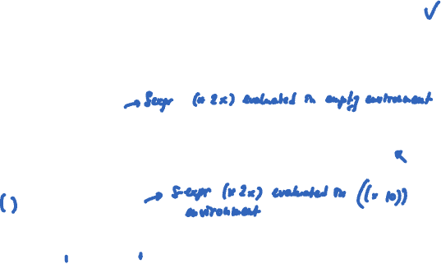
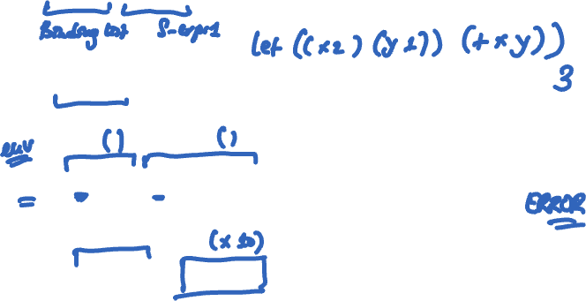
Questions
(let ((x 2)) (* x x)) yields 4
(let ((x 2)) (let ((y 1)) (+ x y)) ) yields what?
(let ((x 10) (y (* 2 x))) (* x y)) yields what?
(let* ((x 10) (y (* 2 x))) (* x y)) yields what?
Notes:
we see f is the function that returns a list consisting of 5 times each element in the given list.
(f ‘(1 2 3)) yields (5 10 15)
(let ((x 2)) (let ((y 1)) (+ x y) ) ) yields what 3.
(let ((x 10) (y (* 2 x))) (* x y)) yields ERROR!
(let* ((x 10) (y (* 2 x))) (* x y)) yields 200.

Slide 14
Let Expressions
Letrec-expr ::= ( letrec ( Binding-list ) S-expr1 )
Binding-list ::= ( Var S-expr ) { ( Var S-expr ) }
letrec Vars are bound to fresh locations holding undefined values; S-exprs are evaluated “in parallel” in augmented environment
letrec allows for definition of mutually recursive functions
(letrec (( even? (lambda (n) (if (zero? n) #t (odd? (- n 1)))) )
( odd? (lambda (n) (if (zero? n) #f (even? (- n 1)))) )
)
(even? 88)
)

Slide 15
Regions (Scopes) in Scheme
let, let* and letrec give rise to block structure
They have the same syntax but define different regions (scopes)
let
Region where binding is active: body of let

Slide 16
Regions (Scopes) in Scheme
let, let* and letrec give rise to block structure
They have the same syntax but define different regions (scopes)
let*
Region: all bindings to the right plus body of let*

Slide 17
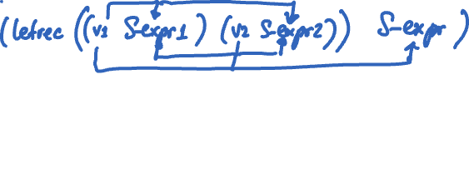
Regions (Scopes) in Scheme
let, let* and letrec give rise to block structure
They have the same syntax but define different regions (scopes)
letrec
Region: entire letrec expression

Slide 18
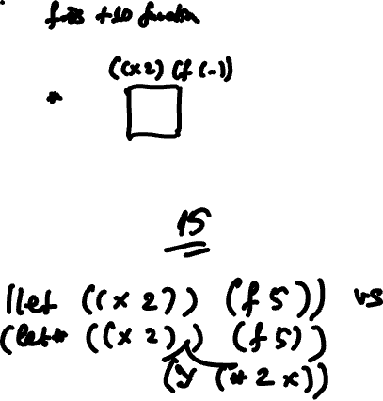
Let Introduces Nested Scopes
(let ((x 10)) ;causes x to be bound to 10
(let ((f (lambda (a) (+ a x))) ;causes f to be bound to a lambda expression
(let ((x 2)) (f 5) ) ))
Assuming that Scheme uses static scoping, what would
this expression yield?

Slide 19
Question
(define (f z)
(let* ( (x 5) (f (lambda (z) (* x z))) )
(map f z) ) )
What does this function do?
Answer: takes a list of numbers, z, and maps it to the times-5 list. E.g., (f ‘(1 2 3)) yields (5 10 15).

Slide 20
Scoping in Scheme: Two Choices
a is a “bound” variable
(let ((x 10))
(let ((f (lambda (a) (+ a x))))
(let ((x 2))
(* x (f 3) ) ) )
x is a “free” variable;
must be found in
“outer” scope
With static scoping it evaluates to
(* x ((lambda (a)(+ a x)) 3)) -->
(* 2 ((lambda (a)(+ a 10)) 3) ) --> ???
With dynamic scoping it evaluates to
(* x ((lambda (a)(+ a x)) 3)) -->
(* 2 ((lambda (a)(+ a 2)) 3) ) --> ???
Programming Languages CSCI 4430, A. Milanova/B. G. Ryder

Slide 21
Scheme Chose Static Scoping
(let ((x 10))
(let ((f (lambda (a) (+ a x))))
(let ((x 2))
(* x (f 3) ) ) )
f is a closure:
The function value: (lambda (a) (+ a x))
The environment: { x → 10 }
Scheme chose static scoping:
(* x (lambda (a)(+ a x) 3)) -->
(* 2 ((lambda (a)(+ a 10) 3) ) --> 26
Programming Languages CSCI 4430, A. Milanova/B. G. Ryder

Slide 22
Closures
A closure is a function value plus the environment in which it is to be evaluated
Function value: e.g., (lambda (x) (+ x y))
Environment consists of bindings for variables not local to the function so the closure can eventually be evaluated: e.g., { y → 2 }
A closure can be used as a function
Applied to arguments
Passed as an argument
Returned as a value

Slide 23
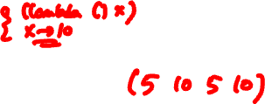
Closures
Normally, when let expression exits, its bindings disappear
Closure bindings (i.e., bindings part of a closure) are special
When let exits, bindings become inactive, but they do not disappear
When closure is called, bindings become active
Closure bindings are “immortal”
(let ((x 5))
(let (( f (let ((x 10)) (lambda () x ) ) ))
(list x (f) x (f)) ) )

Slide 24
Lecture Outline
Scheme
Exercises with map, foldl and foldr
Binding with let, let*, and letrec
Scoping in Scheme
Closures
Scoping, revisited

Slide 25
Scoping, revisited (Scott, Ch. 3.6)
We discussed the two choices for mapping non-local variables to locations
Static scoping (early binding)
and
Dynamic scoping (late binding)
Most languages choose static scoping

Slide 26
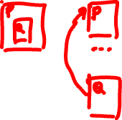
Scoping, revisited
When we discussed scoping earlier, we assumed that functions were third-class values (i.e., functions cannot be passed as arguments or returned from other functions)
Functions as third-class values…
When functions are third-class values, the function’s static reference environment (i.e., closure bindings) is available on the stack. Function cannot outlive its referencing environment!

Slide 27
Functions as Third-Class Values and Static Scoping
program
a, b, c: integer;
procedure P
c: integer;
procedure S
c, d: integer;
procedure R
…
end R;
R();
end S;
R();
S();
end P;
procedure R
a: integer;
= a, b, c;
end R;
…; P(); …
end program
main
---
---
a
b
c
main.P
c
main.R
a
Static Scoping:
a bound to R.a,
b to main.b,
c to main.c

Slide 28
Scoping, revisited
Functions as first-class values
Static scoping is more involved. Function value may outlive static referencing environment!
Therefore, need “immortal” closure bindings
In languages that choose static scoping, local variables must have “unlimited extent” (i.e., when stack frame is popped, local variables do not disappear!)

Slide 29
Scoping, revisited
In functional languages local variables typically have unlimited extent
In imperative languages local variables typically have limited extent (i.e., when stack frame is popped, local variables disappear)
Imperative languages (Fortran, Pascal, C) disallow truly first-class function values
More and more languages do allow first-class functions, e.g., Java 8, C++11

Slide 30
More on Dynamic Scoping
Shallow binding vs. deep binding
Dynamic scoping with shallow binding
Reference environment for function/routine is not created until the function is called
I.e., all non-local references are resolved using the most-recent-frame-on-stack rule
Shallow binding is usually the default in languages with dynamic scoping
All examples of dynamic scoping we saw so far used shallow binding

Slide 31
More on Dynamic Scoping
Dynamic scoping with deep binding
When a function/routine is passed as an argument, the code that passes the function/routine has a particular reference environment (the current one!) in mind. It passes this reference environment along with the function value (it passes a closure).

Slide 32
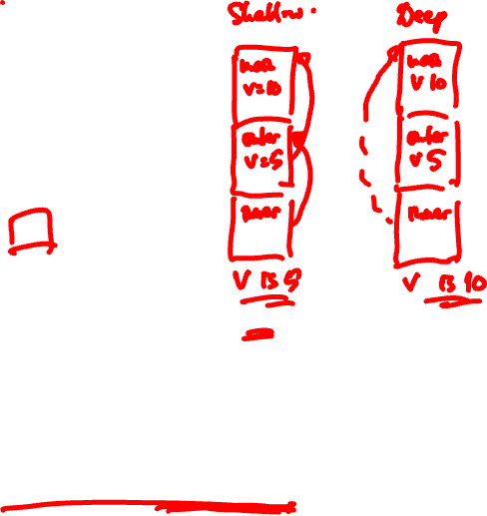
Example
v : integer := 10
people : database
print_routine (p : person) if p.age > v write_person(p)
other_routine (db : database, P : procedure) v : integer := 5 foreach record r in db P(r) other_routine(people, print_routine) /* call in main */
Notes:
With static scoping, print_routine prints persons older than 10.
With dynamic scoping with shallow binding, print_routine
references other_routine’s v, and prints 5.
With dynamic scoping with deep binding, when main calls other_routine, it not only sends print_routine as an argument,
but it also sends its reference environment { v -> 10 } to be used when print_routine is actually called. Thus, prints 10.

Slide 33
Exercise
(define A
(lambda ()
(let* ((x 2)
(C (lambda (P) (let ((x 4)) (P) )))
(D (lambda () x))
(B (lambda () (let ((x 3)) (C D)))))
(B))))
When we call > (A) in the interpreter, what gets printed? What would get printed if Scheme used dynamic scoping with shallow binding? Dynamic scoping and deep binding?

Slide 34
Evaluation Order
(define (square x) (* x x))
Applicative-order (also referred to as eager) evaluation
Evaluates arguments before function value
(square (+ 3 4)) =>
(square 7) =>
(* 7 7) =>
49

Slide 35
Evaluation Order
(define (square x) (* x x))
Normal-order (also referred to as lazy) evaluation
Evaluates function value before arguments
(square (+ 3 4)) =>
(* (+ 3 4) (+ 3 4)) =>
(* 7 (+ 3 4)) =>
(* 7 7)
49
Scheme uses applicative-order evaluation

Slide 36
So Far
Essential functional programming concepts
Reduction semantics
Lists and recursion
Higher-order functions
Map and fold (also known as reduce)
Scoping
Evaluation order
Scheme

Slide 37
Coming Up
Lambda calculus: theoretical foundation of functional programming
Haskell
Algebraic data types and pattern matching
Lazy evaluation
Type inference
Monads

Slide 38
The End

