Slide 1
Announcements
Quiz 5
HW4 due today
HW5 is out
More advanced Scheme programming
Team assignment
Maximal team size is 2

Slide 2
Lambda Calculus
Reading: Scott, Ch. 11 on CD

Slide 3
Lecture Outline
Lambda calculus
Introduction
Syntax and semantics
Free and bound variables
Substitution, formally

Slide 4
Lambda Calculus
A theory of functions
Theory behind functional programming
Turing complete: any computable function can be expressed and evaluated using the calculus
“Lingua franca” of PL research
Lambda (λ) calculus expresses function definition and function application
f(x)=x*x becomes λx. x*x
g(x)=x+1 becomes λx. x+1
f(5) becomes (λx. x*x) 5 → 5*5 → 25

Slide 5
Syntax of Pure Lambda Calculus
Convention:
notation f, x, y, z for variables;
E, M, N, P, Q for expressions
E ::= x | ( λx. E₁ ) | ( E₁ E₂ )
A λ-expression is one of
Variable: x
Abstraction (i.e., function definition): λx. E₁
Application: E₁ E₂
λ-calculus formulae (e.g., ( λx. (x y) )) are called expressions or terms
( λx. (x y) ) corresponds to (lambda (x) (x y)) in Scheme!
Notes:
I use notation f, x, y, z for variables; E, M, N, P, Q for expressions

Slide 6
Syntactic Conventions
Parentheses may be dropped from ( E₁ E₂ ) or ( λx.E )
E.g., ( f x ) may be written as f x
Function application groups from left-to-right (i.e., it is left-associative)
E.g., x y z abbreviates ( ( x y ) z )
E.g., E₁ E₂ E₃ E₄ abbreviates ( ( ( E₁ E₂ ) E₃ ) E₄ )
Parentheses in x (y z) are necessary! Why?

Slide 7
Syntactic Conventions
Application has higher precedence than abstraction
Another way to say this is that the scope of the dot extends as far to the right as possible
E.g., λx. x z = λx. ( x z ) = ( λx. ( x z ) ) = ≠ ( ( λx. x ) z )
WARNING: This is the most common syntactic convention (e.g., Pierce 2002). Some books give abstraction higher precedence.

Slide 8
Terminology
Parameter (also, formal parameter)
E.g., x is the parameter in λx. x z
Argument (also, actual argument)
E.g., expression λz. z is the argument in
(λx. x) (λz. z)
Can you guess what this evaluates to?

Slide 9
Currying
In lambda calculus, all functions have one parameter
How do we express n-ary functions?
Currying expresses an n-ary function in terms of n unary functions
f(x,y) = x+y, becomes (λx.λy. x + y)
(λx.λy. x + y) 2 3 → (λy. 2 + y) 3 → 2 + 3 = 5

Slide 10
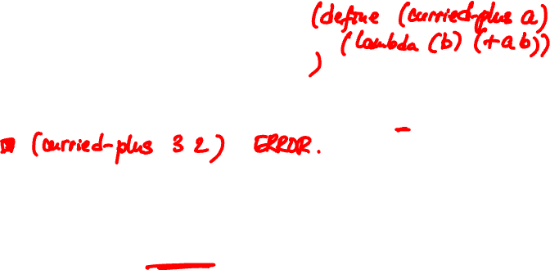
Currying in Scheme
(define curried-plus
(lambda (a) (lambda (b) (+ a b))))
(curried-plus 3) returns what?
Returns the plus-3 function (or more precisely, it returns a closure)
((curried-plus 3) 2) returns what?
5
Notes:
Scheme departs from the lamda calculus and allows us to define n-ary functions.
Of course, we can still defined curried functions in Scheme. Here is an example.

Slide 11
Currying
f(x₁, x₂,…,x_{n}) = g x₁ x₂ … x_{n}
Function g is said to be the curried form of f.
g₁ x₂
g₂ x₃
…

Slide 12
Semantics of Pure Lambda Calculus
An expression has as its meaning the value that results after evaluation is carried out
Somewhat informally, evaluation is the process of reducing expressions
E.g., (λx.λy. x + y) 3 2 → (λy. 3 + y) 2 → 3 + 2 = 5
(Note: this example is just an informal illustration. There is no + in the pure lambda calculus!)
λx.λy. x is assigned the meaning of TRUE
λx.λy. y is assigned the meaning of FALSE

Slide 13
Lecture Outline
Lambda calculus
Introduction
Syntax and semantics
Free and bound variables
Substitution, formally

Slide 14
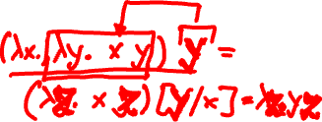
Free and Bound Variables
Reducing expressions
Consider expression ( λx.λy. x y ) (y w)
Try 1:
Reducing this expression results in the following
( λy. x y ) [(y w)/x] = ( λy. (y w) y )
The above notation means: we substitute argument (y w) for every occurrence of parameter x in body ( λy. x y ).
But what is wrong here?
( λx.λy. x y ) (y w): different y’s! If we substitute (y w) for x, the “free” y will become “bound”!

Slide 15
Free and Bound Variables
Try 2:
Rename “bound” y in λy. x y to z: λz. x z
(λx.λy. x y) (y w) => (λx.λz. x z) (y w)
E.g., in C, int id(int p) { return p; } is exactly the same as int id(int q) { return q; }
Applying the reduction rule results in
( λz. x z ) [(y w)/x] => ( λz. (y w) z )

Slide 16
Free and Bound Variables
Abstraction ( λx. E ) is also referred as binding
Variable x is said to be bound in λx. E
The set of free variables of E is the set of variables that are unbound in E
Defined by cases on E
Var x:
App E₁ E₂:
Abs λx.E:
free(x) = {x}
free(E₁ E₂) = free(E₁) U free(E₂)
free(λx.E) = free(E) - {x}

Slide 17
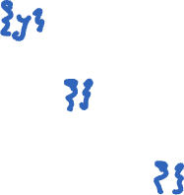
Free and Bound Variables
A variable x is bound if it is in the scope of a lambda abstraction: as in λx. E
Variable is free otherwise
1. (λx. x) y
2. (λz. z z) (λx. x)
3. λx.λy.λz. x z (y (λu. u))
Notes:
y is free.
No free variables
No free variables

Slide 18
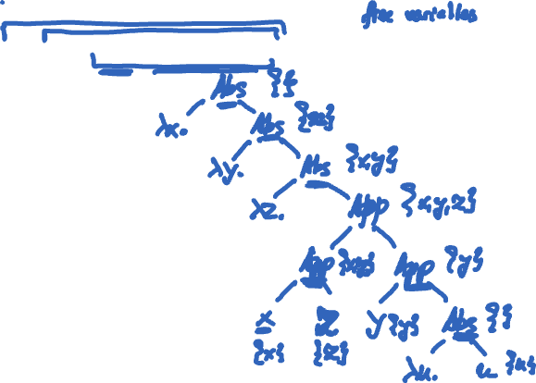
Free and Bound Variables
λx.λy.λz. x z (y (λu. u))
Notes:
Draw parse tree here and show the attribute grammar!

Slide 19
Free and Bound Variables
We must take free and bound variables into account when reducing expressions
E.g., (λx.λy. x y) (y w)
Reduction rule defined in terms of substitution:
( λy. x y ) [(y w)/x]
First, rename bound y in λy. x y to z: λz. x z ( more precisely, we have to rename to a variable that is NOT free in either (y w) or (x y) )
Second, replace x with argument (y w) safely: ( λz. (y w) z ) = λz. y w z

Slide 20
Lecture Outline
Lambda calculus
Introduction
Syntax and semantics
Free and bound variables
Substitution, formally

Slide 21
Substitution, formally
(λx.E) M → E[M/x] replaces all free occurrences of x in E by M
E[M/x] is defined by cases on E:
Var: y[M/x] =
y[M/x] =
App: (E₁ E₂)[M/x] =
Abs: (λy.E₁)[M/x] =
(λy.E₁)[M/x] =
M if x = y
y otherwise
(E₁[M/x] E₂[M/x])
λy.E₁ if x = y
λz.((E₁[z/y])[M/x]) otherwise,
where z NOT in free(E₁) U free(M) U {x}

Slide 22
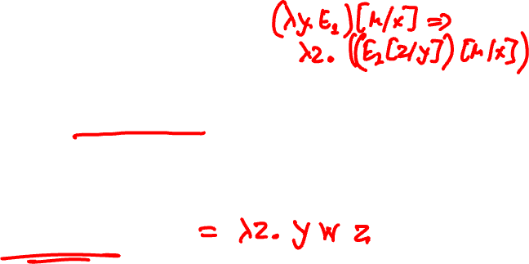
Substitution, formally
(λx.λy. x y) (y w)
(λy. x y)[(y w)/x]
λ1_. ( ((x y)[1_/y])[(y w)/x] )
λ1_. ( (x 1_)[(y w)/x] )
λ1_. ( (y w) 1_ )
λ1_. y w 1_
You will have to implement this substitution algorithm in Haskell

Slide 23
Substitution, formally
(λx.λy. λz. x z (y z)) (λx.x)

Slide 24
The End

