Slide 1
Lambda Calculus
Reading: Scott, Ch. 11 on CD

Slide 2
Lecture Outline
Lambda calculus, continued
Substitution, review
Rules of the lambda calculus
Normal forms
Reduction strategies

Slide 3
Syntax of Pure Lambda Calculus
Convention:
notation f, x, y, z for variables;
E, M, N, P, Q for expressions
E ::= x | ( λx. E₁ ) | ( E₁ E₂ )
A λ-expression is one of
Variable: x
Abstraction (i.e., function definition): λx. E₁
Application: E₁ E₂
λ-calculus formulae (e.g., ( λx. (x y) )) are called expressions or terms
( λx. (x y) ) corresponds to (lambda (x) (x y)) in Scheme!
Notes:
I use notation f, x, y, z for variables; E, M, N, P, Q for expressions

Slide 4
Syntactic Conventions
May drop parenthesis from ( E₁ E₂ ) or ( λx. E )
E.g., ( f x ) may be written as f x
Function application is left-associative
I.e., it groups from left-to-right
E.g., x y z abbreviates ( ( x y ) z )
E.g., E₁ E₂ E₃ E₄ abbreviates ( ( ( E₁ E₂ ) E₃ ) E₄ )
Application has higher precedence than abstraction
Another way to say this is that the scope of the dot extends as far to the right as possible
E.g., λx. x y = λx. ( x y ) = ( λx. ( x y ) ) ≠ ( ( λx. x ) y )

Slide 5
Free and Bound Variables
Abstraction ( λx. E ) introduces a binding
Variable x is said to be bound in λx. E
The set of free variables of E is the set of variables that are unbound in E
Defined by cases on E
Var x:
App E₁ E₂:
Abs λx.E:
free(x) = {x}
free(E₁ E₂) = free(E₁) U free(E₂)
free(λx.E) = free(E) - {x}

Slide 6
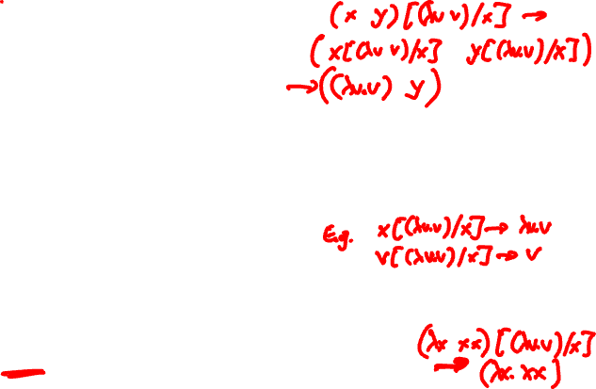
Substitution, formally
(λx. E) M → E[M/x] replaces all free occurrences of x in E by M
E[M/x] is defined by cases on E:
Var: y[M/x] =
y[M/x] =
App: (E₁ E₂)[M/x] =
Abs: (λy. E₁)[M/x] =
(λy. E₁)[M/x] =
M if x = y
y otherwise
(E₁[M/x] E₂[M/x])
λy. E₁ if x = y
λz. ((E₁[z/y])[M/x]) otherwise,
where z NOT in free(E₁) U free(M) U {x}

Slide 7
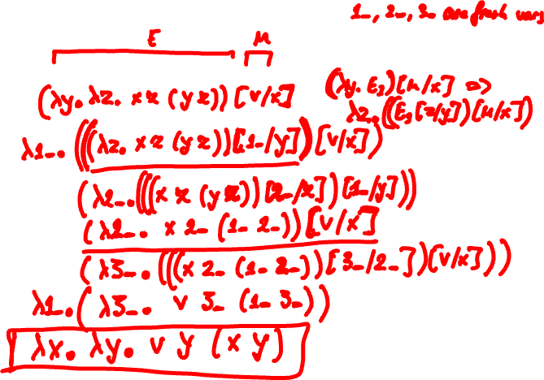
Substitution, formally
(λx.λy. λz. x z (y z)) v

Slide 8
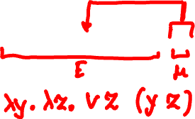
Substitution, formally
(λx.λy. λz. x z (y z)) v

Slide 9
Rules (Axioms) of Lambda Calculus
α rule (α-conversion): renaming of parameter (choice of parameter name does not matter)
λx.E →_{α} λz.(E[z/x]) provided that z is not free in E
e.g., λx. x x is the same as λz. z z
β rule (β-reduction): function application (substitutes argument for parameter)
(λx. E) M →_{β} E[M/x]
Note: E[M/x] as defined on previous slide!
e.g., (λx. x) z →_{β} z

Slide 10
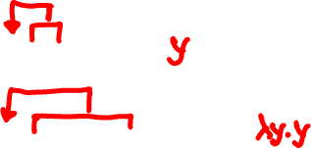
Rules of Lambda Calculus: Exercises
Use α-conversion and/or β-reduction:
(λx. x) y →_{αβ} ?
(λx. x) (λy. y) →_{αβ} ?
(λx.λy.λz. x z (y z)) (λu. u) (λv. v) →_{αβ}
Notation: →_{αβ} denotes that expression on the left reduces
to the expression on the right, through a sequence α-conversions
and β-reductions.

Slide 11
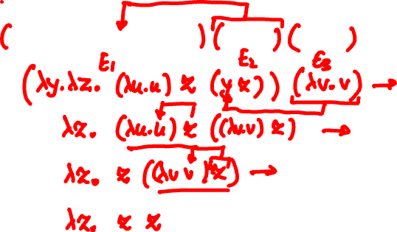
Rules of Lambda Calculus: Exercises
Use α-conversion or β-reduction:
(λx.λy.λz. x z (y z)) (λu. u) (λv. v) →_{αβ}

Slide 12
Reductions
An expression ( λx.E ) M is called a redex (for reducible expression)
An expression is in normal form if it cannot be β-reduced
The normal form is the meaning of the term, the “answer”

Slide 13
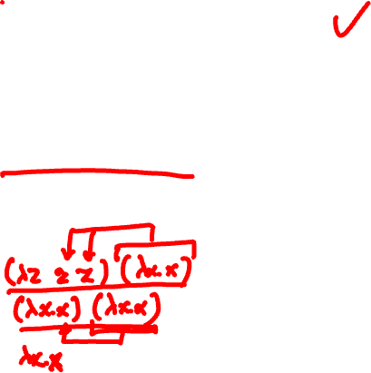
Questions
Is λz. z z in normal form?
Answer: yes, it cannot be beta-reduced
Is (λz. z z) (λx. x) in normal form?
Answer: no, it can be beta-reduced

Slide 14
Lecture Outline
Lambda calculus, continued
Substitution, review
Rules of the lambda calculus
Normal forms
Reduction strategies

Slide 15
Definitions of Normal Form
Normal form (NF): a term without redexes
Head normal form (HNF)
x is in HNF
(λx. E) is in HNF if E is in HNF
(x E₁ E₂ … E_{n}) is in HNF
Weak head normal form (WHNF)
x is in WHNF
(λx. E) is in WHNF
(x E₁ E₂ … E_{n}) is in WHNF

Slide 16
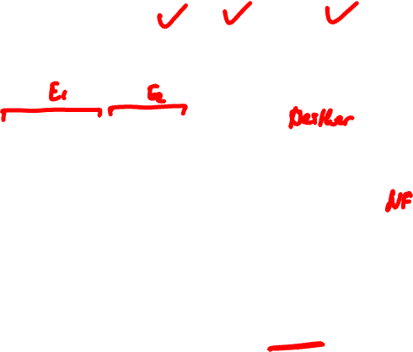
Questions
λz. z z is in NF, HNF, or WHNF?
(λz. z z) (λx. x) is in?
λx.λy.λz. x z (y (λu. u)) is in?
(We will be reducing to NF, mostly)

Slide 17
Questions
(λx.λy. x) z ((λx. z x) (λx. z x)) is in?

Slide 18
Questions
z ((λx. z x) (λx. z x)) is in?

Slide 19
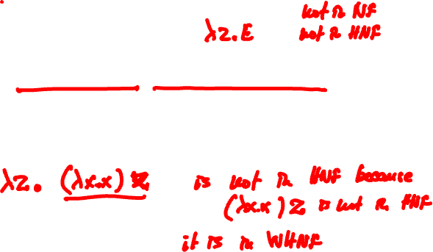
Questions
λz.(λx.λy. x) z ((λx. z x) (λx. z x)) is in?

Slide 20
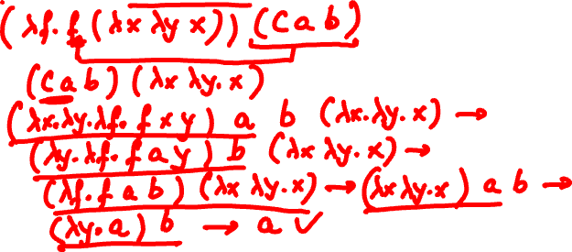
More Reduction Exercises
C = λx.λy.λf. f x y
H = λf. f (λx.λy. x) T = λf. f (λx.λy. y)
What is H (C a b)?

Slide 21
Exercise
An expression with no free
variables is called combinator.
S, I, C, H, T are combinators.
S = λx.λy.λz. x z (y z)
I = λx. x
What is S I I I?
Reducible expression is underlined
at each step.

Slide 22
Lecture Outline
Lambda calculus, continued
Substitution, review
Rules of the lambda calculus
Normal forms
Reduction strategies

Slide 23
Reduction Strategy
Look again at (λx.λy.λz. x z (y z)) (λu. u) (λv. v)
Actually, there are (at least) two “reduction paths”:
Path 1: (λx.λy.λz. x z (y z)) (λu. u) (λv. v) →_{β} (λy.λz. (λu. u) z (y z)) (λv. v) →_{β}
(λz. (λu. u) z ((λv. v) z)) →_{β} (λz. z ((λv. v) z)) →_{β}
λz. z z
Path 2: (λx.λy.λz. x z (y z)) (λu. u) (λv. v) →_{β} (λy.λz. (λu. u) z (y z)) (λv. v) →_{β}
(λy.λz. z (y z)) (λv. v) →_{β} (λz. z ((λv. v) z)) →_{β}
λz. z z

Slide 24
Reduction Strategy
A reduction strategy (also called evaluation order) is a strategy for choosing redexes
How do we arrive at a normal form (answer)?
Applicative order reduction chooses the leftmost-innermost redex in an expression
Also referred to as call-by-value reduction

Slide 25
Reduction Strategy
A reduction strategy (also called evaluation order) is a strategy for choosing redexes
How do we arrive at a normal form (answer)?
Normal order reduction chooses the leftmost-outermost redex in an expression
Also referred to as call-by-name reduction

Slide 26
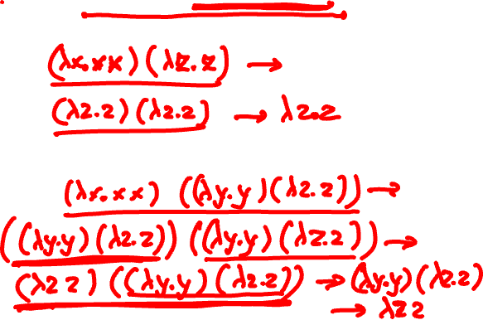
Reduction Strategy: Examples
Evaluate (λx. x x) ( (λy. y) (λz. z) )
Using applicative order reduction:
Using normal order reduction
Notes:
Both orders arrived at the same normal form (generally, but not always true!)
Normal order took more work (generally true).

Slide 27
Reduction Strategy
In our examples, both strategies produced the same result. This is not always the case
First, look at expression (λx. x x) (λx. x x). What happens when we apply β-reduction to this expression?
Then look at (λz. y) ((λx. x x) (λx. x x))
Applicative order reduction – what happens?
Normal order reduction – what happens?
Notes:
Applicative order never terminates!
Normal order reduction terminates. It evaluates to y.

Slide 28
Church-Rosser Theorem
Normal form implies that there are no more reductions possible
Church-Rosser Theorem, informally
If normal form exists, then it is unique (i.e., result of computation does not depend on the order that reductions are applied; i.e., no expression can have two distinct normal forms)
If normal form exists, then normal order will find it
Church-Rosser Theorem, more formally:
For all pure λ-expressions M, P and Q, if M →* P and M →* Q, then there must exist an expression R such that P →* R and Q →* R

Slide 29
Reduction Strategy
Intuitively:
Applicative order (call-by-value) is an eager evaluation strategy. Also known as strict
Normal order (call-by-name) is a lazy evaluation strategy
What order of evaluation do most programming languages use?

Slide 30
Exercises
Evaluate (λx.λy. x y) ((λz. z) w)
Using applicative order reduction
Using normal order reduction

Slide 31
Exercise
Let S = λxyz. x z (y z) and let I = λx. x
Evaluate S I I I using applicative order

Slide 32
Exercise
Let S = λxyz. x z (y z) and let I = λx. x
Evaluate S I I I using normal order

Slide 33
The End

