Slide 1
Announcements
Quiz 6
HW5 due on Friday
Exam 2 in one week
Practice tests on Submitty
Review and practice on Friday

Slide 2
Lambda Calculus

Slide 3
Lecture Outline
Quiz 6
Lambda calculus
Reduction strategies (catch-up)
Applied lambda calculus
Introduction to types and type systems
Simply typed lambda calculus (System F₁)
If we have time

Slide 4
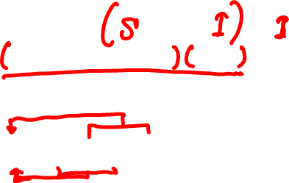
Reduction Strategy
Look again at (λx.λy.λz. x z (y z)) (λu. u) (λv. v)
Actually, there are (at least) two “reduction paths”:
Path 1: (λx.λy.λz. x z (y z)) (λu. u) (λv. v) →_{β} (λy.λz. (λu. u) z (y z)) (λv. v) →_{β}
(λz. (λu. u) z ((λv. v) z)) →_{β} (λz. z ((λv. v) z)) →_{β}
λz. z z
Path 2: (λx.λy.λz. x z (y z)) (λu. u) (λv. v) →_{β} (λy.λz. (λu. u) z (y z)) (λv. v) →_{β}
(λy.λz. z (y z)) (λv. v) →_{β} (λz. z ((λv. v) z)) →_{β}
λz. z z

Slide 5
Reduction Strategy
A reduction strategy (also called evaluation order) is a strategy for choosing redexes
How do we arrive at a normal form (answer)?
Applicative order reduction chooses the leftmost-innermost redex in an expression
Also referred to as call-by-value reduction

Slide 6
Reduction Strategy
A reduction strategy (also called evaluation order) is a strategy for choosing redexes
How do we arrive at a normal form (answer)?
Normal order reduction chooses the leftmost-outermost redex in an expression
Also referred to as call-by-name reduction

Slide 7
Reduction Strategy: Examples
Evaluate (λx. x x) ( (λy. y) (λz. z) )
Using applicative order reduction:
Using normal order reduction
Notes:
Both orders arrived at the same normal form (generally, but not always true!)
Normal order took more work (generally true).

Slide 8
Reduction Strategy
In our examples, both strategies produced the same result. This is not always the case
First, look at expression (λx. x x) (λx. x x). What happens when we apply β-reduction to this expression?
Then look at (λx.λy. y) ((λx. x x) (λx. x x)) z
Applicative order reduction – what happens?
Normal order reduction – what happens?
Notes:
Applicative order never terminates!
Normal order reduction terminates. It evaluates to z

Slide 9
Church-Rosser Theorem
Normal form implies that there are no more reductions possible
Church-Rosser Theorem, informally
If normal form exists, then it is unique (i.e., result of computation does not depend on the order that reductions are applied; i.e., no expression can have two distinct normal forms)
If normal form exists, then normal order will find it
Church-Rosser Theorem, more formally:
For all pure λ-expressions M, P and Q, if M →* P and M →* Q, then there must exist an expression R such that P →* R and Q →* R

Slide 10
Reduction Strategy
Intuitively:
Applicative order (call-by-value) is an eager evaluation strategy. Also known as strict
Normal order (call-by-name) is a lazy evaluation strategy
What order of evaluation do most programming languages use?

Slide 11
Exercises
Evaluate (λx.λy. x y) ((λz. z) w)
Using applicative order reduction
Using normal order reduction

Slide 12
Exercise
Let S = λxyz. x z (y z) and let I = λx. x
Evaluate S I I I using applicative order

Slide 13
Exercise
Let S = λxyz. x z (y z) and let I = λx. x
Evaluate S I I I using normal order

Slide 14
Lecture Outline
Quiz 6
Lambda calculus
Reduction strategies (catch-up)
Applied lambda calculus
Introduction to types and type systems
Simply typed lambda calculus (System F₁)
If we have time

Slide 15
Applied Lambda Calculus (from Sethi)
E ::= c | x | ( λx.E₁ ) | ( E₁ E₂ )
An applied lambda calculus augments the pure lambda calculus with constants. It defines its set of constants and reduction rules. For example:
Constants: Reduction rules:
if, true, false
(all these are λ terms,
e.g., true=λx.λy. x)
0, iszero, pred, succ
if true M N →_{δ} M
if false M N →_{δ} N
iszero 0 →_{δ} true
iszero (succ^{k} 0) →_{δ} false, k>0
iszero (pred^{k} 0) →_{δ} false, k>0
succ (pred M) →_{δ} M
pred (succ M) →_{δ} M

Slide 16
From an Applied Lambda Calculus to a Functional Language
Construct Applied λ-Calculus A Language (ML)
Variable x x
Constant c c
Application M N M N
Abstraction λx.M fun x => M
Integer succ^{k} 0, k>0 k
pred^{k} 0, k>0 -k
Conditional if P M N if P then M else N
Let (λx.M) N let val x = N in M end

Slide 17
The Fixed-Point Operator
One more constant and one more rule:
fix fix M →_{δ} M (fix M)
Needed to define recursive functions:
Therefore, we need:
plus = λx.λy. if (iszero x) y (plus (pred x) (succ y))
M(M(M… ))
y if x = 0
plus (pred x) (succ y) otherwise
plus x y =
x-1
y+1

Slide 18
The Fixed-Point Operator
But how do we define plus?
Define plus = fix M, where
M = λf. λx.λy. if (iszero x) y (f (pred x) (succ y))
We must show that
fix M =_{δβ} λx.λy. if (iszero x) y ((fix M) (pred x) (succ y))
?

Slide 19
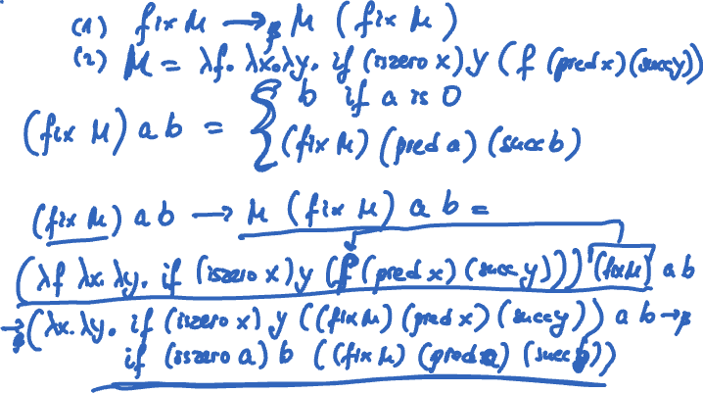
plus = fix M
?
otherwise
)

Slide 20
The Fixed-Point Operator
We have to show
fix M =_{δβ} λx.λy. if (iszero x) y ((fix M) (pred x) (succ y))
fix M =_{δ} M ( fix M ) =
(λf. λx.λy. if (iszero x) y (f (pred x) (succ y))) ( fix M ) =_{β}
λx.λy. if (iszero x) y ((fix M) (pred x) (succ y))

Slide 21
The Fixed-Point Operator
Define times =
fix (λf.λx.λy. if (iszero (pred x)) y (plus y (f (pred x) y)))
Exercise: define factorial = ?

Slide 22
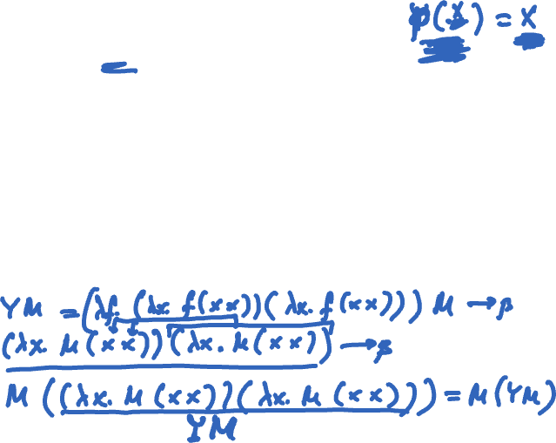
The Y Combinator
fix is, of course, a lambda expression!
One possibility, the famous Y combinator:
Y = λf. (λx. f (x x)) (λx. f (x x))
Show that Y M indeed reduces to M (Y M)

Slide 23
Types!
Constants are convenient
But they raise problems because they permit “bad” terms such as
if 0 y z (0 doesn’t make sense as first argument; true/false values do)
(0 x) (0 does not apply as a function)
succ true (undefined in our language)
plus true 0 etc.

Slide 24
Types!
Why types?
Safety. Catch semantic errors early
Data abstraction. Simple types and ADTs
Documentation (statically-typed languages only)
Type signature is a form of specification!
Statically typed vs. dynamically typed languages
Type annotations vs. type inference
Type safe vs. type unsafe

Slide 25
Type System
Informally, it is a set of rules that we apply on syntactic constructs in the language
In type theory, it is defined in terms of
Type environment
Typing rules, also called type judgments
This is typically referred to as the type system

Slide 26
Example, More On This Later
looks up the type of x in environment Γ
x:τ Γ
(Variable)
Γ |- x : τ
Γ |- E₁ : σ→τ Γ |- E₂ : σ
(Application)
Γ |- (E₁ E₂) : τ
binding: augments environment Γ
with binding of x to type σ
Γ,x:σ |- E₁ : τ
(Abstraction)
Γ |- (λx:σ. E₁) : σ → τ

Slide 27
Type System
A type system either accepts a term (i.e., term is “well-typed”), or rejects it
Type soundness, also called type safety
Well-typed terms never “go wrong”
A sound type system never accepts a term that can “go wrong”
A complete type system never rejects a term that cannot “go wrong”
Whether a term can “go wrong” is undecidable
Type systems choose type soundness (i.e., safety)

Slide 28
Putting It All Together, Formally
Simply typed lambda calculus (System F₁)
Syntax of the simply typed lambda calculus
The type system: type expressions, environment, and type judgments
The dynamic semantics
Stuck states
Type soundness theorem: progress and preservation theorem

Slide 29
Type Expressions
Introducing type expressions
τ ::= b | τ → τ
A type is a basic type b (we will only consider int and bool, for simplicity), or a function type
Examples
int
bool → (int → int) // → is right-associative, thus can write just bool → int → int
Syntax of terms:
E ::= x | ( λx:τ. E₁ ) | ( E₁ E₂ )

Slide 30
Type Environment and Type Judgments
A term in the simply typed lambda calculus is
Type correct i.e., well-typed, or
Type incorrect
The rules that judge type correctness are given in the form of type judgments in an environment
Environment Γ |- E : τ (|- is the turnstile)
Read: environment Γ entails that E has type τ
Type judgment
Premises
Γ |- E₁ : σ→τ Γ |- E₂ : σ
Γ |- (E₁ E₂) : τ
Conclusion

Slide 31
Semantics
looks up the type of x in environment Γ
x:τ Γ
(Variable)
Γ |- x : τ
Γ |- E₁ : σ→τ Γ |- E₂ : σ
(Application)
Γ |- (E₁ E₂) : τ
binding: augments environment Γ
with binding of x to type σ
Γ,x:σ |- E₁ : τ
(Abstraction)
Γ |- (λx:σ. E₁) : σ → τ

Slide 32
Examples
Deduce the type for
λx: int.λy: bool. x in the nil environment

Slide 33
Extensions
Γ |- E₁ : int Γ |- E₂ : int
Γ |- c : int
Γ |- E₁+E₂ : int
Γ |- E₁ : int Γ |- E₂ : int
(Comparison)
Γ |- E₁=E₂ : bool
Γ |- b : bool Γ |- E₁ : τ Γ |- E₂ : τ
Γ |- if b then E₁ else E₂ : τ

Slide 34
Examples
Is this a valid type?
Nil |- λx: int.λy: bool. x+y : int → bool → int
No. It gets rightfully rejected. Term reaches a state that goes wrong as it applies + on a value of the wrong type (y is bool, + is defined on ints)
Is this a valid type?
Nil |- λx: bool.λy: int. if x then y else y+1 : bool → int → int

Slide 35
Examples
Can we deduce the type of this term?
λf. λx. if x=1 then x else (f (f (x-1))) : ?
Γ |- E₁ : int Γ |- E₂ : int
Γ |- E₁=E₂ : bool
Γ |- E₁ : int Γ |- E₂ : int
Γ |- E₁+E₂ : int
Γ |- b : bool Γ |- E₁ : τ Γ |- E₂ : τ
Γ |- if b then E₁ else E₂ : τ

Slide 36
Examples
Can we deduce the type of this term?
foldl =
λf.λx.λy.if x=() then y else (foldl f (cdr x) (f y (car x))):
Γ |- E : list τ
Γ |- E : list τ
Γ |- (car E) : τ
Γ |- (cdr E) : list τ

Slide 37
Examples
How about this
(λx. x (λy. y) (x 1)) (λz. z) : ?
x cannot have two “different” types
(x 1) demands int → ?
(x (λy. y)) demands ( τ → τ ) → ?
Program does not reach a “stuck state” but is nevertheless rejected. A sound type system typically rejects some correct programs

Slide 38
The End

