Slide 1
Exam 2 Topics

Slide 2
Topics
Scheme (Lectures 12 and 13, plus chapters)
S-expression syntax
Lists and recursion
Shallow and deep recursion
Equality
Higher-order functions
map, foldl, and foldr
Programming with map, foldl, and foldr
Tail recursion

Slide 3
Topics
Scheme (Lecture 14, plus chapters)
Binding with let, let*, letrec
Scoping in Scheme
Closures and closure bindings

Slide 4
Topics
Scoping, revisited (Lecture 14, plus chapters)
Static scoping
Reference environment
Functions as third-class values vs.
Functions as first-class values
Dynamic scoping
With shallow binding
With deep binding

Slide 5
Topics
Lambda calculus (Lectures 15, 16, and 17)
Syntax and semantics
Free and bound variables
Substitution
Rules of the Lambda calculus: Alpha-conversion and Beta-reduction
Normal forms
Reduction strategies: Normal order and Applicative order
Fix-point combinator and recursion

Slide 6
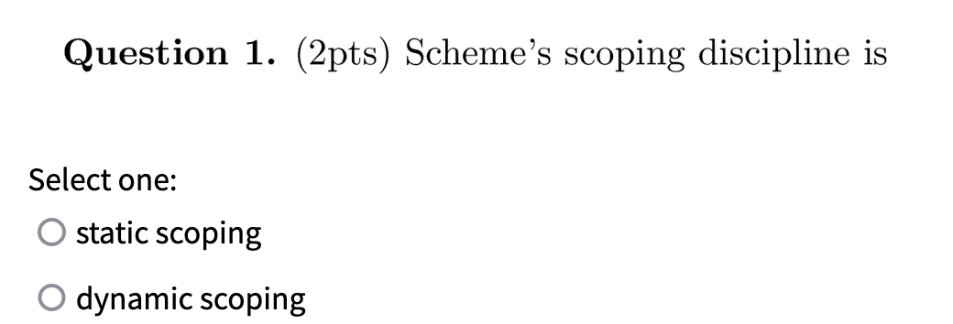
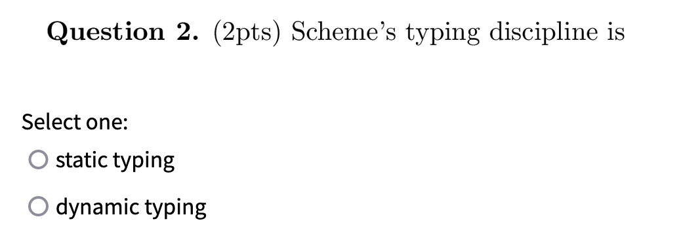
Quiz 5

Slide 7
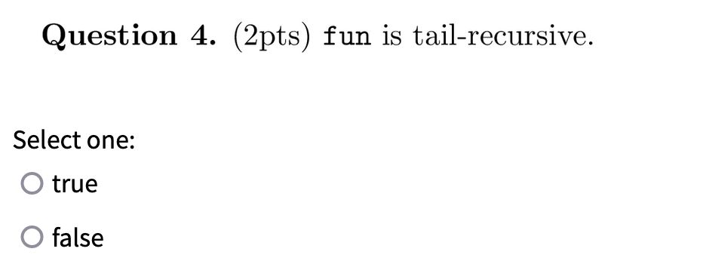
Quiz 5

Slide 8
Quiz 5

Slide 9
Scoping with First-Class Functions
Functions as first-class values
Static scoping is more involved
Function value may outlive static referencing environment!
Therefore, we need “immortal” closure bindings

Slide 10
Scoping with First-Class Functions
Dynamic scoping is more involved
Shallow binding vs. deep binding
Dynamic scoping with shallow binding
Reference environment for function/routine is not created until the function is called
As a result, all non-local references are resolved using the most-recent-frame-on-stack rule

Slide 11
Scoping with First-Class Functions
Dynamic scoping with deep binding
When a function/routine is passed as an argument, the code that passes the function/routine has a particular reference environment (the current one!) in mind. It passes this reference environment along with the function value (it passes a closure).

Slide 12
Example
v : integer := 10
people : database
print_routine (p : person) if p.age > v write_person(p)
other_routine (db : database, P : procedure) v : integer := 5 foreach record r in db P(r) other_routine(people, print_routine) /* call in main */
Notes:
With static scoping, print_routine prints persons older than 10.
With dynamic scoping with shallow binding, print_routine
references other_routine’s v, and prints 5.
With dynamic scoping with deep binding, when main calls other_routine, it not only sends print_routine as an argument,
but it also sends its reference environment { v -> 10 } to be used when print_routine is actually called. Thus, prints 10.

Slide 13
Quiz 6

Slide 14
Quiz 6

Slide 15
Quiz 6

Slide 16
Unification (simplified)
Unify: tries to unify terms τ₁ and τ₂ and binds variables to values if τ₁ = τ₂ if unification is successful
def Unify(τ₁,τ₂) =
case (τ₁,τ₂)
(τ₁,V₂) -> success with binding [τ₁/V₂] if V₂ does not occur in τ₁; fail otherwise
(V₁,τ₂) -> success with binding [τ₂/V₁] if V₁ does not occur in τ₂;
fail otherwise
(c₁,c₂) -> success if (eq? c₁ c₂); fail otherwise
(p(τ₁₁,τ₁₂), p(τ₂₁,τ₂₂)) -> Unify(τ₁₁,τ₂₁); Unify(τ₁₂,τ₂₂)
otherwise = fail
This is the occurs check!

Slide 17
Questions?

Slide 18
The End

