Slide 1
Intro to Haskell, conclusion

Slide 2
Announcements
Quiz 7
HW6 due Tuesday Nov. 29
Please to install GHC as soon as possible
Post on Submitty forum if you hit a snag
Released Exam 2 and latest Rainbow grades
Please let me know if you find anything amiss

Slide 3
Lecture Outline
Haskell
Basic syntax and interpreters
Lazy evaluation
Static typing and static type inference
Algebraic data types and pattern matching
Type classes
Monads … and more

Slide 4
Generic Functions in Haskell
We can generalize a function when a function makes no assumptions about the type:
const :: a -> b -> a
const x y = x
apply :: (a->b)->a->b
apply g x = g x

Slide 5
Generic Functions
-- List datatype
data List a = Nil | Cons a (List a)
Can we write a function sum over a list of a’s?
sum :: a -> List a -> a
sum n Nil = n
sum n (Cons x xs) = sum (n+x) xs
Type error: No instance for (Num a) arising from a use of ‘+’
a no longer unconstrained. Type and function definition imply we apply + on a but
+ is not defined on all types!

Slide 6
Haskell Type Classes
Not to be confused with Java classes/interfaces
Let us define a type class containing the arithmetic and comparison operators:
class Num a where
(==) :: a -> a -> Bool
(+) :: a -> a -> a
…
instance Num Int where
x == y = ...
...
instance Num Float where
…
Read: A type a is an instance of the type
class Num if it provides “overloaded”
definitions of operators ==, +, …
Read: Int and Float are instances of Num

Slide 7
Generic Functions with Type Class
sum :: (Num a) => a -> List a -> a
sum n Nil = n
sum n (Cons x xs) = sum (n+x) xs
One view of type classes: predicates
(Num a) is a predicate in type definitions
Constrains the specific types we can instantiate a generic function with
A type class has associated laws

Slide 8
Type Class Hierarchy
Each type class corresponds to one concept
Class constraints give rise to a hierarchy
Eq is a superclass of Ord
Ord inherits specification of (==) and (/=)
Notion of “true subtyping”
class Eq a where
(==), (/=) :: a -> a -> Bool
class (Eq a) => Ord a where
(<), (<=), (>), (>=) :: a -> a -> Bool
min, max :: a -> a -> a

Slide 9
Lecture Outline
Haskell
Covered syntax and interpreters
Lazy evaluation
Static typing and static type inference
Algebraic data types and pattern matching
Type classes
Monads … and more

Slide 10
Monads
One source: All About Monads (haskell.org)
Another source: textbook
A way to cleanly compose computations
E.g., f may return a value of type a or Nothing
Composing computations becomes tedious: case (f s) of
Nothing → Nothing
Just m → case (f m) …
In Haskell, monads encapsulate IO and other imperative features
Notes:
“A monad is just a monoid in the category of endofunctors, what's the problem?”

Slide 11
An Example: Cloned Sheep
type Sheep = …
father :: Sheep → Maybe Sheep
father s = ...
mother :: Sheep → Maybe Sheep
mother s = …
(A sheep may have a mother and a father, just a mother, or just a father.)
maternalGrandfather :: Sheep → Maybe Sheep
maternalGrandfather s = case (mother s) of
Nothing → Nothing
Just m → father m

Slide 12
An Example
mothersPaternalGrandfather :: Sheep → Maybe Sheep
mothersPaternalGrandfather s = case (mother s) of
Nothing → Nothing
Just m → case (father m) of
Nothing → Nothing
Just gf → father gf
Tedious, unreadable, difficult to maintain
Monads help!

Slide 13
The Monad Type Class
Haskell’s Monad class requires 2 operations, >>= (bind) and return
class Monad m where
// >>= (the bind operation) takes a monad // m a, and a function that takes a and turns
// it into a monad m b
(>>=) :: m a → (a → m b) → m b
// return encapsulates a value into the monad
return :: a → m a

Slide 14
The Maybe Monad
data Maybe a = Nothing | Just a
instance Monad Maybe where
Nothing >>= f = Nothing
(Just x) >>= f = f x
return = Just
Cloned Sheep example:
mothersPaternalGrandfather s =
(return s) >>= mother >>= father >>= father
(Note: if at any point, some function returns Nothing, Nothing gets cleanly propagated.)

Slide 15
The List Monad
The List type is a monad!
lis >>= f = concat (map f lis)
return x = [x]
Note: concat::[[a]] → [a]
e.g., concat [[1,2],[3,4],[5,6]] yields [1,2,3,4,5,6]
Use any f s.t. f::a→[b]. f may yield a list of 0,1,2,… elements of type b, e.g.,
> f x = [x+1]
> [1,2,3] >>= f --- yields ?

Slide 16
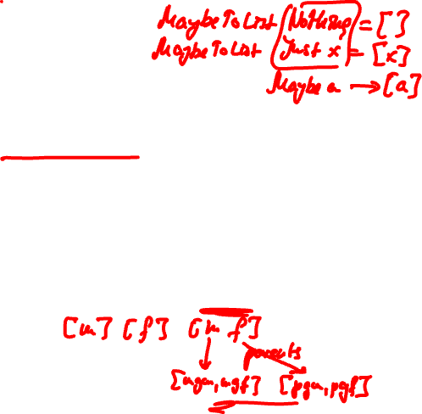
The List Monad
parents :: Sheep → [Sheep]
parents s = MaybeToList (mother s) ++
MaybeToList (father s)
grandParents :: Sheep → [Sheep]
grandParents s = (parents s) >>= parents

Slide 17
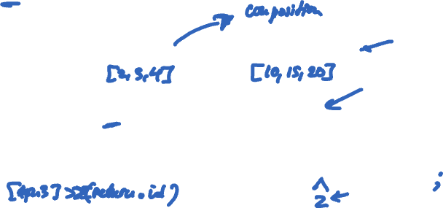
The do Notation
do notation is syntactic sugar for monadic bind
> f x = x+1
> g x = x*5
> [1,2,3] >>= (return . f) >>= (return . g)
Or
> [1,2,3] >>= \x->[x+1] >>= \y->[y*5]
Or, make encapsulated element explicit with do
> do { v <- [1,2,3]; w <- (\x->[x+1]) v; (\y->[y*5]) w }
Notes:
. Means function composition.

Slide 18
List Comprehensions
> [ x | x <- [1,2,3,4] ]
[1,2,3,4]
> [ x | x <- [1,2,3,4], x `mod` 2 == 0 ]
[2,4]
> [ [x,y] | x <- [1,2,3], y <- [6,5,4] ]
[[1,6],[1,5],[1,4],[2,6],[2,5],[2,4],[3,6],[3,5],[3,4]]

Slide 19
List Comprehensions
List comprehensions are syntactic sugar on top of the do notation!
[ x | x <- [1,2,3,4] ] is syntactic sugar for
do { x <- [1,2,3,4]; return x }
[ [x,y] | x <- [1,2,3], y <- [6,5,4] ] is syntactic sugar for
do { x <- [1,2,3]; y<-[6,5,4]; return [x,y] }
Which in turn, we can translate into monadic bind…

Slide 20
So What’s the Point of the Monad…
Conveniently chains (builds) computation
Encapsulates “mutable” state. E.g., IO:
openFile :: FilePath -> IOMode -> IO Handle
hClose :: Handle -> IO () -- void
hIsEOF :: Handle -> IO Bool
hGetChar :: Handle -> IO Char
These operations break “referentially transparency”.
For example, hGetChar typically returns different value
when called twice in a row!

Slide 21
The End

