Slide 1
Intro to Haskell, continued

Slide 2
Announcements
Moved Quiz 7 to Friday
HW6 is posted, due Tuesday Nov. 29
Please to install GHC as soon as possible
Post on Submitty forum if you hit a snag
We will release Exam 2 grades later this week

Slide 3
Lecture Outline
Haskell
Covered basic syntax and interpreters
Lazy evaluation
Static typing and static type inference
Algebraic data types and pattern matching
Type classes
Monads … and more

Slide 4
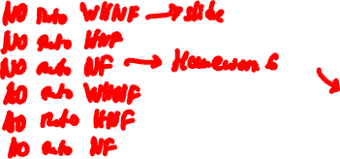
Normal Order to WHNF Interpreter
Haskell syntax:
let …. in
case f of
→
Definition by cases on E ::= x | λx. E₁ | E₁ E₂
interpret(x) = x
interpret(λx.E₁) = λx.E₁
interpret(E₁ E₂) = let f = interpret(E₁)
in case f of
λx.E₃ → interpret(E₃[E₂/x])
- → f E₂
Apply function
before “interpreting” the argument

Slide 5
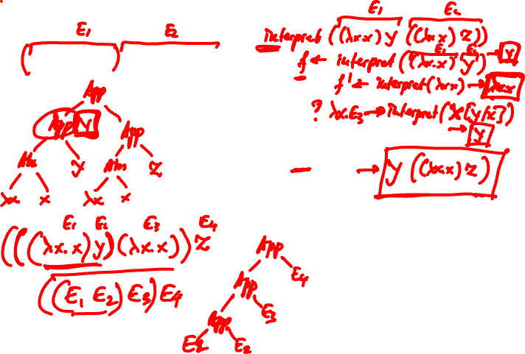
Interpreter Example
(λx.x) y ((λx.x) z)

Slide 6
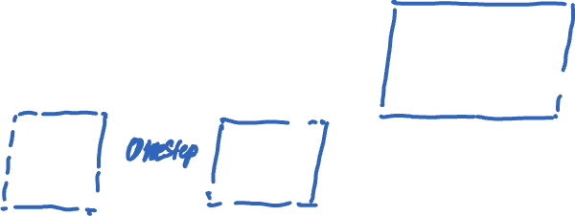
Homework
A step-by-step Normal order to Normal form interpreter

Slide 7
Lazy Evaluation
Unlike Scheme (and most programming languages) Haskell does use lazy evaluation, i.e., normal order reduction
It won’t evaluate an expression until it is needed
> f x y = x*y
> f (5+1) (5+2)
--- evaluates to (5+1) * (5+2)
--- evaluates argument when needed

Slide 8
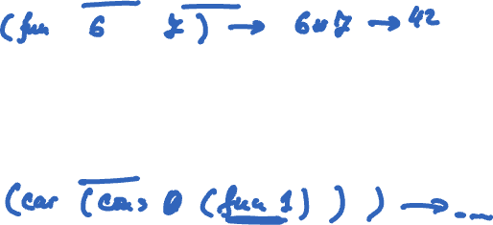
Lazy Evaluation
In Scheme:
(define (fun x y) (* x y))
> (fun (+ 5 1) (+ 5 2)) ->
(define (fun n)
(cons n (fun (+ n 1))))
> (car (fun 0))
>

Slide 9
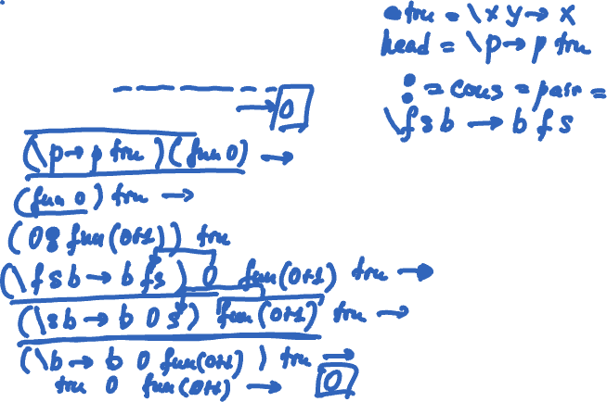
Lazy Evaluation
: denotes “cons” :
constructs a list with
head n and tail fun(n+1)
In Haskell:
fun n = n : fun(n+1)
> head (fun 0)
>

Slide 10
Lazy Evaluation
> f x = [] --- f takes x and returns the empty list
> f (repeat 1) --- repeat produces infinite list [1,1…
> []
> head ([1..]) --- [1..] is the infinite list of integers
> 1
Lazy evaluation allows infinite structures!

Slide 11
Aside: Python Generators
def gen(start):
n = start
while True:
yield n
n = n+1
gen_obj = gen(0)
print(next(gen_obj))
print(next(gen_obj))
print(next(gen_obj))

Slide 12
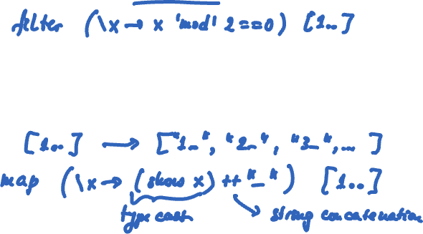
Lazy Evaluation
Generate the (infinite) list of even numbers
Generate an (infinite) list of “fresh variables”

Slide 13
Lazy Evaluation
Exercise: write a function that generates the (infinite) list of prime numbers

Slide 14
Static Typing and Type Inference
Unlike Scheme, which is dynamically typed, Haskell is statically typed!
Unlike Java/C++ we don’t have to write type annotations. Haskell infers types!
> let f x = head x in f True
• Couldn't match expected type ‘[a]’ with actual type ‘Bool’
• In the first argument of ‘f’, namely ‘True’
In the expression: f True …

Slide 15
Static Typing and Type Inference
Recall apply_n f n x:
> apply_n f n x = if n==0 then x else apply_n f (n-1) (f x)
> apply_n (+ 1) True 0
<interactive>:32:1: error:
• Could not deduce (Num Bool) arising from a use of ‘apply_n’
from the context: Num t2
bound by the inferred type of it :: Num t2 => t2
at <interactive>:32:1-22
• In the expression: apply_n (+ 1) True 0
In an equation for ‘it’: it = apply_n (+ 1) True 0

Slide 16
Lecture Outline
Haskell
Covered syntax and interpreters
Lazy evaluation
Static typing and static type inference
Algebraic data types and pattern matching
Type classes
Monads … and more

Slide 17
Algebraic Data Types
Algebraic data types are tagged unions (aka sums) of products (aka records)
data Shape = Line Point Point
| Triangle Point Point Point
| Quad Point Point Point Point
union
Haskell keyword
new constructors (a.k.a. tags, disjuncts, summands)
Line is a binary constructor, Triangle is a ternary …
the new type
Notes:
Quaternary

Slide 18
Algebraic Data Types
Constructors create values of the data type
let
l1::Shape
l1 = Line e1 e2
t1::Shape = Triangle e3 e4 e5
q1::Shape = Quad e6 e7 e8 e9
in
…

Slide 19
Algebraic Data Types in Haskell Homework
Defining a lambda expression
type Name = String
data Expr = Var Name
| Lambda Name Expr
| App Expr Expr deriving (Eq, Show)
> e1 = Var “x” // Lambda term x
> e2 = Lambda “x” e1 // Lambda term λx.x

Slide 20
Exercise: Define an ADT for Expressions as in your HW4
type Name = String
data Expr = Var Name
| Val Bool
| Myand Expr Expr
| Myor Expr Expr
| Mylet Name Expr Expr
deriving (Eq, Show)
evaluate :: Expr → [(Name,Bool)] → Bool
evaluate e env = …

Slide 21
Pattern Matching
Type signature of anchorPnt: takes
a Shape and returns a Point.
Examine values of an algebraic data type
anchorPnt :: Shape -> Point
anchorPnt s = case s of
Line p1 p2 -> p1
Triangle p3 p4 p5 -> p3
Quad p6 p7 p8 p9 -> p6
Two points
Test: does the given value match this pattern?
Binding: if it matches, deconstruct it and bind pattern params to corresponding arguments

Slide 22
Pattern Matching
Pattern matching “deconstructs” a term
> let h:t = "ana" in t
”na”
> let (x,y) = (10,”ana”) in x
10

Slide 23
Examples of Algebraic Data Types
Polymorphic types.
a is a type parameter!
data Bool = True | False
data Day = Mon | Tue | Wed | Thu | Fri | Sat | Sun
data List a = Nil | Cons a (List a)
data Tree a = Leaf a | Node (Tree a) (Tree a)
data Maybe a = Nothing | Just a
Maybe type denotes that result of computation can be a or Nothing. Maybe is a monad.

Slide 24
Type Constructor vs. Data Constructor
Bool and Day are nullary type constructors:
data Bool = True | False
data Day = Mon | Tue | Wed | Thu | Fri | Sat | Sun
E.g., x::Bool, y::Day
Maybe is a unary type constructor
data Maybe a = Nothing | Just a
E.g., s::Maybe Sheep, e::Maybe Expr

Slide 25
Lecture Outline
Haskell
Covered syntax and interpreters
Lazy evaluation
Static typing and static type inference
Algebraic data types and pattern matching
Type classes
Monads … and more

Slide 26
Generic Functions in Haskell
We can generalize a function when a function makes no assumptions about the type:
const :: a -> b -> a
const x y = x
apply :: (a->b)->a->b
apply g x = g x

Slide 27
Generic Functions
-- List datatype
data List a = Nil | Cons a (List a)
Can we write a function sum over a list of a’s?
sum :: a -> List a -> a
sum n Nil = n
sum n (Cons x xs) = sum (n+x) xs
Type error: No instance for (Num a) arising from a use of ‘+’
a no longer unconstrained. Type and function definition imply we apply + on a but
+ is not defined on all types!

Slide 28
Haskell Type Classes
Not to be confused with Java classes/interfaces
Define a type class containing the arithmetic operators
class Num a where
(==) :: a -> a -> Bool
(+) :: a -> a -> a
…
instance Num Int where
x == y = ...
...
instance Num Float where
…
Read: A type a is an instance of the type
class Num if it provides “overloaded”
definitions of operations ==, +, …
Read: Int and Float are instances of Num

Slide 29
Generic Functions with Type Class
sum :: (Num a) => a -> List a -> a
sum n Nil = n
sum n (Cons x xs) = sum (n+x) xs
One view of type classes: predicates
(Num a) is a predicate in type definitions
Constrains the specific types we can instantiate a generic function with
A type class has associated laws

Slide 30
Type Class Hierarchy
Each type class corresponds to one concept
Class constraints give rise to a hierarchy
Eq is a superclass of Ord
Ord inherits specification of (==) and (/=)
Notion of “true subtyping”
class Eq a where
(==), (/=) :: a -> a -> Bool
class (Eq a) => Ord where
(<), (<=), (>), (>=) :: a -> a -> Bool
min, max :: a -> a -> a

Slide 31
Lecture Outline
Haskell
Covered syntax and interpreters
Lazy evaluation
Static typing and static type inference
Algebraic data types and pattern matching
Type classes
Monads … and more

Slide 32
Monads
One source: All About Monads (haskell.org)
Another source: textbook
A way to cleanly compose computations
E.g., f may return a value of type a or Nothing
Composing computations becomes tedious: case (f s) of
Nothing → Nothing
Just m → case (f m) …
In Haskell, monads encapsulate IO and other imperative features
Notes:
“A monad is just a monoid in the category of endofunctors, what's the problem?”

Slide 33
An Example: Cloned Sheep
type Sheep = …
father :: Sheep → Maybe Sheep
father = ...
mother :: Sheep → Maybe Sheep
mother = …
(A sheep may have a mother and a father, just a mother, or just a father.)
maternalGrandfather :: Sheep → Maybe Sheep
maternalGrandfather s = case (mother s) of
Nothing → Nothing
Just m → father m

Slide 34
An Example
mothersPaternalGrandfather :: Sheep → Maybe Sheep
mothersPaternalGrandfather s = case (mother s) of
Nothing → Nothing
Just m → case (father m) of
Nothing → Nothing
Just gf → father gf
Tedious, unreadable, difficult to maintain
Monads help!

Slide 35
The Monad Type Class
Haskell’s Monad class requires 2 operations, >>= (bind) and return
class Monad m where
// >>= (the bind operation) takes a monad // m a, and a function that takes a and turns
// it into a monad m b
(>>=) :: m a → (a → m b) → m b
// return encapsulates a value into the monad
return :: a → m a

Slide 36
The Maybe Monad
data Maybe a = Nothing | Just a
instance Monad Maybe where
Nothing >>= f = Nothing
(Just x) >>= f = f x
return = Just
Cloned Sheep example:
mothersPaternalGrandfather s =
(return s) >>= mother >>= father >>= father
(Note: if at any point, some function returns Nothing, Nothing gets cleanly propagated.)

Slide 37
The List Monad
The List type is a monad!
lis >>= f = concat (map f lis)
return x = [x]
Note: concat::[[a]] → [a]
e.g., concat [[1,2],[3,4],[5,6]] yields [1,2,3,4,5,6]
Use any f s.t. f::a→[b]. f may yield a list of 0,1,2,… elements of type b, e.g.,
> f x = [x+1]
> [1,2,3] >>= f --- yields ?

Slide 38
The List Monad
parents :: Sheep → [Sheep]
parents s = MaybeToList (mother s) ++
MaybeToList (father s)
grandParents :: Sheep → [Sheep]
grandParents s = (parents s) >>= parents

Slide 39
The do Notation
do notation is syntactic sugar for monadic bind
> f x = x+1
> g x = x*5
> [1,2,3] >>= (return . f) >>= (return . g)
Or
> [1,2,3] >>= \x->[x+1] >>= \y->[y*5]
Or, make encapsulated element explicit with do
> do { v <- [1,2,3]; w <- (\x->[x+1]) v; (\y->[y*5]) w }
Notes:
. Means function composition.

Slide 40
List Comprehensions
> [ x | x <- [1,2,3,4] ]
[1,2,3,4]
> [ x | x <- [1,2,3,4], x `mod` 2 == 0 ]
[2,4]
> [ [x,y] | x <- [1,2,3], y <- [6,5,4] ]
[[1,6],[1,5],[1,4],[2,6],[2,5],[2,4],[3,6],[3,5],[3,4]]

Slide 41
List Comprehensions
List comprehensions are syntactic sugar on top of the do notation!
[ x | x <- [1,2,3,4] ] is syntactic sugar for
do { x <- [1,2,3,4]; return x }
[ [x,y] | x <- [1,2,3], y <- [6,5,4] ] is syntactic sugar for
do { x <- [1,2,3]; y<-[6,5,4]; return [x,y] }
Which in turn, we can translate into monadic bind…

Slide 42
So What’s the Point of the Monad…
Conveniently chains (builds) computation
Encapsulates “mutable” state. E.g., IO:
openFile :: FilePath -> IOMode -> IO Handle
hClose :: Handle -> IO () -- void
hIsEOF :: Handle -> IO Bool
hGetChar :: Handle -> IO Char
These operations break “referentially transparency”.
For example, hGetChar typically returns different value
when called twice in a row!

Slide 43
The End

