Slide 1
Types
Read: Scott, Chapters 7.1-7.2 and 8

Slide 2
Announcements
Check your Rainbow grades
Exam 1-2, Quiz 1-7, HW 1-5
Happy Thanksgiving!

Slide 3
Types and Type Systems
A key concept in programming languages
Haskell’s type system
Today, a more pragmatic view of types

Slide 4
Lecture Outline
Types
Type systems
Type checking
Type safety
Type equivalence
Types in C (next time)
Primitive types (next time)
Composite types (next time)

Slide 5
What Is a Type?
A set of values and the valid operations on those values
Integers:
+, -, *, /, <, <=, ==, ,>=, >
Arrays:
lookUp(<array>,<index>)
assign(<array>,<index>,<value>)
initialize(<array>), setBounds(<array>)
User-defined types:
Java interfaces

Slide 6
What Is the Role of Types?
What is the role of types in programming languages?
Semantic correctness
Data abstraction
Abstract Data Types (as we saw in Java)
Documentation (static types only)

Slide 7
3 Views of Types
Denotational (or set) point of view:
A type is simply a set of values. A value has a given type if it belongs to the set. E.g.
int = { …-1,0,1,2,... }
char = { ‘a’,’b’,... }
bool = { true, false }
Abstraction-based point of view:
A type is an interface consisting of a set of operations with well-defined meaning

Slide 8
3 Views of Types
Constructive point of view:
Primitive/simple types: e.g., int, char, bool
Composite/constructed types:
Constructed by applying type constructors
pointer e.g., pointer(int)
array e.g., array(char) or array(char,20) or ...
record/struct e.g., record(age:int, name:array(char))
union e.g., union(int, pointer(char))
CAN BE NESTED! pointer(array(pointer(char)))
For most of us, types are a mixture of these 3 views

Slide 9
What Is a Type System?
A mechanism to define types and associate them with programming language constructs
Deduce types for program constructs
Deduce if a construct is “type correct” or “type incorrect”
Additional rules for type equivalence, type compatibility
Important from pragmatic point of view
Notes:
As part of the mechanism, we have rules to 1) deduce types of expressions and 2) deduce if an expression is typed-correct or type-incorrect.

Slide 10
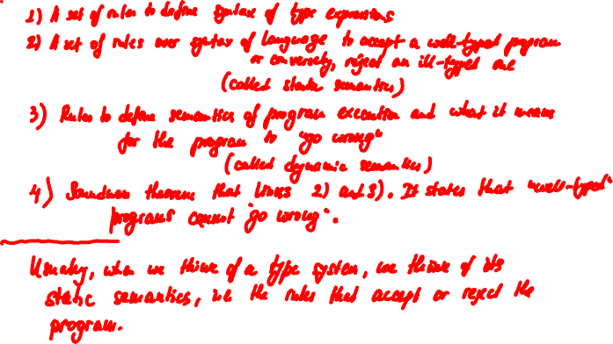
What Is a Type System?
Notes:
In formal type theory, a type system is made up of several components: type sytamx, a dynamic semantics that describes program execution, and a static semantics (a set of rules)
But in practice, what we typically refer to as a type system is that set of rules that 1) deduce types for constructs, and 2) either reject our program as type-incorrect (also called ill-typed), or accept our program as type-correct (or well-typed).

Slide 11
What Is Type Checking?
The process of ensuring that the program obeys the type rules of the language
Type checking can be done statically
At compile-time, i.e., before execution
Statically typed (or statically checked) language
Type checking can be done dynamically
At runtime, i.e., during execution
Dynamically typed (or dynamically checked) language

Slide 12
What Is Type Checking?
Statically typed (better term: statically checked) languages
Typically require type annotations (e.g., A a, List<A> list)
Typically have a complex type system, and most of type checking is performed statically (at compile-time)
Ada, Pascal, Java, C++, Haskell, ML/OCaml
A form of early binding
Dynamically typed (better term: dynamically checked) languages. Also known as Duck typed…
Typically require no type annotations!
All type checking is performed dynamically (at runtime)
Smalltalk, Lisp and Scheme, Python, JavaScript

Slide 13
What Is Type Checking?
The process of ensuring that the program obeys the type rules of the language
Type safety
Textbook defines term prohibited application (also known as forbidden error): intuitively, a prohibited application is an application of an operation on values of the wrong type
Type safety is the property that no operation ever applies to values of the wrong type at runtime. I.e., no prohibited application (forbidden error) ever occurs
Notes:
“Obey the type rules” is the same as “be type safe”.

Slide 14
Language Design Choices
Design choice: what is the set of forbidden errors?
Obviously, we cannot forbid all possible semantic errors…
Define a set of forbidden errors
Design choice: Once we’ve chosen the set of forbidden errors, how does the type system prevent them?
Static checks only? Dynamic checks only? A combination of both?
Furthermore, are we going to absolutely disallow forbidden errors (be type safe), or are we going to allow for programs to circumvent the system and exhibit forbidden errors (i.e., be type unsafe)?

Slide 15
Forbidden Errors
Example: indexing an array out of bounds
a[i], a is of size Bound, i<0 or Bound≤i
In C, C++, this is not a forbidden error
0≤i and i<Bound is not checked (bounds are not part of type)
What are the tradeoffs here?
In Pascal, this is a forbidden error. Prevented with static checks
0≤i and i<Bound must be checked at compile time
What are the tradeoffs here?
In Java, this is a forbidden error. It is prevented with dynamic checks
0≤i and i<Bound must be checked at runtime
What are the tradeoffs here?

Slide 16
Type Safety
Java vs. C++:
Java: Duck q; …; q.quack()class Duck has quack
C++: Duck *q; …; q->quack()class Duck has quack
Can we write code that passes the type checker, and yet it calls quack()on an object that isn’t a Duck at runtime?
In Java?
In C++?
Java is said to be type safe while C++ is said to be type unsafe

Slide 17
C++ Is Type Unsafe
//#1
void* x = (void *) new A;
B* q = (B*) x; //a safe downcast?
int case1 = q->foo()//what happens?
//#2
void* x = (void *) new A;
B* q = (B*) x; //a safe downcast?
int case2 = q->foo(66); //what happens?
A
virtual foo()
B
virtual foo() vritual foo(int)
q->foo(66) is a prohibited application (i.e., application of an
operation on a value of the wrong type, i.e., forbidden error).
Static type B* q “promises” the programmer that q will point to a
B object. However, language does not “honor” this promise…
Notes:
We create an A object and we upcast the object into a void *.
Next, we downcast x into a B* type. X is assigned to q where q is declared to be of B* type, or in other words, the type system promises us that q will point to a B object at runtime.
Next, we call foo of no arguments on q. What happens here? There is no easy answer. In fact this is undefined beharior and what happens depends on the implementation of the C++ compiler. I believe what happens in most implementation is that the runtime invokes A’s foo, given that the receiver object is an A. However, it is possible the compiler does some optimization based on the static types, that can cause seg fault or other incorrect behavior.

Slide 18
What Is Type Checking
statically not statically typed
typed (i.e., dynamically typed)
type safe
type unsafe Assembly
ML/Ocaml,
Haskell, Java*
Python, Scheme, R, JavaScript
C/C++
Notes:
Type safe/statically typed: ML/Ocaml, Java, Haskell
Type unsafe/statically typed: C/C++
Type safe/dynamically typed: Python, JS, Scheme, PHP, R, etc.

Slide 19
What Is Type Checking?
Static typing vs. dynamic typing
What are the advantages of static typing?
What are the advantages of dynamic typing?

Slide 20
Lecture Outline
Types
Type systems
Type checking
Type safety
Type equivalence
Types in C
Primitive types
Composite types

Slide 21
Type Equivalence
We now move in the world of procedural von Neumann languages
E.g., Fortran, Algol, Pascal and C
Value model
Statically typed
Notes:
The type checker checks expressions and statements and determines if they are type correct
or they are type incorrect.
Two types are “same type” if
They are equivalent according to the rules of type equivalence or
They are compatible, according to the rules of the language. In other words, compatible type A can be used where B is expected.

Slide 22
Type Equivalence
Constructive point of view:
Primitive/simple types: e.g., int, char, bool
Composite/constructed types:
Constructed by applying type constructors
pointer e.g., pointer(int)
array e.g., array(char) or array(char,20) or ...
record/struct e.g., record(age:int, name:array(char))
union e.g., union(int, pointer(char))

Slide 23
Type Equivalence
Two ways of defining type equivalence
Structural equivalence: based on “shape”
Roughly, two types are the same if they consists of the same components, put together in the same way
Name equivalence: based on lexical occurrence of the type definition
Strict name equivalence
Loose name equivalence
T1 x; …
T2 y;
x = y;

Slide 24
Structural Equivalence
A type is structurally equivalent to itself
Two types are structurally equivalent if they are formed by applying the same type constructor to structurally equivalent types (i.e., arguments are structurally equivalent)
After type declaration type n = T or typedef T n in C, the type name n is structurally equivalent to T
Declaration makes n an alias of T. n and T are said to be aliased types
Notes:
Keyword “type” or “typedef” denotes a type declaration.

Slide 25
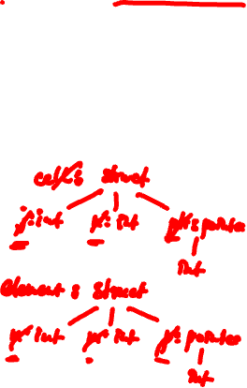
Structural Equivalence
This is a type definition: an application of the array type constructor
Example, Pascal-like language:
type S = array [0..99] of char
type T = array [0..99] of char
Example, C:
typedef struct {
int j, int k, int *ptr
} cell;
typedef struct {
int n, int m, int *p
} element;
Notes:
Assuming that names of fields are NOT PART of the struct constructed type, cell and element are structurally equivalent.

Slide 26
Structural Equivalence
Shown by isomorphism of corresponding type trees
Show the type trees of these constructed types
Are these types structurally equivalent?
struct cell struct element
{ char data; { char c;
int a[3]; int a[5];
struct cell *next; struct element *ptr;
} }
Equivalent types: are field names part of the struct constructed type?
are array bounds part of the array constructed type?
Notes:
Assume that the names of the fields are NOT PART of the
struct constructed type. Assume that the array bound
is NOT PART of the struct constructed type.
Cell and element area structurally equivalent if we do not take into account names of fields and array bounds.

Slide 27
Structural Equivalence
struct cell struct element
{ char data; { char c;
int a[3]; int a[5];
struct cell *next; struct element *ptr;
} }
cell: struct
element: struct
data: char
a: array
next: pointer
c: char
a: array
ptr: pointer
int
int
Notes:
Recall our assumption that the names of the fields are NOT PART of the struct constructed type. Only the types of the fields are part of the struct constructed type.
And that the array bound is NOT PART of the array constructed type. Only the array element type is part of the array type.
Under this assumption, Cell and Element are structurally equivalent.
Let’s look at the type trees that correspond to these struct types. And “tree” is a misnomer in this case, because we obviously have a directed cyclic graph here. In most cases, the types end up being represented as trees. In case of recursive types, they are represented by cyclic graphs. I will call the graphical representation “type tree”.

Slide 28
Structural Equivalence
struct cell struct element
{ char data; { char c;
int a[3]; int a[5];
struct cell *next; struct element *ptr;
} }
cell: struct
element: struct
data: char
a: array
next: pointer
c: char
a: array
ptr: pointer
int
int
Notes:
Recall our assumption that the names of the fields are NOT PART of the struct constructed type. Only the types of the fields are part of the struct constructed type.
And that the array bound is NOT PART of the array constructed type. Only the array element type is part of the array type.
Under this assumption, Cell and Element are structurally equivalent.
Let’s look at the type trees that correspond to these struct types. And “tree” is a misnomer in this case, because we obviously have a directed cyclic graph here. In most cases, the types end up being represented as trees. In case of recursive types, they are represented by cyclic graphs. I will call the graphical representation “type tree”.

Slide 29
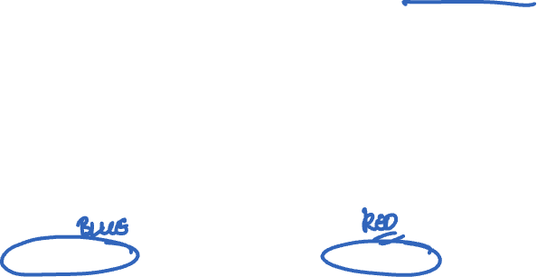
Name Equivalence
Name equivalence
An application of a type constructor is a type definition.
Under name equivalence each type definition is a distinct type. E.g., the red array[1..20] of int; is one type definition (and one type) and the blue array[1..20] of int; is a different type definition (and a different type):
type T = array [1..20] of int;
x,y: array [1..20] of int;
w,z: T;
v: T;
x and y are of same type, w, z,v are of same type, but x and w are of different types!
Notes:
A type definition is an application of a type constructor.
For example, the red array [1..20] of int; is ONE TYPE DEFINITION.
The blue array [1..20] of int; is ANOTHER TYPE DEFINITION.

Slide 30
Question
Name equivalence
w,z,v: array [1..20] of int;
x,y: array [1..20] of int;
Are x and w of equivalent type according to name equivalence?
Answer: x and w are of distinct types.
Notes:
A type definition is an application of a type constructor.
For example, the red array [1..20] of int; is ONE TYPE DEFINITION.
The blue array [1..20] of int; is ANOTHER TYPE DEFINITION.

Slide 31
Name Equivalence
A subtlety arises with aliased types (e.g., type n = T, typedef int Age in C)
Strict name equivalence
A language in which aliased types are considered distinct, is said to have strict name equivalence (e.g., int and Age are distinct types)
Loose name equivalence
A language in which aliased types are considered equivalent, is said to have loose name equivalence (e.g., int and Age are same)

Slide 32
Exercise
type cell = … // record type
type alink = pointer to cell
type blink = alink
p,q : pointer to cell
r : alink
s : blink
t : pointer to cell
u : alink
Group p,q,r,s,t,u into equiv. classes, according to structural equiv., strict name equiv. and loose name equiv.
Notes:
Group variables p, q, r, s, t and u into equivalence classes
according to strict name equivalence. Loose name equivalence.
Strict:
r,u
s
p,q
t
Loose:
r,u,s
p,q
t

Slide 33
Exercise: Structural Equivalence
type cell = … // record type
type alink = pointer to cell
type blink = alink
p,q : pointer to cell
r : alink
s : blink
t : pointer to cell
u : alink
p,q,r,s,t,u
Notes:
Group variables p, q, r, s, t and u into equivalence classes
according to strict name equivalence. Loose name equivalence.
Strict:
r,u
s
p,q
t
Loose:
r,u,s
p,q
t

Slide 34
Exercise: Strict Name Equivalence
type cell = … // record type
type alink = pointer to cell
type blink = alink
p,q : pointer to cell
r : alink
s : blink
t : pointer to cell
u : alink
p,q
r,u
s
t
Notes:
Group variables p, q, r, s, t and u into equivalence classes
according to strict name equivalence. Loose name equivalence.
Strict:
r,u
s
p,q
t
Loose:
r,u,s
p,q
t

Slide 35
Exercise: Loose Name Equivalence
type cell = … // record type
type alink = pointer to cell
type blink = alink
p,q : pointer to cell
r : alink
s : blink
t : pointer to cell
u : alink
p,q
r,s,u
t
Notes:
Group variables p, q, r, s, t and u into equivalence classes
according to strict name equivalence. Loose name equivalence.
Strict:
r,u
s
p,q
t
Loose:
r,u,s
p,q
t

Slide 36
Example: Type Equivalence in C
First, in the Algol family, field names are part of the record/struct constructed type. E.g., the record types below are NOT even structurally equivalent
type A = record
x,y : real
end;
type B = record
z,w : real
end;

Slide 37
Type Equivalence in C
Compiler assigns internal (compiler-generated) names to anonymous types
struct RecA typedef struct struct
{ char x; { char x; { char x;
int y; int y; int y;
} a; } RecB; } c;
RecB b;
What variables are of equivalent type according to the rules in C?
This struct is of type anon1.

Slide 38
Type Equivalence in C
C uses structural equivalence for everything, except unions and structs, for which it uses loose name equivalence
struct A struct B
{ char x; { char x;
int y; int y;
} }
typedef struct A C;
typedef C *P;
typedef struct B *Q;
typedef struct A *R;
typedef int Age;
typedef int (*F) (int);
typedef Age (*G) (Age);

Slide 39
Type Equivalence in C
struct B { char x; int y; };
typedef struct B A;
struct { A a; A *next; } aa;
struct { struct B a; struct B *next; } bb;
struct { struct B a; struct B *next; } cc;
A a;
struct B b;
a = b;
aa = bb;
bb = cc;
Which of the above assignments pass the type checker?

Slide 40
Question
Structural equivalence for record types is considered a bad idea. Can you think of a reason why?
Notes:
Generally, if programmer defines a record type, they have a specific concept in mind.
The programmer may define a structurally equivalent record type, but with a completely different concept in mind.
E.g.,
struct School {
char *name;
char *address;
}
E.g., Person {
char *name;
char *addres;
}

Slide 41
Lecture Outline
Types
Type systems
Type checking
Type safety
Type equivalence
Types in C (next time)
Primitive types
Composite types

