Slide 1
Final Exam Review

Slide 2
Announcements
Quiz 9
Check your Rainbow grades
  Exams 1-2, Quiz 1-8, HW 1-5 are in
  We’ll have HW 6 and Quiz 9 by tomorrow and we’ll have HW 7 as soon as possible, likely by Wednesday
Let me know if you see any problems

Slide 3
Announcements
Final exam
  Thursday December 15th 6:30pm to 9:30pm
  Darrin 308 and 318. Assigned seating zones.
  6 pages crib sheet
  Instructors and TAs office hours Monday through Thursday. No Mentor office hours.
  I will post an announcement on Submitty

Slide 4
Final Exam is Cumulative
Programming Language Syntax (Ch. 2.1-2.3.3)
Logic Programming and Prolog (Ch. 12)
Scoping (Ch. 3.1-3.3)
Programming Language Semantics (Sc. Ch. 4.1-4.3)
Functional programming (Ch. 11)
  Scheme and Haskell, map/fold questions
Lambda calculus (Ch. 11 Companion)
Data abstraction: Types (Ch. 7, 8)
Control abstraction: Parameter Passing (Ch. 9.1-9.3)
Object-oriented languages (10.1-10.2)
Concurrency (13.1). “What can go wrong?” questions
Comparative Programming Languages

Slide 5

Exam 1 Topics
Formal languages (Lecture 2 plus chapters)
  Regular languages
    Regular expressions
    DFAs
    Use of regular languages in programming languages
  Context-free languages
    Context-free grammars
    Derivation, parse, ambiguity
    Use of CFGs in programming languages
    Expression grammars, precedence, and associativity

Slide 6

Exam 1 Topics
Parsing (Lecture 3 plus chapters)
LL Parsing (Lectures 3 and 4 plus chapters)
  Recursive-descent parsing, recursive-descent routines
  LL(1) grammars
  LL(1) parsing tables
  FIRST, FOLLOW, PREDICT
  LL(1) conflicts

Slide 7
Exam 1 Topics
Logic programming concepts (Lecture 5 plus chapters
  Declarative programming
  Horn clause, resolution principle
Prolog (Lectures 5, 6, and 7 plus chapters)
  Prolog concepts: search tree, rule ordering, unification, backtracking, backward chaining
  Prolog programming: lists and recursion, arithmetic, backtracking cut, negation-by-failure, generate-and-test

Slide 8

Exam 1 Topics
Binding and scoping (Lecture 8 plus reading)
  Object lifetime
  Combined view of memory
  Stack management
  Scoping (in languages where functions are third-class values)
  Static and dynamic links
  Static (lexical) scoping
  Dynamic scoping

Slide 9
Exam 1 Topics
Attribute grammars
  Attributes
  Attribute rules
  Bottom-up (i.e., S-attributed) grammars

Slide 10

Exam 2 Topics
Scheme (Lectures 12 and 13, plus chapters)
  S-expression syntax
  Lists and recursion
  Shallow and deep recursion
  Equality
  Higher-order functions
  map, foldl, and foldr
  Programming with map, foldl, and foldr
  Tail recursion

Slide 11

Exam 2 Topics
Scheme (Lecture 14, plus chapters)
  Binding with let, let*, letrec
  Scoping in Scheme
  Closures and closure bindings

Slide 12

Exam 2 Topics
Scoping, revisited (Lecture 15, plus chapters)
  Static scoping
    Reference environment
    Functions as third-class values vs.
    Functions as first-class values
  Dynamic scoping
    With shallow binding
    With deep binding

Slide 13

Exam 2 Topics
Lambda calculus (Lectures 15, 16, 17)
  Syntax and semantics
  Free and bound variables
  Substitution
  Rules of the Lambda calculus
    Alpha-conversion
    Beta-reduction
  Normal forms
  Reduction strategies
  Fixed-point combinator and recursion

Slide 14

Topics
Haskell (Lectures 19, 20, and 21)
  Basic syntax
  Algebraic data types
  Pattern matching
  Lazy evaluation
  Types and type inference
  Basics of type classes
  Maybe and List monads

Slide 15

Topics
Data abstraction and types (Lecture 22, 23)
  Types and type systems
  Type equivalence
  Types in C

Slide 16

Topics
Parameter passing mechanisms (Lecture 24_Part1)
  Call by value
  Call by reference
  Call by value-result
  Call by name
  Call by sharing

Slide 17
Topics
Object-oriented languages and polymorphism (Lecture 24_Part2)
  Subtype polymorphism
  Parametric polymorphism
    Explicit parametric polymorphism
    Implicit parametric polymorphism

Slide 18
Topics
Concurrency in Java (Lecture 25)
  Threads and tasks
  Synchronized blocks
  Concurrency errors
    Data races
    Atomicity violations

Slide 19
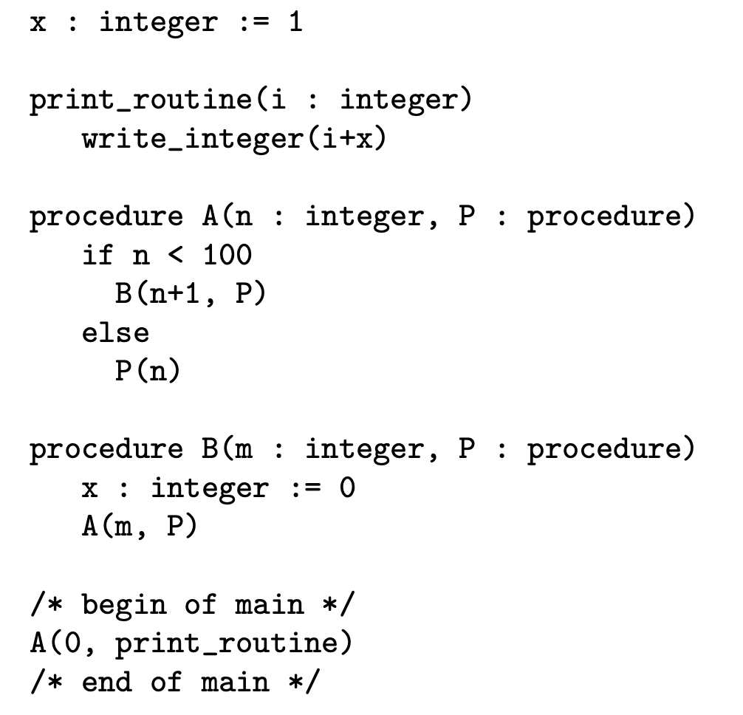
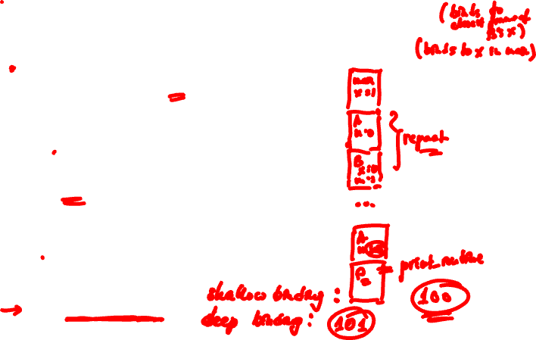
Practice Problems
Dyn. with shallow binding: 100
Dyn. with deep binding: 101

Slide 20
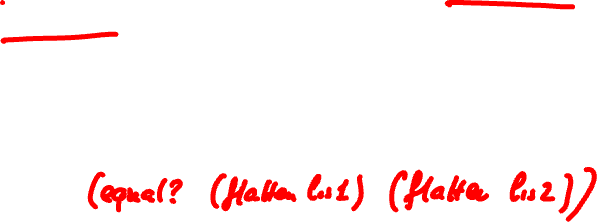
Practice Problems
Consider the problem of figuring out whether two trees (lists in Scheme) have the same fringe, that is, the same leaves, in the same order, regardless of structure. E.g., ((1 2) 3) and (1 (2 3)) have the same fringe. What is a straight-forward way to solve this problem?
Flatten, then compare with equal?

Slide 21
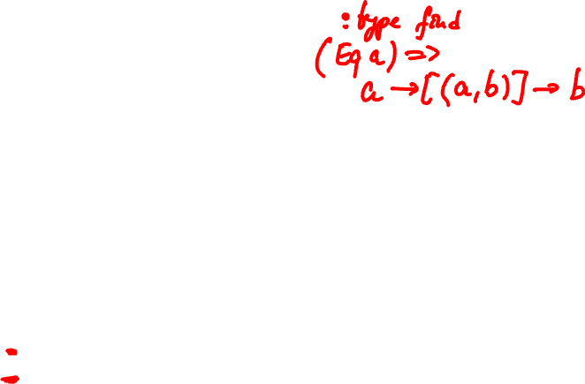
Practice Problems (Quiz 7)
type Name = String
data Expr = Var Name
| Val Bool
| And Expr Expr
| Or Expr Expr
| Not Expr
| Let Name Expr Expr
Fill in the type signature of find:
-- Looks up variable n in binding environment env.
-- Returns first binding or throws Exception if no binding of n.
-- Ex: find "x" [("x",True),("x",False),("y",True)] returns True
find :: _________________________________
find n env = head [ bool | (var,bool) <- env, var == n ]
Name -> [(Name,Bool)] -> Bool

Slide 22
Practice Problems (Quiz 7)
Fill in the Or and Let arms of eval:
-- Purpose: evaluates expression e in binding environment env
-- Returns the boolean value of e or throws an Exception
-- Ex.: eval (Var "x") [("x",True),("x",False)] returns True
eval :: Expr -> [(Name,Bool)] -> Bool
eval e env =
case e of
Var n -> find n env
Val b -> b
And e1 e2 -> (eval e1 env) && (eval e2 env)
Or e1 e2 -> ______________________________
Not e1 -> not (eval e1 env)
Let n e1 e2 -> _____________________________
(eval e1 env) || (eval e2 env)
eval e2 ((n,(eval e1 env)):env)

Slide 23
Practice Problems
In programming languages types and type checking
Prevent runtime errors
Abstract data organization and implementation
Document variables and subroutines
All of the above

Slide 24

Practice Problems
Let A denote all syntactically valid programs. Let S denote all syntactically valid programs that execute without forbidden errors. Let T denote all programs accepted by certain type-safe static type system. Which one best describes the relation between T, S and A?

Slide 25
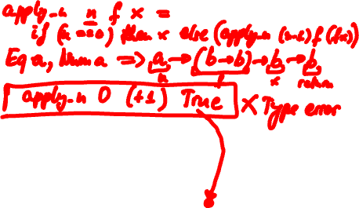
Cont.
A: All programs
S: All programs that run without
forbidden errors
T: All programs accepted by a
type-safe static type system

Slide 26
Practice Problems
Again, let S denote all syntactically valid programs that execute without forbidden errors. Let T’ denote all programs accepted by certain type-unsafe static type system.

Slide 27

Cont.
A: All programs
S: All programs that run without
forbidden errors
T’: All programs accepted by a
type-unsafe static type system

Slide 28
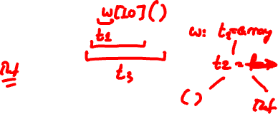
Practice Problems
int w[10]() is an invalid declaration in C. Why?
true
false
In C, functions are third-class values. Thus, we cannot
pass a function as argument, return a function as a
result, or assign a function value to a variable, or structure.

Slide 29
Practice Problems
w in declaration int (*w[10])() is
A function
An array
A pointer

Slide 30
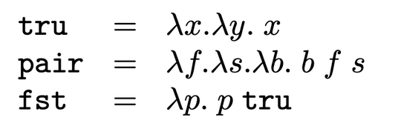
Practice Problems (Quiz 8)
Question 1. tru v w ->* v
Question 2. pair v w ->* 𝜆b. b v w
Question 3. fst (pair v w) ->* v

Slide 31
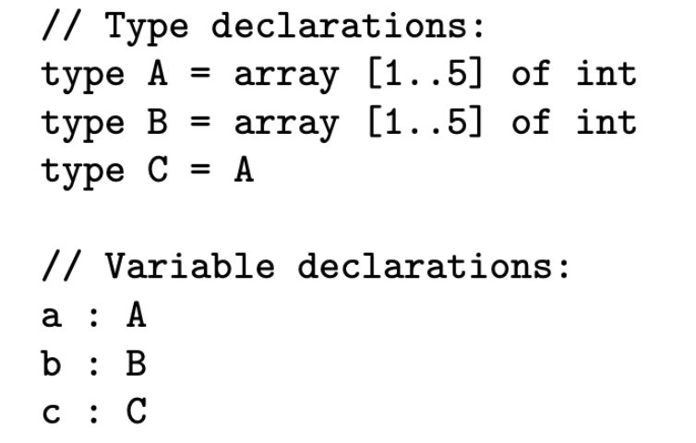
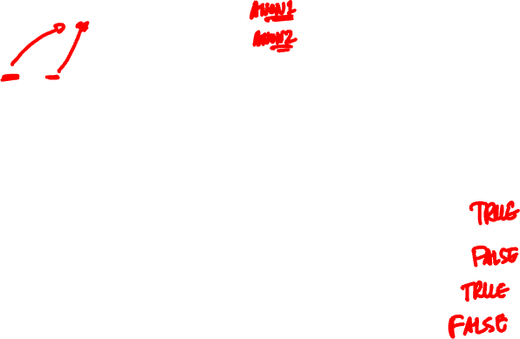
Practice Problems (Quiz 8)

Slide 32
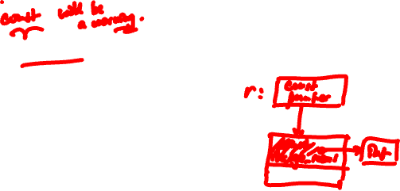

Practice Problems (Quiz 9)
typedef struct { int *i; char c; } huge_record;
void const_is_shallow(
const huge_record* const r) {
int *x = r->i; // or just *(r->i) = 0;
*x = 0;
}
Is this a compile time error?
No.

Slide 33
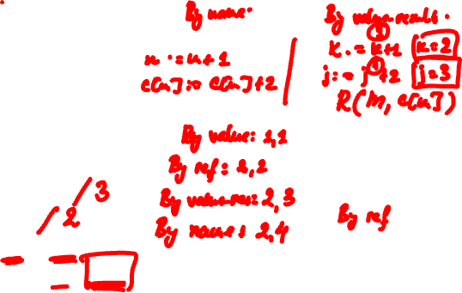
Practice Problems (Quiz 9)
Notes:
By value-result, we assume 2 things. First, addresses (l-values) are recalculated at procedure exit. Second, parameter write-out happens from left to right.

Slide 34
Practice Problems (Quiz 9)
Question 7. Consider the C++ code:
bar x;
bar y = x;
At y = x C++ calls
(b) copy constructor bar::bar(bar&)

Slide 35
Practice Problems (Quiz 9)
Question 8. Consider the C++ code:
bar x, y;
y = x;
At y = x C++ calls
(a) assignment operator bar::operator=(bar&)

Slide 36
Practice Problems (Quiz 9)
Question 9. Now suppose this was Java code:
bar x, y;
y = x;
At y = x Java calls
(b) neither

Slide 37
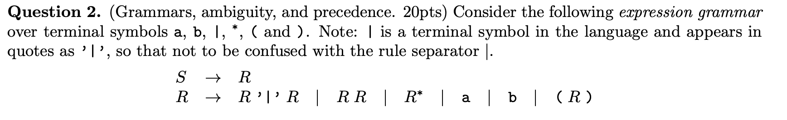
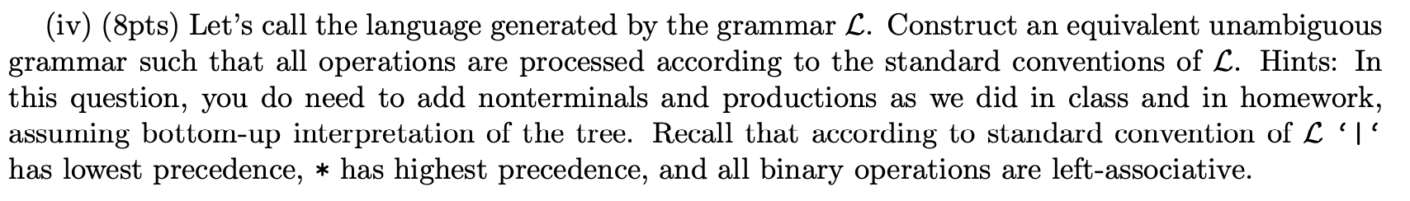
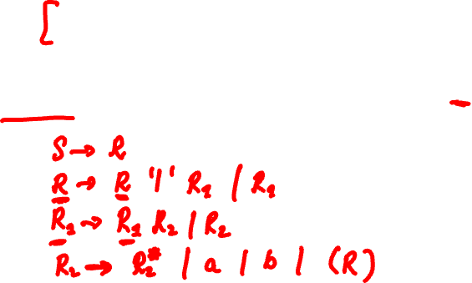
Practice Problems (Exam 1)

Slide 38
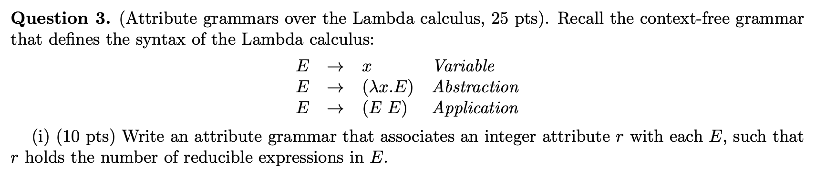
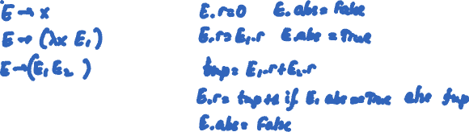
Practice Problems (Exam 2)

Slide 39
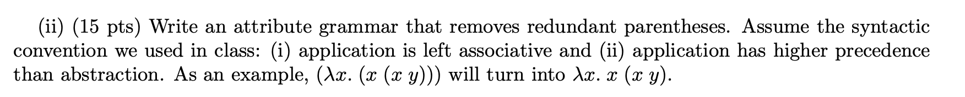
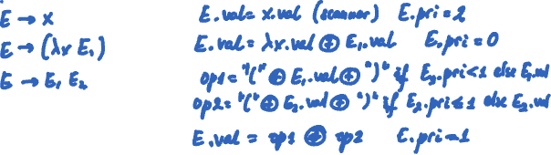
Practice Problems (Exam 2)
(
)

Slide 40
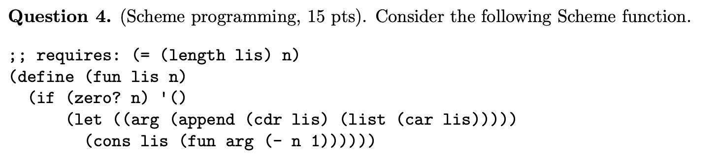
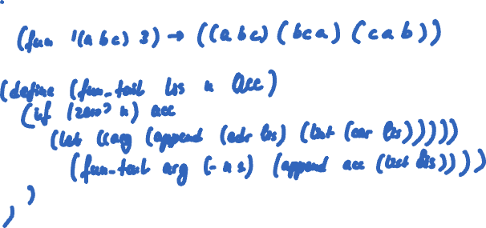
Practice Problems (Exam 2)

Slide 41
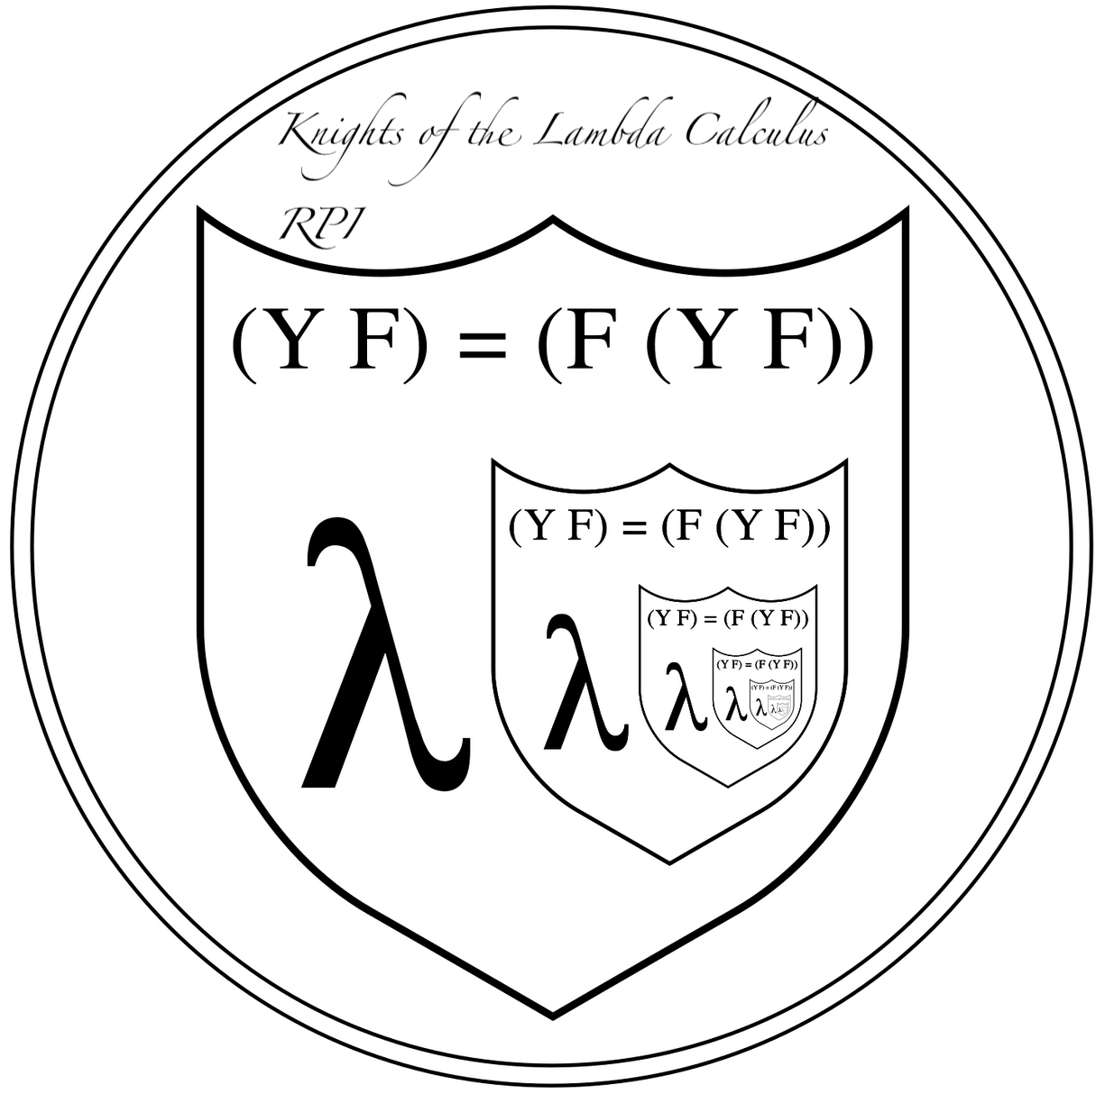


Thanks!
Modified from: https://en.wikipedia.org/w/index.php?curid=12675230
Source: https://users.cs.northwestern.edu/~robby/logos/
Source: https://www.numi.tech/software-logos/haskell

