Slide 1
Programming Language Syntax: Scanning and Parsing
Read: Scott, Chapter 2.2 and 2.3.1

Slide 2
Lecture Outline
Quiz 1
Overview of scanning
Overview of top-down and bottom-up parsing
Top-down parsing
Recursive descent
LL(1) parsing tables

Slide 3
Scanning
Scanner groups characters into tokens
Scanner simplifies the job of the parser
Scanner is essentially a Finite Automaton
Regular expressions specify the syntax of tokens
Scanner recognizes the tokens in the program
position = initial + rate * 60;
Scanner
id = id + id * num ;
Parser

Slide 4
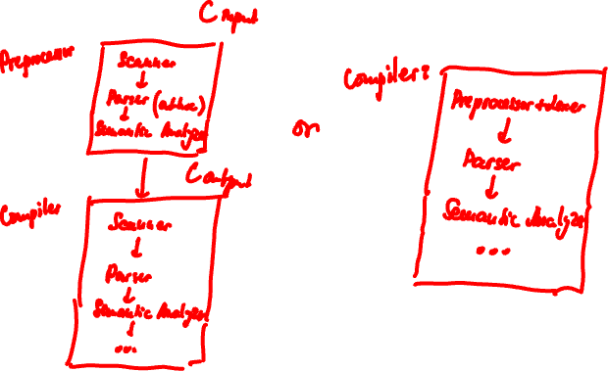
Preprocessor

Slide 5
Calculator Language
Tokens
times → *
plus → +
id → letter ( letter | digit )*
except for read and write which are keywords (keywords are tokens as well)
Notes:
Textbook has a much large set of tokens in the language
(note that our language does not accept numerical constants for example).
I include only a few tokens in order to make slides readable.

Slide 6
Ad-hoc (By hand) Scanner
skip any initial white space (space, tab, newline)
if current_char in { +, * } return corresponding single-character token (plus or times)
if current_char is a letter read any additional letters and digits check to see if the resulting string is read or write
if so, then return the corresponding token
else return id
else announce an ERROR
Notes:
This scanner recognizes the tokens from the previous slide, plus, times, id and keywords read and write.

Slide 7
The Scanner as a DFA
space, tab, newline
Start
1
*
+
letter
2
3
4
letter, digit
Notes:
State 1 is the start state. States 2, 3 and 4 are final (accepting) states.

Slide 8
Building a Scanner
Scanners are (usually) automatically generated from regular expressions:
Step 1: From a Regular Expression to an NFA
Step 2: From an NFA to a DFA
Step 3: Minimizing the DFA
lex/flex utilities generate scanner code
Scanner code explicitly captures the states and transitions of the DFA
Notes:
NFA = Nondeterministic Finite Automaton

Slide 9
Table-Driven Scanning
…
cur_state := 1 loop read cur_char case scan_tab[cur_char, cur_state].action of move:
…
cur_state = scan_tab[cur_char, cur_state].new_state
recognize: // emits the token
tok = token_tab[current_state] unread cur_char --- push back char
exit loop
error:
…
Notes:
The scanner code can be a sequence of nested case statements.

Slide 10
Table-Driven Scanning
space,tab,newline * + digit letter other
1 5 2 3 - 4 -
2 - - - - - - times
3 - - - - - - plus
4 - - - 4 4 - id
5 5 - - - - - space
Sketch of table: scan_tab and token_tab. See Scott for details.

Slide 11
Today’s Lecture Outline
Overview of scanning
Overview of top-down and bottom-up parsing
Top-down parsing
Recursive descent
LL(1) parsing tables

Slide 12
A Simple Calculator Language
asst_stmt → id = expr // asst_stmt is the start symbol
expr → expr + expr | expr * expr | id
Character stream: position = initial + rate * time
Scanner
Token stream: id = id + id * id
Parser
asst_stmt
Parse tree:
id
=
expr
id
+
expr
id
*
id
(Parse tree simplified to fit on slide.)
Notes:
A valid program in this language is a simple assignment statement.
The rules for what makes a valid program in the language are given by the grammar above.

Slide 13
A Simple Calculator Language
asst_stmt → id = expr // asst_stmt is the start symbol
expr → expr + expr | expr * expr | id
Character stream: position + initial = rate * time
Scanner
Token stream: id + …
Parser
Parse tree:
Token stream is ill-formed according to our grammar,
parse tree construction fails, therefore Syntax error!
Most compiler errors occur in the parser.

Slide 14
Parsing
Given an arbitrary CFG, one can build a parser that parses a string of length n in (essentially) O(n³)
Well-known algorithms
But O(n³) time is unacceptable for a parser in a compiler!

Slide 15
Parsing
Objective: build a parse tree for an input string of tokens from a single scan of input
Only special subclasses of context-free grammars (LL and LR) can do this
Two approaches
Top-down: builds parse tree from the root to the leaves
Bottom-up: builds parse tree from the leaves to the top
Both are easily automated
Notes:
The goal of the parser is to recognize a string as belonging to a language.
In a compiler, the parser recognizes whether the program we have written
obeys the syntactic rules of the programming language. If yes, the parser outputs a parse tree, which is given as input to the next phase of the compiler; compilation proceeds. Otherwise, the parser issues a parse error; compilation halts.
In compilers, the objective of the parser is to build a parse tree efficiently,
in linear time!

Slide 16
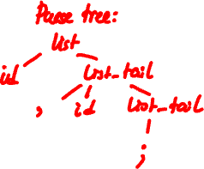
Grammar for Comma-separated Lists
list → id list_tail // list is the start symbol
list_tail → , id list_tail | ;
Generates comma-separated lists of id’s.
E.g., id ; id, id, id ;
Example derivation:
list ⇒ id list_tail ⇒ id , id list_tail ⇒ id , id ;
Notes:
list is the starting nonterminal.

Slide 17
Top-down Parsing
list → id list_tail
list_tail → , id list_tail | ;
Terminals are seen in the
order of appearance in
the token stream
id , id , id ;
The parse tree is constructed
From the top to the leaves
Corresponds to a leftmost derivation
Look at leftmost nonterminal in current sentential form, and lookahead terminal and “predict” which production to apply
list
id
list_tail
,
id
list_tail
,
id
list_tail
;

Slide 18
Bottom-up Parsing
list → id list_tail
list_tail → , id list_tail | ;
Terminals are seen in the
order of appearance in the
token stream
id , id , id ;
The parse tree is constructed
From the leaves to the top
A rightmost derivation in reverse
list
id
list_tail
,
id
list_tail
,
id
list_tail
;

Slide 19
Today’s Lecture Outline
Overview of scanning
Overview of top-down and bottom-up parsing
Top-down parsing
Recursive descent
LL(1) parsing tables

Slide 20
Top-down Predictive Parsing
“Predicts” production to apply based on one or more lookahead token(s)
Predictive parsers work with LL(k) grammars
First L stands for “left-to-right” scan of input
Second L stands for leftmost derivation
Parse corresponds to leftmost derivation
k stands for “need k tokens of lookahead to predict”
We are interested in LL(1)

Slide 21
Question
list → id list_tail
list_tail → , id list_tail | ;
Can we always predict (i.e., for any input)
what production to applies, based on
one token of lookahead?
id , id , id ;
Yes, there is at most one choice (i.e., at most one production applies)
This grammar is an LL(1) grammar
list
id
list_tail
,
id
list_tail
,
id
list_tail
;

Slide 22
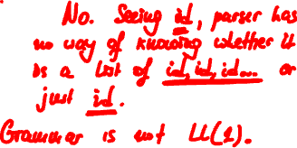
Question
list → list_prefix ;
list_prefix → list_prefix , id | id
A new grammar
What language does it generate?
Same, comma-separated lists
Can we predict based on one
token of lookahead?
id , id , id ;
list
list_prefix
;
?
Notes:
Answer: No. Let the token of lookahead be id. There is no way to know whether we have a list of 100 ids, or we have a list of just
one id. In other words, we cannot predict whether we expand by production list_prefix → list_prefix , id or by production
list_prefix → id.
This grammar is not an LL(1) grammar.

Slide 23
Top-down Predictive Parsing
Back to predictive parsing
“Predicts” production to apply based on one or more lookahead token(s)
Parser always gets it right!
There is no need to backtrack, undo expansion, then try a different production
Predictive parsers work with LL(k) grammars

Slide 24
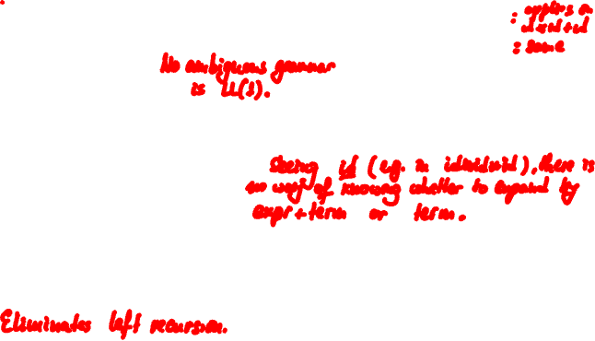
Top-down Predictive Parsing
expr → expr + expr
| expr * expr
| id
Expression grammar:
Not LL(1)
Unambiguous version:
Still not LL(1). Why?
LL(1) version:
expr → expr + term | term
term → term * id | id
expr → term term_tail
term_tail → + term term_tail | ε
term → id factor_tail
factor_tail → * id factor_tail | ε

Slide 25
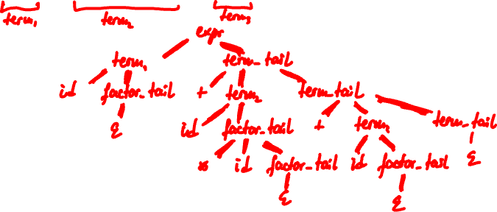
Exercise
expr → term term_tail
term_tail → + term term_tail | ε
term → id factor_tail
factor_tail → * id factor_tail | ε
Draw parse tree for expression
id + id * id + id
Notes:
This grammar is simplified from the one in our textbook.
Look for the complete grammar in the textbook.

Slide 26
Recursive Descent
Each nonterminal has a procedure
The right-hand-sides (rhs) of productions for that nonterminal form the body of its procedure
lookahead()
Peeks at current token in input stream
match(t)
if lookahead() == t then consume current token, else PARSE_ERROR
Notes:
Recursive Descent uses recursive procedures to
perform top-down “predictive” parsing.
Consuming the token means we move the input pointer
one token to the right.

Slide 27
Recursive Descent
start → expr $$ expr → term term_tail term_tail → + term term_tail | ε
term → id factor_tail factor_tail → * id factor_tail | ε
start()
case lookahead() of
id: expr(); match($$) ($$ - end-of-input marker)
otherwise PARSE_ERROR
expr()
case lookahead() of
id: term(); term_tail()
otherwise PARSE_ERROR
term_tail()
case lookahead() of
+: match(‘+’); term(); term_tail()
$$: skip
otherwise: PARSE_ERROR
Predicting production term_tail → + term term_tail
Predicting epsilon production term_tail → ε
Notes:
This is the skeleton of a recursive descent “predictive”
parser.
We have added an extra nonterminal start and a special token $$. $$ is a special token, which denotes
the end-of-input. The Scanner adds this symbol at the end of the input, which allows the parser to cleanly terminate, once it has seen the entire input string.

Slide 28
Recursive Descent
start → expr $$ expr → term term_tail term_tail → + term term_tail | ε
term → id factor_tail factor_tail → * id factor_tail | ε
term()
case lookahead() of
id: match(‘id’); factor_tail()
otherwise: PARSE_ERROR
factor_tail()
case lookahead() of
*: match(‘*’); match(‘id’); factor_tail();
+,$$: skip
otherwise PARSE_ERROR
Predicting production factor_tail → *id factor_tail
Predicting production factor_tail → ε

Slide 29
LL(1) Parsing Table
But how does the parser “predict”?
E.g., how does the parser know to expand a factor_tail by factor_tail → ε on + and $$?
It uses the LL(1) parsing table
One dimension is nonterminal to expand
Other dimension is lookahead token
We are interested in one token of lookahead
Entry “nonterminal on token” contains the production to apply or contains nothing

Slide 30
LL(1) Parsing Table
One dimension is nonterminal to expand
Other dimension is lookahead token
E.g., entry “nonterminal A on terminal a” contains production A → α
Meaning: when parser is at nonterminal A and lookahead token is a, then parser expands A by production A → α
a
A
α

Slide 31
LL(1) Parsing Table
start → expr $$ expr → term term_tail term_tail → + term term_tail | ε
term → id factor_tail factor_tail → * id factor_tail | ε
 | id | + | * | $$
start | expr $$ | - | - | -
expr | term term_tail | - | - | -
term_tail | - | + term term_tail | - | ε
term | id factor_tail | - | - | -
factor_tail | - | ε | * id factor_tail | ε
Notes:
The column headings are the tokens: id, +, * and the special token $$.
The row headings list the nonterminals in the grammar: start, expr, trem_tail,
term, factor_tail.
Entry “term_tail on +” indicates that when the parser needs to expand
term_tail and the next token in the input stream is +, then it should expand by production term_tail → + term term_tail. Entry – indicates a parse error.
For example, entry “term on +” is a -. If the parser needs to expand term and the next token is +, it will issue a parse error indicating invalid input (input that does not belong to the language).

Slide 32
Question
Fill in the LL(1) parsing table for the comma-separated list grammar
start → list $$
list → id list_tail
list_tail → , id list_tail | ;
 | id | , | ; | $$
start
list
list_tail
list $$
-
-
-
id list_tail
-
-
-
-
, id list_tail
;
-
Notes:
Again, - indicates a parse error.

Slide 33
The End

