Slide 1
Programming Language Syntax: Top-down Parsing
Read: Scott, Chapter 2.3.2 and 2.3.3

Slide 2
Lecture Outline
Top-down parsing (also called LL parsing)
LL(1) parsing table
FIRST, FOLLOW, and PREDICT sets
LL(1) grammars
Bottom-up parsing (also called LR parsing)
A brief overview, no detail

Slide 3
Recursive Descent
start → expr $$ expr → term term_tail term_tail → + term term_tail | ε
term → id factor_tail factor_tail → * id factor_tail | ε
start()
case lookahead() of
id: expr(); match($$) ($$ - end-of-input marker)
otherwise PARSE_ERROR
expr()
case lookahead() of
id: term(); term_tail()
otherwise PARSE_ERROR
term_tail()
case lookahead() of
+: match(‘+’); term(); term_tail()
$$: skip
otherwise: PARSE_ERROR
Predicting production term_tail → + term term_tail
Predicting epsilon production term_tail → ε
Notes:
This is the skeleton of a recursive descent “predictive”
parser.
We have added an extra nonterminal start and a special token $$. $$ is a special token, which denotes
the end-of-input. The Scanner adds this symbol at the end of the input, which allows the parser to cleanly terminate, once it has seen the entire input string.

Slide 4
Recursive Descent
start → expr $$ expr → term term_tail term_tail → + term term_tail | ε
term → id factor_tail factor_tail → * id factor_tail | ε
term()
case lookahead() of
id: match(‘id’); factor_tail()
otherwise: PARSE_ERROR
factor_tail()
case lookahead() of
*: match(‘*’); match(‘id’); factor_tail();
+,$$: skip
otherwise PARSE_ERROR
Predicting production factor_tail → *id factor_tail
Predicting production factor_tail → ε

Slide 5
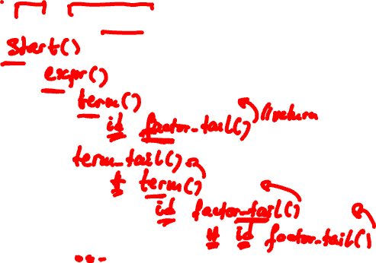
Recursive Descent Parsing
Parse
id + id * id $$

Slide 6
LL(1) Parsing Table
But how does the parser “predict”?
E.g., how does the parser know to expand a factor_tail by factor_tail → ε on + and $$?
It uses the LL(1) parsing table
One dimension is nonterminal to expand
Other dimension is lookahead token
We are interested in one token of lookahead
Entry “nonterminal on token” contains the production to apply or contains nothing

Slide 7
LL(1) Parsing Table
One dimension: nonterminal to expand
Other dimension: lookahead token
E.g., entry “nonterminal A on terminal a” contains production A → α
Meaning: when parser is at nonterminal A and lookahead token is a, then parser expands A by production A → α
a
A
α

Slide 8
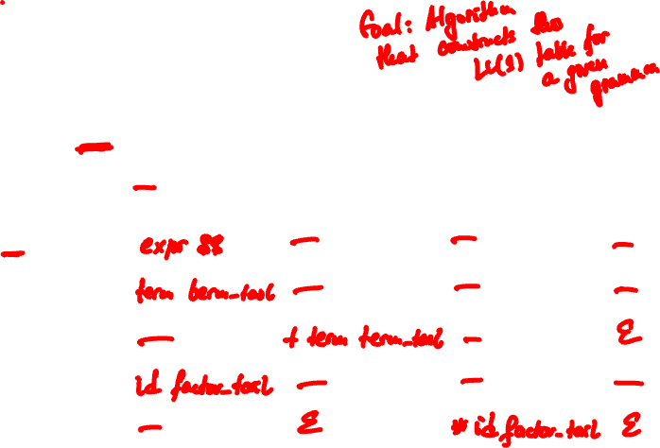
LL(1) Parsing Table
start → expr $$ expr → term term_tail term_tail → + term term_tail | ε
term → id factor_tail factor_tail → * id factor_tail | ε
 | id | + | * | $$
start
expr
term_tail
term
factor_tail
Notes:
The column headings are the tokens: id, +, * and the special token $$.
The row headings list the nonterminals in the grammar: start, expr, trem_tail,
term, factor_tail.
Entry “term_tail on +” indicates that when the parser needs to expand
term_tail and the next token in the input stream is +, then it should expand by production term_tail → + term term_tail. Entry – indicates a parse error.
For example, entry “term on +” is a -. If the parser needs to expand term and the next token is +, it will issue a parse error indicating invalid input (input that does not belong to the language).

Slide 9
Intuition
expr → term term_tail
term_tail → + term term_tail | ε
term → id factor_tail
factor_tail → * id factor_tail | ε
Top-down parsing
Parse tree is built from the top to the leaves
Always expand the leftmost nonterminal
expr
id + id + id*id
term
term_tail
factor_tail → * id factor_tail
factor_tail → ε
id
factor_tail
ε
What production applies for factor_tail on +?
+ does not belong to an expansion of factor_tail. However, factor_tail has an epsilon production and + belongs to an expansion of term_tail which follows factor_tail. Thus, predict the epsilon production.

Slide 10
Intuition
expr → term term_tail
term_tail → + term term_tail | ε
term → id factor_tail
factor_tail → * id factor_tail | ε
Top-down parsing
Parse tree is built from the top to the leaves
Always expand the leftmost nonterminal
expr
id + id + id*id
term
term_tail
term_tail → + term term_tail
term_tail → ε
id
factor_tail
+
term
term_tail
What production applies for term_tail on +?
+ is the first symbol in expansions of + term term_tail.
Thus, predict production term_tail → + term term_tail
ε

Slide 11
LL(1) Tables and LL(1) Grammars
We can construct an LL(1) parsing table for any context-free grammar
In general, the table will contain multiply-defined entries. That is, for some nonterminal and lookahead token, more than one production applies
A grammar whose LL(1) parsing table has no multiply-defined entries is said to be LL(1) grammar
LL(1) grammars are a very special subclass of context-free grammars. Why?

Slide 12
FIRST and FOLLOW sets
Let α be any sequence of nonterminals and terminals
FIRST(α) is the set of terminals a that begin the strings derived from α. E.g., expr $$ ⇒* id…, thus id in FIRST(expr $$)
If there is a derivation α ⇒* ε, then ε is in FIRST(α)
Let A be a nonterminal
FOLLOW(A) is the set of terminals b (including special end-of-input marker $$) that can appear immediately to the right of A in some sentential form:
start ⇒* …Ab… ⇒*…
Notes:
Recall that α ⇒* ε means that α derives ε after zero or more steps.
The LL(1) parsing table is constructed using PREDICT sets.
The PREDICT sets are defined in terms of two other sets, FIRST and FOLLOW.

Slide 13
Computing FIRST
Notation:
α is an arbitrary sequence
of terminals and nonterminals
Apply these rules until no more terminals or ε can be added to any FIRST(α) set
(1) If α starts with a terminal a, then FIRST(α) = { a }
(2) If α is a nonterminal X, where X → ε, then add ε to FIRST(α)
(3) If α is a nonterminal X → Y₁Y₂…Y_{k} then add a to FIRST(X) if for some i, a is in FIRST(Y_{i}) and ε is in all of FIRST(Y₁), … FIRST(Y_{i-1}). If ε is in all of FIRST(Y₁), … FIRST(Y_{k}), add ε to FIRST(X).
Everything in FIRST(Y₁) - {ε} is surely in FIRST(X)
If Y₁ does not derive ε, then we add nothing more;
Otherwise, we add FIRST(Y₂) - {ε}, and so on
Similarly, if α is Y₁Y₂…Y_{k} , we’ll repeat the above

Slide 14
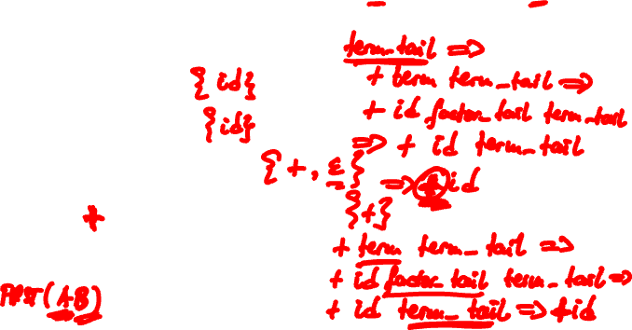
Warm-up Exercise
start → expr $$ expr → term term_tail term_tail → + term term_tail | ε
term → id factor_tail factor_tail → * id factor_tail | ε
FIRST(term) = { id }
FIRST(expr) =
FIRST(start) =
FIRST(term_tail) =
FIRST(+ term term_tail) =
FIRST(factor_tail) =
Notes:
Intuitively, the FIRST(α) is the set of terminals that begin the
strings derived from α.
FIRST is defined over arbitrary sequences of grammar symbols.
What we are interested in, is the FIRSTs of the nonterminals, and the FIRSTs of the production right-hand-sides.

Slide 15
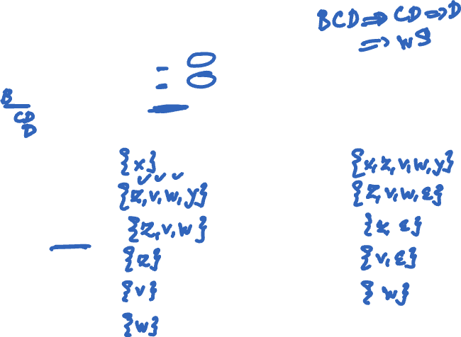
Exercise
start → S $$ B → z S | ε
S → x S | A y C → v S | ε
A → BCD | ε D → w S
Compute FIRST sets:
FIRST(x S) = FIRST(S) =
FIRST(A y) = FIRST(A) =
FIRST(BCD) = FIRST(B) =
FIRST(z S) = FIRST(C) =
FIRST(v S) = FIRST(D) =
FIRST(w S) =
Notes:
Intuitively, the FIRST(α) is the set of terminals that begin the
strings derived from α.
FIRST is defined over arbitrary sequences of grammar symbols.
What we are interested in, is the FIRSTs of the nonterminals, and the FIRSTs of the production right-hand-sides.
FIRST(x S) = { x }
FIRST(A y) = { z,v,w,y }
FIRST(BCD) = { z,v,w }

Slide 16
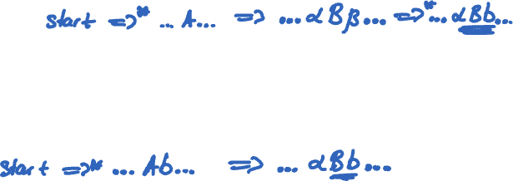
Computing FOLLOW
Notation:
A,B,S are nonterminals.
α,β are arbitrary sequences
of terminals and nonterminals.
Apply these rules until nothing can be added to any FOLLOW(A) set
(1) If there is a production A → αBβ, then everything in FIRST(β) except for ε should be added to FOLLOW(B)
(2) If there is a production A → αB, or a production A → αBβ, where FIRST(β) contains ε, then everything in FOLLOW(A) should be added to FOLLOW(B)

Slide 17
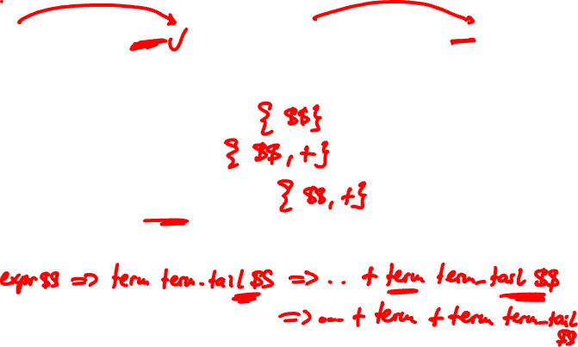
Warm-up
start → expr $$ expr → term term_tail term_tail → + term term_tail | ε
term → id factor_tail factor_tail → * id factor_tail | ε
FOLLOW(expr) = { $$ }
FOLLOW(term_tail) =
FOLLOW(term) =
FOLLOW(factor_tail) =
Notes:
Follow(term_tail) = { $$ }
Follow(term) = { +, $$ }
Follow(factor_tail) = { +, $$ }

Slide 18
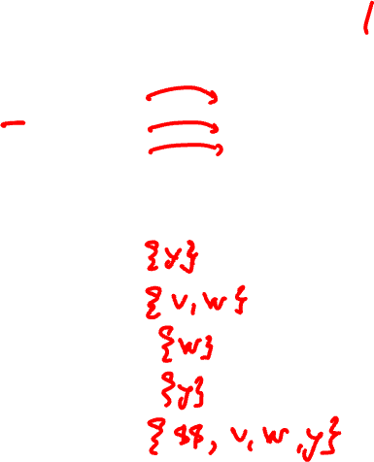
Exercise
start → S $$ B → z S | ε
S → x S | A y C → v S | ε
A → BCD | ε D → w S
Compute FOLLOW sets:
FOLLOW(A) =
FOLLOW(B) =
FOLLOW(C) =
FOLLOW(D) =
FOLLOW(S) =

Slide 19
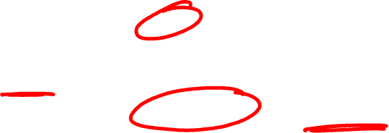
PREDICT Sets
FIRST(α) if α does not derive ε
PREDICT(A → α) =
(FIRST(α) – {ε}) U FOLLOW(A) if α derives ε

Slide 20
Constructing LL(1) Parsing Table
Algorithm uses PREDICT sets:
foreach production A → α in grammar G
foreach terminal a in PREDICT(A → α)
add A → α into entry parse_table[A,a]
If each entry in parse_table contains at most one production, then G is said to be LL(1)

Slide 21
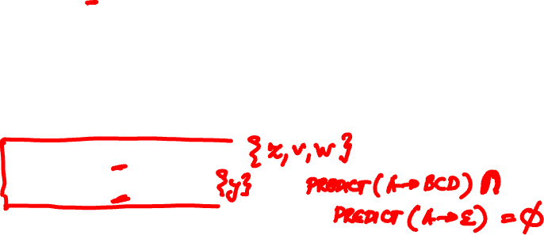
Exercise
start → S $$ B → z S | ε
S → x S | A y C → v S | ε
A → BCD | ε D → w S
Compute PREDICT sets:
PREDICT(S → x S) =
PREDICT(S → A y) =
PREDICT(A → BCD) =
PREDICT(A → ε) =
… etc…
Notes:
Answer:
PREDICT( S -> x S ) = {x}
PREDICT(S -> A y) = { y, z,v,w }
PREDICT(A -> BCD) = { z,v,w }
PREDICT(A -> \epsilon) = { y }

Slide 22
Writing an LL(1) Grammar
Most context-free grammars are not LL(1) grammars
Obstacles to LL(1)-ness
Left recursion is an obstacle. Why?
Common prefixes are an obstacle. Why?
expr → expr + term | term
term → term * id | id
stmt → if b then stmt else stmt | if b then stmt |
a
Notes:
I sometimes omit the starting production start -> … $$ for brevity.
Left recursion. A grammar is left recursive when there is a production A -> A\beta | …

Slide 23
Removal of Left Recursion
Left recursion can be removed from a grammar mechanically
Started from this left-recursive expression grammar:
After removal of left recursion, we obtain this equivalent grammar, which is LL(1):
expr → expr + term | term
term → term * id | id
expr → term term_tail
term_tail → + term term_tail | ε
term → id factor_tail
factor_tail → * id factor_tail | ε
Notes:
See textbook for more on removal of left recursion.

Slide 24
Removal of Common Prefixes
Common prefixes can be removed mechanically as well by using left-factoring
Original if-then-else grammar:
After left-factoring:
stmt → if b then stmt else stmt | if b then stmt |
a
stmt → if b then stmt else_part | a else_part → else stmt | ε
Notes:
if, b, then, else and a are the terminals (tokens) in the grammar.

Slide 25
Exercise
start → stmt $$
stmt → if b then stmt else_part | a else_part → else stmt | ε
Compute FIRSTs:
FIRST(stmt $$), FIRST(if b then stmt else_part), FIRST(a), FIRST(else stmt)
Compute FOLLOW:
FOLLOW(else_part)
Compute PREDICT sets for all 5 productions
Construct the LL(1) parsing table. Is this grammar an LL(1) grammar?

Slide 26
Exercise
start → stmt $$
stmt → if b then stmt else_part | a else_part → else stmt | ε
Compute FIRSTs:
FIRST(stmt $$) =
FIRST(if b then stmt else_part) =
FIRST(a) =
FIRST(else stmt) =

Slide 27
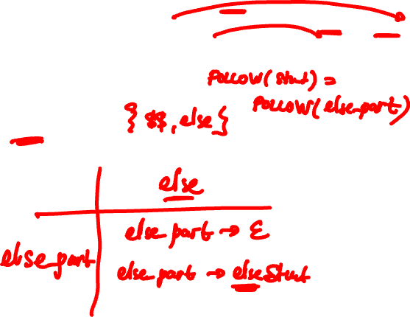
Exercise
start → stmt $$
stmt → if b then stmt else_part | a else_part → else stmt | ε
Compute FOLLOW:
FOLLOW(else_part) =

Slide 28
Exercise
start → stmt $$
stmt → if b then stmt else_part | a else_part → else stmt | ε
Construct the LL(1) parsing table
Is this grammar an LL(1) grammar?

Slide 29
Exercise

Slide 30
Lecture Outline
Top-down parsing (also called LL parsing)
LL(1) parsing table
FIRST, FOLLOW, and PREDICT sets
LL(1) grammars
Bottom-up parsing (also called LR parsing)
A brief overview, no detail

Slide 31
Bottom-up Parsing
Terminals are seen in the
order of appearance in the
token stream
id , id , id ;
Parse tree is constructed
From the leaves to the top
A rightmost derivation in reverse
list
id
list_tail
,
id
list_tail
,
id
list_tail
;
list → id list_tail
list_tail → , id list_tail | ;

Slide 32
Bottom-up Parsing
list → id list_tail
list_tail → , id list_tail | ;
Stack Input Action
id,id,id; shift
id ,id,id; shift
id, id,id; shift
id,id ,id; shift
id,id, id; shift
id,id,id ; shift
id,id,id; reduce by list_tail→;
Notes:
Parser looks at the stack and the current lookahead in the token stream and decides whether to shift the current lookahead on top of the stack, or to pop a suitable production right-hand-side off the top of the stack and reduce this right-hand-side to its corresponding left-hand-side.

Slide 33
Bottom-up Parsing
list → id list_tail
list_tail → , id list_tail | ;
Stack Input Action
id,id,id list_tail reduce by
list_tail → ,id list_tail
id,id list_tail reduce by
list_tail → ,id list_tail
id list_tail reduce by
list → id list_tail
list ACCEPT

Slide 34
Bottom-up Parsing
Also called LR parsing
LR parsers work with LR(k) grammars
L stands for “left-to-right” scan of input
R stands for “rightmost” derivation
k stands for “need k tokens of lookahead”
We are interested in LR(0) and LR(1) and variants in between
LR parsing is better than LL parsing!
Accepts larger class of languages
Just as efficient!

Slide 35
LR Parsing
The parsing method used in practice
LR parsers recognize virtually all PL constructs
LR parsers recognize a much larger set of grammars than predictive parsers
LR parsing is efficient
LR parsing variants
SLR (or Simple LR)
LALR (or Lookahead LR) – yacc/bison generate LALR parsers
LR (Canonical LR)
SLR < LALR < LR

Slide 36
Main Idea
Stack ← Input
Stack: holds the part of the input seen so far
A string of both terminals and nonterminals
Input: holds the remaining part of the input
A string of terminals
Parser performs two actions
Reduce: parser pops a “suitable” production right-hand-side off top of stack, and pushes production’s left-hand-side on the stack
Shift: parser pushes next terminal from the input on top of the stack

Slide 37
Example
Recall the grammar
This is not LL(1) because it is left recursive
LR parsers can handle left recursion!
Consider string
id + id * id
expr → expr + term | term
term → term * id | id

Slide 38
id + id*id
Stack Input Action
id+id*id shift id
id +id*id reduce by term→ id
term +id*id reduce by expr→ term
expr +id*id shift +
expr+ id*id shift id
expr+id *id reduce by term → id
expr → expr + term | term
term → term * id | id

Slide 39
id + id*id
Stack Input Action
expr+term *id shift *
expr+term* id shift id
expr+term*id reduce by term→term *id
expr+term reduce by expr→expr+term
expr ACCEPT, SUCCESS
expr → expr + term | term
term → term * id | id

Slide 40
id + id*id
Sequence of reductions performed by parser
id+id*id
term+id*id
expr+id*id
expr+term*id
expr+term
expr
A rightmost derivation in reverse
The stack (e.g., expr) concatenated with remaining input (e.g., +id*id) gives a sentential form (expr+id*id) in the rightmost derivation
expr → expr + term | term
term → term * id | id

Slide 41
The End

