Slide 1
Logic Programming and Prolog
Keep reading: Scott, Chapter 12

Slide 2
Lecture Outline
Prolog
Lists
Programming with lists
Arithmetic

Slide 3
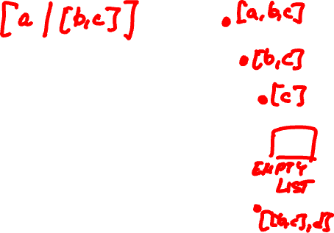
Lists
list head tail
[a,b,c] a [b,c]
[X,[cat],Y] X [[cat],Y]
[a,[b,c],d] a [[b,c],d]
[X | Y] X Y
a
b
c
[ ]
a
b
c
[ ]
[ ]
d
Notes:
Lists are the one and only data structure in Prolog.
A list is written in two ways:
as a comma-separated list of terms, e.g., [a,b,c] or
as a structure that has a head and a tail, e.g., [ a | [b,c] ] The head of the list is the first element in the list. The tail of the list is the rest-of-list, the list which includes all the remaining elements in the list.
In both cases, a list is represented in memory as a binary tree
where the left child is the head, and the right child is the rest-of-list structure.

Slide 4
Lists: Unification
[ H1 | T1 ] = [ H2 | T2 ]
Head H1 unifies with H2, possibly recursively
Tail T1 unifies with T2, possibly recursively
E.g., [ a | [b, c] ] = [ X | Y ]
X = a
Y = [b, c]
NOTE: In Prolog, = denotes unification, not assignment!

Slide 5
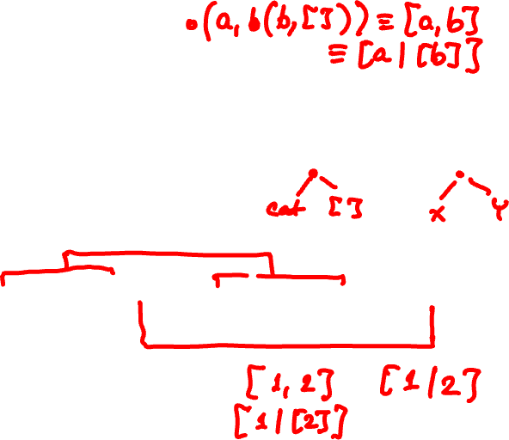
Question
[X,Y,Z] = [john, likes, fish]
X = john, Y = likes, Z = fish
[cat] = [X | Y]
X = cat, Y = [ ]
[[the, Y]|Z] = [[X, hare]|[is,here]]
X = the, Y = hare, Z = [is, here]

Slide 6
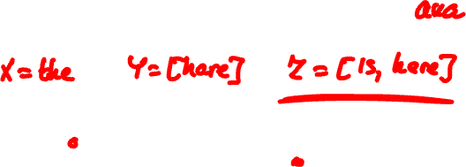
Lists: Unification
Sequence of comma separated terms, or
[ first term | rest_of_list ]
[ [the | Y] | Z ] = [ [X, hare] | [is, here] ]
Z
the
Y
is
X
here
[ ]
hare
[ ]

Slide 7
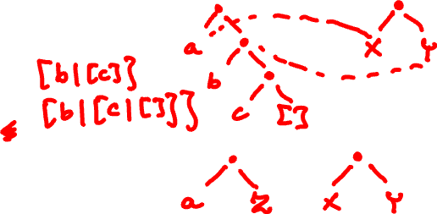
Lists Unification
Look at the trees to see how this works!
[ a, b, c ] = [ X | Y ]
X = a, Y = [b,c].
[a | Z ] =? [ X | Y ]
X = a, Y = Z.

Slide 8
Improper and Proper Lists
[1 | 2] versus [1, 2]
1
1
2
2
[ ]
Notes:
[1|2] is an improper list because the rest-of-list branch in the tree
is 2, which is a numeric constant, not a list. Proper lists always have rest-of-list
branches that are one of 1) a proper list, or 2) the special empty list, [].
Another example of improper list is [1,2|3].

Slide 9
Question. Can we unify these lists?
[abc, Y] =? [ abc | Y ]
abc
abc
Y
Y
[ ]
Answer: No. There is no value binding for Y that makes these two trees isomorphic
Notes:
First, Prolog unifies the heads abc = abc. Succeeds.
Next, Prolog tries to unify [Y] with Y. But this is impossible, there does not exist a value binding for Y which will make the two trees isomorphic.
In fact, Prolog cannot unify a variable Y with a structure if Y occurs somewhere in the structure (e.g., Y = abc(Y), or Y = abc([Y],X), etc.)
The Prolog interpreter prevents infinite recursion by performing the so called “occurs check”: if the occurs check returns true, unification fails; otherwise, it succeeds.

Slide 10
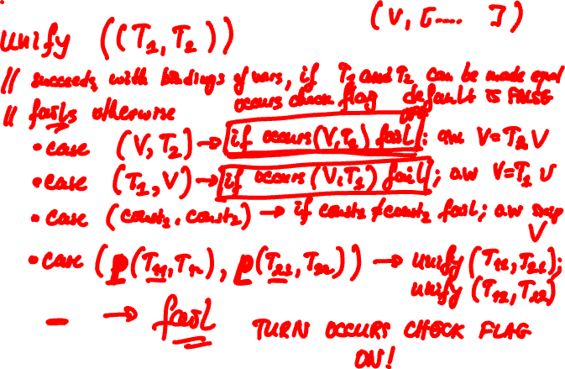
Unification and the Occurs check

Slide 11
Lecture Outline
Prolog
Lists
Programming with lists
Arithmetic

Slide 12
Member_of
?- member(a,[a,b]).
true.
?- member(a,[b,c]).
false.
?- member(X,[a,b,c]).
X = a ;
X = b ;
X = c ;
false.
1. member(A, [A | B]).
2. member(A, [B | C]) :- member(A, C).
Notes:
In Prolog, “procedures” are invertible.
Normally, we think as the element and the list as arguments, which we have to bind to values when calling procedure “member”.
But in Prolog, we can “invert” the arguments, i.e., give unbound variables for the element and/or the list and Prolog computes values for them! These are the values that make the “member” query true.

Slide 13
Member_of
?- member(a,[a,b]).
true.
?- member(a,[b,c]).
false.
?- member(X,[a,b,c]).
X = a ;
X = b ;
X = c.
?- member(a,[b,c,X]).
X = a ;
false.
1. member(A, [A | B]).
2. member(A, [B | C]) :- member (A, C).
Notes:
In Prolog, “procedures” are invertible.
Normally, we think as the element and the list as arguments, which we have to bind to values when we call procedure “member”.
But in Prolog, we can “invert” the arguments, i.e., give unbound variables for the element and/or the list, and Prolog computes values for them, these are the values that make member true.

Slide 14
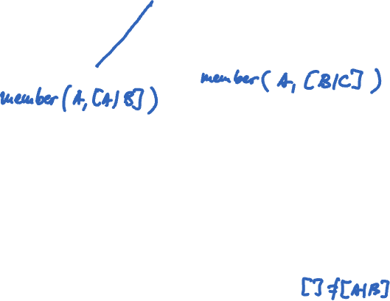
Prolog Search Tree (OR levels only)
member(X,[a,b,c])
A=X=a,B=[b,c]
A=X,B=a,C=[b,c]
X=a
success
member(X,[b,c])
A’=X,B’=b,C’=[c]
A’=X=b,B’=[c]
member(X,[c])
X=b
success
A”=X=c,B”=[]
A”=X
B”=c, C”=[]
X=c
success
member(X,[])
fail
fail
1. member(A, [A | B]).
2. member(A, [B | C]) :- member (A, C).

Slide 15
Member_of
member(A, [A|B]).
member(A, [B|C]) :- member(A,C).
logical semantics: For every A,B and C member(A,[B|C]) if member(A,C)
procedural semantics: Head of clause is procedure entry. Tail of clause is procedure body; subgoals correspond to calls.

Slide 16
“Procedural” Interpretation
member(A, [A|B]).
member(A, [B|C]) :- member(A,C).
member is a recursive “procedure”
member(A, [A|B]). is the base case. “Procedure” exits with true if the element we are looking for, A, is the first element in the list. It exits with false if we have reached the end of the list
member(A, [B|C]) :- member(A,C). is the recursive case. If element A is not the first element in the list, call member recursively with arguments A and tail C

Slide 17
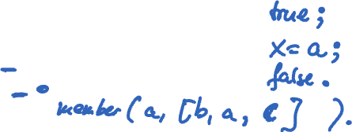
Question
Give all answers to the following query:
?- member(a,[b, a, X]).
Answer:
true ;
X = a ;
false.
1. member(A, [A | B]).
2. member(A, [B | C]) :- member(A, C).

Slide 18
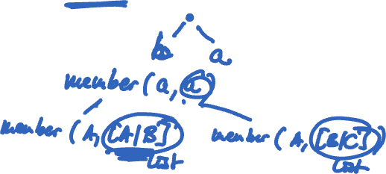
Question
Give all answers to the following query:
?- member(a, [b | a]).
Answer:
false.
1. member(A, [A | B]).
2. member(A, [B | C]) :- member(A, C).

Slide 19
Append
append([ ], A, A).
append([A|B], C, [A|D]) :- append(B,C,D).
Build a list:
?- append([a,b,c],[d,e],Y).
Y = [a,b,c,d,e]
Break a list into constituent parts:
?- append(X,Y,[a,b]).
X = [], Y = [a,b]; X = [a], Y = [b];
X = [a,b], Y = []; false.
Notes:
If we want our Prolog “procedure” to return a result other than true or false, then we need to give an additional “result”
argument.

Slide 20
More Append
append([ ], A, A).
append([A|B], C, [A|D]) :- append(B,C,D).
Break a list into constituent parts
?- append(X,[b],[a,b]).
X = [ a ]
?- append([a],Y,[a,b]).
Y = [ b ]

Slide 21
More Append
? - append(X,Y,[a,b]).
X = [ ],
Y = [a,b] ;
X = [a],
Y = [b] ;
X = [a,b],
Y = [ ] ;
false.
Notes:
Show the search tree for this query at board

Slide 22
Unbounded Arguments
Generating an unbounded number of lists
?- append(X,[b],Y).
X = [ ]
Y = [b] ;
X = [ _G604]
Y = [ _G604, b] ;
X = [ _G604, _G610]
Y = [ _G604, _G610, b] ;
Etc.
Be careful when using append with 2 unbounded arguments!
An underscore, “don’t care” variable.
Unifies with anything.
E.g., bad(Dog) :- bites(Dog,_).

Slide 23
Question
What does this “procedure” do:
p([],[]).
p([A|B],[[A]|Rest]) :- p(B,Rest).
?- p([a,b,c],Y).
Y = [ [a],[b],[c] ]

Slide 24
Common Structure
“Processing” a list:
p([],[]).
p([H|T],[H1|T1]) :- f(H,H1),p(T,T1).
Base case: we have reached the end of list. In our case, the result for [ ] is [ ].
Recursive case: result is [H1|T1]. H1 was obtained by calling f(H,H1) --- processes element H into result H1. T1 is the result of recursive call of p on T.

Slide 25
Lecture Outline
Prolog
Lists
Programming with lists
Arithmetic

Slide 26
Arithmetic
Prolog has all arithmetic operators
Built-in predicate is
is(X, 1+3) or more commonly we write
X is 1+3
is forces evaluation of 1+3:
?- X is 1+3
X = 4
= is unification not assignment!
?- X = 4-1.
X = 4-1 % unifies X with 4-1!!!

Slide 27
Arithmetic: Pitfalls
is is not invertible! That is, arguments on the right cannot be unbound!
3 is 3 – X.
ERROR: is/2: Arguments are not sufficiently instantiated
This doesn’t work either:
?- X is 4, X = X+1.
false.
Why? What’s going on here?

Slide 28
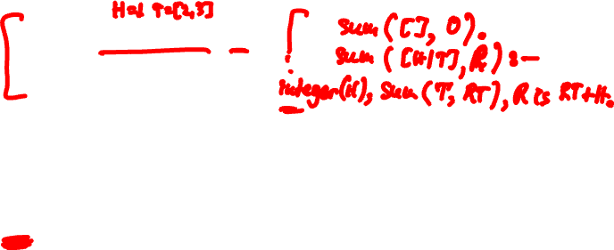
Exercise
Write sum, which takes a list of integers and computes the sum of the integers. E.g.,
sum([1,2,3],R).
?- R = 6.
How about if the integers are arbitrarily nested? E.g.,
sum([[1],[[[2]],3]],R).
?- R = 6.

Slide 29
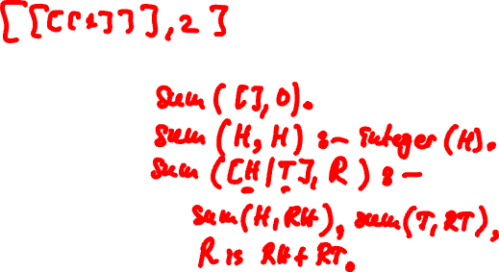
Exercise

Slide 30
Exercise
Write plus10, which takes a list of integers and computes another list, where all integers are shifted +10. E.g.,
plus10([1,2,3],R).
?- R = [11,12,13].
Write len, which takes a list and computes the length of the list. E.g.,
len([1,[2],3],R).
?- R = 3.

Slide 31
Exercise
Write atoms, which takes a list and computes the number of atoms in the list. E.g.,
atoms([a,[b,[[c]]]],R).
?- R = 3.
Hint: built-in predicate atom(X) yields true if X is an atom (i.e., symbolic constant such as x, abc, tom).

Slide 32
Negation
not(member(a,[a,b])).
not(member(c,[a,b])).
sister_of(X,Y) :- female(X),parents(X,M,F), parents(Y,M,F).

Slide 33
The End

