Slide 1
Logic Programming and Prolog
Finish reading: Scott, Chapter 12

Slide 2
Lecture Outline
Quiz 3
Prolog
Imperative control flow
Negation by failure
Generate and test paradigm

Slide 3
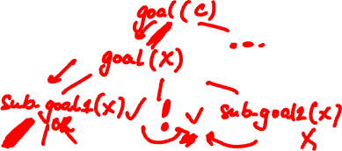
Imperative Control Flow
Programmer has explicit control on backtracking process
cut (!)
! is a subgoal
As a goal it succeeds, but with a side effect:
Commits interpreter to all bindings made since unifying left-hand side of current rule with parent goal

Slide 4
Cut (!) Example
rainy(seattle).
rainy(rochester).
cold(rochester).
snowy(X) :- rainy(X), !, cold(X).
?- snowy(C).
Notes:
Returns false.

Slide 5
Cut (!) Example
rainy(seattle).
rainy(rochester).
cold(rochester).
snowy(X) :- rainy(X), !, cold(X).
snowy(C)
cold(seattle) fails; no backtracking to rainy(X).
GOAL FAILS.
_C = _X
snowy(X)
AND
rainy(X)
!
cold(X)
X = seattle
OR
cold(rochester)
rainy(seattle)
rainy(rochester)

Slide 6
Cut (!) Example 2
rainy(seattle).
rainy(rochester).
cold(rochester).
snowy(X) :- rainy(X), !, cold(X).
snowy(troy).
?- snowy(C).

Slide 7
Cut (!) Example 2
rainy(seattle).
rainy(rochester).
cold(rochester).
snowy(X) :- rainy(X), !, cold(X).
snowy(troy).
2 committed OR bindings:
_C = _X and X = seattle
GOAL FAILS.
snowy(C)
OR
_C = _X
snowy(X)
snowy(troy)
AND
rainy(X)
!
cold(X)
X = seattle
OR
cold(rochester)
rainy(seattle)
rainy(rochester)
How about query ?- snowy(troy)?
Notes:
snowy(troy) succeeds.

Slide 8
Cut (!) Example 3
rainy(seattle) :- !.
rainy(rochester).
cold(rochester).
snowy(X) :- rainy(X), cold(X).
snowy(troy).
?- snowy(C).
Notes:
Fails for rochester, succeeds for troy.

Slide 9
Cut (!) Example 3
C = troy SUCCEEDS
Only rainy(X) is committed to bindings (X = seattle).
rainy(seattle) :- !.
rainy(rochester).
cold(rochester).
snowy(X) :- rainy(X), cold(X).
snowy(troy).
snowy(C)
OR
_C = _X
C = troy
snowy(X)
snowy(troy)
AND
rainy(X)
cold(X)
X = seattle
OR
cold(rochester)
rainy(seattle)
rainy(rochester)
How about query ? - snowy(rochester)?
!

Slide 10
Cut (!) Example 4
rainy(seattle).
rainy(rochester).
cold(rochester).
snowy(X) :- !, rainy(X), cold(X).
?- snowy(C).
Notes:
C = rochester.
But it won’t find C = troy.

Slide 11
Cut (!) Example 4
rainy(seattle).
rainy(rochester).
cold(rochester).
snowy(X) :- !, rainy(X), cold(X).
snowy(C)
_C = _X
success
cold(seattle) fails; backtrack.
snowy(X)
AND
!
rainy(X)
cold(X)
X = seattle
OR
X = rochester
cold(rochester)
rainy(seattle)
rainy(rochester)

Slide 12
Cut (!) Example 5
rainy(seattle).
rainy(rochester).
cold(rochester).
snowy(X) :- rainy(X), cold(X), !.
?- snowy(C).

Slide 13
Cut (!) Example 5
rainy(seattle).
rainy(rochester).
cold(rochester).
snowy(X) :- rainy(X), cold(X), !.
snowy(C)
_C = _X
success
snowy(X)
AND
!
rainy(X)
cold(X)
X = seattle
OR
X = rochester
cold(rochester)
rainy(seattle)
rainy(rochester)

Slide 14
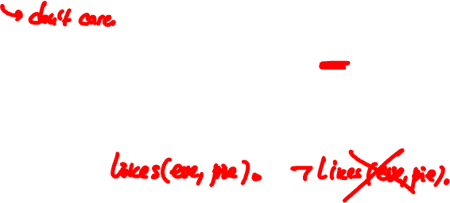
Negation by Failure: not(X), \+(X)
not(C) succeeds when C fails
Called negation by failure, defined:
not(X) :- X,!,fail.
not(_).
Not the same as negation in logic ¬X!
In Prolog, we can assert that something is true, but we cannot assert that something is false
Notes:
\+(G) works properly only in the following cases:
1. When G is fully instantiated at the time prolog processes the goal \+(G). (In this case, \+(G) is interpreted to mean “goal G does not succeed”.)
2. When all variables in G are unique to G, i.e., they don’t appear elsewhere in the same clause. (In this case, \+(G(X)) is interpreted to mean “There is no value of X that will make G(X) succeed”.)

Slide 15
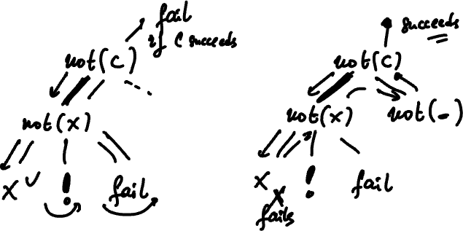

Slide 16
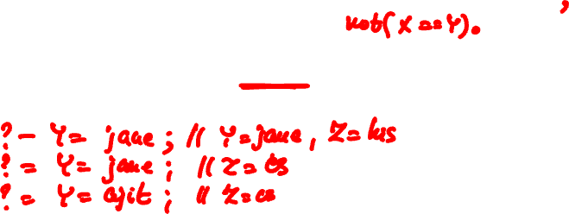
Exercise
takes(jane, his).
takes(jane, cs).
takes(ajit, art).
takes(ajit, cs).
classmates(X,Y) :- takes(X,Z),takes(Y,Z).
?- classmates(jane,Y).
What are the bindings of Y?
Notes:
Answers:
What are the bindings for Y.
Y = jane ; %Z is bound to his
Y = jane ; %Z is bound to cs
Y = ajit. %Z is bound to cs again.
classmates(X,Y) :- takes(X,Z),takes(Y,Z),not(X==Y).

Slide 17
Exercise
p(X) :- q(X), not(r(X)). r(X) :- w(X), not(s(X)). q(a). q(b). q(c). s(a). s(c). w(a). w(b).
Evaluate:
?- p(a).
?- p(b).
?- p(c).
Notes:
p(a) is true.
p(b) is false.
p(c) is true.

Slide 18
Lecture Outline
Prolog
Imperative control flow
Negation by failure
Generate and test paradigm

Slide 19
Generate and Test Paradigm
Search in space
Prolog rules to generate potential solutions
Prolog rules to test potential solutions for desired properties
Easy prototyping of search
solve(P) :- generate(P), test(P).

Slide 20
A Classical Example: n Queens
Given an n by n chessboard, place each of n queens on the board so that no queen can attack another in one move
Queens can move either vertically,
horizontally, or
diagonally.
A classical generate and test problem

Slide 21
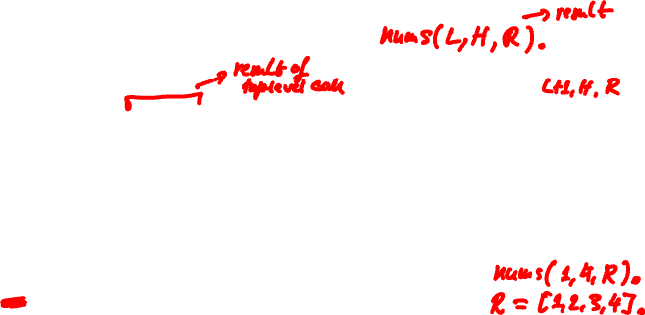
n Queens
my_not(X):- X, !, fail. %same as not
my_not(_).
in(H,[H|_]). %same as member
in(H,[_|T]):- in(H,T).
nums(H,H,[H]).
nums(L,H,[L|R]):- L<H, N is L+1, nums(N,H,R).
%%%nums generates a list of integers between two other numbers, L,H by putting the first number at the front of the list returned by a recursive call with a number 1 greater than the first. It works when L and H are bound to integers. It stops when it gets to the higher number
queen_no(4).
%%%The number of queens/size of board - use 4

Slide 22
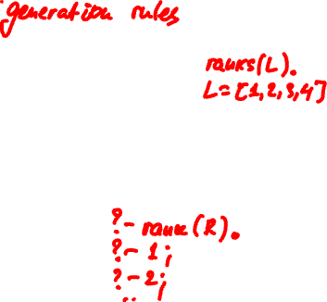
n Queens (ii)
ranks(L):- queen_no(N), nums(1,N,L).
files(L):- queen_no(N), nums(1,N,L).
%%%ranks and files generate the x and y axes of the chess board. Both are lists of numbers up to the number of queens; that is, ranks(L) binds L to the
list [1,2,3,…,#queens].
rank(R):- ranks(L), in(R,L).
%%% R is a rank on the board; selects a particular rank R from the list of all ranks L.
file(F):- files(L), in(F,L).
%%% F is a file on the board; selects a particular file F from the list of all files L.
Notes:
(choice of rank, choice of file) selects a position on the board.
In usual x,y co-ordinates, rank picks the position on the x axis, and file picks the positon on the y axis

Slide 23
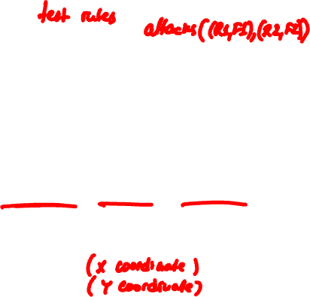
n Queens (iii)
%%% Squares on the board are (rank,file) coordinates. attacks decides if a queen on the square at rank R1, file F1 attacks the square at rank R2, file F2 or vice versa. A queen attacks every square on the same rank, the same file, or the same diagonal.
attacks((R,_),(R,_)).
attacks((_,F),(_,F)). %a Prolog tuple
attacks((R1,F1),(R2,F2)):-
diagonal((R1,F1),(R2,F2)).
%%%can decompose a Prolog tuple by unification
(X,Y)=(1,2) results in X=1,Y=2; tuples have fixed size and there is not head-tail type construct for tuples
same rank
same file
q
same diagonal
What is safe placement
for next queen on board?

Slide 24
n Queens (iv)
%%% Two squares are on the same diagonal if the slope of the line between them is 1 or -1. Since / is used, real number values for 1 and -1 are needed.
diagonal((X,Y),(X,Y)). %degenerate case
diagonal((X1,Y1),(X2,Y2)):-N is Y2-Y1,D is X2-X1,
Q is N/D, Q is 1 . %diagonal needs bound arguments!
diagonal((X1,Y1),(X2,Y2)):-N is Y2-Y1,D is X2-X1,
Q is N/D, Q is -1 .
%%%because of use of “is”, diagonal is NOT invertible.

Slide 25
n Queens (v)
%%% This solution works by generating every list of squares, such that the length of the list is the same as the number of queens, and then checks every list generated to see if it represents a valid placement of queens to solve the N queens problem;
assume list length function
queens(P):- queen_no(N), length(P,N), placement(P), ok_place(P).
“generate” code given first “test” code follows
Notes:
Overview of what is happening - then we ‘ll go down into the details.
Key steps are: get a placement -- check it
if fail, then get another placement
if succeed, then return.

Slide 26
n Queens (vi)
%%%placement can be used as a generator. If placement is called with a free variable, it will construct every possible list of squares on a chess board.
The first predicate will allow it to establish the empty list as a list of squares on the board. The second predicate will allow it to add any (R,F) pair onto the front of a list of squares if R is a rank of the board and F is a file of the board.
placement first generates all 1 element lists, then all 2 element lists, etc. Switching the order of predicates in the second clause will cause it to try varying the length of the list before it varies the squares added to the list
placement([]).
placement([(R,F)|P]):- placement(P), rank(R), file(F).
Notes:
Placement() predicate needs to be used in a fashion where we control the length of the list
of positions being generated. Try out and see that it continues to generate an unbouded number of lists.

Slide 27
n Queens (vii)
%%%these two routines check the placement of the next queen
%%%Checks a list of squares to see that no queen on any of them would attack any other. does by checking that position j doesn’t conflict with positions (j+1),(j+2) etc.
ok_place([]).
ok_place([(R,F)|P]):- no_attacks((R,F),P),ok_place(P).
%%% Checks that a queen at square (R,F) doesn't attack any square (rank,file pair) in list L; uses attacks predicate defined previously
no_attacks(_,[]).
no_attacks((R,F),[(R2,F2)|P]):- my_not(attacks((R,F),(R2,F2))), no_attacks((R,F),P).
Notes:
Check the list of potential positions by always seeing if the first position can attack a queen in any of the other positions. If so, then ok_place() fails. Is recursive in that as soon as one position checks okay it goes on to check the next position until it hits the end of the list

Slide 28
Homework Solution Structure
Typical Prolog homework: search in space (e.g., paths in a maze, paths in graph, parsing sequences, various puzzles)
Typical solution:
search(F,Partial,Total) :-
final(F), … % get Total from Partial
search(C,Partial,Total) :-
generate(C,N), % generate next position
valid(N),… % test if N is a valid position
augment(Partial,New_partial),
% augment Partial solution with N, typically we would need not(member(N,Partial)) too.
search(N,New_partial,Total).

Slide 29
A Harder Exercise
Remember grammar from one of the quizzes…
S → aSbS
S → bSaS
S → ε
Write a top-down depth-first parser in Prolog:
?- parse([a,b,a,b],R).
R = [1, 2, 3, 3, 3] ; // seq. of productions
R = [1, 3, 1, 3, 3] ; // different seq
false. // no more seqs
Hint: break list into constituent parts

Slide 30
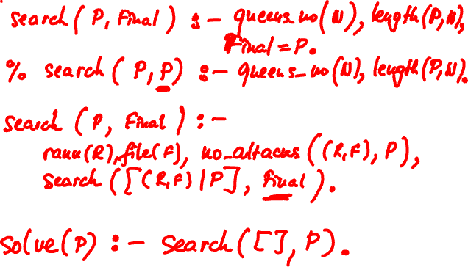
The End

