Slide 1
Semantic Analysis
Read: Scott, Chapter 4.1-4.3

Slide 2
Announcements
HW 1 grades are up
Quiz 1,2,3 grades up
We will release answers next week
Rainbow grades
Please check if your grade shows up correctly

Slide 3
Lecture Outline
Syntax vs. static semantics
Static semantics vs. dynamic semantics
Attribute Grammars
Attributes and rules
Synthesized and inherited attributes (next time)
S-attributed grammars (next time)
L-attributed grammars (next time)

Slide 4
Static Semantics
Earlier we considered syntax analysis
Informally, syntax deals with the form of programming language constructs
We now look at static semantic analysis
Semantics deals with the meaning of programming language constructs
The distinction between the two is fuzzy
In practice, anything that is not expressed in terms of certain CFG (LALR(1), in particular) is considered semantics

Slide 5
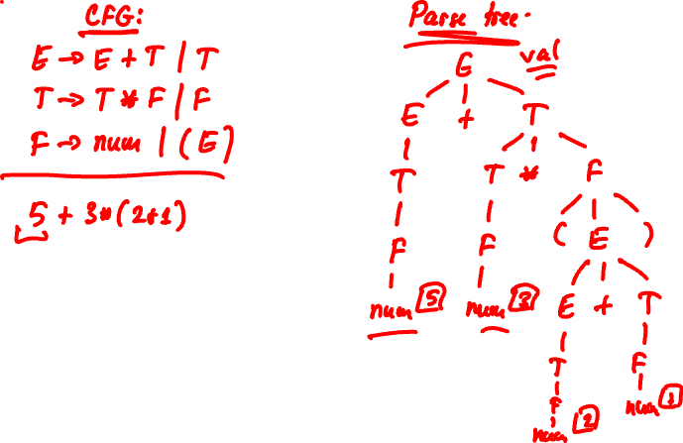
Static Semantics

Slide 6
Static Semantics vs. Dynamic Semantics
Static semantic analysis (compile-time)
Informally, reasons about program properties statically, before program execution
E.g., determine static types of expressions, detect certain errors
Dynamic semantic analysis (run-time)
Reasons about program properties dynamically, during program execution
E.g., could expression a[i] index out of array bounds, etc.?

Slide 7
The Role of Semantic Analysis
Detect errors in programs!
Static semantic analysis
Detect as many errors as possible early, before execution
Type inference and type checking
Dynamic semantic analysis
Detect errors by performing checks during execution
Again, detect errors as early as possible. E.g., flagging an array-out-of-bounds at assignment a[i] = … is useful
Tradeoff: dynamic checks slow program execution
Languages differ greatly in the amount of static semantic analysis and dynamic semantic analysis they perform
Notes:
C++: almost none. C++ is said to be “unsafe”
Java: many (we’ll see examples). Java is said to be “safe”

Slide 8
Examples of Static Semantic Errors
Type mismatch:
x = y+z+w: type of left-hand-side does not “match” type of right-hand-side
A a; … ; a.m(): m() cannot be invoked on a variable of type A
Definite assignment check in Java: a local variable must be assigned before it is used

Slide 9
Examples of Dynamic Semantic Errors
Null pointer dereference:
a.m() in Java, and a is null (i.e., uninitialized reference)
What happens?
Array-index-out-of-bounds:
a[i], i goes beyond the bounds of a
What happens in C++? What happens in Java?
Casting an object to a type of which it is not an instance
C++? Java?
And more…

Slide 10
Static Semantics vs. Dynamic Semantics
Again, distinction between the two is fuzzy
For some programs, the compiler can predict run-time behavior by using static analysis
E.g., there is no need for a nullness check:
x = new X();
x.m(); // x is non-null
In general, the compiler cannot predict run-time behavior
Static analysis is limited by the halting problem

Slide 11
Semantic Analyzer
compiler
character stream
scanner
optimizer
token stream
modified
intermediate
form
parser
parse trees
code generator
semantic analyzer and intermediate code generator
assembly code
intermediate
form
Semantic analyzer performs static semantic analysis on parse trees and ASTs.
Optimizer performs static semantic analysis on intermediate 3-address code.
Notes:
The semantic analyzer performs semantic analyses: most importantly type checking (or inference) and
intermediate code generation.

Slide 12
Lecture Outline
Syntax vs. static semantics
Static semantics vs. dynamic semantics
Attribute Grammars
Attributes and rules
Synthesized and inherited attributes (next time)
S-attributed grammars (next time)
L-attributed grammars (next time)

Slide 13
Attribute Grammars: Foundation for Static Semantic Analysis
Attribute Grammars: generalization of Context-Free Grammars
Associate meaning with parse trees
Attributes
Each grammar symbol has one or more values called attributes associated with it. Each parse tree node has its own instances of those attributes; attribute value carries the “meaning” of the parse tree rooted at node
Semantic rules
Each grammar production has associated rule, which may refer to and compute the values of attributes

Slide 14
Example: Attribute Grammar to Compute Value of Expression (denote grammar by AG1)
S → E E → E + T | T T → T * F | F F → num
Production Semantic Rule
S → E print(E.val)
E → E₁+T E.val := E₁.val + T.val
E → T E.val := T.val
T → T₁*F T.val := T₁.val * F.val
T → F T.val := F.val
F → num F.val := num.val
val: Attributes

Slide 15
Example: Decorated parse tree for input 3*5 + 2*4
S → E print(E.val)
E → E₁+T E.val := E₁.val+T.val
E → T E.val := T.val
T → T₁*F T.val := T₁.val*F.val
T → F T.val := F.val
F → num F.val := num.val
S
E
23
E
15
+
T
8
T
15
T
2
*
F
4
T
3
*
F
5
F
2
num
4
F
3
num
5
2
num
num
3

Slide 16
Example
val: Attributes associated to symbols
Intuitively, A.val holds the value of the expression, represented by the subtree rooted at A
Separate attributes are associated with separate nodes in the parse tree
Indices are used to distinguish between symbols with same name within same production
E.g., E → E₁+T E.val := E₁.val+T.val
Attributes of terminals supplied by scanner
In example, attributes of + and * are never used

Slide 17
Building an Abstract Syntax Tree (AST)
An AST is an abbreviated parse tree
Operators and keywords do not appear as leaves, but at the interior node that would have been their parent
Chains of single productions are collapsed
Compilers typically work with ASTs

Slide 18
Building ASTs for Expressions
Parse tree for 3*5+2*4
Abstract syntax tree (AST)
+
E
*
*
E
+
T
num:4
num:3
num:2
T
T
*
F
num:5
T
*
F
num:4
F
F
num:5
num:3
num:2
How do we construct syntax trees for expressions?

Slide 19
Attribute Grammar to build AST for Expression (denote by AG2)
An attribute grammar:
Attribute “nodepointer”
points to AST
Production Semantic Rule
E → E₁+T E.nptr := mknode(+, E₁.nptr, T.nptr)
E → T E.nptr := T.nptr
T → T₁ *F T.nptr := mknode(*, T₁.nptr, F.nptr)
T → F T.nptr := F.nptr
F → num F.nptr := mkleaf(num, num.val)
mknode(op,left,right) creates an operator node with label op, and two fields containing pointers left, to left operand and right, to right operand
mkleaf(num,num.val) creates a leaf node with label num, and a field containing the value of the number
Notes:
E.nptr is the “nodepointer”. Attribute is a pointer to the
AST node that is the root of the AST for the expression
represented by E.

Slide 20
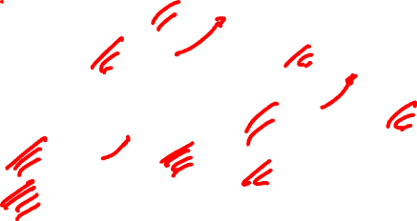
Constructing ASTs for Expressions
Input:
3 * 5 + 2 * 4
E → E₁+T E.nptr := mknode(‘+’, E₁.nptr, T.nptr)
E → T E.nptr := T.nptr
T → T₁ *F T.nptr := mknode(‘*’, T₁.nptr, F.nptr)
T → F T.nptr := F.nptr
F → num F.nptr := mkleaf(‘num’, num.val)
S
E
+, ,
E
+
T
* , ,
T
* , ,
T
*
F
T
*
F
F
num,4
F
num,5
num,2
num,3

Slide 21
Exercise
We know that the language L = a^{n}b^{n}c^{n} is not context free. It can be captured however with an attribute grammar. Give an underlying CFG and a set of attribute rules that associate an attribute ok with the root S of each parse tree, such that S.ok is true if and only if the string corresponding to the fringe of the tree is in L.

Slide 22
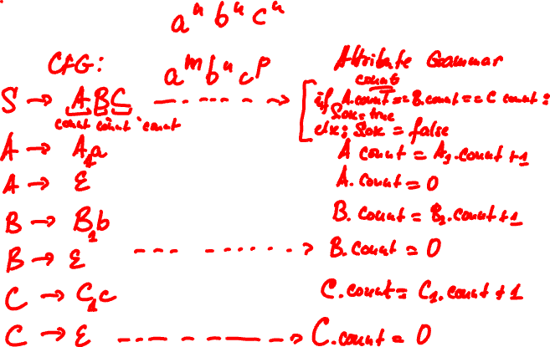
Exercise

Slide 23
Exercise
Consider the expression grammar
Give attribute rules to accumulate into the root a count of the maximum depth to which parentheses are nested in the expression. E.g., ((1 + 2)*3 + 4)*5 + 6 has a count of 2.
E → E + T | T
T → T * F | F
F → num | ( E )

Slide 24
Exercise

