Slide 1
Welcome to Computational Vision CSCI 4968 and 6270
Professor Chuck Stewart

Slide 2
Lecture Overview
Course mechanics and administrative details
Introduction to computer vision
Start of material on image processing
Trying to catch-up a bit from missing class Monday due to Irene.

Slide 3
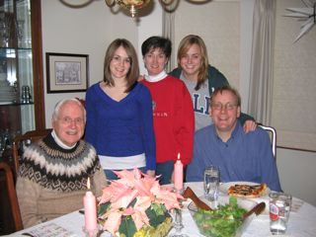
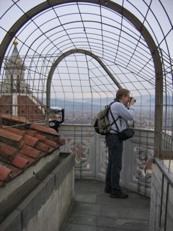
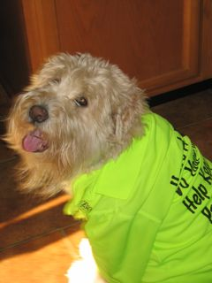
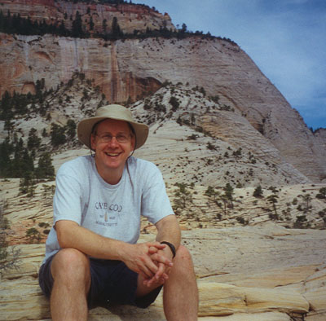
About Me…

Slide 4
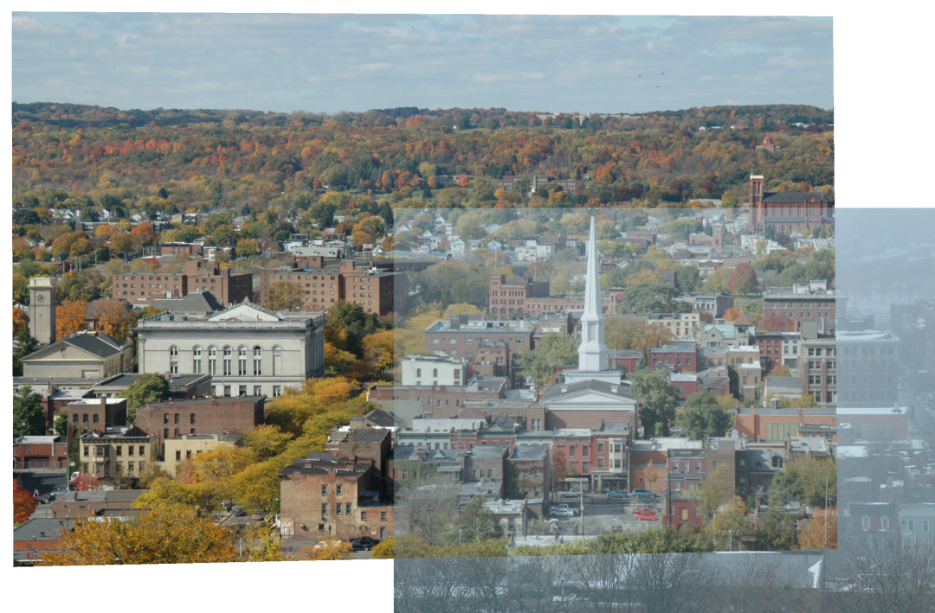
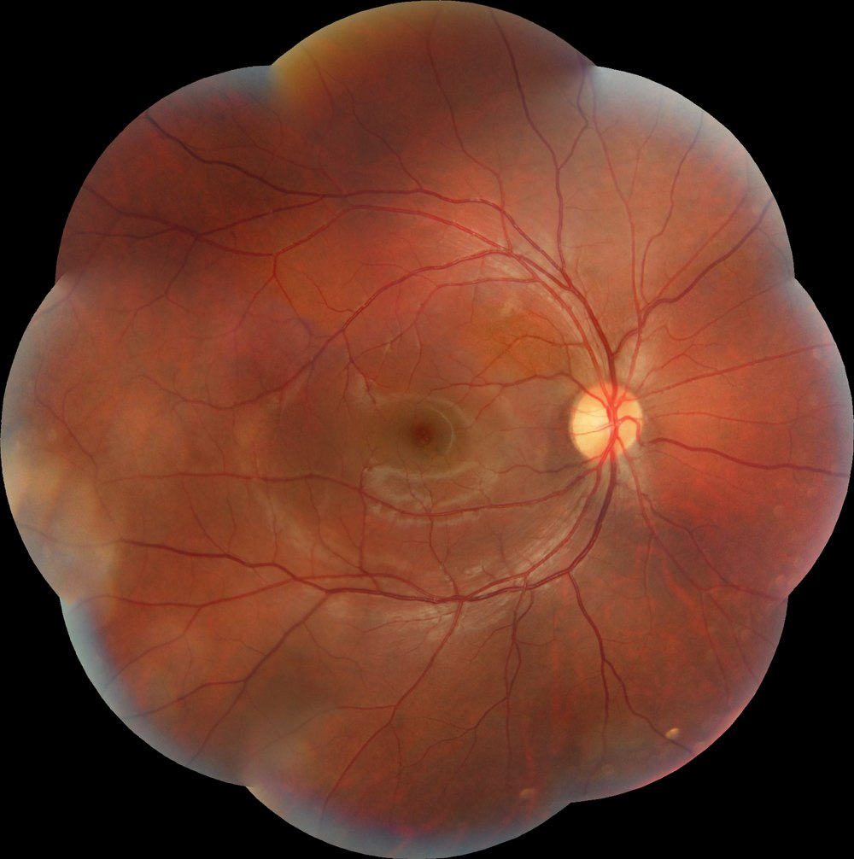
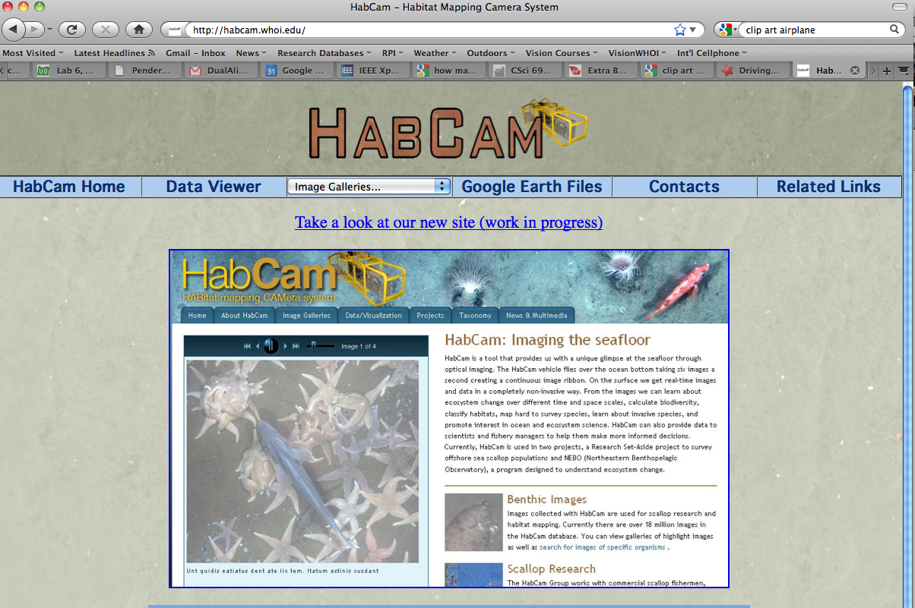
About Me…

Slide 5
About Me…

Slide 6
Dates, Times, Locations
Class: Mon, Thurs 10:00 – 11:30 (or so), Low 3045
Office: MRC 330B
Email: stewart@rpi.edu, stewart@cs.rpi.edu, cvstewart@gmail.com
Hours: after class, Tues 1-3, by apt
URL (coming soon)
http://www.cs.rpi.edu/~stewart/cv_2011

Slide 7
Learning Objectives
At the end of this course, each successful student will be able to
Apply techniques of calculus and linear algebra to solve problems involved in building the components of a computer vision system.
Develop efficient algorithms for solving problems in computer vision.
Write small-sized and intermediate-sized programs for solving problems in computer vision.
Assess the difficulty of specific technical problems in computer vision and select potential solution techniques.

Slide 8
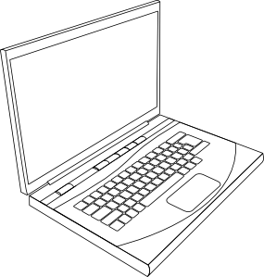
Pre-requisites
Computer Science
Intro programming
Data structures
Algorithms
Mathematics
Calculus
Multivariable and linear algebra?

Slide 9
Requirements – 10% Participation
Class attendance
Questions and ideas in class
On rotating basis:
Email questions about one day’s lecture by 7:00 am on the day of the next lecture
Accumulate points

Slide 10
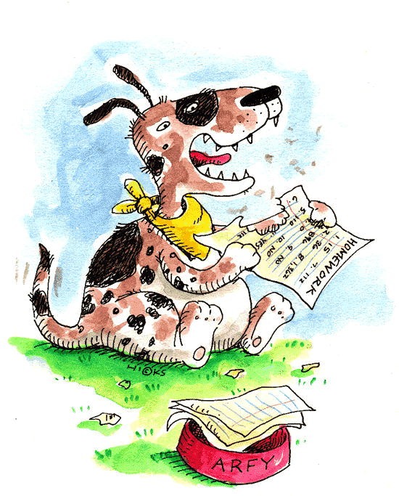
Requirements – 60% Homework
Five assignments – see syllabus for tentative dates
Analysis, algorithms, programming and evaluation
“Break” your algorithms and code
Three late days can be used

Slide 11
Requirements – 30% Final Project
Propose, research, analyze, implement and evaluate
Individual or team of two
Multiple due dates

Slide 12
Programming
Include use of the image processing toolkit

Slide 13
Undergraduate vs. Graduate Level
Credits
4 undergraduate
3 graduate
Common lectures
Mostly common homework
Additional project requirements for graduate level

Slide 14
Textbook
Selected readings from Rick Szeliski’s new textbook
On-line version at
http://szeliski.org/Book/
Using the September 3, 2010 draft

Slide 15
Academic Integrity
On assignments that require individual work, students are expected to submit their own solutions and write-ups. Students may work together to understand problem requirements, sketch solution ideas, and discuss results. Implementations and write-ups must be individual.
On assignments that allow students to work together, the work should be shared equally, and each student in the group will be responsible for understanding all aspects of the assignment and solution. Discuss between groups is allowed on the same level as discussion between individuals for single-person assignments.
Each individual or group will be working on a different final project. Therefore, discussion between individuals and groups is greatly encouraged. Within a group, once again, all work must be shared, and each individual is responsible for understanding all aspects of the project. Students who find resources to help with the final project must (a) reference these resources in their write-up and (b) add to these with their own work; each individual or team will be graded on the work that is its own.

Slide 16
So, Are You In?
Anyone satisfying the pre-requisites who wishes to join the course may do so.
Seniors wishing to enroll in the graduate version may do so by filling out the appropriate form, which I will sign.
If you have any questions whatsoever, come see me after class.

Slide 17
Definition of Computer Vision
Wikipedia (8/26/2010): Computer vision is the science and technology of machines that see, where see in this case means that the machine is able to extract information from an image that is necessary to solve some task. As a scientific discipline, computer vision is concerned with the theory behind artificial systems that extract information from images. The image data can take many forms, such as video sequences, views from multiple cameras, or multi-dimensional data from a medical scanner.
Other definitions emphasize:
Image formation
Construction of geometric and photometric models of the 3d world
Recognition

Slide 18
Closely Allied Fields
Image processing
Pattern recognition
Machine learning
Computer graphics
Computer algorithms

Slide 19
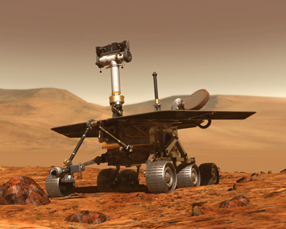
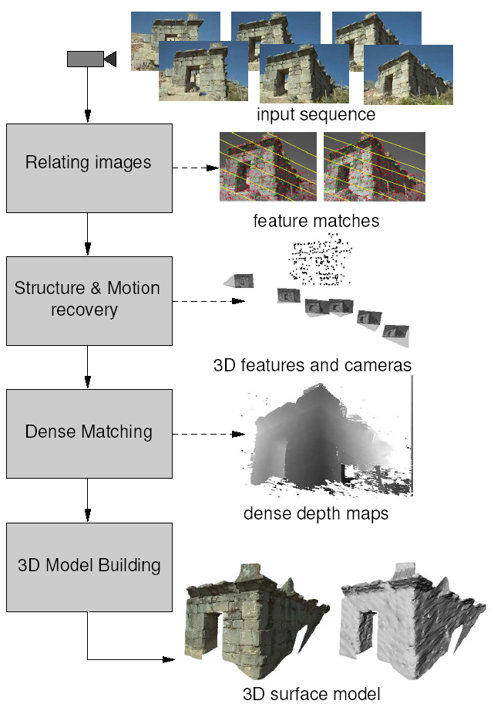
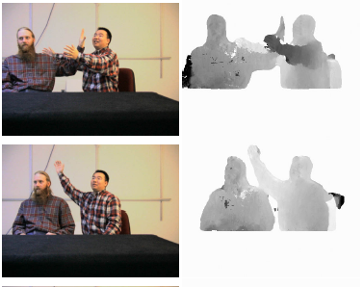
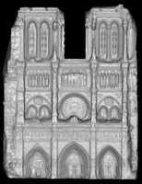
Vision for Measurement
Multi-view stereo for community photo collections
Real-time stereo
Structure from motion
NASA Mars Rover
Pollefeys et al.
Goesele et al.
Slide credit: L. Lazebnik

Slide 20
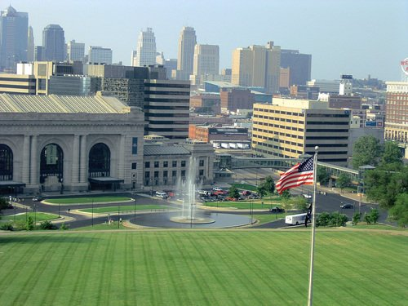
Vision for Recognition and Labeling
What can you recognize in these images?
Water? Trees? Buildings? Sky?
How can you recognize the sky?
Do you know where these were taken?

Slide 21
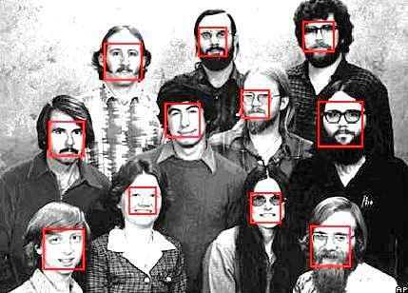
Drilling Down… Face Detection and Recognition

Slide 22
Who is the “Afghan Girl”?

Slide 23
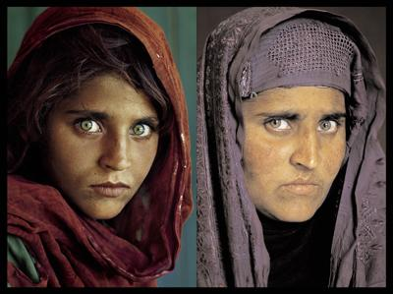
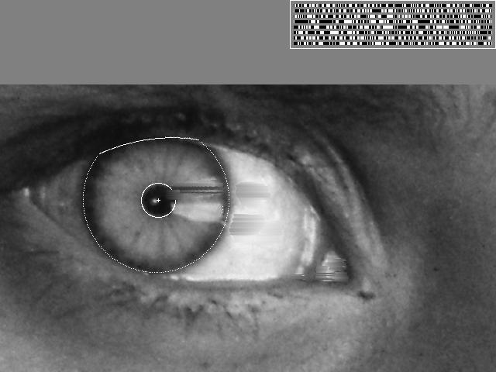
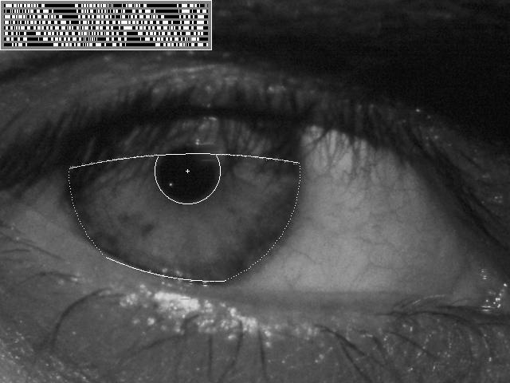
Identified Through Her Iris Patterns

Slide 24
Other Biometrics

Slide 25
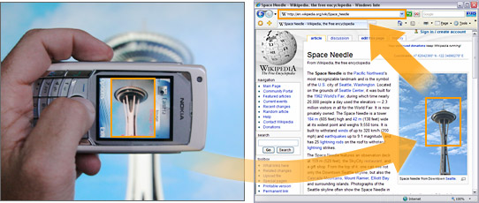
Object and Location Recognition Using Mobile Phones

Slide 26
Category Recognition

Slide 27
Mobile Robots
Larry Matthies et al, IJCV 2007

Slide 28
Smart Cars
Taken from the Mobileye web site

Slide 29
PhotoTourism and Photosynth
http://photosynth.net

Slide 30
Special Effects: Face Morphing

Slide 31
Gaming

Slide 32
Many, Many Other Applications
HCI
Image-based search
Biomedical image analysis and robotic surgery
Industrial inspection
…

Slide 33
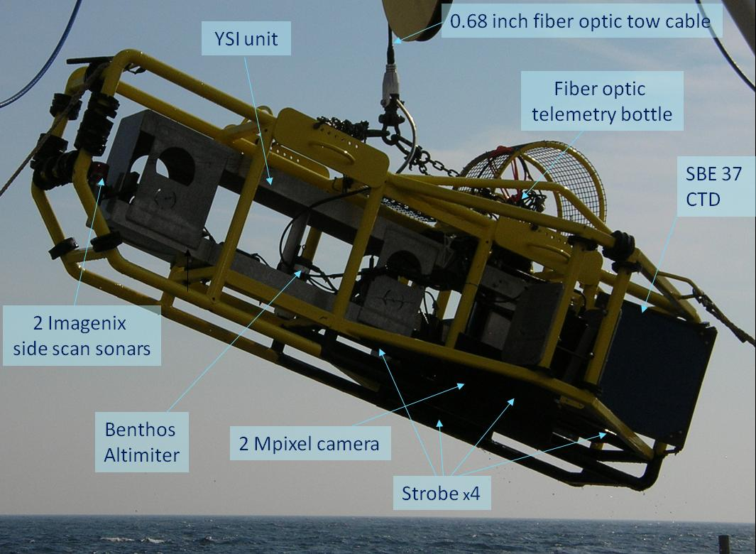
Woods Hole Oceanographic Institution’s (WHOI) Habcam
http://habcam.whoi.edu

Slide 34
500K Images Per Day
Most are uninteresting, and should be thrown out. What about this one?

Slide 35
Scallop Fishing Is a Multi-Billion Dollar Industry: Are We Harvesting Too Many or Too Few?

Slide 36
Name That Species

Slide 37
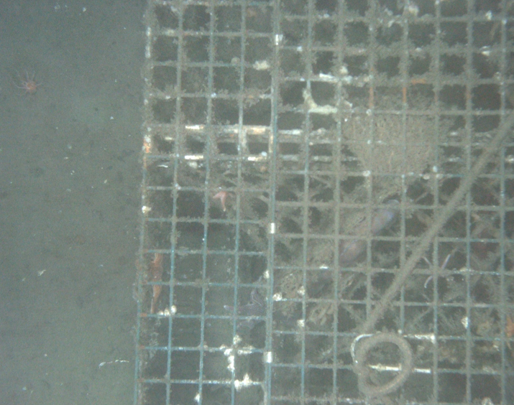
Can You Automatically Identify Images Containing Marine Debris?

Slide 38
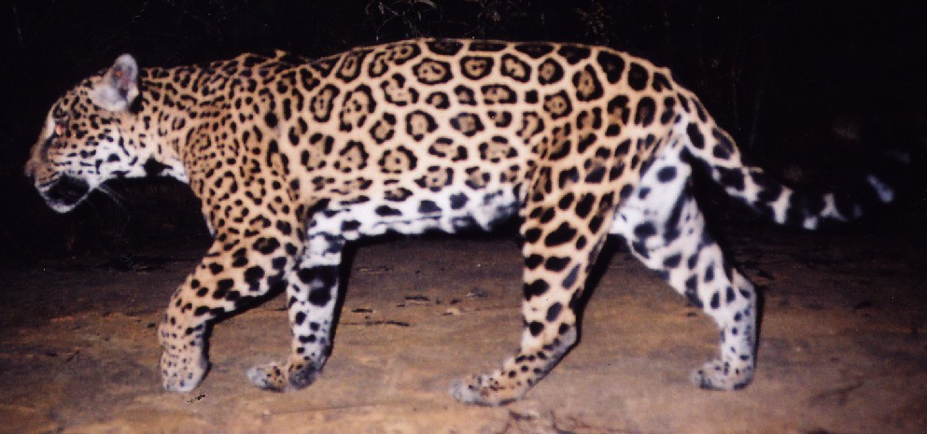
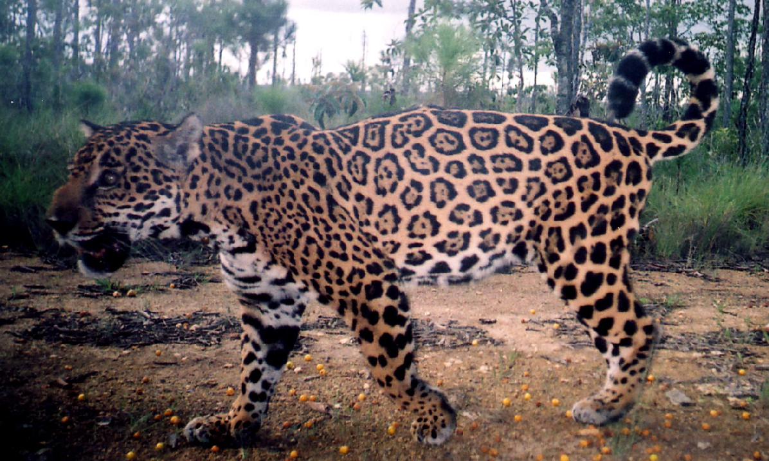
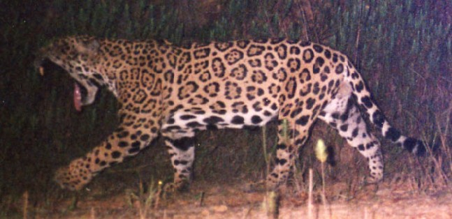
Mark / Recapture: Which Two are the Same Jaguar?

Slide 39
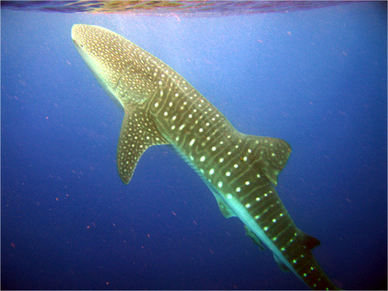
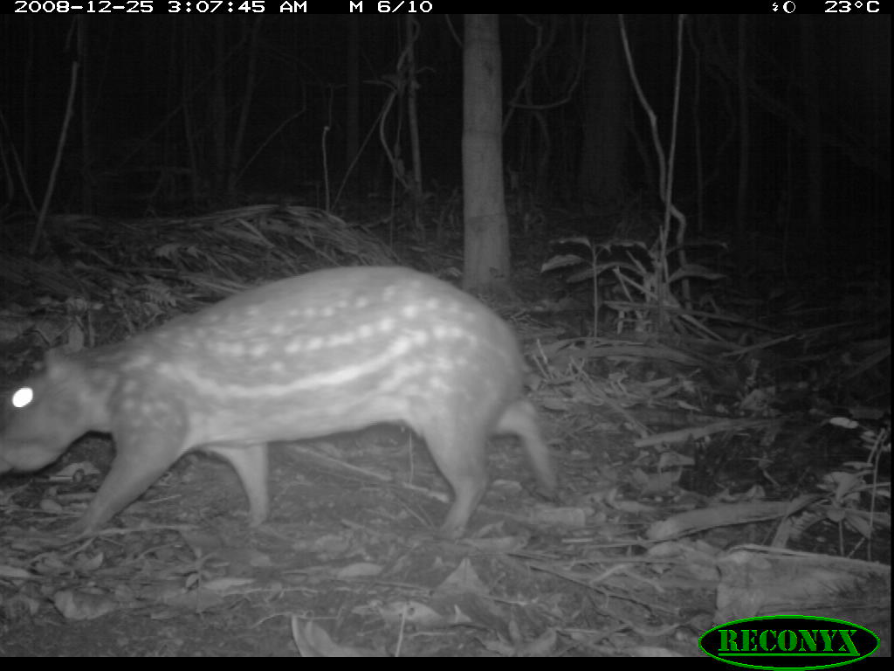
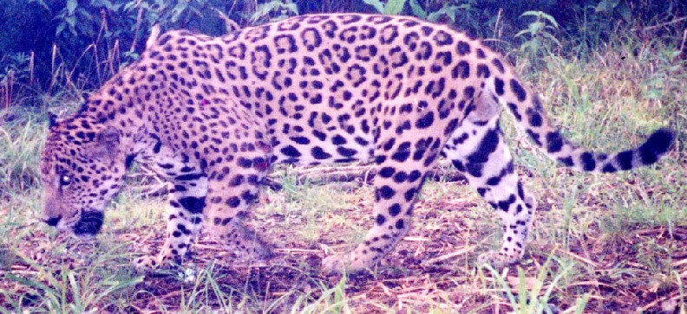
Mark / Recapture
Migratory pattern analysis
Longevity studies
Predator range
Population density

Slide 40
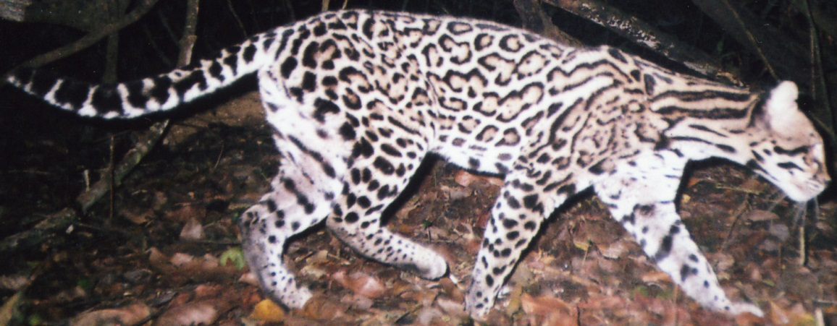
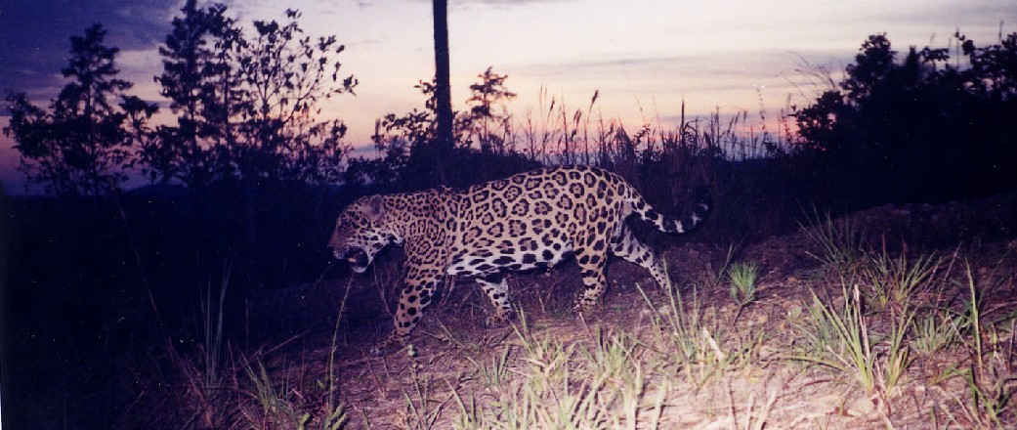
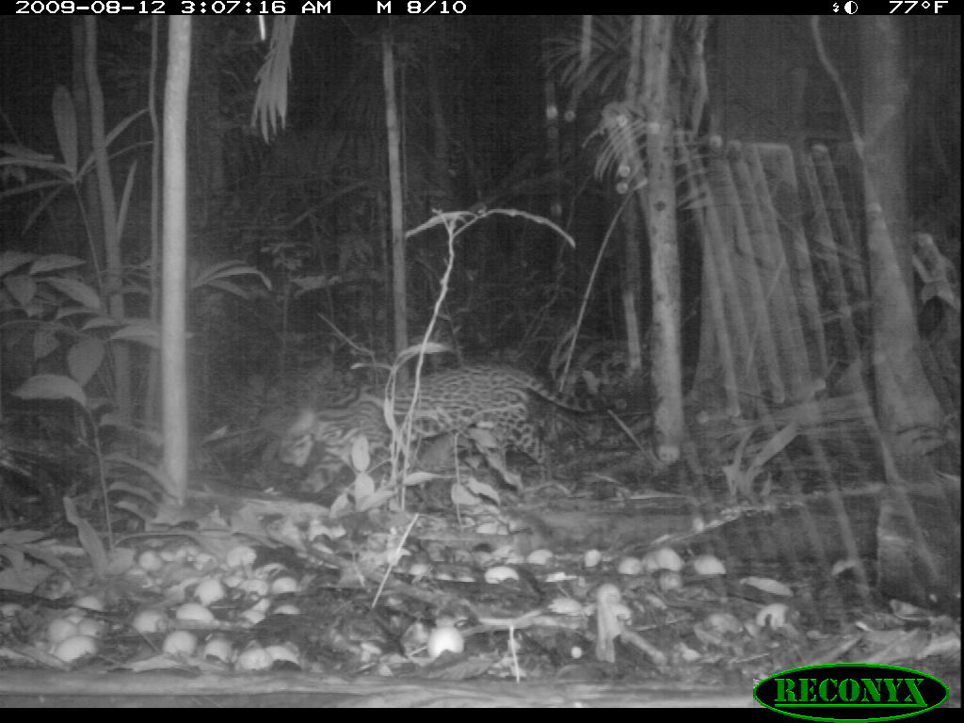
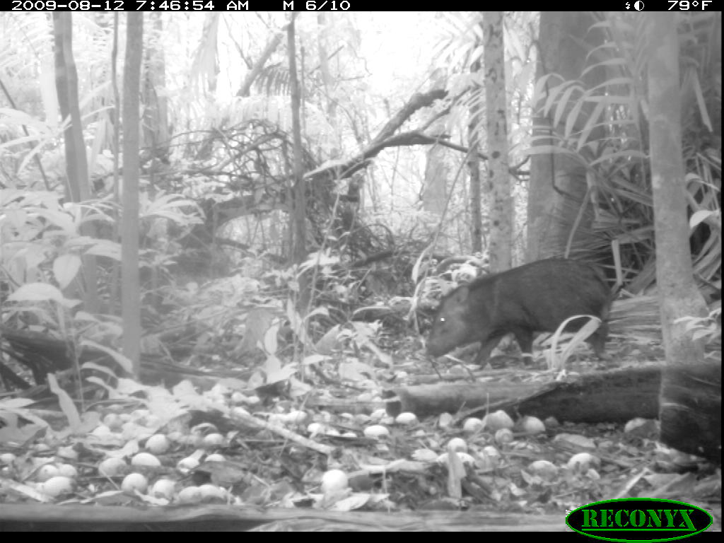
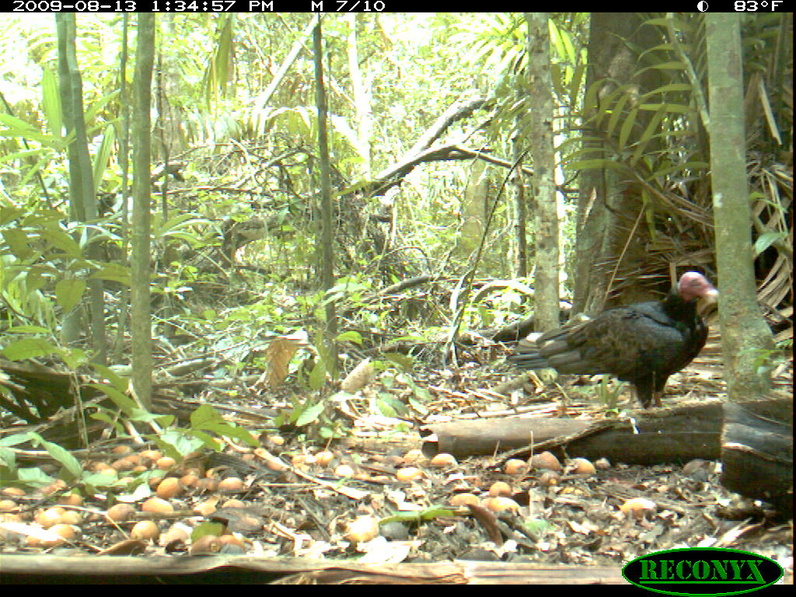
Species Identification

Slide 41
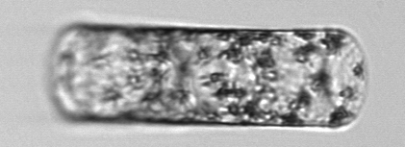
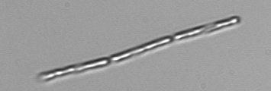
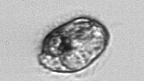
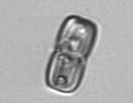
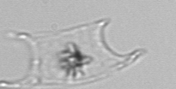
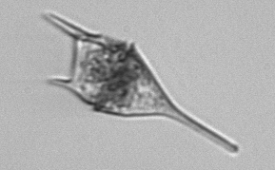
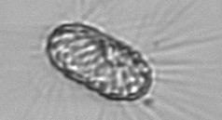
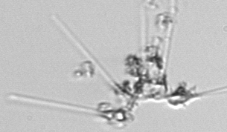
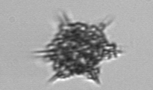
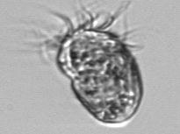
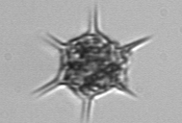
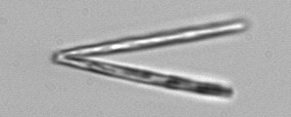
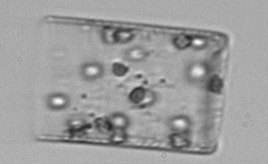
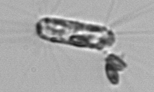
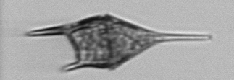
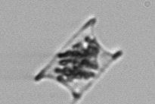
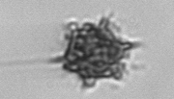
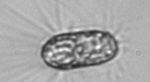
Marine Plankton Images
Acquired automatically underwater during long deployments
(10000s h⁻¹ continuously for months to years)
Current archive of near 1 billion images
Ultimate goal: automated taxonomic identification to investigate species specific population dynamics in a changing environment
First step: automated image processing
Objectives:
edge detection and feature extraction
basic geometry (perimeter, area, symmetry measures, etc.)
Need to improve quality and computational speed
Imaging FlowCytobot
automated submersible

Slide 42
New Students and Projects
Plankton classification and characterization
Fish species identification
Schooling and shoaling behaviors
Interested students should start with one of these as a semester topic

Slide 43
Thinking About Human Vision: Optical Illusions

Slide 44
Copyright A.Kitaoka 2003

Slide 45
Shadow, What Shadow?

Slide 46
Quick, Who is in These Pictures?

Slide 47
Geometry, Photometry, Optics

Slide 48
Raw Data of an Image: What’s This?
(202,184,175)

Slide 49
Raw Data of an Image: What’s This?

Slide 50
Raw Data of an Image: What’s This?

Slide 51
Illumination Affects Brightness and Color

Slide 52
Perspective Affects Size and Angles

Slide 53
Can We Find Big Ben Among These Pictures of London? How?

Slide 54
Ignore Illumination and Perspective!
But still, somehow, “match” these images and discard the others!

Slide 55
Extract, Describe and Match Features!
Features are “distinctive” point locations.
Vector to summarize the surrounding image regions.
Repeatable locations and distinctive, invariant vectors.
( 78, 89, 103, 106, 78, 24, 45, … 124 )

Slide 56
For Thursday
Get started with Matlab and the image processing toolkit
See course website for pointers
Send me email (stewart@cs.rpi.edu):
Tell me a little about yourself
How far did you get with Matlab or whatever other environment? (Get somewhere!)
Find and brief describe an application of computer vision that interests you. (One paragraph only.) Why is it important? Why is computer vision the way to solve it? Why might it be hard? Use your intuitions.

