Slide 1

Frontiers of Network Science
Fall 2021
Class 4: Graph Theory II
(Chapter 2 in Textbook)
Boleslaw Szymanski
based on slides by Albert-László Barabási & Roberta Sinatra

Slide 2
Section 2.2 Reference Networks

Slide 3
Section 2.3
Degree, Average Degree and Degree Distribution

Slide 4
A BIT OF STATISTICS
Network Science: Graph Theory

Slide 5
AVERAGE DEGREE
Undirected
j
i
N – the number of nodes in the graph
B
D
Directed
C
E
A
F
Network Science: Graph Theory

Slide 6
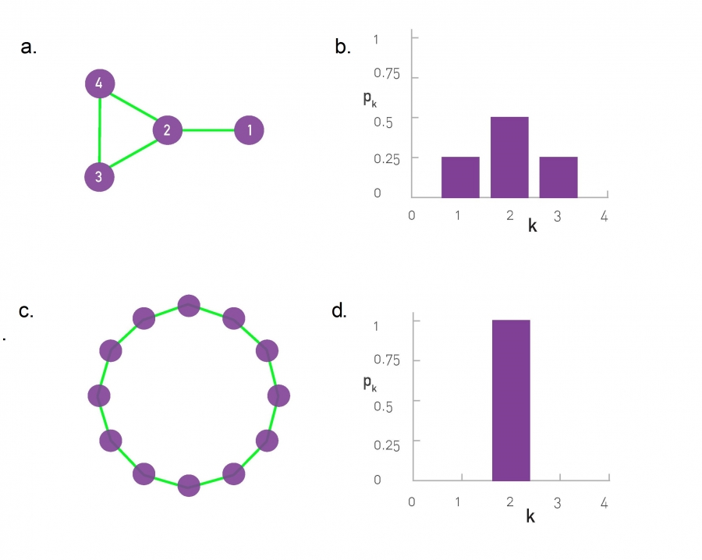

DEGREE DISTRIBUTION
Degree distribution
P(k): probability that a
randomly chosen node
has degree k
Nk = # nodes with degree k
P(k) = Nk / N ➔ plot

Slide 7
DEGREE DISTRIBUTION
Notes:
In many real networks, the node degree can vary considerably.
For example, as the degree distribution (a) indicates, the degrees of the proteins in the protein interaction network shown in (b) vary between k=0 (isolated nodes) and k=92, which is the degree of the largest node, called a hub. There are also wide differences in the number of nodes with different degrees: as (a) shows, almost half of the nodes have degree one (i.e. p1=0.48), while there is only one copy of the biggest node, hence p92 = 1/ N=0.0005. (c) The degree distribution is often shown on a so-called log- log plot, in which we either plot log pk in function of log k, or, as we did in (c), we use logarithmic axes.

Slide 8
DEGREE DISTRIBUTION
Discrete Representation: p_{k} is the probability that a node has degree k.
Continuum Description: p(k) is the pdf of the degrees, where
represents the probability that a node’s degree is between k₁ and k₂.
Normalization condition:
where K_{min} is the minimal degree in the network.
Network Science: Graph Theory

Slide 9
Section 2.4
Adjacency matrix

Slide 10
ADJACENCY MATRIX
4
4
3
2
3
2
1
1
A_{ij}=1 if there is a link between node i and j
A_{ij}=0 if nodes i and j are not connected to each other.
Note that for a directed graph (right) the matrix is not symmetric.
if there is a link pointing from node j and i
if there is no link pointing from j to i.
Network Science: Graph Theory

Slide 11
ADJACENCY MATRIX AND NODE DEGREES
4
Undirected
2
3
1
Directed
4
2
3
1

Slide 12
ADJACENCY MATRIX
a
e
a b c d e f g h
a 0 1 0 0 1 0 1 0
b 1 0 1 0 0 0 0 1
c 0 1 0 1 0 1 1 0
d 0 0 1 0 1 0 0 0
e 1 0 0 1 0 0 0 0
f 0 0 1 0 0 0 1 0
g 1 0 1 0 0 0 0 0
h 0 1 0 0 0 0 0 0
h
b
d
f
g
c
Network Science: Graph Theory
Notes:
The adjacency matrix can take far more complicated forms for a larger network….

Slide 13
Section 4
Real networks are sparse

Slide 14
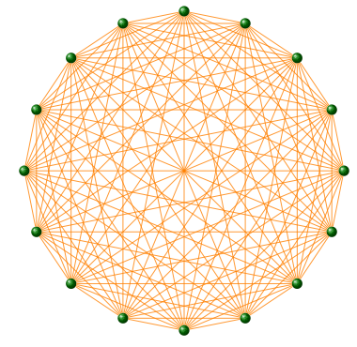
COMPLETE GRAPH
The maximum number of links a network
of N nodes can have is:
A graph with degree L=L_{max} is called a complete graph,
and its average degree is <k>=N-1
Network Science: Graph Theory

Slide 15
REAL NETWORKS ARE SPARSE
Most networks observed in real systems are sparse:
L << L_{max}
or
<k> <<N-1.
WWW (ND Sample): N=325,729; L=1.4 10⁶ L_{max}=10¹² <k>=4.51
Protein (S. Cerevisiae): N= 1,870; L=4,470 L_{max}=10⁷ <k>=2.39
Coauthorship (Math): N= 70,975; L=2 10⁵ L_{max}=3 10¹⁰ <k>=3.9
Movie Actors: N=212,250; L=6 10⁶ L_{max}=1.8 10¹³ <k>=28.78
(Source: Albert, Barabasi, RMP2002)
Network Science: Graph Theory

Slide 16
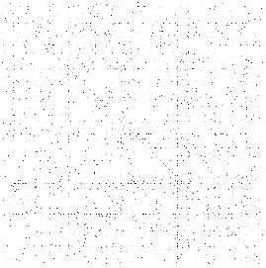
ADJACENCY MATRICES ARE SPARSE
Network Science: Graph Theory
Notes:
The adjacency matrix of the yeast protein-protein interaction network, consisting of 2,018 nodes, each representing a yeast protein (Table 2.1).
A dot is placed on each spot of the adjacent matrix for which Aij = 1, indicating the presence of an interaction. There are no dots for Aij = 0. The small fraction of dots underlines the sparse nature of the protein-protein interaction network.

Slide 17
Section 2.6
WEIGHTED AND UNWEIGHTED NETWORKS

Slide 18
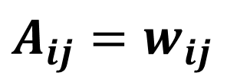
WEIGHTED AND UNWEIGHTED NETWORKS
$A_{ij}=w_{ij}$

Slide 19
GRAPHOLOGY
1
Unweighted
(undirected)
Weighted
(undirected)
4
4
1
1
2
2
3
3
protein-protein interactions, www
Call Graph, metabolic networks
Network Science: Graph Theory

Slide 20
GRAPHOLOGY
2
Self-interactions
Multigraph
(undirected)
4
4
1
1
2
2
3
3
Protein interaction network, www
Social networks, collaboration networks
Network Science: Graph Theory

Slide 21
GRAPHOLOGY
3
Complete Graph
(undirected)
4
1
2
3
Actor network, protein-protein interactions
Network Science: Graph Theory

Slide 22
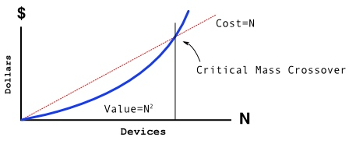
METCALFE’S LAW
The maximum number of links a network
of N nodes can have is:
Network Science: Graph Theory
Notes:
Metcalfe's law, frequently quoted during the internet boom of 2000, states that the value of a network is proportional to the square of the number of its nodes, i.e. $N^2$. Formulated around 1980 in terms of communication devices by Robert M. Metcalfe, the inventor of Ethernet\cite{Gilder_Forbes-ASAP_1993}, the idea behind Metcalfe's law is that the more individuals use a network, the more valuable it becomes. Indeed, a fax machine is useless to you if there is no one to send a fax to. The more of your acquaintances have a fax machine, the more valuable it is to you as well. The $N^2$ dependence encodes the fact that if a network has $N=10$ members, there are $L_{max}=45$ different possible connections that these members can make to each other. If the network doubles in size to $N=20$, the number of connections doesn't merely double but roughly quadruples to 190, an effect often called "network effect" or "network externality" in economics.
During the Internet boom Metcalfe's law was frequently used to offer a quantitative valuation for internet companies, supporting a "build it and they will come " mentality\cite{Briscoe_Spectrum-IEEE_2006}. It implied that the value of a service is proportional to the square of the number of its consumers or users, while costs would grow only linearly. Hence if the service attracts sufficient number of users, it will inevitably become profitable, as $N^2$ will surely surpass $N$ at some sufficiently large $N$ value. Hence Metcalf's Law offered credibility to growth, while neglecting profitability, fueling the Internet bubble of 2001.
Metcalfe's law imagines that networks are complete graphs. It is based on Eq. (\ref{EQ-L-Max}), indicating that if all links of communication network with $N$ nodes are equally valuable, the total value of the network is proportional to $N(N-1)/2$, that is, roughly, $N^2$.
There are two fundamental problems with Metcalfe's law:
While all links are possible, in real networks not all links are present. Indeed, most real networks are sparse, which means that only a very small fraction of the links are present. If we assign a value to each link, then the total value of the network will grow slower than $N^2$, as we will see in the coming chapters.
Not all links are of equal value. Some links are used heavily while the vast majority of links are 'weak', i.e. they are rarely utilized.

Slide 23
Section 2.7
BIPARTITE NETWORKS

Slide 24
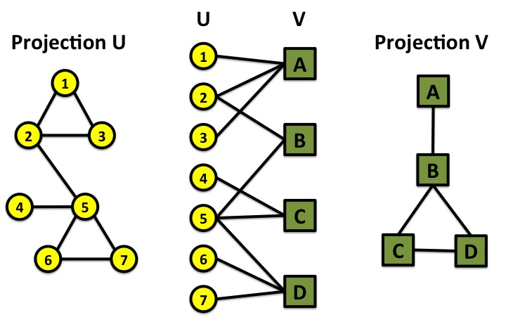
BIPARTITE GRAPHS
bipartite graph (or bigraph) is a graph whose nodes can be divided into two disjoint sets U and V such that every link connects a node in U to one in V; that is, U and V are independent sets.
Examples:
Hollywood actor network
Collaboration networks
Disease network (diseasome)
Network Science: Graph Theory

Slide 25
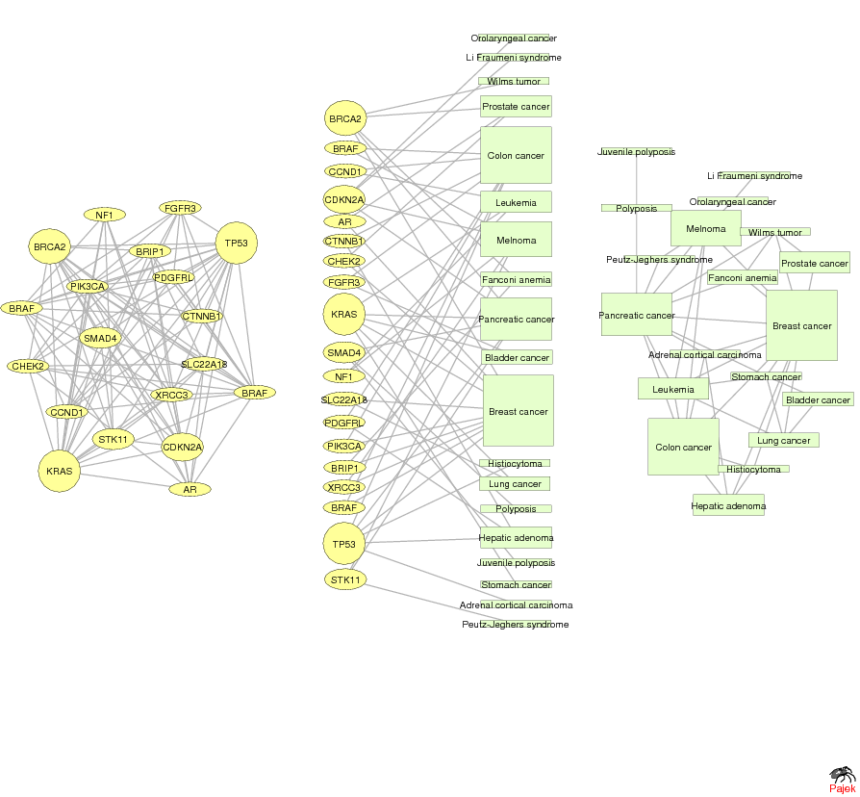
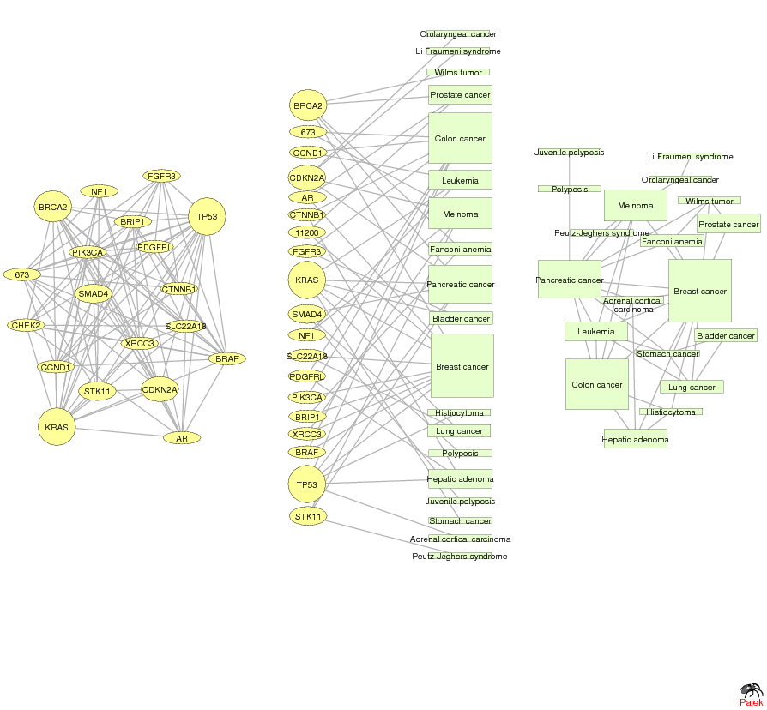
GENE NETWORK – DISEASE NETWORK
DISEASOME
PHENOME
GENOME
Gene network
Disease network
Goh, Cusick, Valle, Childs, Vidal & Barabási, PNAS (2007)
Network Science: Graph Theory

Slide 26
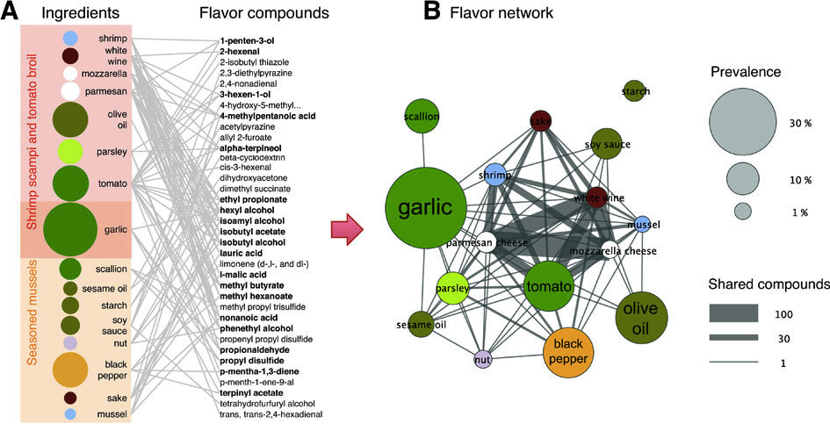
Ingredient-Flavor Bipartite Network
Y.-Y. Ahn, S. E. Ahnert, J. P. Bagrow, A.-L. Barabási Flavor network and the principles of food pairing , Scientific Reports 196, (2011).
Network Science: Graph Theory

Slide 27
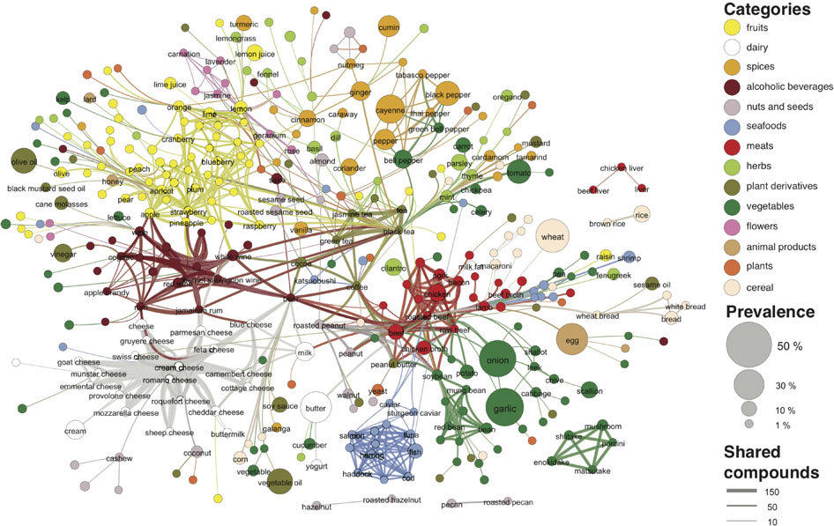

Slide 28
Section 2.8
PATHOLOGY

Slide 29
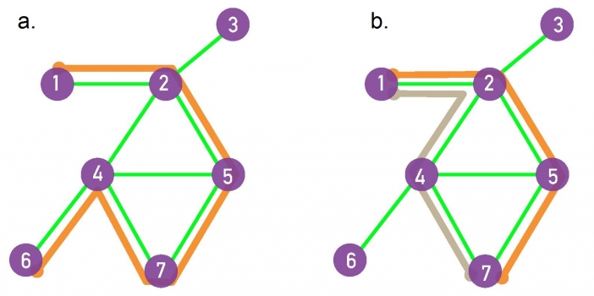
PATHS
A path is a sequence of nodes in which each node is adjacent to the next one
P_{i0,in} of length n between nodes i₀ and i_{n} is an ordered collection of n+1 nodes and n links
In a directed network, the path can follow only the direction of an arrow.
Network Science: Graph Theory

Slide 30
DISTANCE IN A GRAPH Shortest Path, Geodesic Path
The distance (shortest path, geodesic path) between two nodes is defined as the number of edges along the shortest path connecting them.
*If the two nodes are disconnected, the distance is infinity.
In directed graphs each path needs to follow the direction of the arrows.
Thus in a digraph the distance from node A to B (on an AB path) is generally different from the distance from node B to A (on a BCA path).
B
A
C
D
B
A
C
D
Network Science: Graph Theory

Slide 31
NUMBER OF PATHS BETWEEN TWO NODES Adjacency Matrix
N_{ij},number of paths between any two nodes i and j:
Length n=1: If there is a link between i and j, then A_{ij}=1 and A_{ij}=0 otherwise.
Length n=2: If there is a path of length two between i and j, then A_{ik}A_{kj}=1, and A_{ik}A_{kj}=0 otherwise.
The number of paths of length 2:
Length n: In general, if there is a path of length n between i and j, then A_{ik}…A_{lj}=1 and A_{ik}…A_{lj}=0 otherwise.
The number of paths of length n between i and j is*
*holds for both directed and undirected networks.
Network Science: Graph Theory

Slide 32
FINDING DISTANCES: BREADTH FIRST SEARCH
Distance between node 0 and node 4:
Start at 0.
3
3
4
2
4
3
2
1
1
1
3
0
4
2
4
3
3
4
1
4
3
4
4
2
2
3
Network Science: Graph Theory
Network Science: Graph Theory
Network Science: Graph Theory

Slide 33
FINDING DISTANCES: BREADTH FIRST SEARCH
Distance between node 0 and node 4:
Start at 0.
Find the nodes adjacent to 1. Mark them as at distance 1. Put them in a queue.
3
3
4
2
4
2
1
3
1
1
0
1
3
1
4
2
4
3
3
4
1
1
4
3
4
4
2
2
3
Network Science: Graph Theory
Network Science: Graph Theory

Slide 34
FINDING DISTANCES: BREADTH FIRST SEARCH
Distance between node 0 and node 4:
Start at 0.
Find the nodes adjacent to 0. Mark them as at distance 1. Put them in a queue.
Take the first node out of the queue. Find the unmarked nodes adjacent to it in the graph. Mark them with the label of 2. Put them in the queue.
3
3
4
2
2
4
2
1
3
3
2
1
1
1
4
1
0
1
2
2
4
3
3
4
1
1
1
4
3
4
4
2
2
2
2
3
Network Science: Graph Theory
Network Science: Graph Theory
Network Science: Graph Theory

Slide 35
FINDING DISTANCES: BREADTH FIRST SEARCH
Distance between node 0 and node 4:
Repeat until you find node 4 or there are no more nodes in the queue.
The distance between 0 and 4 is the label of 4 or, if 4 does not have a label, infinity.
3
3
4
2
4
3
2
1
0
1
3
4
2
4
3
3
4
1
4
3
4
4
2
2
3
Network Science: Graph Theory

Slide 36
NETWORK DIAMETER AND AVERAGE DISTANCE
Diameter: d_{max} the maximum distance between any pair of nodes in the graph.
Average path length/distance, <d>, for a connected graph:
where d_{ij} is the distance from node i to node j
In an undirected graph d_{ij} =d_{ji} , so we only need to count them once:
Network Science: Graph Theory

Slide 37
PATHOLOGY: summary
Shortest Path
1
2
5
3
4
The path with the shortest length between two nodes (distance).
Network Science: Graph Theory

Slide 38
PATHOLOGY: summary
Diameter
Average Path Length
1
1
2
5
2
5
3
4
3
4
The longest shortest path in a graph
The average of the shortest paths for all pairs of nodes.
Network Science: Graph Theory

Slide 39
PATHOLOGY: summary
Cycle
Self-avoiding Path
1
1
2
5
2
5
3
4
3
4
A path with the same start and end node.
A path that does not intersect itself.
Network Science: Graph Theory

Slide 40
PATHOLOGY: summary
Eulerian Path
Hamiltonian Path
1
1
2
5
2
5
3
4
3
4
A path that traverses each link exactly once.
A path that visits each node exactly once.
Network Science: Graph Theory

