Slide 1

Detecting communities in time-evolving networks:
Application to voting patterns in the US Senate
Based on
“Sequential detection of temporal communities
by estrangement confinement”
Kawadia, Sreenivasan, Sci. Rep. 1:794 (2015)

Slide 2
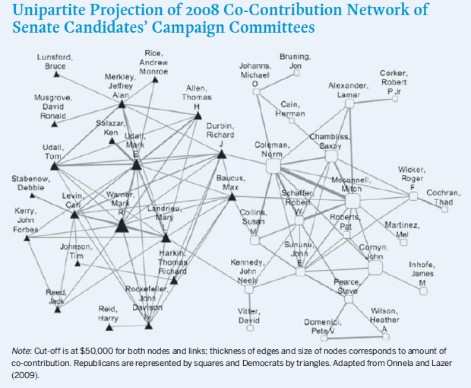
What are the networks that pervade the political arena?
Onnela and Lazer (2009)

Slide 3
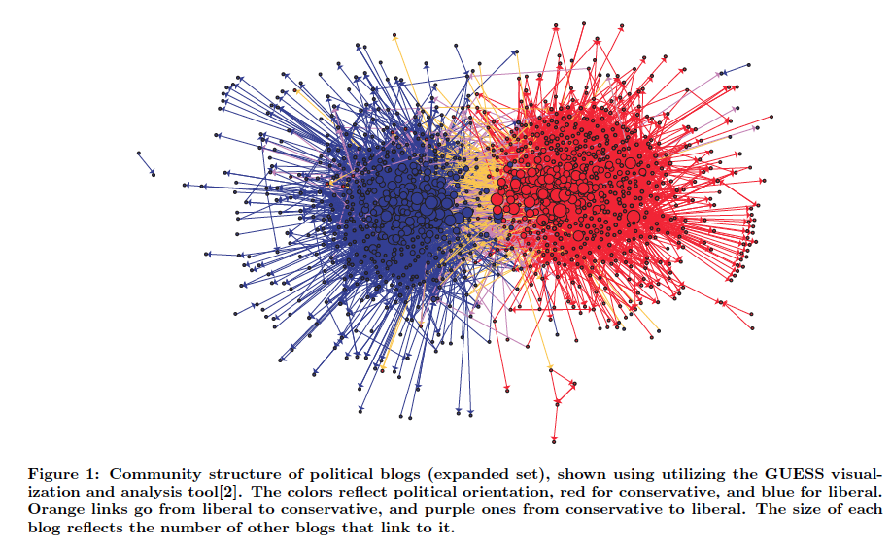
What are the networks that pervade the political arena?
Adamic and Glance, Proceedings of the 3rd international workshop on Link discovery, 36 (2005)

Slide 4
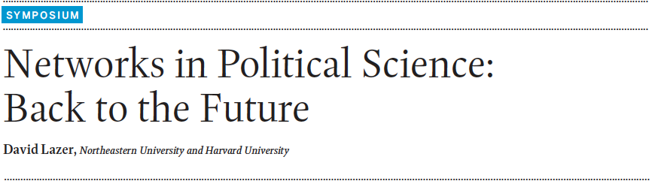
What are the networks that pervade the political arena?
A nice review of prior research on networks in politics:
PS: Political Science & Politics, Volume 44, Issue 01, January 2011, pp 61-68

Slide 5
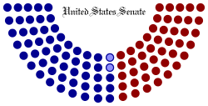
The United States Senate
The United States Senate is a legislative chamber in the bicameral legislature of the United States of America, and together with the U.S. House of Representatives makes up the U.S. Congress.
Each U.S. state is represented by two senators, regardless of population.
Senators serve terms of six years each; the terms are staggered so that approximately one-third of the seats are up for election every two years.
Democratic (53)
Independent (2)
Republican (45)

Slide 6
Roll Call Voting Network
Each senator’s vote on a particular bill (yea or nay) is recorded. This kind
of vote is called a roll call vote. Distinct from a voice vote where only total
vote tallies are recorded.
Roll call voting data for all senate sessions available at:
http://voteview.com/DWNL.htm
Using this data, we can construct for each senate session, a network
among senators which indicates the similarity between their voting records for that session.
Weight of an edge/link between two senators:
Number of times they voted similarly
Number of bills they both voted on

Slide 7
Q:
Can we detect groups in the senate
characterized by similar voting behavior?

Slide 8
Formal method to find communities in networks
What is a good way to define a community/group?
A subset of nodes whose induced subgraph has more links than expected by chance.
Example:
4-regular graph: every node has 4 edges
Let’s try some candidate “partitions” of this graph into communities.

Slide 9


Total number of links: = 6
Total number of links: = 4
Number of links expected by chance:
= 3
Number of links expected by chance:
= 3
Difference = 3
Difference = 1
More plausible community partition

Slide 10

Formal method to find communities in networks
More formally:
For a specific partition of nodes, sum over all communities that the
partition creates:
: Modularity of the given partition.
One way to find communities: Find the partition that maximizes

Slide 11
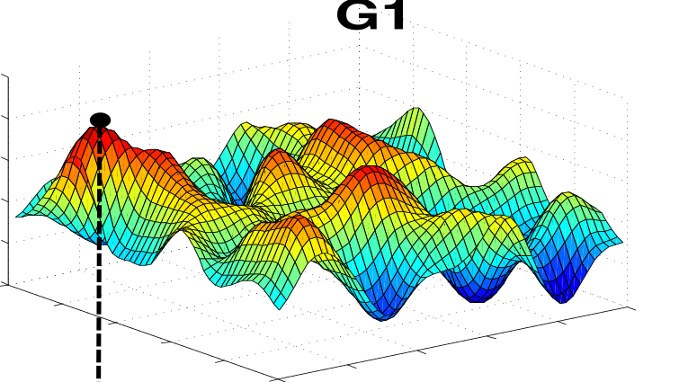
Formal method to find communities in networks
One way to find communities: Find the partition that maximizes
Partition space

Slide 12

Formal method to find communities in networks
Modularity maximization using the Label Propagation Algorithm (LPAm)
M. J. Barber and J. W. Clark, Phys. Rev. E 80, 026129
Steps:
Initialize each node’s community label to the respective node’s index.
do:
for each node update its label using the following rule:
while: at least one node label has changed.

Slide 13
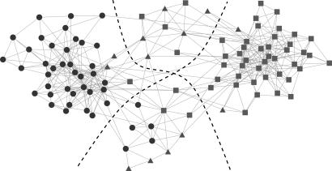
Formal method to find communities in networks
Communities found by modularity maximization on the co-purchasing network of political books
Liberal
Conservative
Centrist/Unaligned

Slide 14
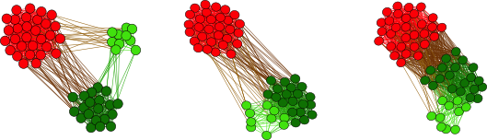



Community detection in temporally evolving networks
Network structure changes in time => community structure could also be evolving
Simplest method:
Apply the modularity hammer on each snapshot independently.
…there is a problem, though.

Slide 15
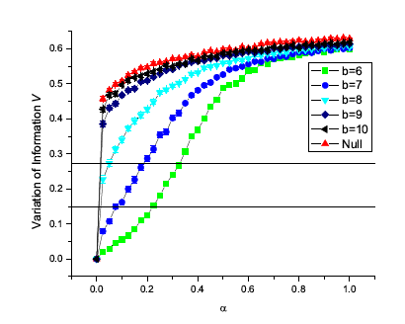
Community detection in temporally evolving networks
Small change in network structure can have a large effect on landscape
4 communities,
b edges btw. communities
Distance between partitions
Karrer, Levina and Newman,
Phys. Rev E 77 046119 (2008)
Edge randomization probability
Undesirable consequence: there can be a big “jump” in community structure, even when the network structure change is small.

Slide 16
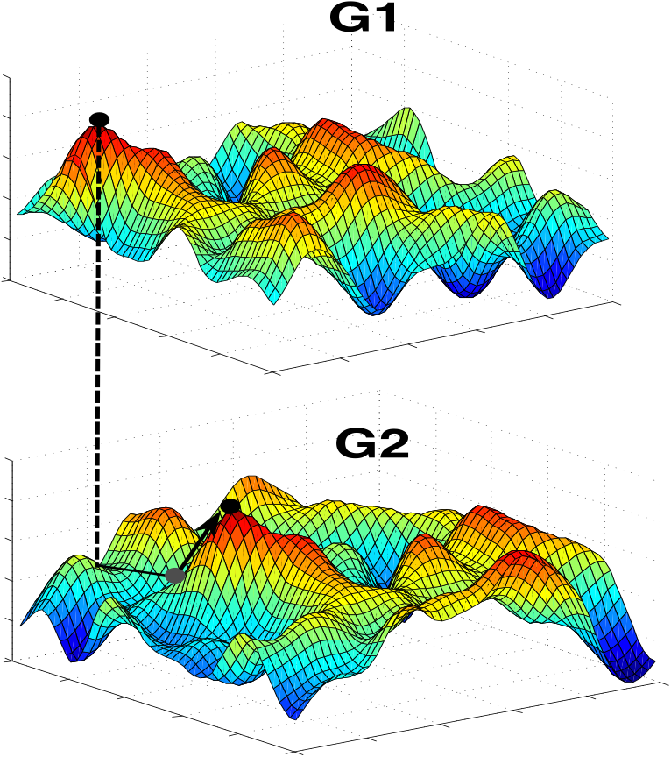
Community detection in temporally evolving networks
If network change is small we want to maximize but with the constraint that the new partition is close to the old one => smooth community evolution.
(If network change is large, allow partition to change more)
Partition space

Slide 17
Community detection in temporally evolving networks
We need a penalty function that:
Penalizes changes in partition structure with consideration of how much the network has changed.
Penalizes changes in partition structure locally – different parts of the network
can have different extents of partition change, depending on their respective
link churns.
Can be broken down into local contributions (just like modularity), so that
it can be incorporated into the Label Propagation rule.

Slide 18
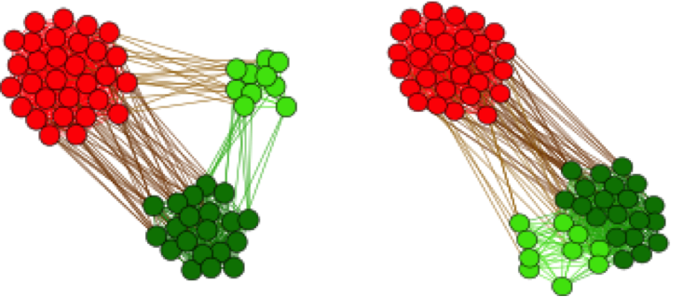




Community detection in temporally evolving networks
A candidate penalty function: Estrangement
Definition 1:
Estranged link/edge: A link/edge present in both and ,
whose end points belonged to the same community in but
belong to different communities in .

Slide 19
Community detection in temporally evolving networks
A candidate penalty function: Estrangement
Definition 2:
Estrangement:
Total number of estranged edges between and
Total number of edges in

Slide 20


Community detection in temporally evolving networks
Two quantities associated with any given partition of graph at time t:
Modularity
Estrangement

Slide 21


Community detection in temporally evolving networks
Choice of partition at time t becomes a constrained optimization problem:
: Quantifies how much “jumpiness” is tolerated in community evolution

Slide 22
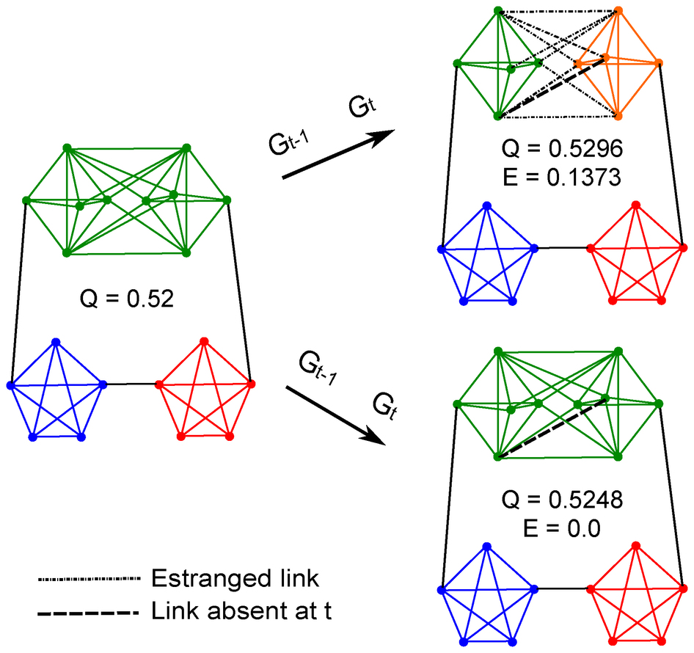
Community detection in temporally evolving networks
Example:
Higher modularity
Higher estrangement
Lower modularity
Zero estrangement

Slide 23

Community detection in temporally evolving networks
Constrained Modularity maximization using the Label Propagation Algorithm
Steps:
Initialize each node’s community label to the respective node’s index.
do:
for each node update its label using the following rule:
while: at least one node label has changed.
Lagrange
multiplier
Contribution of node to if it accepted as its community label

Slide 24
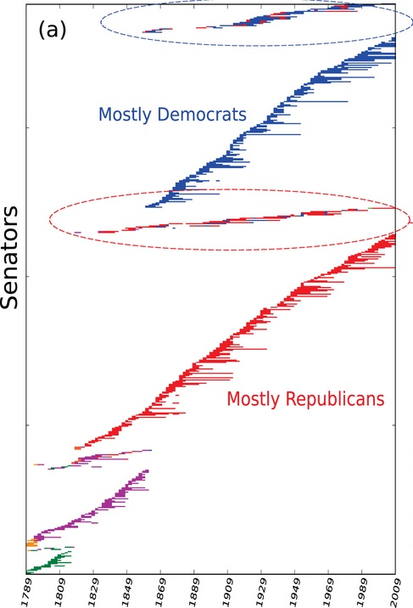
Estrangement constrained community detection
on the US Senate co-voting network
Each color represents a
distinct discovered community
Senators
Only two communities
in each senate session
from the late 1800s
onwards.

Slide 25
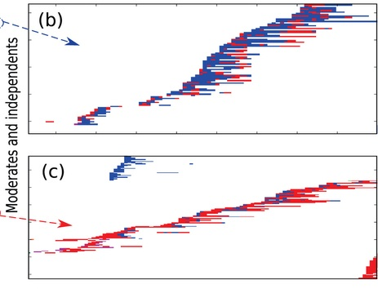
Estrangement constrained community detection
on the US Senate co-voting network
Senators whose community membership switches often

Slide 26
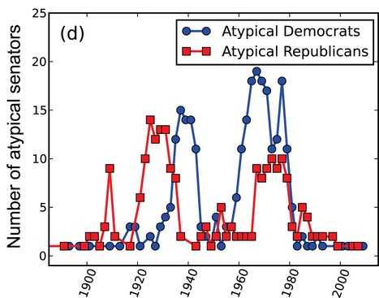
Estrangement constrained community detection
on the US Senate co-voting network
“Atypical” senators: A senator whose community label
is different from the majority of his party colleagues.
Larger
partisanship

Slide 27
Summary
Community detection on an implicit or explicit network is a useful
approach to segmenting populations based on behavior.
Can be applied to other networks, for example:
Politics: networks based on co-sponsorship of bills by senators,
campaign co-contribution network for senate candidates etc.
Recommendation systems: similarity networks among users based
on products they buy, movies they watch etc.
Methods and results presented here were published in:
V. Kawadia and S. Sreenivasan, Scientific Reports 2, 794 (2012)
https://www.nature.com/articles/srep00794

